Slide 1
Vanderbilt Summer Science Academy Responsible Conduct of Research
Kathy Friedman (with help from Beth Bowman)
June 2021

Slide 2
Outline
What is Responsible Conduct of Research?
Why do we need training in Responsible Conduct of Research?
Components of Responsible Conduct of Research
Core components
More about Research Misconduct
What should I be thinking about this summer?

Slide 3
What is Responsible Conduct of Research?
Do good work
Show respect for others
Exercise social responsibility

Slide 4
What is Responsible Conduct? Do Good Work
Have passion for your work
Care about the quality and impact of your work
Become an expert and use best practices
Design
Conduct
Analysis/interpretation
Dissemination of results
Honesty in all aspects of your work
Notes:
Doing good work refers to scholarly research or creative activity.
To do good work
Have passion for your work – care about the quality and impact of your work
Become an expert and collaborate with others whose expertise enhances the group work
Demonstrate care in the design, conduct, analysis/interpretation, and dissemination of your work
Demonstrate integrity/honesty

Slide 5
What is Responsible Conduct? Show Respect for Others
Collegiality
Protection of human and animal subjects
Compliance with institutional, professional, and governmental regulations and policies
Notes:
Collegiality refers to the respect you show to other people
Respect and consideration of ideas
Respect for intellectual property
Fairness in assigning effort and credit for work
Confidentiality in peer review
Protection of human and animal subjects
Concern for the health, safety, privacy, and protection of human subjects in research
Consideration of animal welfare
Compliance with institutional, professional, and governmental regulations and policies

Slide 6
What is Responsible Conduct? Exercise Social Responsibility
Relevant, significant hypotheses, questions, and purposes
Appropriate dissemination of scholarly work
Active participation in the work of the scientific community

Slide 7
Why do we need training in Responsible Conduct of Research?

Slide 8
“With growing public support for research has come an understandable
concern about the way it is conducted. Public funds support roughly one-third
of all research and development (R&D) in the U.S. and half of all basic research.
Many researchers, therefore, spend a significant portion of their time working for the public. As public servants and also professionals, researchers have clear obligations to conduct their research in a responsible manner.”
“However, the specifics of good citizenship in research can be a challenge to understand and put into practice.”
Steneck, N. (2007). ORI Introduction to the Responsible Conduct of Research. Washington, D.C.: Health and Human Services.

Slide 9
“With growing public support for research has come an understandable
concern about the way it is conducted. Public funds support roughly one-third
of all research and development (R&D) in the U.S. and half of all basic research.
Many researchers, therefore, spend a significant portion of their time working for the public. As public servants and also professionals, researchers have clear obligations to conduct their research in a responsible manner.”
“However, the specifics of good citizenship in research can be a challenge to understand and put into practice.”
Ignorance does not excuse inappropriate behavior/practices
Steneck, N. (2007). ORI Introduction to the Responsible Conduct of Research. Washington, D.C.: Health and Human Services.

Slide 10
Components of Responsible Conduct of Research

Slide 11
Responsible Conduct of Research
research misconduct;
data management - i.e., data acquisition, record-keeping, retention, ownership, analysis, interpretation, and sharing;
scientific rigor and reproducibility;
responsible authorship and publication;
peer review;
conflicts of interest in research;
mentor/mentee responsibilities and relationships;
collaborative science;
civility issues in research environments, including but not limited to, harassment, bullying, and inappropriate behavior;
policies regarding laboratory safety, biosafety, and human and animal research subjects
https://oir.nih.gov/sourcebook/ethical-conduct/responsible-conduct-research-training
Notes:
RCR means responsible conduct of research
The next 11 slides in this presentation serve as an introduction to the more comprehensive information provided in separate PowerPoint presentations about each topic.

Slide 12
Research Misconduct
Continuum from research integrity to misconduct
Research integrity
Questionable research practices
Unacceptable research practices
Research misconduct
Definition of Misconduct,
Fabrication – make-up data or results
Falsification – manipulate data inappropriately
Plagiarism – steal another person’s work
Definition of misconduct, U.S. Office of Research Integrity http://ori.dhhs.gov/policies/fed_research_misconduct.shtml

Slide 13
Data Management
Control
Ownership
Access
Data management is a general term that refers to the control, access, and ownership of research data
Control refers to data collection, storage, security, disaster recovery, and retention
Access refers to which persons may use the data under which conditions
Ownership refers to legal rights to the data

Slide 14
Scientific Rigor and Reproducibility
Rigorous experimental design/statistical analysis
Transparency in reporting
Replicates
Statistics
Randomization
Blinding
Sample-size estimation
Inclusion and exclusion criteria
Data and material sharing

Slide 15
Publication and Authorship
Researchers should observe the authorship policies established by the journals and other venues in which they publish
Authors should not:
Submit a manuscript to more than one journal at the same time
Engage in duplicate publication
Submit a manuscript or other work without the explicit approval of all authors

Slide 16
Peer Review
Peer review
Helps establish the quality of the research and manuscript – it is judged by experts
Contributes to fair editorial decisions about what does and does not get published and funded
Three principles of peer review
Fairness – provide an objective and impartial review
Confidentiality – do not use ideas from the manuscript until it is published
Speed – complete the review within a reasonable amount of time

Slide 17
Conflict of Interest
Conflicts of interest include:
Possibility of financial gain from research
Competing work commitments that may affect an investigator’s attention to a research project
Conflicts of interest may lead to bias in the planning, conduct, or reporting of research
Conflicts of interest are not inherently bad
Disclosure helps everyone be aware of and manage conflicts of interest

Slide 18
Mentor/Trainee Responsibilities
Mentors should establish clear expectations for trainees with respect to all aspects of planning, conducting, and reporting research
Collegiality and learning are enhanced when mentors and trainees understand each other’s interests and responsibilities
Concerns about mentoring include finding mentors, conflicts between mentors and trainees, amorous or sexual relationships, “toxic mentors”, networking, and equal opportunity for all trainees

Slide 19
Collaborative Science
Research team members – courtesy, respect, managing roles and relationships
University – interdisciplinary collaborations
Scientific community – sharing research data and findings
Public partners – study relevant questions, share results

Slide 20
Civility issues in research environments, including but not limited to, harassment, bullying, and inappropriate behavior
Treat others in the workplace with respect
Be aware of community standards of conduct
Say something if you or a peer are experiencing inappropriate behavior
https://www.vanderbilt.edu/compliance/includes/StandardsofConductSeptember2019.pdf

Slide 21
Protection of Human Subjects
Three principles from the Belmont Report describe the protection of human subjects in research
Respect for persons
Participation must be voluntary
Special consideration and protection is extended to “vulnerable” subjects
Beneficience – No person shall be placed at risk unless the risks are reasonable in relation to the anticipated benefits
Justice – Risks and benefits should be justly distributed

Slide 22
Animal Research
Animal-related activities are an integral part of teaching, research and outreach missions and help us advance the quality of life for people and animals
Researchers should understand the roles and responsibilities of the scientist, attending veterinarian, Institutional Animal Care and Use Committee (IACUC), and administration
If you expect to use or study living animals in your activities, talk with your research mentor about training that is required

Slide 23
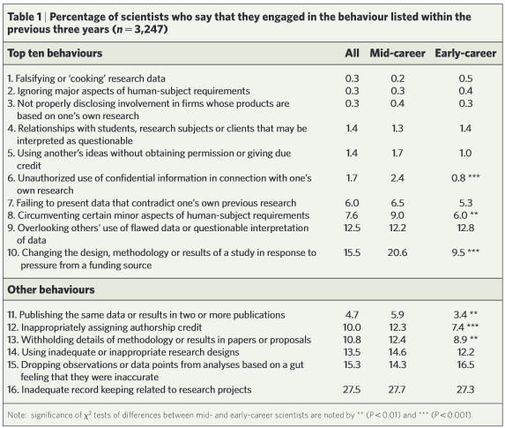
How often do problematic behaviors occur?
Martinson et al. 2005Nature. Vol.435(7043):737-8.

Slide 24
Taking a closer look:
Research Misconduct

Slide 25
What is Research Misconduct?
Fabrication
Falsification
Plagiarism
OSTP Federal Policy on Research Misconduct (2005)

Slide 26
What is Research Misconduct? Fabrication
“Fabrication” is making up data or results and recording or reporting them.
Examples include: Recording data for non-existent research subjects, reporting results for experiments that were not done.
NOTE - Even just writing down bogus data (e.g., in a lab notebook) is considered RM. The bad data doesn’t have to be published or released in any way for it to be a problem.

Slide 27
What is Research Misconduct? Falsification
“Falsification” is manipulating research materials, equipment, or processes, or changing or omitting data or results such that the research is not accurately represented in the research record.
Examples include:
The reuse of an image as representing different experimental conditions,
image manipulation (splicing, cropping, obscuring, enhancing),
changing data results for a better “fit”, etc…

Slide 28
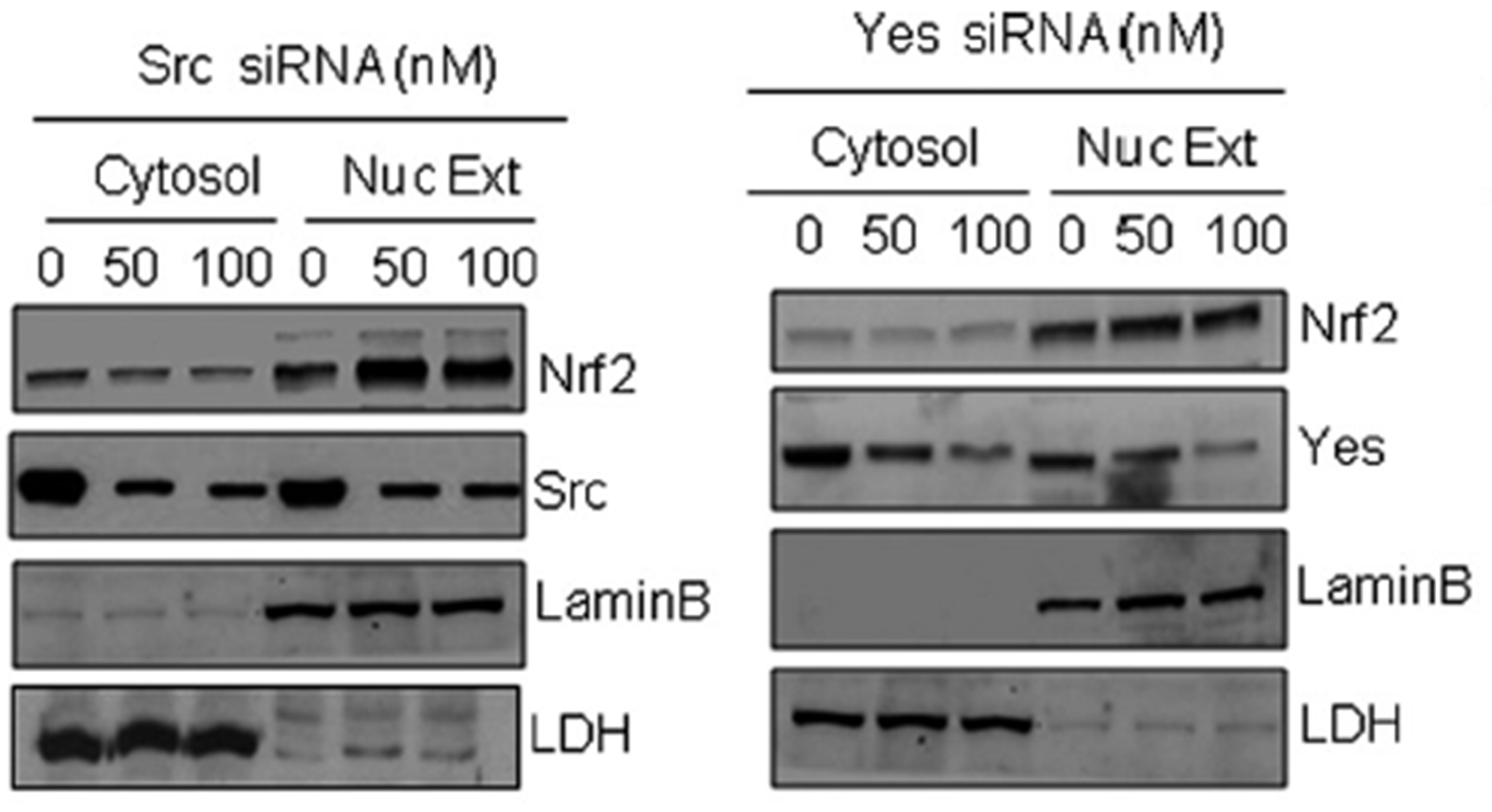
X
Y
A
B
Photoshop Analysis shows
That same picture was flipped horizontally and vertically

Slide 29
Key points:
Be informed when working with data images
Ask for assistance if unsure
Always keep original scan/picture
Be careful when changing file size/resolution, manipulating brightness/contrast, clipping images

Slide 30
What is Research Misconduct? Plagiarism
“Plagiarism” is the appropriation of the ideas, processes, results, or works of another person, without giving appropriate credit.
Examples include:
Cutting and pasting whole sections of text from another source without clearly indicating its origin.
Pulling images from the web or other sources without attribution.
Self-plagiarism is also prohibited (but can be a grey area)

Slide 31
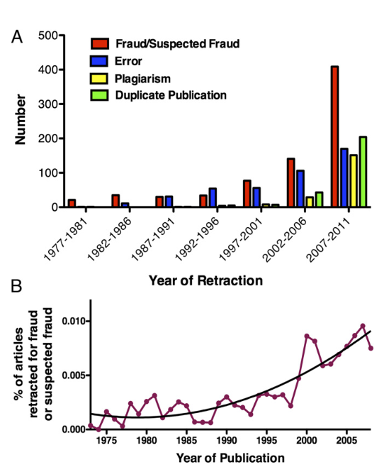
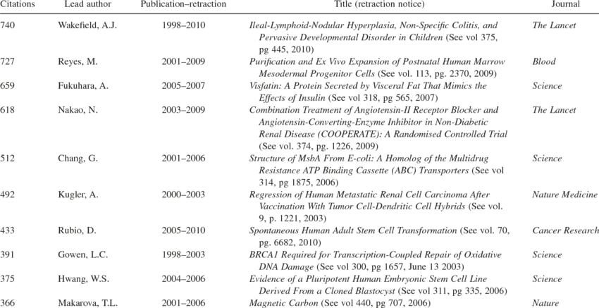
Research misconduct represents a low percentage, but…
Fang et al. Proc Natl Acad Sci (2012) Vol 109 p17028-33
…consequences could be catastrophic

Slide 32
Estimated grant funding associated with retracted articles
Between 1992 and 2012, 291 articles published in the US were retracted for research misconduct.
The estimated funding totals of all NIH grants that contributed in any way to the retracted papers:
$2,324,906,182
Stern AM et al. Elife. 2014 Aug 14;3

Slide 33
What should you be thinking about now?

Slide 34
Be informed!
Use papers you read as an opportunity to discuss and think about good practices (check out the supplementary or extended data)
Read about best practices (Rigor and Reproducibility)
Take a course in biostatistics
Learn about ways to present data that maximize transparency
Ask questions!! Why? How? When?
http://jbcresources.asbmb.org/collecting-and-presenting-data

Slide 35
Ask about data recording practices
In notebooks or electronic?
How much detail is required/expected?
Ask to see examples
Ask your lab mentor to check your notes and give you feedback
Ask about practices for electronic data, including back-up
Record why you did something and not just what you did
Make sure someone else could figure out what you are doing
Keep your notes up-to-date (every day!)

Slide 36
Give (and take) credit appropriately
Don’t use “we” when you really mean “the lab”
Even better, use the names of the people who did the work
When you DID do the work, use “I” or “Dr. Smith and I”
Ask about authorship if you are uncertain (who should be included?)
If presenting the work you did (for example, an abstract or poster presentation at your home institution), include appropriate authors and get permission from all of them
The PI of the lab should always be included at the end of the author list; the person who trained/helped you should likely be included

Slide 37
Admit if you don’t know something or made a mistake
You aren’t expected to be perfect and we all make mistakes!!
Admitting uncertainty or getting help is critical, especially when working with hazardous and/or expensive equipment/reagents or organisms
Take good notes while being shown how to do something
Pay attention to details and ask if something seems wrong or broken

Slide 38
Be a good lab citizen
Keep your own work area clean – respect the work areas of others
Clean up after yourself in common areas – ask if you don’t know what is expected or how to clean or dispose of something
Respect the needs of others to concentrate – ask respectfully before interrupting
Tell someone or follow instructions you are given for reporting supplies/reagents that are low or if you take the last one
If you have a lab “job,” complete it on time and with care
Ask for help if you are unsure!

Slide 39
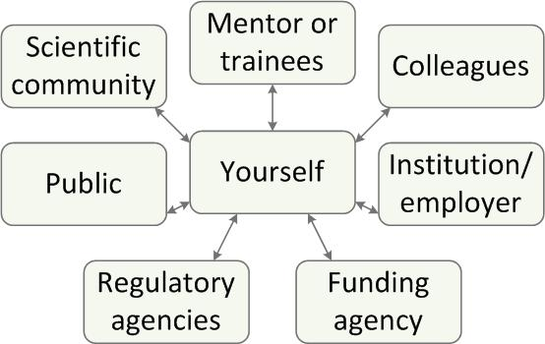
Instead of responsible for what, think about responsible to whom
Learn, question, read, explore, and HAVE FUN!

Slide 40
For more information
MSU Research Integrity Website, http://grad.msu.edu/researchintegrity/
On Being a Scientist: A Guide to Responsible Conduct in Research, 3rd edition, 2009, page ix, http://www.nap.edu/catalog.php?record_id=12192#toc
Steneck, N. (2006-HTML Version). ORI Introduction to the Responsible Conduct of Research, http://ori.dhhs.gov/education/products/RCRintro/

Slide 41
Slides modified from
Michigan State University Graduate School
Responsible Conduct of Research, Scholarship, and Creative Activities, 2010
http://grad.msu.edu/
Grand Valley State University
Responsible Conduct in Research Workshop
February 24, 2018
Ohio State University
Academic Publishing and the Responsible Conduct of Research
Melanie Schlosser - University Libraries Jen Yucel - Office of Research Compliance

