Slide 1
2021 VSSA Orientation
Beth Bowman, PhD
VSSA Director

Slide 2
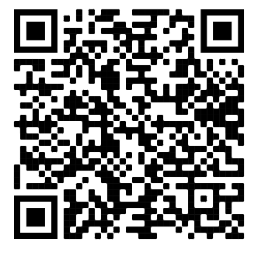
Overview
Sign in
8:00 What is VSSA?
Handbook
VSSA calendar/schedule
Covid considerations
Welcome bags
9:00 Bio-safety training
Note: Animal safety training not included
11:00 Chem safety training
12:00 Radiation training
12:15 Sexual Harassment training
Sign in:
https://bit.ly/3zfF1iG
Welcome bags; ID Cards

Slide 3
What is the VSSA?
AHA-SURE
ASPIRNAUT
BECKMAN SCHOLARS
BP-ENDURE
CHEM-BIO REU
LEADERSHIP ALLIANCE
MCB
MSTP
PAECER
PRIDE
SURI-BMI
UCRIP
Vascular Biology STTP
VDSRP (Diabetes)
VI4
VICC-CURE
V-SURE
VVC
Independents

Slide 4
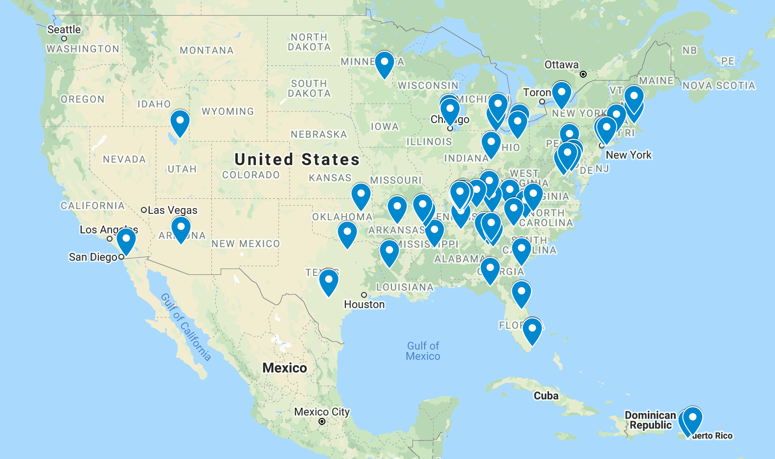
Who is the VSSA?

Slide 5
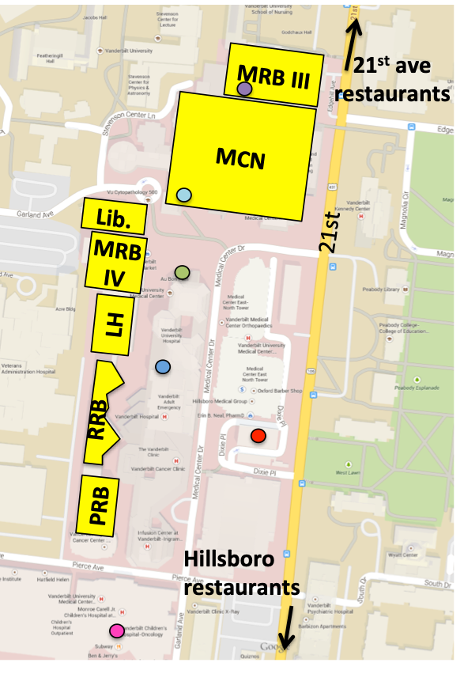
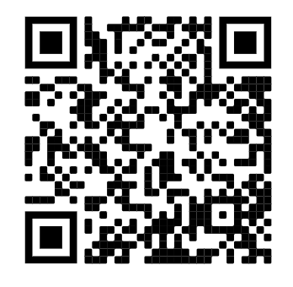
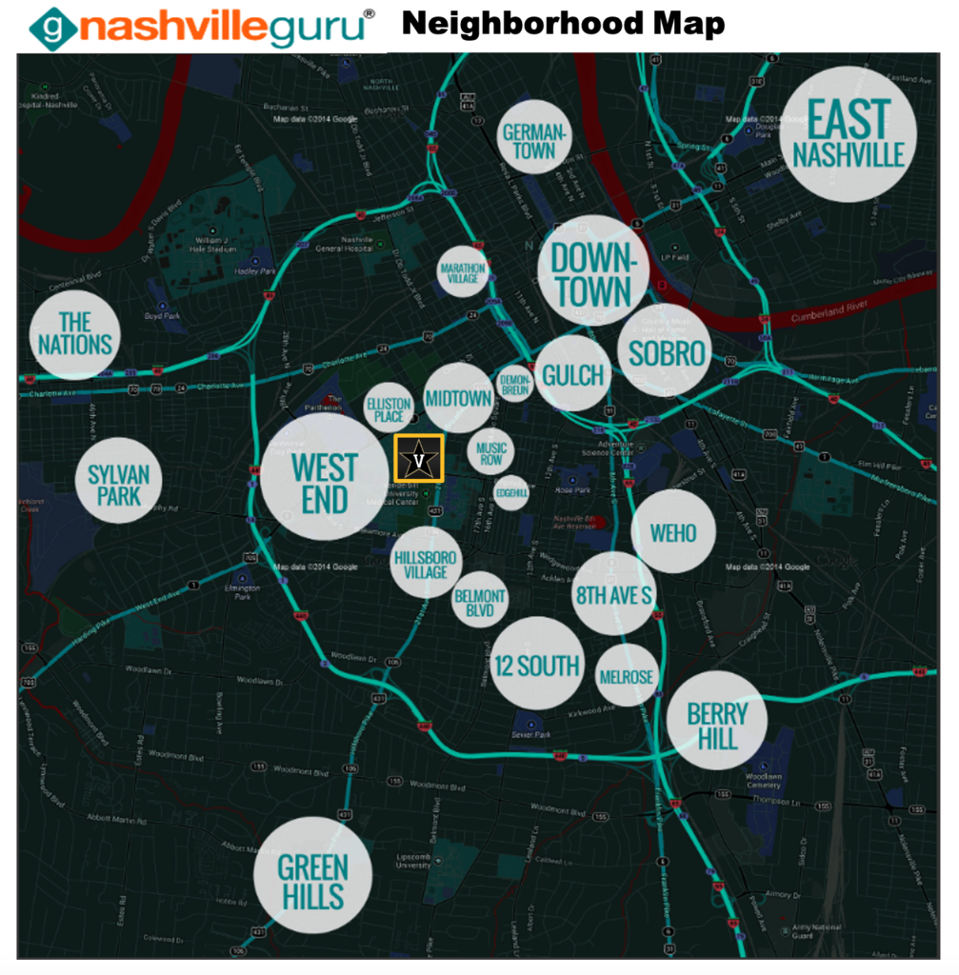
VSSA Handbook
https://medschool.vanderbilt.edu/vssa/2021-in-person-vssa/
Password: VSSAStudent
Info about program activities
Covid Considerations
Important contact info
Living at Scarritt Bennett
Stuff to do nearby and around town

Slide 6
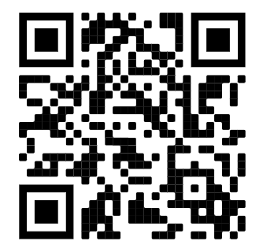
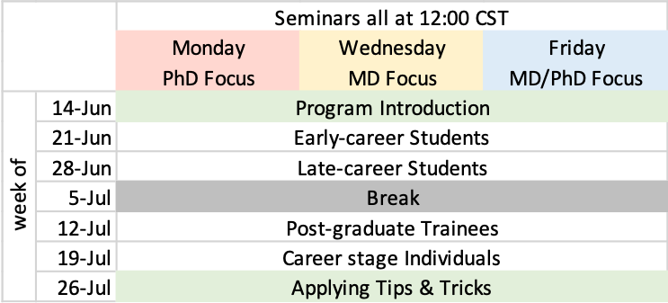
Schedule
https://medschool.vanderbilt.edu/vssa/calendar
Password: VSSAStudent
Schedule
RCR: Wednesday 9th, 12:00
Virtual VSSA, 12:00 CST
Mon: PhD
Wed: MD
Fri: MD/PhD
Various social activities! ☺
Poster Session: Thursday, August 5th
Titles and abstracts due by Friday, July 2nd (info coming)
Preparing Your Poster Talk– July 7th
Posters due by Monday, August 2nd

Slide 7
Social Activities
Virtual Social Activities
Every-other-week
In-person Social Activities
June 13th: Canoeing/Kayaking
June 19th: Tour of African American Museum (first come first served)
June 26/27th: Movie
July 3rd: Picnic

Slide 8
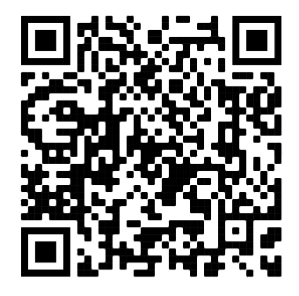
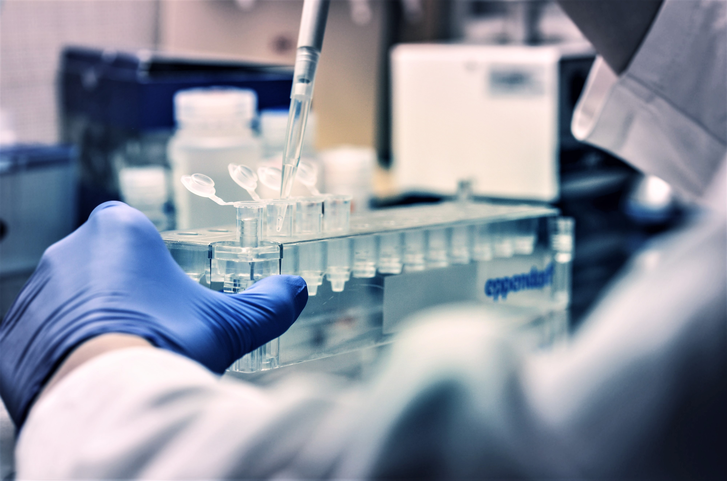
Tips for a successful summer
In the lab
VSSA Mentor & Mentee Discussion form (https://cdn.vanderbilt.edu/vu-web/medschool-wpcontent/sites/61/2021/04/04002944/Mentor-Mentee-form.docx)
Understand your project
Ask questions! Your PI, your mentor, other lab mates
Share your own ideas
Communicate with your mentor
Take initiative
Honesty in lab work
Be courteous & professional
Lab chores, ordering reagents
Letter of recommendation

Slide 9
Tips for a successful summer
Outside of the lab
Be courteous and professional to all
Be responsible in your apartment
Check out Campus Safety Tips
https://medschool.vanderbilt.edu/vssa/vanderbilt-campus-safety
Overall: science is a small world!
If you’re unsatisfied, schedule a meeting with Beth

Slide 10
VSSA Survey & Evaluation
Goals & purpose
Initial survey due, Friday, June 11th
Overall program survey, end of the program
Follow-up survey, in 1 year

Slide 11
Vanderbilt Summer Science Mentoring (VSSM)
Grad–Undergrad mentoring group
Connect with a Vanderbilt grad student
For PhD and MD/PhD students
(not for students who already have near-peer mentoring through their funding program)
Any Problem? No Problem!!
That’s what we are here for!!

Slide 12
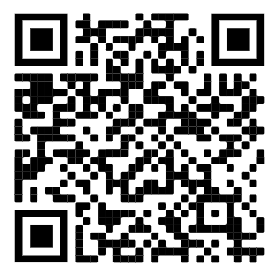
Covid Guidelines
Submit vaccination card to VU https://www.vanderbilt.edu/coronavirus/covid-19-vaccine-information/
Approved as fully vaccinated
Generally no testing or masking needed
Not yet approved as fully vaccinated
Download testing app (https://www.vanderbilt.edu/coronavirus/safer-vanderbilt/)
Weekly testing at Rec center
Monday from 7am-3pm
Tuesday from 7am-1pm
Wednesday from 7am-1pm
Thursday from 7am-1pm
Carry mask with you: follow area guidelines. You are welcome to wear a mask!
More information: https://medschool.vanderbilt.edu/vssa/2021-in-person-vssa/
https://outlook.office.com/vanderbilt.edu

Slide 13
Where to Get Vaccinated
Vanderbilt University Medical Center (615-322-5000)
Vaccines.gov
www.vaccines.gov/search
Zip code 37212

Slide 14
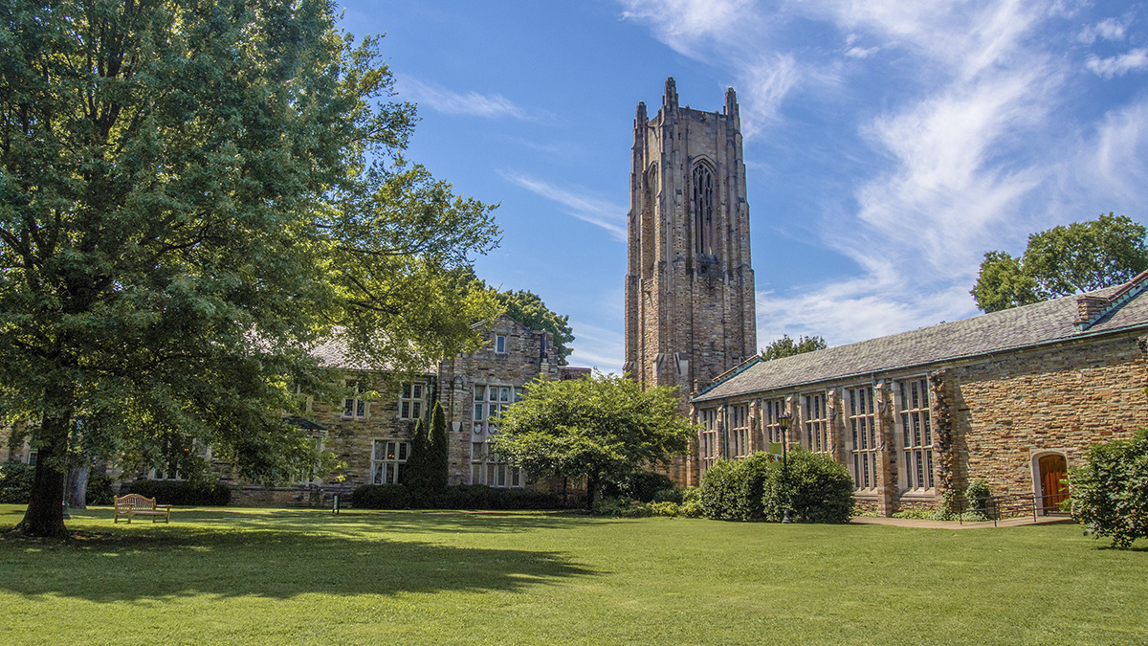
Scarritt Bennett
No visitors in dorms
Gibson and Bragg laundry sign ups
Weekly cleaning
Kitchen cart
1st floor Ereny Morcos (585) 820-3545
Another floor? (text me)

Slide 15
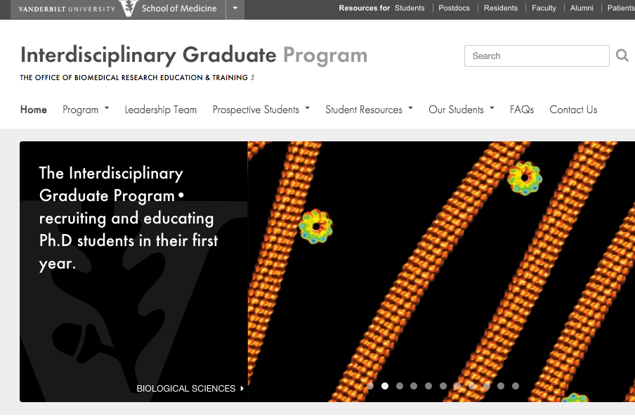
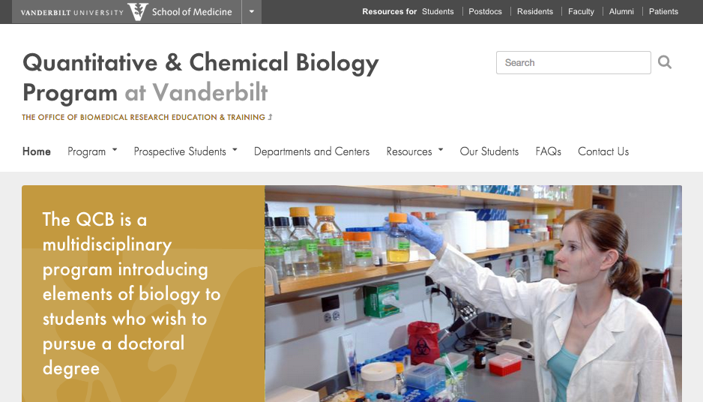
Vanderbilt Medical/ Graduate programs
MSTP (MD/PhD)
https://medschool.vanderbilt.edu/mstp/
MD
https://medschool.vanderbilt.edu/md-admissions/
Graduate programs
PhD & Masters
Biomedical Engineering: http://engineering.vanderbilt.edu/bme/GraduateProgram/
Computer Science: http://engineering.vanderbilt.edu/eecs/Graduate/Programs.php
PhD
Chemistry: http://www.vanderbilt.edu/chemistry/graduate.php
IGP: https://medschool.vanderbilt.edu/igp/
QCB: https://medschool.vanderbilt.edu/qcb/
https://vanderbiltbiomedg.com/

Slide 16
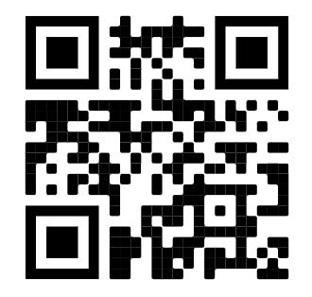
Questions?
ID and Welcome bags
340 Light Hall
Slack
https://bit.ly/3z71qyn
Contact:
elizabeth.a.bowman@vanderbilt.edu
Cell: 615-979-2870 (program it now!)

Slide 17
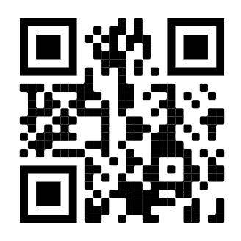
Social Activities & Sign Up
Social Activities
$ June 13th: Canoeing/Kayaking
$ June 19th: Tour of African American Museum (first come first served)
$ June 26/27th: Movie
July 3rd: Picnic
VSSA Mentoring (VSSM) sign up
For those interested in PhD or MD/PhD
Photo for website
Electronic Sign up and Photos:
https://redcap.link/k44qsfrq

