Slide 1
2015 NDOGS Meeting
NIGMS T32 Session
John Laffan, Scientific Review Officer, NIGMS
Richard Okita, Program Director, NIGMS

Slide 2
Agenda
Update on Predoc Training
Review Update (Laffan)

Slide 3
Program Updates
  New Director of NIGMS Training, Workforce Development, and Diversity (TWD) – Alison Gammie
  GM T32 Admin Supplement Program for 2015
    Training in Reproducibility and Rigor and/or Science Careers for PhDs
  RPPR Receipt Date Change For GM T32s (11-15)
  New T32 Grant Application Tables Are Coming*
  Publications for RPPRs (NOT-OD-15-091)*
  Reporting of Outcome Data*

Slide 4
New Training Tables for
RPPRs and Applications
To be used for RPPRs due December 1, 2015
  New GM RPPR Receipt Date for Non-Competing Renewals is November 15, 2015
To be used in competing T32 grant applications beginning May 25, 2016 receipt date – PIs applying for July 1, 2017 NoA start dates (submission dates 09/25/2015 or 01/25/2016 – current 12 Table format).

Slide 5
Publication Reporting on T32 RPPRs
        Notice Number: NOT-OD-15-091**
        Guidance for Reporting Publications for T32 Awards
        Trainee, scholar, and participant publications must be reported in section C.1 of the RPPR if:
  the publication was accepted for publication or published during the reporting period (T5 - 12/1/2014 to 11/14/2015 or T1/T2 - 7/1/2015 to 11/14/2015).
  the publication resulted from work conducted while the individual was supported by the award (i.e., receiving a stipend or salary from the award).
        **Publications resulting from work conducted while not actively supported by the institutional training, career development, or related award should not be reported in section C.1.

Slide 6
T32 Outcomes – Compliance Requirements
New Reporting and Assurance Requirements for Institutions Receiving Awards for Training of Graduate Students for Doctoral Degrees
Issued by National Institutes of Health (NIH)
Notice Number: NOT-OD-09-141
http://grants.nih.gov/grants/guide/notice-files/NOT-OD-09-141.html
Release Date: August 28, 2009

Slide 7
Background Information
The NIH Health Reform Act of 2006 (P.L. 109-482), Section 403C of the PHS Act requires institutions to annually report to the NIH the following information for graduate students that have been supported by NIH training awards:
  Percentage of students who successfully attain a PhD
  Average time to receipt of a doctoral degree.
Institutions must also provide this same information to all applicants to doctoral programs supported by NIH training awards.

Slide 8
Implementation of Policy
As of October 1, 2009, grantees must provide information on completion rates and time to degree in the new Program Statistics section of Table 12A when submitting a renewal application or non-competing continuation progress report.
Institutions may decide how best to present the required information to applicants and may wish to consider consolidating data by department or broad program to which candidates apply,

Slide 9
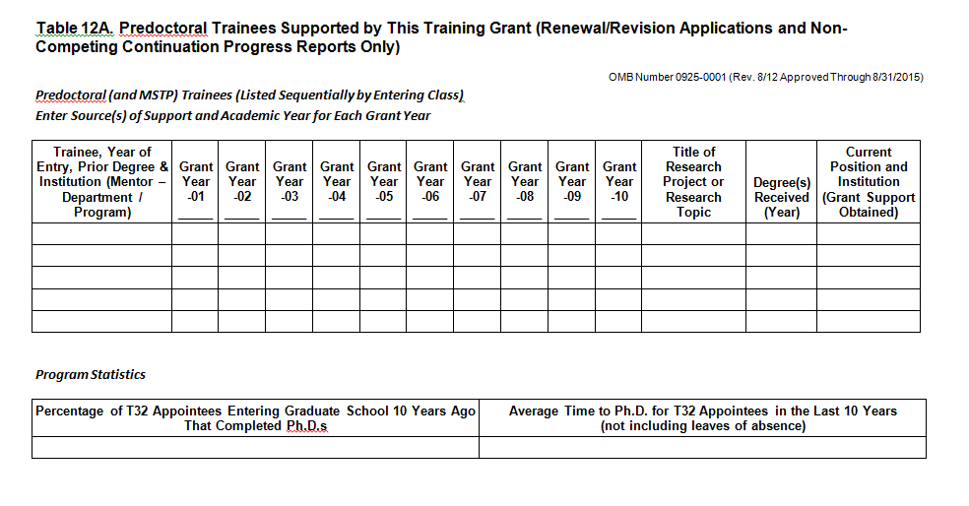
Reporting of Outcomes Data to NIH
Table 12A

Slide 10
ACD Biomedical Workforce Working Group
The working group believes that graduate programs must accommodate a greater range of anticipated careers for students. Graduate programs should reflect that range, and offer opportunities for students to explore a variety of options while in graduate school without adding to the length of training.
Graduate programs should also openly communicate the career outcomes of their graduates to potential students.

Slide 11
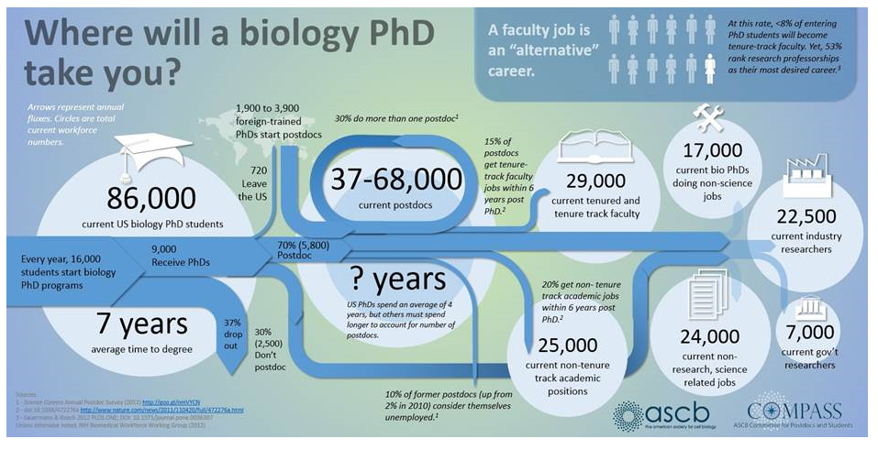
Changing Landscape of PhD Training
http://ascb.org/where-will-a-biology-phd-take-you

Slide 12
Reporting to Your Applicants - Examples
UT Southwestern - http://www.utsouthwestern.edu/education/graduate-school/programs/phd-degrees/select-training-opportunities/students.html#pharm
Johns Hopkins - http://www.hopkinsmedicine.org/pharmacology_molecular_sciences/grad_program/pharmacology_alumni/
University of Stony Brook - http://www.pharm.stonybrook.edu/about-phd-graduate-program
UNC – Chapel Hill - https://www.med.unc.edu/pharm/graduate-program/pharmacological-sciences-training-program-1

Slide 13
UTHSCD - T32 in Pharmacological Sciences http://www.utsouthwestern.edu/education/graduate-school/programs/phd-degrees/select-training-opportunities/students.html#pharm
Outcomes of Past Trainees
  During the past 10 years, 61 trainees have been supported by this grant. Of those, 31 have earned doctorates, 10 have earned MD/PhDs, and 3 have earned Master’s degrees; 17 are still in training.
  Average time to degree for the 31 appointees who earned a PhD was 5.6 years.
  Summary of the positions held by their graduates

Slide 14
Southwestern – T32 Outcomes (continued)
7 are principal investigators in research-intensive institutions such as University of Pittsburgh, Furman University, UT Southwestern, Texas State
8 are postdoctoral fellows in institutions like UC – Berkeley, Harvard, UT San Antonio Health Science Center, Institute of the Foundation for Fundamental Research on Matter (AMOLF) in the Netherlands, UT Southwestern, Fred Hutchinson Cancer Research Center
4 are research staff in a research-intensive institution such as Vanderbilt, UT Arlington, Michael J. Fox Foundation, UT Southwestern
5 are employed in industry as researchers or sales and marketing of science-related products in companies like Onyx Pharmaceuticals, Molecular Templates, Genetech, Sigma-Aldrich, Bio-Rad Life Sciences
3 are in teaching careers in either K-12 or college level
1 is a scientific writer
1 is working in a non-science technical field
2 are searching for positions

Slide 15
Stony Brook University SOM – Ph.D. in Molecular and Cellular Pharmacology http://www.pharm.stonybrook.edu/about-phd-graduate-program
The quality of the education and training offered by our Program is reflected by 38 years of continuous NIH-funded training grant support, the participation of many affiliated faculty outside of the core department and outstanding outcomes for more than 137 PhD graduates who hold academic positions at top Universities and in the pharmaceutical industry. In the last fifteen years, we have graduated 61 students, with an average time to degree of 4.9 years, with over 90% of our students graduating in no more than 6 years after entering the program.

Slide 16
Johns Hopkins – Pharmacology http://www.hopkinsmedicine.org/pharmacology_molecular_sciences/grad_program/pharmacology_alumni/
Pharmacology Alumni - Roster
  Below is a Pharmacology roster representing alumni who have provided us with their correct position and affiliation information. The alumni are listed below in the year they graduated. Also included is the year they matriculated into our graduate program and the mentor they worked with to earn their degree. The time to degree varies for each individual in the program based on many factors, but over the last 28 years the average time it takes from matriculation until graduation is 5.5 years.
  Name; Degree(s) earned; Year started; Mentor; Current Job Title and affiliation (Roster is from 1989 to present)

Slide 17
UNC School of Medicine – Pharmacology https://www.med.unc.edu/pharm/graduate-program/pharmacological-sciences-training-program-1
Pharmacological Sciences Training Program
  Short description of their T32 training grant award
  Career Pathways
  Time to Degree - Although individual time to degrees vary based on the student and the project, on average, Ph.D. degrees are awarded by the Program 5.5 years after entering graduate school.
  Individual Development Plans (IDP's)
  Application Information: Training Grant Appointments

Slide 18
Questions or Comments

Slide 19
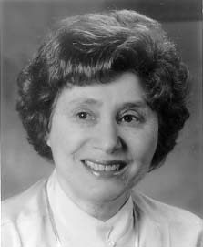
PhD Training Continues to Evolve
NIH has supported research training since 1930s
National Research Service Award 1975
(i.e. T32, F30/31, F32; MARC)
Ruth L. Kirschstein
-funding to scientists, not health professionals
-to enhance research training
-in scientific areas with need for researchers
-good curricula, facilities, program AND research
-dedication to developing talent

Slide 20
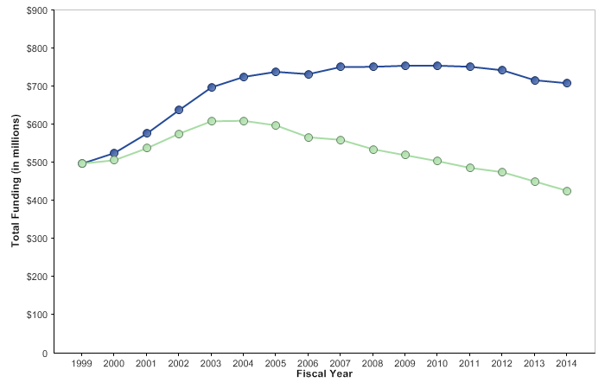
Kirschstein-NRSA training grants and fellowships
Funding in current and constant dollars
NDOGS Workshop, 2015
Notes:
20
Data and chart description for this slide can be located at http://report.nih.gov/NIHDatabook/Charts/Default.aspx?showm=Y&chartId=50&catId=17

Slide 21
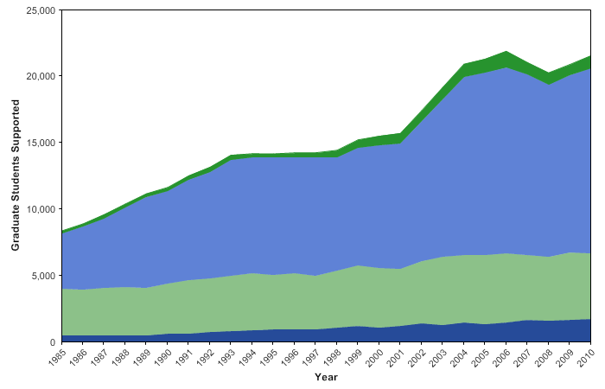
PhD support is largely on research grants
Apprenticeship vs. a Program
other
Research Project Grants
Training Grants
fellowships

Slide 22
Success of T32 trainees

Slide 23
NIGMS T32 Program Areas
Behavioral-Biomedical Sciences Interface
Bioinformatics and Computational Biology
Biostatistics
Biotechnology
Cellular, Biochemical and Molecular Sciences
Chemistry-Biology Interface
Genetics
Medical Scientist Training Program
Molecular Biophysics
Molecular Medicine
Pharmacological Sciences
Systems and Integrative Biology
NDOGS Workshop, 2015

Slide 24
Training, Workforce Development and Diversity
[TWD] Review Committees
TWD-A
TWD-B
SCIENTIFIC REVIEW OFFICER
LAFFAN, JOHN, PHD
SCIENTIFIC REVIEW OFFICER
NEWMAN, LISA, ScD
Standing
committees
21 MEMBERS
20 MEMBERS
TWD-S
SCIENTIFIC REVIEW OFFICER
Seetharam, Sara
SEPs
? MEMBERS
NDOGS Workshop, 2015

Slide 25
NIGMS T32 GOALS
Develop cross-disciplinary interactions that transcend departmental boundaries to provide interdisciplinary training in the broad research areas listed in the program announcement.
Develop mechanisms to provide a much broader training experience than would normally be available in a single laboratory or department (i.e., much broader than required for completion of their thesis research).
NDOGS Workshop, 2013

Slide 26
Predoctoral Training Grant Application Deadlines
Application Receipt Date | Initial Review Group Meeting | Advisory Council Review | Earliest Start Date
September 25, 2015 | March 2014 | May 2014 | July 2017
January 25, 2016 | June 2016 | September 2016 | July 2017
May 25, 2016 | November 2014 | January 2017 | July 2017
Most applications
this round
Postdoctoral Training Grant Application Deadlines
Application Receipt Date | Initial Review Group Meeting | Institute Advisory Council Review | Earliest Start Date
January 25, 2016 | June 2016 | September 2017 | July 2017
NDOGS Workshop, 2015

Slide 27
SITE VISIT “POLICY”
Deferred applications
Ongoing program not visited for 10 years
Ongoing program at first renewal
Ongoing program suggested for visit in previous review
Ongoing program with new PI, student-related problems
Video site visits
NDOGS Workshop, 2015

Slide 28
Newish T32 Issues
New PA (no 6 points) - Dec 2013
Include disabled in Diversity Plan section
Unlimited A0 new applications – 2014
  Use A1 as before
  Do NOT mention previous reviews
  Use new biosketch format – 2015
  Multi-career outcomes
  2 week grace for service

Slide 29
New Tables
Reducing the number of tables from 12 to 8
Minimizing reporting of individual-level information
Tracking of trainee outcomes now 15 years
No GREs
Available September 2015
Required for May 25, 2016, due date and after
To be used for RPPRs due December 1, 2015
xTRACT required starting 2017

Slide 30
IDPs - Individual Development Plans
NOT required
Highly suggested
IDPs have been successfully implemented in many different ways
Did I mention that they are highly recommended?

Slide 31

Discussion

Slide 32
2. Sizable, distinct group of highly qualified students interested in the interdisciplinary research training to be provided.
THE INGREDIENTS
1. Sizable group of high quality experienced faculty mentors from a number of departments/programs who have broad-based research interests and are committed to provide and participate in the specified type of interdisciplinary graduate education.
3. Research training environment includes resources for students, for research, and strong institutional support [dedicated stipends from the institution, impresses]
NDOGS Workshop, 2015

Slide 33
Required laboratory rotations for mentor selection and/or to provide exposure to research experiences in more than one discipline.
ONE RECIPE ?
A didactic component that provides the students with both discipline-specific and multi-disciplinary training; may consist of a core of courses for all trainees, or at least one required (capstone) course common to all trainees. Critical for focus and identity for the trainees, in early years of study.
NDOGS Workshop, 2015

Slide 34
Effective programmatic mechanisms for:
-monitoring mentoring effectiveness and participation by the faculty… [selection/ “de”selection, for participation, discipline diversity, and faculty mentorship ability. ]
- Selection of students to be supported
-monitoring progress of the trainees [>thesis committee]
-providing trainees with enhanced career guidance.
Dedicated leadership and an effective administrative structure to ensure that all participants have representation and input.
NDOGS Workshop, 2015

Slide 35
Interactive research presentation mechanism for trainees /mentors; a required seminar and/or retreat, that significantly involves students throughout their graduate training.
Ongoing exposure to research in the various disciplines included in the broader area specified by the training grant.
NDOGS Workshop, 2015

Slide 36
Strategies to Develop a Strong Proposal
Start Early
Why a TG is important for your program
Be very sure there is a PROGRAM
Complete tables before finalizing narrative
  Scientists notice discrepancies
Study the review criteria
Explain, explain, explain.
  Remember reviewers are expert faculty familiar with training

Slide 37
Hallmarks of Good Training Programs
Student development for biomedical team
experience, contributions, growth, project
Contemporary, mentored research education
broad and deep academic curriculum
research skills and knowledge
conceptual judgment, right questions
communication skills
Career development for multiple outcomes
as a scientist (fellowships, meetings, papers)
teaching activity? Leadership? Mgmt?
externships? Policy? Workshops?
Responsible Conduct of Research

Slide 38



Where to find information
http://grants.nih.gov/grants/oer.htm
Everything is here, but search with
  TWD web site - http://www.nigms.nih.gov/Training/
Make sure the funding announcement is:
  Still active - - Expiration dates listed
  Most current - - Updates listed on first page
NDOGS Workshop, 2015

Slide 39
Instructions are clear!
It is critical that applicants follow the instructions in the SF 424 (R&R) Application Guide except where instructed to do otherwise (in the FOA or in a Notice from the NIH Guide for Grants and Contracts). Conformance to all requirements (both in the Application Guide and the FOA) is required and strictly enforced. Applicants must read and follow all application instructions in the Application Guide as well as any program-specific instructions noted in Section IV. When the program-specific instructions deviate from those in the Application Guide, follow the program-specific instructions.
Applications that do not comply with these instructions may be delayed or not accepted for review.
NDOGS Workshop, 2015

Slide 40
ELECTRONIC SUBMISSION PROCESS
Retrieve current funding opportunity announcement
  TWD web site - http://www.nigms.nih.gov/Training/
Submit application through Grants.gov
  Download Adobe-based application package - http://www.grants.gov/applicants/apply_for_grants.jsp
  Submit text, data tables, completed forms
  “On Time” = receive tracking number and timestamp by 5:00 p.m. local time on submission deadline date
  NO error correction window!!!
NDOGS Workshop, 2015

Slide 41
Pay attention to:
Where to place attachments
Budget pages
Biosketches
Tables
Page and Character Limits
Allowed appendix material
NDOGS Workshop, 2015

Slide 42
CONFIRM SUBMISSION AND TRACK REVIEW
Confirm submission via eRA Commons
  View assembled application in eRA Commons
  Correct any errors/warnings IMMEDIATELY;
    NO ERROR correction window!!!
  If you cannot view it in Commons, we can’t see it either!
Track review process in eRA Commons
  Get contact information for assigned NIH Program, Review Office, and Grants Management staff
  Determine assigned review panel
  Obtain impact score and summary statement
NDOGS Workshop, 2015

Slide 43
Review Process

Slide 44
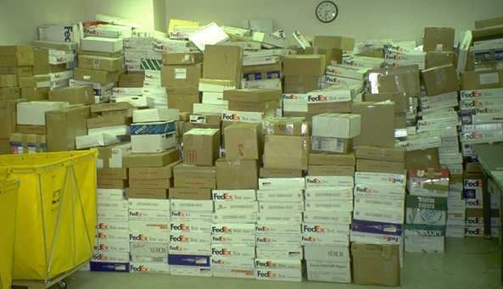
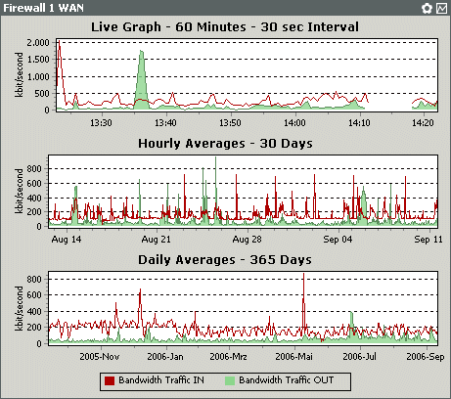
When your application arrives at NIH
THEN
NOW
Grants.gov
http://www.grants.gov/
eRA Commons
http://era.nih.gov/

Slide 45
Review process
Prior to review meeting
  Each application assigned to at least 3 reviewers
  Reviewers submit preliminary scores & written comments
At review meeting
  Persons with conflicts of interest excused
  Assigned reviewers provide preliminary overall impact scores (1 - 9); at NIGMS, average of scores ≥ 5, streamline considered)
  Discussion of application’s scientific merit & other review criteria
  Restatement of scores by assigned reviewers
  All present panel members score privately
  Consideration of budget and any additional review criteria
NDOGS Workshop, 2015

Slide 46

Feedback from review
Overall Impact Score & Percentile
  Available in eRA Commons 1 – 2 days after review meeting
  Impact score = average reviewer score (1 – 9) X ten = (10 – 90)
  Percentile = NIGMS does not percentile T32s
Summary Statement
  Available in eRA Commons 4 – 6 weeks after review group meeting
  Summary of discussion written by Scientific Review Officer
  Core criteria scores and written reviewer comments
  Budget recommendations, administrative notes including
  acceptability of human subjects, vertebrate animal,
  diversity plans
Training Program: 2
Program Director: 2
Mentors: 3
Trainees: 2
Training Record: 1
NDOGS Workshop, 2015

Slide 47
Overall impact score
Takes into consideration core and additional review criteria as well as panel discussion
Weights at discretion of reviewers
NOT arithmetic mean of core criteria scores
Average x 10 of final scores from all voting panel members
Range is 0 – 90
Interpret according to descriptors on chart

Slide 48
Current Scoring System
The likelihood that the proposed training program will prepare individuals for successful, productive scientific research careers and thereby exert a sustained influence on the research field(s) involved.
Evaluating Overall Impact:
Consider the 5 criteria (weighting based on reviewer’s judgment):
Ts: Training Program and Environment, Training PD(s)/PI(s), Preceptors/Mentors, Trainees, Training Record
and other score influences, e.g. human subjects, animal welfare, inclusion plans, and biohazards.
e.g., Proposes a high-value training or career development program that is well designed to prepare individuals for highly successful, productive scientific research careers. May have some or no weaknesses in the criteria.
e.g., Proposes a high-value training or career development program that is adequately designed to prepare individuals for successful, productive scientific research careers. Weaknesses in the criteria reduce the overall impact to medium.
e.g., Proposes a training or career development program of moderate value that is adequately designed. May have some or no weaknesses in the criteria.
e.g., Proposes training or career development program of moderate or value that is adequately designed to prepare individuals for successful, productive scientific research careers. Weaknesses in the criteria reduce the overall impact to low.
e.g., Proposes a low-value training or career development program that is inadequately designed. Has some weaknesses in the criteria.

Slide 49
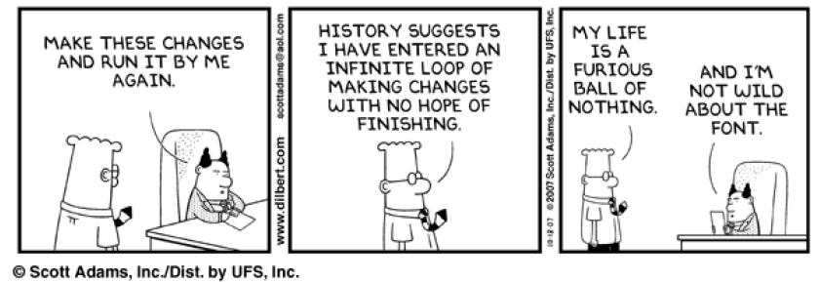
Deciding when (or if) to resubmit
One resubmission allowed, then new again
Digest your summary statement CALMLY
Talk with your program officer

Slide 50
Application Preparation Tips
MRT

Slide 51
Preparing your application
There is no amount of
Grantsmanship that will turn a
bad idea into a good one . . . .
But there are many ways to
disguise a good idea.
Dr. William Raub
Past Deputy Director, NIH

Slide 52
Content and context
Include the right information
  Read the CURRENT FOA and ensure that your application contains the necessary elements
  Successful submission through Grants.gov and eRA Commons does not mean appropriate responsiveness to the FOA
  Make sure all parts are successfully uploaded!
Present your unique framework
  Present institutional context/environment of your program, i.e. BASELINE DATA
  Be realistic in your program’s goals
  How does your program address your students’ needs?

Slide 53
Comprehensive
Address all requirements
  If you don’t have institutional baseline data, explain how you plan to obtain it
  If you haven’t fully formed your evaluation plan, at least acknowledge that you are working on it
Describe how your proposed program “works”
  How are students recruited and selected? By whom?
  What does the advisory committee do? How often do they meet?
  How have you used evaluation information in designing/improving your program?
  How/when are the program activities implemented? Are the number/timeframes realistic?

Slide 54
Clear
Make your application easy to read and understand
  Don’t bury important information
  Don’t expect reviewers to “read between the lines” to figure out what you are proposing
Present outcomes data in a straightforward manner
  Don’t exaggerate
  Don’t hide data
    Reviewers “do the math”
  It is far better to present results as they are and address how the program aims to improve

Slide 55
Current and Consistent
Provide latest information
  Make sure faculty biosketches are up-to-date & new form
    Statement might include training
  Provide data on current and prior students
  Use the most recent institutional data
Information should be consistent throughout
  Data in tables and text should match
  Data should be the same across tables
  Match justification to budget items
  Refer to the correct program in text and tables

Slide 56
When and Who to Contact
When
Who
Pre-application
Submission
Receipt & Referral
Review
Summary Statement
Advisory Council
Funding Decision
Resubmit - or not?
Award
Colleagues, Institute Program Staff
Your Office of Sponsored Research, eRA Helpdesk
Scientific Review and Program Officers
Only Scientific Review Officer
Program Officer
Program Officer or Grant Specialist

Slide 57
Application Specific Preparation
Presentation from Dr. Alison Hall, NIGMS

Slide 58
Active Program Beyond “Normal degree”
“value added”
PROGRAM IS MORE THAN GET THE DEGREE
Active nomination, selection of candidates from pool
Planned academics with flexibility
Seminars, enhancement activities
Longitudinal program beyond funding
Faculty trainer responsibilities make program strong
Intentional activities to achieve outcomes

Slide 59
1. Training Program and Environment
Are the research facilities and training environment conducive to prepare trainees for successful careers as biomedical scientists?
Do the objectives, design and direction of the proposed research program ensure effective training?
Is the proposed program of training likely to ensure that trainees will be prepared for successful and productive scientific careers?
Do the courses, where relevant, and research training experiences address state-of-the-art science relevant to the aims of the program?
Does the program provide training in inter- or multidisciplinary research and/or provide training in state-of-the-art or novel methodologies and techniques?
Is a significant level of institutional commitment to the program evident?

Slide 60
2. Training Program Director/Principal Investigator
Does the Training PD/PI have the scientific background, expertise, and experience to provide strong leadership, direction, management, and administration to the program?
  His/her trainees, outcomes
Does the PD/PI plan to commit sufficient time to the program to ensure its success?
Is sufficient administrative and research training support provided for the program?
Is a strong justification provided that the multiple PD/PI leadership approach will benefit the training program and the trainees?
roles and responsibilities, governance, and organizational structure consistent with and justified by training program and with the complementary expertise of PD/PIs?

Slide 61
3. Preceptors/Mentors
Are sufficient numbers of experienced preceptors/mentors with appropriate expertise and funding available to support the number and level of trainees proposed in the application?
3-4x faculty available to student, not all one lab…
Do the preceptors/mentors have strong records as researchers, including successful competition for research support in areas directly related to the proposed research training program?
    How diverse are faculty?
Do the preceptors/mentors have strong records of training pre- and/or postdoctorates?

Slide 62
4. Trainees
Is a recruitment plan proposed with strategies to attract high quality, diverse, trainees?
Are there well-defined and justified selection criteria and retention strategies?
  Nomination, re-appointment criteria, process
Is there evidence of a competitive applicant pool in sufficient numbers to warrant the proposed size and levels?
  TG is catalytic, supports a third(?) of relevant TGE students

Slide 63
4. Trainees (cont)
For renewal applications, how successful has program been in attracting and retaining individuals from diverse populations, including populations underrepresented in science?
Report Trainees
Training Grant Eligible
Students from groups underrepresented in biomedical science
Students with disabilities, defined as physical or mental impairment that substantially limits one or more major life activities.

Slide 64
The IDP involves
The scholar The mentor
self assessment familiarity with opportunities
Survey opportunities discuss opportunities
Write IDP review IDP, help revise
Implement plan assess new tasks, progress
in light of the plan
Skills assessment-strengths and weaknesses
Career match- do goals match skills and interest
Do it again next year

Slide 65
5. Training Record
How successful are the trainees in completing the program?
How productive are trainees in terms of research accomplishments and publications?
How successful are trainees in obtaining further training appointments, fellowships, and/or career development awards?
How successful are the trainees in achieving productive scientific careers, as evidenced by successful competition for research grants, receipt of honors or awards, high-impact publications, receipt of patents, promotion to scientific leadership positions, and/or other such measures of success?

Slide 66
5. Training Record
For programs that provide research training to health-professional doctorates, is there a record of retaining health professionals in research training or other research activities for at least two years?
Does the program have a rigorous evaluation plan to assess the quality and effectiveness of the training?
  Annually assess outcomes?
  Adapt to changes?
  Test intervention hypothesis?
Are effective mechanisms in place for obtaining feedback from current and former trainees and monitoring trainees’ subsequent career development?

Slide 67
Institutional Training
Additional Review Criteria & Considerations
Additional Review Criteria
  Protection for Human Subjects
  Inclusion of Women, Minorities, and Children
  Vertebrate Animals
  Biohazards
  Resubmission, Renewal, Revision factors
Additional Review Considerations:
  Diversity Recruitment Plan
  Training in Responsible Conduct of Research
  Select Agent Research
  Budget and Period of Support
Blue – not helpful to T32 application
Red - super important to do correctly
Notes:
Unless a specific part of the training in the training grant we do not want to see the human subjects or vertebrate animals. But if you have a required lab with human subjects or vertebrate animal experimentation then yes we need to see this.

Slide 68
The Narrative
Background
  Summarize data in Tables:
  Departmental Membership, Participating Faculty Members, Other TG Support
Program Plan
  What students will do & why
  timeline? Course structure? Expectations?
  Program Faculty
  Faculty Grant Support, Trainees, Publication of Trainees

Slide 69
The Narrative (cont)
Proposed Training
Training Program Evaluation
Trainee Candidates-Recruitment
Institutional Environment and Commitment
Admissions and Completion Records of Trainees (summarize tables)
Qualifications of Applicants (summarize tables)

Slide 70
The Narrative (cont)
Current Trainee Qualifications (Tables 9A and/or 9B)
Recruitment and Retention Plan to Enhance Diversity (Tables 1, 7 A/B, Renewal Apps Table 10)
Plan for Instruction in Responsible Conduct of Research
For Renewal Applications—Progress Report (Tables 11, 12 A and/orB)

Slide 71
Appendix
Can only have 10 but you can combine them
Don’t use to circumvent page limits
Have mercy on reviewers
They are not required to read the appendix

Slide 72
Supplemental information
Limited to 3 pages
Very limited - always check with SRO
New faculty allowed only if new to Institution since submission (then give biosketch).
NIGMS allows student biosketches in update (not part of 3 pages)

Slide 73
Thank You
For more info contact:
Your Program Officer and/or Me
LaffanJo@NIGMS.NIG.gov

