Slide 1
Departmental Administrators Meeting
Tuesday, October 28, 2014
Flynn Auditorium – Law School
9:00 – 11:00 AM
Presented by OCGA and OSP

Slide 2
Agenda
Introductions
FY 2014 Recap of Sponsored Projects
Pre-award Reminders
Uniform Guidance Update

Slide 3
Introductions

Slide 4
Sponsored FY14 Award Activity
~1,100 proposals submitted in FY14…..
 | FY14
Federal | $116,879,335
Non-Federal | $14,725,353
Total | $131,604,688
 | Non-Fed | DOD | DOED | DOE | NASA | NSF | NIH | USAID | Other Fed | Total
FY 14 Award Count | 138 | 92 | 36 | 40 | 15 | 105 | 111 | 4 | 20 | 561

Slide 5
1st No-Cost-Extension Requests
NIH
NSF
The NCE request should be prepared and submitted to OSP a minimum of three (3) full business days prior to the NIH due date. It is important to plan ahead!! If the NCE is not submitted prior to the project close date, as a grantee, we lose the opportunity to submit via Commons resulting in a possible situation where NIH may not approve.
If you require a one-time extension of the grant expiration date to assure completion of the original scope of work with funds already available, you must notify your NSF Program Officer through FastLane at least 10 days before the award expiration date specified in the grant.

Slide 6
Progress Reporting Updates and Reminders
NSF
NSF has transitioned to Research.gov for submission of all project reporting http://www.research.gov/
NIH
NIH has transitioned the majority of progress reporting to the RPPR format (snap and fellowships)
NIH will begin piloting non-snap progress reports for FDP Institutions using the RPPR format
Dep. of Education
Continue to use G5 system
Reminder: A Coeus Continuation application and PEER log is required if a progress report triggers the next funding increment

Slide 7
NIH Publications-Open Access Policy
Policy was effective April 7, 2008
Non-compliance could result in loss of or delay of funding
For non-competing continuation grant awards with a start date of July 1, 2013 or beyond:
NIH will delay processing of an award if publications arising from it are not in compliance
Investigators will need to use My NCBI to enter papers onto progress reports. Papers can be associated electronically using the RPPR, or included in the PHS 2590 using the My NCBI generated PDF report

Slide 8
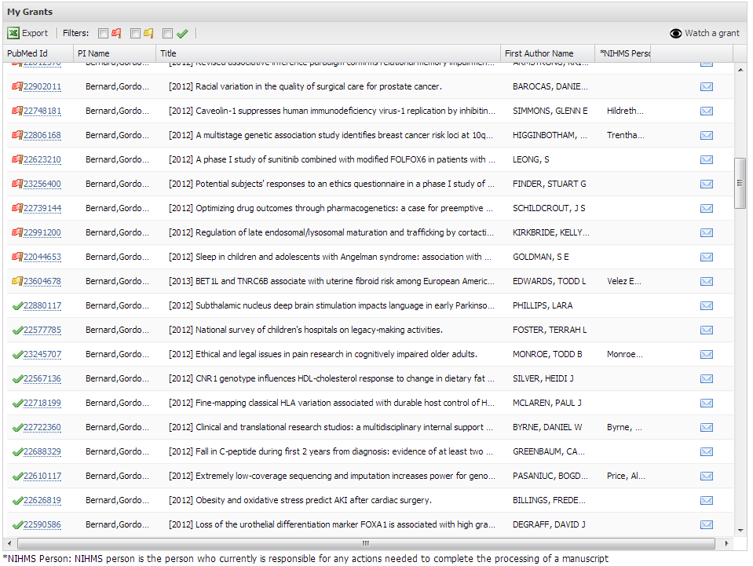
NIH Publication Compliance Dashboard
https://starbrite.vanderbilt.edu/pubaccess/
Add any grant to your dashboard
Expandable to monitor status of each publication
Email individual publication information to someone

Slide 9
Award Acceptance
As part of OSP’s review of any final restricted budget (new or continuation/adding new funding), we have been charged with ensuring proper IRB and IACUC review has occurred.
This will not hold up receiving a center number, however, if IRB and or IACUC has not been approved, the center will remain in DRAFT, meaning no drawdown or invoicing will take place.

Slide 10
Award Acceptance
Research Involving Animals…..
The VU-IACUC Office expects any award received where animal work is involved regardless of when it will be performed during the granting period - to have received a full review by the IACUC prior to any draw down of funds.
If at any point the proposed work changes in a way that results in additional procedures, the PI would be expected to submit an amendment to the approved protocol (if the change involved simply not performing procedures described in the original grant/protocol, then nothing would be required of the PI)

Slide 11
Award Acceptance
Research Involving Human Subjects…..
For Human Subject Research, if the HS work is to be preformed at a later time in the project period and the PI does not have all the information to build the protocol application at the time of award, the IRB has an established process called “grant review” formally known as an “umbrella review” that meets federal regulations. This review will suffice for the documentation needed for the sponsor and at final budget time for invoicing and drawing down funding.
https://www4.vanderbilt.edu/irb/forms/applications-and-consents/

Slide 12
Award Acceptance
Research Involving Human Subjects…..
https://www4.vanderbilt.edu/irb/forms/applications-and-consents/

Slide 13
Office of Management and Budget Uniform Guidance
Key Changes Impacting Research Administration at Vanderbilt for Federal Awards

Slide 14
What Is The Uniform Guidance?
Major changes in regulations impacting research administration with heavy emphasis on documentable evidence of compliance
On December 26, 2013 the Office of Management and Budget (OMB) released its final rule of “Uniform Administrative Requirements, Cost Principles, and Audit Requirements for Federal Awards” (2 CFR Chapters I, II, Part 200, et al).
This guidance compiles eight existing OMB circulars applicable to Educational Institutions, Non-Profit Organizations, and State, Local and Indian Tribal Governments into one document.
Federal agencies must develop their own agency-specific policies that conform to the Uniform Guidance. Additional changes can occur once those policies are released.
Vanderbilt must ensure compliance with the Uniform Guidance and with agency-specific policies.

Slide 15
When is the Uniform Guidance Effective?
December 26, 2013
OMB Issued the Final Rule on the Uniform Guidance
June 26, 2014
Due date for federal agencies to submit proposed implementation plans to OMB
December 26, 2014
Uniform Guidance goes into effect for all new federal awards and funding increments (subject to a change in award terms and conditions) provided on or after this date
FY2015
July 1, 2015
This guidance needs to be incorporated into Vanderbilt’s next Facilities and Administrative Rate Proposal, which is based on FY2015.
Uniform Guidance audit requirements are applicable to Vanderbilt federal awards

Slide 16
Highlights of Key Changes
Procurement
Computing Devices
Administrative and Clerical
Internal Controls
Performance Measurement
Fixed Amount Sub-awards
Sub-recipient Monitoring
Disclosure Statement
10% de minimus F&A Rate
Utility Cost Allowance within the F&A Proposal
Effort Reporting

Slide 17
Major Changes in Procurement (200.317- 200.326)
Topic
Procurement Records
Uniform Guidance Synopsis
Contains a prescriptive description of records that must be maintained to document the history of the procurement.
What Does This Mean?
Documentable evidence of compliance imbedded in our procurement records

Slide 18
Major Changes in Procurement (200.317- 200.326)
Topic
Procurement Methods
Uniform Guidance Synopsis
Institutions must use one of five procurement methods when purchasing goods or services that are directly charged to a Federal award.
What Does This Mean?
For purchases over $3,000, price or rate quotations must be obtained from an adequate number of qualified sources.
One of the five methods is a key change:
Small Purchases are defined as purchases that are >$3,000 and <=$150,000
Vanderbilt must define “adequate” (must be more than one) and the methods of obtaining the price or rate quotations must be defined and documented for audit purposes.

Slide 19
Major Changes in Procurement (200.317- 200.326)
Due to the extensive changes to procurement standards, OMB is allowing a grace period to FY2017 for implementing procurement policies and procedures.
Grace Period

Slide 20
Major Changes in Procurement (200.317- 200.326)

Slide 21
Major Changes in Procurement (200.317- 200.326)

Slide 22
Computing Devices (200.453)
Topic
Direct Charging of Computing Devices to Federal Awards
Uniform Guidance Synopsis
Specific language was added that allows non-capital computing devices (under $5,000) to be charged as a direct cost to a federal award if they are essential and allocable to the performance of the Federal award, even if they are not solely dedicated to the project.
What Does This Mean?
While this language was added to the regulations, it supports Vanderbilt’s current practice of how and when we charge computing devices to federal awards. A justification will still be required to document necessity and proper allocation.
Uniform Guidance language requires consistent treatment of costs in like circumstances, so charging any portion of a non-capital computing device would still require an unlike circumstance justification.

Slide 23
Administrative and Clerical (200.413)
Topic
Direct Charging of Administrative and Clerical Salaries to Federal Awards
Uniform Guidance Synopsis
In order to charge administrative and clerical salaries direct to federal awards, all of the following criteria must be met:
What Does This Mean?
While this language was changed in the regulations, it supports Vanderbilt’s current practice of how and when we charge administrative and clerical salary to federal awards. A justification will still be required to document necessity and proper allocation.
Administrative or clerical services are integral to a project or activity;
Individuals involved can be specifically identified with the project or activity;
Such costs are explicitly included in the budget or have the prior written approval of the Federal awarding agency; and
The costs are not also recovered as indirect costs.
PIs/departments should add a new justification statement to proposals to facilitate the required agency approval.

Slide 24
Internal Controls (200.303)
Topic
Strong Emphasis on Internal Controls
Uniform Guidance Synopsis
References “Standards for Internal Controls in the Federal Government”, issued by the Comptroller General (also known as the “Green Book”) and “Internal Control Integrated Framework”, issued by the Committee of Sponsoring Organizations of the Treadway Commission (COSO)
What Does This Mean?
While OMB has clarified in an FAQ that there is no expectation that we have to explicitly follow these referenced guidelines (as long as we have effective internal controls in place), it is unclear what the audit community will expect.
Mentioned 103 times in the 12/26/2013 Federal Register notice

Slide 25
Performance Measurement (200.301)
Topic
Performance Measurement
Uniform Guidance Synopsis
Clear directive for funding agencies to relate financial data to performance requirements of the federal award and provide cost information to demonstrate cost effective practices (e.g. unit cost data).
What Does This Mean?
While reporting of performance and financial information has been separate in the past, it is unclear how federal agencies will relate the two going forward.

Slide 26
Fixed Amount Sub-awards (200.332)
Topic
Fixed Amount Sub-awards
Uniform Guidance Synopsis
Requires prior written approval from the federal agency for all fixed price sub-awards
What Does This Mean?
VU Contracting Offices will have to ensure they obtain prior approval and abide by the $150,000 limit.
All fixed price sub-awards are limited to $150,000

Slide 27
Sub-recipient Monitoring (200.330 - 200.332)
Topic
Sub-recipient Monitoring
Uniform Guidance Synopsis
Our federally negotiated rates should be honored
What Does This Mean?
Increased burden to manage sub-recipients from both a pre and post award perspectives
Sub-recipients without an F&A rate can get an automatic 10% MTDC
Mandatory list of data elements for sub-awards
Increased number of sub-recipients with no audit
Must monitor financial and programmatic activities
Prior approval necessary to use a fixed price award
Increased burdens with sub-recipient monitoring overall
Good News:
Concerns:
Increased scrutiny and review by auditors of documentable compliance evidence during Vanderbilt’s required annual single audit (formerly referred to as the A-133 audit)

Slide 28
Disclosure Statement (DS-2) (200.419)
Topic
Disclosure Statement (DS-2)
Uniform Guidance Synopsis
What Does This Mean?
Vanderbilt’s current DS-2 was approved on October 31, 2006. A revision will be required, but unclear if we submit before the Uniform Guidelines takes effect or after that would incorporate the changes due to the Uniform Guidelines.
Vanderbilt is required to submit a DS-2 to our federal cognizant agency, Health and Human Services (HHS), Cost Allocation Services. A DS-2 is a formal description, prepared and certified by the institution, of the educational institution’s cost accounting practices.
Uniform Guidance now requires prior approval to any changes in accounting practices as currently stated in the approved DS-2 at least 6 months in advance.
Must request approval at least six months before the changes are put into effect.
May implement the change after the six month period unless notified by the cognizant agency that additional time is needed or agency expresses concern.

Slide 29
F&A Rate (200.414 and 200.331)
Topic
Facilities and Administrative (F&A) Rate
Uniform Guidance Synopsis
What Does This Mean?
On pass-through entities, Vanderbilt should determine which approach to use when the sub does not have a negotiated F&A rate and develop a policy to ensure consistent treatment to all subs.
Federal Agency Acceptance:
when required by Federal statute or regulation
when approved by a Federal awarding agency head
May only use a rate different from the negotiated rate:
If the sub-recipient has a federally recognized, negotiated rate, use it.
Pass-through Entities:
If not:
Negotiate a rate with the sub-recipient, or
Use the de minimus rate of 10%

Slide 30
Utility Cost Allowance within the F&A Proposal
Topic
Utility Cost Allowance within the Facilities and Administrative (F&A) Rate Proposal
Uniform Guidance Synopsis
What Does This Mean?
There is a risk going forward that Vanderbilt may not be able to calculate 1.3% under the weighting methodology, which would result in a reduction of F&A recovery on federal awards.
Because research laboratory space generally consumes more utilities than other types of space, the government allows for a Utility Cost Allowance in the F&A proposal.
Currently, Vanderbilt is allowed to add and automatic 1.3% Utility Cost Adjustment (UCA) to the calculated F&A rate.
Under the Uniform Guidance, a UCA of up to 1.3% may be included, but must be justified based on a weighting of research laboratory space. Weighting parameters are provided within the guidance.
Increased burden to calculate and defend the Utility Cost Adjustment to the federal government.

Slide 31
Effort Reporting
Topic
Effort Reporting
Uniform Guidance Synopsis
What Does This Mean?
Effort Reporting is still required.
In the Uniform Guidance, some terminology changed and specific methods were removed.
Vanderbilt’s current effort reporting process is compliant with the Uniform Guidance.
Effort reporting is an important issue with the audit community and it is unclear what changes to effort reporting processes will be accepted.
The Uniform Guidance included language that opens the door for changes in effort reporting.

Slide 32
How is this being addressed at Vanderbilt?
A task force has been in place at Vanderbilt to monitor and respond to the proposed guidance over the last couple of years.
The task force has reviewed the new Uniform Guidance to determine what changes will be needed at Vanderbilt.
A draft matrix of potential issues has been developed
Assessments of who is impacted was determined
Assessments of what Vanderbilt policies may be impacted was completed
Issues are currently being prioritized
Subject matter experts are involved.
The task force is committed to making sure Vanderbilt is positioned to comply with the new guidance as it becomes effective.
Communication plan
An initial communication to the research community has been released.
Website has been developed to track internal and external guidance updates: http://www.vanderbilt.edu/ocga/Uniform_Guidance/UniformGuidance.htm
Training and informational sessions are being planned for the fall.
Additional communication will occur as policies are revised.

Slide 33
Summary
The Uniform Guidance is effective December 26, 2014.
Federal Agency implementations of this guidance will not be released prior to December 26, 2014.
Policies will need to be created or revised to comply with the new regulations.
Efforts to ensure compliance with the Uniform Guidance and Federal Agency Regulations will be a work in progress over the next two years as clarifications and additional information is released.

Slide 34
Questions??

