Slide 1
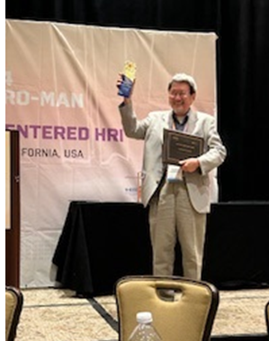
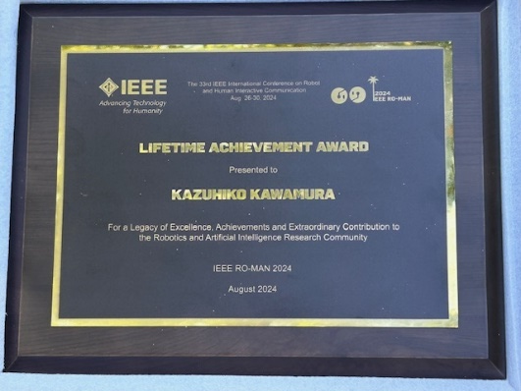
IEEE Award
August 30, 2024
a

Slide 2
43 Years of innovation:
My research journey at
Vanderbilt
1981-2024
Professor Kazuhiko Kawamura
October 15, 2024
Emilites Professor of Electrical Engineering, Computer Engineering & Engineering Management,
Life Fellow, IEEE

Slide 3
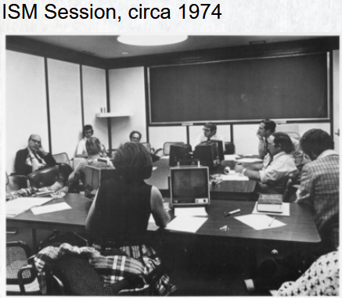

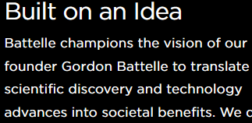
My Life Before Vanderbilt:
Research Scientist, Battelle Columbus Lab.
1972-1981

Slide 4


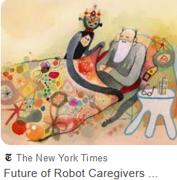
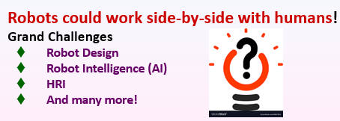
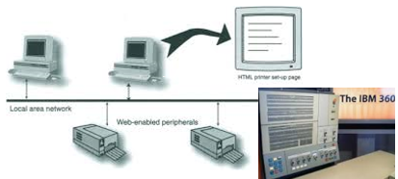

My Life Before Vanderbilt:
Research Scientist, Battelle Columbus Lab.
1972-1981
Age of ARPANET
(Advanced Research
Projects
Agency Network)

Slide 5



Disclaimer
This talk is a broad-brush talk, so I won’t be diving into specifics. For details, please refer to my latest article written for the International Journal of Humanoid Robotics, published in December 2023:
Also, some events/photos shown in this presentation may or may not be chronologically correct.

Slide 6


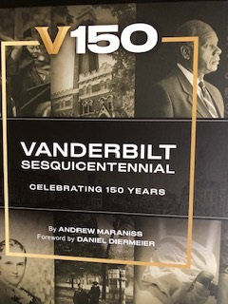
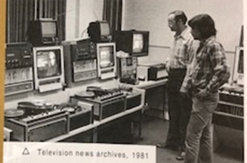
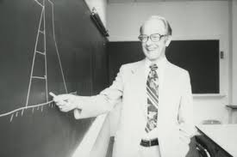
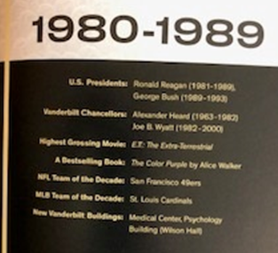
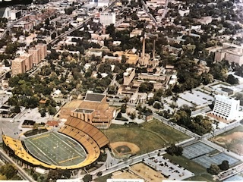
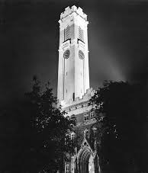
Vanderbilt in 1981
Dean Paul
Harrawood
V150
VANDERBILT
SESQUICENTENNIAL

Slide 7
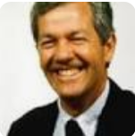
Vanderbilt in 1981
Dean Paul
Harrawood
Gerald Cook
New Dept Chair

Slide 8
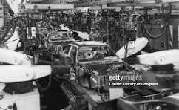
State of Robotic Technology in 1981
Robots in 1981 were excursively used in manufacturing. They were called “3-D” robots, i.e., Dangerous, Dirty and Dumb.

Slide 9
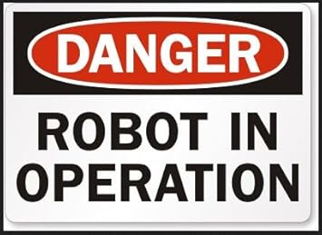
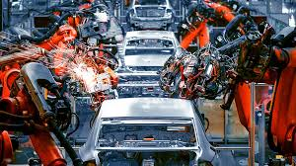

Dangerous , Stay Away!
Since industrial robots are big, strong and blind, workers were told to stay away from the robot in operation.

Slide 10
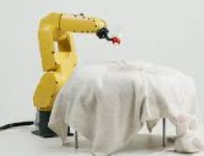
My Dream: Robot Helper

Slide 11

My Dream: Robot Helper

Slide 12
My Dream: Robot Helper

Slide 13


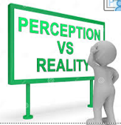
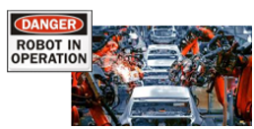
Big Gap

Slide 14
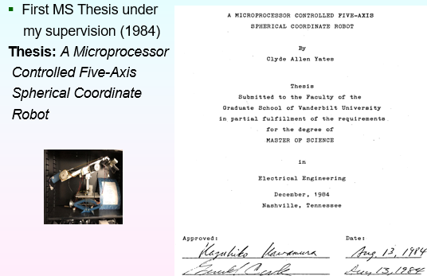
Early Days
In 1982, I got my first M.S. student, Alan Yates, and started the Intelligent Robotics Lab. Together, we designed and built the first home-made robot at Vanderbilt. We named it Vandy-1:

Slide 15
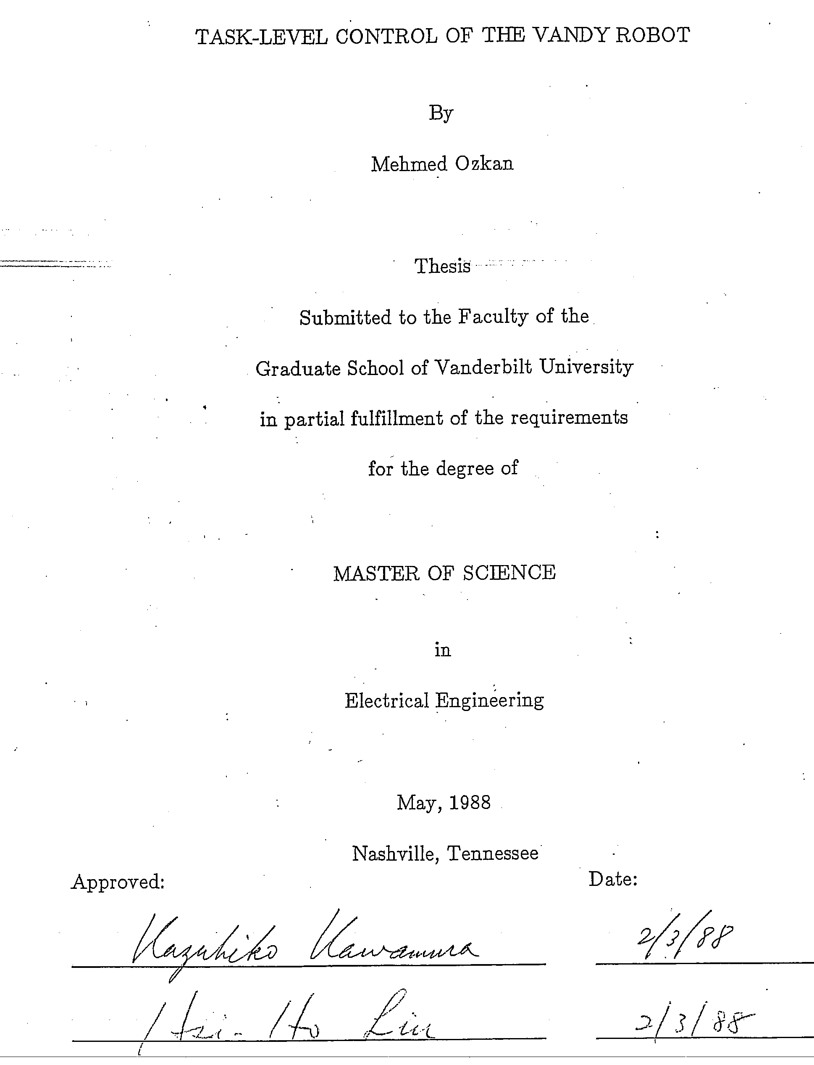
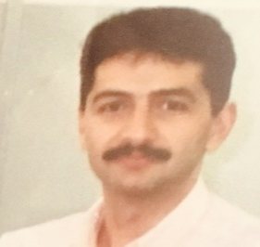
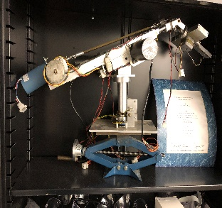
Early Days
Second Graduate Student: Mehmed Ozkan
  Second MS Thesis under
  my supervision (1988)
  Thesis: Task-Level
  Control of The
  Vandy-1

Slide 16


Early Days
Second Graduate Student: Mehmed Ozkan
  Second MS Thesis under
  my supervision (1988)
  Thesis: Task-Level
  Control of The
  Vandy-1

Slide 17
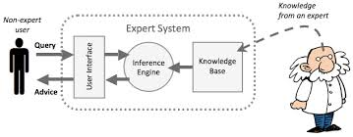
Early Day’s Funding
Decade of 1980s saw a second boom of AI called the symbolic AI. Among symbolic AI programs, a system called the expert system* became popular among many academics and companies.
* An expert systems a rule-based AI program designed to mimic human’s decision-making skills in design and diagnosis in engineering and medicine.

Slide 18


Early Day’s Funding
Using my experiences gained at Battelle, I learned how to build expert systems in engineering and began getting projects from a number of companies (e.g., Teledyne Brown Engineering in Alabama, and Bridgestone Corporation in Japan, to name two.) This supported early development of Intelligent Robotics Lab at Vanderbilt.

Slide 19
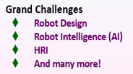

Time to start working on My Dream: Robot Helper

Slide 20

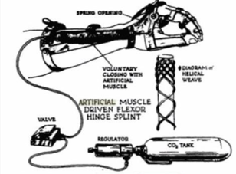
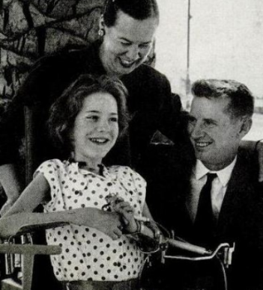
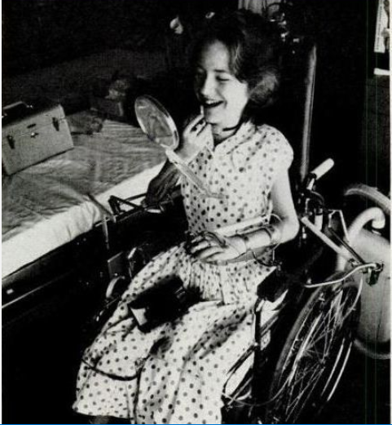
Hardware Decision
From steel-based arm to soft arm:
My first task was to find a material to build a robot arm to interact with a human safely. After some efforts, I discovered a candidate device called the McKibben pneumatic muscle.
Nylon
tube
CO₂
gas
Nuclear physicist at
Los Alamos, NM

Slide 21
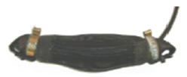

Hardware Decision
Two Options:
1. Shadow Robots Ltd., London, UK
2. Bridgestone Corp., Tokyo, Japan
“Rubbertuator”

Slide 22
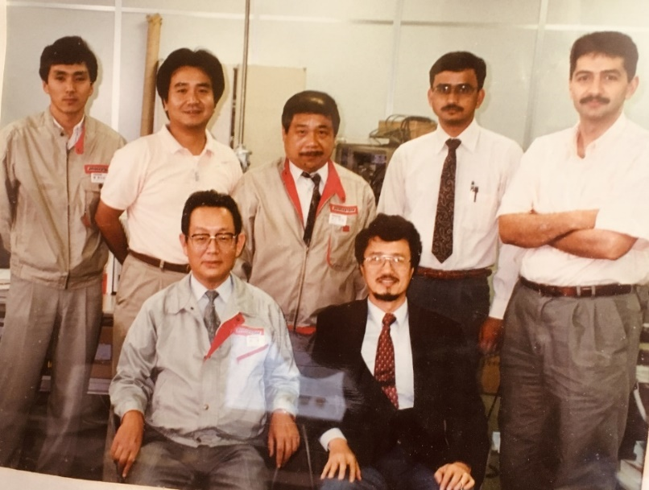
Early Day’s Key to Success
Good Industry Support
We were fortunate that Bridgestone Corporation
spent substantive funds and human resources to help
us build the robot arm.

Slide 23

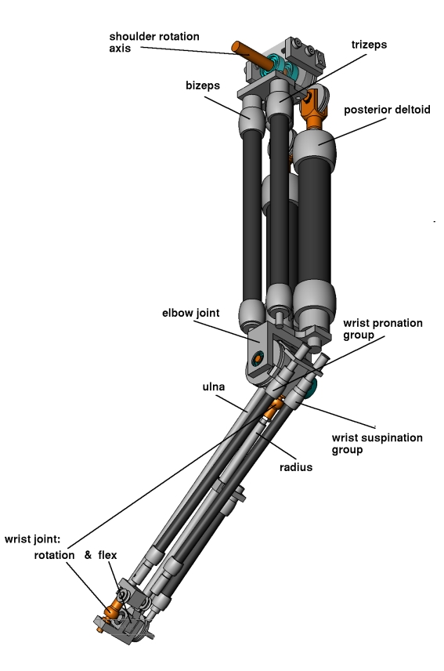
Soft Arm
Soft Arm emulated adult human arm movements.

Slide 24
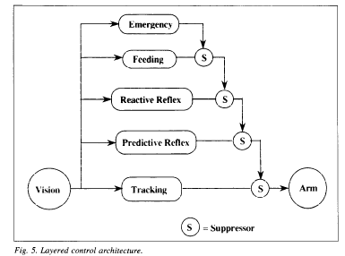
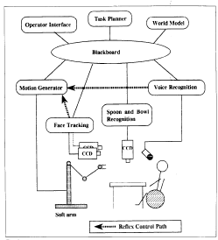

Software Decision
Layered Control using a Blackboard architecture:

Slide 25

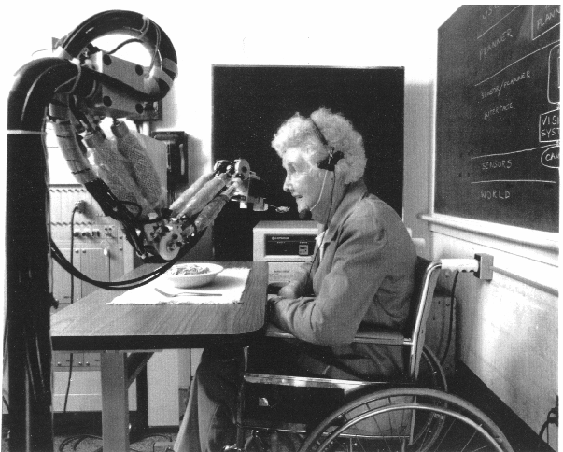
Prototype Feeding Robot
Demonstrated in 1991
One arm and an on-off gripper. We named the arm “ISAC” (Intelligent Soft Arm Control).
Showcased safety and softness: A Public Demo were conducted in 1991, with local and national news media invited.
Feeding the physically-disabled

Slide 26
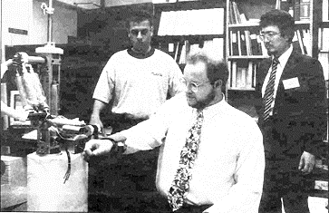
Early Days of ISAC Robot
Another Demonstration
This was the world’s first demonstration of force-feedback rehabilitation robot showcasing safety and softness.

Slide 27

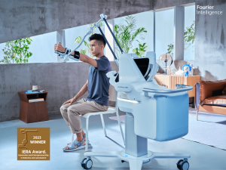
40 Years Later
Another Demonstration
This was the world’s first demonstration of force-feedback rehabilitation robot showcasing safety and softness.
Fourier Intelligence, China, was
awarded IERA during 2023 ICRA,
London, UK.

Slide 28
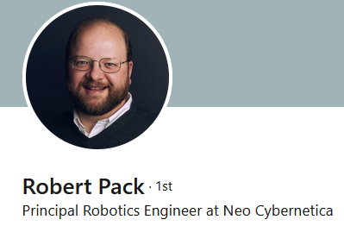
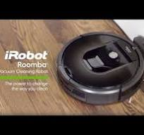
Early Days of ISAC Robot
Another Demonstration
This was the world’s first demonstration of force-feedback rehabilitation robot showcasing safety and softness.

Slide 29
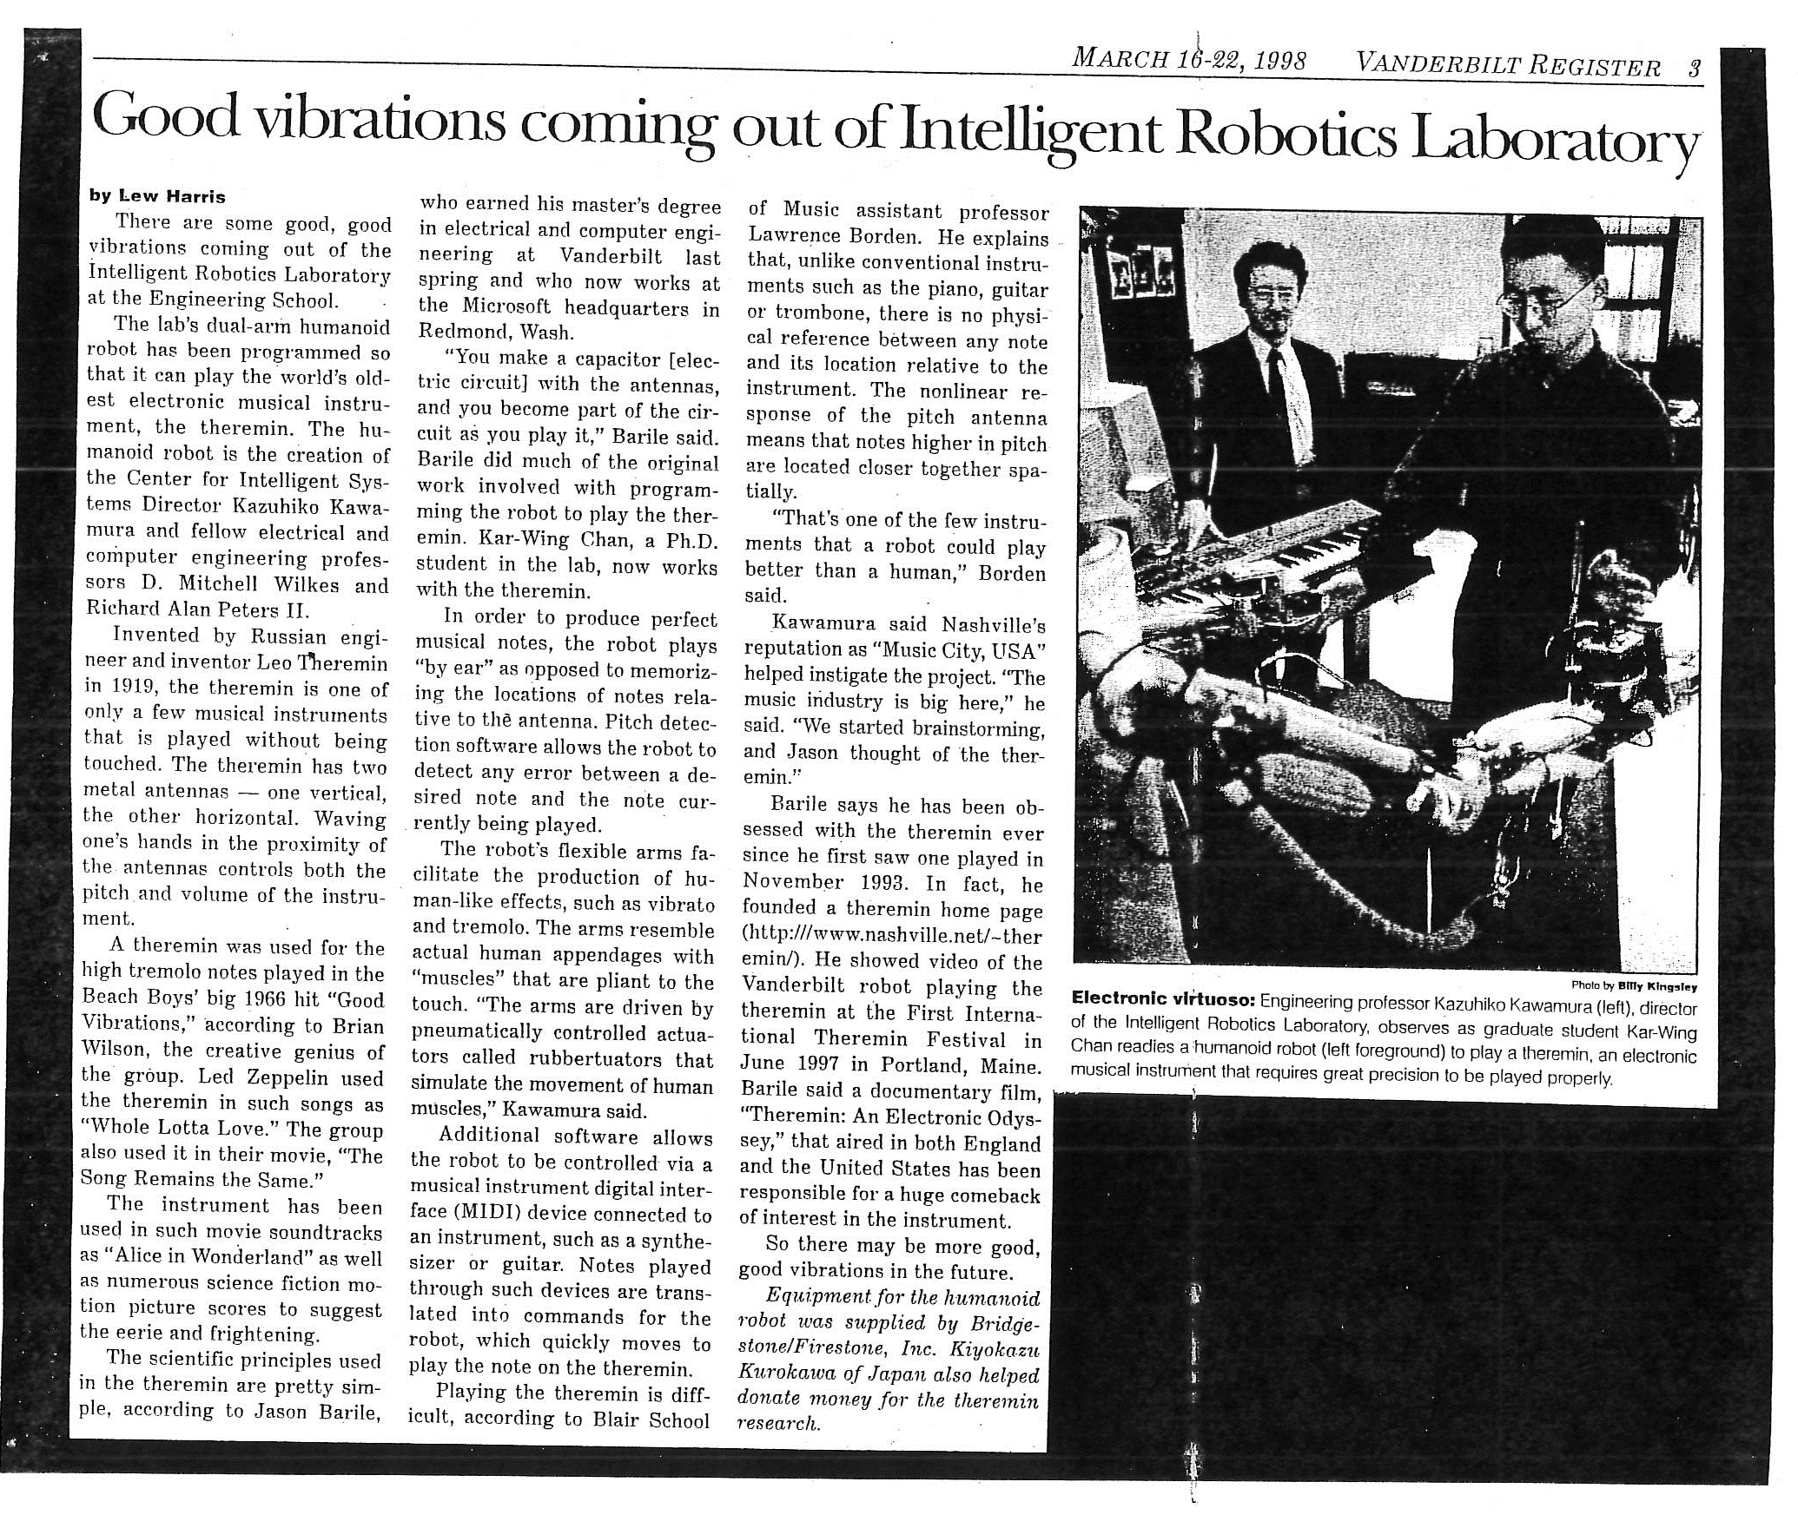
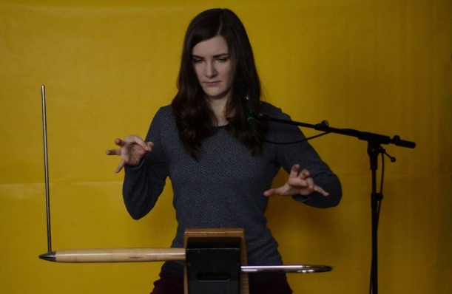

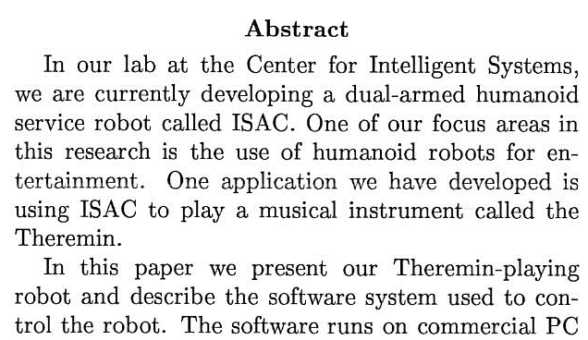
Theremin-Playing ISAC
Nashville’s reputation as “Music City, USA” helped instigate the project.(1998-99)

Slide 30
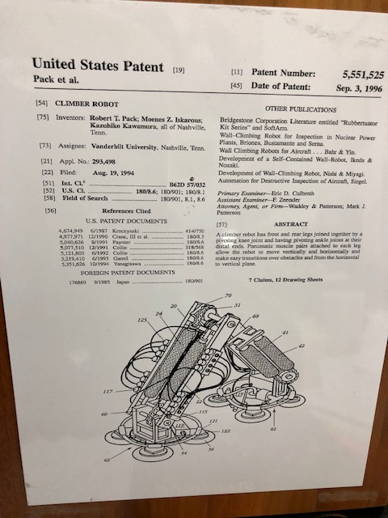
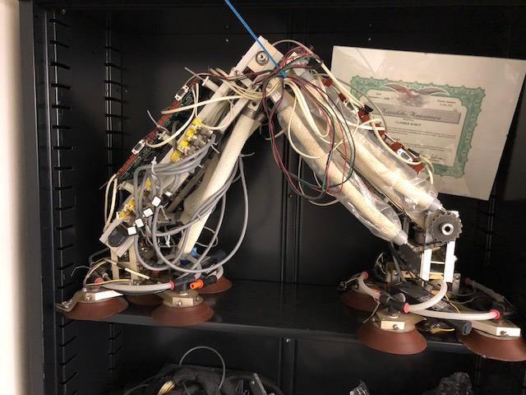
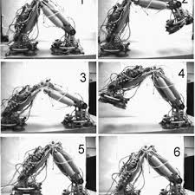
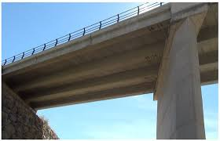
Early Days
Another early robot we designed was the bridge inspection robot ROBIN (ROBotic Inspection).

Slide 31
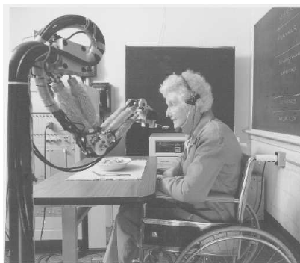
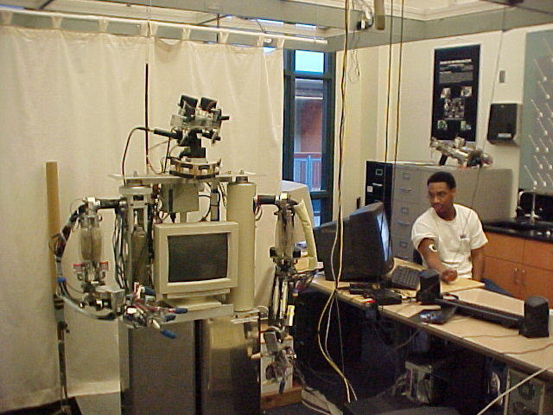
From One Arm to Dual Arms & a Head
After successful applications of the one-arm ISAC robot, we then designed and built a next version of ISAC with additional arm plus a head.
By this time, IRL has become the Center for Intelligent Systems (CIS).

Slide 32
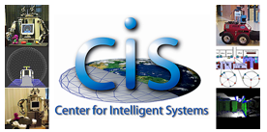
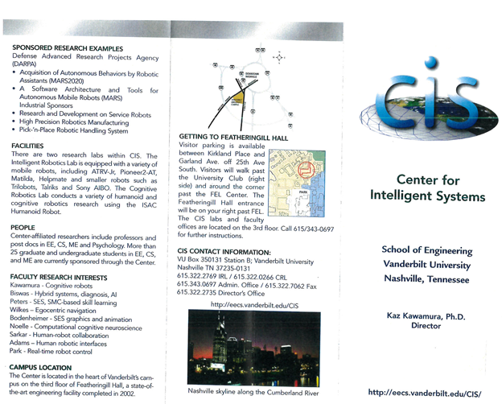


Center for Intelligent Systems
By this time, IRL has become the Center for Intelligent Systems (CIS).

Slide 33

Key to Continuous Success
A Good Vision and A Good Team:
Core Faculty: Kawamura, Peters and Wilkes
Supporting Faculty: Biswas and Sarkar

Slide 34



Flo (1957-2011)

Slide 35


ISAC Head
ISAC head was designed and implemented by a team headed by Prof. Alan Peters (joined CIS in 1988) and his Ph.D. student Magued Beshay.

Slide 36


Software Decision - 2
From Layered Control to Multi-Agent Control System

Slide 37


Innovation in HRI
Computer screen as a means for HRI

Slide 38



15 Years Later
Computer screen as a means for HRI
Pepper: Jointly developed
by Aldebaran and SoftBank
in 2014.

Slide 39


National Leaders in Humanoid Research
Our group became one of the three research leaders in humanoid robotics in the U.S. Others are:
MIT AI Lab headed by Prof. Rod Brooks, and
NASA’s Robonaut Group at JSC.
Gradually, ISAC became internationally well known.
ISAC
COG
Robonaut

Slide 40






ISAC Sampler

Slide 41

My Sabbatical Year and Cognitive Robotics
In 2004, I spent six months as a visiting professor at University of Reading, Faculty of Cybernetics, Reading, UK. During my stay, I and a young lecturer, Dr. Will Browne discussed a new breed of robotics based on the principle of cybernetic.
Founder of Cybernetics: Prof. Nobert Wiener, MIT
who invented a mathematical theory of
feedback (control and communication) in biological and engineering systems.

Slide 42

Examples of Cybernetics Systems
(I and Prof. Browne called such Robots Cognitive Robots.)
ISAC HRI
machine (control)
Biologics
system
Feeding the physically-disabled
Communication link
Riken, Japan

Slide 43
Key Features of Cognitive Robots
(From: K. Kawamura and W. Browne, Cognitive Robots, 2010)
Ability to perceive the world in a similar way to humans (or better) (e.g., “active perception”, Olaf Sporns)
Ability to develop cognition through sensorymotor coordination (e.g., “morphological computation”, Rolf Pfeifer)
Ability to communicate with humans using natural language and mental models (robust HRI such as ChatGPT)
Ability to have a sense of self awareness (machine consciousness, Owen Holland )
Ability to use attention and emotion to control behaviors (cognitive control, Kawamura)

Slide 44


Cognitive Robot Research and Development Phase (2010-)
Key Features:
* Sensory EgoSpherel
* Cognitive Control
* Working Memory
Key Challenge
* Timely Action
Selection
Source:
K. Kawamura, et al.,
“Implementation of Cognitive Control
for a Humanoid Robot “, International Journal of Humanoid Robotics, Vol 5, No 4, 547-586, 2008.

Slide 45

Sensory EgoSpehere (SES)
Developed by Professor Alan
Peters is a system designed
to represent a robot’s sensory
data in a way that is closely
aligned with how humans
perceive the environment
around them.
The concept is modeled after the idea of an "egosphere" — a spherical coordinate system centered on the robot itself, encompassing all the sensory information detected from its surroundings.

Slide 46
Other Features
Cognitive Control for robots is the attention- and emotion-based sensory-motor icoordination to execute the task in hand or switch tasks under conflicting goals.
Working Memory for robots is a limited capacity memory for performing task leaning and execution.
Source: K. Kawamura and S. Gordon, From Intelligent
Control to Cognitive Control, in 2006 International
Symposium on Robots and Applications (ISORA).

Slide 47


Working Memory-based Sensorimotor Association Learning
- A neuroscience-inspired working
memory system for sensory-motor
binding:

Slide 48



s
In 2014, IEEE RAS establishing a TC on Cognitive Robotics. Its web site states:

Slide 49

s
In 2014, IEEE RAS establishing a TC on Cognitive Robotics. Its web site states:

Slide 50

Spectrum of Cognition in Robotics
History of Robot Cognition

Slide 51




Cognitive Robotics:
Key Contributing Fields
Cognitive
Science
Artificial
Intelligence
Mechatronics
(Mechanical+Electrical)
Human Society

Slide 52

My Dream
Can we see a day robots dream?

Slide 53

Present Day ISAC
Currently ISAC resides in the lab of Prof. Ederm Erdemir, Assoc. Prof. of CS, TSU, quietly spending his retirement days.

Slide 54


Thank YOU & Vanderbilt!

