Slide 1
Creating an Expense Report
Last updated 1/29/2024 - DA

Slide 2
Who Can Create a report
Faculty
One Card Holders
Staff
Any student who has a work relationship set up
***For a student who is not employed, they will need to be “hired” in an expense only position

Slide 3
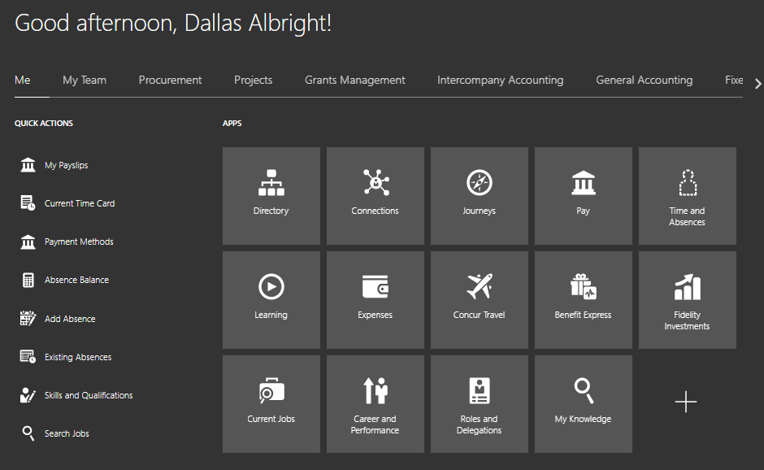

Slide 4
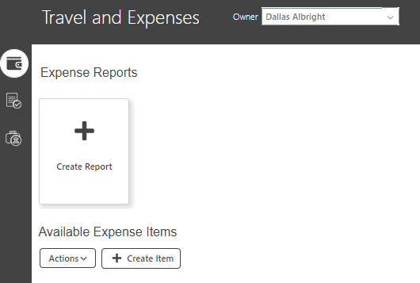

Slide 5
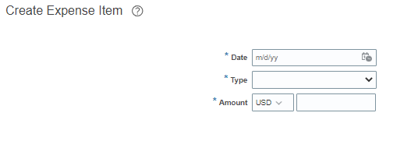
By entering in the date and type, more fields will appear

Slide 6
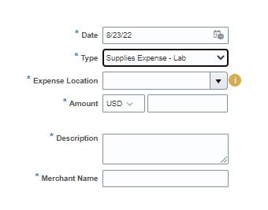
Date: What is listed on the receipt (not the current date)
Type: Pick the closest matching type
Miscellaneous Expense should not be used. Please select the closest match.
Expense Location: Where the charge occurred OR the trip destination and where most expenses took place
For example, a plane ticket to Spain would list Spain here (even if it is round trip)
Meals ate while in the US airport would list the US
Description: To describe the purpose of the purchase, not necessarily what was bought
If software such as Calendly was purchased, you would state “software to help schedule student workers”
If you are not attaching a receipt, also include what was bought in addition to the purpose – receipts only required for $75+
If a group meal was purchased, list the occasion and who attended
***Any entertainment expense, event, or group food purchase requires a list of attendees. If more than 10, describe the group and approximate number of attendees.

Slide 7
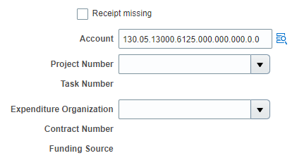
The highlighted portion is based on your expense type and should automatically update. *Do not change this.*
The circled portion indicates what financial unit is to approve the report. The Expenditure Organization is based on that 5-digit segment.
Ex. 14000 - Divinity: Office of the Dean; 14100 - Divinity: Business Affairs; 13210 - Divinity: Faculty
How do I use a POET? Ex. FF_123456.13000.20
Project Number = FF_123456
Expenditure Organization = 14000 – Divinity: Office of the Dean (hint: if you type the number and hit tab, it will fill in)
Expense Type = auto populated in the COA (usually no need to touch the COA if using a POET)
Task Number = 20 (usually between one and three digits)

Slide 8
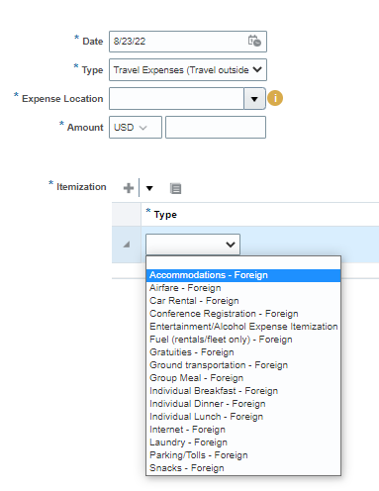
Only 3 expense types require the Itemization section: Travel Expenses, Utilities, and Services
Travel Expenses always require itemization as do One Card personal expense violations
Alcohol requires itemization if it is part of a larger expense (meal, catering, etc.)
Multiple funding sources can be added through itemization
The Travel expense type pulls up numerous options to narrow down the type of purchase
Any purchase made while traveling needs to fall under the main type of Travel Expenses and then select the subtype under itemization
Ex: Meals purchased while traveling should not use the Food and Beverages category, but should be Travel Expenses – Individual Breakfast (or other meal)
Please select to REMOVE the itemization section via the X on the right if not needed!

Slide 9
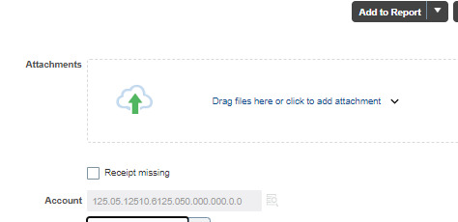
When the itemization section is used, the funding source applied there is what is charged. The COA under the attachment section no longer matters

Slide 10
If you only have one expense, select “Add to Report.” To submit more, select “Save and Close.”
Please do add multiple items to each report when possible!

Slide 11
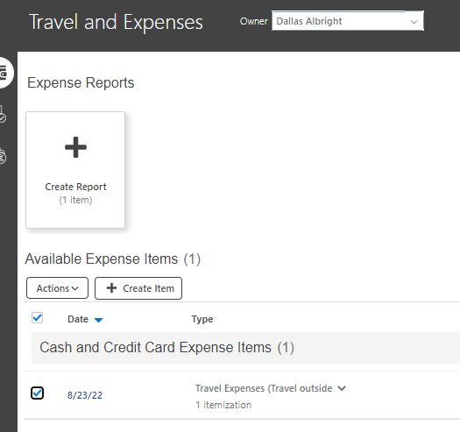
If you selected “Save and Close” repeat the previous steps to create more expenses.
Each transaction MUST be its own item
This can be tedious, but it is mandatory. Submitting multiple purchases under one item will always be returned for correction
Once all expenses are created, check the box beside the items and “Create Report”

Slide 12
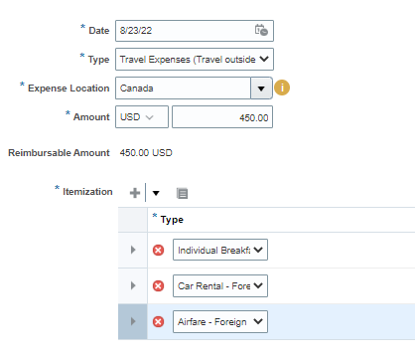
Even if all these expenses were meals purchased on the same date, lumping them as one expense with multiple itemizations is not allowed

Slide 13
Specify a purpose of the report. This should include name of event attended/to be attended, dates, location, and business reason.
Acronyms are not allowed – please write out the event/conference name!
If expenses are not related, something simple like “Needed Expenses for Lab Purposes and Conference Travel” is fine. The descriptions will then need to be very specific!
Purpose
Submit
Checkbox
***Add as many items to the reports as you want. The fewer the reports, the happier the auditors!***

Slide 14
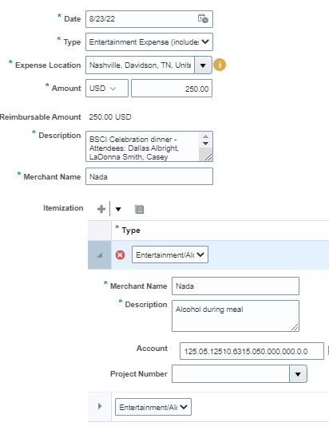
If alcohol is purchased, you must itemize out the food and alcohol costs (with associated tax and tip). If the entire purchase was alcohol this is still required
2 sections required – one for food, one for alcohol

Slide 15
Tips and tricks
When submitting a flight reimbursement, the merchant is the airline (not Concur/World Travel/WTS).
If you see the dropdown asking whether this is property of the individual or university, the answer is always the university.
Receipts are not required for any purchases under $75 dollars (We are actually being encouraged to not include the receipts for these expenses). Please refrain from including these receipts.
When a meal costs less than $75, you must confirm in the description whether alcohol was purchased. For no alcohol, simply state “No alcohol.” If alcohol was included, you will need to itemize the alcohol and food costs, with associated tax and tip.
There is a “Duplicate” option in the “Actions” dropdown menu. If you are entering multiple similar items, this could help reduce having to enter similar data.
Receipts must be itemized and have a proof of payment – either stating paid via Mastercard or Credit Card, or stating $0 balance owed & who paid.

Slide 16
Rules to keep in mind
All purchases for equipment and services must be processed through Purchasing Services before goods are received and services are rendered.
Gift Card purchases, donations, contributions, and sponsorships are not allowed.
Expenses older than 60 days are reported to Payroll as taxable income.
Expenses older than 90 days will not be reimbursed.
All flights and hotels must be booked through Concur/World Travel, or the expense will not be reimbursed. If lower rates for accommodations are available through a conference rate, the traveler may book through that website, and attach the documentation in the expense report.
Per Diem: When using sponsored funds (grant/contract) per diem is not an option. If not using sponsored funds, it is an option if you are spending at least one night outside of Davidson County. You can expense each meal OR use per diem; you cannot use both.
Mileage: Attach a screen shot from Google Maps showing the miles from the start to end point for each trip.
Non-travel business-related expenses for reimbursement should be low dollar at $250.00 or less.

