Slide 1
Welcome to the VERA Celebration
A tribute of gratitude to Vanderbilt colleagues who collaborated on VERA’s successful implementation
Hosted by the Office of the Vice Provost for Research

Slide 2
Research Administrator Working Group
Michele Austin
SPA
Jana Blick
Research Finance
Julie Canada
VUSE
Tania Carter
Divinity
Robert Dortch
SOM-BS
Laurel Duncan Biqiku
SPA
Eric Dye
A&S
Carolyn Fatheree
Peabody
Emma Pacilli
SOM-BS
Magda Paszewska
A&S
Claudia Paz
Finance
Bryan Ratliff
Peabody
Beth Rivas
SOM-BS
Chris Vanags
Peabody
Allison Varble
SON

Slide 3
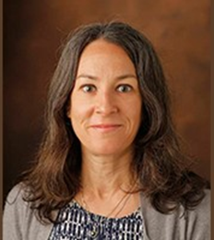
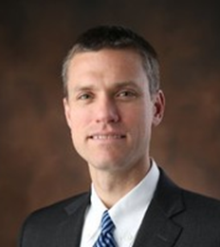
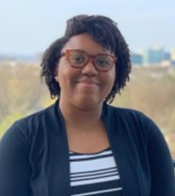
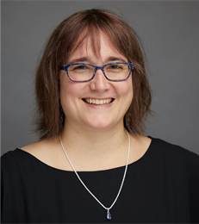
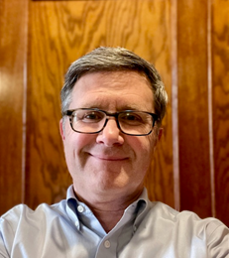
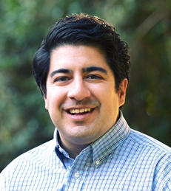
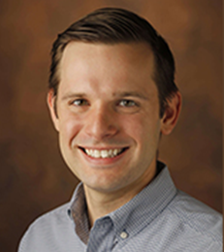
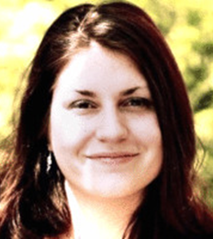
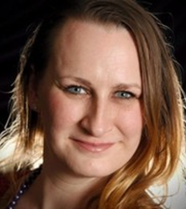
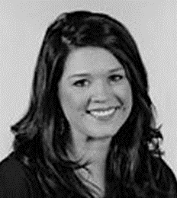
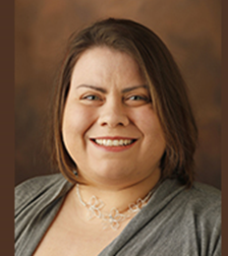
Core Configuration Team
Core Team
Laurel Duncan Biqiku
SPA
Greg Kyle
PSI
Madison Everett
PSI
Hilda McMackin
SPA
Brian Murray
PSI
Aaron Villarreal
PSI
Project
Team
Thomas Hoover
SPA
Julie Canada
VUSE
Emma Pacilli
SOM-BS
Palmer Payne
Peabody
Beth Rivas
SOM-BS
Allison Varble
SON
Michelle Wachter
SPA

Slide 4
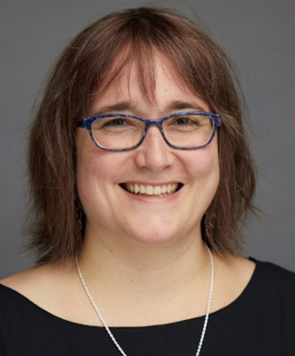
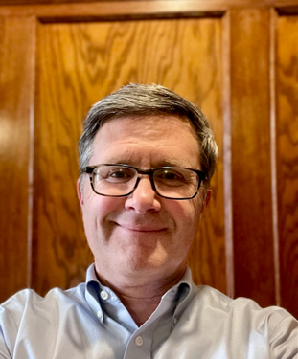
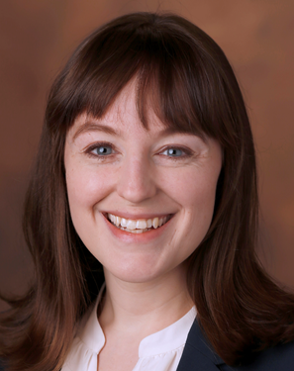
Implementation & Operations Leads
VERA IMPLEMENTATION LEADS
COEUS/PEER OPERATIONS LEADS
Hilda McMackin
Director of Research Administration Systems and Reporting
Office of the Vice Provost for Research
Brian Murray
Executive Director for Academic Affairs
Process and Solution Implementations
Office of the Vice Provost
for University Enrollment Affairs
Jane Hirtle
Senior Director of Research Special Projects and Communications
Office of the Vice Provost for Research
Implementation and operations managed in partnership with Research Finance, VUIT, Finance, and research administrators from colleges and schools.

Slide 5
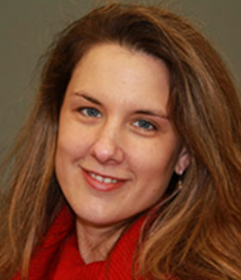
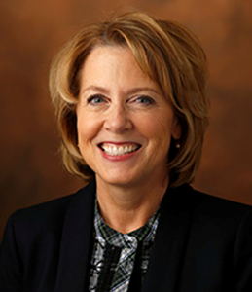
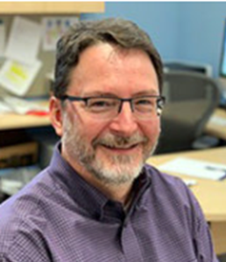
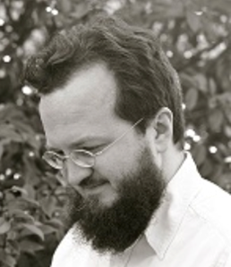
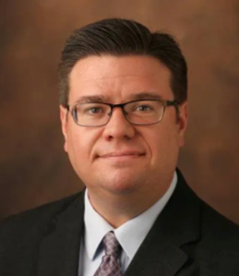
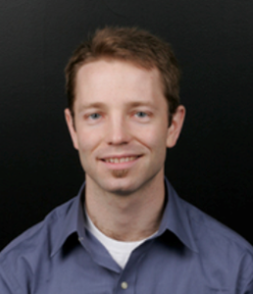
Vanderbilt University Research Council: VERA Working Group
Laurie Cutting
Peabody
Mariann Piano
Nursing
Danny Winder
SOM-BS
David Michelson
Divinity
Paul Stob
A&S
Bob Webster
VUSE

Slide 6
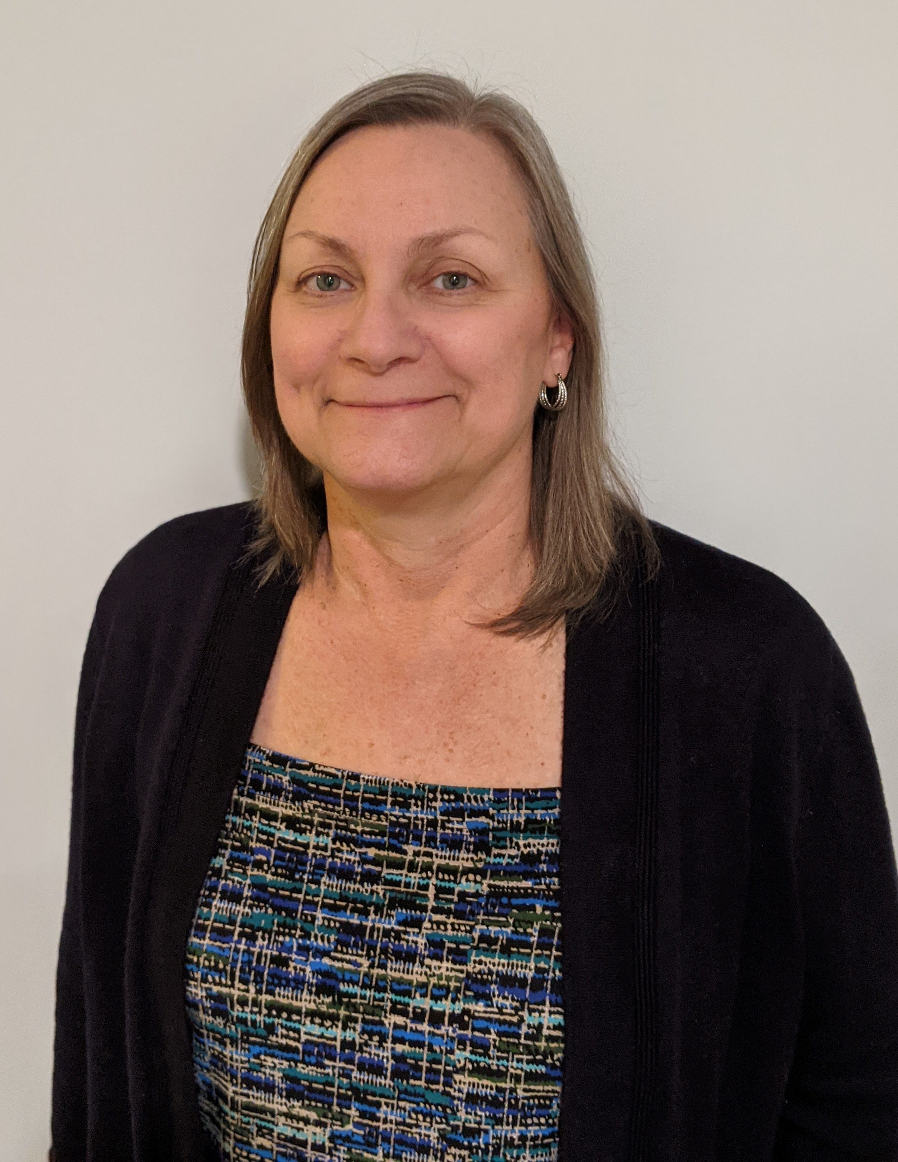
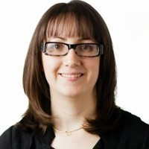
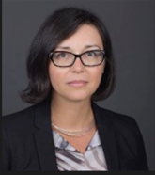
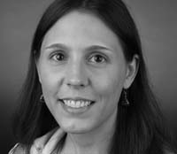
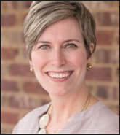
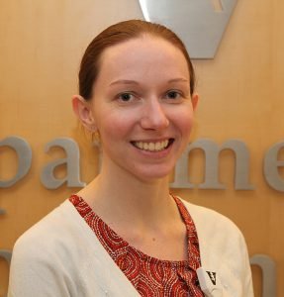
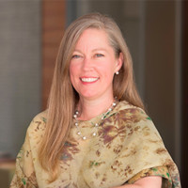
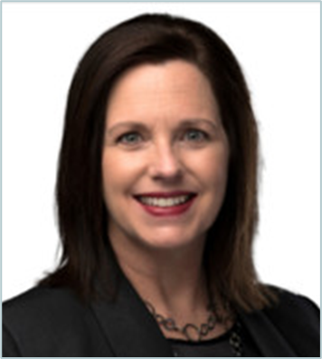
Testing Team, AKA Team VERA
Barb Haseltine
A&S
Sarazen Kokodynsky
A&S
Magda Paszewska
A&S
Donna Baldwin
Peabody
Carolyn Fatheree
Peabody
Stephanie Clapper
SOM-BS
Susan Hotaling
SOM-BS
Chrystal Fizer
VUSE
Brigitta Jozefowski
VUSE
Mary Judd
VUSE
Tania Carter
Divinity
Brittany Johnson
University Press

Slide 7
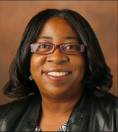
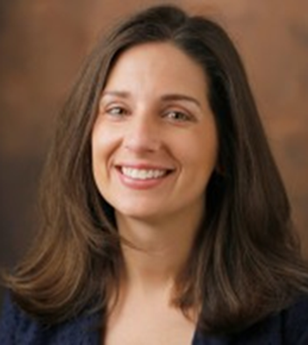
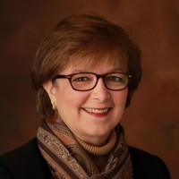
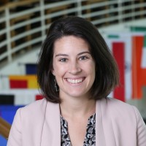
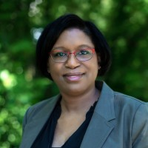
Testing Team, AKA Team VERA (cont.)
Michele Austin
SPA
Jana Blick
Research Finance
Cathy Snyder
Research Finance
Kelsey Bahadursingh
Audit
Tanya Paul
Research Finance

Slide 8
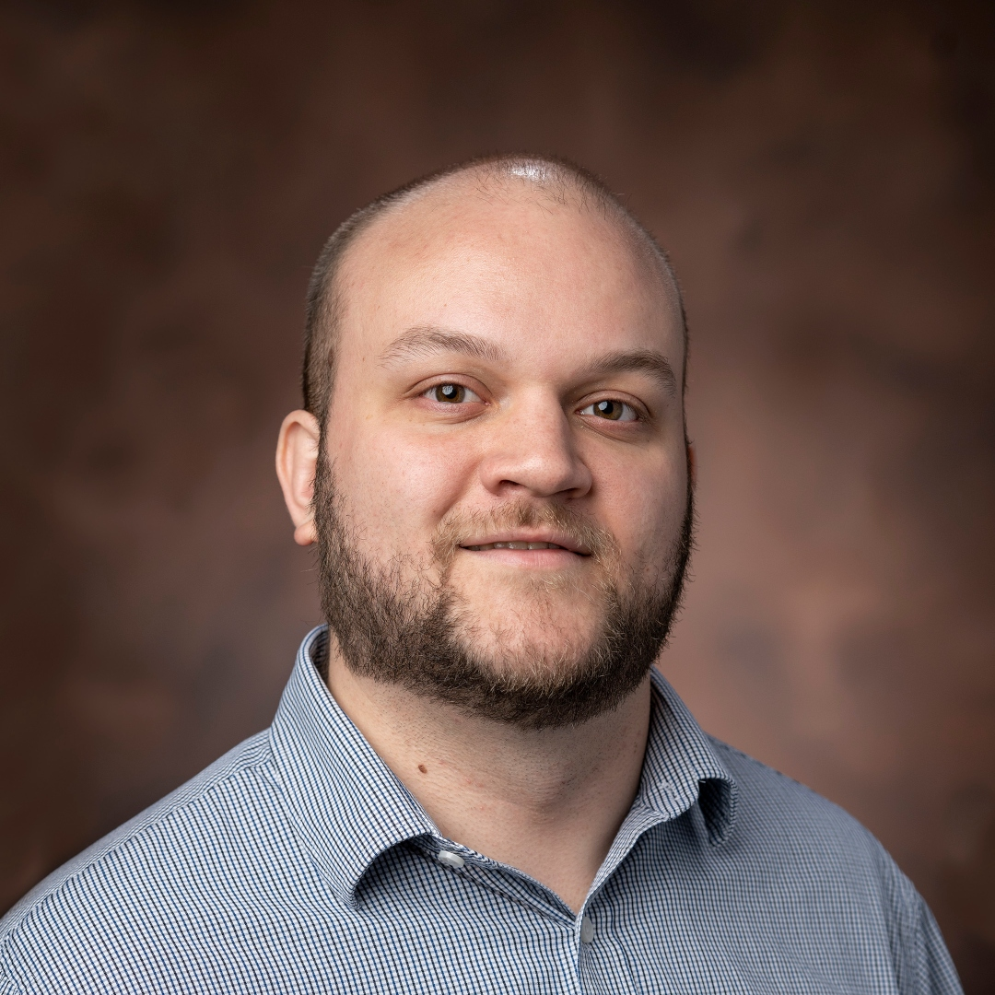
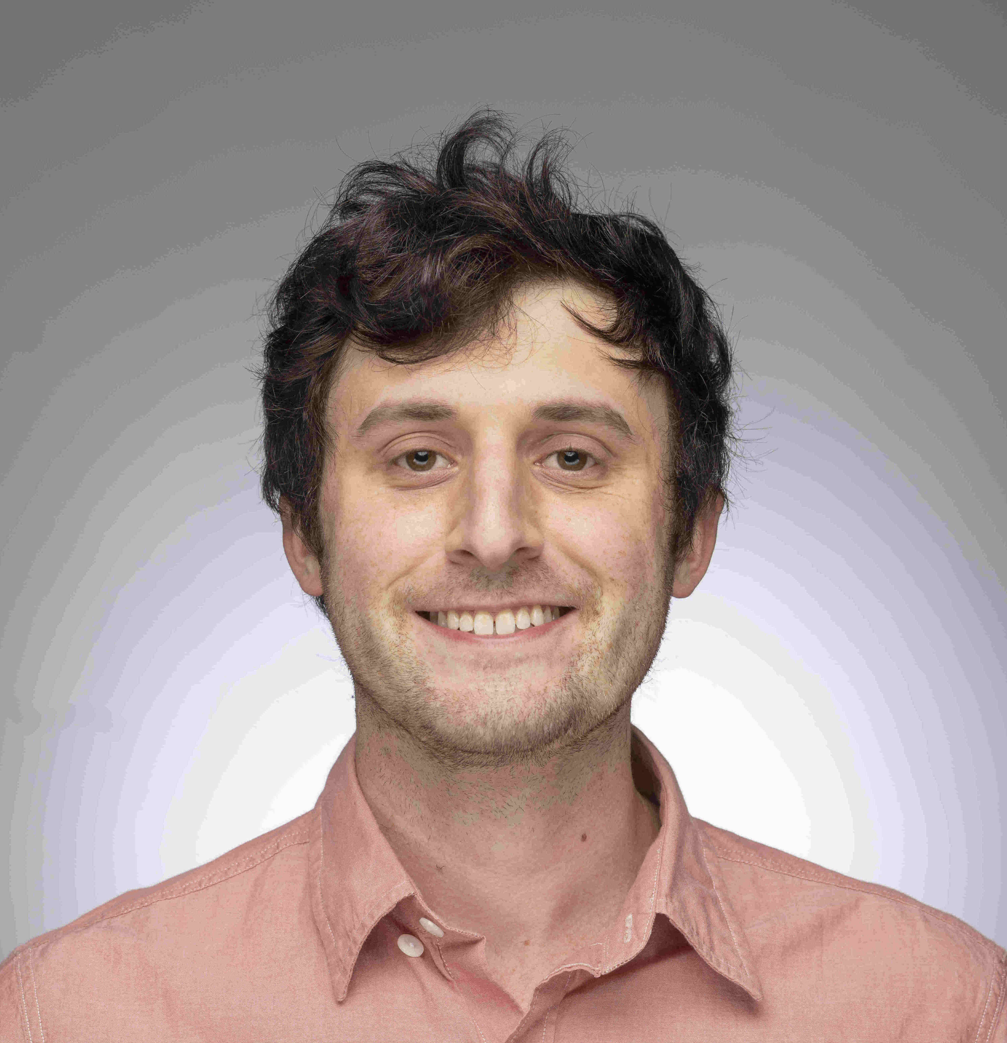
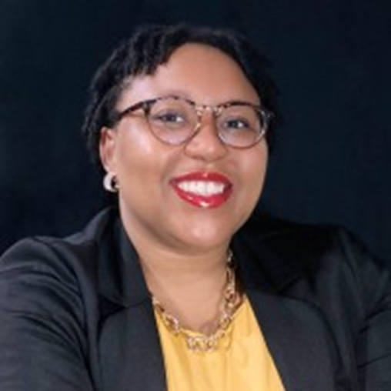
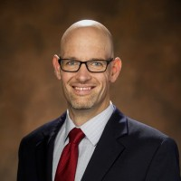
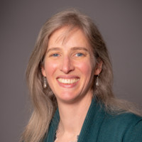
Data Warehouse Team
John Del Tufo
SPA
Max Fishel
SPA
Jane Hirtle
OVPR
Hilda McMackin
SPA
Brian Murray
PSI
Aaron Villarreal
PSI
Madison Everett
PSI
Greg Kyle
PSI
Don Bailey
DSA
Daniel Kirby
DSA
Olivia Kew-Fickus
DSA

Slide 9
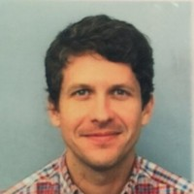
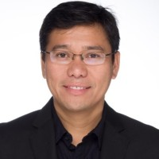
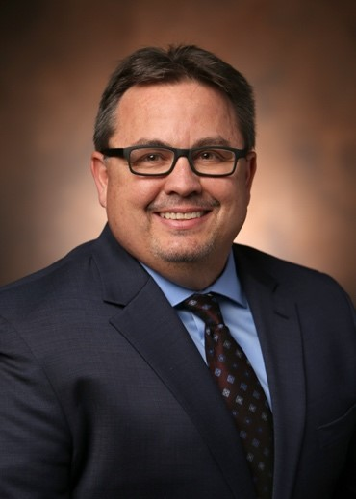
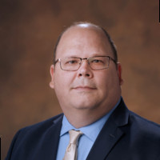
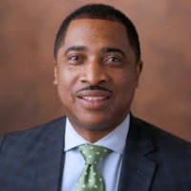
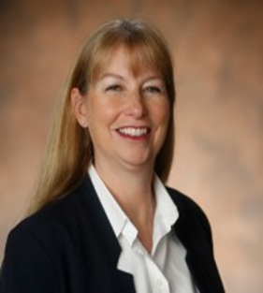
Data Warehouse Team (cont.)
Brett Echerd
VUIT
Dennis Paredes
VUIT
Andy Green
VUIT
Jasen Ingram
VUIT
Ed Wisdom
VUIT
Julie Catellier
VUIT
Shawn Taylor
VUIT
Jennifer LeBlanc
VUIT
Jillian Poris
VUIT
Jeanette Honeysucker
VUIT
Philip Neely
VUIT
Cortlyn Bowers
VUIT

Slide 10
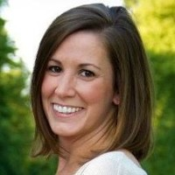
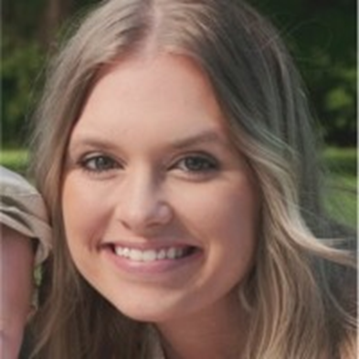
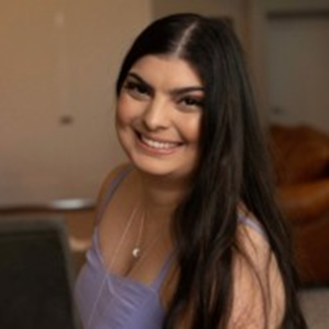
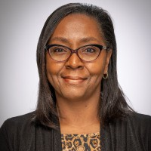
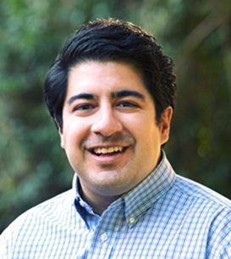
VERA-Oracle Integration Team
Dalana Robertson
VUIT
Jana Blick
Research Finance
Chelsea Miller
Research Finance
Allison Stendardo
Research Finance
Denise Johnson
Research Finance
Brian Murray
PSI
Aaron Villarreal
PSI
Madison Everett
PSI
Greg Kyle
PSI

Slide 11
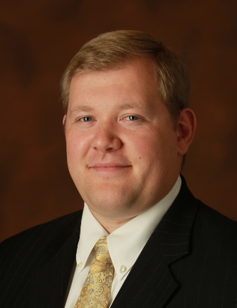
VERA-Oracle Integration Team (cont.)
Michelle Wachter
SPA
Hilda McMackin
SPA
Laurel Duncan Biqiku
SPA
Ben Frazee
PSO
Josh Vincent
PSO
Noah Shook
PSO
Andy Green
VUIT
Jasen Ingram
VUIT
Zhiliang (Terry) Xie
VUIT

Slide 12
Leadership Advisory Committee
Camilla Benbow
Peabody
Philippe Fauchet
VUSE
Padma Raghavan
Research
Larry Marnett
SOM-BS
David Wright
A&S
Doug Horr
Audit
Rich Germano
VUIT
Doug Christiansen
Enrollment Affairs
Eric Bymaster
Finance
Dalana Robertson
VUIT

Slide 13
VERA-COI Integration
Alison Cooper
OGC
Janiece Harrison
SPA
Hilda McMackin
SPA
Brian Murray
PSI
Aaron Villarreal
PSI
Madison Everett
PSI
Greg Kyle
PSI

Slide 14
VERA Superlatives

Slide 15
Spirited Superstars
These individuals were strong advocates for their roles and communities, making sure everyone was heard and supported – thank you!
Beth Rivas
SOM-BS
Emma Pacilli
SOM-BS
Allison Varble
SON

Slide 16
Gung Ho Users
These individuals embraced the change to VERA and helped bring others along with them – thank you!
Jeannie Wagner
A&S
Samantha Cantrell
A&S
Sarazen Kokodynsky
A&S
Casey Sniegowski
A&S

Slide 17
Murphy’s Law Superstars
Any time something didn’t go as planned, these individuals jumped in with grace to help – thank you!
Robert Dortch
SOM-BS
Wesley Wavro
SPA

Slide 18
New-User Superstars
These individuals quickly learned the ropes with VERA and blazed a trail for others – thank you!
Tania Carter
Divinity
Kym Stricklin
Peabody
Allison Stendardo
Research Finance

Slide 19
Supporting-User Superstars
These individuals were particularly supportive of their school or office’s use of VERA, helping their colleagues establish processes and workflows– thank you!
Eric Dye
A&S
Chris Vanags
Peabody
Jana Blick
Research Finance
Chelsea Miller
Research Finance

Slide 20
System-User Superstar
Technical Superstar
These individuals were eager to understand VERA from the user and IT perspectives.
Tassall Lloyd
SPA
Madison Everett
PSI

Slide 21
Synergy Superstars
The Subawards team worked tirelessly together to learn VERA and adapt their processes to increase VERA’s efficiency for their workflows.
Sheila Asbill
SPA
Heather Smith
SPA
Blake Atkins
SPA
Megan Allen
SPA

Slide 22
Team Superstars
These team members worked seamlessly together, from start to finish, to make VERA a success.
Max Fishel
SPA
John Del Tufo
SPA
Brian Murray
PSI
Aaron Villarreal
PSI
Madison Everett
PSI
Greg Kyle
PSI
Jasen Ingram
VUIT

Slide 23
Team Superstars (cont.)
Sponsored Programs Administration
Janiece Harrison
Michelle Wachter
Hilda McMackin
Laurel Duncan Biqiku
Michelle Austin
Matt Kelly
Tassall Lloyd
Karla Woodward
Taylor Smith
Thomas Hoover
Autumn Flores
Christina Leath
Sheila Asbill
Heather Smith
Blake Atkins
Megan Allen
Wesley Wavro

Slide 24
Early-Adopter Faculty Member Superstars
These faculty took initiative and were among the first to learn VERA – thank you!
Çağlar Oskay
Gregor Neuert
Bridget Rogers
Eric Spivey
Ronald Emeson
Carl Johnson
Markus Voehler
Minati Singh
Todd Giorgio
Florence Sanchez
Cynthia Paschal
William Wan
Audrey Bowden
Sharon Weiss
David Kosson
Jonathan Brunger

Slide 25
Special Thanks to Advisory Groups and Individuals
Leadership Advisory Committee
Research Administrator Working Group
Vanderbilt University Research Council
On-boarding Group
Faculty Senate
Alison Cooper—Office of the General Counsel
VUIT
Olivia Kew-Ficus—Data and Strategic Analytics
Data Team

Slide 26
Worst at Retiring, Best at Everything Else
Janiece Harrison
Interim SPA Director

Slide 27
Onward and Upward
These colleagues were instrumental in advancing VERA at VU but have since moved on to other institutions – thank you and best of luck in your new roles!
Abby Regan
SPA
Palmer Payne
Peabody
Greg Kyle
PSI
Michelle Vazin
Research Finance
Tanya Paul
Research Finance
Karla Woodward
SPA
Cathy Snyder
Research Finance

