Slide 1
Rainbows and Color
Fall 2012

Slide 2
Introducing Rainbows
Ask students:
How many of you have seen a rainbow?
What about rainbows in places other than the sky?
Show students the “rainbow” on their handout.
Stress the order of the colors in the rainbow and how they always appear that way
White light is composed of these six colors, and these give color to everything

Slide 3
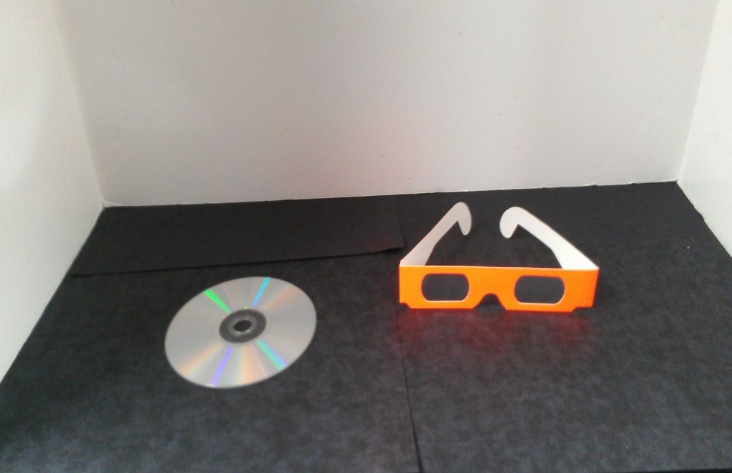
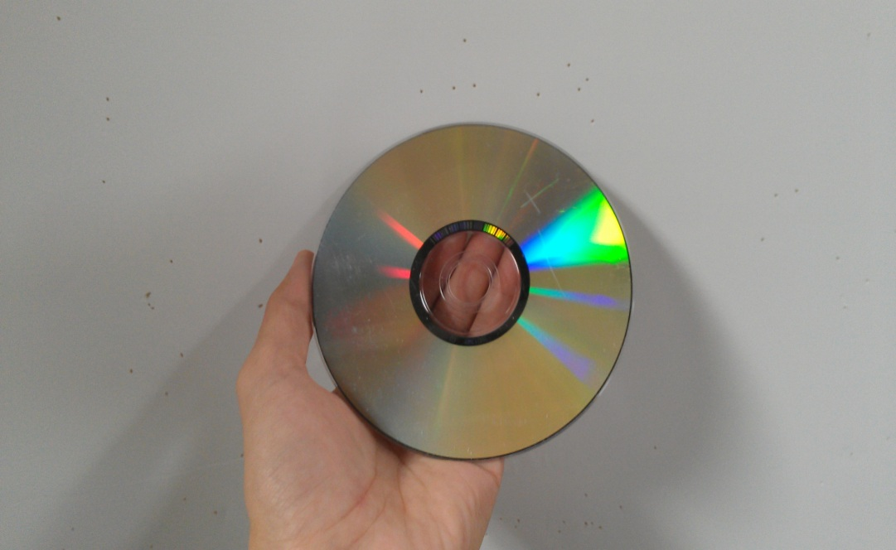
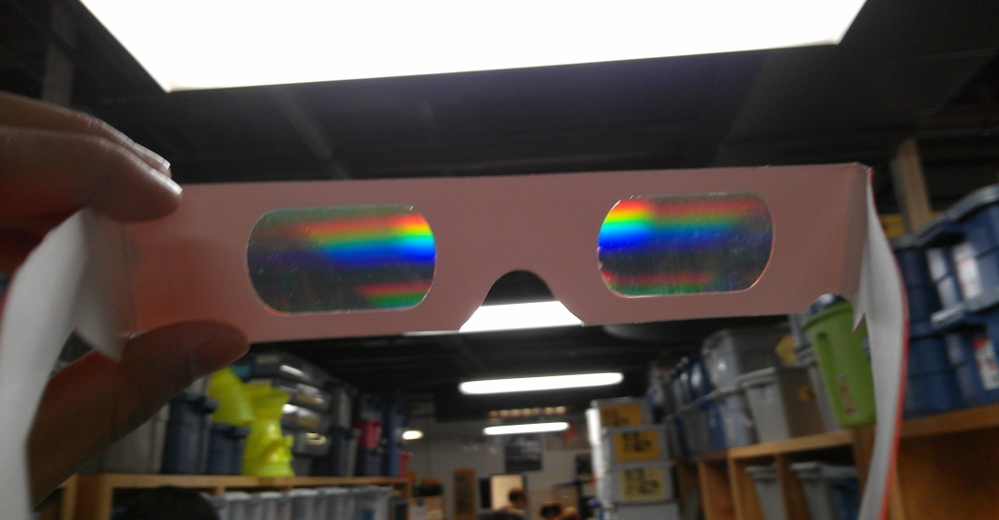
Rainbow glasses and cds
Pass out CDs and rainbow glasses to each student

Slide 4
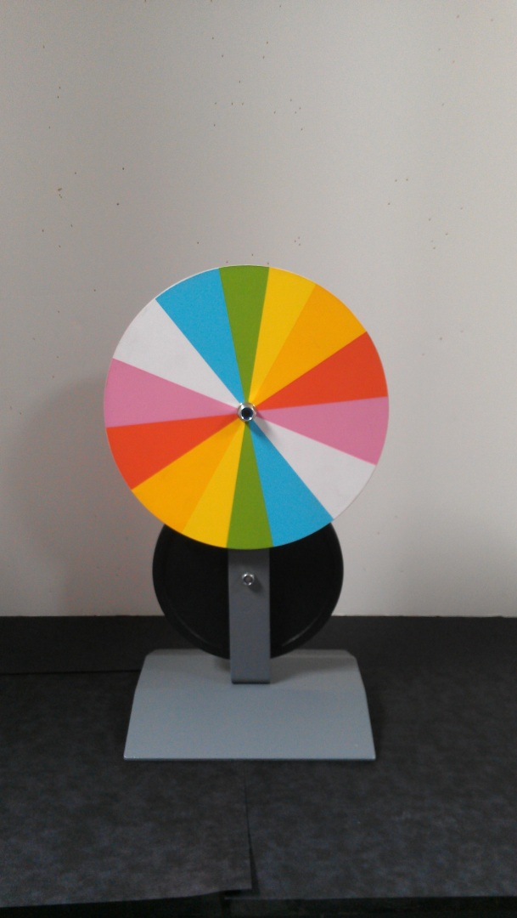
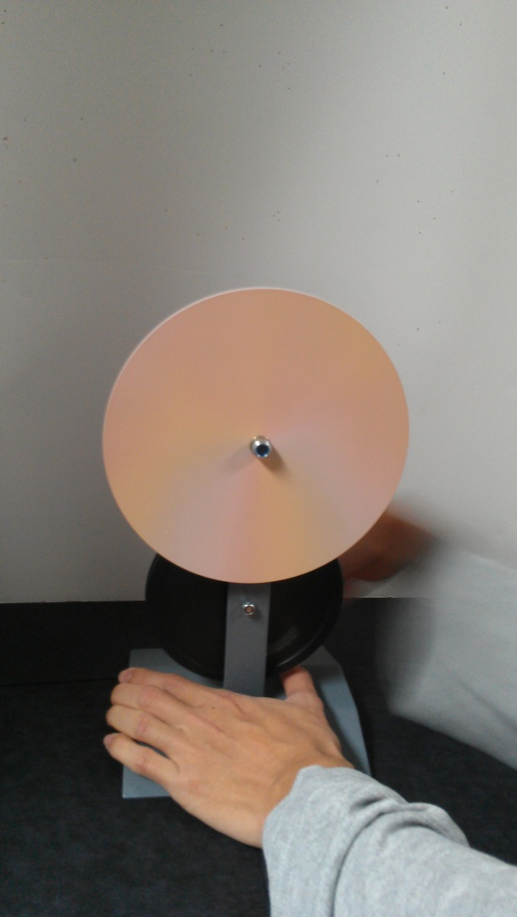
Color wheel demonstration
Demonstrate how the combination of the different colors makes white light

Slide 5
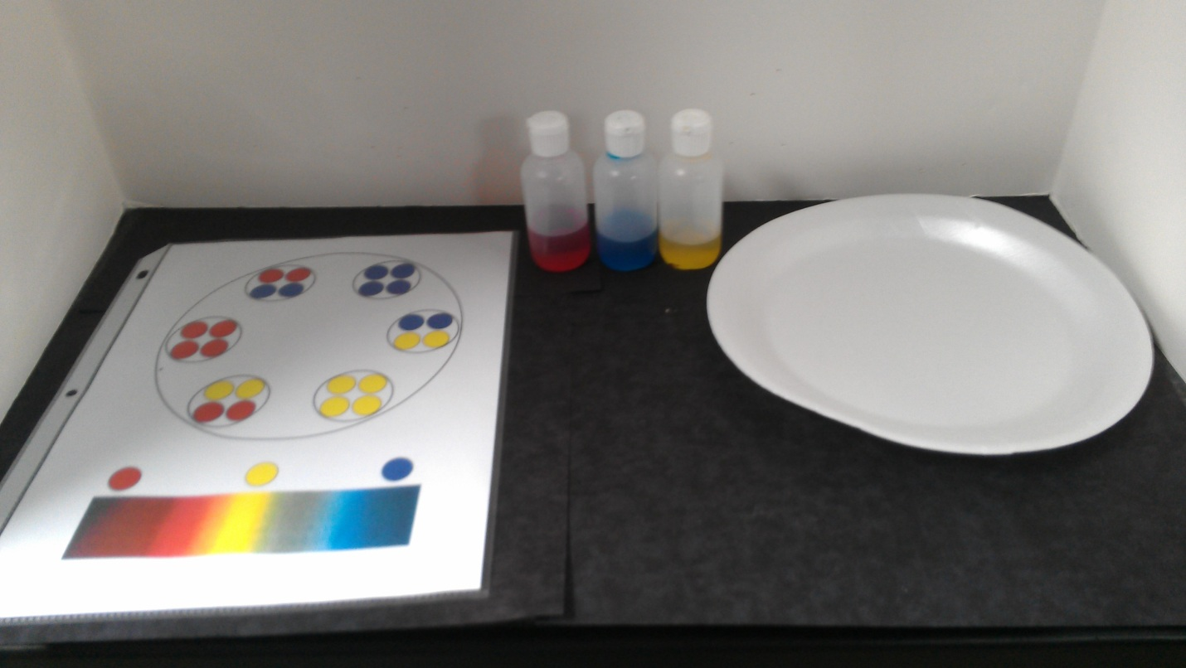
Making a color wheel
Tell students that they are going to make their own color wheel by mixing the primary colors in exact proportions
Have students place the red drops first, followed by the blue, and lastly by the yellow. Stir the colors together with a toothpick (or finger).
Ask students to name what colors they have made
They can keep their colors by laying a paper towel on the sheet and blotting the liquid
They can repeat the experiment and “draw” all the colors into the center of the wheel and see that the end result is a dark brown/black color.

Slide 6
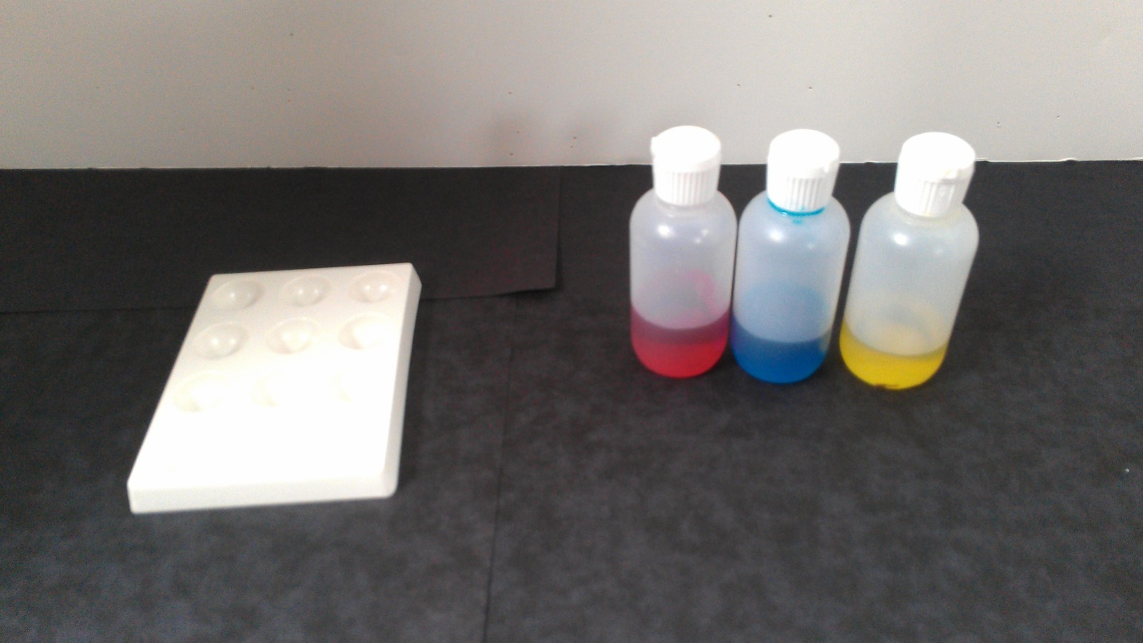
Mixing colors in a palette (optional)
Students can now make their own color combinations in the palettes
Tell students that they can use the color wheel information as a guide to different shades of colors
Ask students how they can make black

