Slide 1
Capacitors
&
Resistors

Slide 2
resistors
A resistor, like batteries and lights, can also be present in an electrical circuit. A resistor limits the flow of electricity in the circuit. Like rocks in a pipe that slow the flow of water, a resistor will limit the flow of electricity. A variable resistor is made of a piece of metal that can change in length. As the length of the resistor changes, so does the resistance in the same direction.
Units: The unit for resistors is the ohm, Ω. Resistance is defined as the ratio of the voltage to the current, R = V/A, where V is volts and A is current measured in amperes. One ohm is the resistance, R, that permits a current of 1 A to flow through a circuit with 1 V. The connecting wires in electric circuits have very low resistance; the copper wire used to wire houses has about 0.004 ohms per meter.

Slide 3
capacitors
A capacitor can also be part of an electrical circuit. A capacitor is made of two plates, usually metal, that conduct electricity separated by an insulating material, such as air. A capacitor can store electricity and is charged when electricity flows to it. The charge builds up in the area between the pieces of metal, and the maximum charge is inversely related to the distance between the plates. When charged, the capacitor can provide electricity to other parts of the circuit until discharged. A variable capacitor has movable plates so if you change the spacing between the plates, the amount of capacitance changes.
Units: Capacitance is measured in farads, F. Commercial capacitors are in the micro-farad range (1 x 10⁻⁶ farads), and the symbol used for micro-farads is μf.

Slide 4
Resolution of a circuit
There is a method for combining multiple resistors and capacitors into one resistor or capacitor depending on whether they are connected in parallel or in series.
Resistors add together to give a larger resistance when connected in series but contribute less and produce a smaller resistance when connected in parallel.
Capacitors add together to give a larger capacitance when connected in parallel but give a smaller capacitance when connected in series.

Slide 5
Light emitting diodes
Light Emitting Diodes
A light emitting diode (LED) is like a light bulb in that light energy is produced, but it uses less electricity because it is not producing light by heating a tungsten wire. An LED only allows movement of electricity in one direction, from positive to negative.
Ask students: Can you think of some examples of LEDS?
Examples: lights in remote controls, small key chain lights…

Slide 6
Divide the students up into groups
There will be 5 set-ups for resistors and 5 set-ups for capacitors.

Slide 7
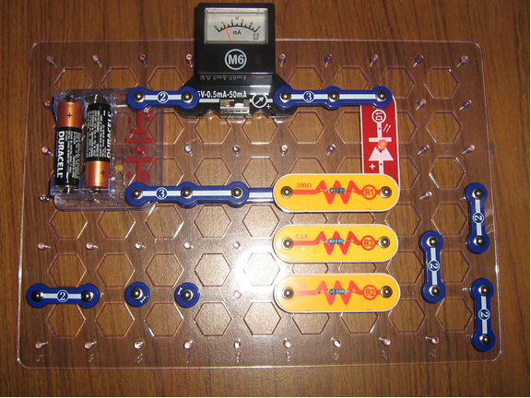
Different resistors
Follow the figure to make the circuit for testing resistors. Put resistor (R1) in the circuit first. Observe and rank the brightness of the LED, and the current through the ammeter. Record this on the worksheet. Then repeat with R2 and R3.
Remember - the more electricity flowing through the LED, the brighter it glows.
R1 will be the brightest.

Slide 8
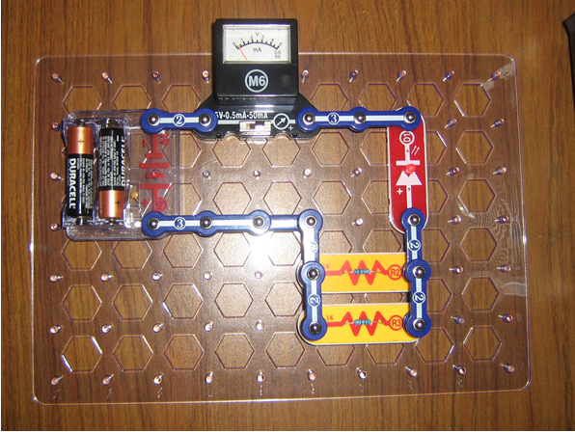
Resistors in parallel
Follow the figure.
Connect the R2 and R3 as shown above. This will place the resistors in parallel. Observe and rank the brightness of the LED and the current through the ammeter. Record this on the worksheet.
Note: use the Number 1 Snaps underneath to complete the circuit

Slide 9
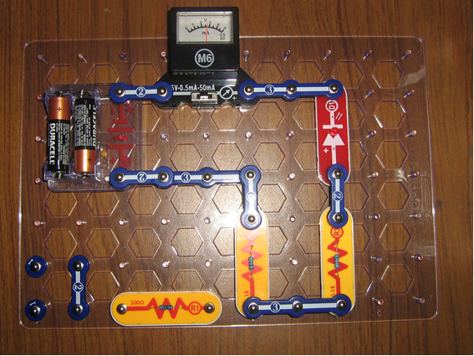
Resistors in series
Follow the figure.
Connect R1 and R2 as shown above. This will place the resistors in series. Observe and rank the brightness of the LED and the current through the ammeter. Record this on the worksheet.

Slide 10
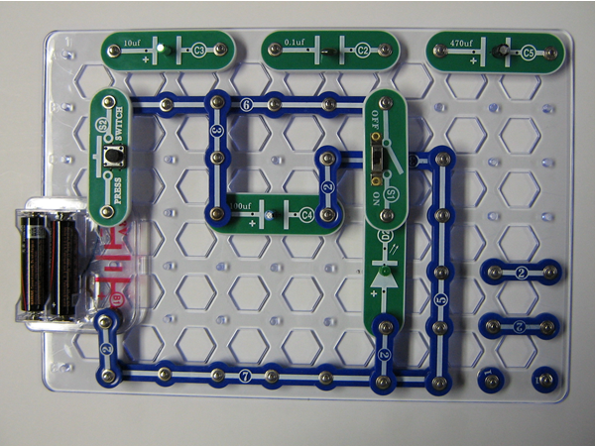
Different capacitors
Follow the figure.
Start with the circuit as shown with the C4 capacitor being tested. Be sure the slide switch is off. Hold the push switch down for a few seconds, then release. Then, while carefully watching the LED, turn the slide switch on. You should observe a brief lighting of the LED. Record both the relative brightness and the length of time on the worksheet. Repeat several times to make sure you have observed the light and time properly. Then remove C4 from the circuit and place C3 in the circuit. Repeat the procedure, noting brightness and length of time on your worksheet. Follow the same procedure for C5 and C2,
By adding the capacitors one by one to the circuit and pressing the S2 switch with the S1 switch off, each capacitor can be charged. Then when the S1 switch is turned on the capacitor will discharge and the LED light up until there is no voltage left.

Slide 11
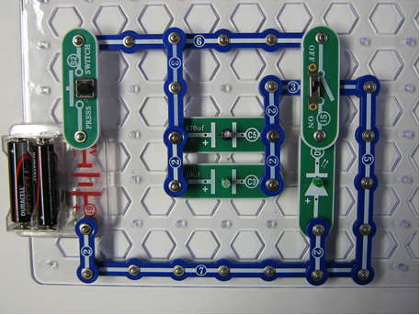
Capacitors in parallel
Follow the figure.
Charge the capacitors as before by pressing down S2, the push switch. Then release and turn on the slide switch, S1. Record your observations on the worksheet.
Note: use the Number 1 Snaps underneath to complete the circuit

Slide 12
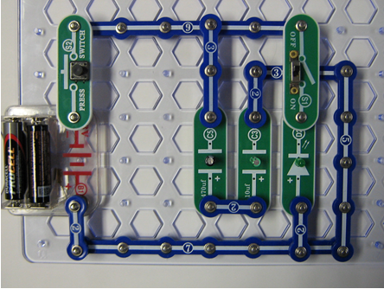
Capacitors in series
Follow the figure– charge the capacitors by pressing the S2 switch, then release.
Observe the relative brightness and length of time the LED is lit when the S1 switch is turned on. Record your observations on the worksheet.

