Slide 1
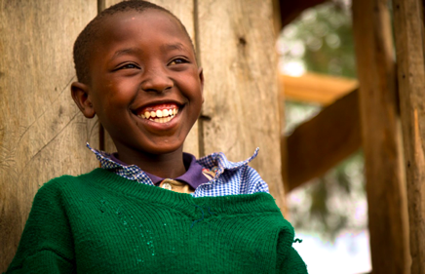
Early Years, Lasting Change
The Potential of Preprimary Education as a Pathway to Improved Child and Adult Outcomes in Sub-Saharan Africa
World Policy Center Analysis
Kelley Lach and Shelby Dodd
Notes:
Both

Slide 2
Preprimary Education
Classified as education for children ages 3-6 (or national entry to primary school)
Sub-goal of the 2030 Sustainable Development Goal 4:
“By 2030, ensure that all girls and boys have access to quality early childhood development, care and preprimary education so that they are ready for primary education” (UN Division for Sustainable Development Goals, 2018).
Characterized by:
Interaction with peers and educators, developing language and socioemotional skills
Introduction to alphabetical and mathematical concepts
Exploration of their surroundings through play and instruction
Gross-motor activities
Preparation for transition to primary school
(UNESCO Institute for Statistics)

Slide 3
Why Preprimary Education?

Slide 4
Benefits of Preprimary Education
Can improve health and wellbeing when combined with nutritional component (Nores and Barnett, 2010)
Community Connection
Connects children and families to community resources + social support (Richter, 2016)
Health
Improves socio-emotional and cognitive development
Pathway to Primary
Free preprimary education increases enrollment and completion by up to 12% in developing nations (Earle, Milovantseva & Heymann, 2018)
Development
Greatest gains seen for children in poverty (Huizen and Plantanega, 2018)
Cost-effective when considering lifespan benefits
(Doyle, Harman, Heckman & Tremblay, 2018)

Slide 5
Case Studies in Preprimary Education
Head Start (US)
Children who attended more likely to complete high school and attend college than siblings
Students less likely to have been booked or charged with a crime later in life
Chile
Significant improvement in reading and math test scores as measured by Chile’s National Education Quality Measurement System when poor children attended preprimary program (Cortazar, 2013)
India
Poor children much more likely to attend school if they had gone to a preprimary program when they were 0-6 years old
Probability of school enrollment increased by 46% percent for 7-14 year old students and by 72% percent for 15-18 year old students (Hazarika, 2016)

Slide 6
Why Sub-Saharan Africa?

Slide 7
Childhood in Sub-Saharan Africa
33 million children are out of school
World’s highest child mortality rate--86 per 1,000 live births
38% of women aged 20-24 were married before eighteen in Sub-Saharan Africa (UNICEF, 2018)
Significant progress under MDGs, but lagged behind as a region (Millenium Development Goals Report, 2015)

Slide 8
Research Questions
What are the patterns in Sub-Saharan Africa of the provisions of preprimary education and protections from early marriage and child labor?
Are preprimary enrollment rates in Sub-Saharan African nations related to national outcomes for child mortality, child labor, child marriage, and adult literacy?

Slide 9
Hypothesized Role of Preprimary Education
Stimulating & healthy environment
Readiness for primary education
Placing value on ECD & the protection of childhood
Improved middle childhood outcomes (Reduced child mortality, child marriage + child labor)
Improved adult outcomes (Increased literacy)

Slide 10
Data and Methods for Analysis
Methods for Analysis:
Question 1: Descriptive statistics on preprimary education rate + protections
Question 2: Correlational analysis of preprimary education + other variables
Data sources:
World Policy Center (Protections from child labor and child marriage)
UNESCO Institute for Statistics (Preprimary enrollment, Adult literacy rate)
Demographic and Health Surveys (Child Marriage)
Gapminder and the UN Population Division (Child Mortality)
World Bank (GDP per capita, PPP)
Understanding Children’s Work--project using ILO, UNICEF & World Bank data (Child labor)
Limitations
Missing data for Western Sahara and Malawi; inconsistencies in years of data collection

Slide 11
What are the patterns in Sub-Saharan Africa of the provisions of preprimary education and protections from early marriage and child labor?

Slide 12
Results:
Preprimary Education
What are the patterns in Sub-Saharan Africa of the provisions of preprimary education and protections from early marriage and child labor?
Average Enrollment: 25.6%
Range: Somalia .409% to Ghana 111.931%
Enrollment Ratio | Number of Countries | Percentage of Region
0-10% | 17 | 35%
>10-20% | 12 | 25%
>20-50% | 11 | 22.90%
>50-80% | 5 | 10.40%
100%+ | 3 | 6.25%

Slide 13
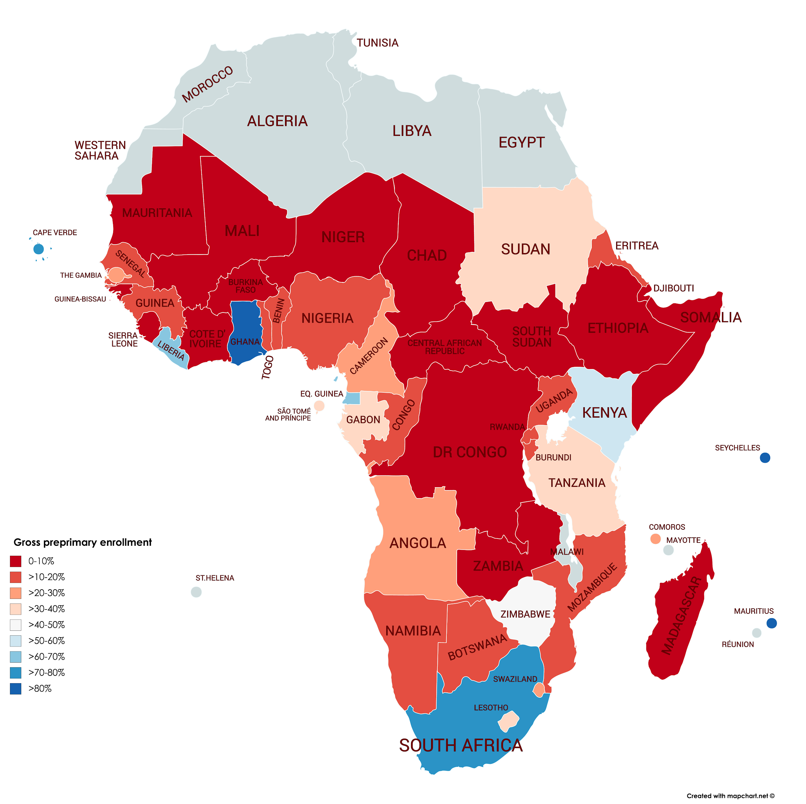
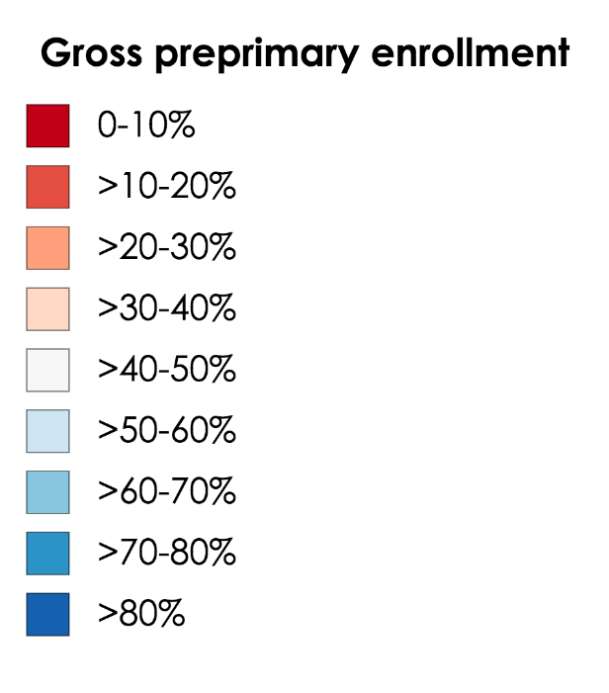
Results:
Preprimary Education

Slide 14
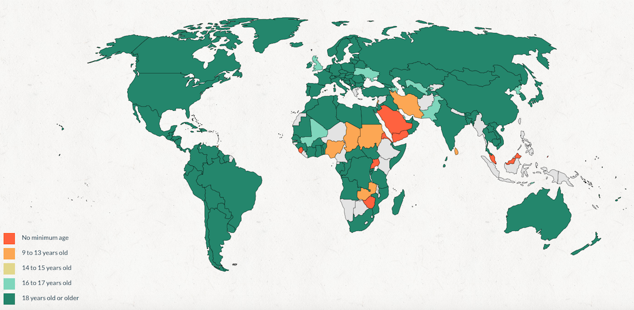
Results:
Child Marriage
What are the patterns in Sub-Saharan Africa of the provisions of preprimary education and protections from early marriage and child labor?
What is the minimum age of marriage for girls including under customary or religious law?

Slide 15
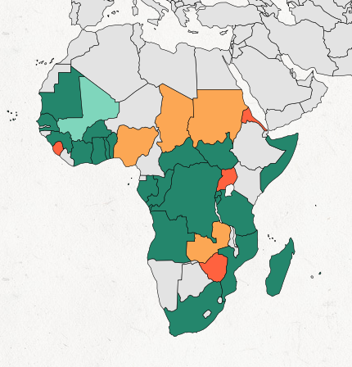
Results:
Child Marriage
What are the patterns in Sub-Saharan Africa of the provisions of preprimary education and protections from early marriage and child labor?
What is the minimum age of marriage for girls including under customary or religious law?
No minimum age: Zimbabwe, Uganda, Sierra Leone, Eritrea
9-13 years old: Nigeria, Chad, Sudan, Zambia
16-17 years old: Mali

Slide 16
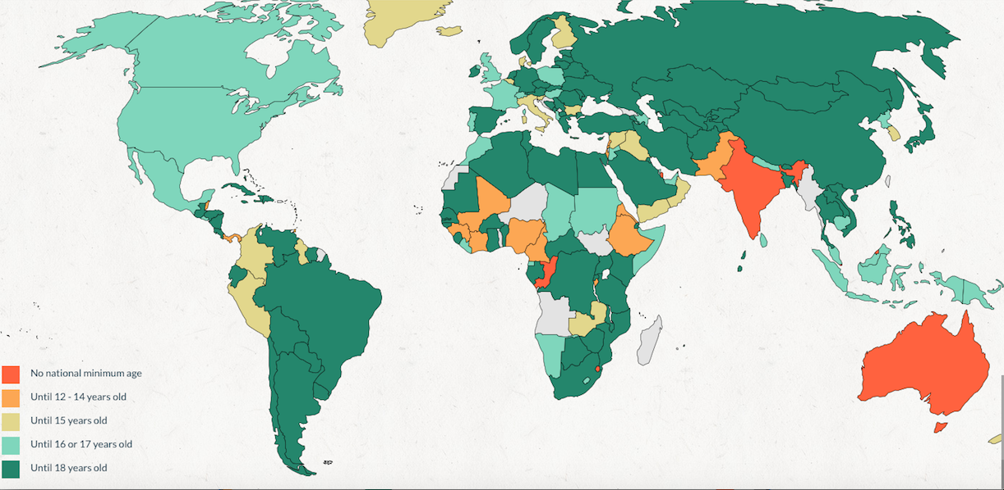
Results:
Child Labor
What are the patterns in Sub-Saharan Africa of the provisions of preprimary education and protections from early marriage and child labor?
How long are children protected from hazardous work when legal loopholes are considered?

Slide 17
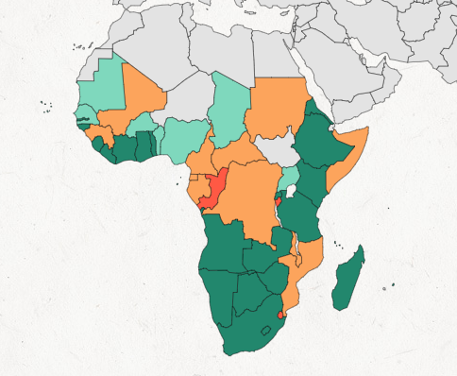
Results:
Child Labor
What are the patterns in Sub-Saharan Africa of the provisions of preprimary education and protections from early marriage and child labor?
What are the patterns in Sub-Saharan Africa of the provisions of preprimary education and protections from early marriage and child labor?
How long are children protected from hazardous work when legal loopholes are considered?
No minimum age: Republic of the Congo
Until 12-14 years old: Guinea, Mali, Cote d’lvoire, Nigeria, Cameroon, Burundi, Ethiopia, Eritrea
Until 16 or 17 years old: Liberia, Chad, Sudan, Somalia, Namibia, Lesotho

Slide 18
Are preprimary enrollment rates in Sub-Saharan African nations related to national outcomes for child mortality, child labor, child marriage, and adult literacy?

Slide 19
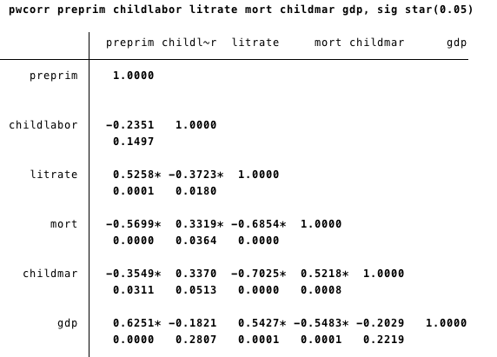
Results
Preprimary education is significantly correlated with:
Adult literacy
Child mortality
Child marriage rates
GDP

Slide 20
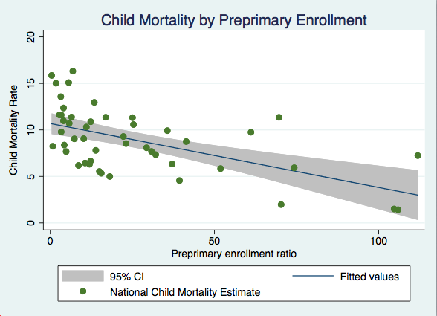
When accounting for GDP, preprimary enrollment still predicted reductions in child mortality (β: -.0413067; p=0.027)

Slide 21
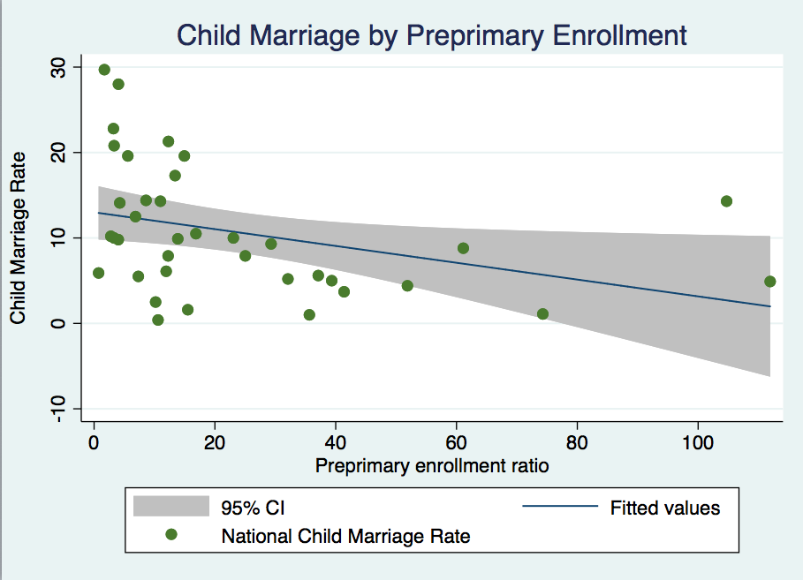
Neither GDP nor preprimary enrollment retained their significance when combined

Slide 22
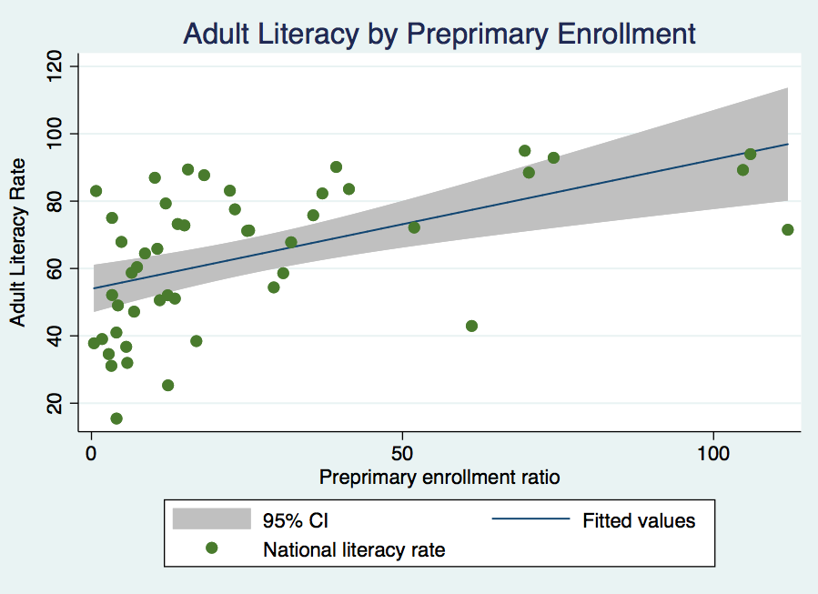
When accounting for GDP, preprimary enrollment did not predict adult literacy

Slide 23
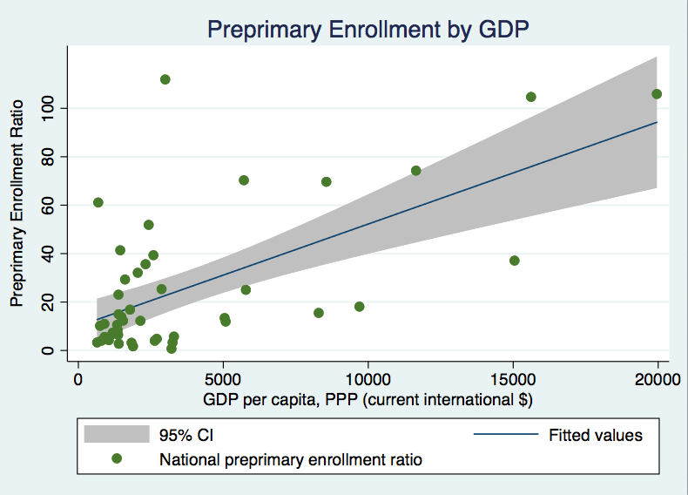
Notes:
Shelby

Slide 24
Summary of Results
& Recommendations
Notes:
Shelby

Slide 25
Summary of Results
Question 1
On average, preprimary enrollment in Sub-Saharan Africa is 25.6%, but there are huge disparities
Policy lags behind regionally regarding child marriage and child labor
Question 2
Preprimary education is related to reductions in child marriage & child mortality, and increases in adult literacy
However, when controlling for GDP, preprimary education is only predictive of reductions in child mortality

Slide 26
Recommendations
Increasing awareness of the importance of early childhood development
Promote pathways from preprimary education to primary education
Quality > Quantity
Improve teacher training for preprimary education to improve quality
Future Study
How have some low-income countries increased preprimary enrollment?
What contributes to child marriage and child labor reductions, if preprimary education does not?

Slide 27
Any questions?
Notes:
Shelby

