Slide 1
Pediatric Videofluoroscopic Seating System for Swallow Studies
Katie Henderson, Noah Mallory, Justin Cruz, & John Kerr
Notes:
Katie
-Hello everyone, thank you for being here today. My name is Katie, and these are my teammates Noah, Justin, and John.
Today we will be giving you an overview of our senior design project, which is to design a pediatric videofluoroscopic seating system for swallow studies. We will start with a brief background of the problem before diving into our needs assessment, progress to date, and timeline moving forward.

Slide 2
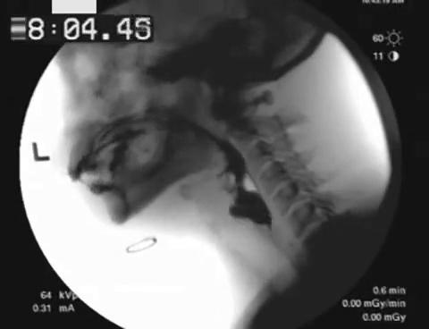
Background
What are pediatric videofluoroscopic swallow studies?
Performed on kids that have developmental and/or birth defects
Enable providers to identify patient's risks and concerns while swallowing
Goal is to mitigate risks through interventional surgeries or feeding tubes
Take X-rays in real time while patient swallows liquids/foods mixed with barium
https://gfycat.com/frailspryfly
Notes:
Katie
-At Monroe Carell Jr. Children's Hospital at Vanderbilt, dozens of videofluoroscopic swallow studies are performed each week for kids that have developmental and birth defects.
-These studies enable providers to identify each patient's potential risks and concerns when swallowing, such as aspiration or an inability to consistently use the epiglottis and pharynx muscles.
-If potential risks can be quickly addressed with interventional surgeries or feeding tubes, physicians can greatly improve patient comfort and safety and put their families at ease.
-These swallow studies are performed by taking X-rays in real time while the patient swallows liquids/foods mixed with barium.

Slide 3
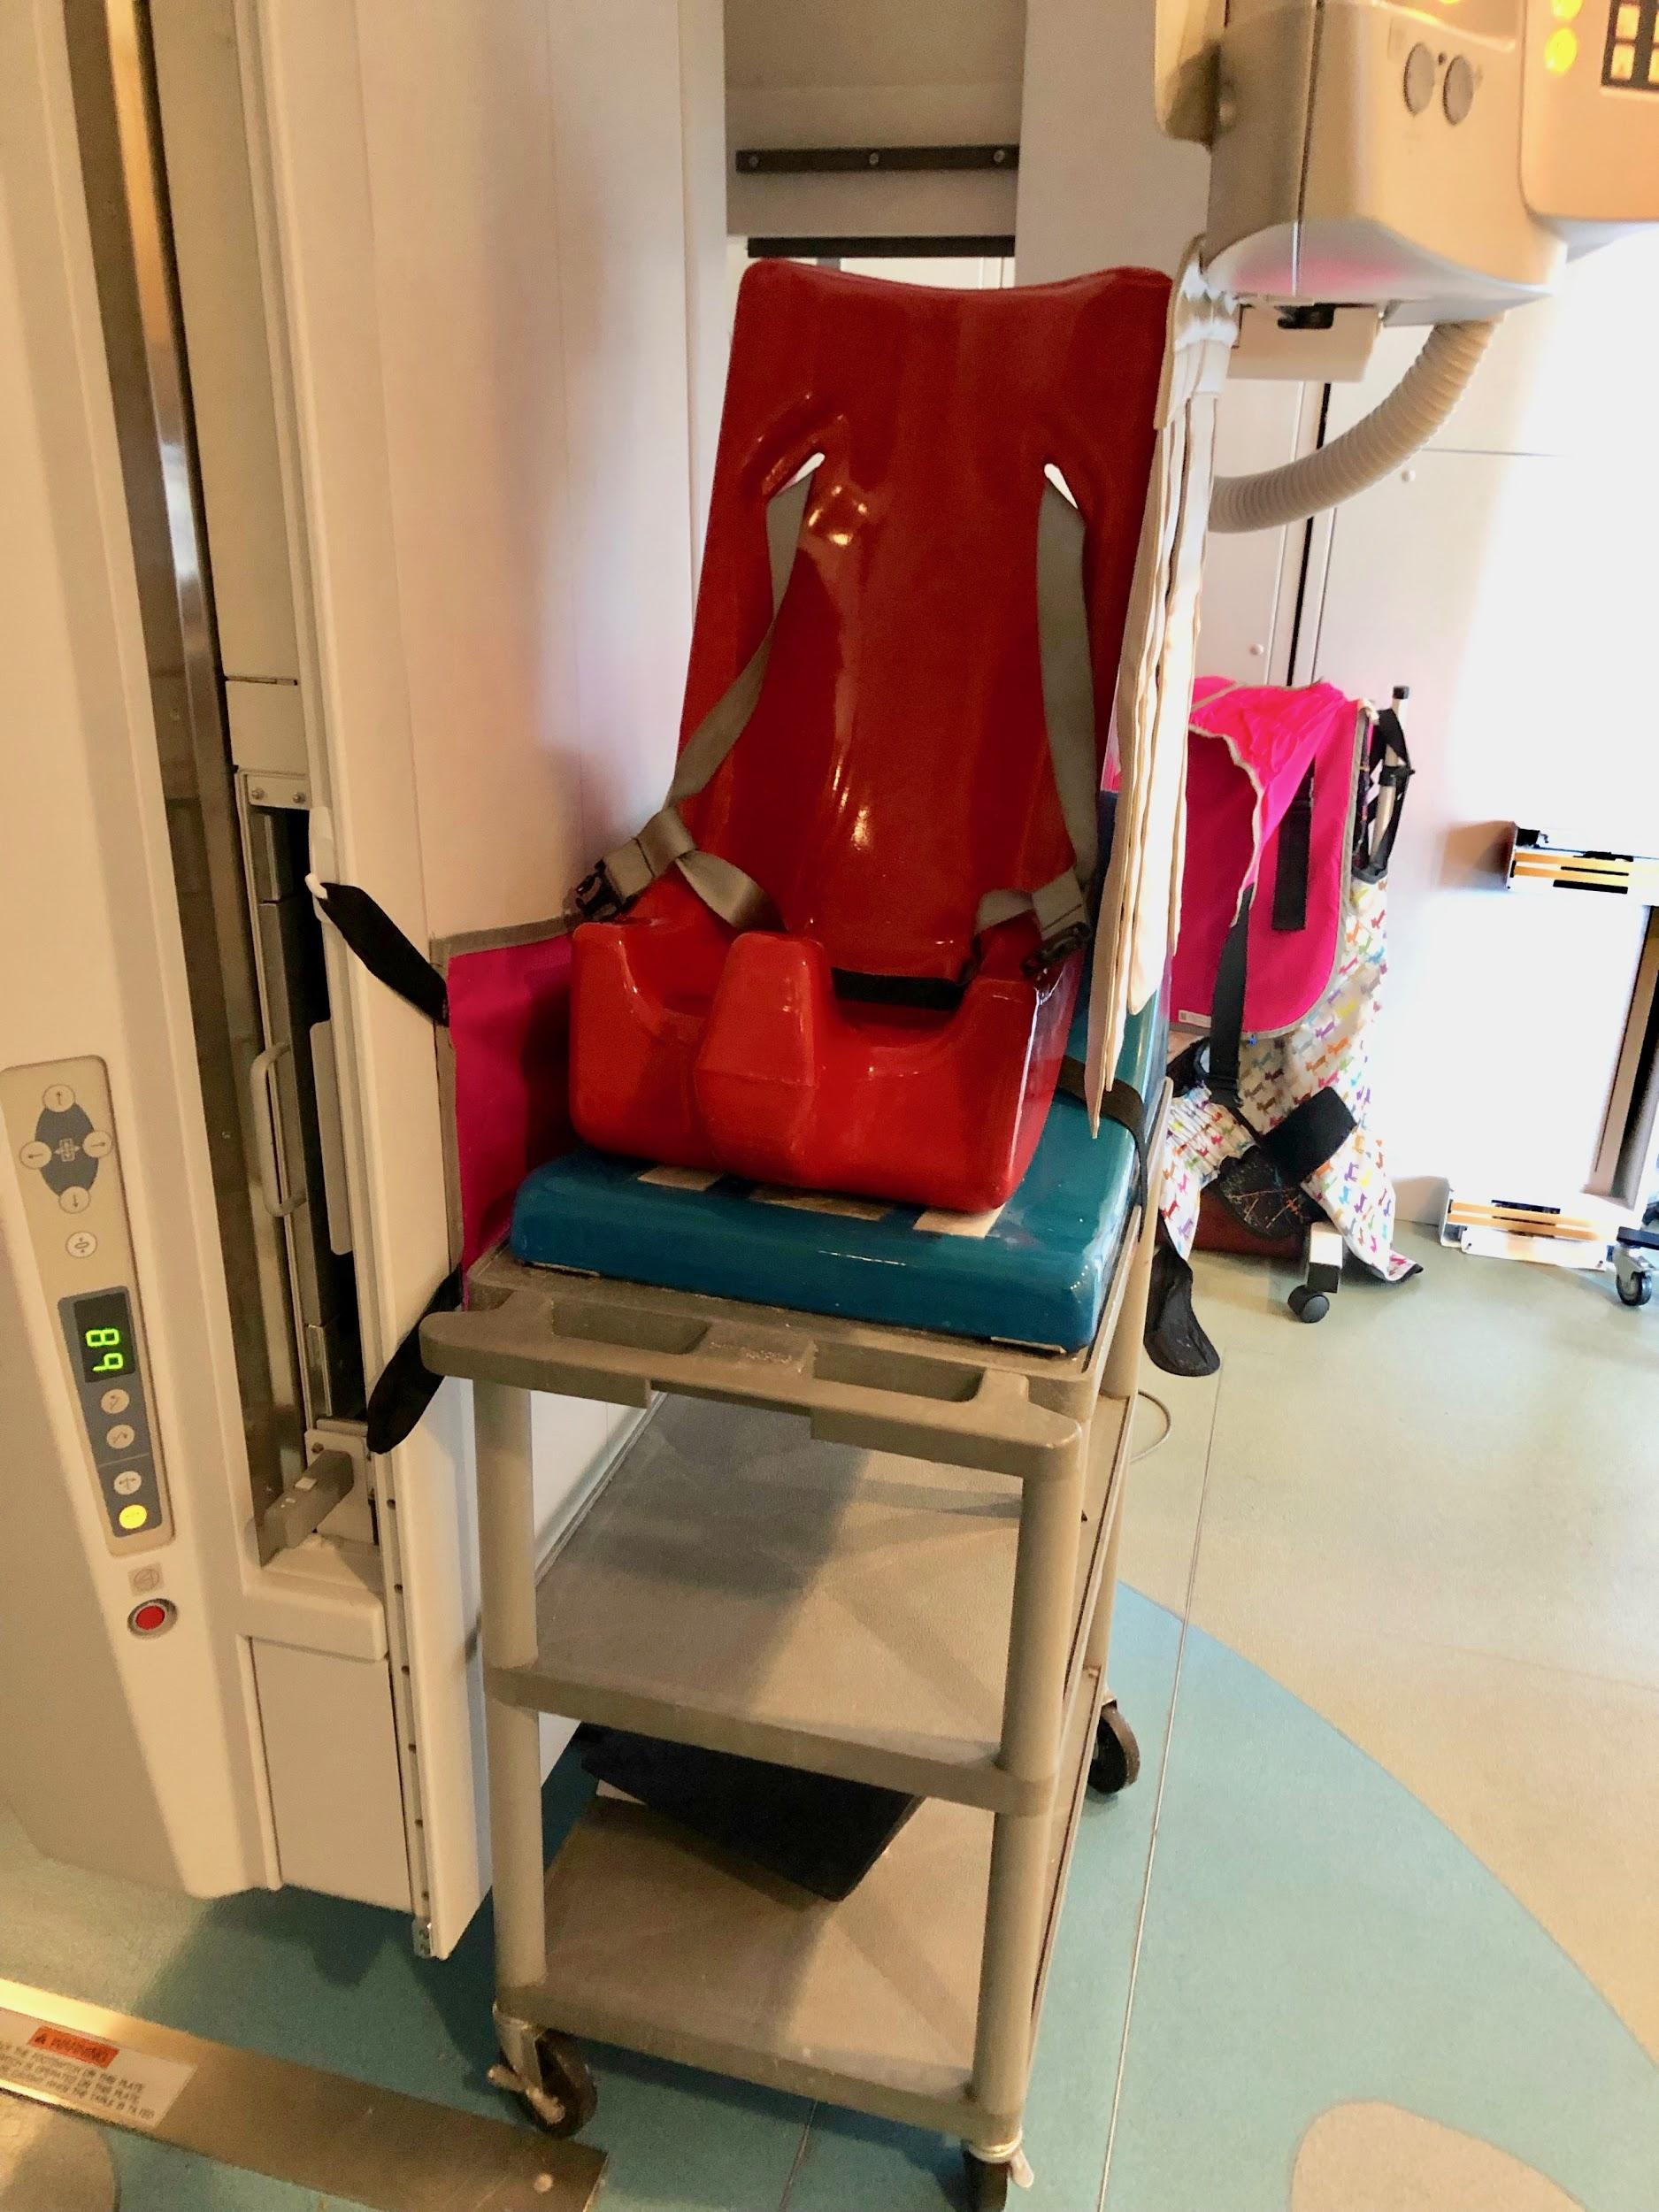
Problem Statement
The chair currently in use at Vanderbilt Children’s Hospital is:
Unstable and unsupportive for children with motor deficiencies
Incompatible with other medical machinery
X-ray arm restricts width to 19” and has a vertical range of movement of 28”
Not adjustable for patients of different ages and sizes.
Notes:
Noah
The current positioning system used for pediatric videofluoroscopic swallow studies is unstable for children with motor deficiencies, incompatible with other medical machinery, specifically the X-ray machine, and not adjustable for patients of different ages and sizes.

Slide 4
Needs Assessment Based on Clinician Feedback
Crucial needs:
Ability to recline
Support from braces and straps
Notes:
Noah

Slide 5
Meeting Updates
Speech Pathologists at Monroe Carell
Presented updates on our progress
Brought in Special Tomato Soft-Touch Sitters
Physicians confirmed that material appears better for cleaning than what they used years ago
Discussed future steps/requirements for testing equipment and gaining hospital approval
Took measurements of vertical range that X-ray arm can accommodate
Can accommodate all chair sizes, but physicians would prefer different heights for each size
Size 5 must be lower to allow for easy loading of teenagers (28” base)
Size 1 must be higher to make it easier to feed small infant (34”-36 base)
Notes:
John

Slide 6
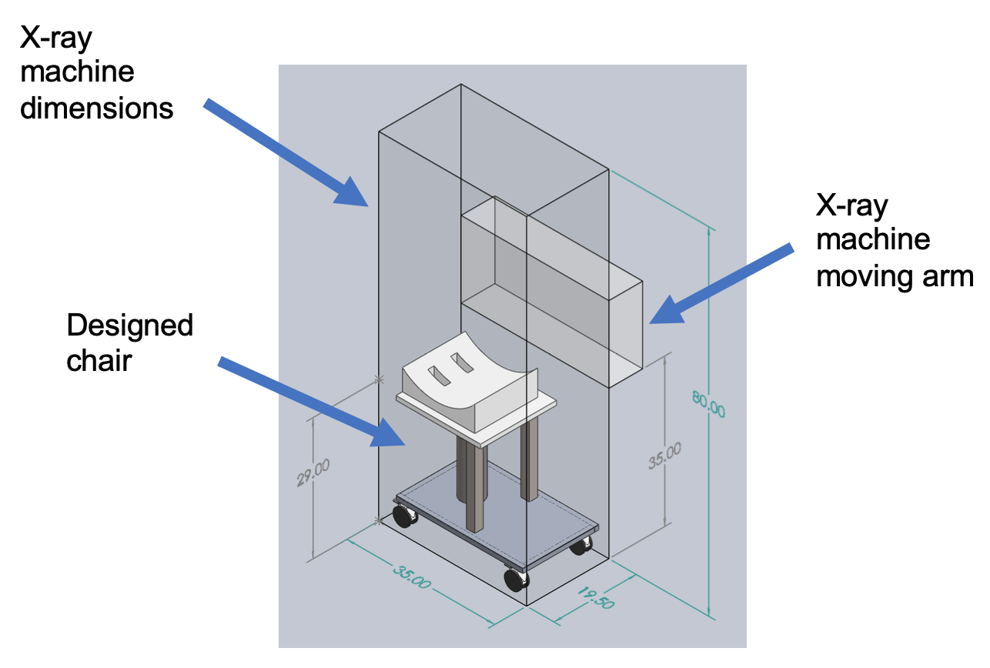
CAD Model - SolidWorks
Notes:
Katie
-overall weight = 174.2 pounds
-seat base alone is ~50 pounds and size 5 sitter is 19 pounds → 70 pounds being lifted by pump, not including child

Slide 7
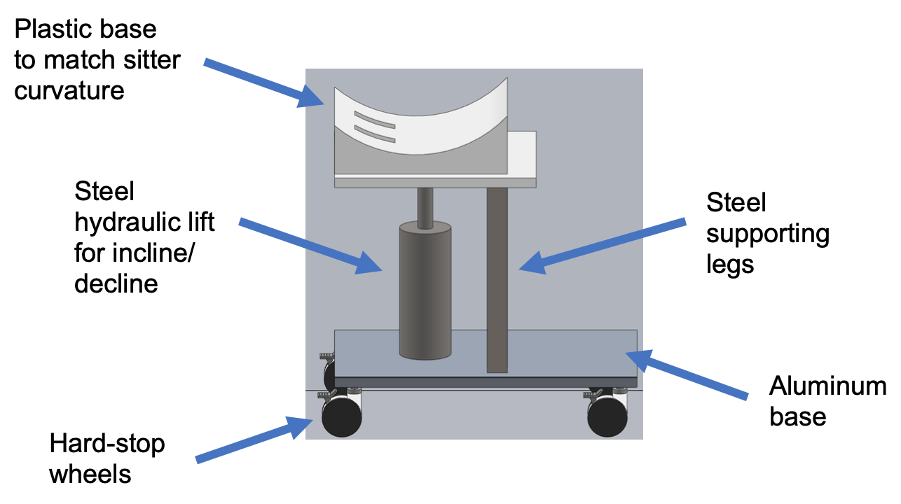
CAD Model - SolidWorks
Notes:
Katie
-overall weight = 174.2 pounds
-seat base alone is ~50 pounds and size 5 sitter is 19 pounds → 70 pounds being lifted by pump, not including child

Slide 8
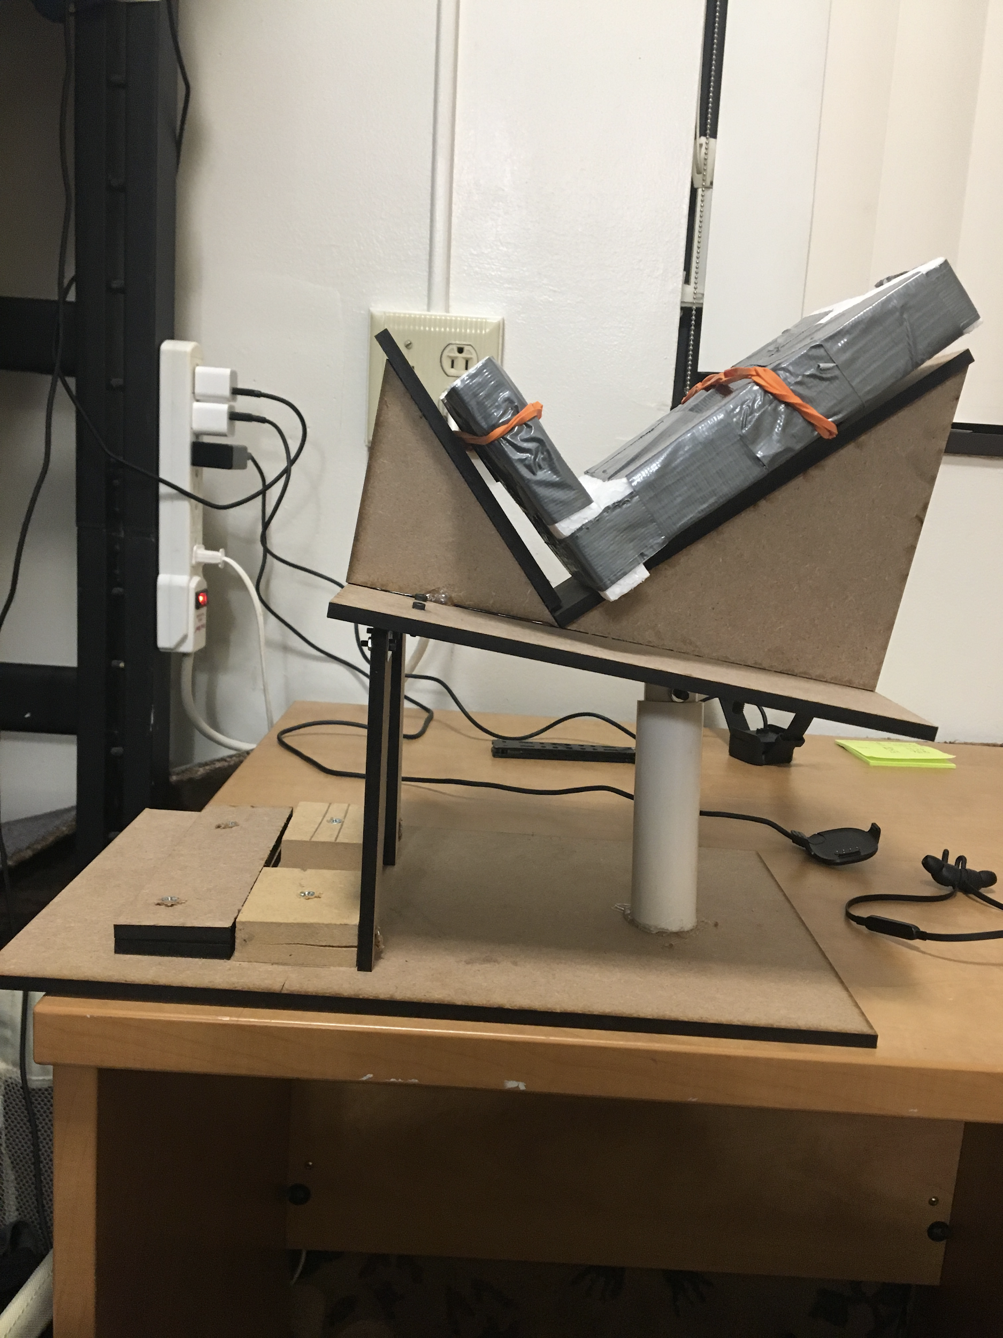
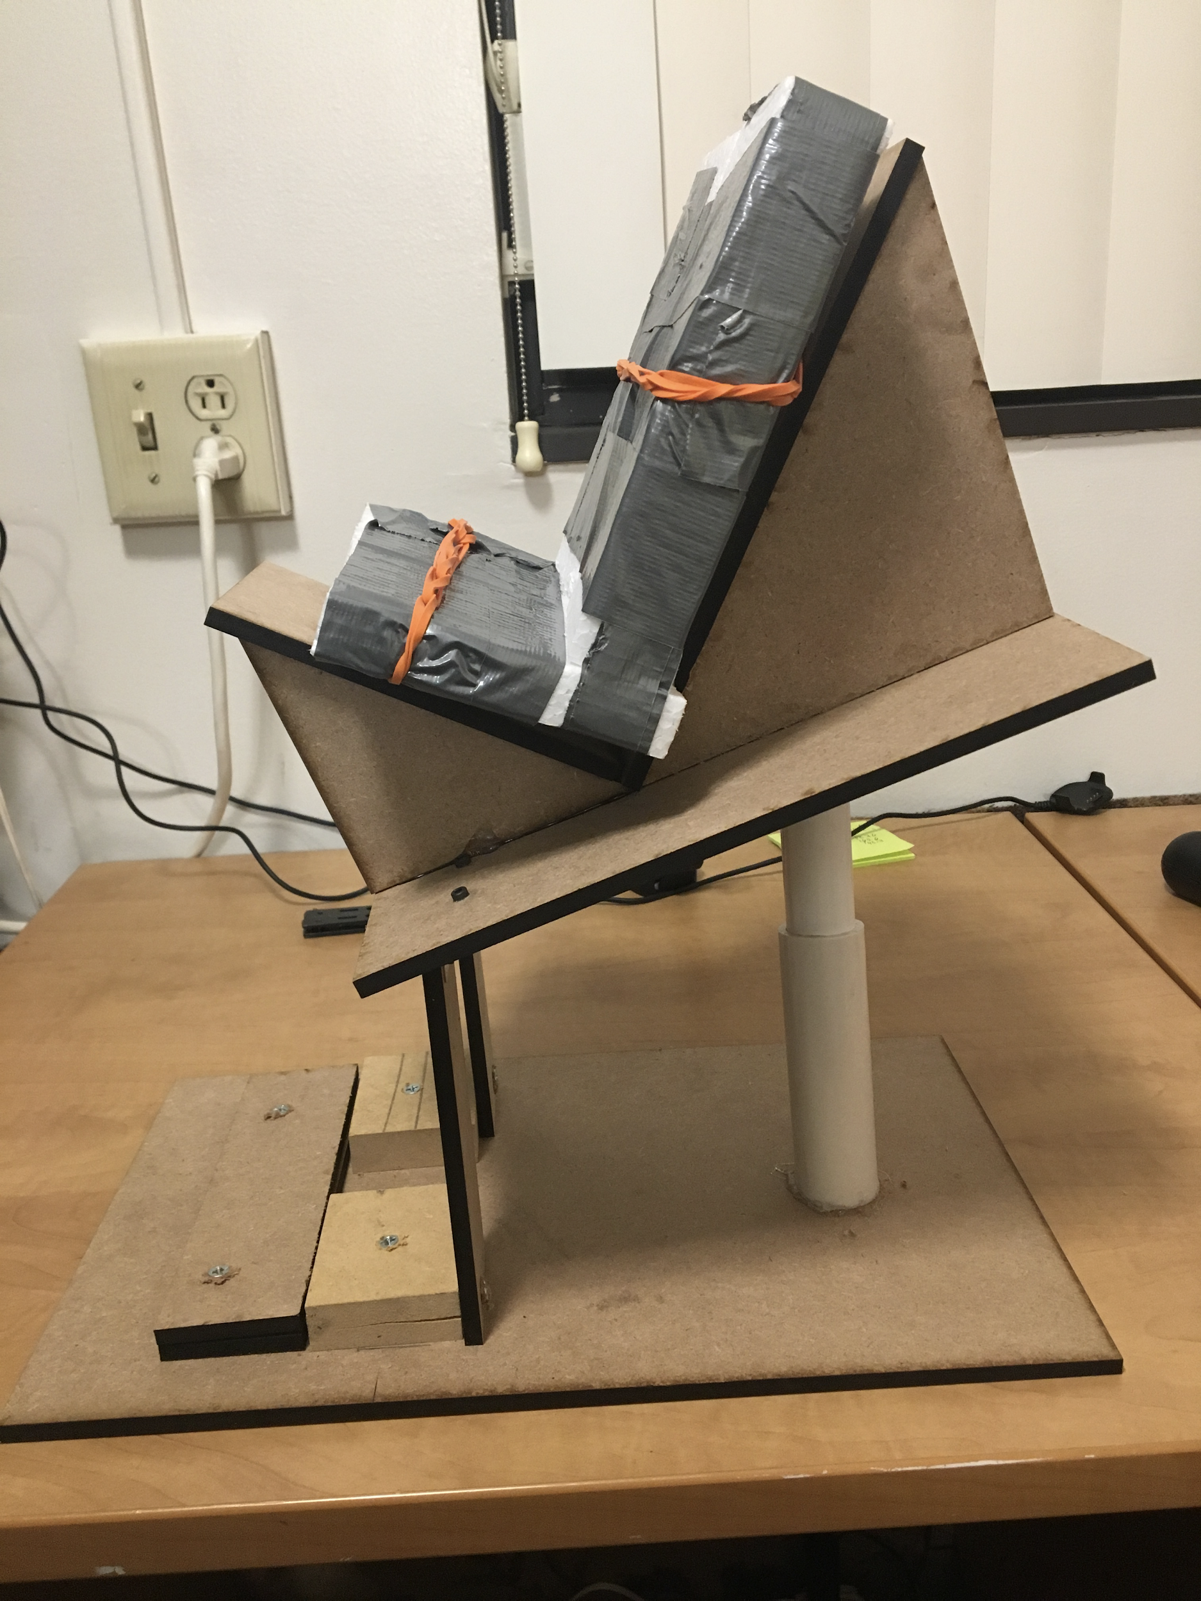
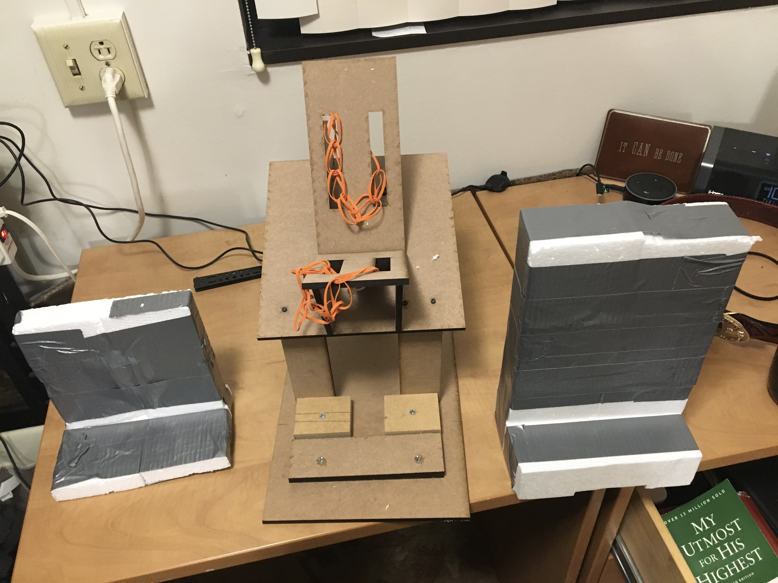
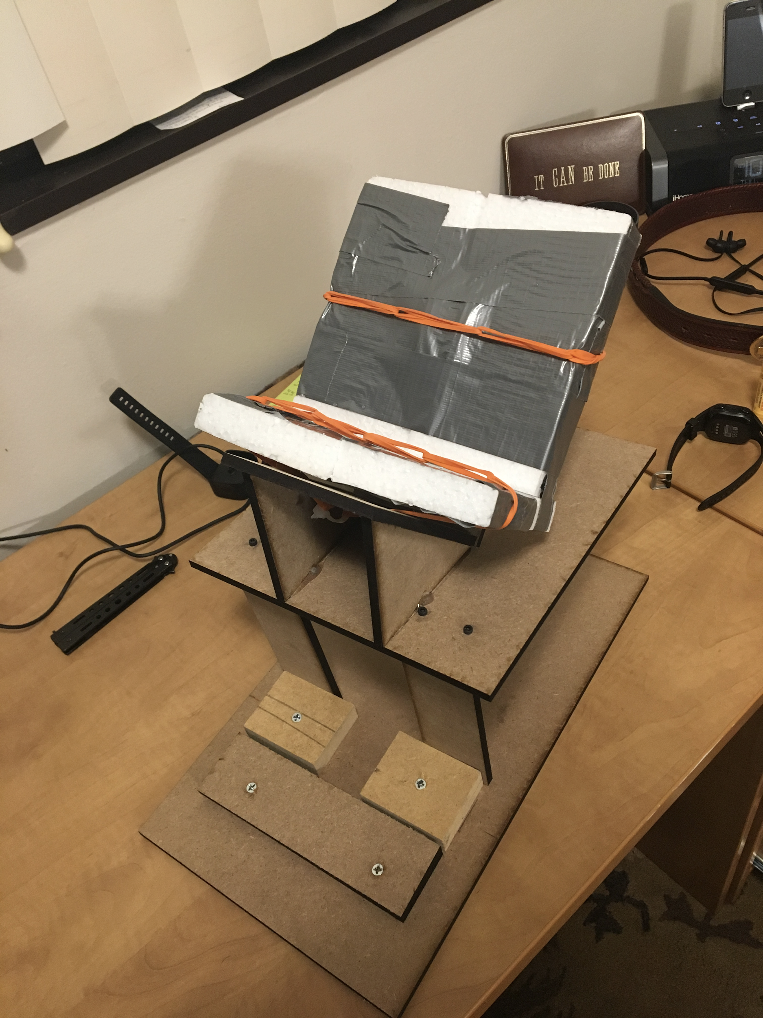
Previous Prototype
Strengths we see
Utilizes a simpler, single pole hydraulic lift design for reclining in the rear
Universal anchor points that all three seat sizes fit in. No seat modifications necessary
More stable than the telescoping model
What we have learned
Current design cannot adjust height
The importance of this is will depend on the measurements we take later this week
Range of the chair angle must increase
Foot supports must be attached to base
Notes:
Noah

Slide 9
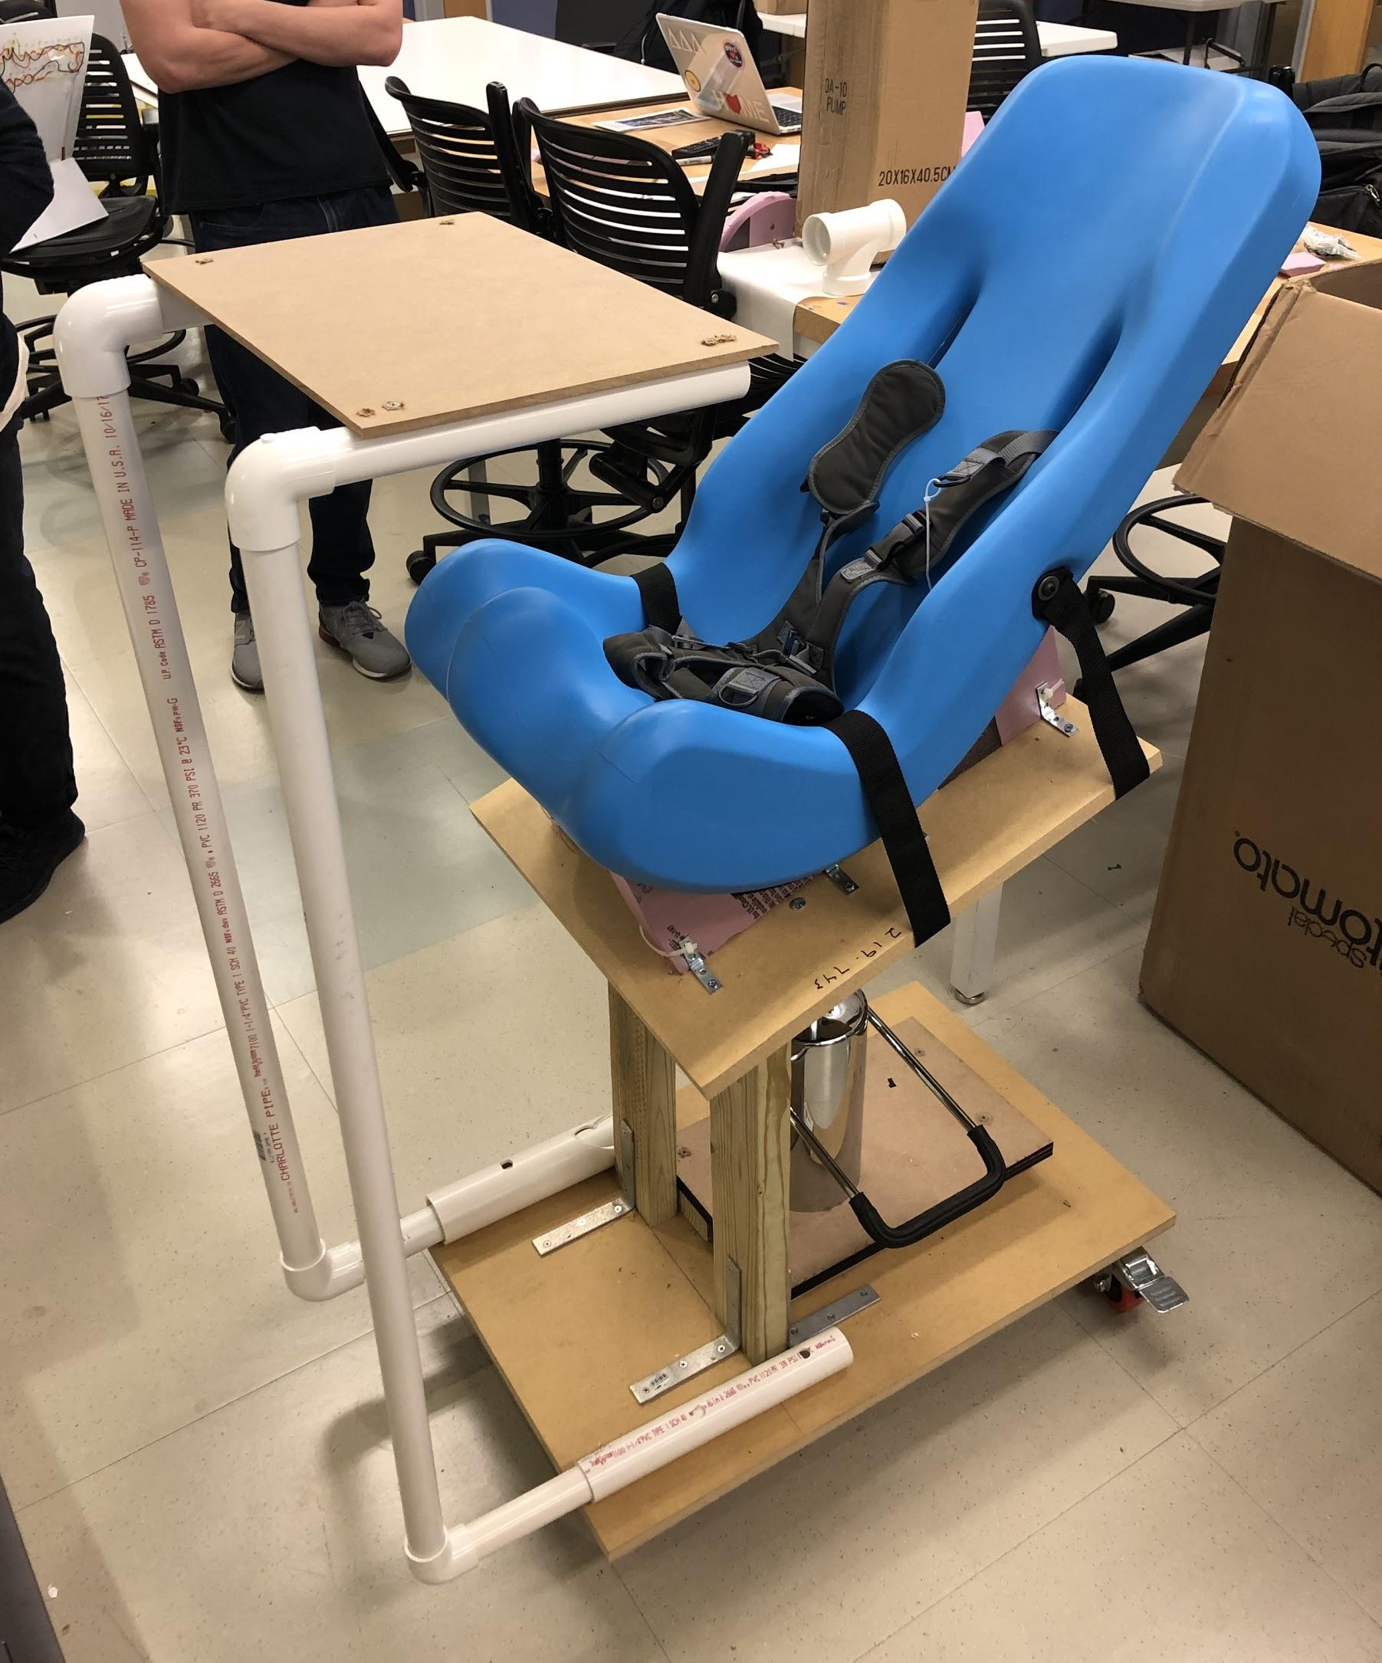
Full-Size Prototype
Strengths we see
Placement of hydraulic lift allows for 70 degrees of rotation
What we have learned
Physical impediments
The lift/platform connection and necessary moving joint
Current vs. previous placement of hydraulic lift
Incorporation of folding leg rest and tray
Areas for improvement
Height adjustability
Booster seats, hydraulics
Wheel stability (changing back two)
Notes:
Justin

Slide 10
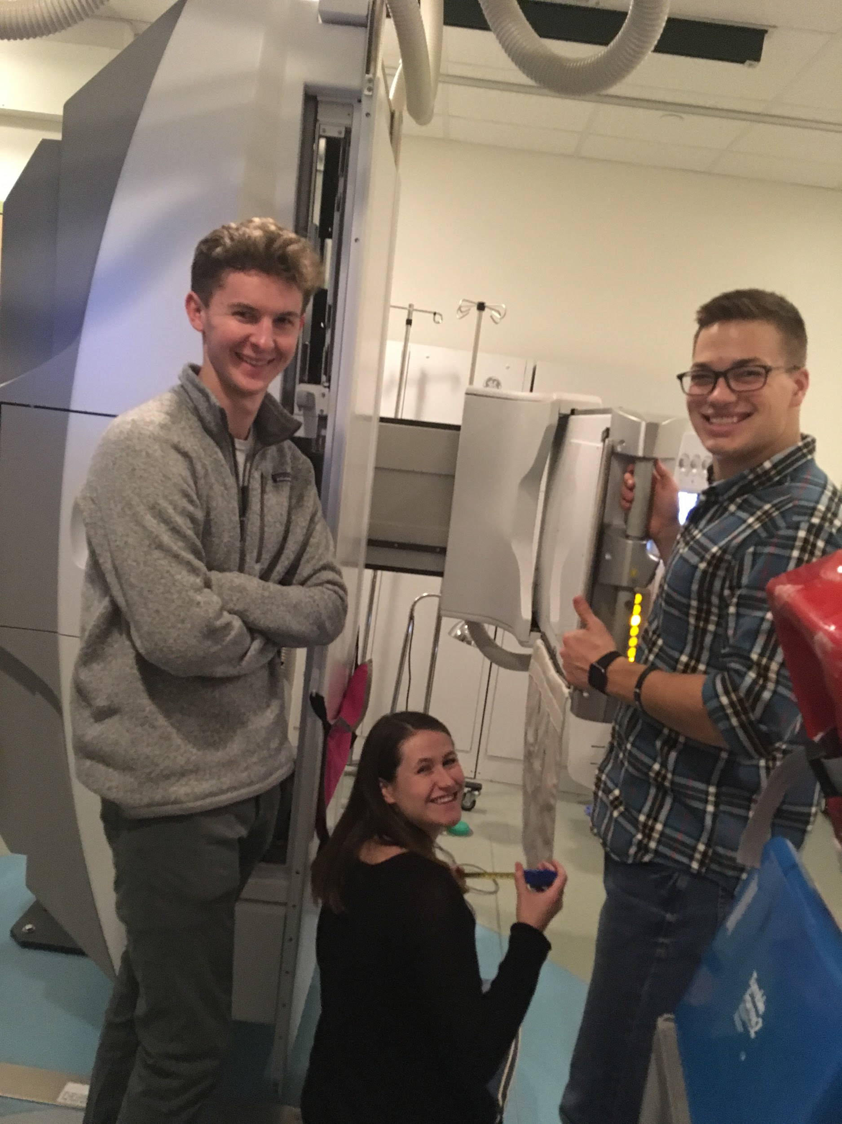
Current Design Challenges
Height range of motion
Size restraints for the large model
Must serve Size 1 Sitter (25” height) to Size 5 (44” height)
Designing a booster seat for Size 1
Structure mobility
Industrial wheels with a hard stop
Materials and weight
Lowering the center of mass
Needs to move easily on wheels
Structurally & economically sound
Notes:
Justin
-Based on input from VFSS staff
-Material has been found to break down after repeated cleanings - looking into protectant/sealant
-Base can be designed to work for all three chair sizes
-12, 16, and 20 inch widths

Slide 11
Updated Project Plan
Notes:
John
We have organized our optimal timetable into a gantt chart. In early september we established communication with our adviser, Kaitlyn Minchin and the rest of the Video Fluoroscopy team with Noah as our primary point of contact. We were then able to tour the facility and the observe important aspects of the fluoroscopy process the seating system would be designed for. Over the past month we have used this information to establish a foundation for the list of needs we identified to be ranked by Kaitlyn and her team. Currently, we are brainstorming and developing promising ideas to pursue based on our list of prioritized needs. In the future we would like to start prototyping with the tools available in the Wondry, before ordering parts over the next couple of months. Then we will proceed with iterative prototyping to optimize our design model all while continuously recording our progress online through our website platform.

Slide 12
Future Design Path
Currently in step five: modifying and improving the design
Rapidly prototyping
Identifying possible issues
Future plans include:
Finalize CAD model
Bring full size prototype to Monroe Carroll
Determine materials and means to make a load bearing model
https://brightspace.vanderbilt.edu/d2l/le/content/142254/viewContent/1111865/View
Notes:
John
Where we are and where we’re going
Diving further into the current stage of our design process. We have started to generate possible design pathways by brainstorming seating models consistent with the needs diagnosed by our team as well as Kaitlyn and her fellow physicians at Monroe carroll. This includes sketches like the one Justin described previously as well as researching past products and analyzing what worked well and what did not. We will continue to communicate our ideas and include drawings in our team meetings, but will also look to start creating physical models in the makerspace out of free, raw materials like plywood and PVC available at the maker’s space.
All members have completed Makerspace training and have scheduled a meeting for this week with Dr. Kevin Galloway to begin prototyping
prototyping

Slide 13
Acknowledgements
We would like to that Dr. Matthew Walker III, Kaitlyn Johnston Minchin, and the entire VFSS staff for their continued support throughout this design process.
Notes:
John

