Slide 1
Student Rapid Check-In

Slide 2
Hello!
I am Matthew Cordova
Everglades High School
You can find me at matthew.cordova@browardschools.com

Slide 3
“When students feel safe and supported, they are truly ready and able to learn.”
-Laura Weaver & Mark Wilding

Slide 4
Personalization Periods
Homework and Study
Counselors
Make-Up Tests
Relationships
Guidance
Notes:
Discuss how Everglades uses personalization periods.

Slide 5
How Do We Keep Track?
Notes:
Student trends beyond the traditional statistics…a.k.a. grades and behavioral issues.

Slide 6
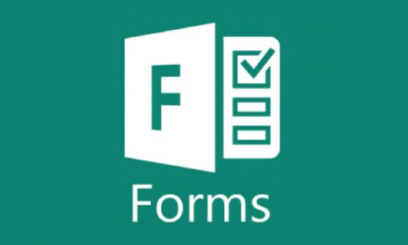
Google Forms
Provides the ability to turn students responses to specific questions into quantifiable data.

Slide 7
School Participation
Notes:
Let’s us know just how many students are participating in extra-curricular programs.

Slide 8
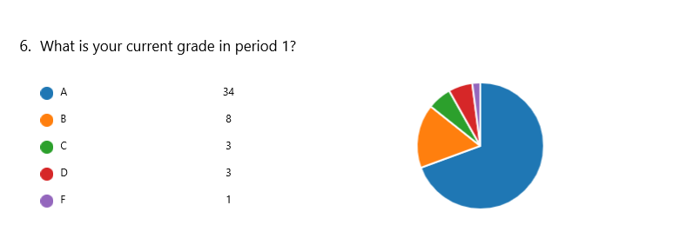
Student Grade Analysis
Notes:
Allows us to track grades of all students by periods to identify trends.

Slide 9
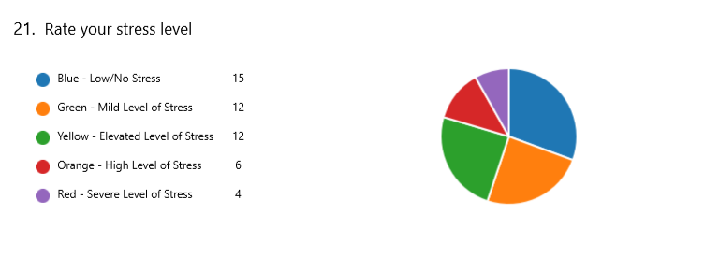
Stress Level Readings
Notes:
Allows us to put a pulse on stress levels students are feeling.

Slide 10
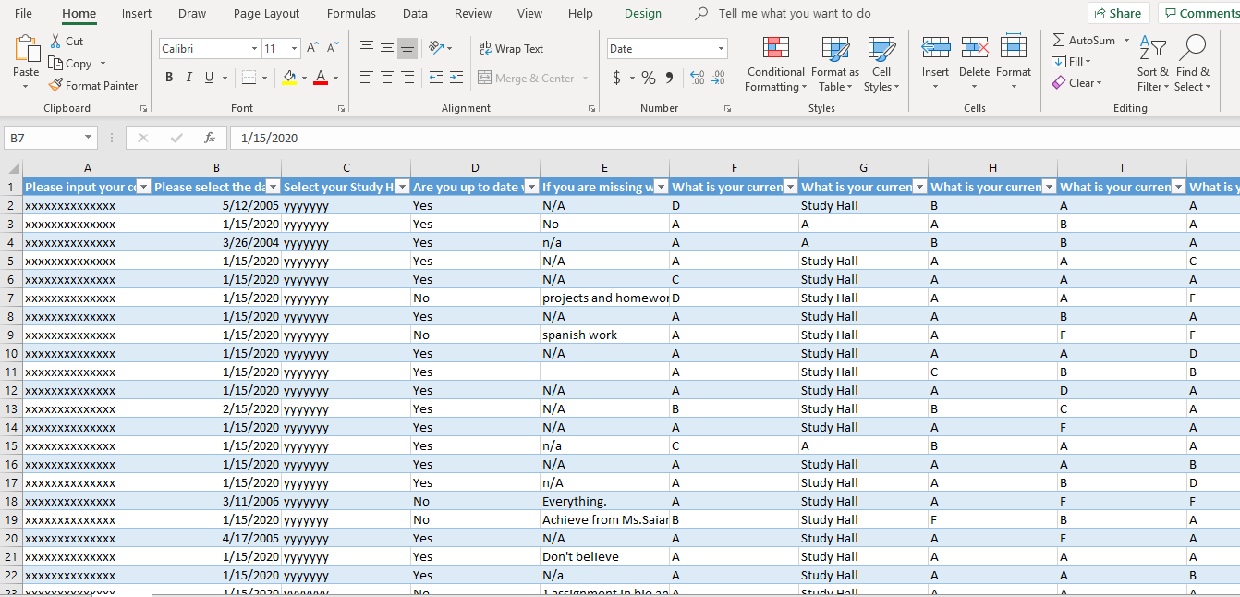
Excel File Available
Notes:
Allows us to sort data to target specific concerns (i.e. students in “RED” stress level

Slide 11
The Process
Rapid Check-In
Teacher/Team Analysis
Targeted One-on-One Time
Students have a safe space to share their thoughts and concerns.
Data trends can be broken down and plans can be made to address needs.
Teachers have substantial conversation starters beyond grades.
Notes:
Student complete check-in during personalization periods. Teachers analyze data for any trends or issues that might be concerning. Teachers have targeted one-on-one conversations that are logged into a FileMaker Pro database.

Slide 12
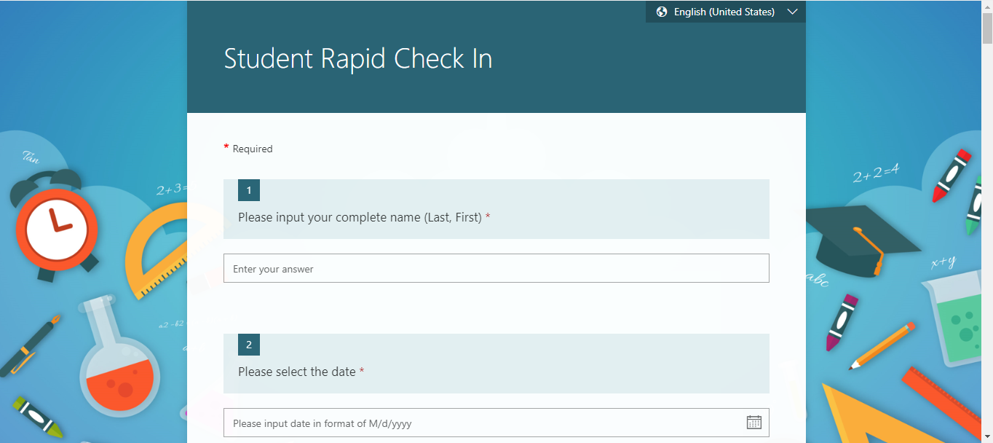
Desktop Compatible
Provide links via Canvas

Slide 13
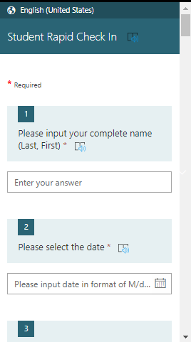
Mobile Device Compatible
Create scannable QR Codes for students to aces any time.

Slide 14
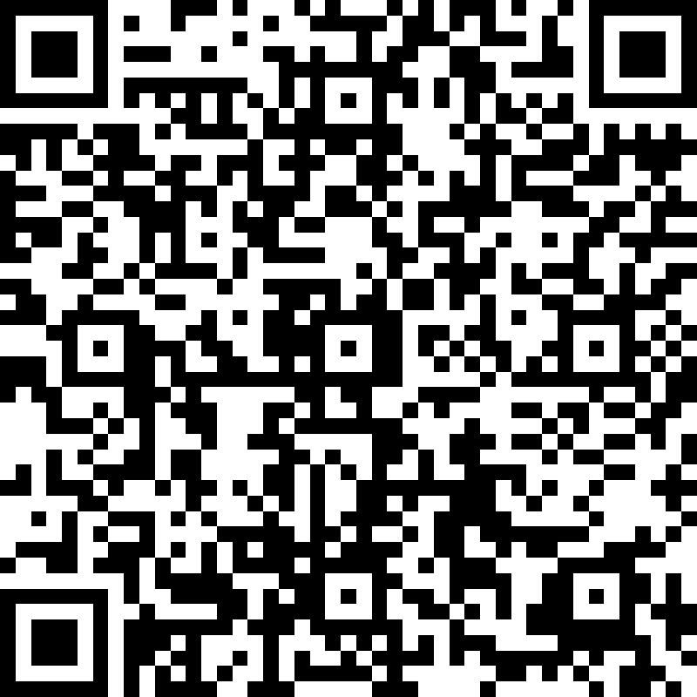
Give It A Try
Scan the QR Code below to see a sample Check-in

Slide 15
Thank You!
I am Matthew Cordova
Feel free to email me at:
Matthew.cordova@browardschools.com

