Slide 1


Semiconductor Nanophotonics
Josh Caldwell
Vanderbilt University June 2017
josh.caldwell@Vanderbilt.edu
Ettore Majorana Summer School, Erice, Italy; July 29, 2017

Slide 2
Outline
Semiconductor Basics
  Bandstructure/defects
  Phonons
Dielectric Functions
  Electronic & vibrational contributions
  ENZ and high index modes
Surface Plasmon Polaritons
  Bulk semiconductor plasmons
  2D material plasmons
Surface Phonon Polaritons
  Initial work
  Carrier-induced tuning
  What makes a ‘good’ SPhP material?
Hyperbolic Semicondutors
  Hyperbolicity in hBN
  Nature and Metamaterial Hyperbolicity
Atomic Scale Heterostructures
  Electromagnetic hybrids
  Crystalline hybrids

Slide 3
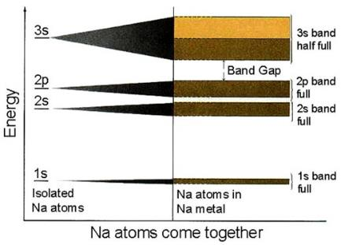
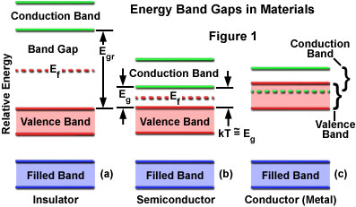
Energy Bands in Crystals
http://micro.magnet.fsu.edu/primer/java/lasers/diodelasers/index.html
Hybridization of atomic orbitals due to bonding
  In diatomic species → bonding/anti-bonding orbitals
  In large atom limit → bands form due to many overlapping states
Highest filled band referred to as valence band (HOMO in chemistry-speak)
Lowest unfilled band referred to as conduction band (LUMO)
Loosely speaking size of band gap defines material operation
  Insulator → Big band gap
  Conductor → Band overlap
  Semiconductor → just right… err… somewhere in between

Slide 4
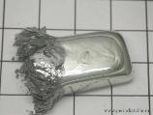
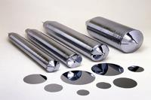
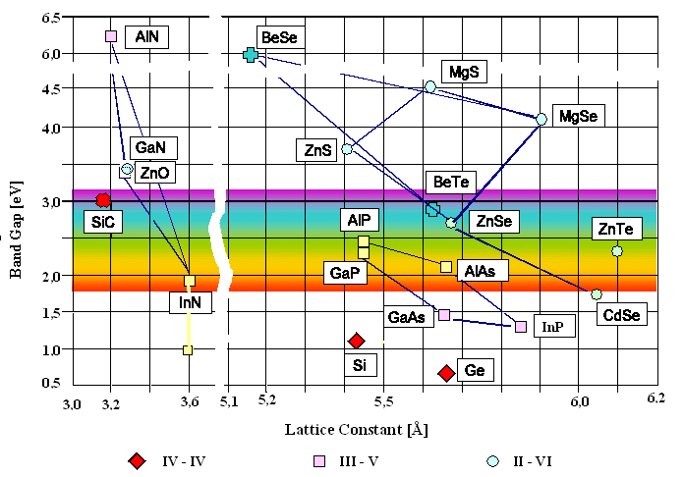


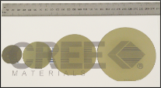

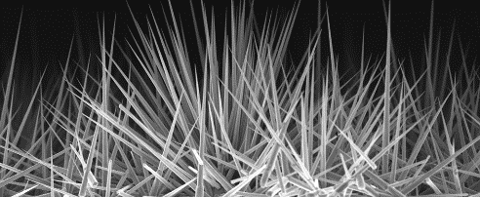
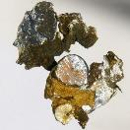

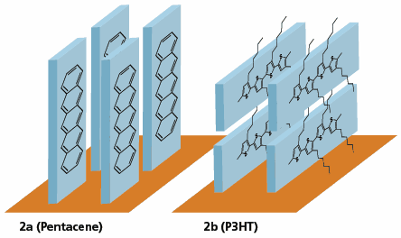
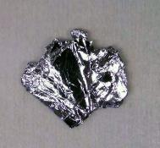
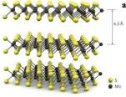
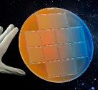
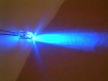

Types of semiconductors
Gray tin: semiconductor!
Elemental
silicon
white tin: metal
Periodictable.ru
Gallium Phosphide
Binary
Gallium Nitride
Wikipedia
Aluminum nitride
Semiwafer
Silicon carbide
Hexatech
Zinc Oxide nanowires
Oxides
Cadmium
Oxide
Organic
Layered
CVD Equipment Corp.
Old Soviet Cu₂O Diodes
Molybdenum Disulfide
Ternaries/Quarternaries
Mercury Cadmium Telluride (MCT)
Indium Gallium Nitride (In_{x}Ga_{1-x}N)
Bao, Material Matters 2007, 2.3, 4.
B. Radisavljevic, A. Radenovic, J. Brivio, V. Giacometti, A. Kis
Nat. Nanotechnol., 6 (2011), pp. 147-150
Wikipedia
Teledyne

Slide 5
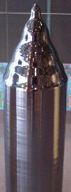
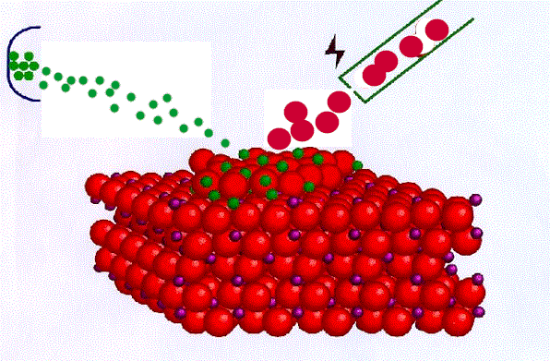
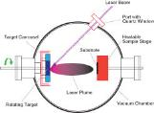
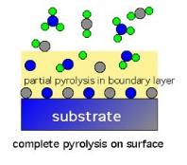
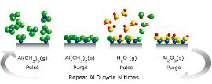
Semiconductor growth
Bulk growth
Epitaxial Growth
Layer/Nano Deposition
MBE
CVD
PLD
http://www.rmvac.com/products/vacuum-equipments/pld.html
http://iramis.cea.fr/en/Phocea/Vie_des_labos/Ast/ast_sstechnique.php?id_ast=494
Atomic Layer Deposition
https://www.withfriendship.com/user/svaruna/Chemical-vapor-deposition.php
Beneq
Goal: High quality layers
Molecular Beam Epitaxy (MBE)
  – single layer precision
  – Physical process
Chemical Vapor Deposition (CVD)
  – few nm precision
  – chemical process
  Vapor-phase epitaxy (VPE); also liquid- and solid-
  Metal-organic CVD
Atomic-Layer Epitaxy (ALE)
Czochralski method
Goal: High quality single crystal material boules
Number of methods
  Czochralski, Acheson…
Perhaps most famous is Czochralski
  Single crystal silicon boules for wafer cuts
Goal: layers/coatings
Pulsed Laser Deposition (PLD)
Sputtering/Evaporation
Atomic Layer Deposition (ALD)
  Conformal, atomic scale control of thin films

Slide 6
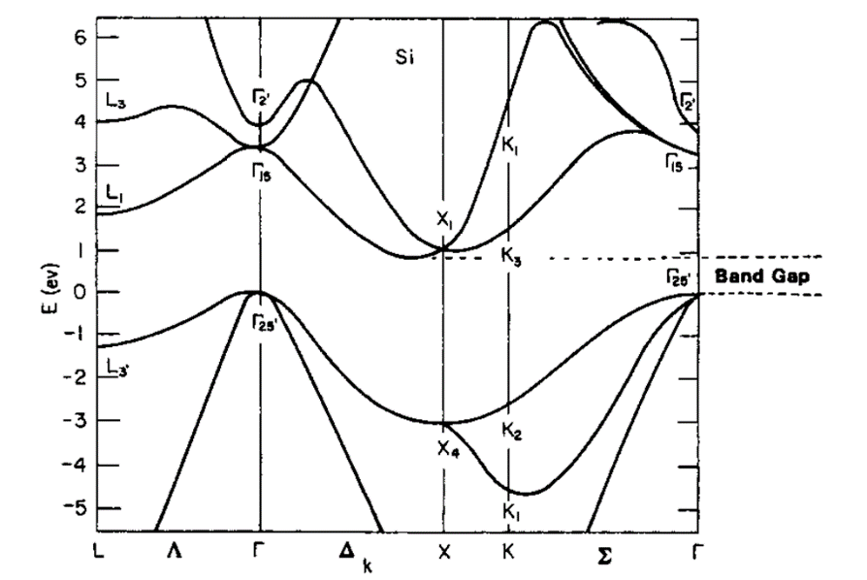
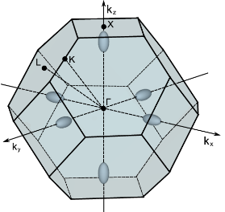
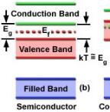
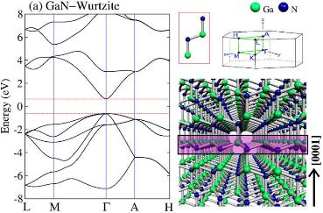
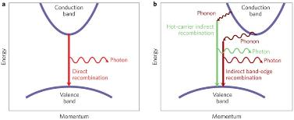
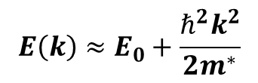
Electronic Band Structure
Band Structure & Brillouin Zone for Si
Ok, so I simplified things
High symmetry in crystals allows for simplified band structure
Direct bandgap
Indirect bandgap
  Nature Photonics 7, 264–265 (2013)
Effective Mass
$$E\left(k\right)≈E_{0}+\frac{ℏ^{2}k^{2}}{2m^{∗}}$$
Near VB/CB edge:
Scientific Reports 5, 17902 (2015).

Slide 7
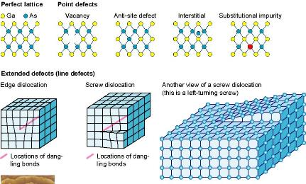
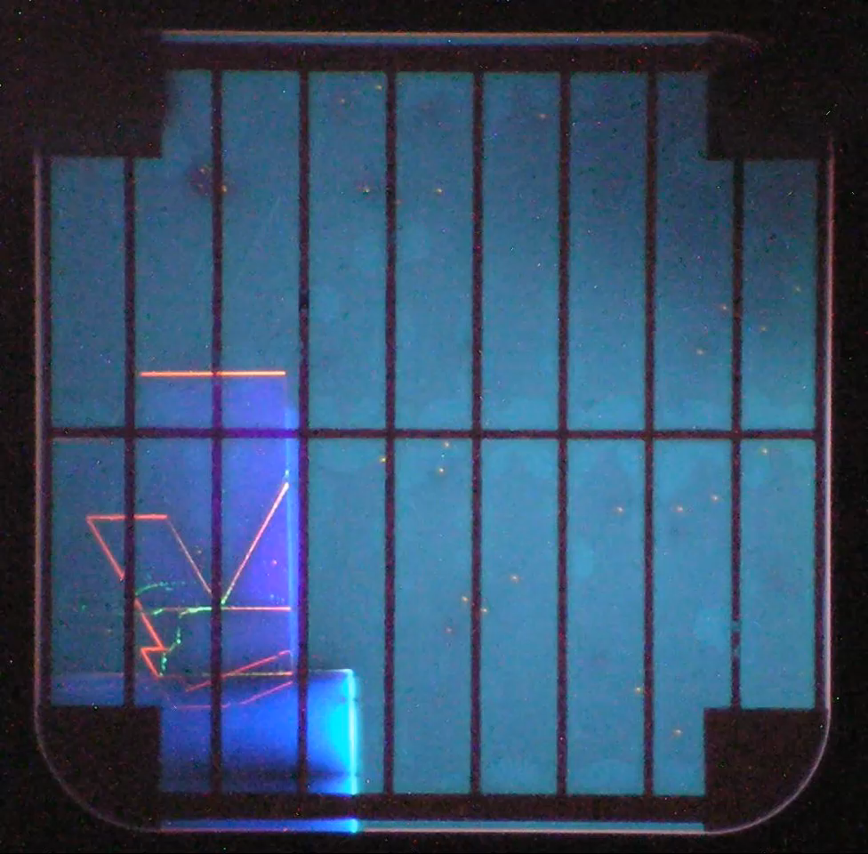
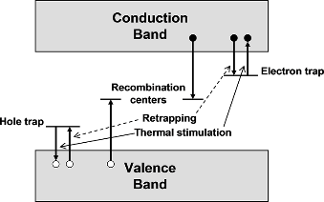
Defects in Semiconductors
http://mechanicstips.blogspot.com/2012/10/materials-crystal-defect.html
Defects cause localized disturbances in the lattice periodicity and thus band structure is preserved
  Induce isolated states within band structure
  Can induce states within the band gap
Many types, but two primary categories
  Point defects
  Extended defects
Impact of defects
  Reduce carrier lifetime
  Induce or eliminate luminescence
  Can act as current traps
“Luminescence - An Outlook on the Phenomena and their Applications”,
Edited by J. Thirumalai, Ch. 10, Fig. 1, Publisher: InTech, DOI: 10.5772/62517

Slide 8
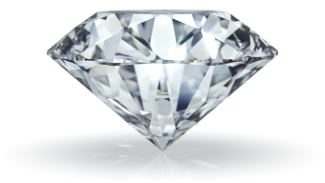

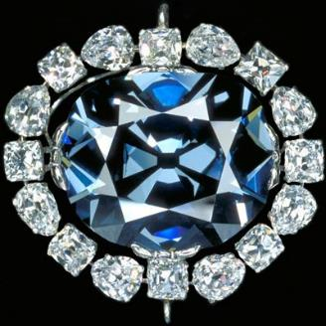
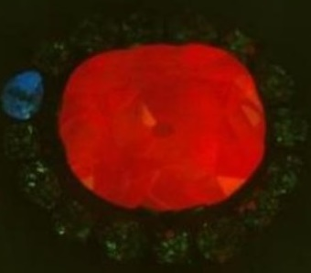
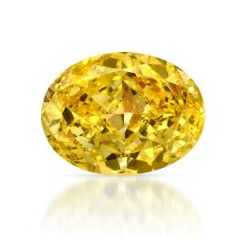
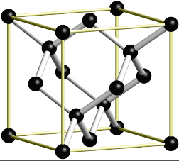
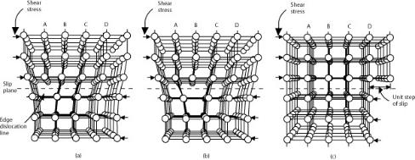
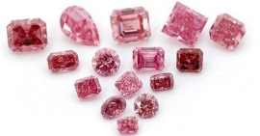
The Beauty of Defects
The Hope Diamond The biggest Blue Diamond
Yellow Diamonds
Nitrogen Defects
Boron Defects
Pink/Red Diamonds
http://www.igr-global.com/blog-detail/the-science-of-precious-pink-diamonds-plastic-deformation

Slide 9

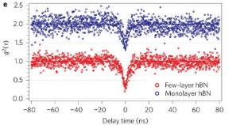
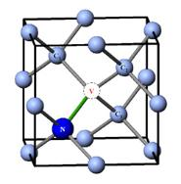
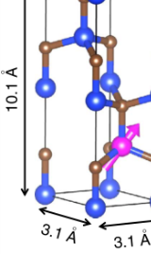
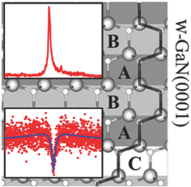

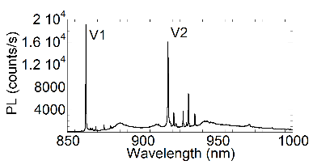
Defect-based Single Photon Emitters
Room-temp single
photon emission in hBN
NV Center in Diamond
1.2
1
0.8
g⁽²⁾(τ)
0.6
0.4
0.2
637nm
0
T.T. Tran, et al. Nat. Nano11, 37-41 (2016).
-40
-20
0
20
40
τ (ns)
Room-temp single
photon emission in GaN
Courtesy of S. Carter, NRL
Si Vacancies in SiC
Ensemble PL of V_{Si} in 4H-SiC at 20 K
Fuchs, F. et al., Nat. Comm 6:7578 doi: 10.1038/ncomms8578 (2015).
Courtesy of S. Carter, NRL
A.M. Bethane, et al. Adv. Mat. 29(12) (2017)

Slide 10
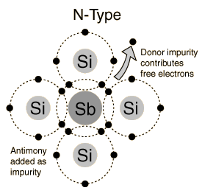
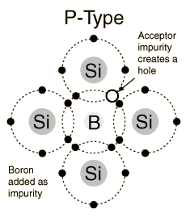
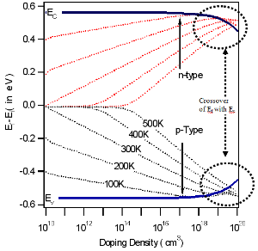
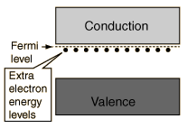
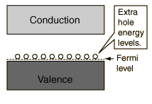
Dopants: The Best Defects
http://nptel.ac.in/courses/115102025/module2/2.html
http://hyperphysics.phy-astr.gsu.edu/hbase/Solids/dope.html#c3
E_{F}/E_{C} (E_{V}) crossover:
Metal/semiconductor transition
‘degenerate doping’
Certain impurities and corresponding defects states are beneficial
  Impurities w/ extra electron in outer shell → n-type defect (electron donor)
  Impurities w/ less electrons in outer shell → p-type defect (electron acceptor)
Shallow energy states (donor/acceptor levels) provide additional free carriers
Increases conductivity by moving Fermi level (chem. Pot.) within bandgap

Slide 11
Revisiting the Definition of Semiconductors
Is Diamond a Semiconductor?
1. yes, 2. no, 3. it depends
Extrinsic
Intrinsic
Intrinsic
C.B.
E_{g}
Narrow gap
Semiconductor
Semiconductor
Semi-insulating
V.B.
@kT=0
@kT>0
@kT>0
@kT>0
C.B.
E_{g}
Wide gap
Insulator?
Semiconductor
Semi-insulating
V.B.
@kT=0
@kT>0
@kT>0
@kT>0

Slide 12
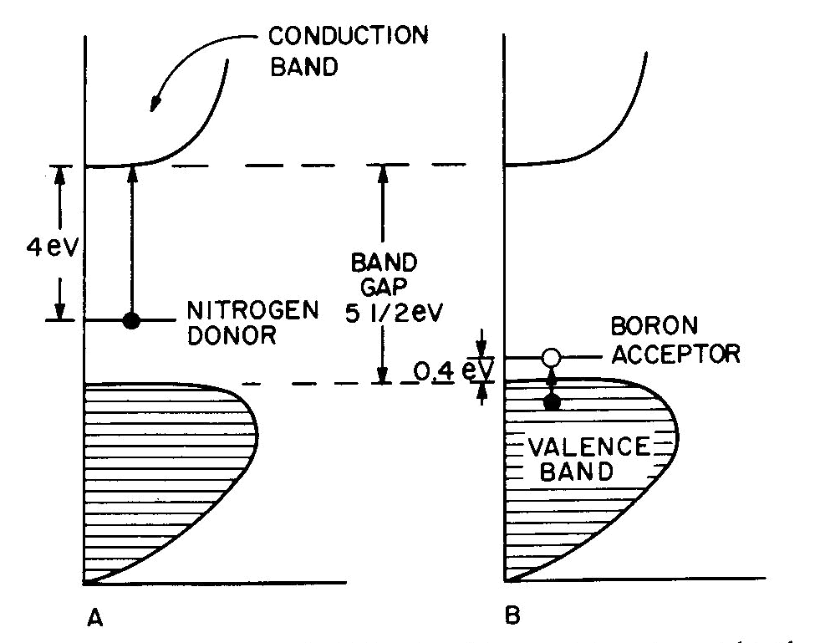
Revisiting the Definition of Semiconductors
Is Diamond a Semiconductor?
3. It depends…

Slide 13
Optical effects of confinement
OD: CdSe QDs
Koole, et al. Ch. 2 in “Nanoparticles”, Springer-Verlag, Berlin (2014). DOI: 10.1007/978-3-662-44823-6
2D GaN
Al Balushi, et al. Nat. Mat. 15, 1166 (2016).
1D: quantum
wire
0D: quantum
dot
3D: Bulk
2D: quantum well
In bulk crystals form bands
Shift back towards nanoscale → approaches individual states (particle in a box)
  Causes lowest energy transitions to increase (quantum confinement)
  Confinement onset occurs when structure size → exciton (e-h pair) wavefunction size

Slide 14
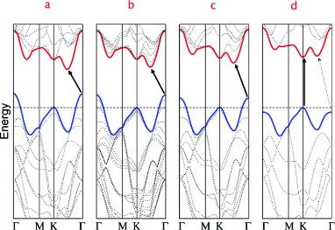
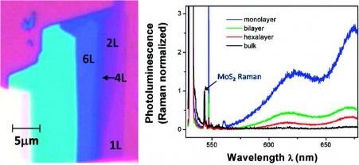
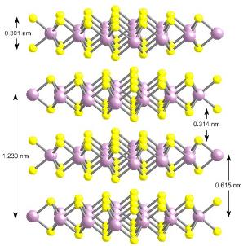
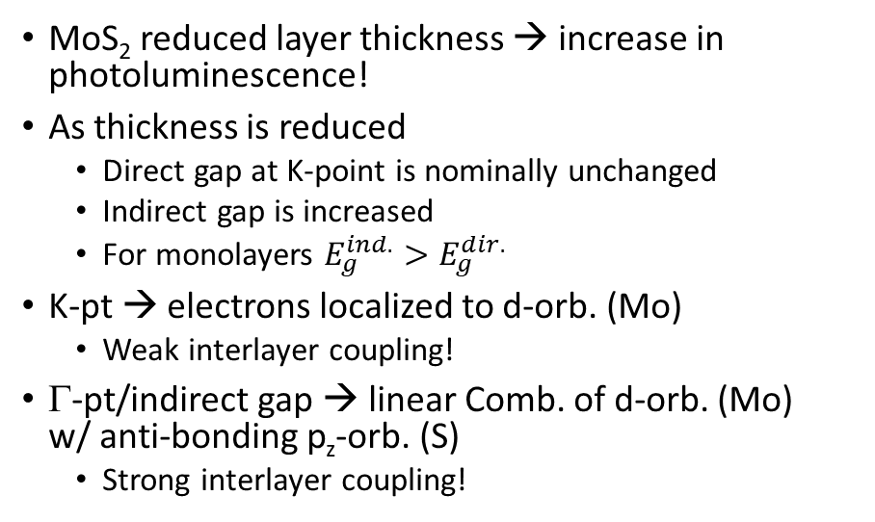
Controlling MoS₂ bandstructure with thickness
Bulk
4-layers
2-layers
monolayer
A. Splendiani, et al. Nano Lett. 10(4), 1271-1275 (2010).
MoS₂ reduced layer thickness → increase in photoluminescence!
As thickness is reduced
  Direct gap at K-point is nominally unchanged
  Indirect gap is increased
  For monolayers $E_{g}^{ind.}>E_{g}^{dir.}$
K-pt → electrons localized to d-orb. (Mo)
  Weak interlayer coupling!
Γ-pt/indirect gap → linear Comb. of d-orb. (Mo)
w/ anti-bonding p_{z}-orb. (S)
  Strong interlayer coupling!
http://nanotribology.mse.ufl.edu/research.html

Slide 15
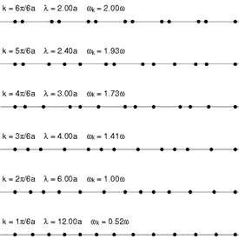






Phonons
Vibrations in a 1D chain
Molecular Vibrations
http://www1.lsbu.ac.uk/water/water_vibrational_spectrum.html
https://www2.warwick.ac.uk/fac/sci/physics/current/postgraduate/regs/mpags/ex5/phonons/
https://commons.wikimedia.org/wiki/File%3A1D_normal_modes.gif
https://en.wikipedia.org/wiki/
Phonon
Each molecule has a set of fundamental vibrations
In a linear chain standing waves are established
  Long-wavelength acoustic
  Short wavelength optic
In a crystal set of normal modes are established
  Results in phonon dispersion
  Brillouin zones can be used to understand electron-phonon interactions
Vibrations in a 3D Crystal: Phonons
http://exciting-code.org/boron-animate-phonons
https://en.wikipedia.org/wiki/Phonon

Slide 16

Optic Phonons
Two types of optic phonon
Si
C
Si
C
Si
C
Si
Si
Si
Si
Si
Si
Si
C
C
Si
Si
Si
Si
Si
Si
Si
c-SiC
C
Si
C
Si
C
Si
Si
Si
Si
Si
Si
Si
C
C
Si
Si
Si
Si
Si
Longitudinal ED
Transverse ED
X
Two types of optic phonon
  Transverse Optic (TO)
  Longitudinal Optic (LO)
Both types are degenerate
J.D. Caldwell, et al., Nanophotonics, 4(1), 44-68 (2015).
Does this picture change for SiC?
No
Yes, TO shifts to higher energy
Yes, LO shifts to higher energy
Zzzz….

Slide 17
Optic Phonons
Two types of optic phonon
+
+
-
-
-
+
+
+
-
-
+
+
Si
c-SiC
-
-
-
+
+
+
-
-
Longitudinal ED
Transverse ED
X
J.D. Caldwell, et al., Nanophotonics, 4(1), 44-68 (2015).
Does this help?
No
Yes, TO shifts to higher energy
Yes, LO shifts to higher energy
Zzzz….

Slide 18
Polar Optic Phonon Splitting
Two types of optic phonon
+
+
-
-
-
LO-TO splitting
Reststrahlen
{
+
+
+
-
-
+
+
Si
c-SiC
-
-
-
+
+
+
-
-
Longitudinal ED
Transverse ED
J.D. Caldwell, et al., Nanophotonics, 4(1), 44-68 (2015).
Polar crystals – optic phonons no longer degenerate
  LO phonon like a parallel plate capacitor: separating charges induces restoring force
  LO phonon shifts to higher energies
  Induces LO-TO phonon splitting → the “Reststrahlen band”
Transverse Optic (TO)
    If polar, can couple to an external electric field (e.g. infrared light)
Longitudinal Optic (LO)
    If polar, can couple to internal electric field from free carriers
Does this help?
No
Yes, TO shifts to higher energy
Yes, LO shifts to higher energy
Zzzz….

Slide 19


LOPC Effect
Caldwell, et al. JAP 101, 093506 (2007).
D. Talwar, et al., Semicond. Sci. Tech. 27, 115019 (2012).
In polar semiconductors, high free carrier conc. creates macroscopic E fields
LO phonons and bulk plasma can couple due to E field results
This coupling causes the LO mode to shift from ω_{LO} → ω⁺_{LPP}
  LOPC (LO phonon-plasmon coupled mode)
Raman – shift and broadening
IR – ‘softening’
Spann et al. PHYSICAL REVIEW B 93, 085205 (2016)

Slide 20



Electronic Transitions in Semiconductors
Donor/Acceptor
Transitions
Defect-Mediated
Transitions
Direct Gap Transition
Indirect Gap Transition
Conduction band
Conduction band
Conduction band
Conduction band
Defect
States
Valence band
Valence band
Valence band
Valence band
Intraband Transitions
Interband Transitions
Many types of electronic transitions
Result in changes in reflection, absorption and transmission
Can be observed as luminescence or lack thereof
Modify carrier recombination pathways
  Modify lifetime and carrier mobilities
Conduction band
Higher Energy
Conduction band
Valence band
Conduction band

Slide 21

Dielectric Function: Electronic Transitions
Lots of physical processes effect dielectric function
Properties impacting electronic and optical regimes are different
Optical regime (electronic and atomic/vibrational)
Electronic Transitions
  Band gap
  Carrier based
  Interband

Slide 22





Influence of Free Carriers: Drude Term
ε’(λ) < 0
electrons
ω_{p}
Ag
$$ε\left(ω\right)=ε_{∞}−\frac{ω_{p}^{2}}{ω^{2}+iγω}$$
Plasma frequency (ω_{p}) → fastest electrons (holes) oscillation frequency
At ω<ω_{p} electrons coherently oscillate
Creates a surface field that opposes the incident light (EM field); high reflectivity
  Negative real part of permittivity $Re\left(ε\right)<0$
carrier density
$$ω_{p}={\left(\frac{Ne^{2}}{m^{∗}ε_{0}}\right)}^{1/2}$$
$$γ=\frac{e}{μm^{∗}}$$
mobility

Slide 23



Influence of Polar Optic Phonons: TOLO Term
SiC Epilayer
ε’(λ) <0
δ+
δ-
Phonon Polariton Resonances
At ω_{LO}>ω>ω_{TO}, polar lattice vibrations collectively oscillate at incident λ through optical phonon excitations
Creates a surface field that opposes the incident
light (EM field); high reflectivity
  Negative real part of permittivity $Re\left(ε\right)<0$
$$ε_{SPhP}=ε_{∞}\left(1−\frac{ω_{LO}^{2}−ω_{TO}^{2}}{ω^{2}−ω_{TO}^{2}+iγω}\right)$$
Recent Review:
J.D. Caldwell, et al., Nanophotonics, 4(1), 44-68 (2015).

Slide 24





Influence of Free Carriers on Polar Optic Phonons
TOLO contribution
Drude contribution
$$ε\left(ω\right)=ε_{∞}\left(1+\frac{ω_{LO}^{2}−ω_{TO}^{2}}{ω_{LO}^{2}−ω^{2}−iωΓ}\right)$$
$$−\frac{ω_{p}^{2}}{ω^{2}+iωγ}$$
$$\left(\frac{ω_{LO}^{2}}{ω_{TO}^{2}}\right)=\frac{ε\left(0\right)}{ε_{∞}}$$
$$ω_{p}=\left(\frac{Ne^{2}}{m^{∗}ε_{0}}\right)$$
$$γ=\left(\frac{e}{{μm}^{∗}}\right)$$
Lyddane-Sachs-Teller
Relationship
LOPC effect!

Slide 25




ENZ condition w/in dielectric functions
Supercoupling
Effect
N. Engheta, Science, Vol. 340 no. 6130 pp. 286-287, 2013
Wavefront Engineering
Where to find ENZ?
Doped Semiconductors
Polar Dielectrics
PHYSICAL REVIEW B 75, 155410 2007
Waveguide from Air
J. Kim, et al. Optica 3(3) 339 (2016).
Metamaterial Designs
Air Hole in ENZ

Slide 26





Light propagation in high index materials
$$d=\frac{λ_{free−space}}{2nsin\left(θ\right)}$$
Dielectric “Mie” Resonances
Electric and Magnetic Dipoles
All-dielectric Metamaterials
Nonlinear Enhancement
Ginn, J. C. et al. Phys. Rev. Lett. 108, 097402 (2012).
Kuznetsov, Sci. Rep. 2, 492 (2012).
Staude, I. et al., ACS Nano 7, 7824–7832 (2013).
Yang, Y, et al., Nature Comm. 5, 5753 (2014).
Perfect / Magnetic Reflectors
Phase Manipulation
Kivshar, Neshev et. al. Nano Lett (2014), ACS Phot. (2015)
Brener et. al. Optica (2014),
Valentine et. al. ACS Phot. (2015)
Brongersma, Science (2014)

