Slide 1
Semiconductor Polaritons
(Inherently Infrared)

Slide 2






Many types of Polaritons in 2D Materials
λ₀
incident wavelength
λ_{P}
polariton wavelength
Plasmon-polaritons
(graphene, black P )
ε_{Α} > 0
Magnon-polaritons,
(Cr₂Ge₂Te₆ )
+
–
–
–
+
–
ε_{Β} < 0
–
–
+
–
+
–
–
+
+
+
–
–
Exciton-polaritons
(MoS_{2,} WSe₂)
Cooper-pair
polaritons
(Cuprates, FeSe)
Phonon-polaritons,
(hBN, topological
insulators, TMDs)
D. N. Basov, M. M. Fogler, and F. J. García de Abajo Science 354, 195 (2016).
Slide courtesy of D. Basov
Another review: Low, Chaves, Caldwell, et al. Nature Materials, 16 182 (2017).

Slide 3
Type 1: SPPs

Slide 4
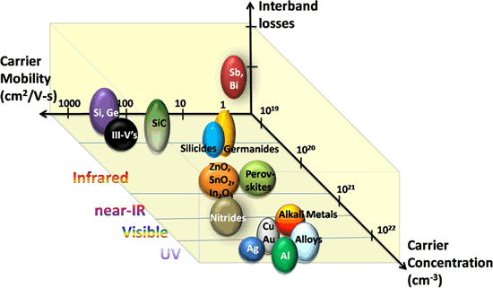
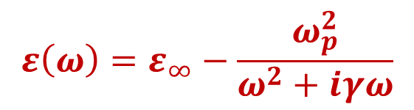

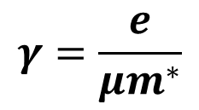
Type 1: Surface Plasmon Polaritons
A. Boltasseva and H. Atwater, Science, vol. 331, pp. 290-291, (2011).
$$ε\left(ω\right)=ε_{∞}−\frac{ω_{p}^{2}}{ω^{2}+iγω}$$
Carrier densities in metals are too high for IR/THz
Doped Semiconductors → IR/THz SPPs
Operating frequency dictated by material and carrier density
Losses dictated by material and mobility
carrier density
$$ω_{p}={\left(\frac{Ne^{2}}{m^{∗}ε_{0}}\right)}^{1/2}$$
$$γ=\frac{e}{μm^{∗}}$$
mobility

Slide 5
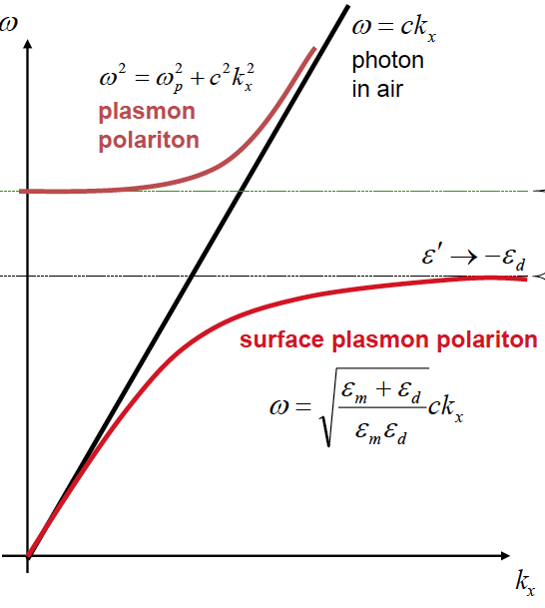
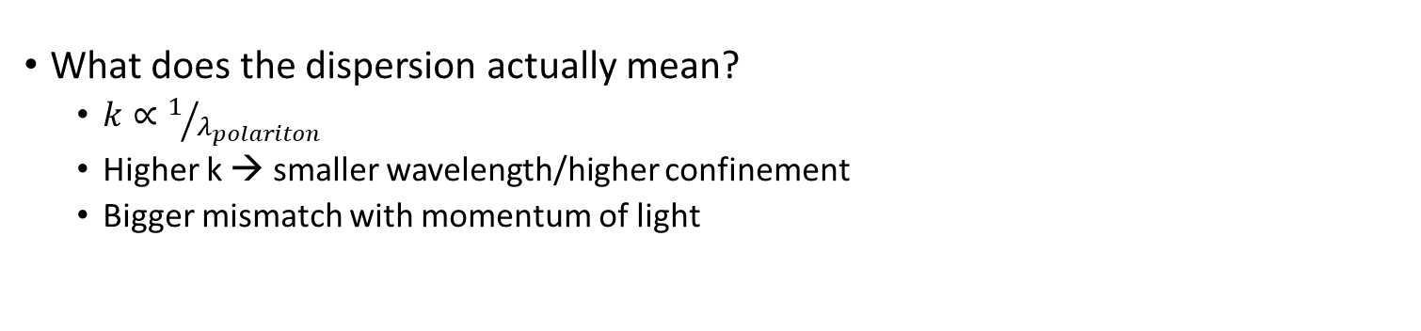
Dispersion Relationship
Dispersion dictates compression of wavelength and therefore focusing of EM fields
Volume
plasmon
charge
+
-
+
-
+
Polaritonic material
What does the dispersion actually mean?
  $k∝1/{λ_{polariton}}$
  Higher k → smaller wavelength/higher confinement
  Bigger mismatch with momentum of light

Slide 6
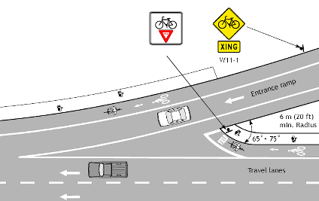

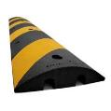

Momentum Mismatch
charge
No Polariton
charge
Volume
plasmon
Polariton!
Photon
Photon
Recent Review:
J.D. Caldwell, et al., Nanophotonics, 4(1), 44-68 (2015).
To achieve high confinement → need high k-modes
Large momentum mismatch
Photon speedbumps

Slide 7
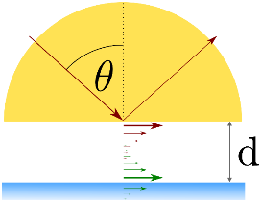
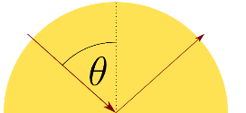
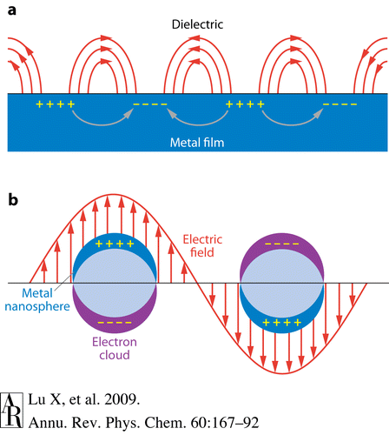

Speedbumps for Light!
High Index Prism
Kretschmann
Otto
Nanostructures
Grating
θ_{i}
d
k_{i}
k_{SPP}
$$α_{NS}\left(ω\right)∝\frac{ε_{i,m}}{{\left(Gε_{d}+ε_{r,m}\right)}^{2}+ε_{i,m}^{2}}$$

Slide 8
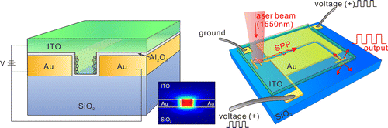
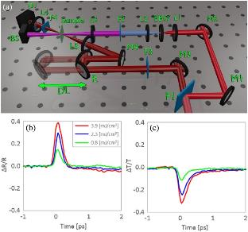
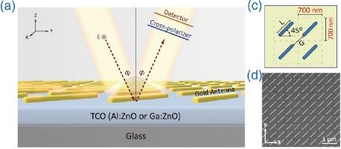
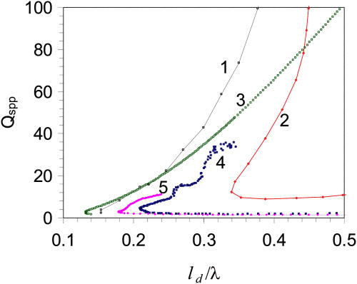
Plasmons in TCOs
PlasMOStor
Fast Carrier Dynamics
H.w. Lee, et al. Nano Lett., 2014, 14 (11), pp 6463–6468
ENZ Effects
N. Kinsey, Optica, vol. 2, no. 7, 2015.
TCO SPPs
Ag
ITO
ZITO
Au
AZO
J. Kim et al., Optica 3(3), 339-346 (2016).
M.A. Noginov, et al., APL 99, 021101 (2011).

Slide 9
Carrier Control of Emissivity
Metamaterial Schematic
Experimental Emissivity Modulation
ZnO-based modulation
  Long carrier lifetime, low req. fluence
UV LED illumination (10mW/cm²)
Opens the door to large area modulation
  Spatially tailor emissivity / apparent temperature
Coppens, et al. Adv. Mat. In press (2017).

Slide 10
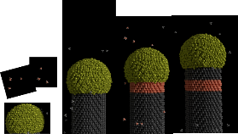
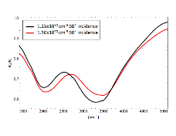
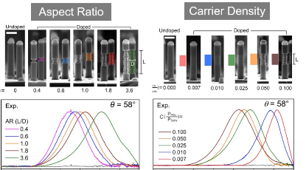
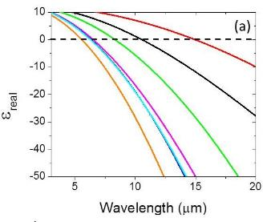
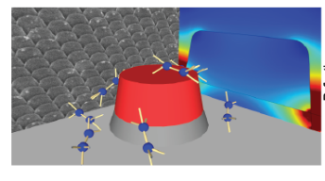
Plasmonics with Doped Semiconductors
Doped Si Nanowires
GaAs-SPP Beam Steering
Ge-doped GaN
Kirste, R. et al. Appl. Phys. Lett. 103, 242107 (2013).
D.C. Adams, et al. Appl. Phys. Lett., 96, 201112 (2010).
InAs – ω_{p} doping dep.
3x10¹⁸cm⁻³
L-W. Chou et al, Angew. Chem. Int. Ed. 52 8079 (2013)
Carrier
Density
Localized SPPs in InAs
9x10¹⁹cm⁻³
S. Law, et al., Nano-Letters, 2013.
S. Law, et al. JVSTB 31, 03C121 (2012).

Slide 11
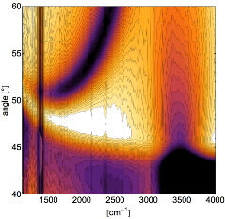
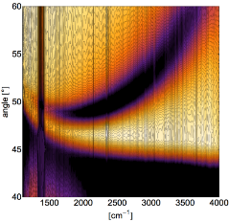

Doped CdO as a Low-Loss SPP Material
4000
t=510 nm
N=1.5x10²⁰ cm⁻³
m=452 cm²/Vs
3000
Wavenumber (cm⁻¹)
2000
t=280 nm
N=3.3x10²⁰ cm⁻³
m=435 cm²/Vs
40
50
60
40
50
60
Angle (degrees)
Material | [cm⁻³] | Mobility [cm²/V·s ] | ε₁=0 [cm-1] | ε₂ at ε₁=0 | ε₂ at ε₁=-2
CdO:Dy | 9.94x10¹⁹ | 474 | 2770 | 0.19 | 0.30
CdO:Dy | 3.70x10²⁰ | 359 | 5350 | 0.13 | 0.20
AZO (2 wt%)* | 7.2x10²⁰ | 47.6 | 6970 | 0.21 | 0.39
ITO (10 wt%)* | 7.7x10²⁰ | 36 | 7122 | 0.69 | 1.29
GaAs** | 1x10¹⁹ | 1000 | 1005 | 1.26 | 1.63
InAs⁺ | 7.5x10¹⁹ | 360 | 1785 | 2.00 | 2.60
**Szmyd, D. M., Hanna, M. C. & Majerfeld, A. Heavily doped GaAs:Se. II. Electron mobility. J. Appl. Phys. 68, 2376–2381 (1990)
⁺ Law, S., Adams, D. C., Taylor, A. M. & Wasserman, D. Mid-infrared designer metals. Opt. Express 20, 12155–12165 (2012).
* Naik, G. V., Shalaev, V. M. & Boltasseva, A. Alternative plasmonic materials: Beyond gold and silver. Adv. Mater. 25, 3264–3294 (2013).

Slide 12
Broad Spectral Coverage for IR SPPs
10⁴
Dy:CdO
10³
10²
mobility [cm²/V·s]
8 -12 µm
3-5 µm
10¹
10⁰
10¹⁷
10¹⁹
10²¹
10²³
carrier density [cm⁻³]
High Q plasmons in both MW and LWIR atmospheric windows

Slide 13
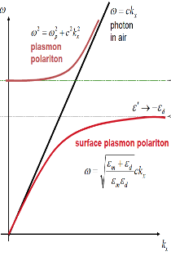
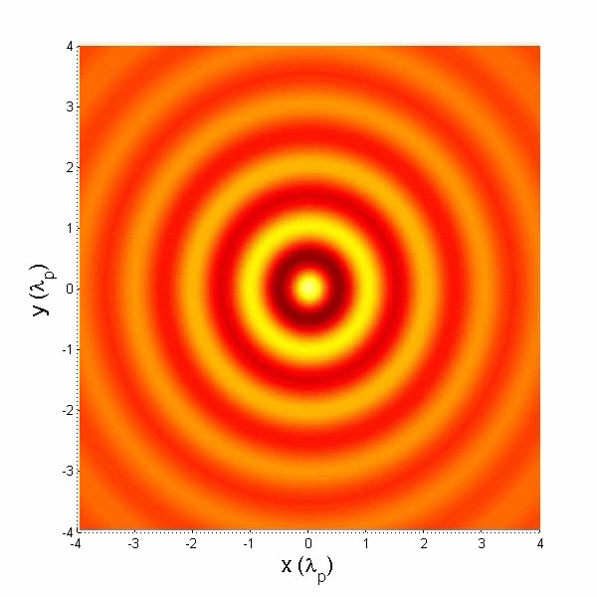
Probing SPPs in 2D Materials:
SNOM
λ₀
incident wavelength
λ_{P}
polariton wavelength
ε_{Α} > 0
+
–
–
–
+
–
ε_{Β} < 0
–
–
+
–
Volume
plasmon
+
–
–
+
Plasmon-polaritons
(graphene, black P )
+
+
–
–
ω_{IR}
1/λ_{SPP}
Slide courtesy of D. Basov

Slide 14
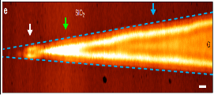
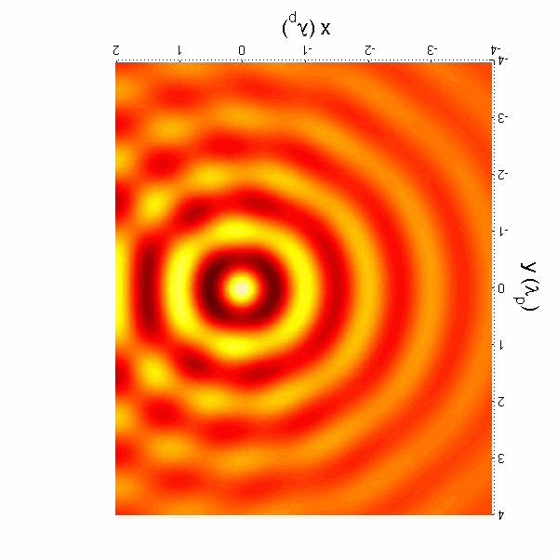
Probing SPPs in 2D Materials:
SNOM of Graphene
λ₀
incident wavelength
λ_{P}
polariton wavelength
ε_{Α} > 0
+
–
–
–
+
–
λ₀/λ_{P}=80-200
ε_{Β} < 0
–
–
+
–
Volume
plasmon
+
–
–
+
Plasmon-polaritons
+
+
–
–
ω_{IR}
1/λ_{SPP}
IR
Zhe Fei et al. Nature 487 82 (2012)
Chen et al. Nature 487, 77 (2012)
λp/2
Slide courtesy of D. Basov

Slide 15
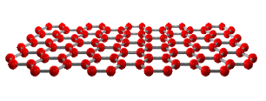
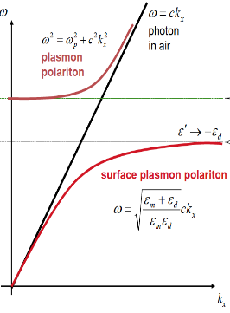

Graphene SPPs: Gate Tuning
–
–
–
Volume
plasmon
Zhe Fei et al. Nature 487 82 (2012)
$$E_{F}$$
1/λ_{SPP}
Chen et al. Nature 487, 77 (2012).
SPP wavelength is changed w/ incident frequency
But it can also be tuned by changing carrier density!
  Not realistic in metals or many highly doped semiconductors
Graphene SPPs are ideal for tuning THz to MWIR (up to 0.01 e/atom)

Slide 16
SPPs in 2D Materials: Beyond Graphene
Low, Chaves, Caldwell, et al. Nature Materials, 16 182 (2017).
State of the art in graphene SPPs
  Published: 500 fs lifetimes in hBN encapsulated graphene (Woessner, et al. Nat. Mat. (2015).
  → 25 cycles before decay to 1/e; confinement to 150x <λ (free-space)
  Basov recent talk → ballistic SPP propagation at cryogenic temperatures (SNOM)
A wide range of other 2D materials can support SPPs
  Ready to be explored!

