Slide 1
Break it Down to Build it Better
Pacing yourself for the RO1 submission
Carol E. Lorenz, PhD

Slide 2
Workshop Agenda
Introductions and workshop objectives
Topics of interest expressed in questionnaires
NIH updates; submission/resubmission cycles; Vanderbilt’s submission process
Form peer accountability groups; hold initial discussion
Background and context
Timelines and milestones (explanation and group work)
Work breakdown—components (explanation and group work)
Work breakdown—activities (explanation and group work)
Building your timeline
Implement, monitor, evaluate
Why do this?
Common pitfalls
Brief evaluation (time permitting)

Slide 3
Objectives of workshop
Establish peer accountability groups
Provide a process for:
  breaking large amount of work (RO1 proposal) into component parts
  identifying associated activities
Develop a timeline for organizing work and tracking progress
Identify common pitfalls and discuss ways to avoid them

Slide 4
What do you find most daunting?
(from questionnaires)
G

Slide 5
NIH updates
Summary of changes—handout: 2016 NIH Updated Resources v4, New Human Subjects Attachments Descriptions
https://nexus.od.nih.gov/all/category/blog/open-mike/
New forms package Forms E (submissions on or after Jan 25, 2018)
https://grants.nih.gov/grants/funding/high-level_summary_of_form_changes-FORMS-E.pdf
(Summary of changes in Forms E packet)

Slide 6
NIH Updates
Most changes minor
Most significant change regards human subjects in research
Consolidated multiple forms previously used to create new form called “PHS Human Subjects and Clinical Trials Information”
Reflects revised Common Rule requiring single IRB for sites using the same protocol
Allows for a Delayed Onset of involvement of human subjects in clinical trials if appropriate
https://www.youtube.com/watch?v=nz9NWFhYOG8&list=PLOEUwSnjvqBJeHcb4yai7_fDnFZFPEmQK&index=1

Slide 7
Additional sites for new form
https://grants.nih.gov/grants/how-to-apply-application-guide/forms-e/research-forms-e.pdf [Section R.500 (p. R-90)]
https://grants.nih.gov/policy/clinical-trials/new-human-subject-clinical-trial-info-form.htm
https://grants.nih.gov/grants/how-to-apply-application-guide/forms-e/general/g.500-phs-human-subjects-and-clinical-trials-information.htm
See Notebook for copy of New Human Subjects Attachments Descriptions

Slide 8
Submission and
resubmission cycles

Slide 9
NIH submission cycles
Cycle 1—all proposals with submission dates of January 25 through May 7
Cycle 2—all proposals with submission dates of May 25 through September 7
Cycle 3—all proposals with submission dates of September 25 through January 7

Slide 10
NIH Review cycles
 | Cycle I | Cycle II | Cycle III
Application Due Dates | January 25 – May 7 | May 25 – September 7 | September 25 – January 7
Scientific Merit Review | June - July | October - November | February - March
Advisory Council Round | August or October | January | May
Earliest Project Start Date | September or December | April | July
Example—new application
Submit in Cycle III October 5, 2018
Reviewed February/March, 2018
Advisory Council May, 2019
Earliest project start date July, 2019

Slide 11
NIH review cycles
Jan | Feb | Mar | Apr | May | Jun | Jul | Aug | Sep | Oct | Nov | Dec
Due Jan 25 thru May 7
Review
Council
Cycle 1
Earliest start dates: Sep/Dec
Due May 25 thru Sep 7
Review
Cycle 2
Council
Earliest start: Apr
Cycle 3
Due Sep 25 thru Jan 7
Jan 7
Review
Council
Earliest start: Jul
Standard resubmission dates
Cycle 1 Mar 5
Cycle 2 Jul 5
Cycle 3 Nov 5

Slide 12
Resubmission timing example
2019
2020
J F M A M J J A S O N D J F M A M J J A S O N D
Submit
10/05/19
Review
02-03/120
Review
06-07/20
Council
09-11/20
Earliest
start
12/20
Re-submit
03/05/20
2019
2020
2021
J A S O N D J F M A M J J A S O N D
J F M A M J
Submit
10/05/19
Review
02-03/20
Review
10-11/20
Council
01/21
Earliest
start
04/21
Re-submit
07/05/20

Slide 13
Resources for NIH cycles
Submissions and resubmissions
https://grants.nih.gov/grants/how-to-apply-application-guide/due-dates-and-submission-policies/standard-due-dates.htm
http://grants.nih.gov/grants/policy/resubmission_q&a.htm

Slide 14
Vanderbilt internal submission process for federal grants
Vanderbilt Internal Process for NIH Federal Grant Proposal Submission
Process v4 (Notebook)

Slide 15
Peer Accountability Groups
Groups of 2-3
Purpose for today: support each other in developing a timeline for your submission
Ongoing purpose: provide peer support, share insights and tips from mentors, and hold each other accountable
Schedule and hold your own interim meetings through submission and evaluation

Slide 16
Peer Accountability Groups
Form groups
Discuss Pre-work Part II

Slide 17
Context for workshop
Borrowing from project management
What is project management?
  A structured and organized approach to accomplishing a specific effort (your project)
What might the effort be?
  Plan, write, and submit a manuscript
  Conduct a research study
  Implement a major program or intervention
  Write and submit a grant proposal

Slide 18
Phases of project management
Project management has five phases
  Assessing feasibility
  Planning
  Implementing
  Monitoring
  Evaluating

Slide 19
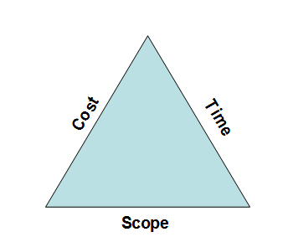
Assessing feasibility
Scope: boundaries of what must be done to produce the project’s end result
Cost: what it will cost to complete the project
Time: amount of time to complete the project
None of the three is unlimited.
Scope, cost, and time exist in a dynamic relationship; altering one will likely alter the other two.

Slide 20
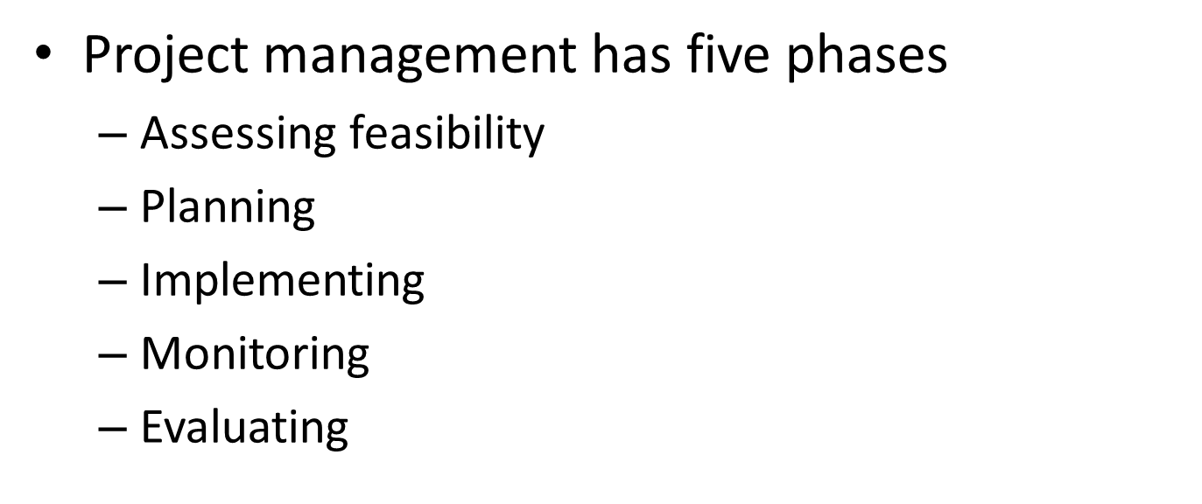

Phases of project management

Slide 21
Planning: Elements
Elements of a plan
  Goals and objectives
  Timelines and milestones
  Components and activities (work breakdown)
  Resources
  Budgets

Slide 22
Planning: Goal for this project
Write and submit a proposal that:
  Fits with the mission and direction of the Institute to which you are applying
  Clearly contributes to the Institute’s mission and direction
  Is well-organized, coherent, and engaging
  Is formatted correctly and submitted by specified date
  Meets all internal requirements and deadlines

Slide 23
Planning: Timelines and Milestones
Elements of a plan
  Goals and objectives
  Timelines and milestones
  Components and activities (work breakdown)
  Resources
  Budgets

Slide 24
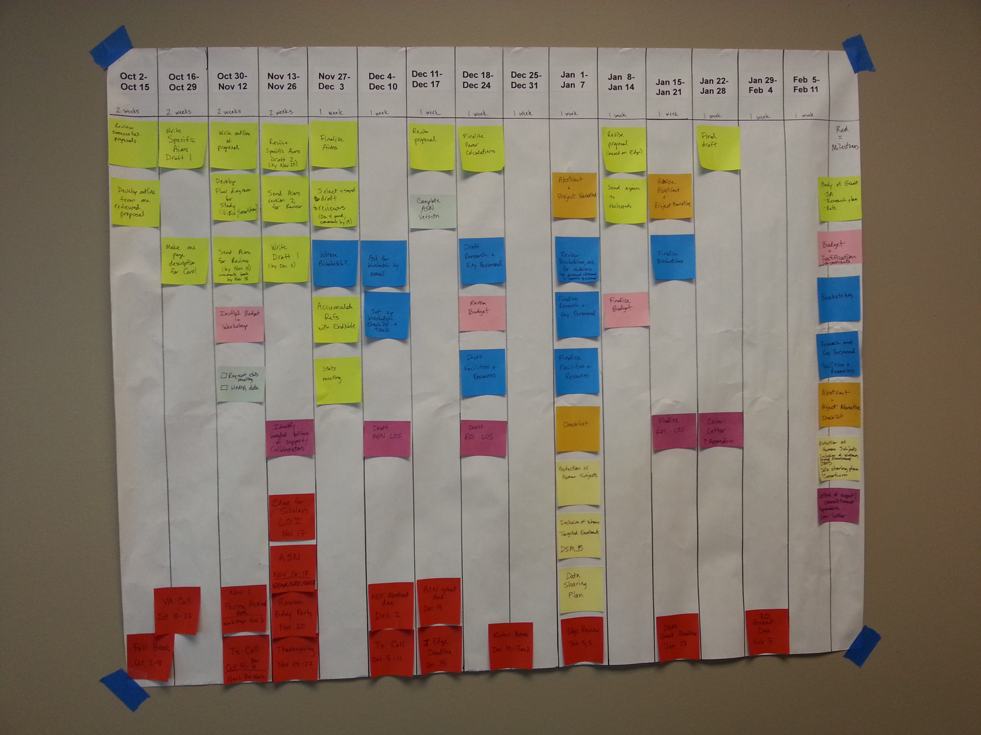

Slide 25
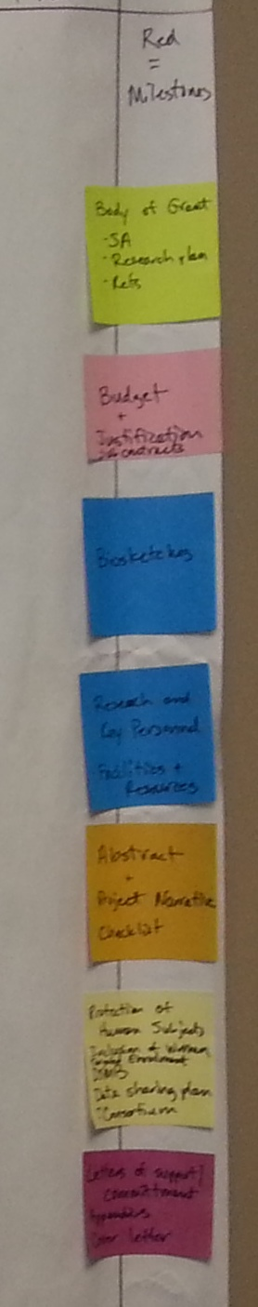
Steps we will take to construct timeline
Step 1: Add milestones and key dates
Step 2: Determine buckets of work and assign color (create legend)
Step 3: Work breakdown of each bucket of work (activities)
Step 4: Write activities on matching color of post-it note
Step 5: Add activities to timeline

Slide 27
Planning: Setting up the timeline
Identify end date of project (submission date)
Break time between then and now into units (can be days, weeks, months, quarters, or combination)
Line the paper with a column for each unit of time
Write time units at top of each column

Slide 28
Your timeline
Provided for you

Slide 29
Timelines versus milestones
Milestones: key events in the project that tell you whether you are proceeding as planned; once set, they should be moved only with extremely good reason to do so
Timeline: describes how work on the project plays out over time; defines where tasks happen along a time continuum. Tasks can be moved, but you must understand consequences.

Slide 30
Planning: Milestones and Key Dates
Write on tablet (or your computer)
  Dates that can not be moved (submission date, internal deadlines, Edge Review cycles for 2018 [Notebook])
  Date for Session 2 of this workshop
    Build in time for completion of pre-work (Notebook)
  Add key dates
    Holidays
    Times your peer accountability group agrees to meet
    On-call times; teaching times
    Vacation or time away (yours, a member of your team, or someone critical to your proposal )
    Kid’s birthday, anniversary, other dates of importance to you
    When will you send drafts out for review other than Edge review?
    When will you get documents to editor if using one?

Slide 31
Constructing your individual timeline
Work in your groups, but focus on your individual timeline
Select single color of post-it note for all milestones and key dates
Write each milestone/key date on separate post-it notes
Place under the appropriate column on your timeline

Slide 32
Milestones
Demonstration
Group work
Reconvene

Slide 33

Planning: Elements
Elements of a plan
  Goals and objectives
  Timelines and milestones
  Work packages and activities (create work breakdown structure)
  Resources
  Budgets

Slide 34
Schematic of work breakdown structure
Write and submit a grant proposal

Slide 35
Work packages
Work packages are a unit of work that needs to be done; they provide a logical basis for defining activities or assigning responsibility to a specific person or organization
Dividing a large piece of work into smaller buckets that can then be divided into doable-sized activities

Slide 36
Planning: Work Packages
Identify all components required for submission (use handout checklist, SF424, Program/Parent Announcement PA, RFA)
Develop your own list of components (combine as you deem appropriate)
Each component or combination of components becomes a work package (recommend no more than 10 work packages)

Slide 37
Components/work packages
OTHER DOCUMENTS
Session 2 May 22
Pre- work due May 17

Slide 38
Planning: Work Packages
Individually
  Assign each work package a color of post-it
  Write the work package name on the post-it and place it in the last column (create the legend)

Slide 39
Schematic of work packages

Slide 40
Components/work packages
Demonstration (Create legend)
Group/individual work
Reconvene

Slide 41
Page limits
Section of Application | Activity Codes | Page Limits * (if different from FOA, FOA supersedes)
Introduction to Resubmission and Revision Applications | For all Activity Codes | 1
Specific Aims | For all Activity Codes that use an application form with the Specific Aims section | 1
Research Strategy | For Activity Codes R03, R21, others | 6
 | For Activity Codes R01, others | 12
Biographical Sketch | For all Activity Codes | 5
http://grants.nih.gov/grants/how-to-apply-application-guide/format-and-write/table-of-page-limits/forms-d.htm

Slide 42
Relationships among components/work packages
OTHER DOCUMENTS
Pre-work for session 2
due May 17

Slide 43
Activities/tasks
Specific tasks within each work package that need to be done to complete that package
Doable-sized pieces of work you plan to complete in the time period you allocate for them

Slide 44
Activities/tasks
Start with a verb, signifying action
Examples: write (first draft of Innovation section), send (version 1 to reviewers), draft (letters of support), call (biostatistician for consultation), review (document returned by reader), incorporate (comments from readers and reviewers)

Slide 45
Schematic of work packages and associated tasks

Slide 46
Planning: Activities/tasks
Select one of your work packages
Brainstorm all activities/tasks that need to be done to complete this package of work; record on tablets at your tables (or on your computer)
Combine so no more than 8 to 10 tasks per work package
Number sequentially

Slide 47
Planning: Activities/tasks
All work must be done; you decide how much time to spend on each package or activity
Select a work package; write each activity associated with it on a separate post-it note of same color
Arrange post-its for a given work package in reverse order
Work backward from the final one and place post-its along the timeline
For today, complete at least one work package, more if time permits
Repeat until all work packages have associated activities/tasks on your timeline

Slide 48
Activities/tasks
Demonstration (Biosketches example)
Develop individual timelines
(Suggested activities for select elements in notebook)
Reconvene

Slide 49
Use of Checklists
List what you need from others—example:
  Advisory Board members Letters of commitment and biosketches
  Core Investigators Bio blurb, biosketch
  Dept chairs (ObGyn and Surgery) Letters of departmental support
  Dept Chair, Dean SOM, OSR Letters of budgetary agreement
Make a checklist that allows you to track what you have done and monitor who owes you what by when
Customize to meet your needs and ways of work

Slide 50
Example of Checklist

Slide 51
Electronic Alternatives
Excel (template available on VU depot)
Trello at https://trello.com/
Lino.it http://en.linoit.com/
Outlook calendar or other calendaring system
Smartsheet https://www.smartsheet.com/cu1
Meistertask https://www.meistertask.com/
Mindview (mind mapping software) http://www.matchware.com/en/products/mindview/default.htm
SmartDraw (mind mapping; also touted as replacement for Visio) https://www.smartdraw.com/?id=264352

Slide 52
Phases of project management
Look down a given week and identify tasks that need
to be completed; check off as you complete each one

Slide 53
Phases of project management
Review at scheduled peer accountability group meetings;
hold yourselves and each other accountable

Slide 54
Phases of project management
Periodically, but especially after the submission, talk about
what worked well and what could be improved

Slide 55
Why do this?
Divide a large amount of work into smaller pieces that you can do
Stay on track and on target
Build a sense of accomplishment
Soften crises of confidence
Organize work so that others can assist—facilitates delegation
Other thoughts

Slide 56
Common pitfalls
Scope creep
Doing a timeline and ignoring it
Failure to reflect on what worked (or is working) and what did not
Being the Lone Ranger
Procrastination
Letting the work manage you
Not allowing time for review of your work
Others

Slide 57
Quick evaluation
Plus/Delta

Slide 58
THANK YOU
and
HAPPY WRITING

