Slide 1
Break it Down to Build it Better
Part II
Tips and techniques not found in grant writing guides

Slide 2
Workshop Agenda
Review of timelines and discussion of pre-work assignment
Career Development Plan
  Long-term goals, short-term goals, and objectives
  SMART objectives
  Organizing your information
Peer group review of long-term career goals
Career development plan; short-term goals, objectives, and activities; peer group reviews (checklist)
Letters
  Letter of institutional support (checklist)
  Mentors (checklist)
  Letters of Reference
Responsible Conduct of Research
Lunch and conversation with Maya Yiadom, MD, MPH and recipient of a K23
Specific aims
Rigor and reproducibility
Flow diagrams as a technique for capturing study design
Options for organizing your research strategy
Timelines for career development plan and research project
Tables and Figures
Edge review video; discussion and tips for improving your proposal for reviewer reading
Session Evaluation

Slide 3
Discussion of timelines
and prework

Slide 4
Important versus Urgent
Urgent
Not Urgent
Important and urgent
Crises
Pressing problems
Deadline-driven projects,
meetings, preparations
Important but not urgent
Preparation and prevention
Values clarification
Planning
Relationship building
Empowerment
Important
Not important but urgent
Interruptions, some phone
calls
Some mail, reports
Some meetings
Many proximate, pressing
matters
Not important or urgent
Trivia, busywork
Junk email, surfing the web
Some phone calls
Time wasters
“Escape” activities
Not important
First Things First by Steven R. Covey, 1994

Slide 5
Long-term goals
(Handout and discussion)

Slide 6
Long-term goal
The long-term goal is a broad statement about where you want to be in the future (eg, 10 years from now)
The goal should describe the following:
  What you want to be
  What you want to do
  In what area
  How, and
  To what end

Slide 7
Long-term career goal examples
My long-term career goal is to advance methods used in measuring and reducing hospital-acquired injury among older hospitalized patients.
My goal as a reproductive epidemiologist is to conduct large-scale population-based cohort studies in order to identify gene-by-environment interactions associated with adverse pregnancy outcomes, with an emphasis on exposures that are susceptible to public health intervention.

Slide 8
Long-term career goal example
My long-term career goal is to become a community-engaged physician-researcher with expertise in mixed qualitative-quantitative methods. I intend to have a diverse portfolio of epidemiologic, health disparities, and health services research related to improving primary care delivery and clinical outcomes for patients with cardiovascular disease. The ultimate outcome of my career is to contribute to a more refined and nuanced understanding of how social contextual factors (eg, the family and broader community environment) contribute to variations in health status, influence health behaviors, and clinical outcomes for vulnerable patients.

Slide 9
Peer group reviews
Long-term career goals

Slide 10
Career Development Plans
Short term goals, objectives (handout), relationships, and organization

Slide 11
Short-term goals/objectives
Short-term goals or objectives are more immediate steps that lead to your goal
Objectives are SMART
  Specific
  Measurable
  Attainable
  Relevant
  Time-bound
Need to show relationship between long-term goal, short-term goals and objectives, and activities, and describe how your mentors relate

Slide 12
Short-term goals/objectives: example
My long-term career goal is to become a community-engaged physician-researcher with expertise in mixed qualitative-quantitative methods. I intend to have a diverse portfolio of epidemiologic, health disparities, and health services research related to improving primary care delivery and clinical outcomes for patients with cardiovascular disease. The ultimate outcome of my career is to contribute to a more refined and nuanced understanding of how social contextual factors (eg, the family and broader community environment) contribute to variations in health status, influence health behaviors, and clinical outcomes for vulnerable patients.
Together with my mentors, I have identified four gaps in my knowledge and skills that need to be addressed as I move toward independence. My short term goals are to close these gaps by:
  Enhancing my skills in measurement and interpretation of data regarding triadic and dyadic communication and patient/family experiences with care.
  Developing knowledge of theoretical and practical applications in social epidemiology
  Gaining proficiency in qualitative research methods and analysis
  Developing competency in the planning, design, and execution of high-quality clinical trials, involving behavioral interventions

Slide 13
Short-term goals/objectives: example

Slide 14
Relationships among components/work packages
Cover letter now
required; must include
names and affiliations
of referees

Slide 15
Organizing your information
(organize, then write)

Slide 16
Matrix of relationships
Matrix for showing relationships between/among goals, objectives, activities, mentors, and Specific Aims
Long-term Career Goal:
 | Activity 1 | Activity 2 | Activity 3 | Activity 4 | Primary mentor | Mentor B | Mentor C | Research Specific Aim related to
Short-term goal/Objective 1: | X |  |  |  | X |  | X | Aim 1
Short-term goal/Objective 2: | X | X | X | X | X | X |  | Aim 2
Short-term goal/Objective 3: | X |  |  | X |  | X |  | Aim 2
Short-term goal/Objective 4: |  | X | X |  |  |  | X | Aim 1

Slide 17
Outline format
Long-term career goal
  Short-term goal/objective 1
    Area of training 1
      Activities
      Measurable criteria
    Area of training 2
      Activities
      Measurable criteria
  Short-term goal/objective 2
    Area of training 1
      Activities
      Measurable criteria
    Area of training 2
      Activities
      Measurable criteria

Slide 18
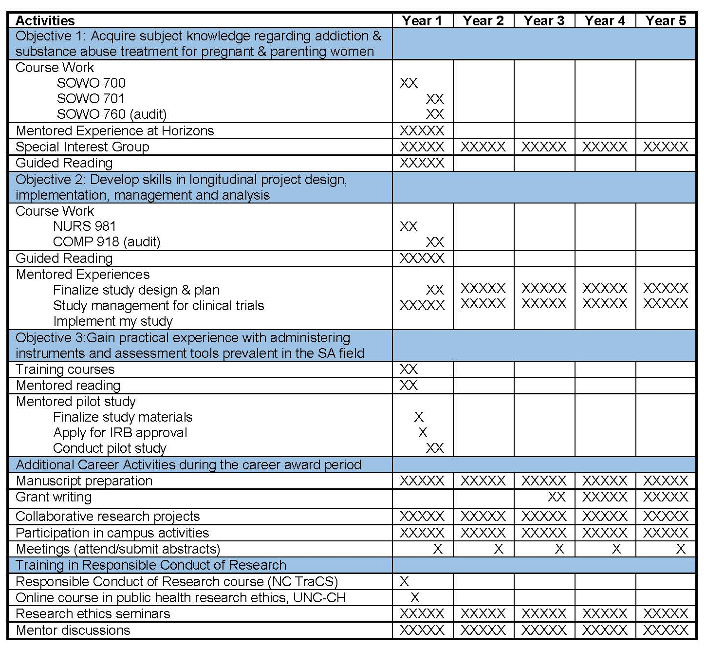
Table

Slide 19
Career development plans
Peer group reviews
(Handout: checklist)

Slide 20
Letters
Mentors
Institutional Support
References

Slide 21
Mentor letters
Not the same as Letter of Institutional Support or Letters of Reference
Mentor letters:
  Provide some context information about you, your career to date at VU, your contributions, and your “bona fides”
  Clearly state what role the letter writer will play on the mentor team
  Provide qualifications of letter writer to be a mentor
  Provide evidence of sufficient research support of mentor to cover costs of proposed research project (yours) in excess of allowable costs
  Describe clearly and specifically what mentor will provide
  Describe how mentoring will be coordinated
  Couple of specific items for the K99
    Plan for transitioning to R00
    Mentor agrees to review and comment on R00

Slide 22
Letter of Institutional Support
Come from the person who can commit resources and your time (typically your Chair)
Letters of institutional support:
  Provide a statement of commitment to your development into a productive, independent investigator, and to meeting the requirements of the award
  Make clear that the commitment to the candidate is not contingent on receiving the award
  Assure that you will be able to devote the appropriate amount of time to research as specified by the award (typically 75%)
  Assure that facilities, resources (office, lab space, equipment, etc.) and training opportunities to support your career development plans will be available
  Provide appropriate time and support for proposed mentor(s) and other staff in your proposed plan
If you are using CTSA resources, include a letter of support from the Program Director or PI in addition; this does not take the place of the letter of institutional support

Slide 23
Letters of Reference
Review your PA to determine whether letters of reference are required
Different from mentor letters and letters of institutional support
Separate process from submitting an application electronically
Submitted through eRA Commons Referee Information Link and not through grants.gov
Use a specific format
Due at the same time as your proposal (as of 2016)
See http://grants.nih.gov/grants/ElectronicReceipt/faq_full.htm#12 and NOT-OD-11-036 at http://grants.nih.gov/grants/guide/notice-files/NOT- OD-11-036.html for additional guidance

Slide 24
Letters of Reference
People to consider
  Big name someone you know well
  Someone from the team that recruited you
  Division chair (if not doing letter of support)
  Someone you know well but who is more junior or less well known
  Thesis/dissertation chair
  Someone on a national agenda group with whom you may have served

Slide 25
Letters of Reference
Writer must certify this is his/her perception, so do not send draft of LOR
Good practice to send bulleted list to provide useful information and/or reminders
  Where met under what circumstances
  How long person has known you
  Your strengths (What are you really good at?)
  Specific points to emphasize if possible
  Provide link to the LOR page on eRA Commons
  When LOR is due (same time as proposal due date)
  Express appreciation for their serving as a reference

Slide 26
Peer Review of Letters (checklist)

Slide 27
Responsible Conduct of Research (RCR)

Slide 28
Responsible Conduct of Research
(NIH Update, 2011)
Definition: the practice of scientific investigation with integrity; involves awareness and application of established professional norms and ethical principles in performance of all activities related to scientific research
Format: substantial face-to-face discussions; combination of didactic and small-group discussions (eg, case studies), and participation of research training faculty members. Online courses acceptable but not sufficient.
Faculty participation: contribute to both formal and informal instruction; serve as speakers, discussion leaders, lecturers, and/or course directors

Slide 29
Responsible Conduct of Research
(NIH Update, 2011)
Subject matter—specific topics not required, but include
  Conflict of interest
  Policies regarding human subjects, live vertebrate animals, and safe laboratory practices
  Mentor/mentee responsibilities and relationships
  Peer review
  Data acquisition and laboratory tools—management, sharing, ownership
  Collaborative research, including with industry
  Research misconduct and policies for handling
  Responsible authorship and publication
  Scientist as a responsible member of society, contemporary ethical issues in biomedical research, environmental and societal impacts of scientific research

Slide 30
Responsible Conduct of Research
(NIH Update, 2011)
Duration of instruction: involve substantive contact hours among trainees/fellows/scholars/participant/participating faculty; instruction should allow for indepth learning with subject matter synthesized within a broader conceptual framework
Frequency of instruction: continue throughout scientist’s career at all levels. Instruction must be undertaken at least once during each career stage (eg, baccalaureate, predoc, postdoc, faculty); instruction to be tailored to the needs of the individual
https://grants.nih.gov/grants/guide/notice-files/NOT-OD-10-019.html

Slide 31
Your RCR Plan
Resource at Vanderbilt is Sam Gannon, EdD (sam.gannon@Vanderbilt.edu)
Include a variety of media
  Self study online (eg, CITI)
  Seminars/didactics
  Group discussions/case studies
  Individual discussions
Include topic to be covered, along with leader, lecturer, instructor, mentor
Indicate timeframe within which activity will be done

Slide 32
Example 1: RCR Plan
Narrative with use of outline
Training prior to award period
Training during award period
  Format
    Classical lecture format instruction mixed with interactive discussion
    Weekly ongoing discussions in area of specialty
    Face-to-face meetings with primary mentor and discuss COI, commitment, collaboration, authorship, etc.
  Subject matter—Targets areas of COI, human and vertebrate animal research, mentoring relationships, peer review, data management, etc.
  Faculty participation—Provides description and names of faculty involved
  Duration of instruction—Provides number of estimated hours based on plan presented
  Frequency of instruction—Defines at least monthly and includes informal meetings

Slide 33
Example 2: RCR Plan
Narrative plus table
Training to date—narrative description
Future training—table
Format | Subject matter | Faculty | Duration | Frequency
RCR Workshop and Case Studies | 1. Overview of Vanderbilt and NIH policies 2. Case studies: Animal use, human subjects, mentoring, authorship and publication 3. Data management, record keeping and conflict of interest 4. New challenges in collaboration and security | Past faculty have included Dr. Heitman, Jim Patton (Professor, Biological Sciences) and Tony Weil (Professor, Molecular Physiology and Biophysics) 8 hour course Once every 2 years next date May 12, 2014 from 8am 5pm | 8 hour course | Once every 2 years next date May 12, 2014 from 8am 5pm
RCR Seminars | Includes conflict of interest, safe laboratory practices, mentoring, collaborations, scientist in society, ethical issues, etc. | Assorted Vanderbilt Faculty | 1 hour seminar | 4 seminars per year
Lab meeting | Formal meetings with a focus on safety and ethics in animal research, collaborations with industry, authorship and peer mentoring | Dr. Cone (mentor) | 1 hour per meeting | Minimum of twice a year
Informal discussions | Issues such as data collection and management, authorship and peer review | Dr. Cone and Dr. Russell (mentors) | As needed during my regularly scheduled one-on-one mentor meetings
Online modules | 1. Human Subject Research (IRB training) 2. Animal Research (IACUC) | Online courses | ~1 hour per course | Yearly
Hands-on Courses | 1. Mouse techniques: proper handling, restraint and common procedures 2. Rodent euthanasia 3. Mouse blood collection | Vanderbilt University Institutional Animal Care and Use Committee (IACUC) Faculty | 2 hours per course | Once per year

Slide 34
Example 3: RCR Plan
Narrative with headers
Brief introduction
  Statement of numbers of hours training to date; plan to further my development through continuing education in RCR and demonstrate mastery by teaching others about RCR as it relates to my work and research in emergency medicine
Narrative of previous training
Narrative of ongoing training
Narrative of planned future training

Slide 35
Conversation with
Maya Yiadom, MD, MPH
Assistant Professor, Emergency Medicine
Recipient of a K23
Improving the Screening Criteria that Trigger an Early ECG to Diagnose STEMI

Slide 36
Research Strategy

Slide 37
Research strategy component should:
Be a project consistent with candidate’s level of research development and with objectives of career development plan
Demonstrate quality of candidate’s research to date
Demonstrate novelty, significance, and creativity
Describe a logical approach to the research question(s)
Demonstrate ability of candidate to carry out proposed research
Describe relationship between mentor’s research and candidate’s proposed plan
Include respective areas of expertise and responsibilities of mentors
K99 proposal describes what candidate will accomplish during the mentored phase, and addresses the R00 phase research plan; also describes how candidate will gain independence from mentors and achieve separation of his/her scientific research program from that of mentor

Slide 38
Rigor and Reproducibility
(new in 2016)

Slide 39
Rigor and reproducibility
New reviewer guidelines
  The scientific premise of the proposed research
    State the strengths and weakness of published research or preliminary data crucial to the support of your application
  Rigorous experimental design for robust and unbiased results
    Describe how your experimental design and methods will achieve robust and unbiased results
  Consideration of relevant biological variables
    Explain how biological variables, such as sex, are factored into research design and provide justification if only one sex is used
New form
  Authentication of key biological and/or chemical resources
http://grants.nih.gov/reproducibility/index.htm

Slide 40
Specific Aims

Slide 41
Specific Aims
Vital part of the proposal
Reviewers need to like your idea by the time they finish reading your aims
Aims page provides an overview of entire project
Needs to persuade reviewers that your project is important, that yours is the right team to do it, and that it will advance the state of the science
Must be carefully written, clear, and concise
http://www.biosciencewriters.com/NIH-Grant-Applications-The-Anatomy-of-a-Specific-Aims-Page.aspx

Slide 42
Powerful Aims Grid
I have conducted a literature review and can document this aim: | AIM 1 | AIM 2 | AIM 3
Example: Makes substantive advances in study design (separate from population, measurement approaches, length of follow-up, and setting) | Yes | No | No
1. Is entirely novel; the association of the expose with the outcome have never been studied.
2. Makes substantive advances in study design (separate from population, measurement approaches, length of follow-up, and setting)
3. Addresses an association that has not previously been studied in this population and there are substantive reasons for research focused on this population.
4. Advances the approach for measurement of key exposure(s).
5. Advances the approach for measurement of outcome(s).
6. Advances the approach for measurement of key covariates, confounders, or effect modifiers.
7. Applies a more appropriate or advanced approach to data analysis and modeling.
8. Will achieve superior power (compared to prior studies) for assessing a primary association (exposure to outcome).
9. Will achieve superior power/precision for assessing other associations (effect modification, prediction, etc.).
10. Makes other meaningful improvements to the current state of knowledge (please explain in annotation, e.g. longer follow-up, more complete retention of subjects, important novel setting, etc.).

Slide 43
Flow diagrams and other cartoons to help organize research design

Slide 44
Flow Diagrams
Combination of techniques borrowed from process engineering and Information Technology
Use standard set of 6 symbols to capture the flow of a study (plus 1 optional)
Why do flow diagrams?
  Linear, step-by-step logic; help organize thinking
  Identify areas needing clarification
  Provide framework for writing narrative (good clue as to how to organize your research strategy section)
  May or may not use in the proposal (thought process is most important element)

Slide 45
Flow Diagram Symbols
End point
Event, activity,
or outcome
Decision point
Yes or No
Connector
List or document
Indicates direction of flow
Outcome Measure
(optional)

Slide 46
Examples of Flow Diagrams

Slide 47
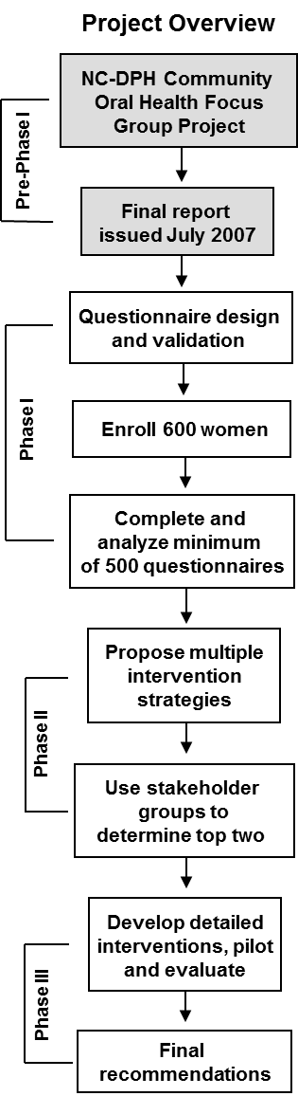

Slide 48
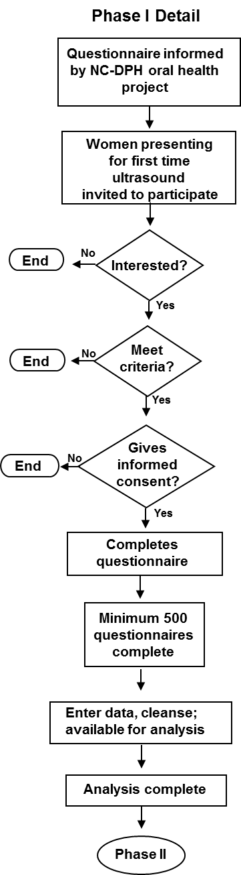
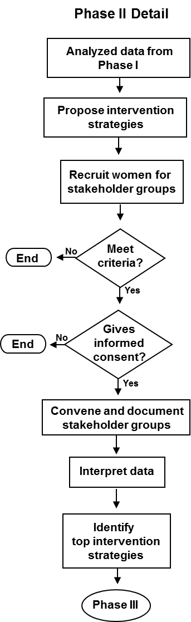
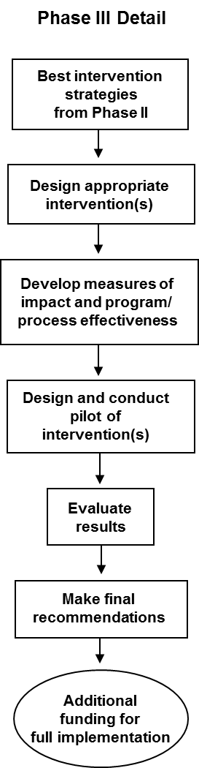

Slide 52
Hybrids of flow diagrams
and other cartoons

Slide 54
Flow diagram/cartoon

Slide 55
Flow diagram/cartoon
Figure X. Flow of Study____

Slide 56
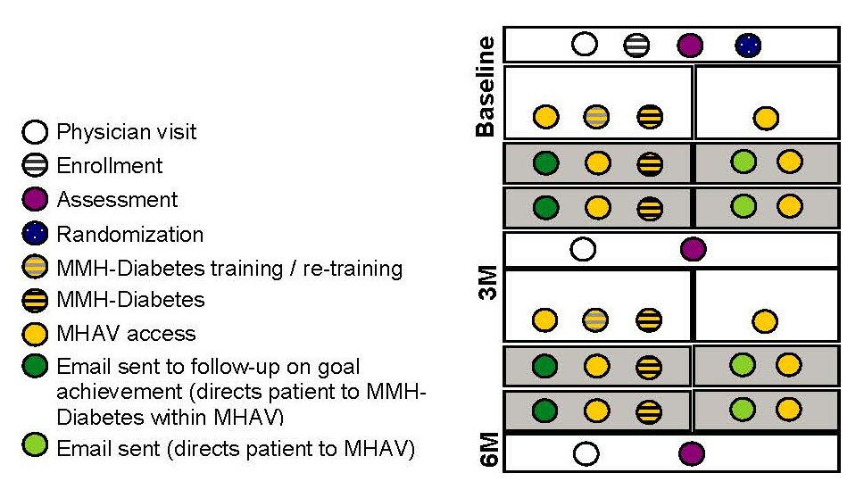
Flow diagram/cartoon
Flow of participants through the study
Figure legend

Slide 57
Systems diagram cartoon

Slide 58
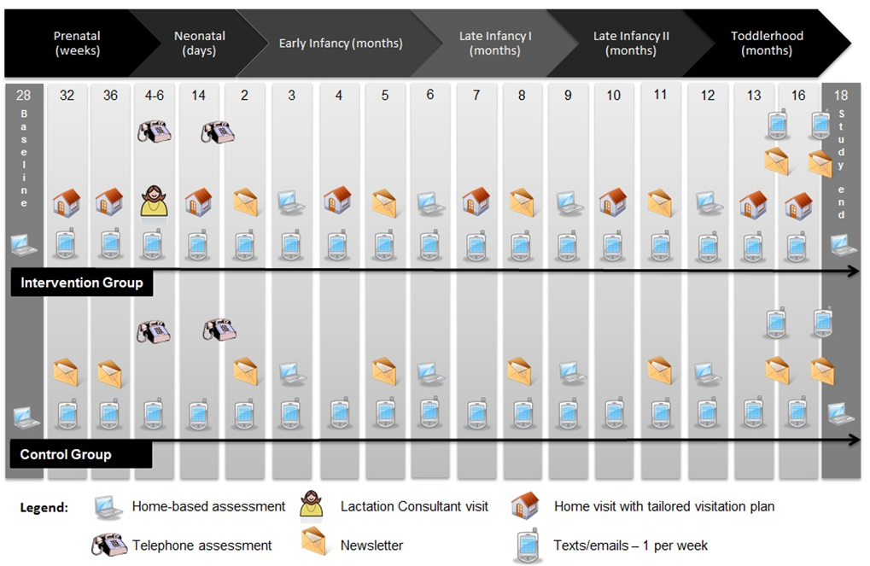
Figure 3. Schematic of XXXXXXX XXX XXXXXX intervention and assessment time points.

Slide 59
Developing your
flow diagrams
(Handout)

Slide 60
Peer review of flow diagrams

Slide 61
Organizing your research strategy

Slide 62
Organizing your research strategy
Look at your flow diagram(s)
Did you do a separate flow diagram for each specific aim?
If yes, consider organizing your research strategy by specific aim
If no, and you did a single flow diagram for the entire study, consider organizing your research strategy by your study design as a whole

Slide 63
Organizing by Specific Aims
Background and significance
Preliminary research/pertinent experience
Research design and methods
  Specific Aim 1
    Overview
    Recruitment
    Methods
    Analysis plan
    Potential limitations and/or alternative strategies
  Specific Aim 2
    Overview
    Recruitment
    Methods
    Analysis plan
    Potential limitations and/or alternative strategies
Summary and future directions

Slide 64
Organizing by Specific Aims
Significance
Innovation
Approach
  Specific Aim 1
    Introduction
    Justification, feasibility, preliminary data/pertinent experience
    Research design
    Expected outcomes (or could be statistical analysis)
    Potential problems and alternative strategies
  Specific Aim 2
    Introduction
    Justification, feasibility, preliminary data/pertinent experience
    Research design
    Expected outcomes (or could be statistical analysis)
    Potential problems and alternative strategies
Summary and future directions

Slide 65
Organizing by study design as a whole
Significance
Innovation
Approach
  Preliminary studies/pertinent experience
  Research design and methods
    Timeline and training/research activities
    Overview of study design
    Data collection
    Quality control procedures
    Statistical analysis and power calculations
      Aim 1
      Aim 2
      Aim 3
Potential limitations and/or alternatives
Summary and future research

Slide 66
Timelines
Career development plans
Research projects

Slide 67
Checklist for Approach Section
of Research Strategy
(Handout)

Slide 68
Examples of timelines for
career development plans

Slide 69
Career Development
Plan

Slide 70
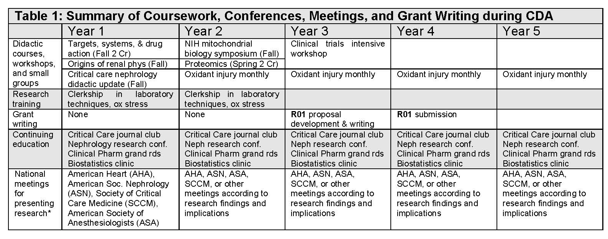
Career development plan

Slide 71
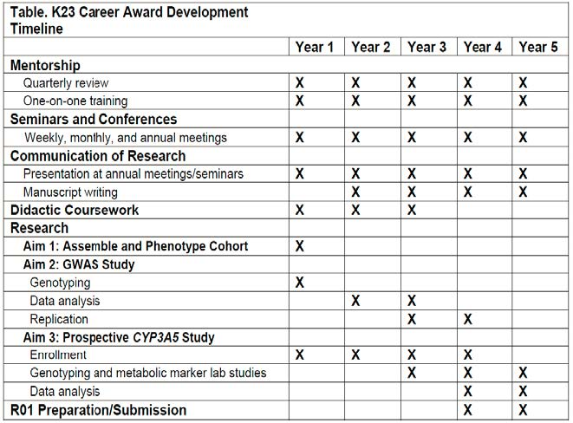
Career development plan

Slide 72
Career development plan
Table 1. Summary of Activities during K01 Period

Slide 73
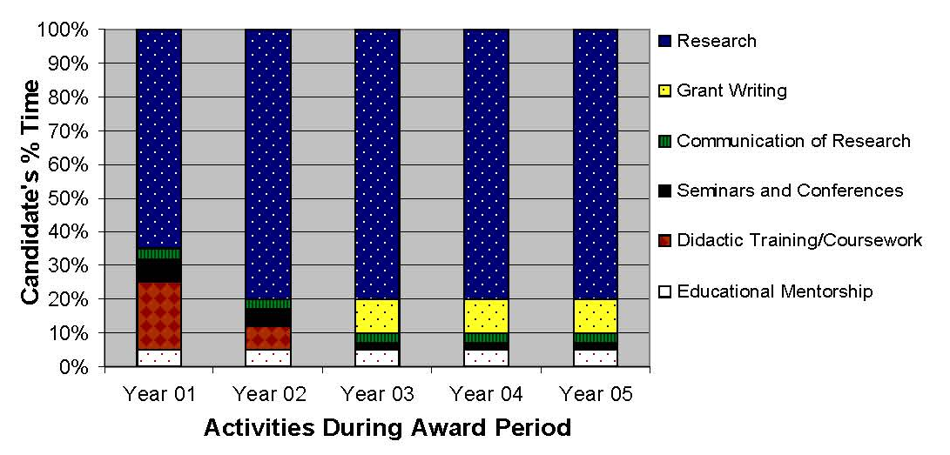
Career Development Plan

Slide 74
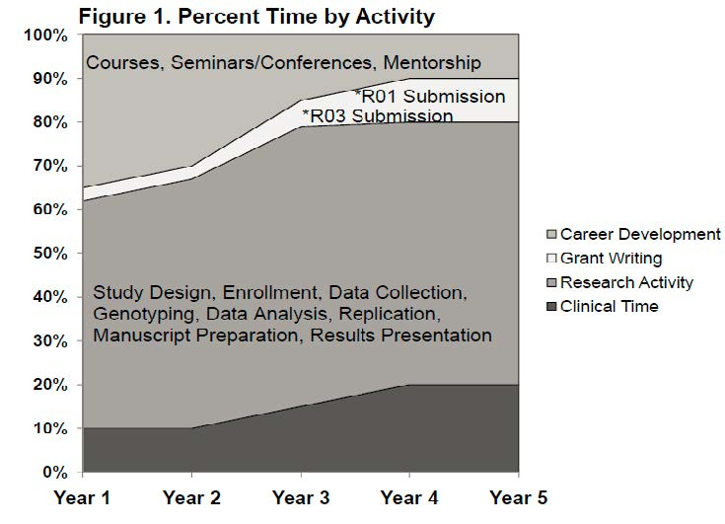
Career Development Plan

Slide 75
Examples of timelines
for research studies

Slide 76
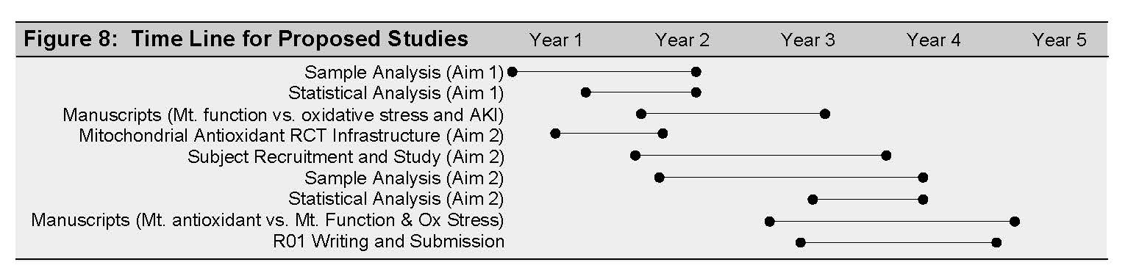
Research Study

Slide 77
Research Study
Table 5. Study timeline
Study Activity | Year 1 | Year 2 | Year 3 | Year 4 | Year 5
Finalize study materials & obtain access to instruments | XX
Conduct pilot & revise materials | XX
Obtain IRB approval for study |  | X
Recruit participants |  | XXXXX | XX
Conduct post-treatment study visits |  | XXX | XXXXXXX | XXXXXXX | XXXXX
Analyze data* |  | XX | XXXXXXX | XXXXXXX | XXXXXX
Disseminate study findings* |  | X | XXXX | XXXXXXX | XXXXXXX
Prepare grant application(s) |  |  |  | XXX | XXXXXXX

Slide 78
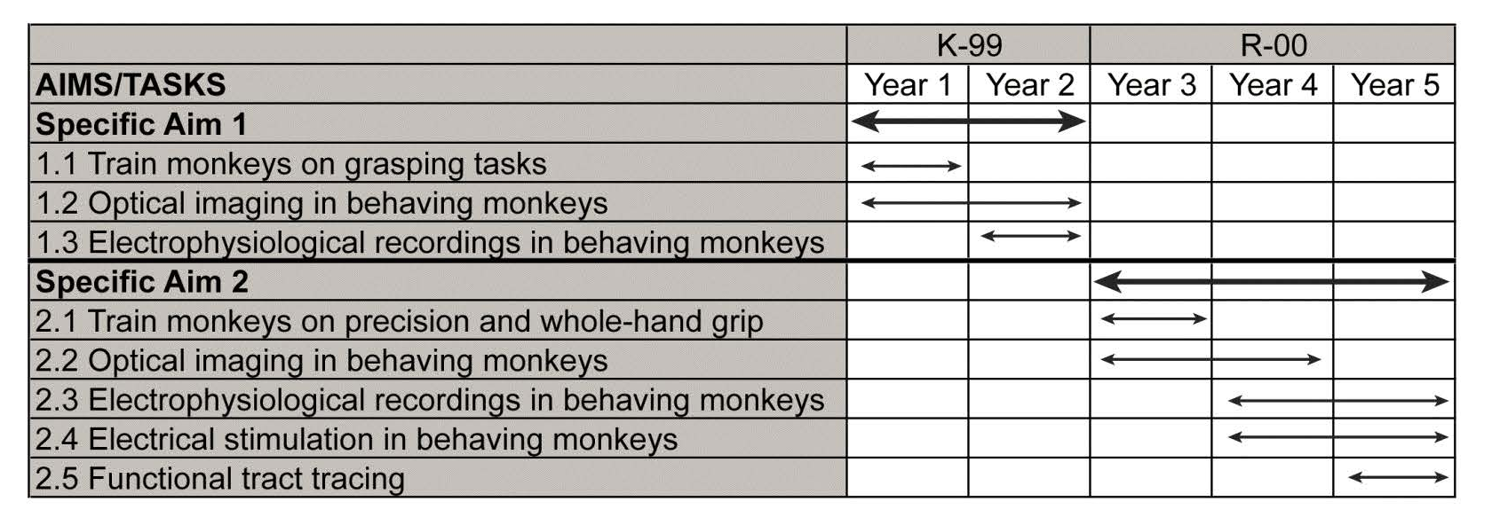
Research Study

Slide 79
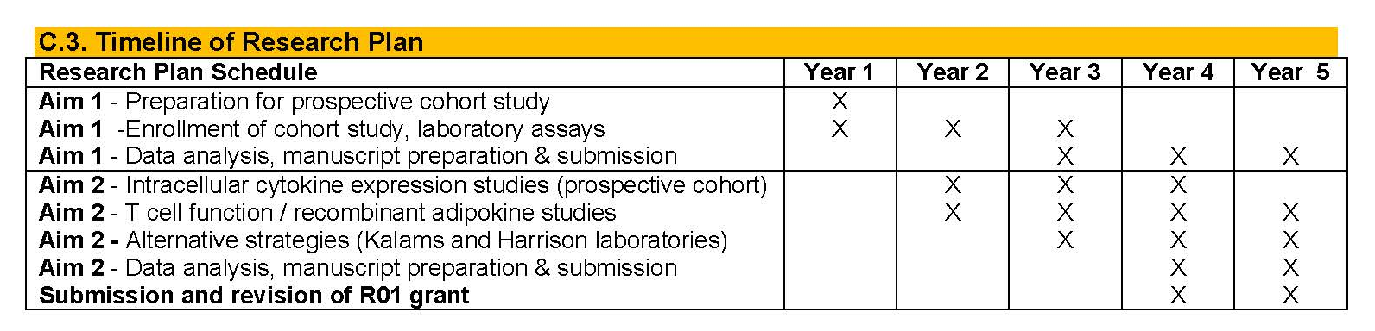
Research Study

Slide 80
Combination examples

Slide 81
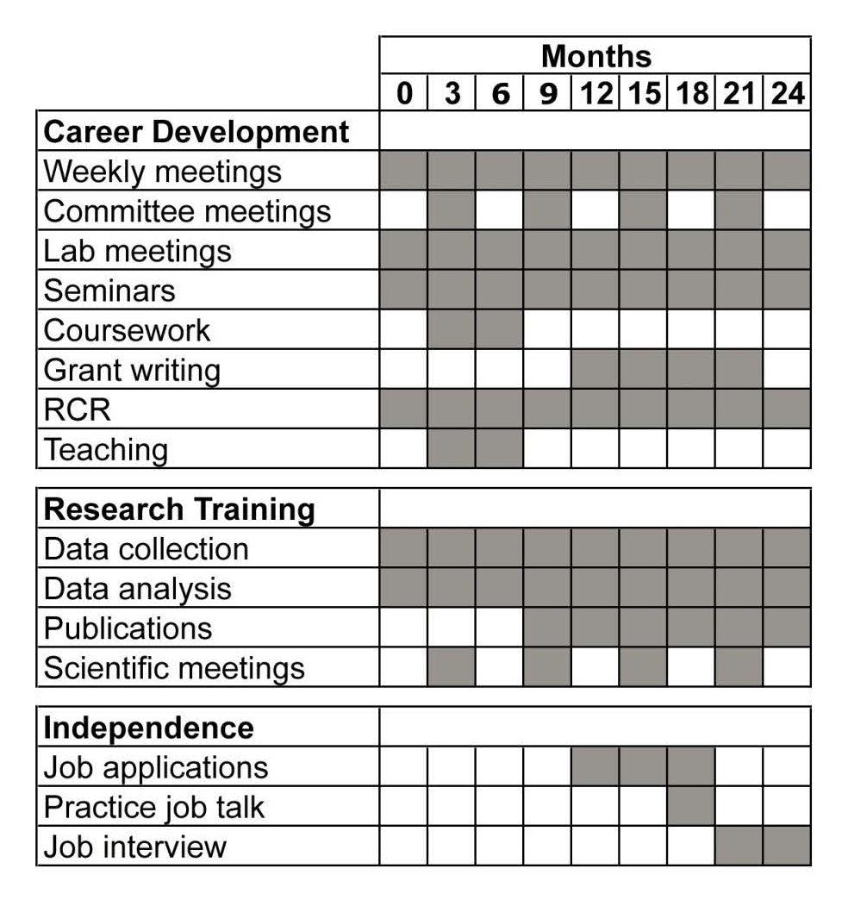
Combination

Slide 82
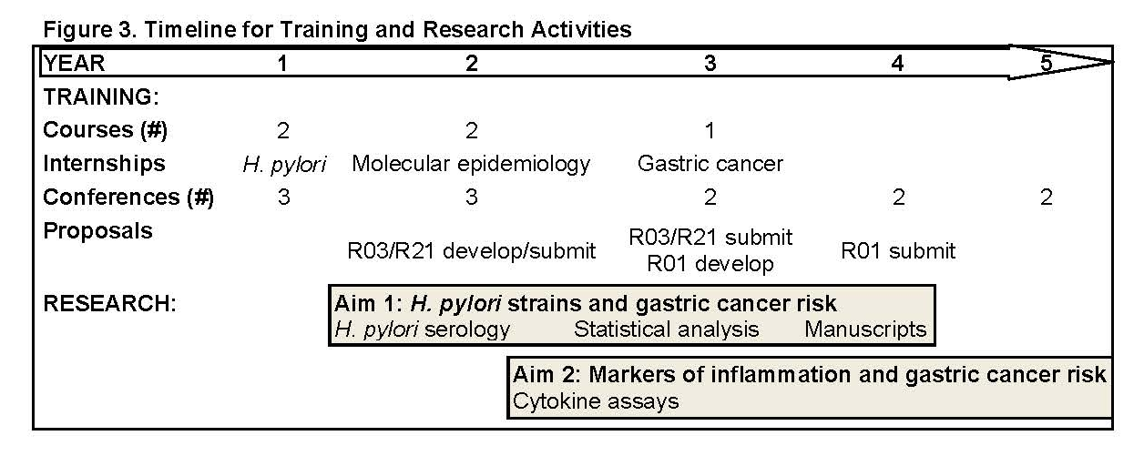
Combination

Slide 83
Tips for timelines
Simple is better
Label appropriately
Refer to the timeline in the text and give some information about it
Use gray scale and patterns; may or may not be printed in color by recipient
Ensure your narrative matches the timeline

Slide 84
Work on your study timelines; peer review

Slide 85
Tables and Figures

Slide 86
Tables versus graphs
Graphs
  Immediate impact
  Good for showing trends/patterns or highlighting differences between two sets of data
Tables
  More precise and exact
  Use when individual or summarized values are more important than trends

Slide 87
Tables
Can present qualitative or quantitative data
Can contain words, symbols, numbers, or a combination
Allow side-by-side comparison of data
Good for presenting large amounts of information too cumbersome or confusing to place in main text

Slide 88
Tables should…
Draw attention to the information and not the table itself
Have clear and concise titles
Augment, amplify, or provide greater detail than what appears in the narrative; table and narrative should work together to get your point across
Contain data deserving to be in a table rather than in the main text

Slide 89
Table components
Title
Column headings
Row headings (stubs)
Data fields
Footnotes
Spanners (optional)

Slide 90
General rules for format and alignment
Left justify row headers (stubs)
In data fields, left justify words, right justify whole numbers
Data fields with symbols such as decimals, plus/minus signs, slashes, hyphens, or parentheses should align in those elements
Text in row headings that wraps to a second line should align with the top line of that row heading

Slide 91
Tips for tables
Create a format for your tables and use it consistently
Create each table as its own document; use placeholder in document, then copy and paste tables into main document
Incorporate title and footnotes into table itself
Number tables and figures independently, in the sequence in which they appear
Do not split a table over two pages
Keep your tables small

Slide 92
Reference for previous six slides
http://www.clinchem.org/cgi/collection/guidetowriting
  http://www.ncsu.edu/labwrite/res/gh/gh-tables.html

Slide 93
Examples of Tables
Table 3. Patient population served in 2009 and 2009 at UNC MFMU sites
 | UNC |  | WakeMed |  | Rex |  | Mission
 | 2008 | 2009 | 2008 | 2009 | 2008 | 2009 | 2008 | 2009
Total number obstetrical patients seen* | 3743 | 3489 | 5197 | 4933 | 6950 | 6540 | 4132 | 3987
Age (%) <18 years 18-35 years >35 years | 3.1 83.9 13.0 | 3.1 83.9 13.7 | 4 86 10 | 4 85 11 | 1 83 16 | 0 83 17 | 3.9 85.4 10.7 | 3.2 85.2 11.6
Race (%) Black White American Indian Other | 16.2 77.9 0.1 5.7 | 16.7 76.0 0.2 7.1 | 28 66 0 6 | 29 66 0 5 | 19 70 0 11 | 18 70 0 12 | 8.9 80.8 0.6 9.6 | 8.9 81.9 0.5 8.8
Ethnicity (%) Hispanic Non-Hispanic | 36.0 64.0 | 34.2 65.8 | 38 62 | 35 65 | 4 96 | 4 96 | 7.0 93.0 | 5.8 94.2
Education (%) <12 years 12-16 years >16 years | 36.6 46.0 16.5 | 36.8 46.6 16.6 | 35.0 56.3 8.7 | 36.0 54.9 9.1 | 1.9 74.2 23.9 | 1.8 72.1 26.1 | 47 43 10 | 43 50 7
Parity (%) Nulliparous Multiparous | 39.8 60.2 | 41 59 | 37 63 | 37 63 | 19 81 | 17 83 | 37 63 | 39 61
Tobacco use (%) | 7.6 | 6.6 | 9.7 | 9.1 | 4 | 3 | 7.6 | 7.7
Payment Status (%) Medicaid/self-pay Private coverage** | 46.3 53.7 | 48.7 51.3 | 80 20 | 76 24 | 14 86 | 12 88 | 57.8 42.2 | 55.2 44.8
* Includes institution and all affiliated clinics and practices ** Includes military coverage

Slide 94
Examples of Tables
Table 1. UNCCH Clinical trials by phases FY 2010-2011-2012*
Phases | FY 2010 | FY 2011 | FY 2012
Pilot | 35 | 34 | 32
Phase I | 17 | 17 | 16
Phase I/II | 12 | 11 | 11
Phase II | 64 | 62 | 60
Phase III | 84 | 83 | 78
Phase IV | 14 | 14 | 13
Other | 63 | 63 | 59
TOTAL | 289 | 284 | 269
*Estimates based on available data

Slide 95

Examples of Tables

Slide 96
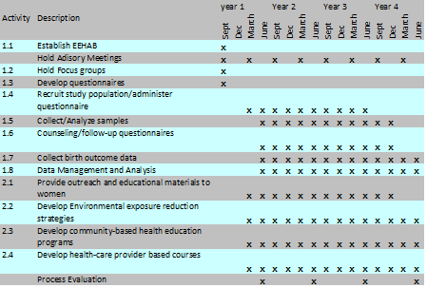
Examples of Tables

Slide 97
Figures
Visual representations
  Graphs, diagrams, photos, drawings, schematics, maps, etc.
Refer to figures within the text
Avoid using a sentence that gives the reader no information other than directing them to the figure
Number tables and figures independently, in the sequence in which they appear
Strive for simplicity
If using color, be sure everything is readable if printed in grayscale
Incorporate the legend and footnotes into the figure itself if at all possible, particularly if using PowerPoint
Recommendation: construct figures as their own documents, use placeholder in text, insert in text when you are ready

Slide 98
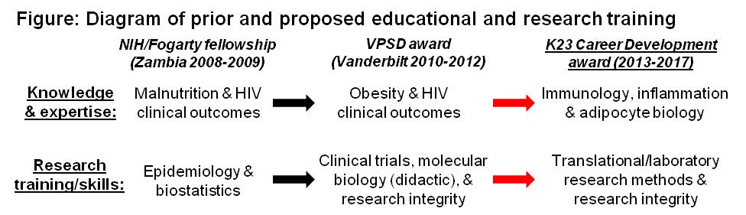
Example 1: Figure

Slide 99
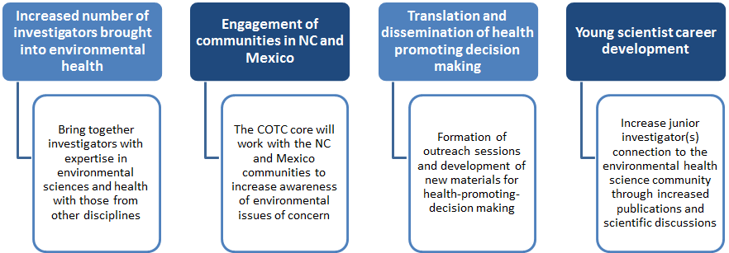
Example 2: Figure
Figure x. Major Anticipated Outcomes of the XXXX Program

Slide 100
Example 3: Figure

Slide 101
Example 4: Figure

Slide 102
Common frustration with Power Point documents
Figure 3. Organizational Chart for Proposed UNC CCTN Site
Protocol Evaluation
and Development
Team
Leadership Team
Pool of Research Assistants
ObGyn Perinatal Research Group
MFMU
TraCS
University Targeted Staffing
Study Implementation Team

Slide 103
Reviewer perspective
Edge Review

Slide 104
Video K Edge Review

Slide 105
Improving a proposal’s quality from the reviewer’s perspective
Know your audience
Much of the quality of a proposal pertains to the way you present your background, career development plan, and mentor section—remember, they are funding the scientist, not the science
However, your science cannot be sloppy or poorly thought-out
Write clearly and succinctly
  Use active voice wherever possible
  Provide context for the reader
  Connect your ideas within sentences and paragraphs, then between paragraphs and sections
  Present a logical argument
  Do not make your reader “hunt” for information
  Pay attention to formatting
  Leave white space on the page(s)
  Break up dense text with tables and/or figures

Slide 106
An appropriate saying
(attributed to various famous people)
If you want me to talk for an hour, I’m ready now
If you want me to talk for 30 minutes, I’ll need two days to prepare
If you want me to talk for 10 minutes, I’ll need a week to prepare
The same is true for writing clearly, logically, and succinctly; it takes time and thought

Slide 107
Final exercise
Identify the two most important action items you need to do this week to move your grant proposal forward

Slide 108
Resources
Figures and tables
  Otto Yang in Guide to Effective Grant Writing, Second Edition (2012) pages 25-29
  http://abacus.bates.edu/~ganderso/biology/resources/writing/HTWtablefigs.html
  http://www.plosone.org/static/figureGuidelines.action
  Works by Edward Tufte on effective presentation of data
Work breakdown
  Gregory T. Haugan; Effective work breakdown structures. Vienna, Va; Management Concepts (2002)
NIH sites
  http://grants.nih.gov/grants/ElectronicReceipt/faq_full.htm#12 (Letters of reference)
  http://grants.nih.gov/grants/guide/notice-files/NOT- OD-11-036.html (Letters of reference)
  http://grants.nih.gov/training/careerdevelopmentawards.htm (General information on career development awards with links to specific sites)
  Open Mike https://nexus.od.nih.gov/all/2015/10/19/welcome-to-the-open-mike-blog-at-nih/ (updates on NIH extramural funding)
Effective writing/grantsmanship
  Expectations; Writing from the Reader’s Perspective, by George D. Gopen, Duke University (2004)
  Otto Yang, Guide to Effective Grant Writing, Second Edition (2012)
  Helen Sword, The Writer’s Diet: A Guide to Fit Prose (2016)
  Morgan Giddings, 4 Steps to Funding (2011)

Slide 109
Session evaluation

Slide 110
Thank you
and
good luck with your
proposal writing

