Slide 1
The (Matthew Walker) Texas Rangers III Developing a Ventriculoperitoneal Shunt Failure Monitoring Approach for Pediatric Hydrocephalic Patients
Oral Report #3
Wednesday, February 21
Zoha Malik, Alvin Mukalel, Cole Pickney, Sungho (John) Suh, Colin Sweeney

Slide 2
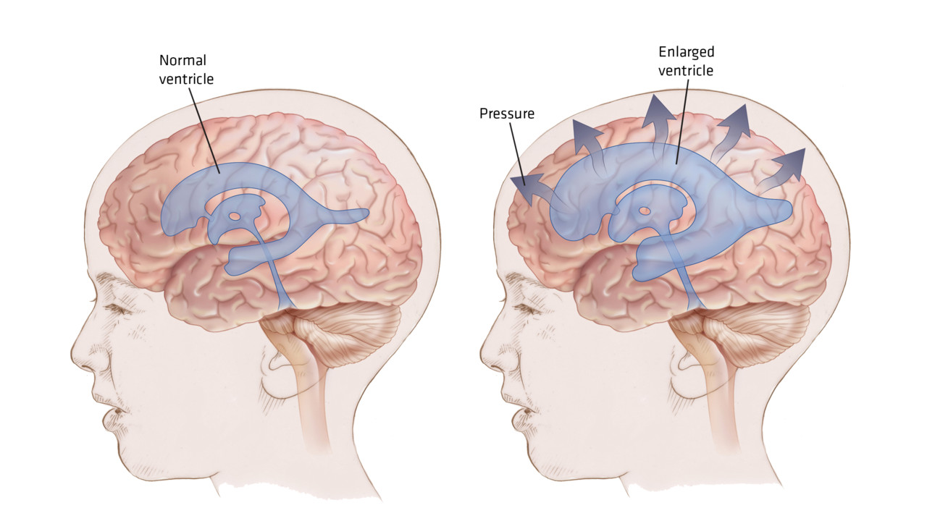
Hydrocephalus
1/1000 live births in the US
Cerebrospinal fluid drains in the brain at 600-700 ml/day (0.2-0.7ml/min)
CSF drainage from the brain is blocked
Leads to build up of CSF:
Ventricles enlarge
Brain swells up
Intracranial pressure increases
Critical at +5mmHg or more
- Loss of vision, headaches, neurological damage or death
Image source: http://r3.emsworld.com/files/base/image/EMSR/2013/09/16x9/1280x720/hydrocephalus-fnl_11140875.jpg

Slide 3
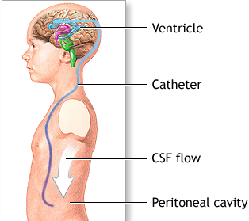
Current Solution: Ventriculoperitoneal Shunts
Gold standard for 50+ years
Shunt surgically inserted:
Proximally: into third ventricle
Distally: Into peritoneal cavity
However…
50% shunts fail within 2 years of implantation
Proximal failure
Distal failure
No means of detecting shunt failure:
Symptoms & damage before shunt replacement
Unnecessary replacement surgeries
Image source: http://umm.edu/~/media/ADAM/Images/en/12726.ashx

Slide 4
The Need
Project Objective Statement
The solution:
Must detect shunt failure before patient develops neurological symptoms
Must remotely communicate failure with minimal error
Communicate
ΔP
Measure the differential pressure between the shunt and the brain for proximal failure detection:
If there is no difference: there is no proximal failure
If there is a difference, there is proximal failure
Optional distal pressure measuring component for distal failure detection
Remotely communicate when the shunt fails

Slide 5
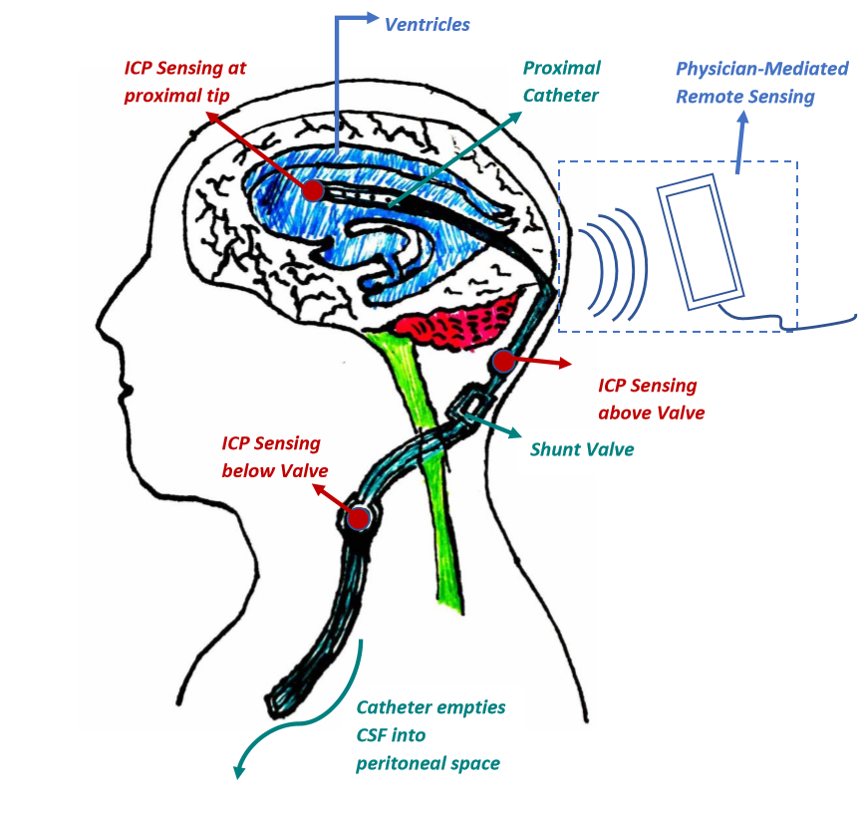
“Smart Shunt” Design
Notes:
For cranial applications, the subQ coil preferably is positioned between the skin and the bone that forms the cranium. Electromagnetic (or inductive) coupling between external coil and SubQ coil provides for the transfer of power and data signals between the coils.

Slide 6
Current Iteration of Design Components
Issues:
Transduction method highly complex – beyond scope of our capabilities
External device is large and requires large amount of power – does not fulfill our need for monitoring in non-clinical setting
Notes:
Explain why fiber optics are out
Explain how strain gauges interfaced with NFC chips are feasible

Slide 7
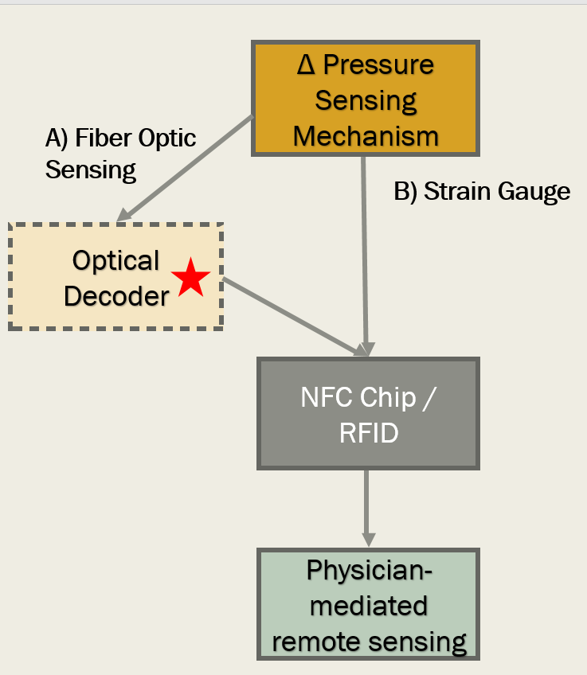
Radio Frequency Identification (RFID) Communication
RFID uses electromagnetic waves to exchange data between an interrogator and the transponder
Transponder is generally composed of an integrated circuit for storing and processing the data signal and an antenna for receiving power and transmitting the signal
The electromagnetic field received from the interrogator is the only source of power to the passive transponder
Power
Catheter
Interrogator
Transponder
Integrated Circuitry
f_{r} = f_{r}
Digital Signal Processing& Display
ADC
Pressure Sensor
Signal
Signal Conditioning
Demodulation
CSF Flow
Skin
Notes:
EZ430-TMS37157
When a tag is placed within the alternating magnetic field created by the reader, it draws energy from the magnetic field. This additional power consumption can be measured remotely as a voltage perturbation at the internal impedance of the reader antenna. The periodic switching on and off of a load resistance at the tag therefore effects voltage changes at the reader’s antenna and thus has the effect of an amplitude modulation of the antenna voltage by the remote tag. If the switching on and off of the load resistor is controlled by the tag’s stored data stream, then this data is transferred from the tag to the reader.

Slide 8
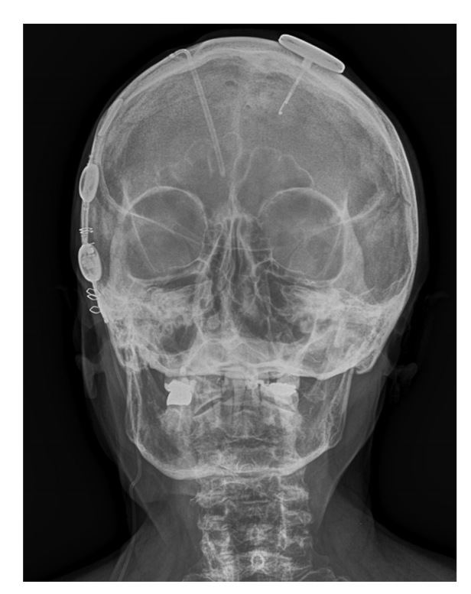
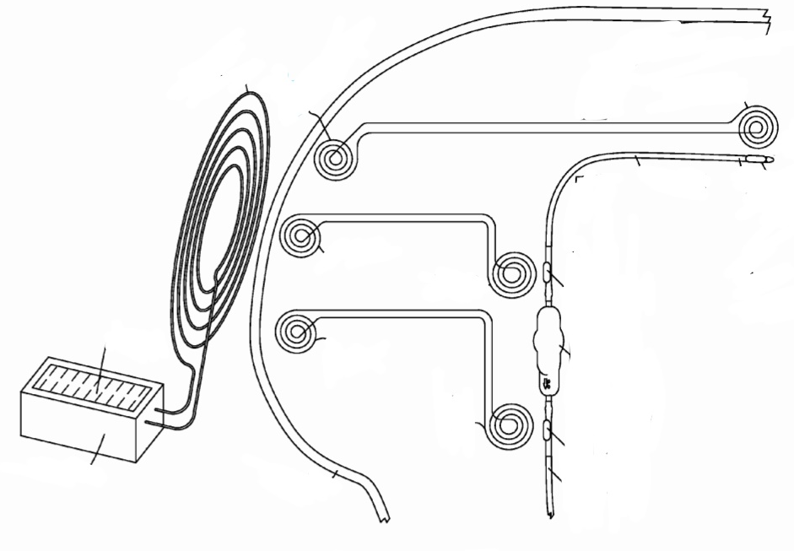
RFID Communication
Benefits:
RFID technology currently being used in FDA-approved continuous ICP monitor
No need for on-board power supply
No potential leakage of battery components
Increased failure detection lifetime
At-home recording possible
If multiple sensors are employed, modules can be configured to transmit information sequentially to ensure signal trains do not interfere
Telemetric Intracranial Pressure Monitoring with the Raumedic Neurovent P-tel
Source: Raumedic AG
Proposed Multi-Sensor unit with multiple RFID sensing points.
Source: Patent US20090204019 A1.

Slide 9
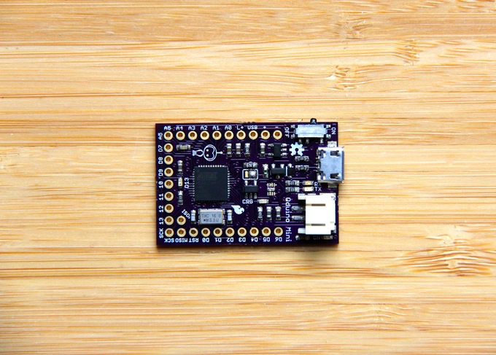
Arduino Implementation
Pressure Sensor
Notes:
https://www.allaboutcircuits.com/projects/read-and-write-on-nfc-tags-with-an-arduino/
Red marker indicates whether or not Arduino itself is capable of sending data rather than NFC depending on our goals. Could have embedded nfc chip at a different location, while arduino is housed in a bigger space like the abdominal cavity.
Qduino (bottom right) can be used instead of read/write depending on processing power needed from the sensor.

Slide 10
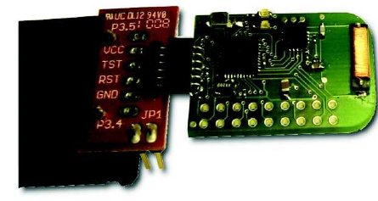
eZ430-TMS37157
RFID Reader
eZ430-TMS37157
PC
Pressure Sensor
Notes:
For ultra-low-power consumption, the TMS37157 offers the possibility to completely switch off the microcontroller (if powered from VBATI) resulting in an overall power consumption of typically 60 nA.

Slide 11
Strain Gauges: PDMS Window
Pore Diameter: .85 mm
# Pores: 24
# Removed Pores: 4
Drainage Surface Area: 64.1 mm²
% Reduction of Drainage Surface Area After Modification: 16.7%
1.0 mm
2.70 mm
Strain Gauge
.625 mm
1.45 mm
2.70 mm
7.5 mm long
Proximal End

Slide 12
Future Directions
Separate into development teams
Order microstrain gauge
Order Arduino + decide on NFC tag
App Development
PDMS + Strain Gauge Mechanical Testing
Fatigue
Stress-Strain Curve
6.1 mm
2.3 mm

Slide 13
Gantt Chart
7 days
Finalize Semester 1 Work
Dec 9 - Dec 19
15 days
Winter Break
Dec 19 - Jan 8
15 days
Determine pressure sensing mechanism
Jan 8 - Jan 27
11 days
Construction of physical model
Jan 25 - Feb 8
11 days
Testing of pressure sensing in physical model
Feb 8 - Feb 22
10 days
Revisions of design
Feb 22 - Mar 7
16 days
Long term testing until shunt failure
Mar 7 - Mar 28
20 days
Final Revisions
Mar 28 - Apr 24
12 days
Preparation of design day deliverables
Apr 7 - Apr 24
2016
2017
2016
Nov
Dec
Jan
Feb
Mar
Apr
2017
12/19/2016
1/9/2017
Today
4/24/2017
Semester 1 Ends
Semester 2 Begins
Design Day

