Slide 1
The (Matthew Walker) Texas Rangers III Developing a Ventriculoperitoneal Shunt Failure Monitoring Approach for Pediatric Hydrocephalic Patients
Oral Report #2
Wednesday, February 7th
Zoha Malik, Alvin Mukalel, Cole Pickney, Sungho (John) Suh, Colin Sweeney

Slide 2
The Problem
Hydrocephalic shunt insertion is the most common pediatric procedure
1/1000 live births
Notes:
Problem has been more or less unsolved for 50+ years…..

Slide 3
Current Solution
All shunts have a 50% chance of failing within 2 years of implantation
Infection

Slide 4
The Need
Project Objective Statement
The solution:
Must detect shunt failure before patient develops neurological symptoms
Must be minimally-invasive & biocompatible
Must remotely communicate failure with minimal error
A “smart shunt” add-on design will incorporate a shunt function monitoring system in order to detect and communicate failure timely.
The device will measure intracranial pressure at two points
Within the ventricles of the brain at the tip of the shunt
Within the shunt itself
This will help tell when and where the shunt fails.
Accuracy within 2mmHg; min allowed 5mmHg
Specifically for children under the age of 5
*Preliminary design and testing to be completed by April 15th, 2017

Slide 5
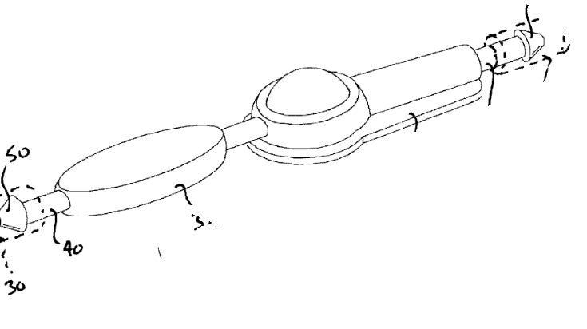
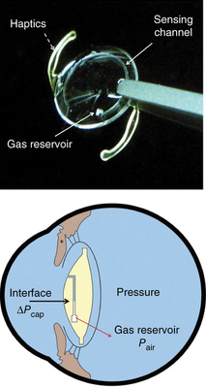
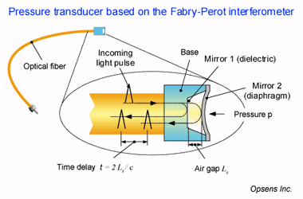
Revised Pressure Sensing Mechanisms
1) Combined Pressure and Flow Instrumentation Sensor
2) MEMS Intraocular Pressure Sensor
3) Fiber-Optic Sensor
4) Strain Gauge Pressure Sensor

Slide 6
Combined Pressure and Flow Instrumentation Sensor
Rationale:
Over time, pressure sensor measurement response of piezo-pressure sensor will undesirably drift due to stress/degredation
Surgical intervention necessary to recalibrate pressure sensor
Better suited for detection of instantaneous pressure changes, not gradual changes over the span of days
High cost of piezo materials
Strain gauges: higher long term stability
Rationale:
Over time, pressure sensor measurement response of piezo-pressure sensor will undesirably drift due to unwanted mechanical stress
Surgical intervention necessary to recalibrate pressure sensor
High cost of piezo materials
Strain gauges show higher long term stability
Processing Circuit
Protective Housing
Processing Circuit
Protective Housing
Loop Antenna
Loop Antenna
CSF Flow
CSF Flow
Pressure Sensor
Flow Sensor
Pressure Sensor
Flow Sensor
Source: Combined Pressure and Flow Sensor Integrated in a Shunt System. Codman Neuroscience, Patent US20090204019 A1. 13 Aug. 2009.
CodmanNeuro developed a prototype of this, and determined device was essentially useless after a few months, as signal drift produced inaccurate ICP readings
Notes:
Compliance = dv/dp
One possible sensing mechanism we investigated was the traditional instrumentation-type device with both pressure and flow sensors attached adjacent to the CSF catheter. From meeting with Dr. Feldman, we discovered this device had actually undergone a significant amount of research by CodmanNeuro, one of the leading shunt manufacturers. After development of a prototype and field testing, they determined that the device was essentially useless after a few months implanted, as signal drift produced inaccurate ICP readings. In addition, physicians suggested there was no clear benefit over the SOC, and the development was discontinued. Therefore, we are leaning away from this device design and are looking towards alternatives.
However, we have identified that not only do these have high drift, they also cannot detect pressure changes which occur over the span of days.
Reflects the ability of the intracranial system to compensate for increases in volumes without increases in ICP

Slide 7
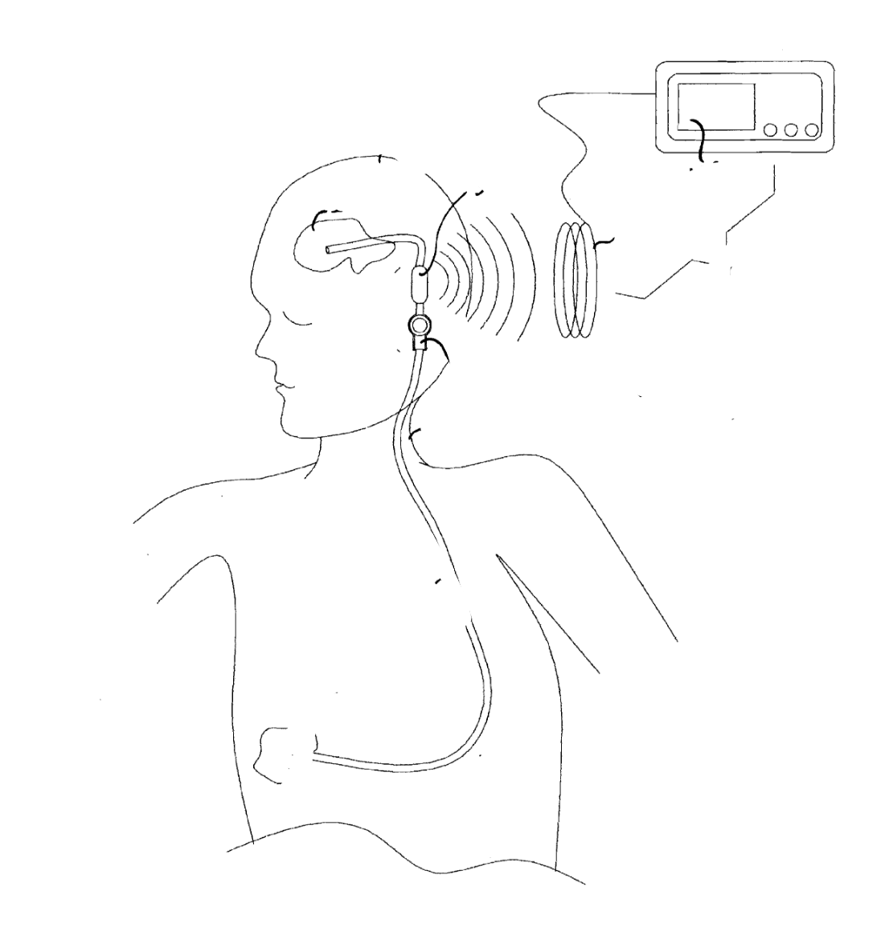
Signal Transmission Mechanism: “RF Wand”
The signal transmission to an external “RF wand” is still valuable:
a clinician or physician moves interrogation antenna of reader near the implanted sensor pod so that RF energy can be received by loop antenna
RF/DC converter transfers RF energy into a power supply that powers all the electrical components
Once powered, processing circuit reads out values to microprocessor unit on external unit, where measurements can be displayed to physician

Slide 8
MEMS Intraocular Pressure Sensor
Rationale:
Novelty of this approach was utilizing the iPhone camera to detect the pressure, which is not possible for ICP detection
Still in very early phases of development
Biocompatibility still needs further research
Physician uptake expected to be little/none
Araci, I. E., Su, B., Quake, S. R., & Mandel, Y. (2014). An implantable microfluidic device for self-monitoring of intraocular pressure. Nature Medicine, 20(9), 1074-8. doi:http://dx.doi.org.proxy.library.vanderbilt.edu/10.1038/nm.3621

Slide 9
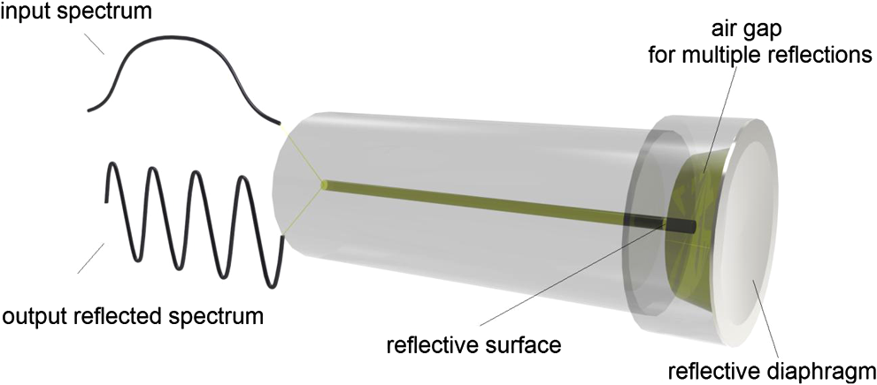
Fiber Optic Sensors
Continuous pressure measurement? |  Shown for 3 day period
Implantable? | 
Accurate within <2mmHg? |  <1 mmHg shown by Camino
Biocompatible? |  Silicon dioxide, chemically & biologically inert
Inconspicuous design? |  A single mode fiber (SMF) is only ~125μm
Remote sensing? |  Light signal itself, or pressure reading from light detector can be transmitted
Source: http://biomedicaloptics.spiedigitallibrary.org/article.aspx?articleid=1693216
Notes:
We have decided to keep fiber optics sensors in the mix for now, especially after further research and feedback from Dr. Michael and Dr. Miga. Let’s take a quick recap of how exactly a fiberoptic pressure sensor will work. In this diagram, you see the main component of the sensor. An LED emits light with known properties which travels through the fibers into this sensor. The sensor itself has two reflective surfaces. The reflective diaphragm is in direct contact with the fluid of concern, and deforms according to the applied pressure. The other reflective surface is fixed. So changes in pressure lead to changes in the distance between these two surfaces. When light hits these surfaces, it reflects off with certain phase and this reflected spectrum travels through the fibers to a detector, which is programmed to calibrate the phase difference into pressure.
The FO sensors are able to do continuous pressure sensing, shown for a 3 day period, are implantable, have an accuracy of under 1 mmHg as shown by Camino. They are also biocompatible as they are made of the chemically inert silicon dioxide. A single fiber is only 125 um, making this a very small system which can be implanted. Since you really just need the reflective component in the brain, the light source and sensor can be placed distally. Lastly, FOS allow for remote sensing as well.

Slide 10
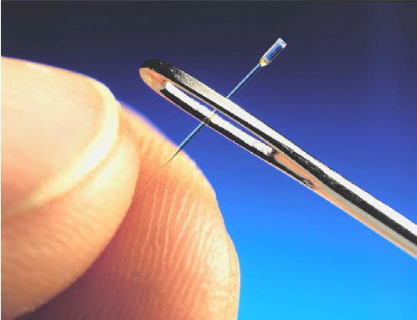
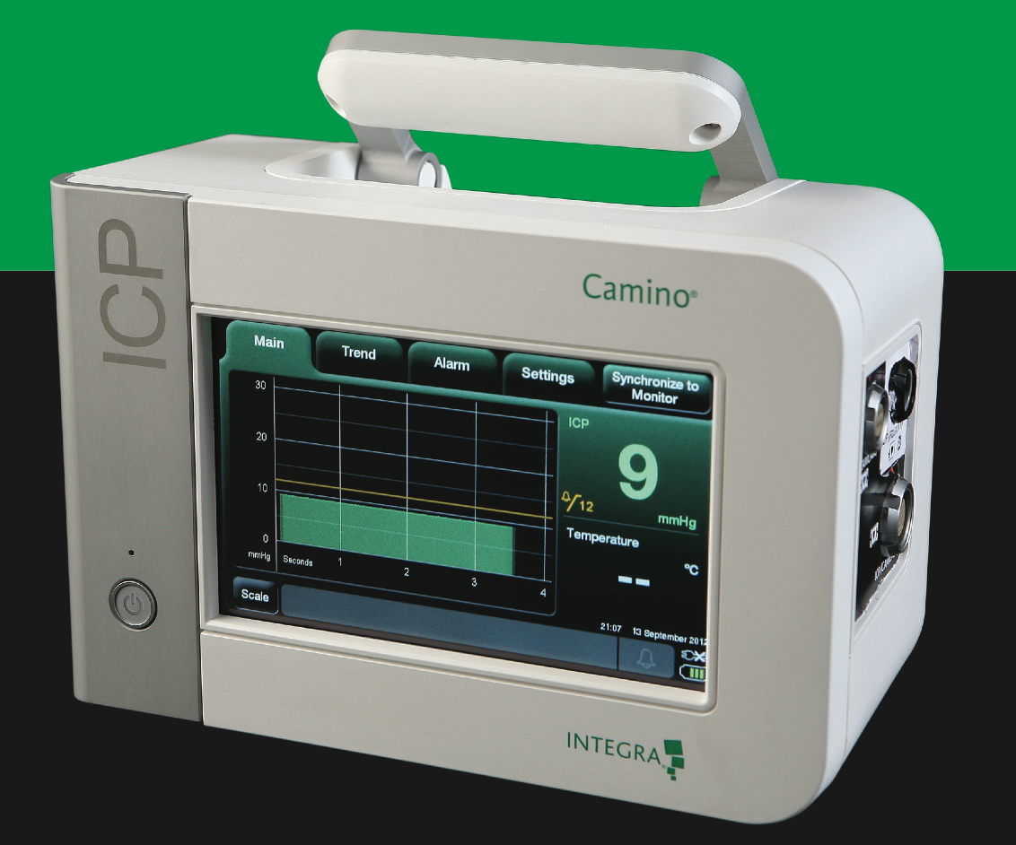
Fiber Optic Sensors: addressing previous concerns
FDA Approval
Several FOS have been approved for clinical trials for in vivo pressure sensing
There are commercially available FOS biomedical devices, though not currently common (e.g. Arrow Intl Inc., Camino Laboratories)
Debris
Only the reflective diaphragm has to be in direct contact with CSF; the fibers themselves can be shielded to prevent risk
Heat production
Could minimize heat production by programming the FOS to take 2-5 readings a day instead of continuous monitoring
Miniaturization
Current detectors are cumbersome; however proof of concept is the more important first step
Show enough potential to make them worth testing
Source: Integra Life Sciences
Notes:
These are some previous concerns which were raised. Firstly, we were not sure whether FDA would approve this novel technology for bio use. However, the FDA has already approved several fos for biomedical devices and pressure sensing, most of which have moved on to clinical stages. There are also commercially available pressure sensors, although a few, from Arrow Intl and camino laboratories. These are becoming competitive with each other.
Secondly, we feared that the fibers could shatter and the debris could lead to severe risk, since they are made of glass and tiny glass shreds are pretty inoperable. However, only the reflective diaphragm needs to be in direct contact with the brain in order to deflect according to the ICP. The rest of the system can be completely isolated inside another compartment, meaning there will be no risk of debris from the fibers coming into contact with any tissue.
Thirdly, heat production is an issue. We believe that if we program the light emitting component to emit light only a few times a day, and accordingly measure pressure 2-5 times a day, instead of continuously measuring pressure, we will be able to minimize heat production while also being able to detect pressure changes due to shunt failure.
Lastly, miniaturization of the detector is an issue. This picture shows a Camino detector which picks up the signals sent from an FOS. It is pretty large. However, Michael said that we really just need to give proof of concept at this point, and miniaturization can be addressed later.
So overall, we think that FOS show enough potential to make them worth acquiring and testing at least. We are attempting to get more info on commercially available sensors right now.
http://biomedicaloptics.spiedigitallibrary.org/article.aspx?articleid=1693216
https://www.researchgate.net/figure/6839641_fig2_Fig-2-Miniature-fiber-optic-pressure-sensor-used-for-a-measurement-of-blast-pressure
http://www.sensorland.com/PDF/OpSensREV2.2.pdf
http://www.sensorsmag.com/sensors/machine-vision/an-introduction-fiber-optic-sensors-1075

Slide 11
Strain Gauges
Unlike fiber optics, uses a physical phenomenon to transduce pressure signal
Highly sensitive to small changes in strain
Already applied in MEMS, commercially available at low cost
Concerns with fatigue
Materials are biocompatible, but are prone to protein aggregation
Easy to control for variations in temperature
Source:
Vishay Precision Group

Slide 12
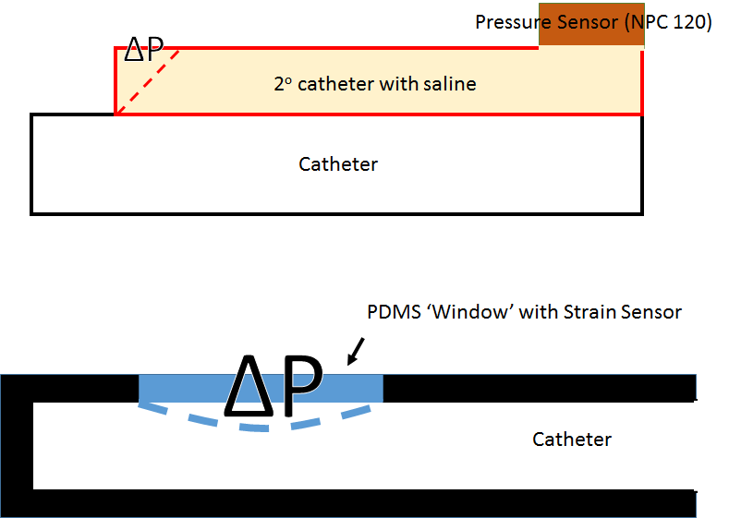
Membranous Pressure Sensors
Utilizes pressure differentials to create deflections in membranes
Relates pressure to mechanical changes
Proximal failure detection
PDMS can be functionalized for protein blocking
Not commercially available

Slide 13
Future Directions
This week we have reached out to multiple groups:
Physics Department – NJIT
Flexible Membrane Pressure Sensor
BioMEMS and Bioelectric Lab - LSU
Thin film metal strain gauges embedded in PDMS
Dr. Baudenbacher – Vanderbilt
Recommends a passive detection approach as differentiator
Numerous patents and attempts at developing active pressure sensing mechanism in literature
Opsens – Fiberoptic Pressure Sensor
Waiting for specifications on this sensor to evaluate feasibility
Collaboration

Slide 14
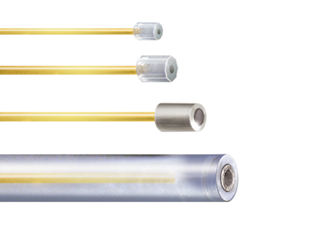
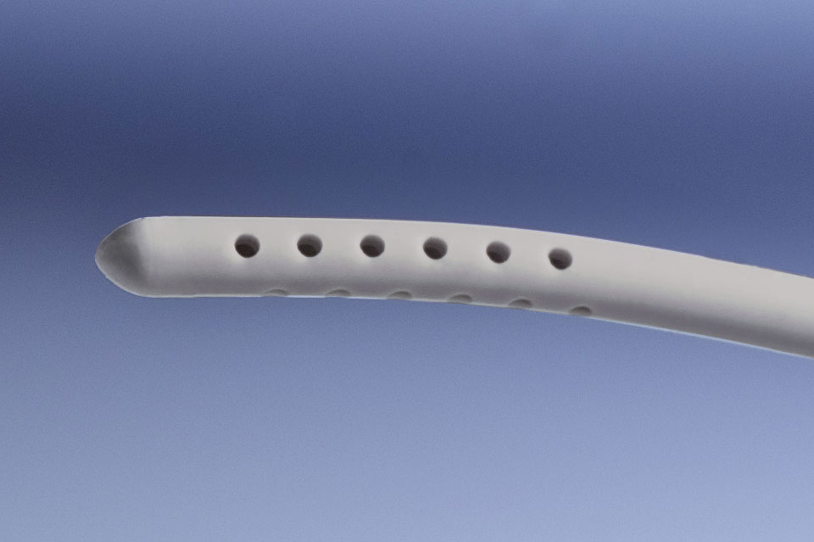
Future Directions
Materials to be acquired
Shunt tubing
Saline
Albumin
Miniaturized versions of deformable membrane strain gauge systems if at all possible
Fiber optics pressure sensor
A.S.A.P. from
Dr. Feldman

Slide 15
Gantt Chart
7 days
Finalize Semester 1 Work
Dec 9 - Dec 19
15 days
Winter Break
Dec 19 - Jan 8
15 days
Determine pressure sensing mechanism
Jan 8 - Jan 27
11 days
Construction of physical model
Jan 25 - Feb 8
11 days
Testing of pressure sensing in physical model
Feb 8 - Feb 22
10 days
Revisions of design
Feb 22 - Mar 7
16 days
Long term testing until shunt failure
Mar 7 - Mar 28
20 days
Final Revisions
Mar 28 - Apr 24
12 days
Preparation of design day deliverables
Apr 7 - Apr 24
2016
2017
2016
Nov
Dec
Jan
Feb
Mar
Apr
2017
12/19/2016
1/9/2017
Today
4/24/2017
Semester 1 Ends
Semester 2 Begins
Design Day

