Slide 1
The (Matthew Walker) Texas Rangers III Developing a Ventriculoperitoneal Shunt Failure Monitoring Approach for Pediatric Hydrocephalic Patients
Oral Report #1
Wednesday, January 25th
Zoha Malik, Alvin Mukalel, Cole Pickney, Sungho (John) Suh, Colin Sweeney

Slide 2
The Problem
Hydrocephalic shunt insertion is the most common pediatric procedure
1/1000 live births
Notes:
Problem has been more or less unsolved for 50+ years…..

Slide 3
Current Solution
All shunts have a 50% chance of failing within 2 years of implantation

Slide 4
The Need
Project Objective Statement
The solution:
Must detect shunt failure before patient develops neurological symptoms
Must be minimally-invasive & biocompatible
Must remotely communicate failure with minimal error
A “smart shunt” add-on design will incorporate a shunt function monitoring system in order to detect and communicate failure timely.
The device will measure intracranial pressure at two points
Within the ventricles of the brain at the tip of the shunt
Within the shunt itself
This will help tell when and where the shunt fails.
Accuracy within 2mmHg; min allowed 5mmHg
Specifically for children under the age of 5
*Preliminary design and testing to be completed by April 15th, 2017

Slide 5
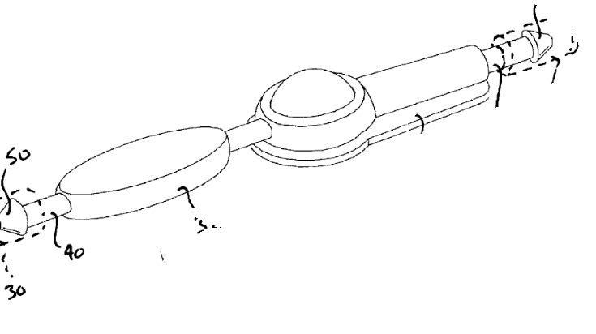
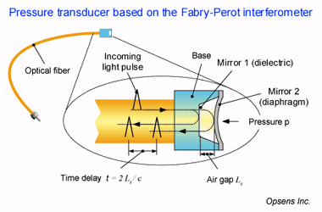
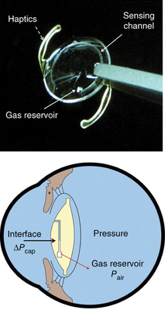
Pressure Sensing Mechanisms Under Consideration
1) Combined Pressure and Flow Instrumentation Sensor
2) Fiber Optic Sensors
3) MEMS Intraocular Pressure Sensor

Slide 6
Combined Pressure and Flow Instrumentation Sensor
Processing Circuit
Protective Housing
MoA
Pressure & flow transducers allow for determination of brain compliance via
$$C= ∫\left[Q\left(t\right)−Qavg\right]\frac{\text{∂}\text{t}}{\text{∂}\text{P}}$$
Pressure sensor: capacitive-type
Flow sensor: uses thermal anemometer
Processing circuit: provides signal conditioning and, via loop antenna, allows for communication with nearby interrogating antenna
Loop Antenna
CSF Flow
Pressure Sensor
Flow Sensor
Continuous Monitoring? | 
Implantable? | 
Accurate with <2 mmHg? | 
Biocompatible? | Protective housing must ensure electronic components will be separate from CSF flow channel, surrounding tissue
Remote Sensing? | Yes, the pressure and rate of flow measurements are compensated by the on-board calibration parameters, multiplexed, and transmitted on a carrier signal back to the remote reader/antenna
Source: Combined Pressure and Flow Sensor Integrated in a Shunt System. Codman Neuroscience, Patent US20090204019 A1. 13 Aug. 2009.
Notes:
Compliance = dv/dp
Reflects the ability of the intracranial system to compensate for increases in volumes without increases in ICP

Slide 7
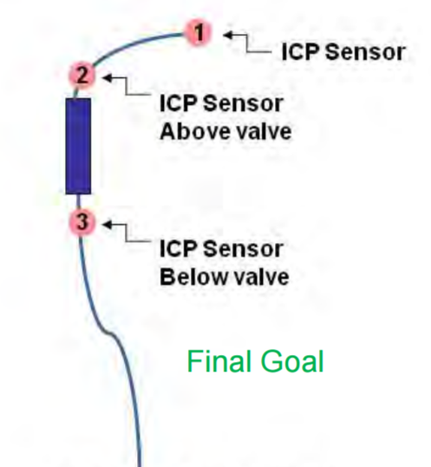
Combined Pressure and Flow Instrumentation Sensor
Processing Circuit
Protective Housing
Loop Antenna
Feasibility
Can use preexisting and commercially available sensors
Ideas familiar
Challenge comes from combining the sensors in a unit, developing processing/receiving circuits
CSF Flow
Pressure Sensor
Flow Sensor
Disadvantages
Realistically might require on-board battery
Design not very novel, lacks the “Wow Factor”
Source 1
1
Source 1
Source 2
Sources:
1) Combined Pressure and Flow Sensor Integrated in a Shunt System. Codman Neuroscience, Patent US20090204019 A1. 13 Aug. 2009.
2) Lutz, Barry. “Overview of Bioengineering & Hydrocephalus: 50 Years in 50 Minutes.”, 2012 Seattle Hydrocephalus Research Conference, 9-11 July 2012. Seattle, WA. Keynote Address.
Notes:
a limited number of pressure sensors have been developed that can be integrated directly into the shunt systems, but the commercial distribution of such pressure sensors has since been discontinued. These sensors include the Cosman sensor, which was sold by Radionics, Inc and a Japanese sensor called the Miyake sensor, which was sold in Japan.
Clinical use of existing sensors has been limited by the following factors: size of the sensor housing, complexity of the interrogation procedure, complexity of the implantation procedure, stability of the sensor reading with time, and lifetime of the sensor.

Slide 8
Fiber Optic Sensors
Four basic components
Light source
Optical fiber
Sensor element
Light detector
Variety of Sensing Elements
Temperature
Pressure
Strain
Compounds
Notes:
Light from the light source sends a signal through the optical fiber.
Along the fiber, there is a sensor that changes the properties of light running through the fiber.
This change in the light property, whether that be amplitude, wavelength, frequency, phase or polarization is then measured by the light detector.
Detector then processes the information to reflect the change seen.
Due to the variety of ways that these four components can be realized, there are a variety of methods that are available for sensing.
Top right picture shows a pressure sensor based on the Fabry-Perot interferometer
Two mirrors at the end of the optical fiber with air in the middle of the mirrors. The first mirror reflects light, second mirror reflects the same light at a different point, and can use the difference in the two light measurements as a way to determine pressure.

Slide 9
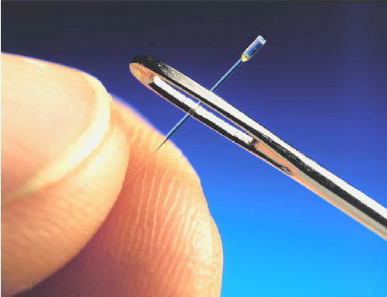
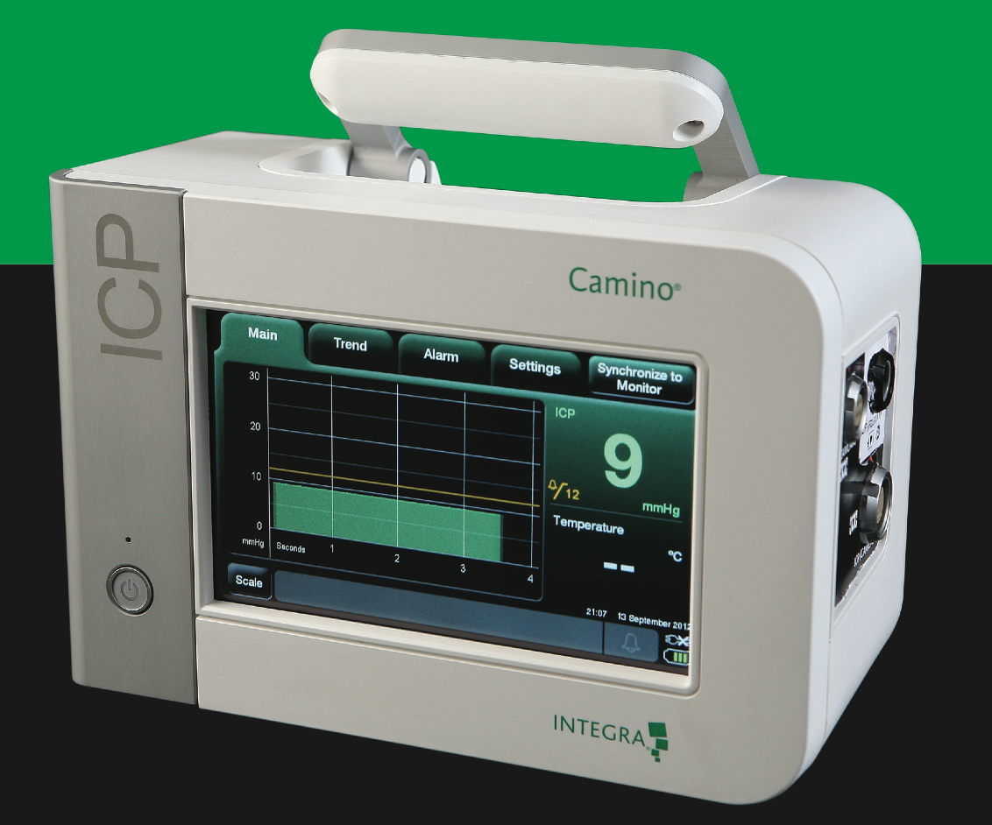
Fiber Optic Sensors (cont.)
Advantages
No power needed along fiber
Extremely small size
Highly sensitive
Immune to interference
Biocompatible
Multiple sensors
Disadvantages
Debris
New technology
Detector size/power usage
Continuous pressure measurement? | 
Implantable? | 
Accurate within <2mmHg? | 
Biocompatible? | 
Inconspicuous design? | 
Remote sensing? | 
Notes:
The coefficient of thermal expansion of an OF is 1/34 of copper
A typical single mode fiber (SMF) has an outer diameter (OD) of only 125 μm. Supplementary protective layers will increase dimensions, but to no more than 500 μm
Resolution <1 mmHg with an accuracy of +- 1mmHg was demonstrated with fiber optics (Camino pressure sensor)
Top right picture is a fiber of a pressure sensor used to measure blast pressure of an explosion
http://biomedicaloptics.spiedigitallibrary.org/article.aspx?articleid=1693216
https://www.researchgate.net/figure/6839641_fig2_Fig-2-Miniature-fiber-optic-pressure-sensor-used-for-a-measurement-of-blast-pressure
http://www.sensorland.com/PDF/OpSensREV2.2.pdf
http://www.sensorsmag.com/sensors/machine-vision/an-introduction-fiber-optic-sensors-1075

Slide 10
MEMS Intraocular Pressure Sensor
MoA
Airtight microfluidic channel
One end connected to aqueous intraocular fluid
Other connected to a gas reservoir
For use in shunt, the open end of channel would be open to the ventricle
Continuous Monitoring? | Yes, although only read when digital camera with optical adaptor is placed
Implantable? | Yes
Accurate with <2 mmHg? | Yes, can sense differentials of <1 mmHg
Biocompatible? | Researchers are seeking to re-engineer device with more biocompatible materials
Remote Sensing? | Yes, but in current application there must be a clear line of sight between camera and device
Araci, I. E., Su, B., Quake, S. R., & Mandel, Y. (2014). An implantable microfluidic device for self-monitoring of intraocular pressure. Nature Medicine, 20(9), 1074-8. doi:http://dx.doi.org.proxy.library.vanderbilt.edu/10.1038/nm.3621

Slide 11
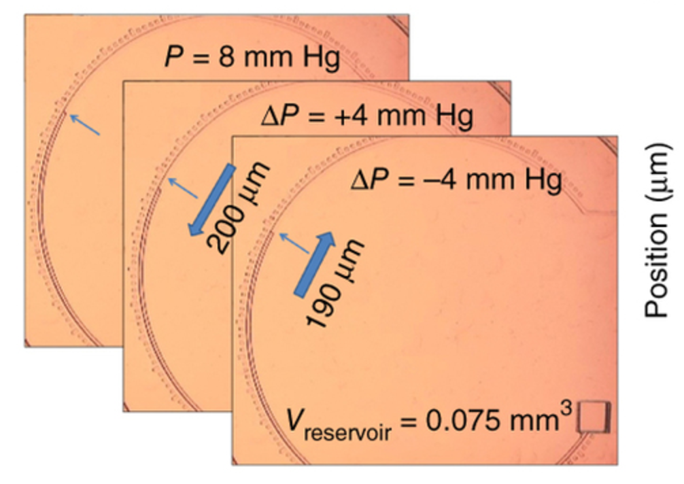
Intraocular Pressure Sensor
Feasibility
Very small components – 500 μm-wide channel, 500 x 500 x 300 μm³ gas reservoir
Tunable dimensions allow for modification of design to suit our needs
Disadvantages
Current method of sensing column height requires line of sight between camera and column
Current design does not include highly biocompatible materials
Not yet in clinical trials, so timeline is very long
Araci, I. E., Su, B., Quake, S. R., & Mandel, Y. (2014). An implantable microfluidic device for self-monitoring of intraocular pressure. Nature Medicine, 20(9), 1074-8. doi:http://dx.doi.org.proxy.library.vanderbilt.edu/10.1038/nm.3621

Slide 12
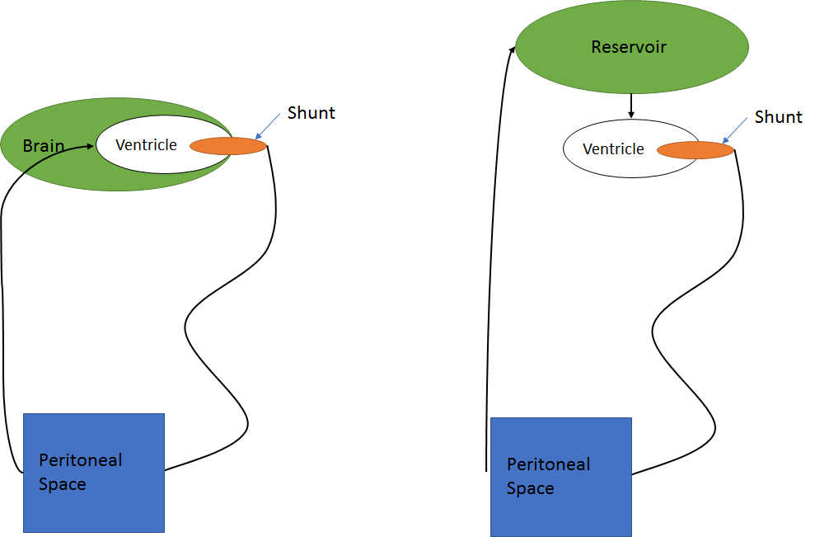
Future Directions
Creation of Model
Synthesis of Model Fluid: Saline + albumin
Method of Failure: coagulation of protein at tip of shunt
Parameterization: Flow rate, albumin concentration
Pressure Sensing Mechanism
Consult on clinical feasibility of transduction methods
Preference towards fiber optics

Slide 13
Gantt Chart
7 days
Finalize Semester 1 Work
Dec 9 - Dec 19
15 days
Winter Break
Dec 19 - Jan 8
15 days
Determine pressure sensing mechanism
Jan 8 - Jan 27
11 days
Construction of physical model
Jan 25 - Feb 8
11 days
Testing of pressure sensing in physical model
Feb 8 - Feb 22
10 days
Revisions of design
Feb 22 - Mar 7
16 days
Long term testing until shunt failure
Mar 7 - Mar 28
20 days
Final Revisions
Mar 28 - Apr 24
12 days
Preparation of design day deliverables
Apr 7 - Apr 24
2016
2017
2016
Nov
Dec
Jan
Feb
Mar
Apr
2017
12/19/2016
1/9/2017
Today
4/24/2017
Semester 1 Ends
Semester 2 Begins
Design Day

