Slide 1
The (Matthew Walker) Texas Rangers III
Developing a Ventriculoperitoneal Shunt Failure Monitoring Approach for Pediatric Hydrocephalic Patients
Oral Report #4
Wednesday, March 15
Zoha Malik, Alvin Mukalel, Cole Pickney, Sungho (John) Suh, Colin Sweeney

Slide 2
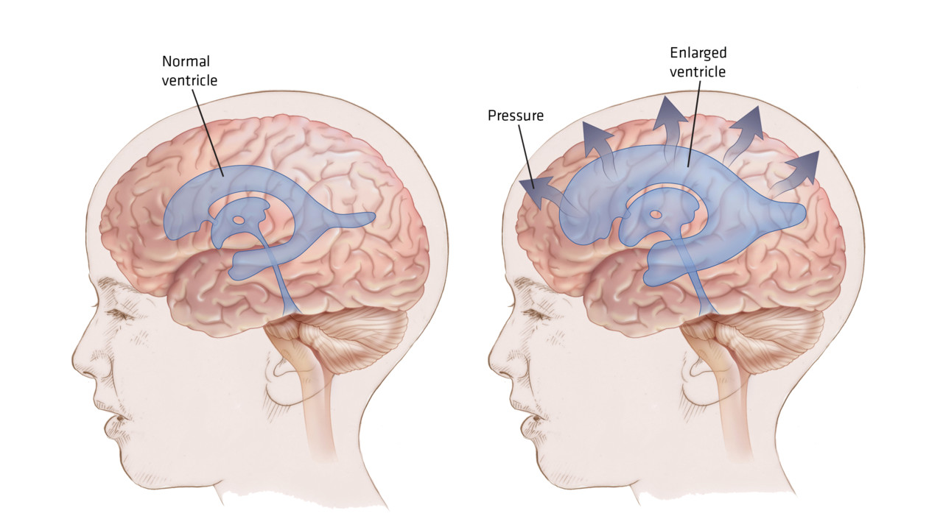
Hydrocephalus
1/1000 live births in the US
Cerebrospinal fluid drains in the brain at 600-700 ml/day (0.2-0.7ml/min)
CSF drainage from the brain is blocked
Leads to build up of CSF:
  Ventricles enlarge
  Brain swells up
  Intracranial pressure increases
    Critical at +5mmHg or more
- Loss of vision, headaches, neurological damage or death
Image source: http://r3.emsworld.com/files/base/image/EMSR/2013/09/16x9/1280x720/hydrocephalus-fnl_11140875.jpg

Slide 3
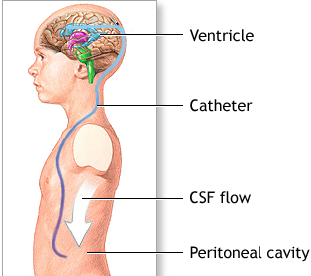
Current Solution: Ventriculoperitoneal Shunts
Gold standard for 50+ years
Shunt surgically inserted:
  Proximally: into third ventricle
  Distally: Into peritoneal cavity
However…
  50% shunts fail within 2 years of implantation
    Proximal failure -> DANGEROUS
    Distal failure
No means of detecting shunt failure:
  Symptoms & damage before shunt replacement
  Unnecessary replacement surgeries
Image source: http://umm.edu/~/media/ADAM/Images/en/12726.ashx

Slide 4
The Need
Project Objective Statement
The solution:
Must detect shunt failure before patient develops neurological symptoms; specifically proximal
Must remotely communicate failure with minimal error
Communicate
ΔP
Measure the differential pressure between the shunt and the brain for proximal failure detection:
  If there is no difference: there is no proximal failure
  If there is a difference, there is proximal failure
    Optional distal pressure measuring component for distal failure detection
Remotely communicate when the shunt fails

Slide 5
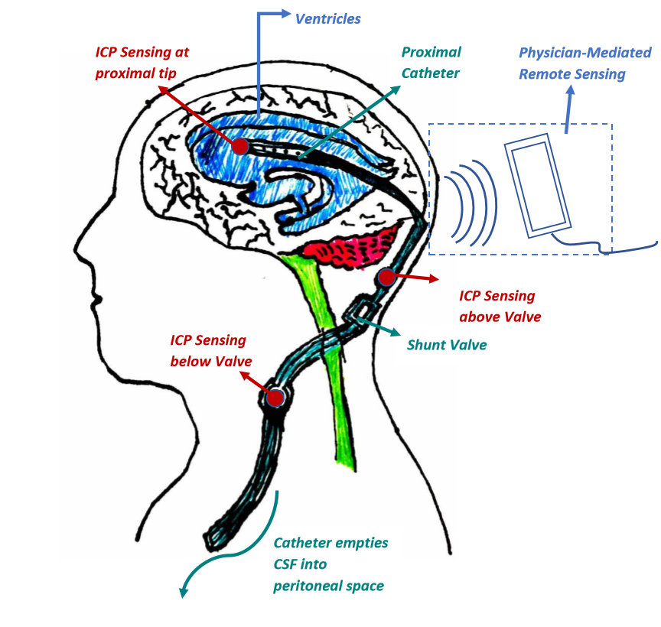
“Smart Shunt” Design
Notes:
For cranial applications, the subQ coil preferably is positioned between the skin and the bone that forms the cranium. Electromagnetic (or inductive) coupling between external coil and SubQ coil provides for the transfer of power and data signals between the coils.

Slide 6
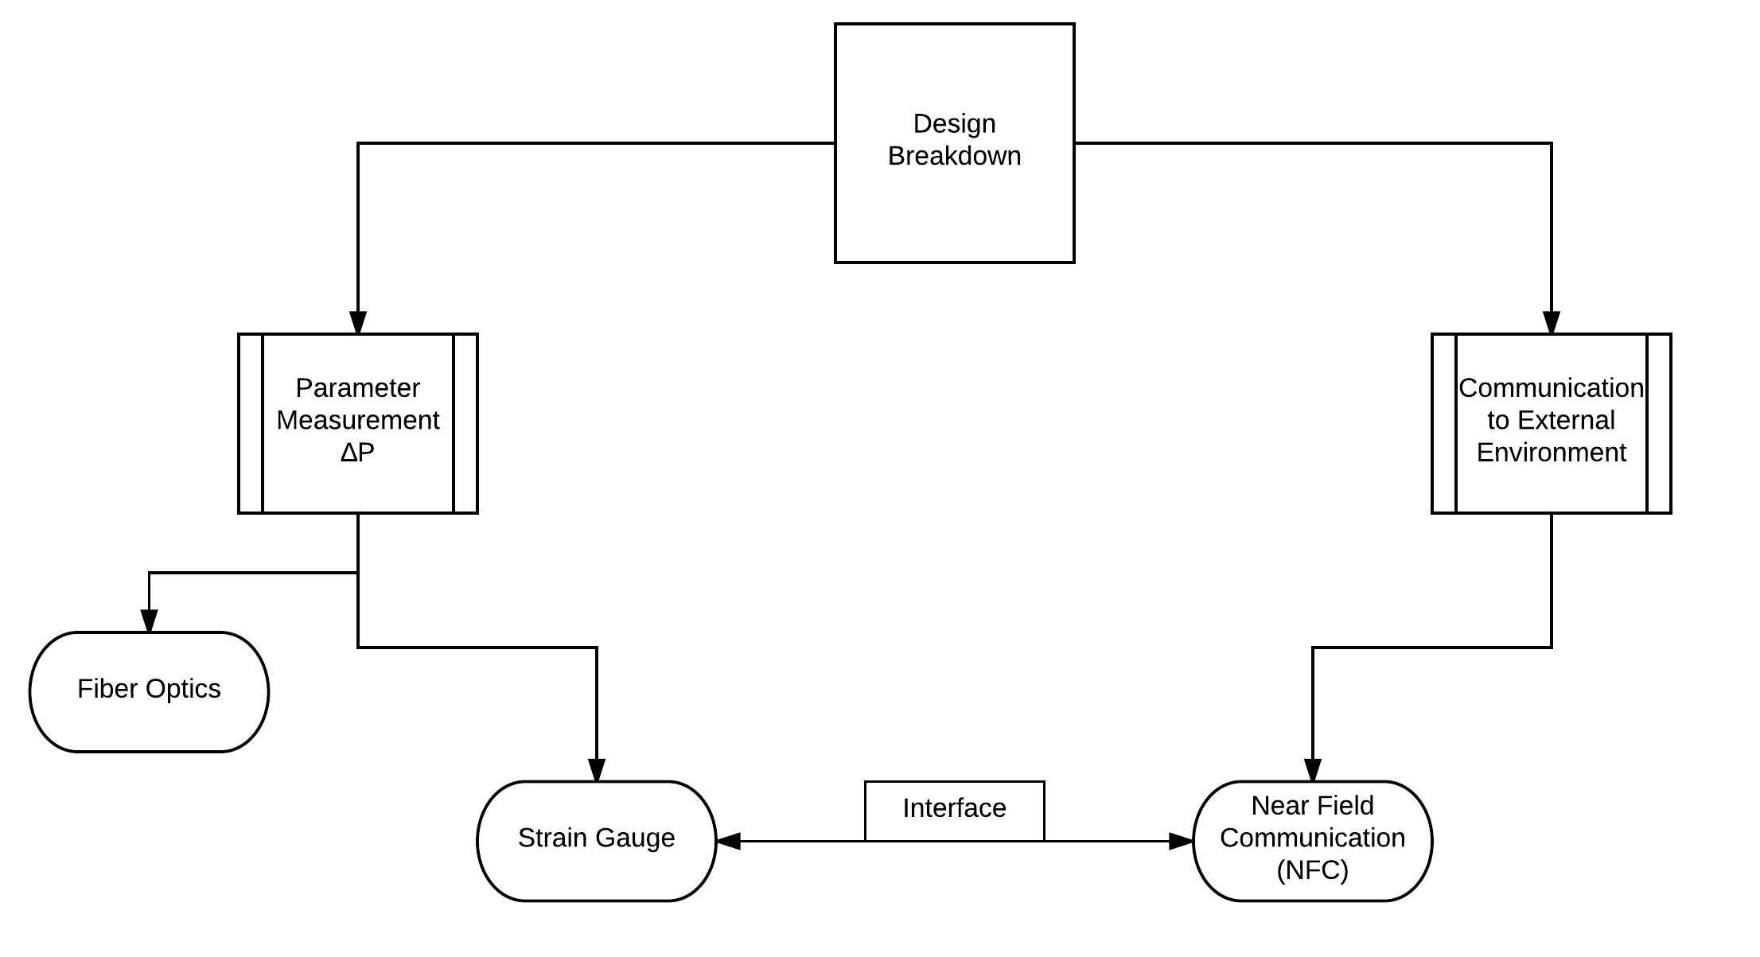
Current Iteration of Design Components
Notes:
Explain why fiber optics are out
Explain how strain gauges interfaced with NFC chips are feasible

Slide 7
Strain Gauge: PDMS Window
Pore Diameter: .85 mm
# Pores: 24
# Removed Pores: 4
Drainage Surface Area: 64.1 mm²
% Reduction of Drainage Surface Area After Modification: 16.7%
Strain Gauge
1.35 mm
Strain Gauge
2.70 mm
2.70 mm
.625 mm
7.5 mm long
Distal End
Proximal End

Slide 8
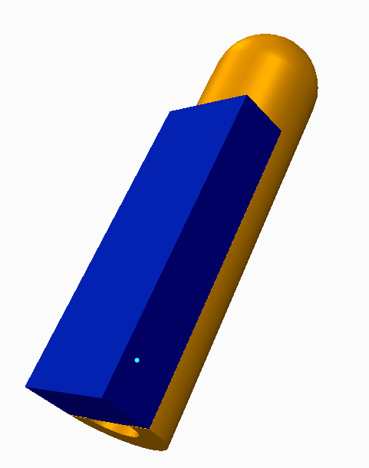
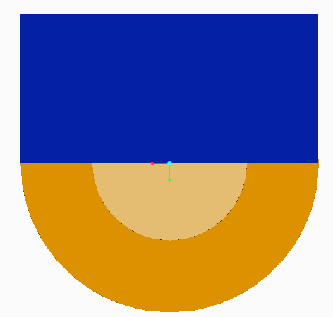
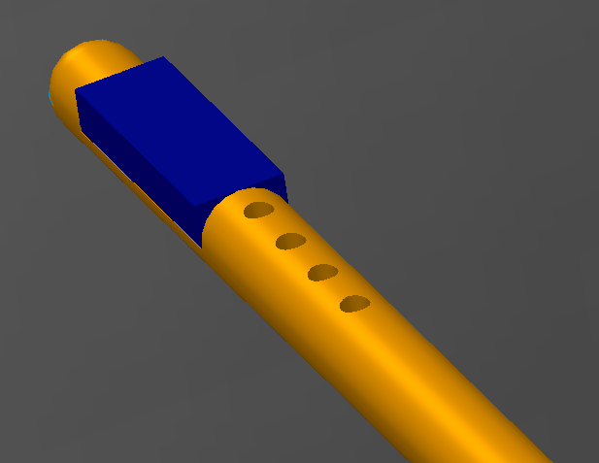
PDMS Window CAD Rendering

Slide 9
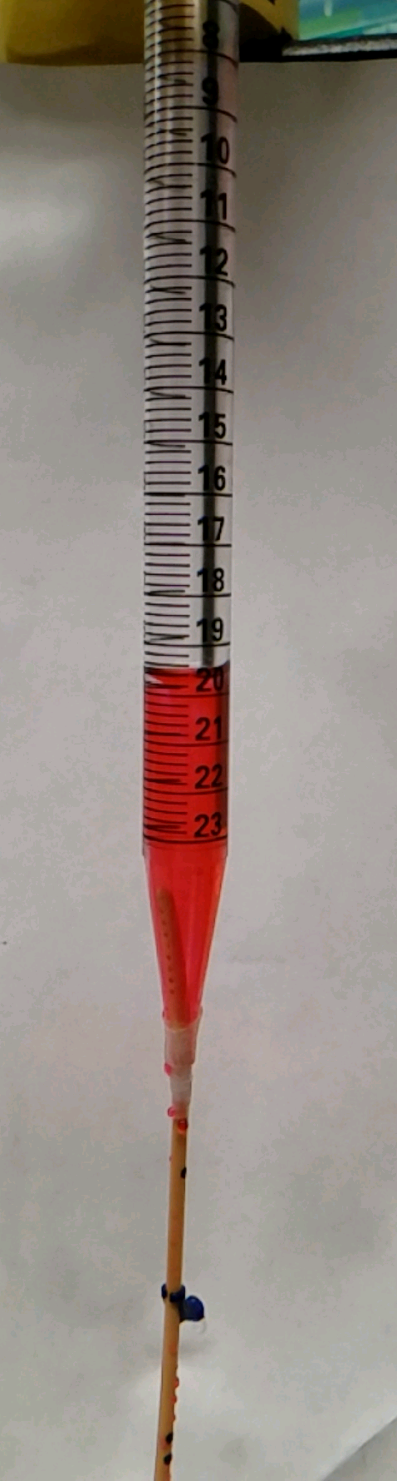
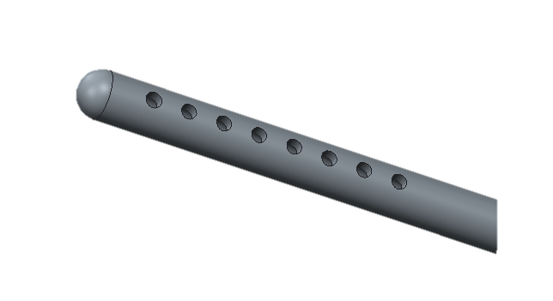
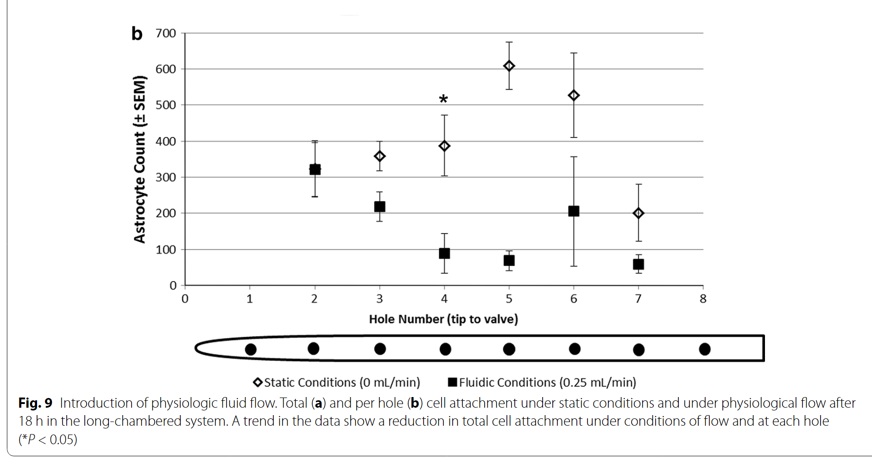
Will Covering Pores Compromise CSF Flow?
24 Pores
18 Pores
# Pores Open | % Area Remaining | Relative Flow Rate
24 | 100% | 100%
18 | 75% | 98%
12 | 50% | 86%
3 | 13% | 75%
0 | 0% | 0%
12 Pores
3 Pores
Flow Experiment Setup
Figure 1: Cell attachment under physiological flow at each pore
Source: Harris et al. (Modeling Shunt Failure by Tissue Obstruction)

Slide 10
RFID/NFC Communication
RFID (radio frequency identification)uses electromagnetic waves to exchange data between an interrogator and the transponder
  Transponder is generally composed of an integrated circuit for storing and processing the data signal and an antenna for receiving power and transmitting the signal
  The electromagnetic field received from the interrogator is the only source of power to the passive transponder
NFC (near field communication) is a subset of RFID
  Allows for peer-to-peer communication
Power
Catheter
Δ Pressure Sensing Mechanism: Strain Gauge
Interrogator
Transponder
Integrated Circuitry
f_{r} = f_{r}
Digital Signal Processing& Display
ADC
Pressure Sensor
Signal
Signal Conditioning
Demodulation
NFC Chip / RFID
CSF Flow
Physician-mediated remote sensing
Skin
Notes:
EZ430-TMS37157
When a tag is placed within the alternating magnetic field created by the reader, it draws energy from the magnetic field. This additional power consumption can be measured remotely as a voltage perturbation at the internal impedance of the reader antenna. The periodic switching on and off of a load resistance at the tag therefore effects voltage changes at the reader’s antenna and thus has the effect of an amplitude modulation of the antenna voltage by the remote tag. If the switching on and off of the load resistor is controlled by the tag’s stored data stream, then this data is transferred from the tag to the reader.

Slide 11
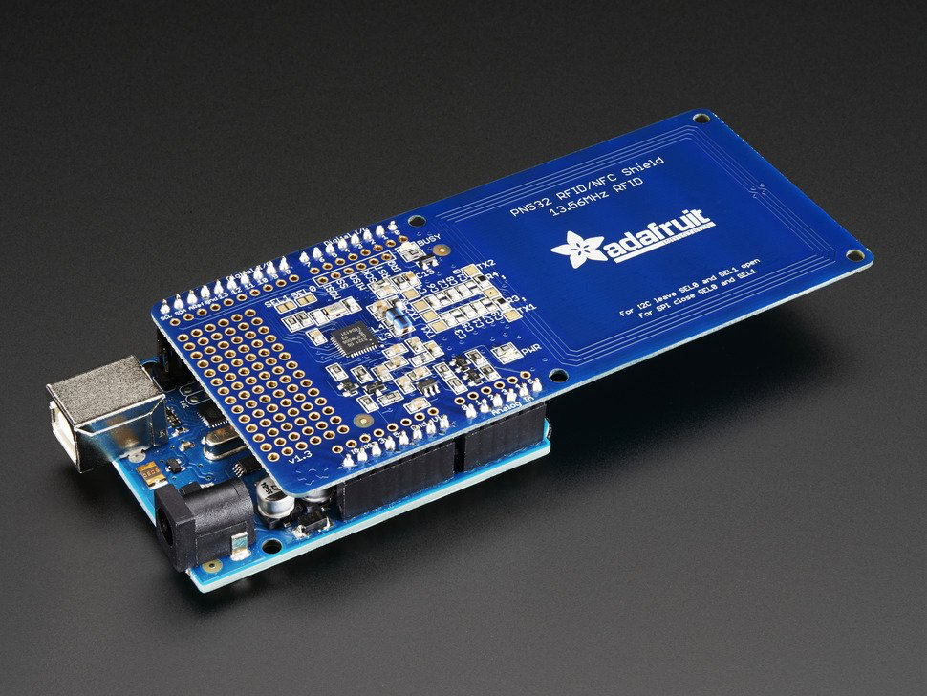

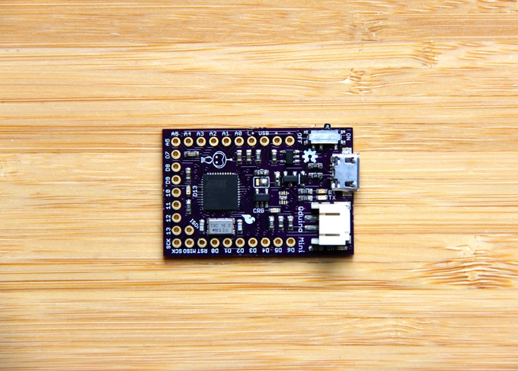

Arduino Implementation
Pressure Sensor
Notes:
https://www.allaboutcircuits.com/projects/read-and-write-on-nfc-tags-with-an-arduino/
Red marker indicates whether or not Arduino itself is capable of sending data rather than NFC depending on our goals. Could have embedded nfc chip at a different location, while arduino is housed in a bigger space like the abdominal cavity.
Qduino (bottom right) can be used instead of read/write depending on processing power needed from the sensor.

Slide 12
Arduino Strain Gauge Setup
INA125P instrumentation amplifier
  Gain ranges from 4-10,000 depending
  6-60kΩ
Strain gauge measurement using analog
in
Use Arduino to power bridge

Slide 13
Arduino NFC Setup
Using SPI
NFC shield uses digital
in/out pins
Write strain gauge info
to NFC tag
Read NFC tag with a
phone
Notes:
4050 level shifter needed to use the SDA/SCL pins of the nfc shield with 3.3V

Slide 14
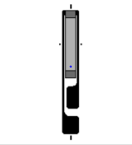
Construction and Testing Plan
During soldering, tape the strain gauge to a piece of aluminum to draw heat away from sensitive components
  Soldering has to be performed under a microscope and in good lighting due to small scale
Two options for wire
  Solid Cu: cheaper, less flexible
  Teflon coated Cu: flexible, more expensive, more suitable for true application
6.1 mm
2.3 mm
Vishay Strain Gauge
Notes:
There are a few different particulars to address when it comes to testing

Slide 15
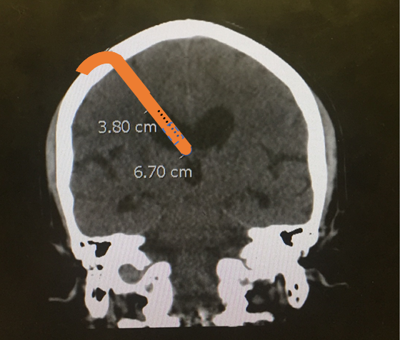
Construction and Testing Plan
Develop a protocol for removal of portion of shunt
  Test cutting and PDMS blocks sealed with bonding adhesive on excess distal tubing
Final ~3 cm of proximal tubing is portion in ventricle
  Experiment with window placement in that 3 cm
  Reference: window is 7.5 mm in length, so many available positions
MR Image of Ventricles
Notes:
There are a few different particulars to address when it comes to testing

Slide 16
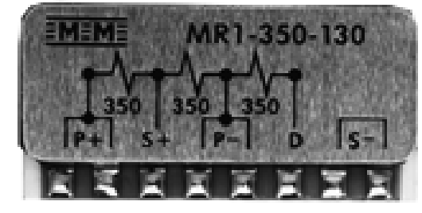
Further Material Needs
336-FTE: 0.127 mm diameter, silver plated Cu wire with Teflon insulation
MR1-350-130: bridge completion module
  Provides a precision 350Ω half bridge and a 350Ω dummy gage
  Output on the scale of microvolts -> need differential op amp to scale the signal up to range where Arduino can resolve
Additional PDMS and Curing agent – available from student lab
Tin-Silver Solder
Portable Strain Gauge Welding & Soldering Unit
Additional Strain Gauges
Proximal catheters from VUMC (hopefully)
MR1-350-130 Bridge Completion Module

Slide 17
Gantt Chart
7 days
Finalize Semester 1 Work
Dec 9 - Dec 19
15 days
Winter Break
Dec 19 - Jan 8
15 days
Determine pressure sensing mechanism
Jan 8 - Jan 27
11 days
Construction of physical model
Jan 25 - Feb 8
11 days
Testing of pressure sensing in physical model
Feb 8 - Feb 22
10 days
Revisions of design
Feb 22 - Mar 7
16 days
Long term testing until shunt failure
Mar 7 - Mar 28
20 days
Final Revisions
Mar 28 - Apr 24
12 days
Preparation of design day deliverables
Apr 7 - Apr 24
2016
2017
2016
Nov
Dec
Jan
Feb
Mar
Apr
2017
12/19/2016
1/9/2017
Today
4/24/2017
Semester 1 Ends
Semester 2 Begins
Design Day

