Slide 1
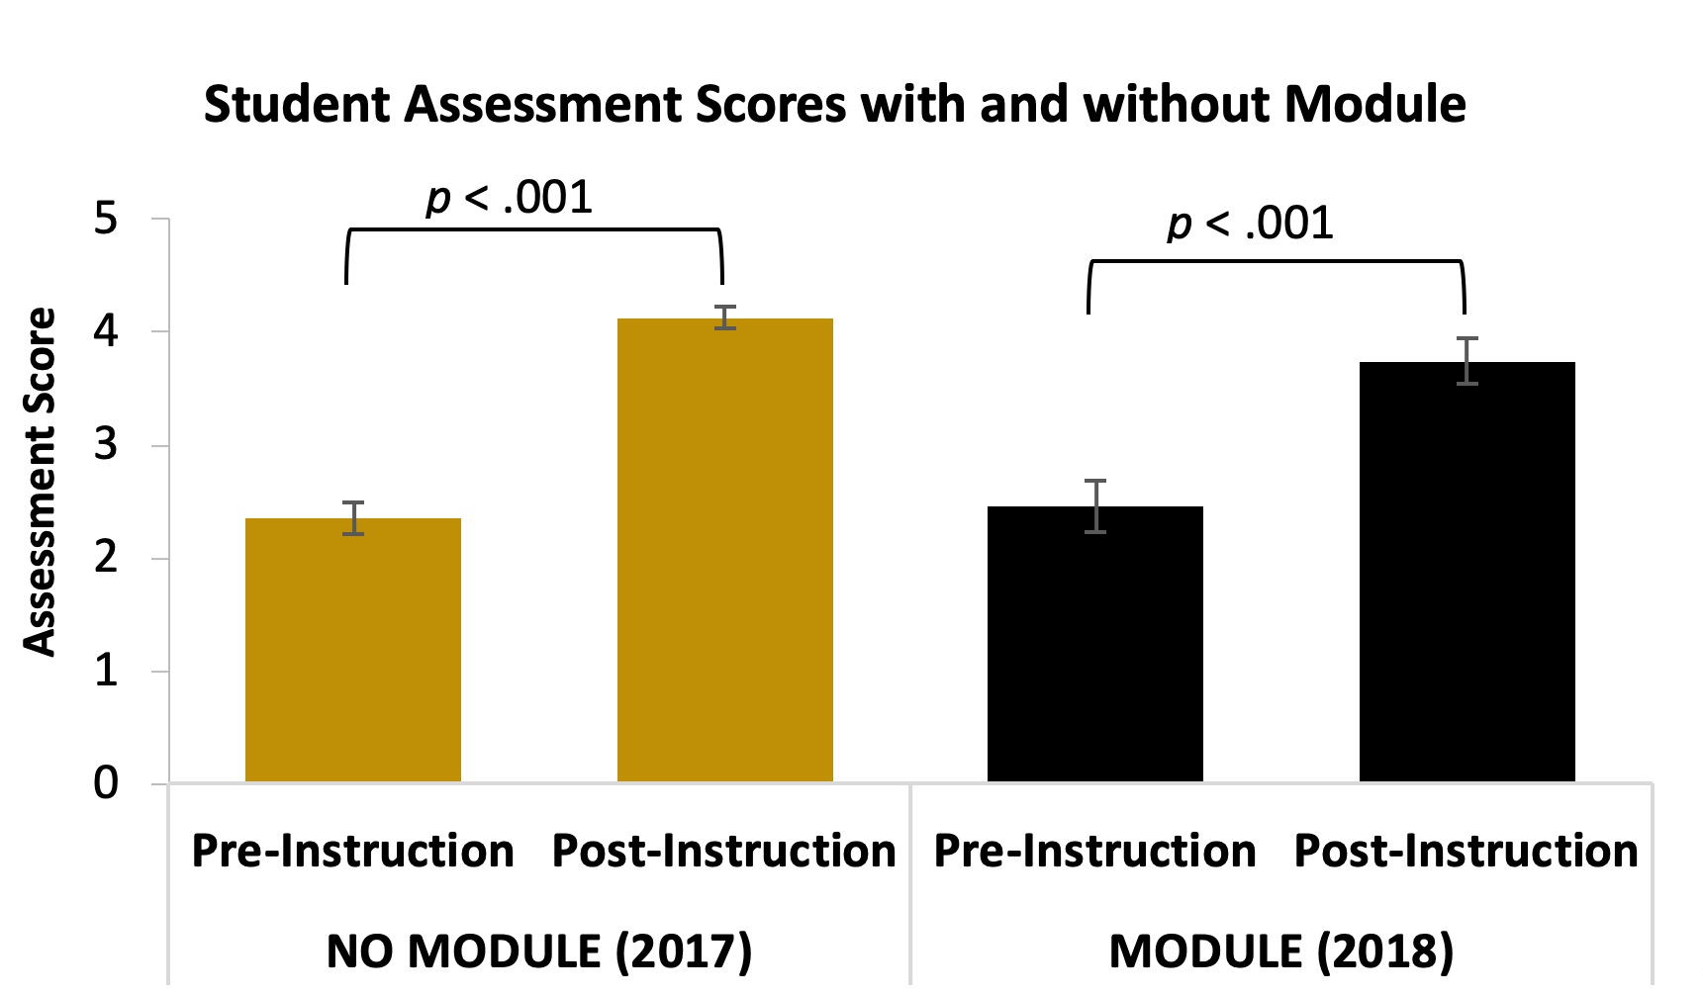
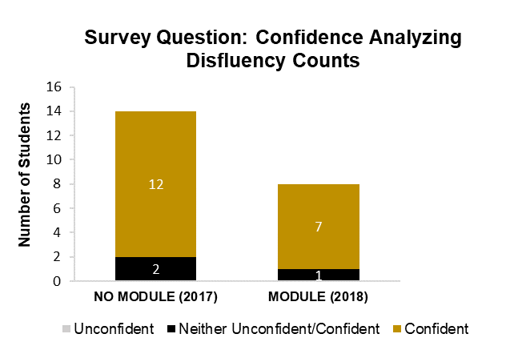
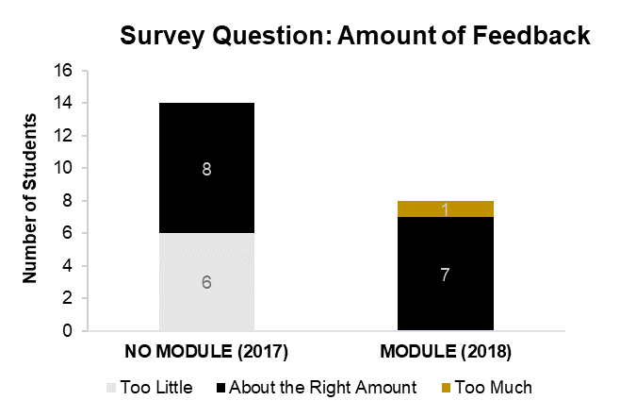
Improving student proficiency and confidence evaluating stuttering using an online module
Dillon G. Pruett, Cara M. Singer, and Robin M. Jones
Department of Hearing and Speech Sciences, Vanderbilt University, Nashville, TN 37232
Introduction
Results
SLP 5311: Stuttering is a required course for graduate students in speech-language pathology at Vanderbilt University. The course covers theoretical perspectives, empirical evidence, assessment, and treatment of stuttering. Disfluency counts taken during spontaneous speech to measure stuttering frequency are often difficult for students to learn. Our goal was to increase student proficiency and confidence performing disfluency counts. To achieve this, we introduced an online module to give students additional practice and feedback.
According to paired sample t-tests, both the No Module (2017) class, t(14) = -8.985, p < .001., and the Module (2018) class, t(12) = -4.920, p < .001, showed a significant increase in assessment scores from the pre-instruction to the post-instruction condition.
According to a one-way ANOVA, there was no significant increase in assessment scores from the No Module (2017) class to the Module (2018) class, F(1,27) = 2.322, p = .14.
approach
Step 1: Evaluate “business-as-usual” practice (2017)
A control sample of masters speech-language pathology students (n = 15) was used to determine student proficiency and confidence following “business-as-usual” instruction in Fall 2017.
Instruction consisted of:
Weekly 1-hour in-class labs during the first 8 weeks of class (approximately half of the semester)
Five 300-word disfluency count speech samples completed as lab homework
Step 2: Develop and implement the experimental disfluency module (2018)
An experimental sample of masters speech-language pathology students (n = 14) was used to determine student proficiency and confidence following instruction with the addition of the online module in Fall 2018.
Instruction consisted of:
Weekly 1-hour in-class labs during the first 8 weeks of class
Five 300-word disfluency count speech samples completed as lab homework
3 additional disfluency count modules with practice videos
Step 3: Compare class results for “business as usual” (2017) with the disfluency module (2018)
According to a chi-squared test, there was no significant difference in self-reported student confidence between the No Module class and the Module class, χ²(1) = .014, p = .907.
The majority of students from both classes reported feeling “confident” analyzing disfluency counts.
Assessment
2017
Pre-Instruction
Post-Instruction
According to a chi-squared test, there was no significant difference in self-reported student feedback between the No Module class and the Module class, χ²(2) = 5.867, p = .053.
Descriptively, the module appears to be helpful for feedback purposes: no students in the Module class stated they received “too little” feedback.
2018
Pre-Instruction
Disfluency Module
Post-Instruction
Proficiency Assessment
An assessment was developed on Brightspace to measure student progress on the learning objectives by comparing proficiency on the first day of class (pre-instruction) to proficiency 9 weeks later (post instruction).
Confidence Survey
A survey was created to collect student demographic information, student-reported confidence post-instruction, and general student feedback.
Discussion and Future directions
module
This initial stage of module development showed modest improvements in ratings of feedback given to students. After reflecting on student outcomes and course design, we plan to continue to develop the module to target greater gains in student proficiency and confidence. In the future, we plan to:
Include annotated disfluency counts alongside videos so students can see the disfluency count happening in real time in order to enhance initial training.
Introduce the module earlier in the semester, building student confidence prior to graded assignments.
Modify assessment scoring to emphasize accurately identifying stuttering-like disfluencies, rather than individual disfluency types.
Add additional questions of varying difficulty to the assessment to allow greater range of scores.
Acknowledgements
Image 1: Screenshot of module content
Image 2: Screenshot of a video embedded in the module
This study was supported by the Vanderbilt University Center for Teaching Blended & Online Learning Design (BOLD) Fellows Program. We would also like to thank those students of SLP 5311 who participated, and the children and families who allowed us to include their videos for the module.

