Slide 1
Grant Manager – Research Finance – SPA meeting
Thursday, June 10th, 2021

Slide 2
AGENDA
Welcome
Research Finance
SPA
VERA
Updates
Reporting
Training
Q&A – 15 minutes

Slide 3
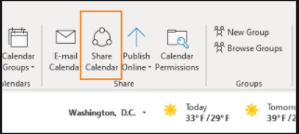
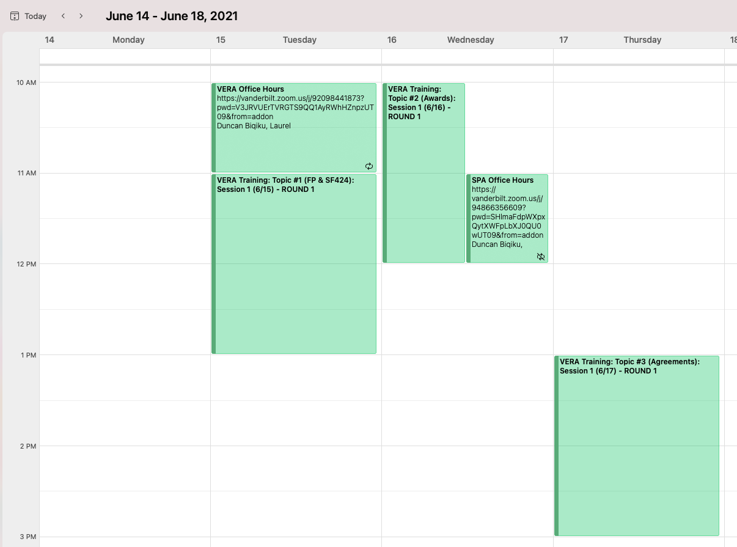
SPA-Training Calendar
Open Shared Calendar & search for –
“SPA-Training” (spa.training@vanderbilt.edu)
Notes:
Online instructions on adding a shared calendar: https://support.microsoft.com/en-us/office/open-another-person-s-exchange-calendar-2257f515-408f-48ea-9363-11d0d5848c77

Slide 4
Vanderbilt Electronic research administration (vera)
VERA PROJECT UPDATE

Slide 5
Business process changes

Slide 6
Streamlining AWARD MANAGEMENT
TODAY
In VERA
SPA emails award notification to DEPT and RF
SPA creates award record in VERA
Increased Efficiency
Duplication of Effort
PI’s DEPT Administrator revises proposal budget and enters into spreadsheet
DEPT imports budget from proposal to revise in VERA
DEPT submits via Ancillary Review in VERA
PI’s DEPT Administrator emails RF Form and spreadsheet
System Facilitated
Manual Effort
RF reviews and finalizes in VERA, sending account request to Oracle
RF creates Award and Project(s) in Oracle
VERA receives Account Numbers from RF/Oracle and notifies DEPT
RF informs DEPT of created numbers

Slide 7
Streamlining Administrative Approvals
In Coeus
In VERA
PI’s DEPT Administrator Submits for Internal Approvals
PI’s DEPT Administrator Submits for Internal Approvals
Ancillary Reviews
DEPT Review & Approval (PI’s DEPT)
DEPT Review & Approval
(Co-PI in same School, diff DEPT)
DEPT Review & Approval
(Co-PI in different School)
PI’s DEPT Review & Approval Path
(1-2 stops, depending on DEPT)
For required approvals
from other DEPTS or DEAN’S OFFICES
DEAN’S OFFICE Review & Approval
DEAN’S OFFICE Review & Approval
SPONSORED PROGRAMS
Review & Approval
SPONSORED PROGRAMS
Review & Approval

Slide 8
Administrative Approvals process
LEAD DEPT REVIEW
NON-LEAD DEPT(s) REVIEW
PI’s DEPT Administrator Submits for Internal Approvals
REQUIRED
Ancillary Review
Approvals are required from NON-LEAD DEPTS with Key Personnel on proposal when:
Cost-share/In-kind matching is needed from NON-LEAD DEPT
NON-LEAD DEPT has component budget or effort
Voluntary reduction of overhead impacts NON-LEAD DEPT
PI’s DEPT Review & Approval Path
(1-2 stops, depending on DEPT)
OPTIONAL Ancillary Review
SPONSORED PROGRAMS
Review & Approval
Optional Ancillary Reviews can be leveraged as an FYI to NON-LEAD DEPTS

Slide 9
Separating Administration from science
ADMINISTRATIVE REVIEW
RESEARCH PROPOSAL DEVELOPMENT
PI Certification in VERA
PI’s DEPT Administrator Creates Funding Proposal in VERA
PI develops research narrative, etc.
DEPT Review & Approval
(PI’s DEPT)
SPA Administrative Review*
*For full SPA Administrative Review, this portion should be submitted to SPA at least 3 days prior to sponsor deadline.
DEPT ADMIN finalizes in VERA
PI finalizes submission documents
SPA Submits to Sponsor

Slide 10
Administrative review
Required Final Documents
Biosketch(s)
Budget Justification
Subaward Documents
Facilities/Other Resources/Equipment
Other Support (if required)
Anything that requires signature
Additional Pertinent Proposal Information
Study Section Submission
Sponsor Communication regarding proposal
Pre-application information
Limited Submission Approval
Review timeline
All required documents in their final forms will be submitted 3 days before the due date of the proposal.
After the review the VERA proposal will be put in “Final Review” status and will not be able to be edited – waiting for submission of Validated SF-424.
Documents can be changed in the SF-424 but there is no guarantee of further review after the administrative review is complete.

Slide 11
Questions?

Slide 12
Vanderbilt Electronic research administration (vera) reporting
June 10, 2021: SPA and Research Finance Meeting

Slide 13
Today’s goals
Overview of pre-award reporting through VERA
VERA reporting
Team and process
Reporting pathways
Reports already in progress
Dual reporting VERA data with Coeus/PEER data
Summary and next steps

Slide 14
overview
What is pre-award reporting through VERA?

Slide 15
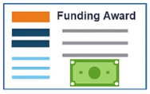
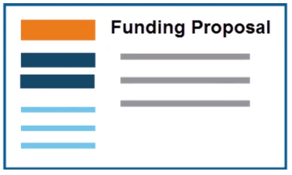
grant lifecycle: pre- & Post-award data domains
VERA
Pre-award functions
ORACLE
Agreement
Post-award functions
Contract Award
Faculty PI
Pre-Award
School/College
Administrator
Sponsored
Programs
Administration
(SPA) Team
Award
Proposal
Grant Award
Faculty PI
Post-Award
School/College
Administrator
Research
Finance*
Team
VERA data are pre-award data:
Proposals
Awards (grants and contracts)
Agreements
Sponsor
Oracle data are post-award data:
Expenditures
Costing and billing
COAs, POETs, etc.
*Formerly Office of Contract & Grant Accounting (OCGA)

Slide 16
pre-award reporting Sponsored Programs Administration (SPA)
Pre-award reporting enables end-users – VU faculty, staff, and leadership – to review and assess research-restricted, externally funded proposal and award activity, answering questions like:
Of all the proposals faculty have submitted over the last fiscal year, how many have been funded by external sponsors?
How much external research funding has been awarded to X department over the last quarter?
What type of external sponsors fund the majority the research portfolio of Y school or college?
How many subawards does Z school or college have in place with other entities outside VU?
What is the portfolio of awards funded by a particular sponsor?
Etc.
Pre-award reporting can be used for:
Assessing current proposal and award activity against past activity
Forecasting future proposal and award activity
Reporting current and past activity to external entities (e.g., FFATA reporting required for compliance with certain federal subawards, reporting current awards and pending proposals to sponsors when submitting a new proposal)
PRE-AWARD REPORTING SYSTEM(S):
Currently Coeus/PEER, phasing into VERA

Slide 17
post-award reporting Research Finance (RF)
Pre-award reporting is separate from post-award reporting.
Only post-award reporting includes financial information about current or past awards like research expenditures, costing, billing, COAs, POETs, etc., and can be used to answer questions like:
How much money has a researcher charged to a given award to date?
How much money remains on a given award?
What are the total research expenditures within a given school or college over the past fiscal year?
POST-AWARD REPORTING SYSTEM:
Currently Oracle, continuing as Oracle

Slide 18
Vera Reporting
Mission
Team and process
Reporting pathways
Reports in progress

Slide 19
mission
Our mission is ensuring our research community’s pre-award reporting needs are met leading up to, during, and after the phased launch of VERA, starting with “soft launch”.
Soft launch is the first of two phases in shifting to VERA as the functional pre-award system and system of record for pre-award data.
SOFT LAUNCH: Proposals
At soft launch, new proposals can be prepared and submitted through VERA for the first time.
Users can still prepare and submit new proposals through Coeus or other means (e.g., NSF Fastlane, Grants.gov, etc.) as usual.
SOFT LAUNCH: Awards and Agreements
Ongoing awards and agreements are copied from Coeus/PEER to VERA; any future adjustments to ongoing awards and agreements will be made in VERA only.
New awards and agreements are created in VERA only (not Coeus or PEER).

Slide 20
team & process
VERA reporting is a joint effort between SPA, Process Solution Implementation (PSI), Planning and Institutional Effectiveness (PIE), VUIT, and the Huron implementation support team in collaboration with end-users.
Analyze
SPA team
End-users (e.g., research admins)
Design
SPA team
PSI team
Build
SPA team
Verify
Huron team
Huron team
VUIT
SPA team
End-users
Fall 2020
Winter 2020-1
Spring, Summer 2021
Summer 2021
PIE team
VERA soft launch*
Define and prioritize our pre-award reporting needs.
Design reports to fulfill pre-award reporting needs through VERA.
Build reports in VERA and data warehouse.
Test and verify reports in VERA and data warehouse.
WE ARE HERE
*At soft launch, new proposals can be prepped and submitted through VERA or Coeus, but all new awards and agreements will be in VERA.

Slide 21
Reporting pathways
There are two non-mutually exclusive approaches to report data from VERA:
We will use both approaches.
VERA Reports
Built within the VERA system by Huron under the direction of SPA
Can report VERA data only
Lightweight, can only handle one type of data per report (e.g., proposals only)
Access determined by user roles within VERA
Data Warehouse Reports
Built outside VERA in a Vanderbilt-created data warehouse (Oracle BI) by SPA, VUIT, and PIE
Can report VERA data as well as Coeus/PEER data (i.e., both databases are accessible through Oracle BI, albeit in separate folders)
More complex, can more readily combine different data types (e.g., proposals and awards)
Access determined independently of VERA user roles

Slide 22
Reports in progress
VERA Reports being built by Huron
FFATA
Foreign involvement
Outgoing subawards
Time in state
Daily Work Log for SPA
CORES and IPA Agreements for Research Finance
Other reports to help research administrators within SPA, Research Finance, and schools/colleges monitor proposals and awards and manage their workloads
Data Warehouse Reports being built by VUIT, PIE
Other support
Award ended
Proposals (sortable/filterable by various variables)
Awards (sortable/filterable by various variables)
All investigators on proposals or awards
Funding allocations by award
Unrecovered indirect costs
Current and pending (by VERA project)
Active and pending (by lead investigator)
And more!
Note that these lists are not exhaustive!

Slide 23
Dual reporting
Pre-award reporting using VERA data and Coeus/PEER data

Slide 24
Coeus/PEER data vs. vera data
Coeus/PEER
All pre-award data up to the phased launch of VERA.
Data will slowly stop being added as VERA phases in.
End-users will have uninterrupted access to Coeus/PEER data for pre-award reporting before, during, and after VERA implementation.
VERA
Only active awards with associated agreements and shell proposals at onset of VERA launch.
Data will start being added and grow significantly as VERA phases in.
End-users will gain access to VERA data for pre-award reporting at the start of the phased VERA launch.

Slide 25
Dual reporting
Post-VERA implementation, some pre-award data that are needed for reporting will be housed in Coeus/PEER, others in VERA. SPA and end-users will have access to all these data.
As VERA launch will be phased, many pre-award reports will necessitate combining data from both Coeus/PEER and VERA.
The SPA team has designed and is vetting techniques to reduce dual reporting burden on end-users for pre-award reporting (e.g., building dual reporting features into VERA and the data warehouse, preparing guidance on how to dual report different types of reports, preparing our team to take on additional responsibilities to assist end-users in dual reporting).

Slide 26
Summary and next steps

Slide 27
Summary
Pre-award reporting and post-award reporting are separate now (Coeus/PEER vs. Oracle) and will remain separate post-VERA implementation (VERA vs. Oracle).
When Research Finance completes its reorganization, we plan to integrate Oracle and VERA and explore options to combine aspects of pre-award and post-award reporting.
Pre-award reporting in VERA is a joint effort between multiple teams.
The analysis and design teams (SPA, end-users, PSI, Huron) have finished their initial work, and now the build teams (Huron, VUIT, PIE) are creating the needed reports.
SPA and end-users will need both Coeus/PEER and VERA data for pre-award reporting post-VERA implementation.
We will continue to have access to Coeus/PEER data indefinitely and will gain access to VERA data as VERA phased launch begins.

Slide 28
Next steps
As Huron and VUIT/PIE complete reports, SPA and end-users will verify them to ensure they’re fully functional before VERA soft launch.
We’ll need help from users like you to vet reports. Stay tuned for more about this process in the coming weeks!
The SPA team is preparing dual reporting resources to reduce the burden of pre-award reporting post-VERA soft launch.

Slide 29
THANK YOU!
Any questions?

Slide 30
Vanderbilt Electronic research administration system

Slide 31
Updates
Who is vera?
Training & Resources
VERA Help
RAWG & TEAM VERA
shout-outs

Slide 32
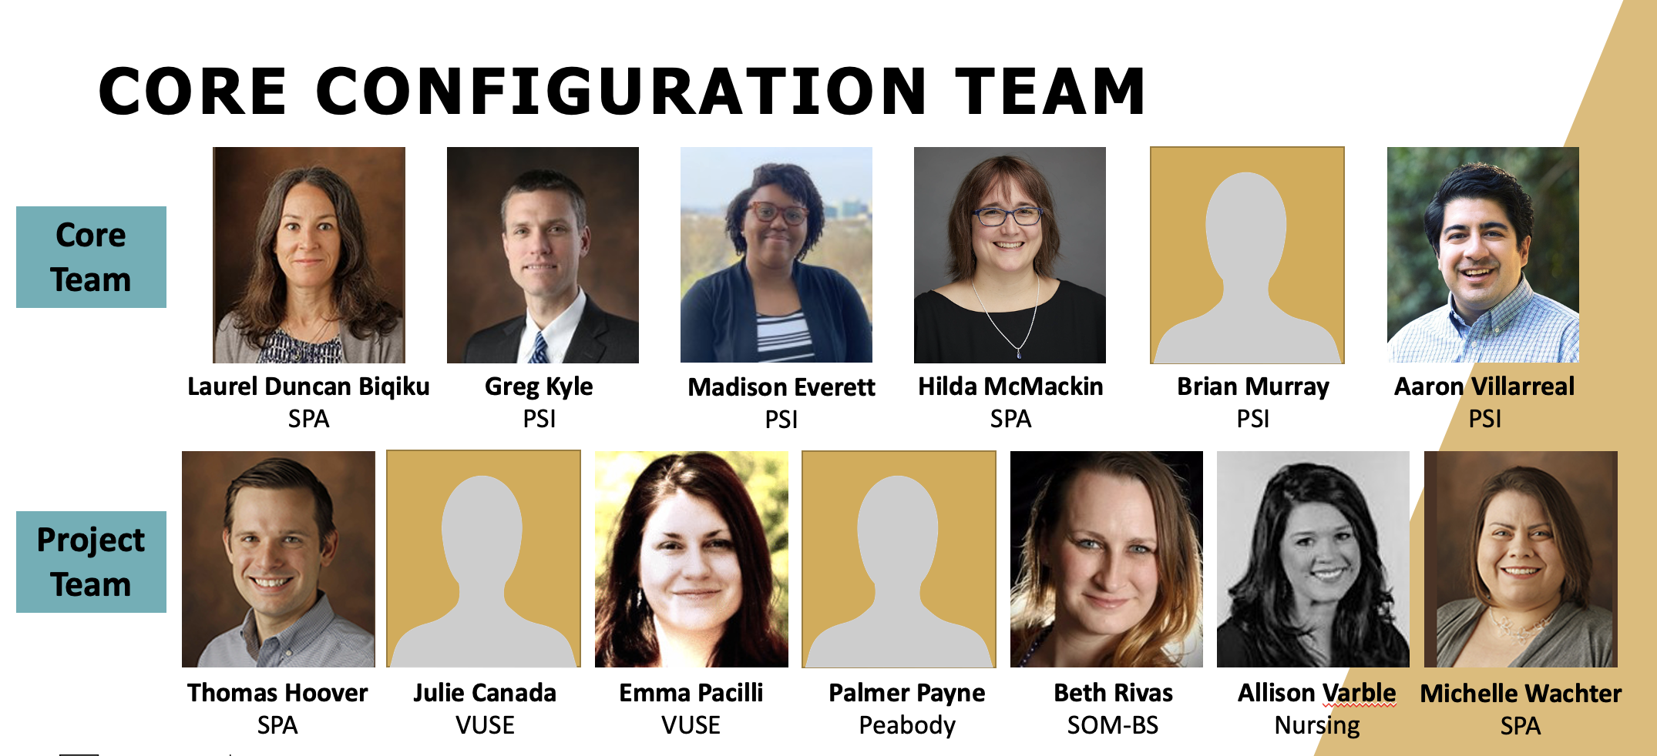
VERA HELP & REPORTING
TEAM VERA
SPA
Notes:
Who is VERA?

Slide 33
Training
Wednesday’s Topic:
Awards &
Award Modifications
10am-12pm
Tuesday’s Topic:
Funding Proposals & SF424
11am-1pm
Thursday’s Topic:
Agreements & Reporting
1-3pm
Week 1: June 15^{th –} June 16^{th –} June 17th
Week 2: June 22^{nd –} June 23^{rd –} June 24th
Week 3: June 29^{th –} June 30^{th –} July 1st
1st
B
I
Week 1: July 13^{th –} July 14^{th –} July 15th
Week 2: July 20^{th –} July 21^{st –} July 22nd
Week 3: July 27^{th –} July 28^{th –} July 29th
2nd
A
B=Beginner
I=Intermediate
A=Advanced/Additional

Slide 34
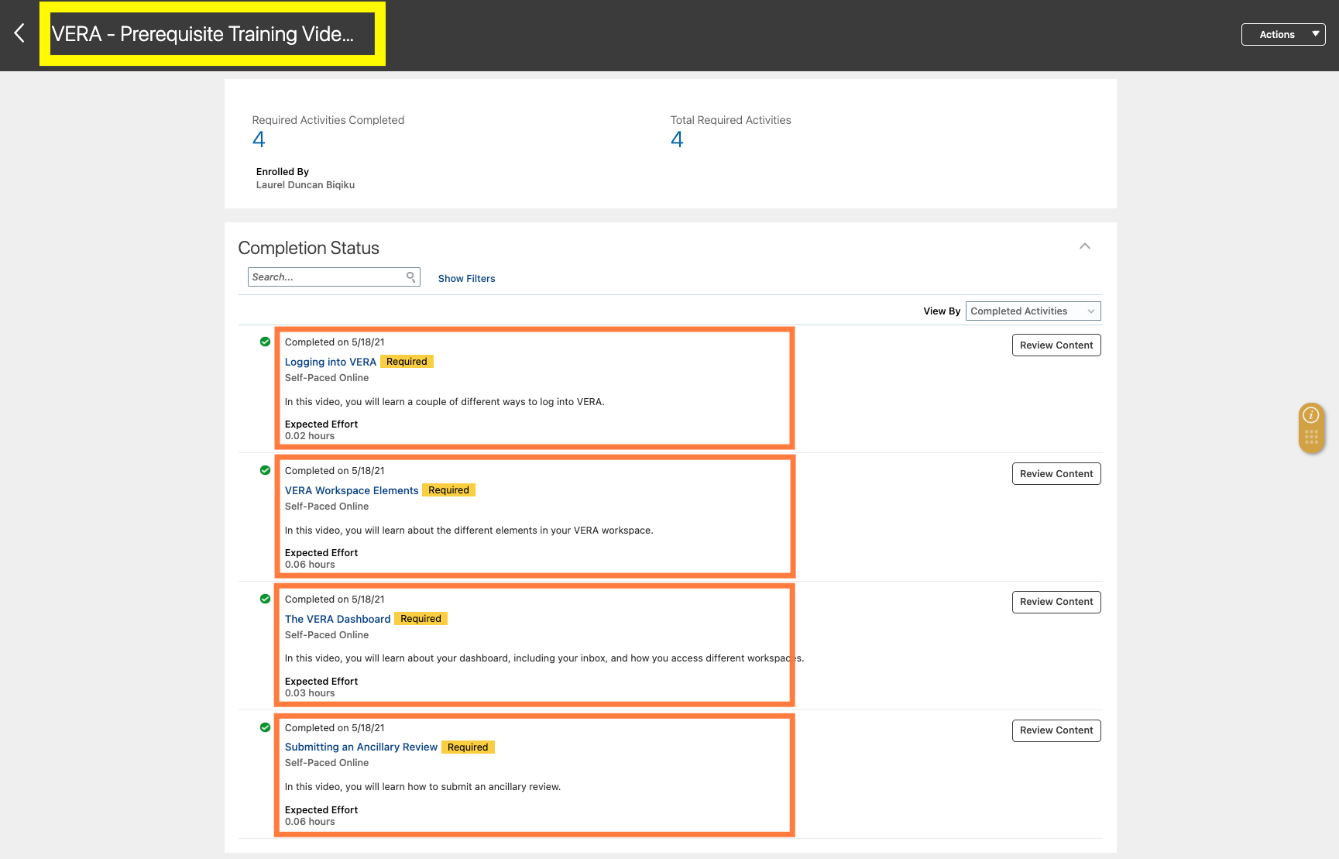
Notes:
This link takes you directly to sign up for the prereq course:
https://ecsr.fa.us2.oraclecloud.com:443/hcmUI/faces/deeplink?objType=WLF_LEARN_LEARNING_ITEM&action=NONE&objKey=learningItemId%3D300001870126321

Slide 35
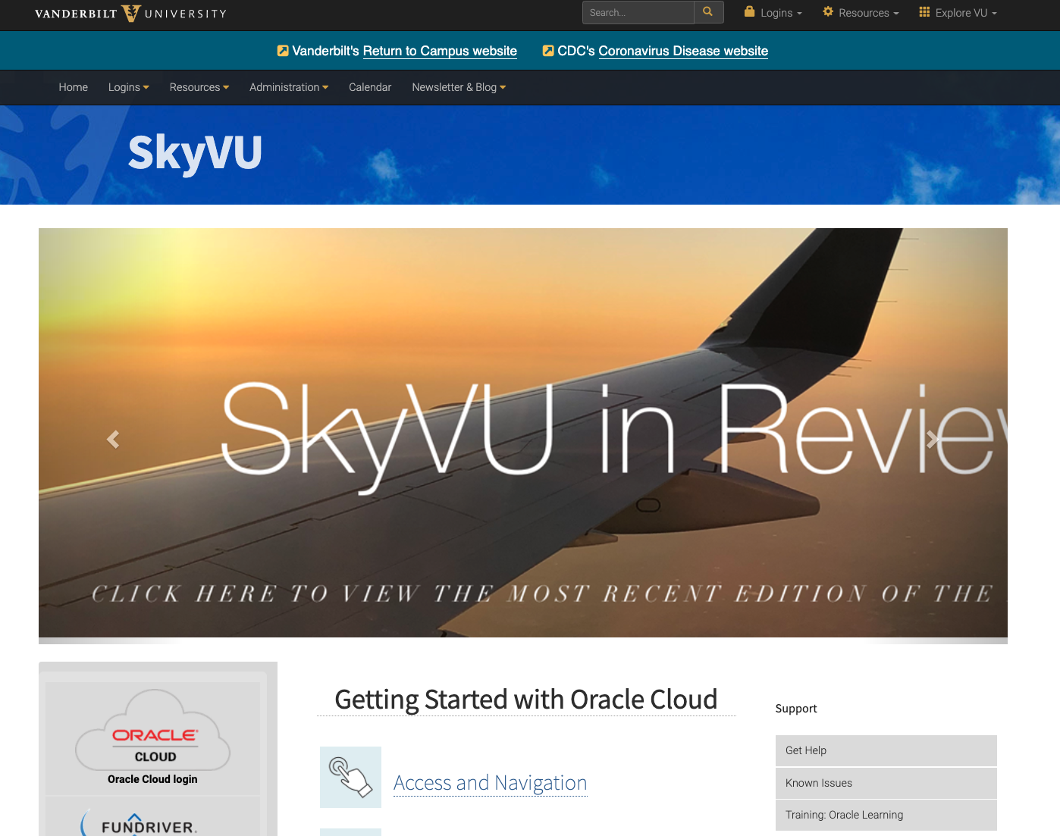
Good morning, VERA User!
VERA, 6/15
Notes:
SkyVU – Oracle Cloud link: https://oraclecloud.vanderbilt.edu/
Click on “Learning” icon
Search for “VERA” – date of session that you want to sign up for

Slide 36
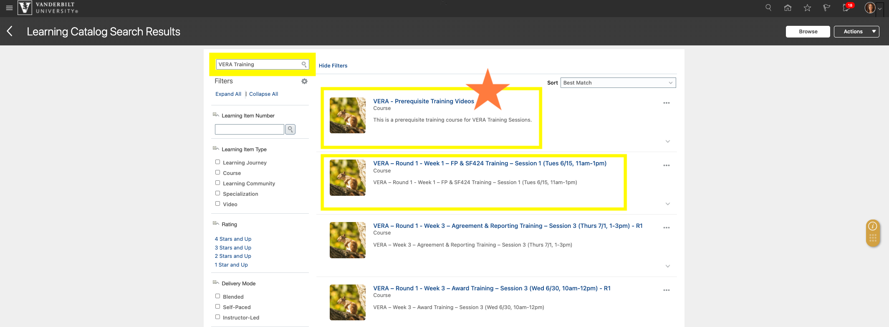
VERA Training

Slide 37
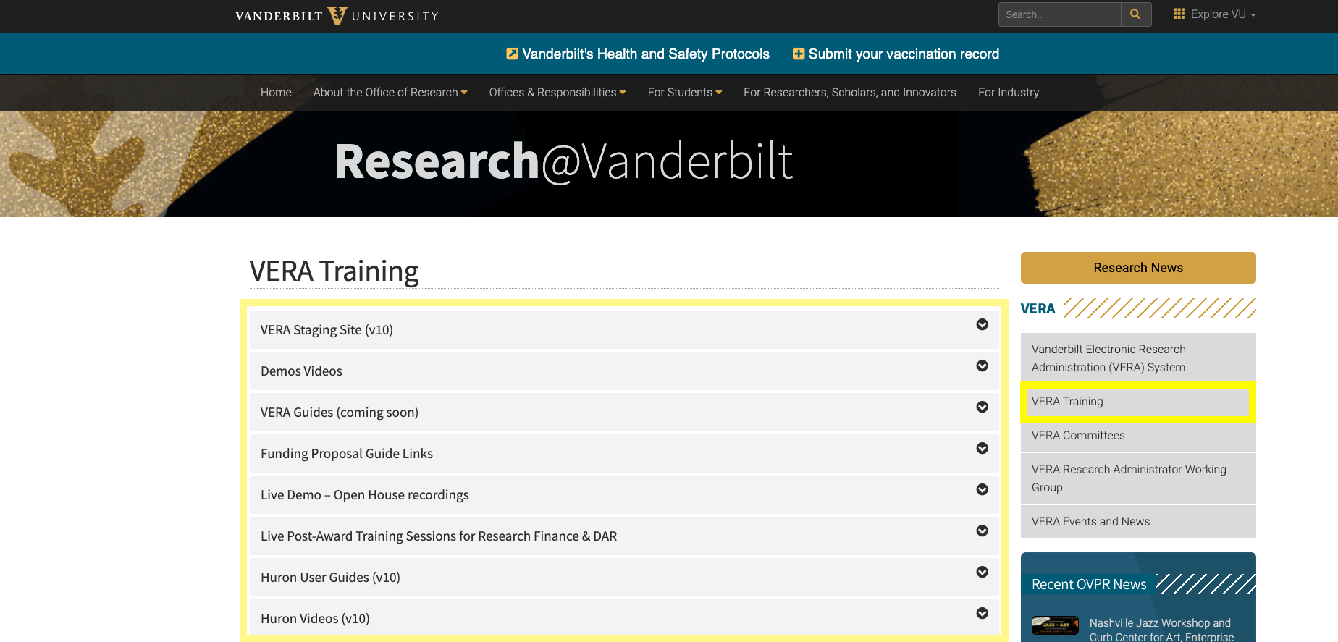
Resources
Notes:
VERA website: https://research.vanderbilt.edu/vera/vera-training
-Training materials
-FAQs

Slide 38
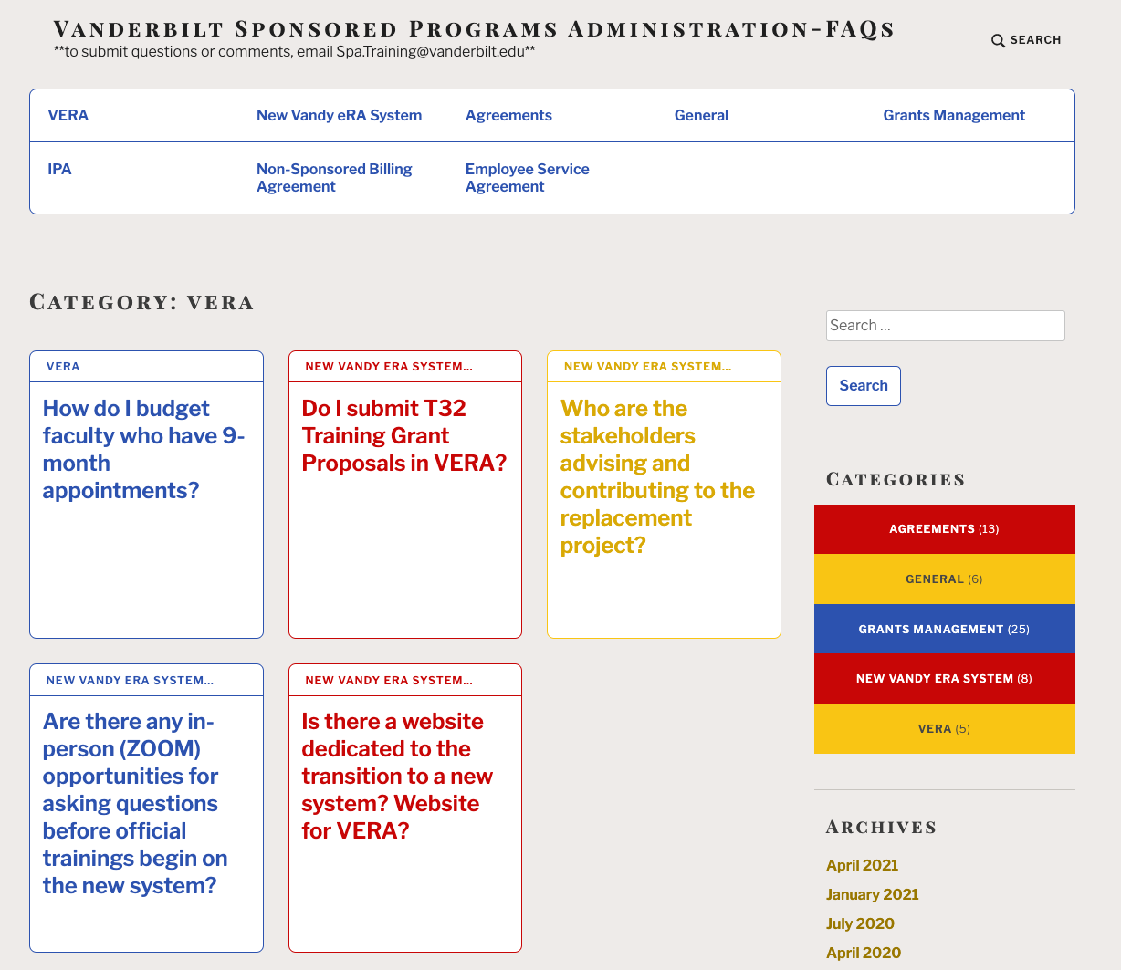
REDCap Survey
-Submit your Questions!
Notes:
SPA FAQs: https://vuspafaqs.wordpress.com/category/vera/
REDCap Survey: https://redcap.link/i2nv1d6x

Slide 39
Tuesdays
Archived – VERA Training website
11/17 – Introduction-Dashboard-Modules
11/24 – Unfunded Agreements (NDAs)
12/1 – New Proposal Submission
12/8 – Award Process: JIT Request through to Award Activation
12/15 – Award Modification: NIH Continuations (Type 5) & NCEs
12/21 – The Outgoing Subaward Process
1/5 – SF424 Center: the system-to-system process
1/12 – Award Modification: Add-on Subrecipient Request (PEER term)
1/19 – Award Modifications: Resubmission & Revision (Type 3)
1/26 – Funded Agreements-Contracts/Incoming Subawards
2/2 – Award Modifications: Renewal (Type 2) & Demo Changes
2/9 – Carryover & Re-budgeting
2/16 – Change Corrected in SF424 & Agreement Amendments
2/23 – Adding Subawards to Funding Proposals + SF424 Subaward Budgets
3/1 – Tentative: Revised NOGA & Early Termination
3/9 – Award Modifications: Odds & Ins
3/16 – Modular Budgets & Cost-Share
3/23 – Advanced Accounts/Interim Accounts
3/30 - Interactive Live Demo – Funding Proposal
4/6 - Interactive Live Demo – Funding Proposal (continued)
4/13 – Interactive Live Demo – SF424 & Awarding
4/20 – Interactive Live Demo – Awarding (cont’d)
4/27 – Interactive Live Demo – Agreements
5/4 – Interactive Live Demo – Agreements + Dataload
5/11 – Interactive Live Demo –Awards in Dataload
5/18 – Interactive Live Demo–Awards in Dataload
Drop in & ask questions!
Notes:
VERA Live Demo – Open House
Every Tuesday at 10am
Archived videos: https://research.vanderbilt.edu/vera/vera-training/

Slide 40
VERA Help
Notes:
VERA Help

Slide 41
Shout outs!

Slide 42
Notes:
Commonly contemplated questions

Slide 43
Drop in & ask questions!
All SPA Teams represented
Next SPA Office Hours
Wednesday, June 16th at 11am
(3rd Wednesday of each month)
via Zoom

Slide 44
Research Finance-SPA-GM Meetings
July – August
Summer Break
September 2021
Thursday, 9/9
October 2021
Thursday, 10/14
November
Thursday, 11/11

