Slide 1
Grant Manager – Research Finance – SPA meeting
Thursday, May 13th, 2021

Slide 2
AGENDA
Welcome
SPA Training: Other Support Changes
VERA Updates
Q&A

Slide 3
Other Support Changes effective for all proposals after January 25, 2022
D. Scholastic Performance updated to remove ‘Research Support’. Section D is solely present on the fellowship version of the Biosketch, and no longer includes research support, only Scholastic Performance.
NOT-OD-21-073
NOT-OD-21-110
OS information on SPA Website
Notes:
https://grants.nih.gov/grants/guide/notice-files/NOT-OD-21-073.html
https://grants.nih.gov/grants/guide/notice-files/NOT-OD-21-110.html
https://www.vanderbilt.edu/sponsoredprograms/other_support.php

Slide 4
Clarification from NIH
The new format is not mandatory until January 25, 2022 but still expected after May 25, 2021
All funding/resources still need to be reported on OS
Email from Mike Lauer, NIH Deputy Director for Extramural Research
“NIH will not require that supporting documentation be disclosed to NIH until January 25, 2022, but institutions may be asked by NIH to provide them prior to this date, if necessary.”
COGR (Council on Governmental Relations) has asked for further clarification as there are some discrepancies between the blog post and FAQ section of the website. We will provide updates through the SPA Listserv so make sure you are subscribed.

Slide 5
Reminder of what should be included
NIH Notice on Other Support – NOT-OD-19-114 issued in July 2019 as a clarification of required disclosures included the following:
Appointments
Resources (in-kind included)
Activities
Award Amounts and Time Commitments
Foreign Components
*Information must be provided about all current support for ongoing projects, irrespective of whether such support is provided through the applicant organization, through another domestic or foreign organization, or is provided directly to an individual that supports the senior/key personnel’s research efforts.

Slide 6
Current Clarification requests
SPA has asked for clarification regarding the following and are waiting to hear back:
For the effort years – should we use the budget start date or end date (consistency with NSF)
Discrepancy between RPPR and JIT requirements – mainly Completed Funding
If you use the new format just specify what you are reporting, ie:
COMPLETED (since last RPPR)
Year (Budget End Date) | Effort
2021 | 5%

Slide 7
SPA Recommendations
Use the new format or start the transition sooner rather than later. Other institutions may still require the new format.
If you use the old format – add an “in-kind section”. Reporting in-kind has been a requirement since 2019. If there is no in-kind funding just list none. Specialists will begin reviewing OS for in-kind label.

Slide 8
Resources
OS webpage on SPA website
Building FAQ section on OS website
SPA has received a lot of questions and is formatting a FAQ. Thank you to all those who have asked questions as well as Robert for bringing to our attention a lot of specific types of in-kind resources.
The FAQ section will be ongoing but should be active soon.
Additional resources are being updated and will be available soon.
Notes:
Other Support webpage on SPA website: https://www.vanderbilt.edu/sponsoredprograms/other_support.php

Slide 9
Questions?

Slide 10
Vanderbilt Electronic research administration (vera)
VERA PROJECT UPDATE

Slide 11
timeline
May-Jun.
Mar.-Apr.
Fall
Summer
Upgrade to v10.0 and Final Development
User Acceptance Testing and Training
Soft Launch
(Awards and Agreements)
Full Launch
(Proposals)
Configurations developed by Huron to meet VU requirements
Need deep collaboration from administrators in schools and colleges to test configurations
Test all workflow, functionality, and system-to-system submissions (with grants.gov test server)
Train faculty and staff
Option to create proposals in VERA or Coeus
Active and new awards/agreements and amendments in VERA
All proposals in VERA

Slide 12
Testing and Training: progress and next steps
Training
25 weeks completed of Live Demo Open Houses with 10-30 attendees each week
Next Step: Structured training with courses for all skill levels
User Acceptance Testing
54 Hours of Testing with 48 participants
5 weeks of scripted testing to tryout common scenarios
4 weeks of exploratory testing with real-life examples
Next Steps:
Testing with Faculty-Admin pairs
Testing award setup with converted data

Slide 13
Soft launch: what does it mean?
All active awards (from Oracle/Coeus) and all active agreements (from PEER) will be put into VERA via a one-time data conversion.
New awards and modifications to active awards MUST go through VERA.
New agreements and amendments to active agreements MUST go through VERA.
New funding proposals can either go through VERA OR Coeus.
Pre-Award Function | Current | After Soft Launch | After Full Launch
Proposals | Coeus & PEER | Coeus or VERA | VERA
Awards | Coeus | VERA | VERA
Agreements | PEER | VERA | VERA

Slide 14
What does soft launch mean for stakeholders?
Administrators in Schools and Colleges
Reconcile award budgets and request award and project numbers in VERA
Submit proposals through VERA or Coeus
Submit Ancillary Reviews on proposals routed in VERA (if non-lead department)
Faculty
Submit PI Certifications in whichever system proposal is routed in (VERA or PEER)
Submit Ancillary Review to approve drafts of subawards and SBAs in VERA
SPA
- Proposals team works in VERA & Coeus/PEER
- Contracts team works in VERA
Research Finance/Development & Alumni Relations
Review and approve Oracle award and project requests in VERA
Manual entry of data into Oracle

Slide 15
preparing for soft launch
Implementation Team Tasks
Upgrade to latest Huron software version (v10)
Complete User Acceptance Testing (UAT)
Scripted
Exploratory
Faculty-Grants Manager Pairs
Award Setup with Converted Data
Integrate with COI
Deliver reports
VERA
Data Warehouse
Provide 6 weeks of training in advance
Train Help Desk staff

Slide 16
Soft launch timeline
VANDERBILT
HURON
Complete UAT
Code Freeze
Soft Launch
User Acceptance Testing (UAT)
COI Integration
VERA Reports
Data Warehouse Reports
Help Desk Support
Training Courses
Respond to Tickets from UAT
Final Development
Practice Soft Launch
2 weeks
6 weeks

Slide 17
discussion
What do we all need to do to be prepared for the VERA soft launch?

Slide 18
Training
Tuesday’s Topic:
Funding Proposals & SF424
11am-1pm
Wednesday’s Topic:
Awards &
Award Modifications
10am-12pm
Thursday’s Topic:
Agreements & Reporting
1-3pm
B
Week 1
Week 2
Week 3
Week 1
Week 2
Week 3
I
1st
+
2nd
= 6 weeks
A
B=Beginner
I=Intermediate
A=Advanced/Additional
Notes:
To access Oracle Learning, log into Oracle Cloud: https://oraclecloud.vanderbilt.edu/,
Then access Learning to access training sessions (coming soon). Coming-Soon-2-1.png

Slide 19
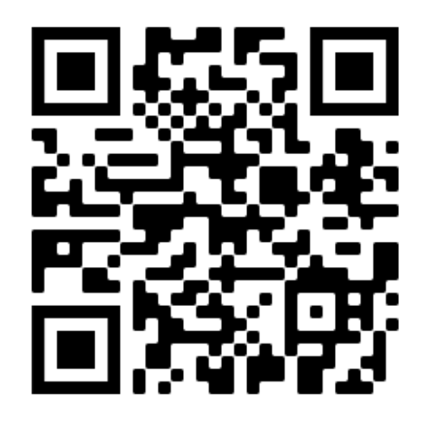
Notes:
https://research.vanderbilt.edu/vera/vera-training/

Slide 20
Tuesdays
Archived
11/17 – Introduction-Dashboard-Modules
11/24 – Unfunded Agreements (NDAs)
12/1 – New Proposal Submission
12/8 – Award Process: JIT Request through to Award Activation
12/15 – Award Modification: NIH Continuations (Type 5) & NCEs
12/21 – The Outgoing Subaward Process
1/5 – SF424 Center: the system-to-system process
1/12 – Award Modification: Add-on Subrecipient Request (PEER term)
1/19 – Award Modifications: Resubmission & Revision (Type 3)
1/26 – Funded Agreements-Contracts/Incoming Subawards
2/2 – Award Modifications: Renewal (Type 2) & Demo Changes
2/9 – Carryover & Re-budgeting
2/16 – Change Corrected in SF424 & Agreement Amendments
2/23 – Adding Subawards to Funding Proposals + SF424 Subaward Budgets
3/1 – Tentative: Revised NOGA & Early Termination
3/9 – Award Modifications: Odds & Ins
3/16 – Modular Budgets & Cost-Share
3/23 – Advanced Accounts/Interim Accounts
3/30 - Interactive Live Demo – Funding Proposal
4/6 - Interactive Live Demo – Funding Proposal (continued)
4/13 – Interactive Live Demo – SF424 & Awarding
4/20 – Interactive Live Demo – Awarding (cont’d)
4/27 – Interactive Live Demo – Agreements
5/4 – Interactive Live Demo – Agreements + Dataload
5/11 – Interactive Live Demo –Awards in Dataload
UPCOMING
5/18 – Interactive Live Demo–Awards in Dataload
Notes:
VERA Live Demo – Open House
Every Tuesday at 10am
Archived videos: https://research.vanderbilt.edu/vera/vera-training/

Slide 21
Drop in & ask questions!
All SPA Teams represented
Next SPA Office Hours
Wednesday, May 19th at 11am
(3rd Wednesday of each month)
via Zoom

Slide 22
Research Finance-SPA-GM Meetings
June 2021
Thursday, 6/10
July – August
Summer Break
September 2021
Thursday, 9/9
October 2021
Thursday, 10/14
November
Thursday, 11/11

