Slide 1

Grant Manager –
Research Finance – SPA meeting
Thursday, January 13th, 2022

Slide 2


AGENDA
Welcome
Research Finance Updates
  Sarah Vest, Effort Reporting & Compliance Coordinator
    Effort Certification Updates
  Katie Janeway, Director of Accounting & Financial Reporting
    How we determine an award goes to RF vs. DAR and why?
VERA – Hilda & Laurel
  Tips, tricks & training
Q&A
Mark your calendars:
February 10th @ 10am
Notes:
90-minute meeting
Recorded, posted later today

Slide 3
Research Finance Update
January 12, 2022

Slide 4

Effort Notification Email
Currently PIs and Effort Coordinators are not notified when an effort statement is reopened following a payroll adjustment.
Enabling a new email notification for reopened effort certification statements.
This will take effect January 17, 2022

Slide 5
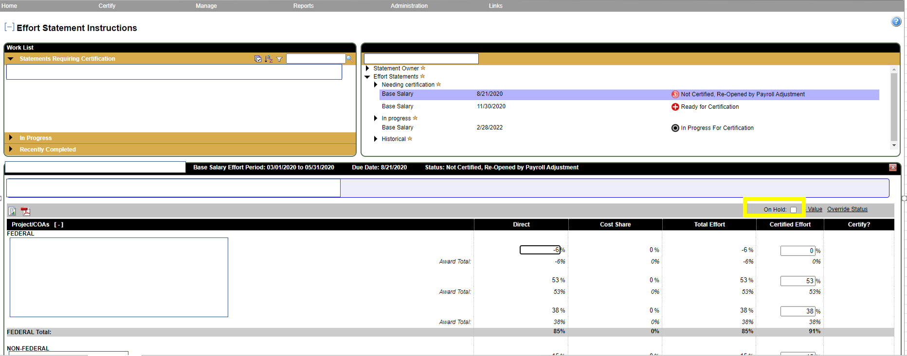
Effort Statement Holds
Primary Effort Coordinators can now manage their own statement holds.
Research Finance can also still place and remove holds and will monitor statements on-hold.
This will take effect January 17, 2022.

Slide 6
DAR/RF AWAR PROCESS PRESENTATION
Katie Janeway, RF

Slide 7
Agenda
Accounting guidance overview
Process to determine proper accounting treatment of contracts and grants
  Step 1: Classify arrangements as exchange or non-exchange/contribution
  Step 2: If non-exchange/contribution, determine whether the arrangement is conditional or unconditional
  Step 3: Determine whether the arrangement is donor-restricted?
Revenue recognition and related process based on transaction type
Questions

Slide 8
Accounting guidance

Slide 9
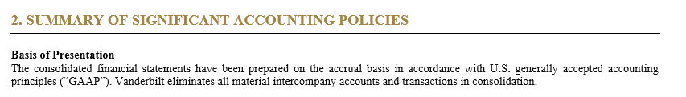
Financial reporting framework
US Generally Accepted Accounting Principles (GAAP) and Financial Accounting Standards Board (FASB)
Vanderbilt University is a private, not-for-profit institution. As such, Vanderbilt utilizes an accrual basis of accounting in accordance with U.S. GAAP. All significant accounting policies are outlined in the audited consolidated financial statements in footnote 2.
Accrual accounting measures an entity’s performance and position by recognizing economic events regardless of whether cash transactions have occurred. As such, revenues and expenses are recorded when a transaction occurs rather than when a payment is received or made. The other method of accounting is cash basis where transactions are only recorded when payments occur.
US GAAP is governed by the Financial Accounting Standards Board (FASB). The FASB is the independent, private-sector, not-for-profit organization, that establishes financial accounting and reporting standards for public and private companies and not-for-profit organizations.
The FASB continually works to update and improve the Accounting Standards Codification (ASC). As such, new standards are implemented by Vanderbilt each year in order to comply with US GAAP.

Slide 10
ASU 2018-08, Not-for-Profit Entities (Topic 958)
Clarifying the Scope and the Accounting Guidance for Contributions Received and Contributions Made
In June 2018, the FASB issued ASU 2018-08, Not-for-Profit Entities (Topic 958), Clarifying the Scope and the Accounting Guidance for Contributions Received and Contributions Made.
This updated guidance clarifies how entities will determine whether to account for a transfer of assets as an exchange transaction or a contribution (non-exchange) and how to determine whether a contribution is conditional.
The distinction is important because contributions are accounted for under ASC 958-605, Not-for-Profit Entities — Revenue Recognition, while exchanges are accounted for under other guidance in ASC 606, Revenue from Contracts with Customers.

Slide 11
Exchange transactions
An exchange transaction is a reciprocal transfer in which each party receives and sacrifices approximately commensurate value, and any potential public benefits are secondary to the potential direct benefits to the resource provider.
Examples include when:
  the goods or services provided directly benefit the resource provider or are for its own use (e.g., resource provider contracts with a third party to build a piece of medical equipment), and
  the resource provider obtains proprietary rights or other privileges, such as patents, copyrights, or advance and exclusive knowledge of research outcomes (e.g., resource provider retains the rights to the results of a clinical trial).

Slide 12
Contribution/Non-exchange transaction
FASB describes a contribution (i.e., non-exchange) transaction as one in which the resource provider often receives value indirectly by providing a societal benefit, although that benefit is not considered to be of commensurate value to the resources transferred.
Examples include a research grant from the federal government to an NFP university for which a summary of findings is submitted to the federal government, but the university retains rights to the findings and has permission to publish them. In this case, the university and presumably the general public receive the primary benefit.

Slide 13
Decision Tree
Given these nuances related to the new accounting guidance in ASC 958 and ASC 606, FASB provides the following decision tree to determine the appropriate guidance for the contracts and grants reviewed:
Step 1: Classify arrangements as exchange or non-exchange/contribution
Step 2: If non-exchange/contribution, determine whether the arrangement is conditional or unconditional
Step 3: If unconditional, determine whether the arrangement is donor-restricted?

Slide 14
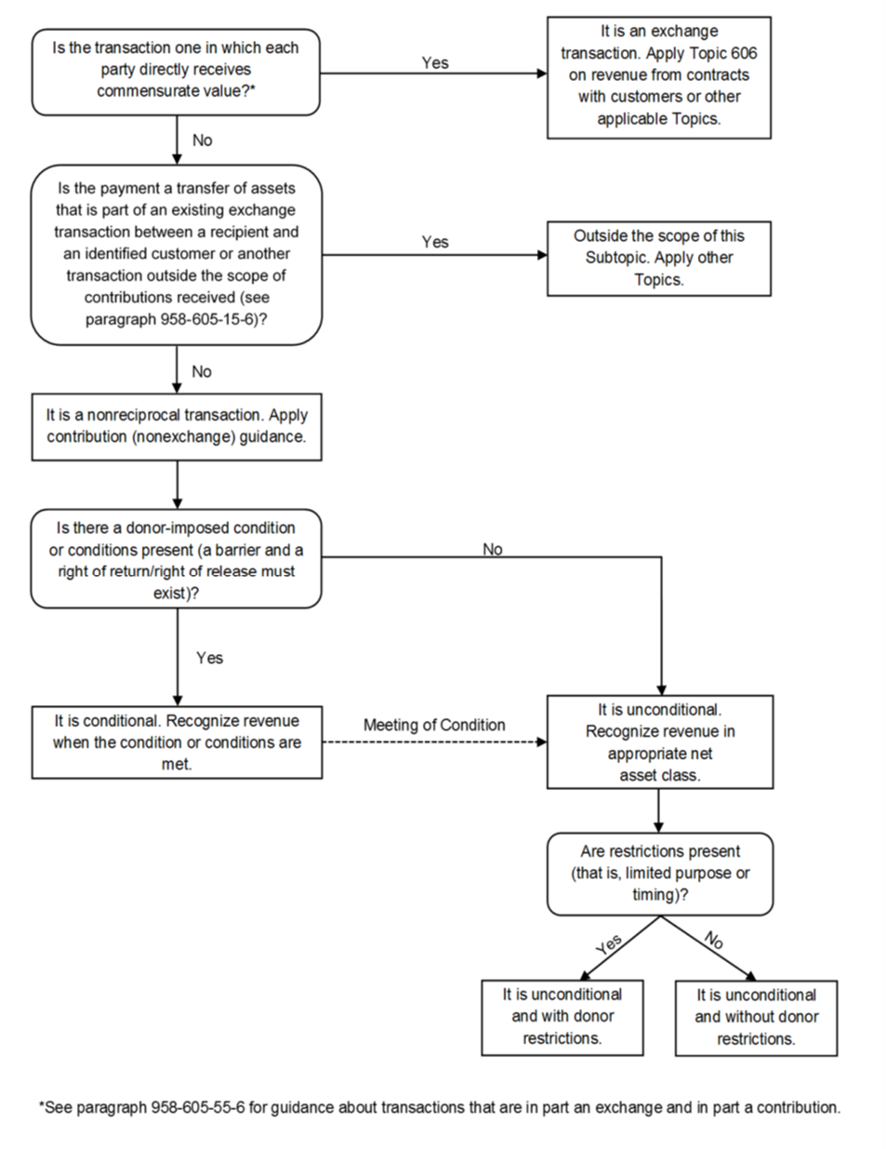
Decision Tree

Slide 15
Step 1
Classify arrangements as exchange or non-exchange/contribution

Slide 16
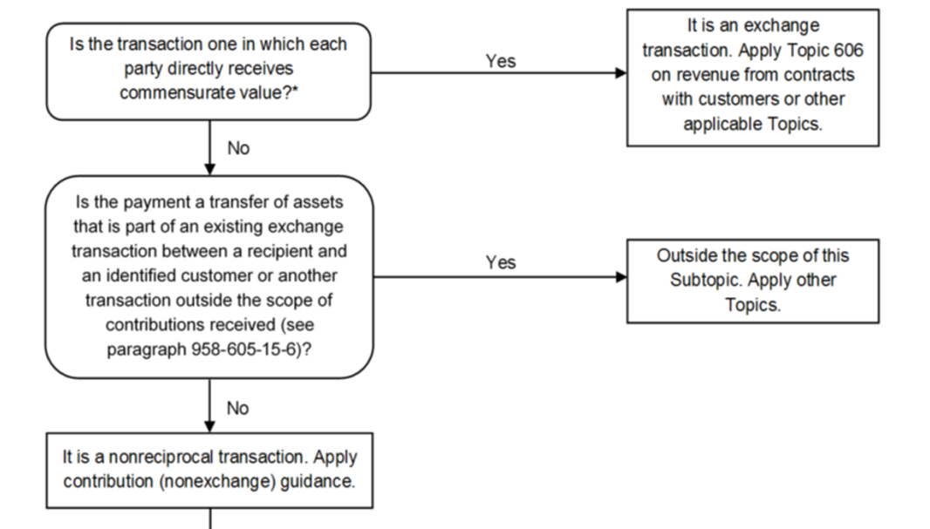
Step 1
Classifying grants as exchange or contributions

Slide 17
Step 1
Classifying grants as exchange or non-exchange (including subawards)
Is the contract one in which each party receives commensurate value? In other words, is the transaction reciprocal?
A contract is used if the principal purpose of the funded activity is to provide something for the direct benefit or use of the federal government. This is also referred to as a “procurement arrangement.” Because a contract is used to acquire something for the government’s “direct benefit or use,” there is a close correlation between this type of instrument and exchange transactions.
If the principal purpose of the activity is to support or stimulate activities that are not for the direct benefit or use of the federal government, the award is considered either a grant or a cooperative agreement. These awards are closely correlated with transactions classified as nonreciprocal (non-exchange) transactions under the ASU.
The new guidance clarifies that when the public receives the primary benefit, that benefit is not considered commensurate value to the resource provider.
It also clarifies that a resource provider is not receiving commensurate value from furthering execution of its mission or generating positive sentiment from acting as a donor.

Slide 18
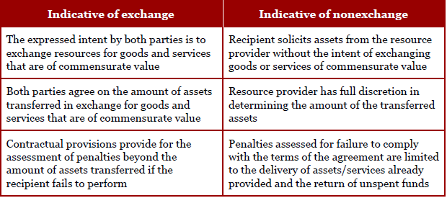
Exchange vs. non-exchange indicators
Source: PWC

Slide 19
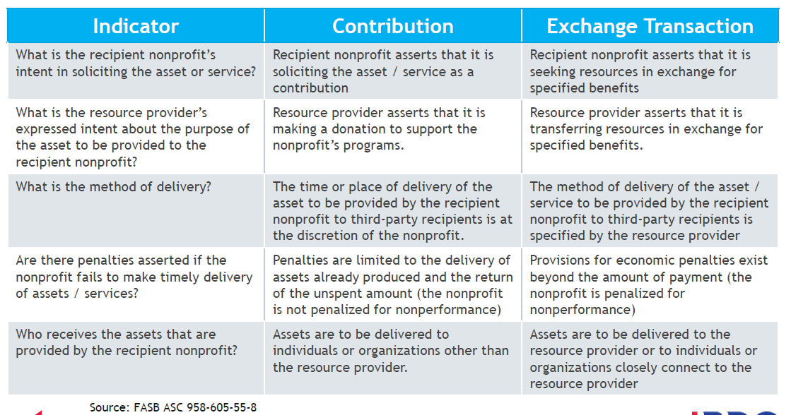
Exchange vs. non-exchange indicators, continued
Source: BDO

Slide 20
Example 1
Vanderbilt employs a scientist who is conducting genetic research. Vanderbilt is awarded a grant from the National Science Foundation (NSF), that requires Vanderbilt to:
Follow the rules and regulations established by the Office of Management and Budget (OMB);
Incur certain expenses (or costs) in compliance with the rules and regulations established by the OMB and the NSF;
Obtain an annual audit in accordance with OMB guidelines;
Submit a summary of research findings to the NSF.
Any unused assets are forfeited, and any unallowed costs that have been drawn down by Vanderbilt are required to be returned to the NSF.
Vanderbilt retains the rights to the findings.

Slide 21
Example 1 solution
Contribution
Commensurate value is not being exchanged between the two parties.
Vanderbilt retains all the rights to the research and findings and receives the primary benefit of the findings.
The NSF’s benefit is considered indirect because the research and findings serve the general public.

Slide 22
Example 2
Vanderbilt regularly conducts research to discover more effective methods of treating cancer and often receives contributions to support its efforts. Vanderbilt receives $1 million from a pharmaceutical entity, Pharma Co., to finance the costs of a clinical trial of an experimental cancer drug Pharma Co developed. The grant agreement between Pharma Co. and Vanderbilt specifies the following.
Pharma Co. specifies the protocol of the testing, including number of participants tested, dosages, and frequency;
Pharma Co. requires a detailed report of the test outcomes within two months of the conclusion of testing.
The rights to the results of the study belong to Pharma Co.

Slide 23
Example 2 solution
Exchange Transaction
Pharma Co. is receiving commensurate value as the resource provider, because the results of the tests have commercial value to Pharma Co.
Pharma Co. receives the rights to the research and findings and receives the primary benefit of the findings.
The fact that the general public might benefit from the findings indirectly is not relevant to the analysis.

Slide 24
Step 2
If non-exchange/contribution, determine whether the arrangement is conditional or unconditional

Slide 25
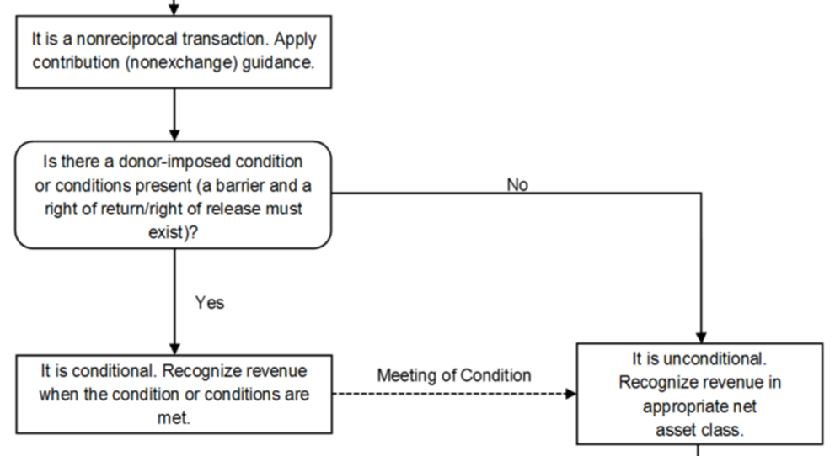
Step 2
If non-exchange, is the grant conditional or unconditional?
A contribution is conditional if the agreement includes both:
  a barrier (or barriers) that must be overcome for the recipient to be entitled to the resources AND
  a right of return for the assets transferred (or a right of release of the promisor’s obligation to transfer assets).

Slide 26
Barriers
An entity will use its judgment to determine whether an agreement contains a barrier or barriers, considering the following indicators:
  Inclusion of a measurable performance-related barrier or other measurable barrier.
  The extent to which a stipulation limits the discretion by the recipient on the conduct of an activity.
  The extent to which a stipulation is related to the purpose of the agreement.
    Note, trivial stipulations and administrative tasks (e.g., producing an annual report or audit requirement to confirm that the resources were spent in accordance with the resource provider’s requirements) are not considered to be “related to the purpose of the grant” will not generally be considered a barrier.
Notes:
Inclusion of a measurable performance-related barrier or other measurable barrier
Does the stipulation either (a) require performance by the entity, or (b) require that an event (outside the recipient’s control) occur? The recipient may be required to provide a specified level of service (e.g., provide 1,000 meals to the homeless) or achieve a specific output or outcome. The stipulation might relate to a milestone or specify a ratio of matching funds.
Limited discretion
Does the stipulation limit the entity’s discretion in how it must conduct the activity funded by the grant? This could be a requirement to incur qualifying allowable expenses (e.g., compliance with rules and regulations established by the Office of Management and Budget), to hire specific individuals or key personnel, or to adhere to a specific protocol. The guidance clarifies that a limit on the recipient’s discretion about how the activity can be conducted is more specific than a donor restriction that limits the use of a contribution to a specified activity or time.
A stipulation related to the purpose of the agreement
Trivial stipulations and administrative tasks (e.g., producing an annual report or audit requirement to confirm that the resources were spent in accordance with the resource provider’s requirements) are not considered to be “related to the purpose of the grant” will not generally be considered a barrier.

Slide 27
Barriers, continued
For a condition to exist, it must be determinable from the agreement that the recipient is only entitled to the transferred assets if it overcomes the barrier(s).
An entity should not consider the likelihood that a stipulation will be met when determining whether the agreement contains a barrier.
An arrangement containing ambiguous donor stipulations that are not clearly unconditional is presumed to be conditional.
Additionally, conditions involving a series of barriers (milestones) rather than a single barrier will become unconditional in stages.

Slide 28
Barriers examples
Do the following situations constitute a barrier?
A minimum of 5,000 meals must be served by a food pantry over the next month in order to receive a contribution. The food pantry regularly serves double this amount in a months’ time.
The NFP must raise $1 million in matching gifts in order to receive a $1 million contribution.
A wealthy donor will give the NFP $2 million once her investment portfolio reaches $50 million.
The NFP must obtain an annual audit under OMB guidance.
Yes
Yes
Yes
No

Slide 29
Right of return
An agreement does not need to include the phrases “right of return” or “release from obligation” but should be sufficiently clear to support a reasonable conclusion about when a recipient is entitled to the transferred assets.
If the recipient does not overcome the barrier, the donor or grantor is released from its obligation to transfer the promised resources or, if assets were advanced, has a right to demand their return.
For example, a grant agreement that requires adherence to OMB regulations for expenditures implies that the recipient must pay back funds spent inappropriately and return any unspent funds advanced. In this situation, the “right of return” is evidenced by inclusion of the reference to the OMB rules.

Slide 30
Step 3
Determine whether the arrangement is donor-restricted?

Slide 31
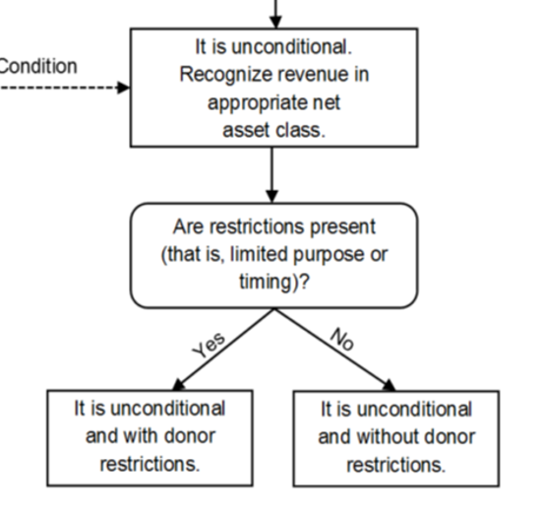
Step 3
Is it donor-restricted?
Donor-restricted contributions include grant awards that have legally binding restrictions on their use. Restrictions must be appropriately identified for each grant as this classification determines accounting, financial statement presentation, and disclosures.
It's important to understand how donor-imposed conditions differ from donor-imposed restrictions. Conditions dictate what an entity must achieve or accomplish in order to initially recognize a grant or contribution (i.e., to be entitled to the resources).
After a grant or contribution is recognized (all conditions are met), restrictions stipulate how or when the resources must be used.

Slide 32
Revenue recognition
Process based on transaction type

Slide 33
Revenue recognition
When you have a non-exchange agreement
Conditional Contributions - Revenue associated with conditional arrangements will be recognized when the respective conditions are met.
Unconditional Contributions - Recognition of revenue upon receipt of funds or upon commitment to give by the resource provider.
To the extent that donor restrictions exist, amounts will generally first be recognized as revenue with donor restrictions to be released from restriction as allowable expenses are incurred.

Slide 34
Revenue recognition at VU
Exchange transactions
As contractual obligations are met.
VU will defer pre-payments and recognize revenue as the contractual expenditures are recognized.
Non-exchange/conditional awards
As conditions are fulfilled.
VU will defer any payments received on awards until the conditions are met.
Non-exchange/unconditional awards
When the award is received.
VU will record contributions receivable/revenue when the resource provider extends the unconditional commitment.

Slide 35
Revenue recognition at VU, continued
Generally, philanthropic grants are donor restricted; accordingly, the revenue will be temp restricted until the donor restrictions are met at which time they will be released from restriction.
In the unlikely event that the university receives an unconditional philanthropic grant without a donor restriction, the revenue will be temp restricted until payment is received at which time the paid amount will be released from restriction.
In the case of gift to VU utilizing Donor Advised Funds (DAF), the language in the agreement will guide the accounting treatment. If a pledge is solely backed by a DAF, it is considered an intent to give and not a contribution, therefore the university will defer any recognition on the awards until the conditions are met and there is an actual contribution. On the other hand, if additional language in the gift agreement includes intent to cover any shortfall from the DAF by other personal resources, VU will record as a contribution in the year the pledge is made.

Slide 36
Revenue recognition at VU, continued
Consistent with current processes, the Office of Sponsored Research Administration will continue to determine whether external support is exchange (contract based) or non-exchange (contribution) when a grant is received.
Post award processing for exchange transactions will be handled by Research Finance.
Processing for non-exchange transactions will vary based on the funding entity. Specifically:
  Non-exchange awards from governmental entities will be directed to the Research Finance for post-award processing.
  Non-exchange from private sources (generally corporations and foundations) will be directed to the Research Finance for review. Research Finance consults with DAR as needed.
    Awards determined to be conditional will be directed to Research Finance for Post award processing.
    Awards determined to be unconditional will be directed to DAR’s Gift and Donor Services for processing.
    All awards will receive a POET assignment in PPM;
      The type of project assigned will be different based on the responsible office.
      This distinction is important as the assignment of the correct project type ensures accounting will comply with US GAAP.

Slide 37
Questions?

Slide 38


Slide 39
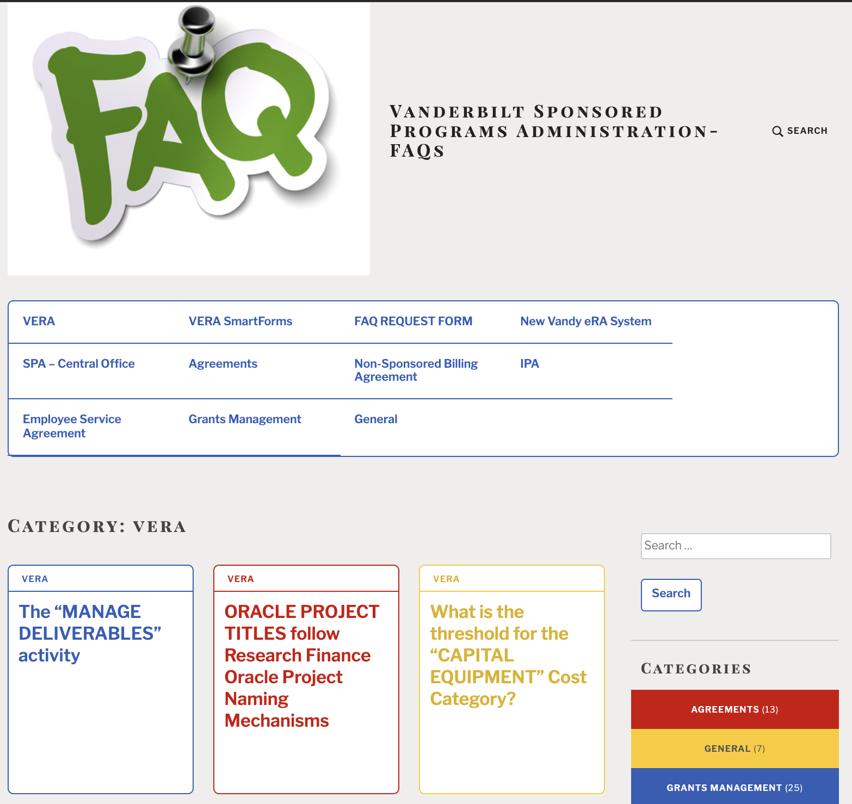
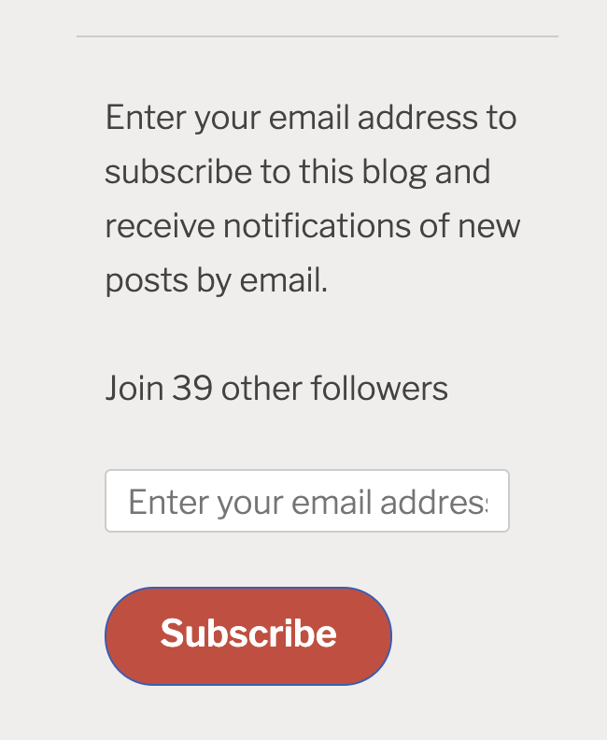
Notes:
FAQ’s page: https://vuspafaqs.wordpress.com/category/vera/
Go to the FAQ's page and scroll down a tad to ”Enter your email address to subscribe to this blog and receive notifications of new posts by email".

Slide 40
Sessions (10/1/2021 – 1/13/2022) | # of participants
Faculty Trainings | 46 = 39 Faculty, 7 Grant Managers
Actions | On average pre-VERA (2-week period) | In VERA: 9/30 -10/13 | 10/14-11/10 | 11/11 – 12/10 | 12/11/21 - current
Award Modification Requests | 30 | 57 | 93 | 109 | 74
Awards Activated | 25 | 37 Activated 31 in Final Review 68 total through DEPT/SPA | 34 Activated 7 in Final Review 41 total through DEPT/SPA | 42 | 40
Agreements (original & amendments) fully-executed | 35 | 51 | 11 – Original activated 40 – AMDs approved 51 – total | 31 – Original 56 – Amendments 87 – total | 9 – Original 40 – Amendments 49 – total

Slide 41

ADMIN CONTACT CHANGES
We can handle one-off changes in Admin Contact fields, but for changes in staffing in which you need all FPs, Awards and/Agreements updated to a new Admin Contact – we will be using…
Bulk Imports
New procedure:
DEPT submits request to VERA Help for Admin Contact updates by Thursday morning
VERA Help submits request to Huron as a Support Case Thursday afternoon
Huron reviews & implements bulk import by Monday
Updated Admin Contact field available by Tuesday
Notes:
verahelp@vanderbilt.edu

Slide 42
Funding Proposals

Slide 43
Salary Cap – Proposed new rate
SPA is aware that the president has approved an increase to federal salaries, which historically include NIH Salary Caps.
At this time, we have not officially heard from NIH that the salary cap has been increased to the new level of $203,700.
SPA is waiting for official notification from HHS before updating VERA with the new salary cap.
However, if you choose to submit using the new salary cap you will be able to manually make those changes in VERA.
The new rate is listed as being effective January 2022.
$203,700

Slide 44
HOW do I Request a Funding Proposal Shell for a Proposal Submitted in COEUS?
You submitted the Proposal in COEUS, and you either have an action to take that needs to come from the Proposal, or an Oracle Award was already set up and you need to do something with that Award. What do you do?
EMAIL SPAPostAwardTeam@vanderbilt.edu & INCLUDE MESSAGE:
AWARD ALREADY CREATED IN ORACLE FINANCIAL
This COEUS Proposal ID # [insert ID #] is not in VERA, and it is in Oracle [insert Oracle Award #].
I need a Funding Proposal Shell, and a Funding Award created to … [fill in the reason for this request – An example: for a re-budget request or courtesy extension on the interim account]
Please contact me with the FP# & AWD# when they are created.
NO AWARD IN ORACLE
This COEUS Proposal ID # [insert ID #] is not in VERA, and it is not in Oracle.
I need a Funding Proposal Shell to … [fill in the reason for this request - An example: need to submit information to Sponsor.]
Once the Funding Proposal Shell is created, please contact me with the FP#.
Notes:
Add to FAQs!

Slide 45
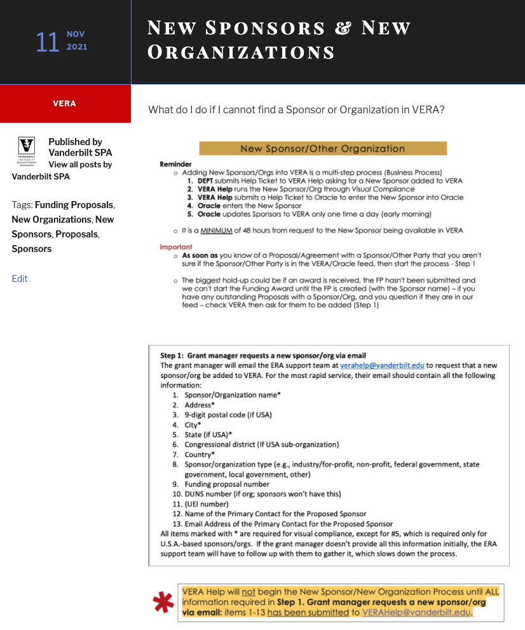
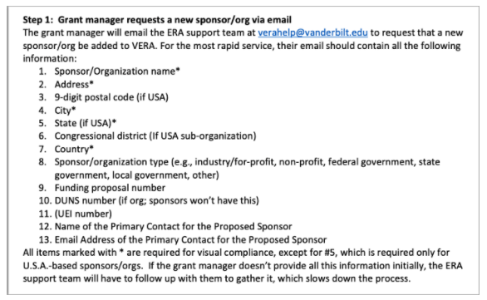

New Sponsor/Other Organization
Reminder
  Adding New Sponsors/Orgs into VERA is a multi-step process (Business Process)
    DEPT submits Help Ticket to VERA Help asking for a New Sponsor added to VERA
    VERA Help runs the New Sponsor/Org through Visual Compliance
    VERA Help submits a Help Ticket to Oracle to enter the New Sponsor into Oracle
    Oracle enters the New Sponsor
    Oracle updates Sponsors to VERA only one time a day (early morning)
  It is a MINIMUM of 48 hours from request to the New Sponsor being available in VERA
  Important
  As soon as you know of a Proposal/Agreement with a Sponsor/Other Party that you aren't sure if the Sponsor/Other Party is in the VERA/Oracle feed, then start the process - Step 1
  The biggest hold-up could be if an award is received, the FP hasn't been submitted and we can't start the Funding Award until the FP is created (with the Sponsor name) – if you have any outstanding Proposals with a Sponsor/Org, and you question if they are in our feed – check VERA then ask for them to be added (Step 1)
Notes:
FAQ for New Sponsor/New Other Organization: https://vuspafaqs.wordpress.com/2021/11/11/new-sponsors-new-organizations/ (includes list of items to send w/ request)
verahelp@vanderbilt.edu

Slide 46
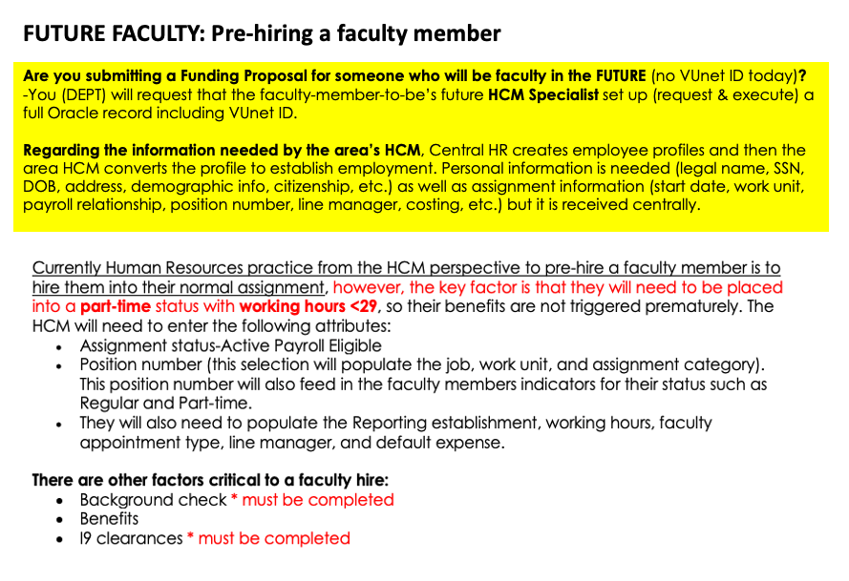
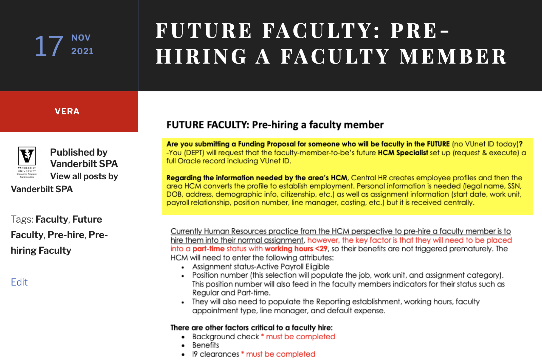
FUTURE FACULTY: Pre-hiring a faculty member
2 parts:
Employee Profile
VUnet ID
Pre-Hire Faculty
will need
to complete their COI Disclosure & Training
-
Will be initiated by SPA upon submission of your Proposal.
Notes:
FAQ for Future Faculty – Pre-hiring a faculty member: https://vuspafaqs.wordpress.com/2021/11/17/future-faculty-pre-hiring-a-faculty-member/
*SPA must tell OGC – COI that we have a Pre-Hire Faculty that needs to be reviewed for the Proposal (include Vunet ID). Alison will make sure an email is triggered to the Pre-Hire Faculty to complete the COI Disclosure & Training. The Pre-Hire Faculty needs to complete the Osprey COI portal for Disclosure & Training…

Slide 47
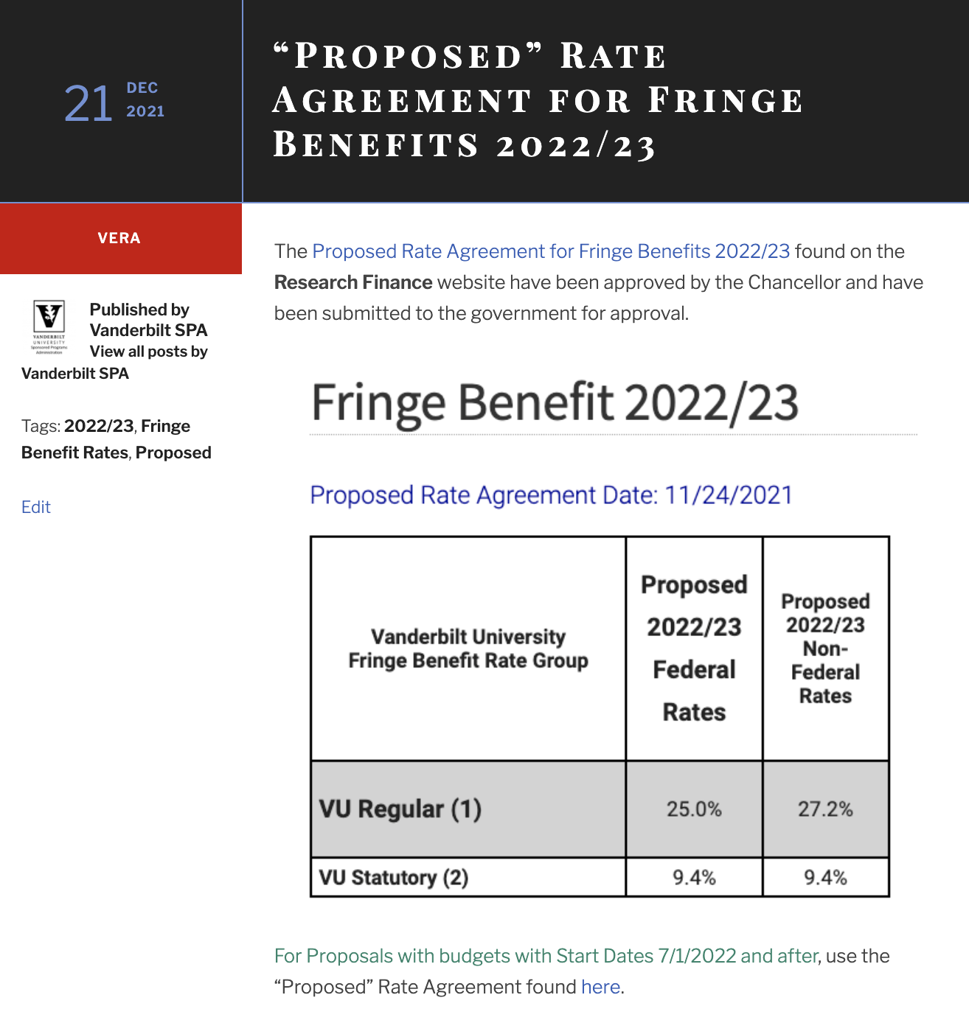
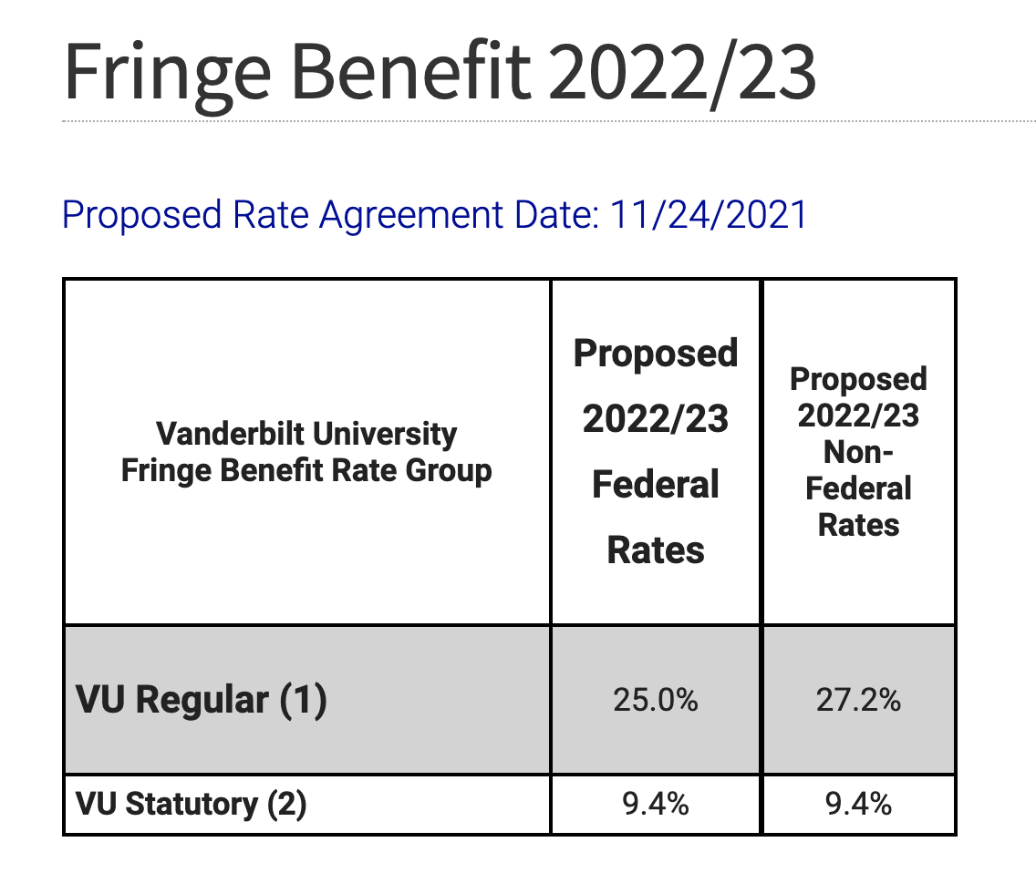
For Proposals with Start Dates after July 1st – please manually enter the Rates below:
For Proposals
with Start Dates after July 1, 2022:
Use the following rates in your Proposal:
(found on the Research Finance website)
Notes:
FAQ: https://vuspafaqs.wordpress.com/2021/12/21/proposed-rate-agreement-for-fringe-benefits-2022-23/
Research Finance Rates website: https://finance.vanderbilt.edu//researchfinance/fringebenefit/
Proposed Fringe Benefit Rate table 2022/23: https://finance.vanderbilt.edu/researchfinance/fringebenefit/fringebenefitfy2223.php

Slide 48
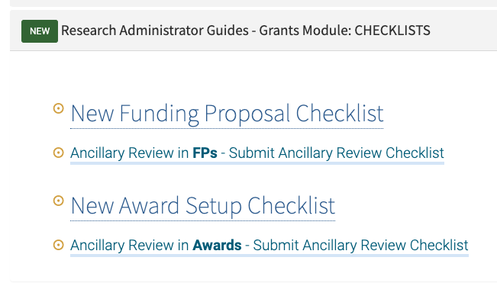
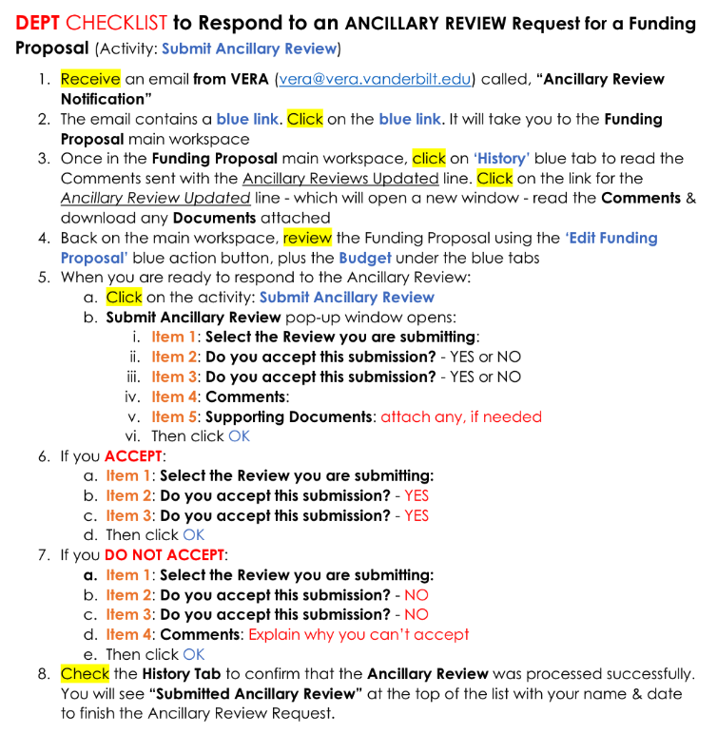
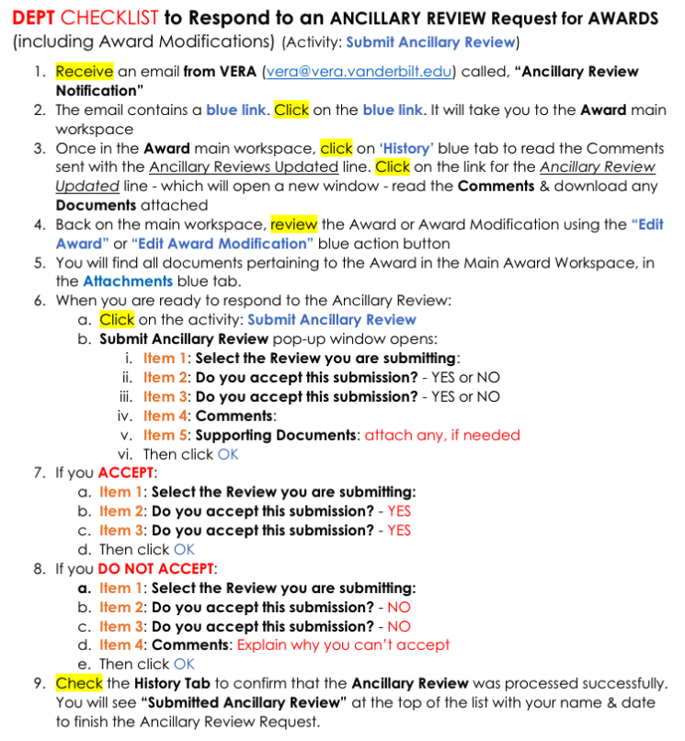

Responding to Ancillary Review requests
Checklists available in VERA Training site:
Funding Proposals
Awards
Notes:
VERA Training Site: https://research.vanderbilt.edu/vera/vera-training/

Slide 49
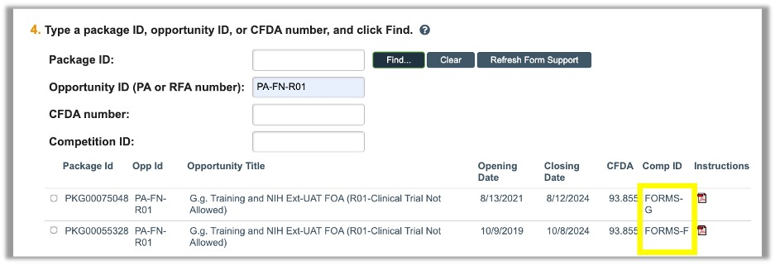
NIH Forms g
If you are applying for a NIH Proposal using Forms G,
they are available for submissions due on or after January 25th.
You can create a Proposal with a Forms G opportunity anytime but will only be able to submit it for proposals due on or after the 25th.
If you enter a Package ID or Opportunity ID that have both Forms-F and Forms-G packages available (depending on when you are submitting), then choose your forms choice (F or G) based on if your proposal is due before or after January 25th.
Please see snippet of how this might look in VERA:

Slide 50
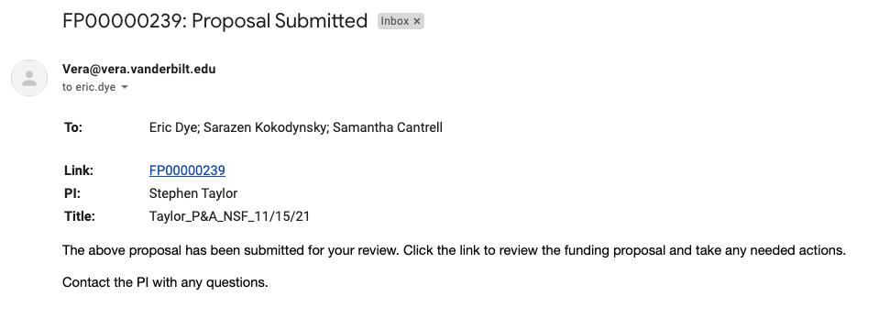
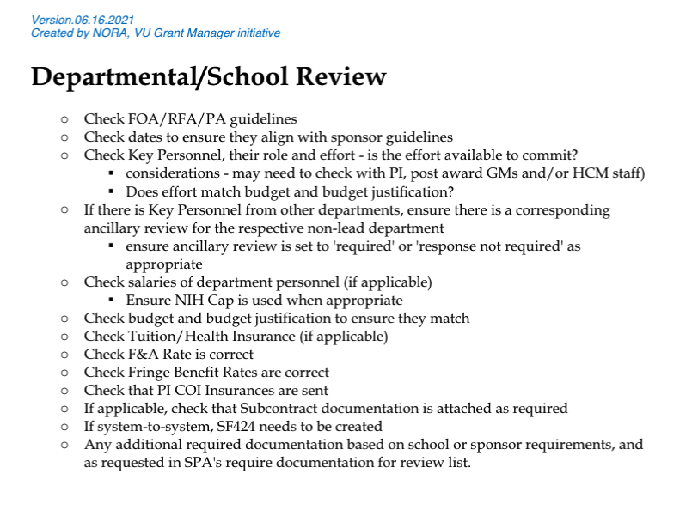
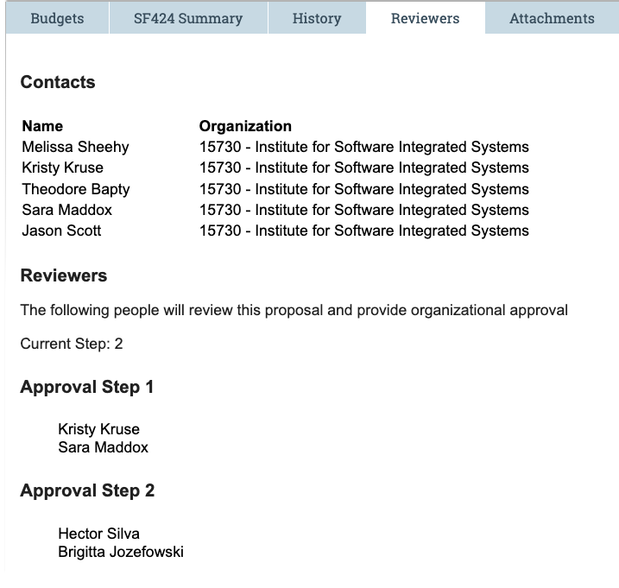
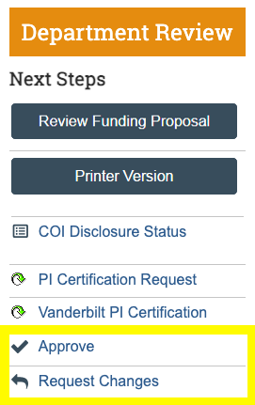
DEPARTMENT REVIEW (Approval Path)
Routed
A notification is sent to each set of Dept Reviews for each Approval Step – Notification: Proposal Routed
Please use the Department Review Checklist before you send it to SPA
If you are a Department Reviewer, the Funding Proposal in Department Review state stays on your Dashboard until the state changes to Specialist Review - i.e., all Approval Steps have been approved
Review the Approval Path Steps:
  in the blue tab: Reviewers
  access the Custom Report: VU - Department Approval Path
Notes:
Department Reviewer Checklist: https://vanderbilt.box.com/s/evw5frihki7eahjwr8m6ncqfiab1d9pf

Slide 51

Loss of COEUS RECALL Function
Add someone to your DEPT’s Approval Path who is only in the Approval Path for the purposes of sending a Funding Proposal back to the Admin Contact when they need to make an edit before the Department Reviewer(s) approve(s) the FP.

Slide 52

JIT
Can you update the budget in the Funding Proposal when the JIT notice has been received?
For the Official JIT,
when SPA clicks on the activity: JIT Changes Required,
the Funding Proposal moves to state: JIT Response Required & is editable.
The GUIDE walks you through:
making a copy of the original budget
tagging both original & new budgets
submitting the JIT Response back to SPA
GUIDE:
Just-in-Time (JIT)/Post-Submission Process in VERA
Notes:
state: JIT Response Required
JIT Guide: https://vanderbilt.box.com/s/ohnhgu92u0iulvqtek1vzfae86tlyezk

Slide 53
Awards/Modifications

Slide 54
Guidance on Awards not converted
There are some Awards that were not converted.
For example: We have a list of DAR awards still being manually entered…
EMAIL SPAPostAwardTeam@vanderbilt.edu & INCLUDE MESSAGE:
AWARD ALREADY CREATED IN ORACLE FINANCIAL
Message:
This COEUS Proposal ID # [insert ID #] is not in VERA, and it is in Oracle [Oracle Award #].
I need a Funding Proposal Shell, and a Funding Award created.
Please contact me with the FP# & AWD# when they are created.
Notes:
Award that was not converted and therefore is not in VERA.

Slide 55

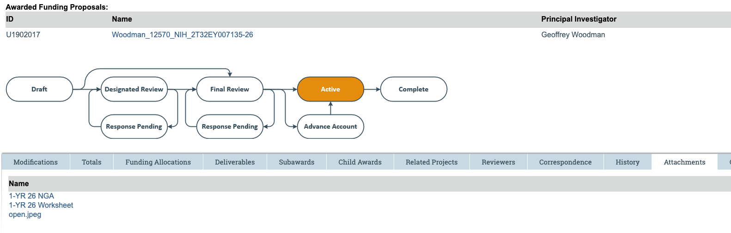
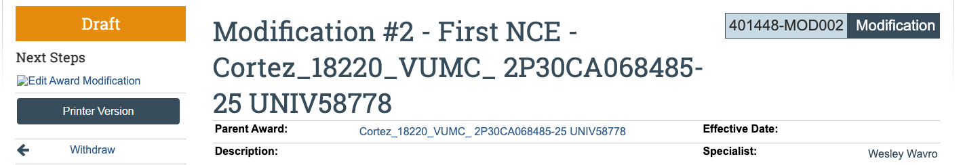
Where are AWARD docs located?
Award documents are located on the Main Award Workspace
Check the blue tab: Attachments (located under the orange flowchart)
Award Modifications do not currently have a mechanism for saving a document.
When working on an Award Modification, use the Parent Award link (on the Award Mod workspace) to go to the Main Award Workspace, click on the Attachments blue tab to all documents saved for the Award.

Slide 56



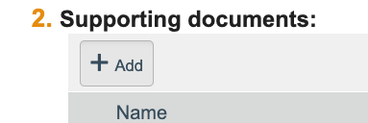
Where’s the doc?
With the conversion of data from COEUS & PEER for awards & agreements, not all award documents or agreements/amendments are currently available in VERA Awards. ☹️
Awards will have the latest sequence document, for each Award converted. 🙂
For example: the Year 3 NOGA or Amendment 2 Agreement.
    For Awards –
    Use activity: “Upload Award Documents” to attach missing Award docs
    Use activity: Send Email to SPA Post Award Team (spapostawardteam@vanderbilt.edu) – SPA will work on the request as time allows
    For Agreements –
    During Create Amendment in state: Pre-Submission, attach any Agreement files to Item 2. Supporting documents (Amendment Information SmartForm)

Slide 57

Naming Award documents
Examples:
Yr 4_NGA
Yr 4_Revised NGA
Yr 4_Revised NGA_Change in PI
Yr 4_Revised NGA_Adding Additional Funds
Yr 4_NGA = Adding time & money, if nothing else written

Slide 58


Financial Setup SmartForm
Oracle Project(s) fields are fully the responsibility of the Department to complete.
Think of the Financial Setup SmartForm like the old Research Finance Spreadsheet.
If you are changing dates in your Award – you must change them in the Oracle Project(s) (Financial Setup SmartForm).
Always review the Financial Setup SmartForm: Oracle Project(s) when you set up a New Award or work on an Award Modification.

Slide 59

BUDGET ALLOCATION SmartForm
A Budget Allocation a POET.
Budget Allocations & POETS are not a 1:1 equivalency.
You can have multiple Allocations per Oracle Project (Oracle Projects = Financial Setup)
The only place to add/create a New Oracle Project Number is in Financial Setup SmartForm

Slide 60

NRSA Fellowship Activation Form
SPA needs the NRSA Fellowship Activation Form in order to send the VERA Award through to Final Review (Research Finance).
The Ancillary Review you will receive for the Award Setup includes a statement about this form, in addition the Award Guide & Checklist reference this.

Slide 61
We’ve learned that Award Modification Requests (AMRs) are only viewable
by the Submitter (person who submits the Request) & the Central Office.
We have logged an Enhancement Request with Huron that Award Modification Requests (AMRs) should be viewable by anyone who can see the award, as it makes duplicative requests possible.
When we learn anything about an improvement to Award Modification Requests (AMRs), we will let you know.
In the meantime, communicate with your colleagues who works with you on shared Awards.

Slide 62
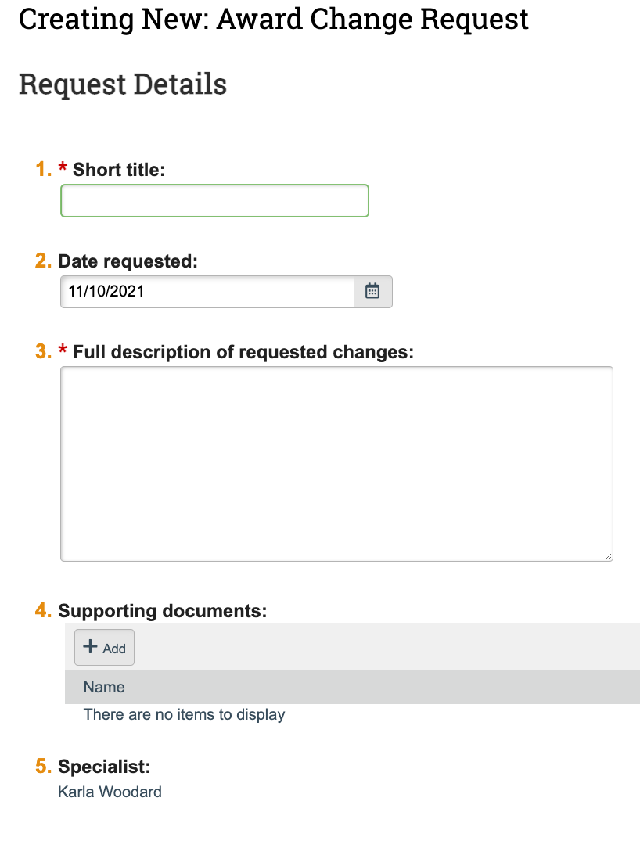
Request Award Modification
SPA is creating a checklist that DEPTs can use to include to help explain exactly is needed with the Award Modification (next slide).
  Short title = Clear & Concise
  Full description = What do you need. Think about what SmartForms are required for you to complete your request. Give details to help SPA determine those.
  Supporting documents = What is required by SPA & Research Finance? Attach all.
Notes:
Request Award Modification is the mechanism by which you communicate about an Award - whether the outcome is an Award Modification or not. It helps you communicate directly with your Specialist & Coordinator and gets it on their Dashboard.
Consider – Do the requests need to be separate requests? NEED EXAMPLES!
SPA request: please make the request very clear – the clearer the request the faster the Award Mod will get created

Slide 63


Checklist of what DEPT wants to accomplish in an Award Modification
Change Award Dates for a NCE
Change Award Dates for [reason]:
Change Oracle Project Dates:
Change Budget Allocation(s) Dates:
Create New Oracle Project:
Create New Oracle Project in Interim Account state:
Create New Budget Allocations:
Update dollar amounts in Budget Allocation(s):
Re-budget between one already-existing Oracle Project:
Re-budget between two (2) already-existing Oracle Projects:
Re-budget between a New Oracle Project & an already-existing Oracle Project:
Courtesy Extension on pre-existing Oracle Project:
Sometimes separate requests –
& sometimes SPA will need to implement separate Award Modifications to affect the Award Modification that you need.

Slide 64
CONVERTED AWARD Allocations
While working on an Award or Award Modification – please DO NOT change Converted Award Allocations.
You will verify that a Budget Allocation is “converted” because the word: “Converted” is written in the “Description” textbox of the Budget Allocation.
This has to do with reporting and ensuring that we don’t have double-reporting from COEUS & VERA.
SPA will not use Award Modification Type: “Budget Allocation Correction” on Converted Awards.

Slide 65
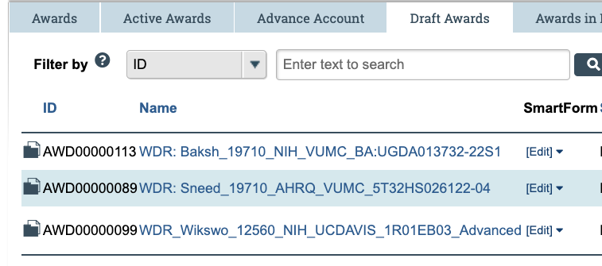
Improving Award & Award Modifications Titles
For Internal Tracking Purposes:
Acronyms will be added at the beginning of the Award & Award Modification title by the Specialist/Coordinator, then removed before being sent to Research Finance for Final Review
FOR EX:
  WAR_ – Waiting on Agency Response
  CORP_ – Central Office Review in Progress
  WID_ – Waiting on Info from Department
  RCO_ – Received by Central Office
  WCOI_ – Waiting for COI
  WDR_ – Waiting for Department Review
  _JIT – Official JIT Request rec’d & sent to DEPT/PI
  WCOI_Modification #1 – Courtesy Extension – Smith_NIH_R01MH12345

Slide 66
Agreements

Slide 67



Choosing Agreement types
Is the Agreement Funded or Unfunded?
If Funded, then choose one of the types: ISBA, ISA, OSBA, OSA, SRA
If Unfunded, then choose DUA, FW, MOU, NDA, OTH (e.g., CORES)
Please do not use the General Grant Agreement (GGA) type –
this is a SPA Use Only type.
Using this type causes downstream impacts regarding Awarding.

Slide 68

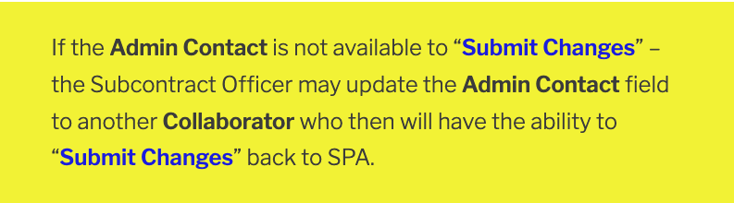

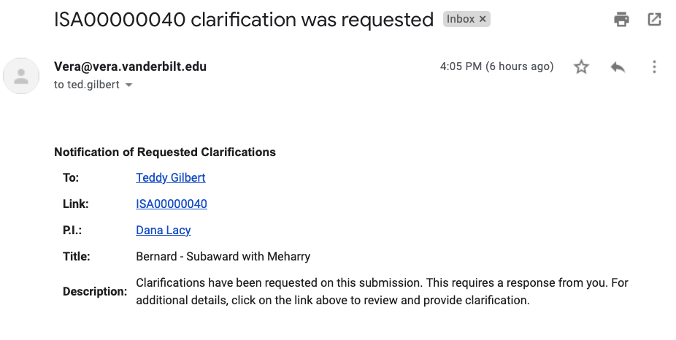
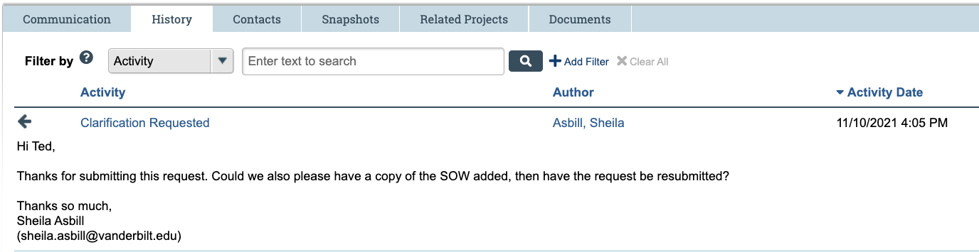
CLARIFICATION REQUESTED in Agreements
  Use Submit Changes activity to respond
  In order to see the message from the Subcontract officer, go to the History Tab, find the activity and view the message there
  Please note:
  Agreements in state: Clarification Requested show up on the PIs Dashboard

Slide 69
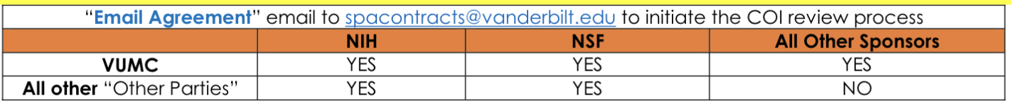
INCOMING SUBAWARDS
Conflict of Interest Process for Award Setup
Due to the need of timely Conflict of Interest reviews
by the Office of General Counsel (OGC)
before an agreement is Awarded in Oracle,
SPA is implementing a NEW PROCESS
for the receipt of draft incoming subawards.
For NEW Original Incoming Subawards:
At the time ISAs are submitted to SPA & assigned to a Subcontract Officer (CO),
CO will send “Email Agreement” through VERA asking the Contract Coordinator (CC) to go to the FP & click on “Funding Anticipated”
CC will go to the FP associated with the ISA & click on “Funding Anticipated” which places the Project on the COI dashboard for OCG to review
Notes:
To speed up awarding

Slide 70
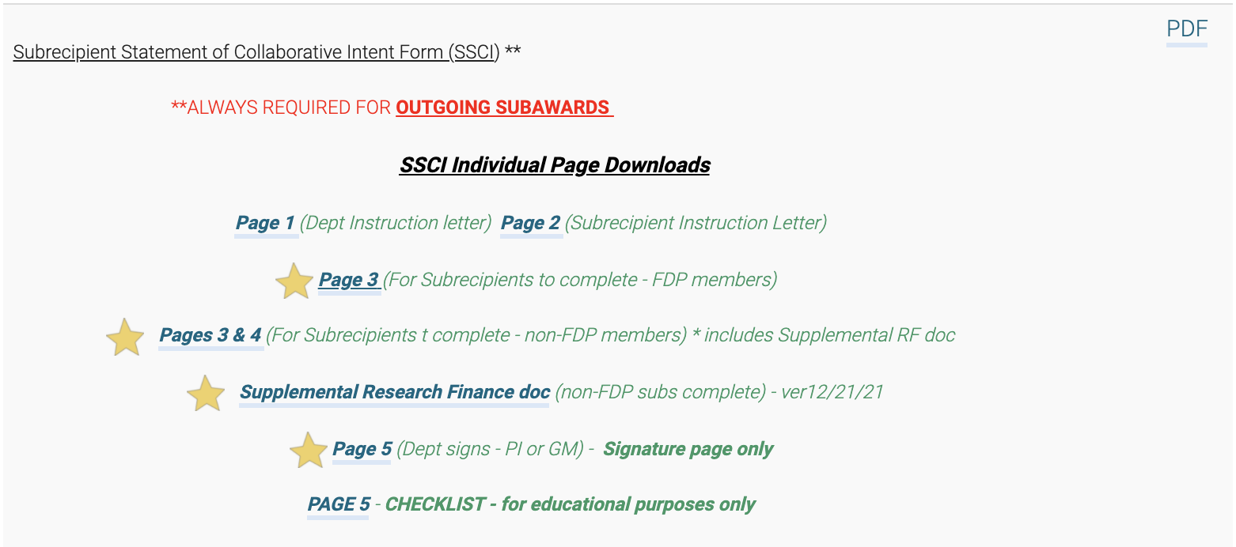

OUTGOING SUBAWARDS: SSCI
Paper Version:
Electronic Version:
Subrecipient Statement of
Collaborative Intent (SSCI)
Notes:
SPA Forms Library: https://www.vanderbilt.edu/sponsoredprograms/forms_library.php
SSCI: REDCap Version: https://redcap.vanderbilt.edu/surveys/?s=WNRT8P8DF9
Supplemental Research Finance doc: SUPPLEMENT – FOR SUBRECIPIENTS NOT SUBJECT TO UNIFORM GUIDANCE AUDITS (updated 12/2021)

Slide 71
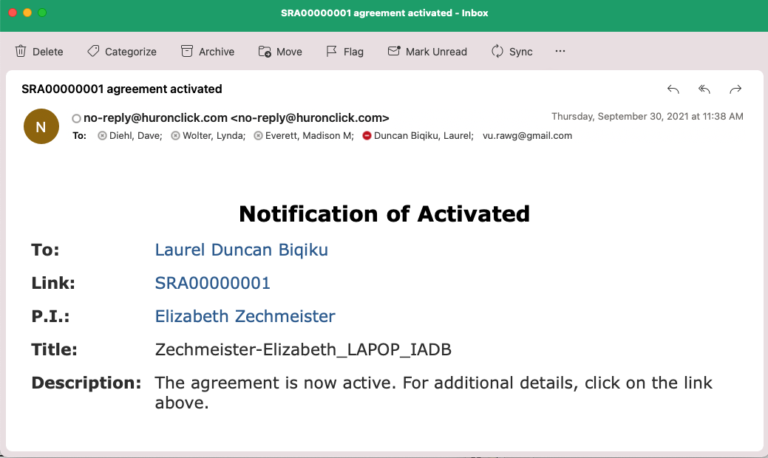
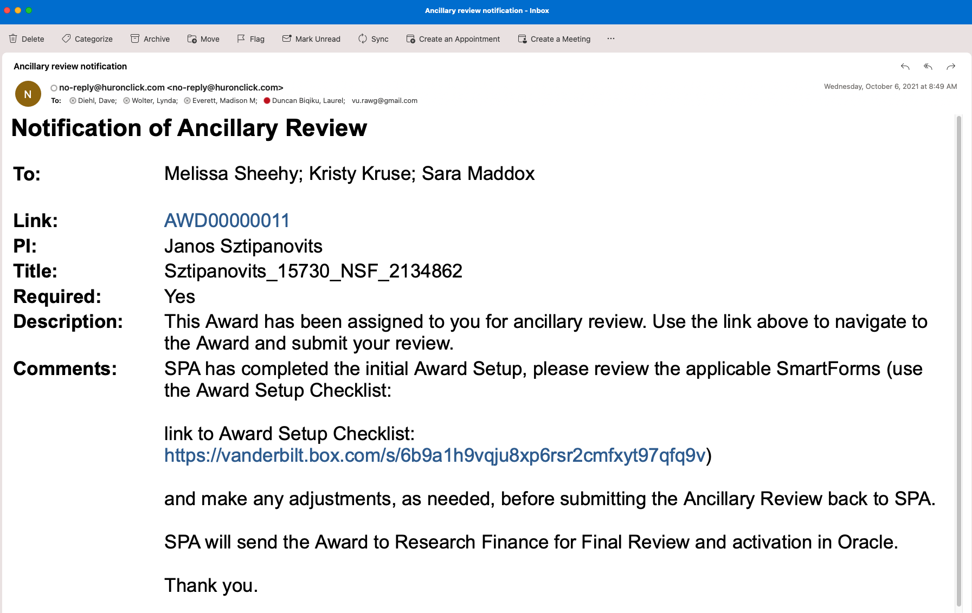


Agreements to Award Process
When you receive the Agreement activated notification –
there is nothing for you to do at that point
the Contract Coordinator will begin the Award process in the Grants Module (you will receive an Ancillary Review to complete Award Setup or Award Modification)
please do not submit an Award Modification Request when an agreement is fully-executed
Notes:
Next slide = flowchart

Slide 72
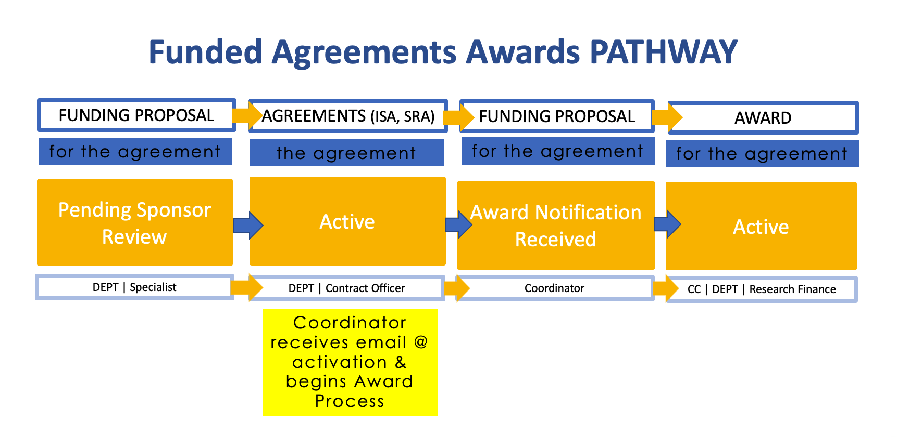

Slide 73
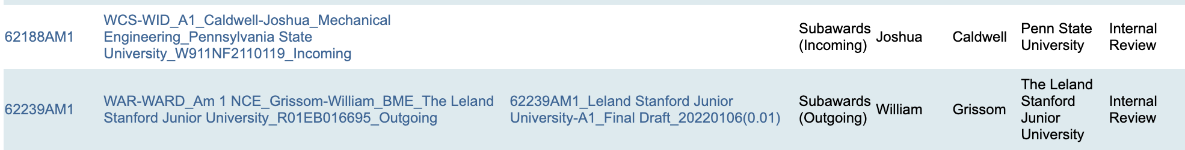
Improving Agreement Titles
For Internal Tracking Purposes:
Acronyms will be added at the beginning of the Subcontract title by the Subcontract Officer while the Agreement is in Internal Review, then removed before being activated.
FOR EX:
WOP – Waiting on Information from Other Party (response to working draft & signed agreement)
CORP – Central Office Review in Progress (agreement assigned/review in progress - both)
WAR – Waiting for Ancillary Review (AR) (Dept/PI)
WCS – Waiting for changes to be submitted (Clarification Request)
  Add WID (i.e., WCS/WID) – Waiting on Info from Department (i.e., Dept waiting on info from OP)
RAQ – RAQ in progress
CAT – CAT in progress
FSQ – FSQ in progress
WAR_A2_Simms-Rebecca_Gastroenterology_VUMC
This file is an Amendment 2 for PI: Rebecca Simms – Other Party=VUMC, and either the CO is waiting for the DEPT or PI to respond to the Ancillary Review request to review & approve the draft agreement.

Slide 74

Helpful Reports that you might not be aware of!
  Grants > Reports > Custom Reports
  Agreements > Reports > Custom Reports

Slide 75
Are there VERA Notifications that other staff need to receive?
Rules in Outlook
  TRY – Setting up Rules for sharing emails from vera@vera.vanderbilt.edu with fellow Team members
The basic steps to set up Rules in Outlook:
See resources: Set up rules video & Use rules to automatically forward messages article
Set up:
  Who the email comes from - vera@vera.vanderbilt.edu
  Who you want to forward the message to (anyone on your Team)
  What terms (rules) you want to use to decide which emails from vera@vera.vanderbilt.edu to forward (for example: "Award Activated", "Award Mod Approved")
Notes:
Resources: Set up rules video & Use rules to automatically forward messages article.

Slide 76
Please keep in mind for Proposal Submissions -
  SPA Specialists are available 8am-5pm

Slide 77
Subaward Funding Proposals – Due Date
If you put the “Due Date” in the Short Title of the Funding Proposal as the same day you submit the Subaward Funding Proposal to SPA, SPA still has a 36-48 hours to review the Subaward Funding Proposal
—Remember everything is due to SPA 3-days before the Due Date to Sponsor

Slide 78
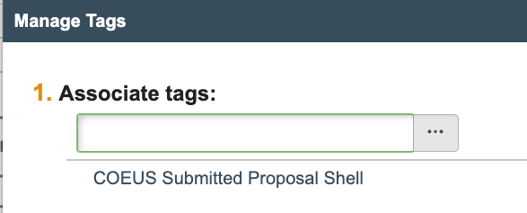

Funding Proposal Shells
Proposal Shells
If you create your own Proposal Shell in order to submit a Resubmission, then please make it obvious so the Specialist knows it is a Shell that they are sending through & not a real Submission
  Add FP SHELL_before the title
  Don’t forget to Manage Tags
If you have a Resubmission coming up that you want to submit from VERA, and you want help from SPA to re-create the Original Funding Proposal as a Proposal Shell in VERA, then please submit the request to create the Proposal Shell Request early (email spapostawardteam@vanderbilt.edu) – provide deadline
Weird happenings – check the Responsible DEPT – if the FP Shell is still listed under SPA, then please contact spapostawardteam@vanderbilt.edu and it will get edited

Slide 79
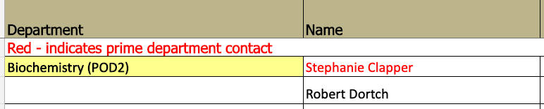
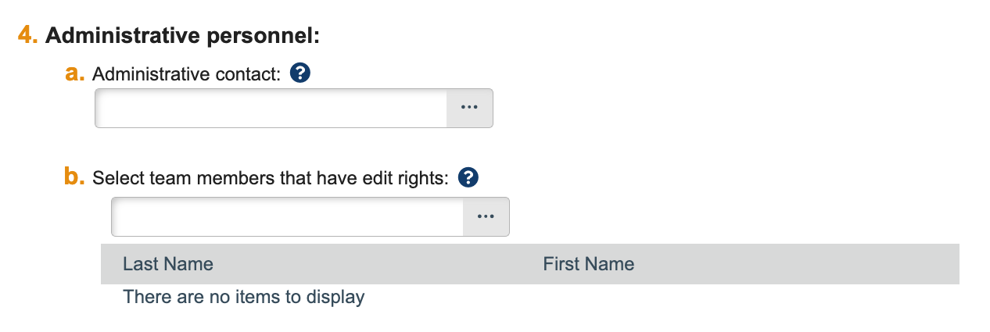

School Department Contact Lists
  Funding Proposal Shells –
  SPA is using the people listed in your online School Department contact Lists to populate DEPT people:
  Personnel SmartForm –
  Item 4a. Administrative contact: - the person listed in RED on your School’s contact list will be this person
  Item 4b. Select team members that have edit rights: everyone else listed for a Dept is then added here
Converted Awards – Award Modification – Manage Guest List
  These people will receive the notification: [ID]: An Award Letter Has Been Received
Notes:
Michelle Wachter
We will send the list editors the link so that you can verify & edit your DEPT Contact Lists.
Converted Awards – when an Award Modification is created – everyone on DEPT Contact List is added to the “Manage Guest List”

Slide 80

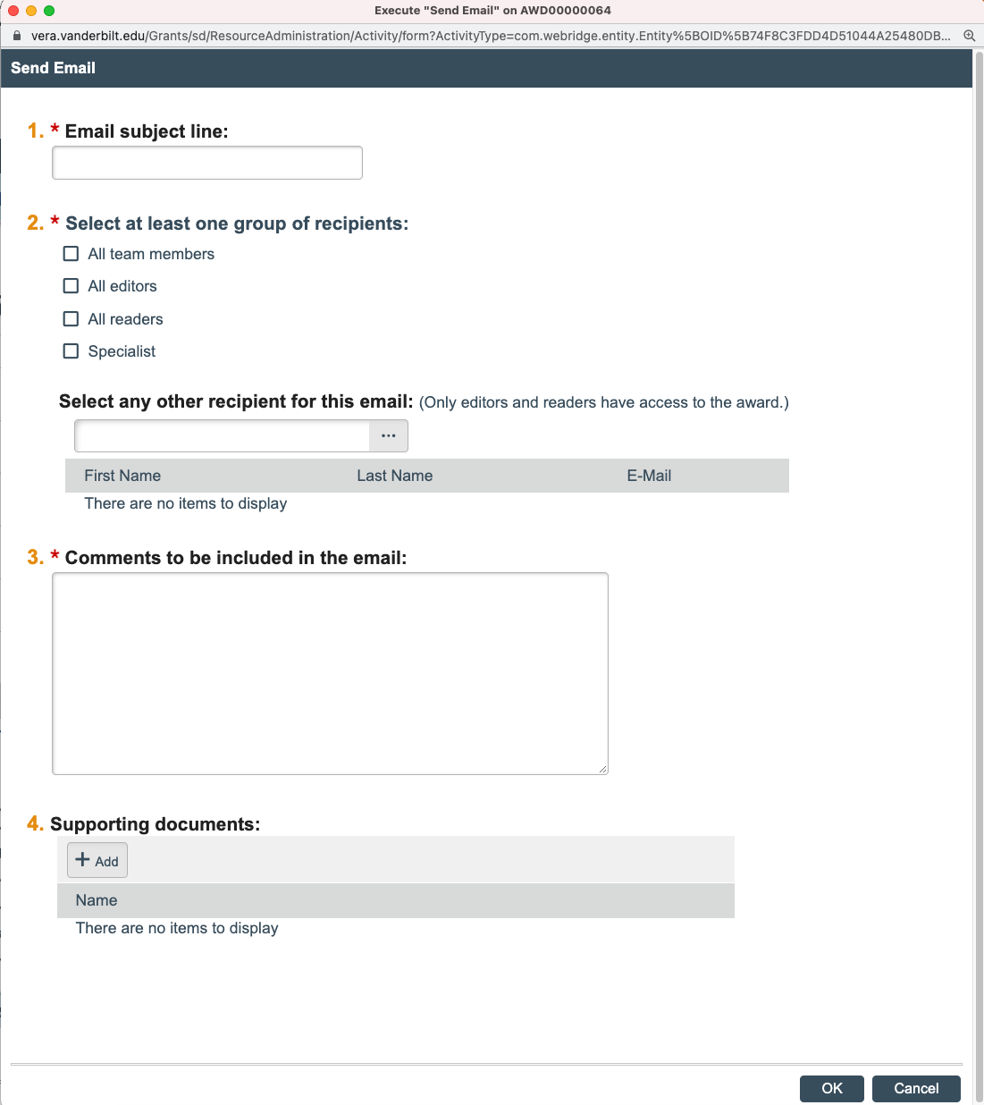
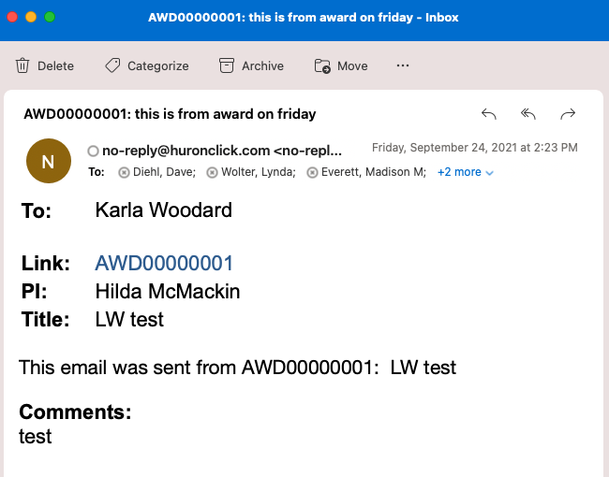
Helpful activities in VERA
Send Email activity – in Funding Proposals & Awards
*Great way to communicate with anyone at VU. The activity sends an email to the VU person’s email address + documents it in the History tab.

Slide 81


Helpful activities in VERA
Add Comment activity – in Funding Proposals
*Great way to communicate information about your Proposal with your Specialist
-Suggestion – Start comment with “For Specialist:”
Manage Guest List for Awards – Post-Award will add all people currently listed on the School-specific Contact List info

Slide 82


VERA Help
Screenshots are super helpful when you submit VERA Help tickets
When you do – please screenshot the full webpage – so that VERA Help can see the full scope of your question (especially context of an error message)
verahelp@vanderbilt.edu
Notes:
VERA Help
John DelTufo
Max Fishel

Slide 83


Slide 84

Tuesdays 10:00AM
Monday – Friday 1:00PM
Drop in & ask questions!
Notes:
VERA Live Demo – Open House
Archived videos: https://research.vanderbilt.edu/vera/vera-training/

Slide 85
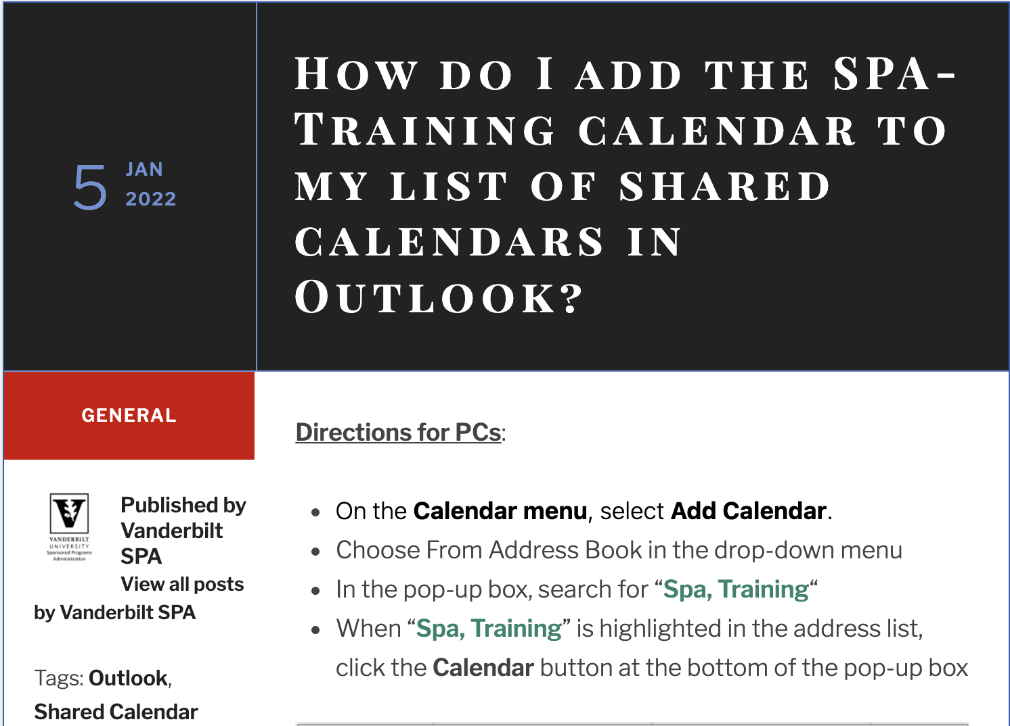
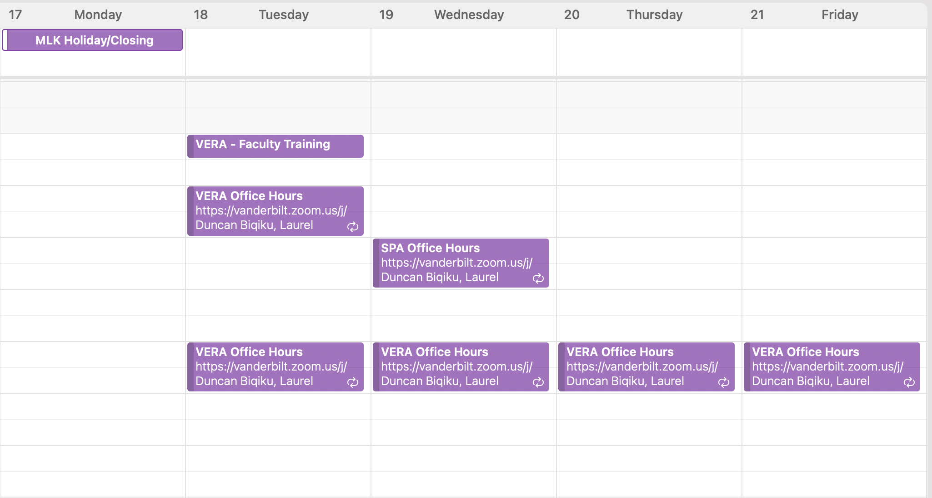
SPA-Training Calendar
Open Shared Calendar & search for –
“SPA-Training” (spa.training@vanderbilt.edu)
Notes:
Microsoft online instructions on adding a shared calendar: https://support.microsoft.com/en-us/office/open-another-person-s-exchange-calendar-2257f515-408f-48ea-9363-11d0d5848c77
VU FAQ site: https://vuspafaqs.wordpress.com/2022/01/05/how-do-i-add-the-spa-training-calendar-to-my-list-of-shared-calendars-in-outlook/

Slide 86

  Drop in & ask questions!
  All SPA Teams represented
Next SPA Office Hours
  Wednesday, January 19 @ 11am
    (3rd Wednesday of each month)
  via Zoom

Slide 87


Research Finance-SPA-GM Meetings
February
Thursday, 2/10
March
Thursday, 3/10
April
Thursday, 4/14
May
Thursday, 5/12
June
Thursday, 6/9
Notes:
2022 Dates
1/13
2/10
3/10
4/14
5/12
6/9
July & August – summer break

Slide 89
Conflict of Interest (COI)
Matrix about determining for FP

Slide 90
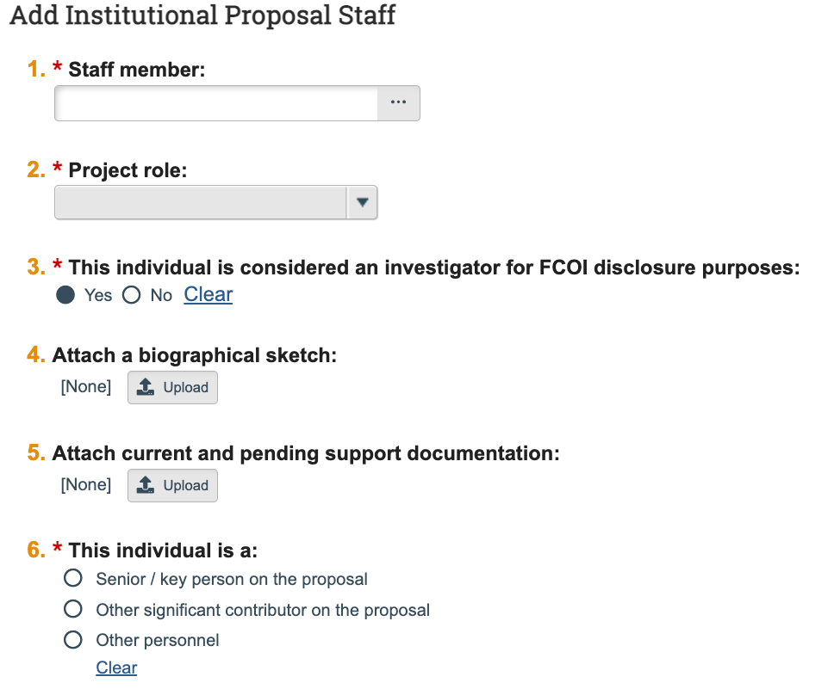
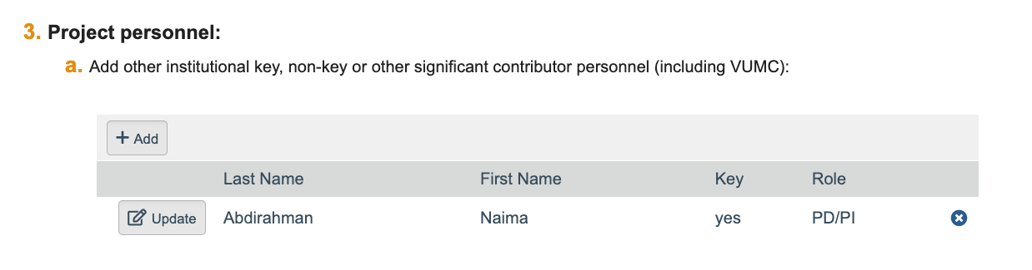
Personnel SmartForm – Item 3a.
Add Additional Personnel –
Item 3. * This individual is considered an investigator for FCOI* disclosure purposes:
VUMC Faculty
If VUMC Faculty is a Subrecipient/Subaward PIs, then answer “No”
If VUMC Faculty is a Mentor (co-Sponsor) for Fellowship, then answer “Yes”
* FCOI = Financial Conflict of Interest

Slide 91
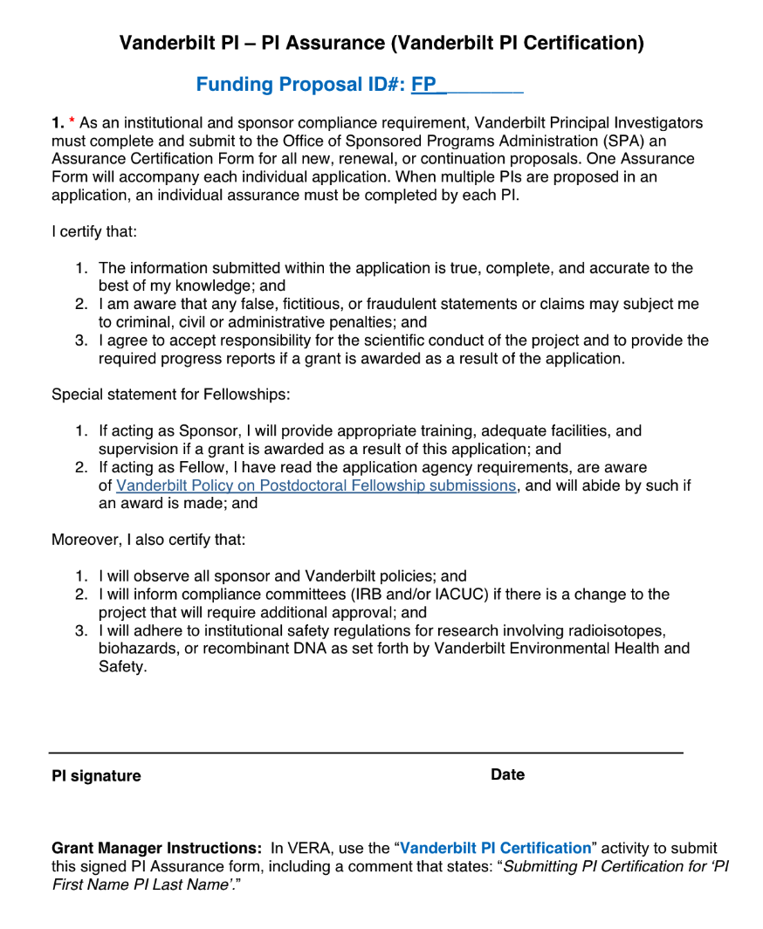
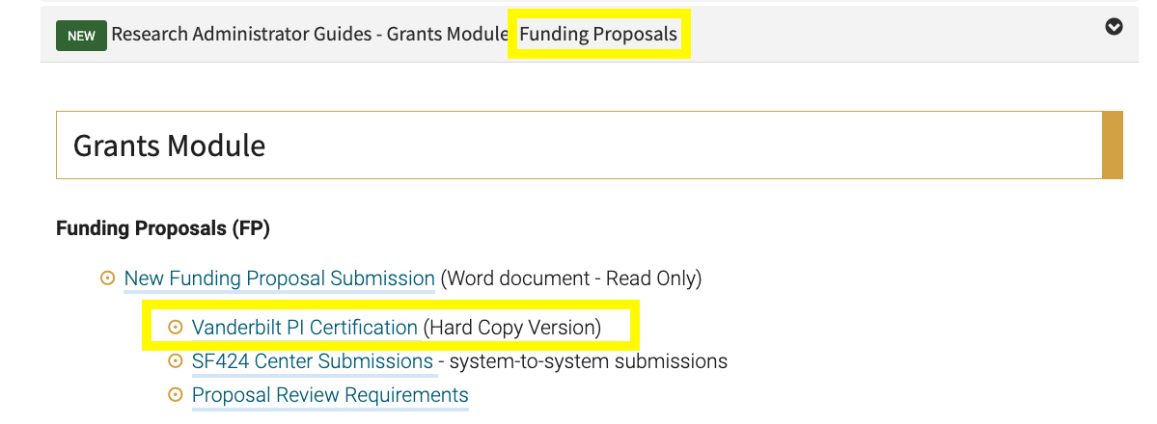
Vanderbilt PI Certification – Hard Copy Version
Two (2) case uses:
The PI is unable to access VERA to respond to the PI Certification Request
The Proposal is multi-PI, and the non-main PI(s) need to complete their Vanderbilt PI Certification
Please follow the “Grant Manager Instructions” –
found at the bottom of the form.
Notes:
Link to form in VERA Training BOX: https://vanderbilt.box.com/s/21mma7hq4cnpz02d88x4a2u3rlu68qro
Viewable in History once submitted (can see the Comment & Attachment)

Slide 92
