Slide 1
START WITH TALENT; FINISH WITH STRENGTH
Unleash your talents
Introduction to CliftonStrengths Assessment
Irene Wallrich
Harmony Relator Learner Intellection Developer
Nick Hyer
Input Ideation Adaptability Intellection Relator

Slide 2
“
What lies behind us and what lies before us are tiny matters compared with what lies within us.”
- UNATTRIBUTED

Slide 3
FOCUS ON YOU
What name do you prefer to be called today?
Home Institution
Tell us about your research
What is one positive word people use to describe you?

Slide 4
Russell G. Hamilton Graduate Leadership Institute
Mission:
Provide graduate students with the tools to thrive in leadership roles at all levels and the ability to recognize and develop leadership skills in themselves and others.

Slide 5
Graduate and Postdoc Academic Success
Mission: Provides the critical infrastructure and support for College/School leadership, departments/programs, and faculty to assist their students and postdocs in reaching their academic goals. We do this through direct outreach to departments and faculty, responsive programming and workshops, and direct support of students and postdocs in alignment with their development as the next generation of scholars and leaders.
"There should be no boundaries to human endeavor. We are all different. However bad life may seem, there is always something you can do and succeed at. While there's life, there is hope.
Stephen Hawking, Cosmologist

Slide 6
The key to success is to fully understand how to apply your greatest talents and strengths in your everyday life.

Slide 7
PEOPLE WHO FOCUS ON USING THEIR STRENGTHS …
are three TIMES as likely to report having an excellent quality of life
are six TIMES as likely to be engaged in their jobs
7

Slide 8
At Work, I Have the Opportunity to do what I do best every day?
A. 10%
B. 25%
C. 40%
D. 67%
Surveyed 10 Million People in almost every industry

Slide 9
At Work, I Have the Opportunity to do what I do best every day?
A. 10%
B. 25%
C. 40%
D. 67%
Surveyed 10 Million People in almost every industry

Slide 10
STAND UP IF YOU ALWAYS …
talk to people in elevators, airplanes, grocery stores, and wherever you go
have a color-coded or otherwise organized closet
write down a list of things to do, and stick to it
make a list of things to do on weekends
need to pick someone to race while driving
ask too many questions
push the elevator button to “remind” the elevator that you are there

Slide 11
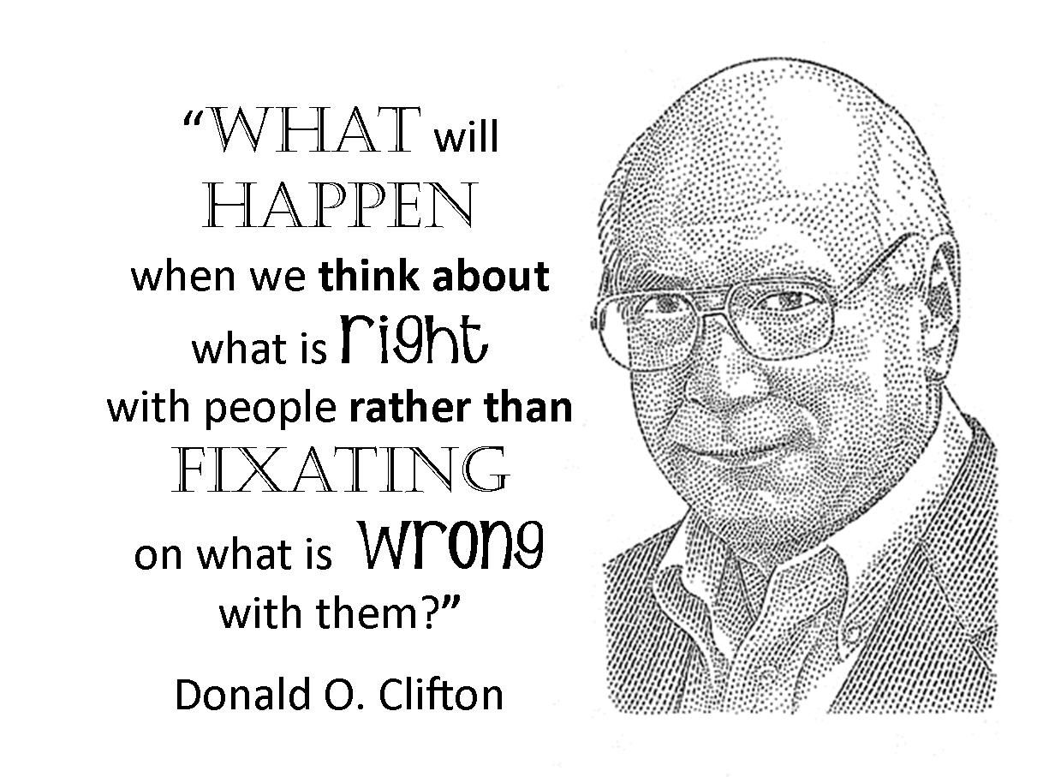
Clifton Strengths Philosophy
Average Readers: 66%
Fast Readers:
828%
Glock, J.W. (1955). The relative value of three methods of improving reading: Tachistoscope, films, and determined effort, Ph.D. Thesis, University of Nebraska-Lincoln

Slide 12
Talent
Naturally, reoccurring patterns of thought, feeling, or behavior that can be productively applied to build relationships, process information, and filter the world (internal potential)
Natural inclination (fast)
Invisible
Point of growth
Being
Examples of talent include:
effortlessly and instinctively starting conversations
thinking in an orderly or timely manner
easily and naturally influencing others
seeing patterns in data
consistently having a positive outlook on life

Slide 13
Talent
a natural way of thinking, feeling or behaving
Strength
x
The ability to consistently produce a positive outcome through near-perfect performance on a specific task (external manifestation of talent)
Intentional
Visible
Maximized Talent
Doing
Investment
Time spent practicing, developing your skill & building your knowledge base
=
Strength
the ability to consistently provide near-perfect performance

Slide 14
PRINT THE FOLLOWING PHRASE THREE TIMES:
“I use my strengths every day.”
14

Slide 15
Five Guiding Principles
Talents are neutral
Talents are not labels
Lead with positive intent how will this make you amazing
Differences are advantages
People need one another

Slide 16
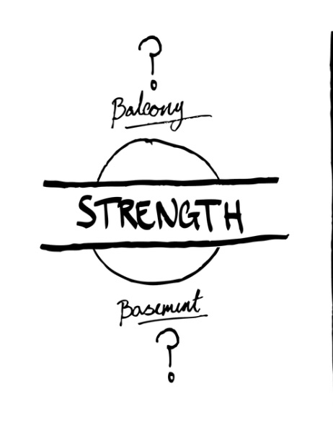
Weakness?
A talent that is unrefined & needs attention.
Flag to check-in

Slide 17
Four Domains of Team Strength
Executing | Influencing | Relationship Building | Strategic Thinking
People with dominant Executing themes know how to make things happen. | People with dominant Influencing themes know how to take charge, speak up, and make sure the team is heard. | People with dominant Relationship Building themes have the ability to build strong relationships that can hold a team together and make the team greater than the sum of its parts. | People with dominant Strategic Thinking themes help teams consider what could be. They absorb and analyze information that can inform better decisions.
Achiever Arranger Belief Consistency Deliberative Discipline Focus Responsibility Restorative | Activator Command Communication Competition Maximizer Self-Assurance Significance Woo | Adaptability Connectedness Developer Empathy Harmony Includer Individualization Positivity Relator | Analytical Context Futuristic Ideation Input Intellection Learner Strategic

Slide 19
CliftonStrengths Report
NAME IT!
Read the descriptions of your themes and highlight or underline the words or phrases that best describe you.
Awareness What words or phrases resonate with me?
Appreciation How does this bring value to me? How has it helped me be successful before?
Application What specific actions can I take to hone this talent and reach my goals?
CLAIM IT!
Which of your talents do you really “own”?
AIM IT!
How could you use this theme more intentionally?

Slide 20
Thank you for sharing your time and talents with me today.
Questions? Thoughts? Concerns? Epiphanies?

Slide 21
COPYRIGHT STANDARDS
Gallup’s strengths-based products are offered as a service of Gallup and were created to enable everyone to discover, develop, and apply their strengths in every aspect of their lives. Your use of strengths products or services is governed by these Purchase and Use Terms. You should not use strengths products or services if these terms are unacceptable to you.
This document contains proprietary research, copyrighted materials, and literary property of Gallup, Inc. It is for the guidance of your company only and is not to be copied, quoted, published, or divulged to others outside of your organization. Gallup®, StrengthsFinder®, Clifton StrengthsFinder®, and each of the 34 Clifton StrengthsFinder theme names are trademarks of Gallup, Inc. All other trademarks are the property of their respective owners.
This document is of great value to both your organization and Gallup, Inc. Accordingly, international and domestic laws and penalties guaranteeing patent, copyright, trademark, and trade secret protection protect the ideas, concepts, and recommendations related within this document.
All strengths material published by Gallup included in this presentation deck, including text, photographs, images, illustrations, audio clips, video clips, poll results, trademarks, service marks, logos, training materials, and other material (collectively the “Content”), are protected by U.S. and international copyright and other intellectual property laws and are owned or controlled by Gallup or the party credited as the provider of the Content. For specific trademark and copyright information, please review the Trademark and Copyright Guidelines included in your kit or available on Gallupstrengthscenter.com. Unless explicitly indicated on specific Content, you may not sell or modify the Content or reproduce, display, distribute, or otherwise use the Content in any way for any public or commercial purpose without the written permission of Gallup. If you are purchasing or accessing strengths Content for use by someone other than yourself, you are responsible for complying with the additional Professional Conduct Rules.
You must notify all participants in writing of Gallup’s trademarks. An acceptable example is provided below:
Gallup®, Clifton StrengthsFinder®, StrengthsFinder®, and each of the 34 Clifton StrengthsFinder theme names are trademarks of Gallup, Inc.
Gallup has not granted authority or certified any external consultants to interpret the Clifton StrengthsFinder or any of the Clifton StrengthsFinder themes. Any interpretation by anyone other than Gallup may be inconsistent and incorrect.

