Slide 1
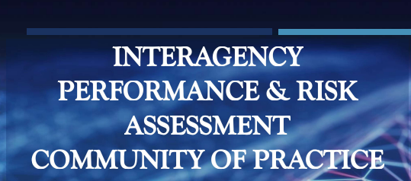
Interagency Performance and Risk Assessment Community of Practice (PRACOP)
David Weyant
Physical Scientist
March 2025

Slide 2
PRACOP Members
Co-Chairs:
David Weyant (Permanent Co-Chair, DOE-EM)
Hai Shen (Alternate Co-Chair, DOE-EM)
Richard Chang (Co-Chair, DOE-EM)
Craig Benson (Co-Chair, CRESP)
Steering Committee:
Angelita Denny (DOE-LM)
George Alexander (NRC)
Kristof Czartoryski (Tennessee DEC)
Jon Richards (EPA)
Justin Marble (DOE-EM)
Steven Hommel (SRMC)
Technical Advisor:
Stuart Walker (EPA)

Slide 3
PRACOP Mission
Purpose
Evaluates the impact of a proposed remedial action on human health and the environment
Provides a demonstration of compliance and important technical inputs to meet regulatory requirements
Waste form development and implementation
Tank closure activities
Waste site closure activities
In-situ decontamination and decommissioning
Soil and groundwater remediation
Management of disposal facilities

Slide 4
PRACOP Mission
Goals and Objectives
Objectives:
Consolidate and expand the body of
Conduct technical exchanges, continuing
Draft guidance based on member experiences
Maintain a repository of P&RAs and risk-based
Goals:
Foster the exchange of information regarding preparation of P&RAs across agencies and practitioners
Enhance consistency in the preparation of P&RAs
Develop appropriate peer guidance and/or recommendations for P&RAs such that they are based on sound science and are defensible
Develop and organize a community of P&RA
practitioners
knowledge relating to preparation and
application of P&RAs and build on lessons
learned
education, and training sessions
and lessons learned to enable continuous
improvement
modeling tools, data, and supporting technical
information

Slide 5
PRACOP Technical Advisors (TA)
Attributes:
May be designated by the Steering Committee
Selected from academia, national laboratories, site contractors, and other federal and state sources of expertise
Serve as subject matter experts on the topics the P&RA CoP is covering

Slide 6
PRACOP Functions & Methods
Hold open meetings to interested parties (except Steering Committee planning meetings)
Review documents which may benefit P&RA preparation methodologies
Encourage the use of lessons learned from these documents
Seek and share guidance available from international, federal, and state agencies and other stakeholders
Develop a process to create, maintain, and publicize consensus-driven guidance documents that can be employed by the stakeholder community

Slide 7
Contact Information
Co-Chairs:
David Weyant: david.weyant@em.doe.gov
Richard Chang: richard.chang@em.doe.gov
Craig Benson: chbenson@wisc.edu
Executive Secretary:
Alexandra Melnyk: alexandra.melnyk@em.doe.gov
Hai Shen: hai.shen@em.doe.gov (alternate)

