Slide 1

Presentation Title
CRESP’s Landfill Partnership and the Performance and Risk Assessment Community of Practice
Author
University
Craig H. Benson, PhD, PE, NAE
Wisconsin Distinguished Professor Emeritus
University of Wisconsin-Madison
Dean of Engineering Emeritus
University of Virginia
chbenson@chbenson.org
March 25, 2025

Slide 2
What is CRESP?
CRESP = Consortium for Risk Evaluation with Stakeholder Participation
CRESP
Technically Sound Base to help DOE accomplish environmental management priorities
Focus Areas
Waste Processing & Special Nuclear
Materials
Remediation, Near Surface Disposal &
Long-term Stewardship
Nuclear Waste Management Policy and Strategy
Stakeholder Engagement and Communication
Certainty
Confidence
in environmental
management
decisions
CRESP
Functional
Approach
Strategic Assessment
Applied Research
Review
Education
Credibility
Capability
Consortium of faculty, research scientists, and students providing research, technology, reviews, strategic assessment and continuing education to support DOE-EM mission
Funded by DOE-EM, but independent and arm’s length.

Slide 3
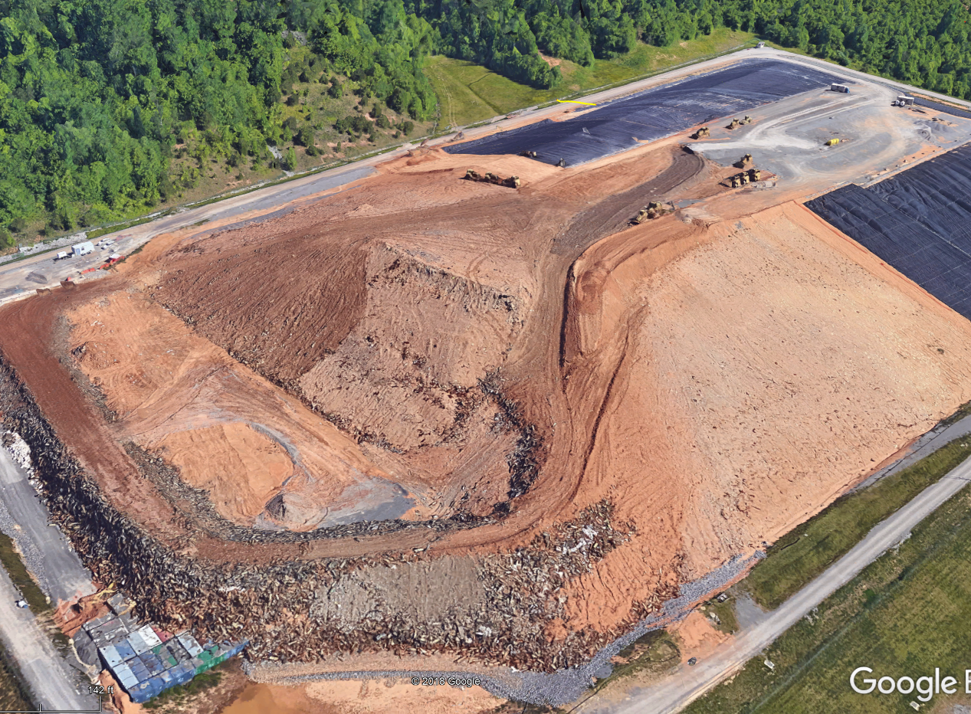
What is CRESP’s Landfill Partnership?
Hands-on practical technology for disposal facilities.
Radon Flux
Water Percolation
Waste
Flux to groundwater
Landfill Partnership conducts applied research, assessment, and technology development for on-site disposal facilities and containment systems at DOE facilities:
Understand and predict long-term performance (lab, field, modeling).
Develop and demonstrate sustainable, effective, and economic strategies.
Develop innovative solutions to address difficult problems (Hg, Tc-99).
Provide site-specific problem solving on containment issues.
Notes:
SA6-01: Waste Forms and Cementitious Barriers Partnership

Slide 4
PRACOP and the Landfill Partnership
CRESP’s Landfill Partnership – solves practical issues that address DOE site operations and performances assessments.
PRACOP – forum to discuss and share real-world issues with technology for environmental management and performance assessment.
PRACOP informs CRESP of current and forthcoming questions/issues that can be resolved through applied research.
Notes:
SA6-01: Waste Forms and Cementitious Barriers Partnership

Slide 5
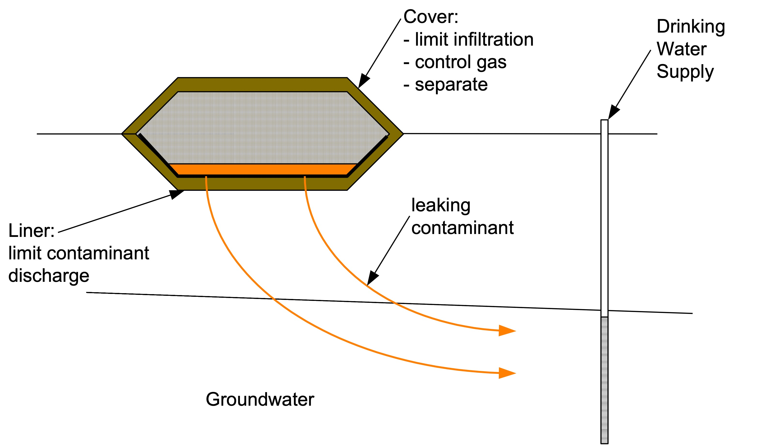

Examples of PRACOP-Informed Activities: Liner Effectiveness for PFAS
PFAS Concentration in Municipal Solid Waste
Landfill Leachates (Lang et al. 2017)
PFAS
Sequestration
Can disposal facility contain PFAS?
PFAS to Groundwater
MCL = 4 ng/L
Are Composite Liners Effective Barriers to PFAS?

Slide 6
Specific Questions to Answer
Conventional Composite Liner System
Do PFAS affect the hydraulic conductivity of clay liners or GCLs?
Do PFAS diffusive readily through geomembranes like some other organic compounds?
Will Subtitle D composite liners protect groundwater given low MCL for PFAS (< 4 ng/L)?
Figures courtesy M. Othman, Geosyntec Consultants
Composite liner consists of geomembrane (1.5 mm HDPE) over a 0.6-1.2 m thick compacted clay liner or geosynthetic clay liner (GCL).
Drainage layer can be gravel (more common) or geocomposite drain (GCD).

Slide 7
PFAS and Hydraulic Conductivity of Compacted Clay Liners and GCLs
Influent solutions for single and multi-PFAS tests (yellow diamonds, blue triangle)
Tests with PFAS (y-axis) yield same hydraulic conductivity within testing reproducibility as tests without PFAS (x-axis).
No impact!

Slide 8
Model Predictions: PFAS Concentration at Groundwater Table (Leachate PFOA = 1000 ng/L)
Section 4
GM Defect
@100 yr
Avg. PFAS flux with Defect:
< 0.0028 ng/m²/yr for CCL Composite
< 7.3x10⁻⁸ ng/m²/yr for GCL Composite
Base of liner 3 m above groundwater table (GWT).
Intact geomembrane (GM) or 10 mm diameter hole in GM (upper left of domain)
PFAS concentrations at GWT extremely low below intact GM.
Concentrations at GWT directly below defect =exceed MCL, but limited to small area below defect (about 3 m diameter). Areal PFAS flux VERY small

Slide 9
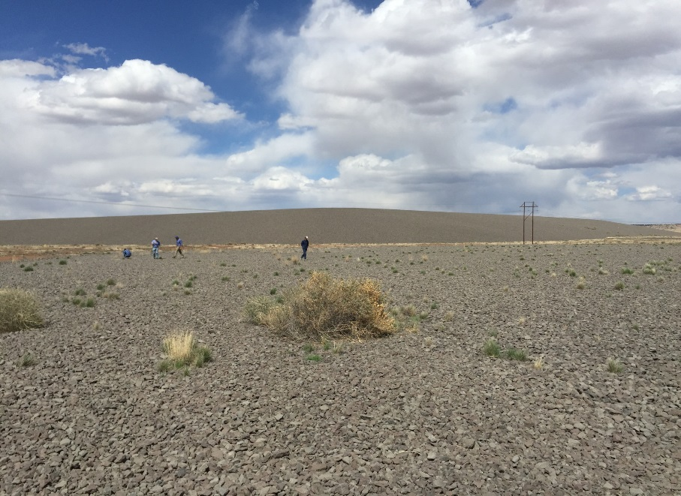
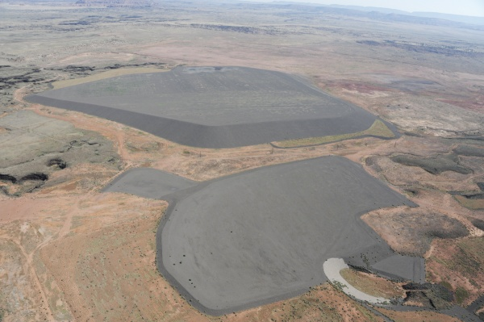
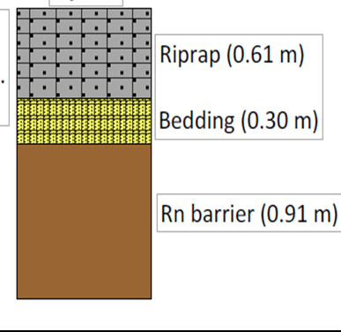
Bluewater, NM U mill tailings disposal facility
Barrier Degradation: Rn Barrier Effectiveness
Do radon (Rn) barriers maintain effectiveness in the presence of pedogenic change of barrier layers in covers?
3,300 acres, main cell: 16 million cubic yards

Slide 10
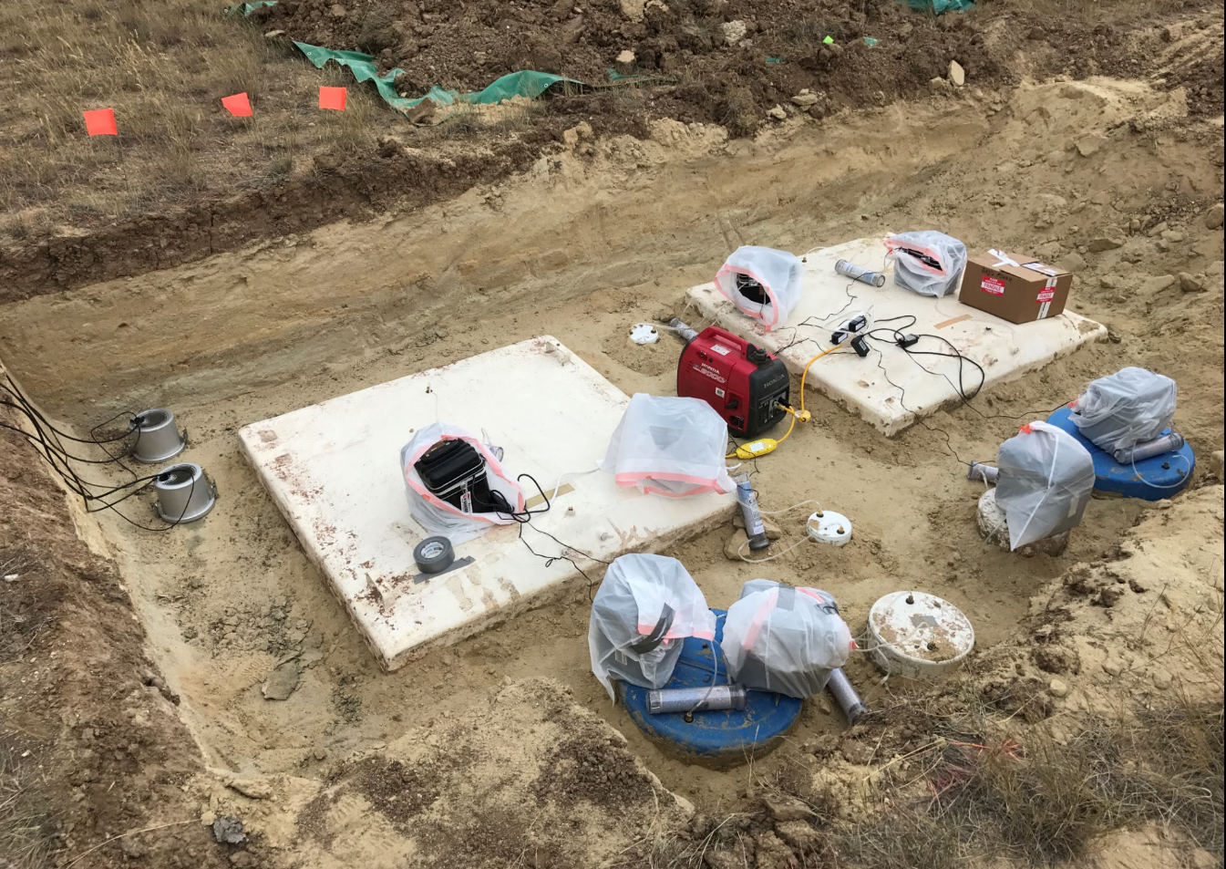
Radon Fluxes on Rn Barrier Surface – Falls City, Texas
20 pCi/m²-s
Test Duration: 5 – 20 hours
CRESP/EM, LM, NRC collaborative study.
Rn fluxes still in compliance with emission standard after 20 yr.

Slide 11
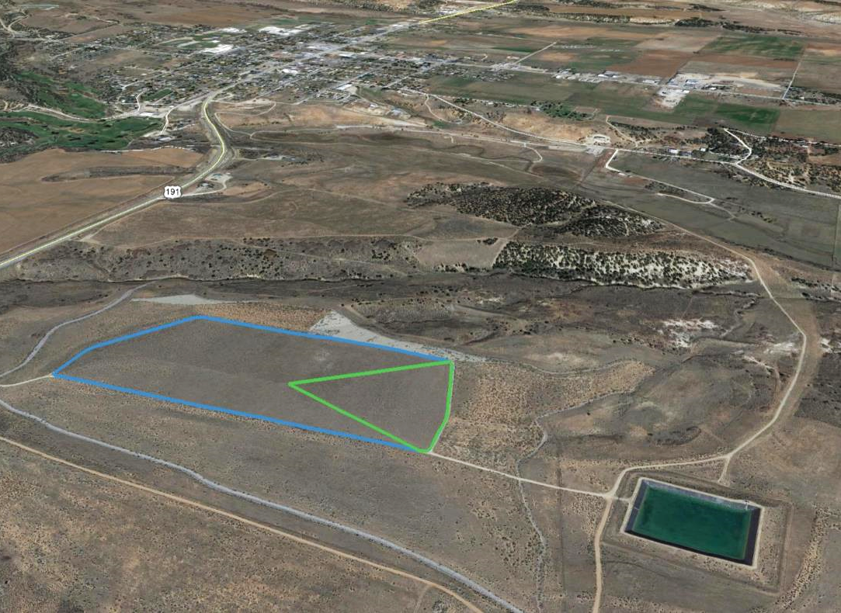
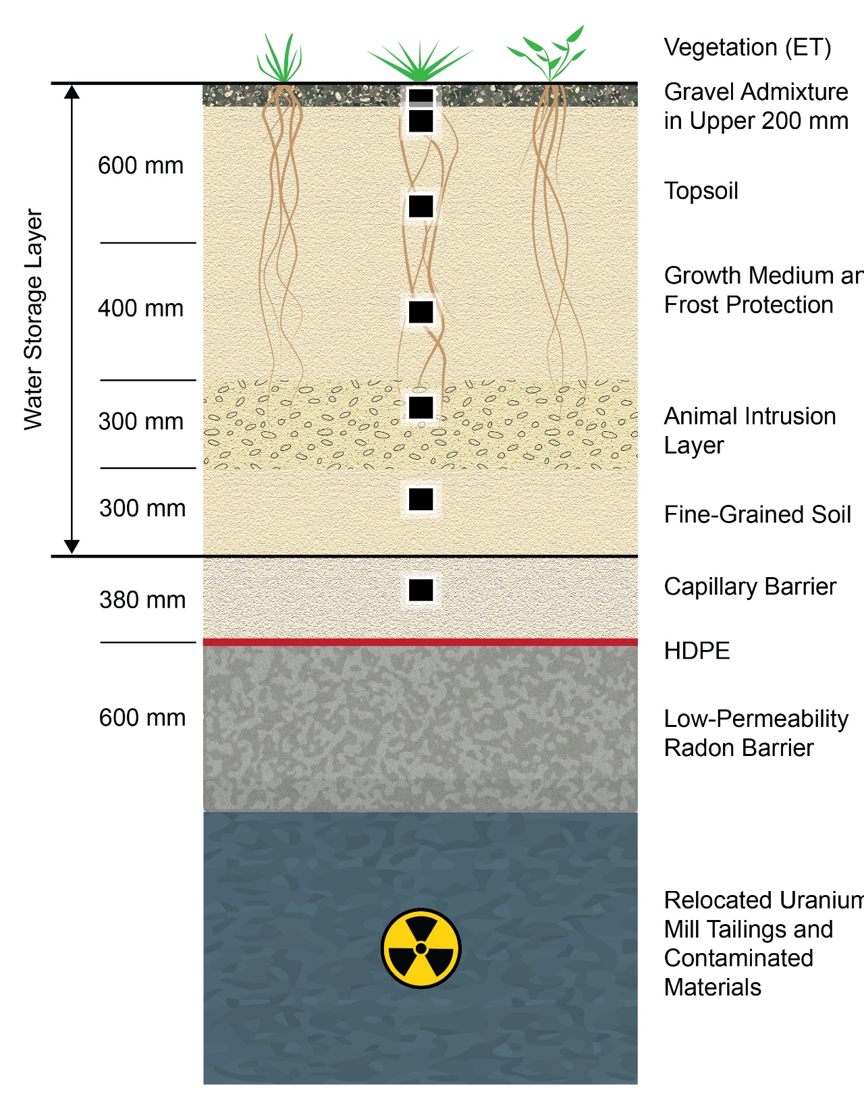
Monticello Disposal Facility - Water Balance Cover
3 ha lysimeter
Will the cover control percolation as projected over its service life?

Slide 12
PRACOP and CRESP Landfill Partnership
PRACOP provides forum to openly discuss uncertainties, challenges, concerns, and successes.
Questions and concerns regarding methodologies and assumptions in PAs drive Landfill Partnership’s applied research agenda.
Ultimate goal and outcome: problem solving, confidence building, and consensus development.
Certainty
Confidence
in environmental
management
decisions
Credibility
Capability

