Slide 1
Importance of Conceptual Model Development for the Pahute Mesa Groundwater Model Nevada National Security Site
Ken Rehfeldt
Navarro Research and Engineering, Contractor to the U.S. Department of Energy (DOE) Environmental Management (EM) Nevada Program
Chuck Russell
Desert Research Institute, Science Advisor to the DOE EM Nevada Program
August 2, 2023

Slide 2
Presentation Organization
Nevada National Security Site (NNSS) History
Regulatory Closure Process for Contaminated Groundwater on the NNSS
Role of Groundwater Flow and Radionuclide Transport Modeling in the Closure Process
Importance and Components of the Conceptual Model

Slide 3
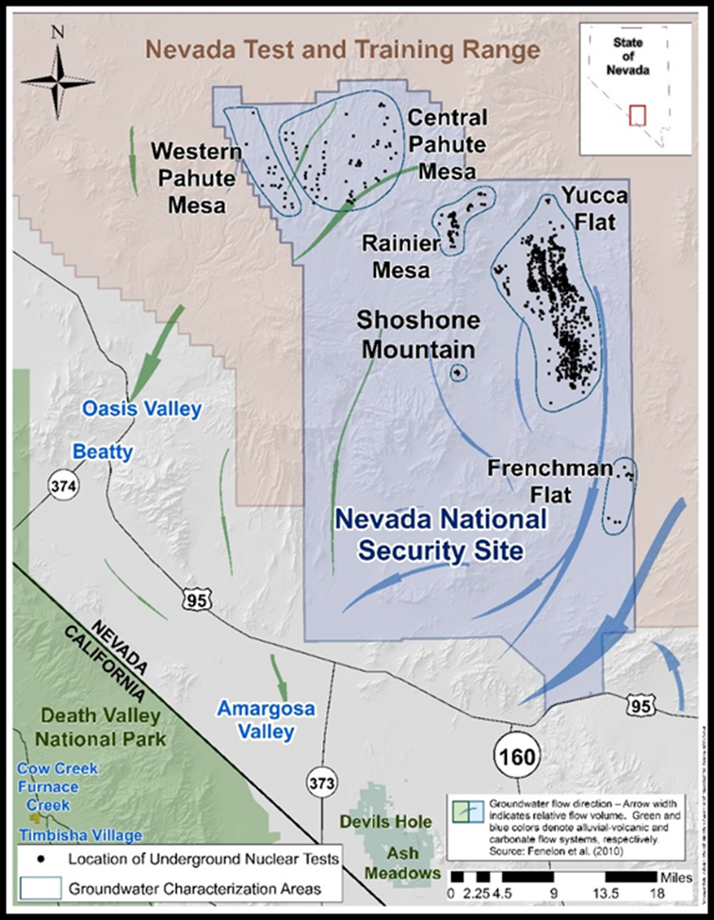
Nevada National Security Site (NNSS)
Big – 1,360 square miles
Secure – Access to site is controlled
Remote – Surrounded by additional 4,500 square miles of federally-owned land controlled by U.S. Air Force (Nevada Test and Training Range)
Current NNSS mission – Supports the national security of the U.S. and its allies
  Stockpile stewardship
  National defense and security programs
  Responsible agency is National Nuclear Security Administration - Nevada Field Office (NNSA/NFO)
Historical use – Nuclear weapons research, development, and testing (1951-1992)
  DOE Environmental Management (EM) Nevada Program implements environmental corrective actions to address legacy contamination from nuclear testing

Slide 4
Nevada National Security Site
Established as the Nevada Test Site on December 18, 1950
828 underground nuclear tests
  Depths up to 4,800 feet below land surface
  One-third conducted at, near, or below the water table
  Radionuclide contamination detected in the groundwater at the NNSS and the Nevada Test and Training Range
UGTA mission – protect groundwater users from exposure to radionuclides

Slide 5
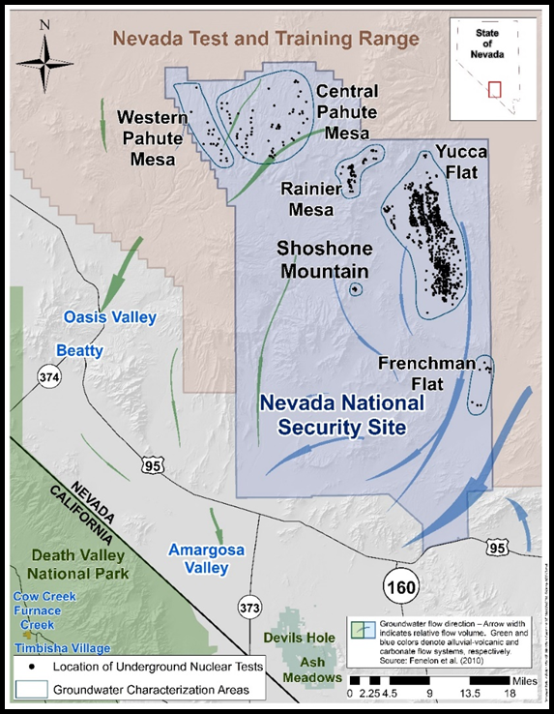
Federal Facility Agreement and Consent Order (FFACO)
FFACO is the regulatory framework for addressing groundwater contamination from underground testing activities
Multi-Party Agreement (1996, as amended)
  Department of Energy
  Nevada Division of Environmental Protection (NDEP)
  Department of Defense
No viable clean-up approach has been identified
Protection of human health and the environment from exposure to contamination from nuclear testing activities

Slide 6
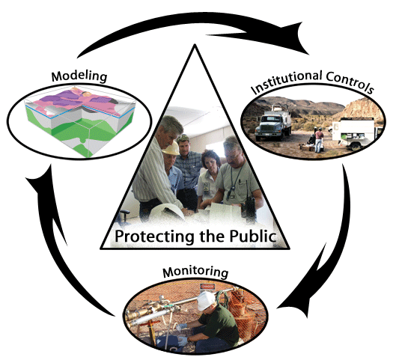
FFACO Groundwater Strategy
Data collection, drilling, testing, sampling to characterize the groundwater system ➔ Conceptual Model
Modeling to forecast radionuclide contamination migration for 1,000 years
Within modeling there is an iterative process of data collection and model evaluation
Groundwater end state is closure in place with monitoring and institutional controls

Slide 7
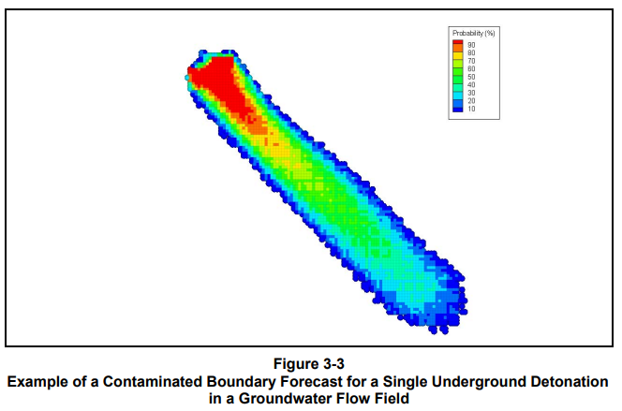
1,000–Year Model Forecast
Contaminant Boundary
Forecast maximum extent within 1,000 years
Based on the EPA Safe Drinking Water Act Standards for radionuclides
Model forecast, with uncertainty, at the 95th Percentile
Modeling is a key component of the regulatory decision process

Slide 8
FFACO Groundwater Contamination Approach
Corrective Action Units (CAUs)
  Defined 5 CAUs
    Three have completed characterization and are in long-term monitoring
    Pahute Mesa CAUs are active investigations
  Pahute Mesa CAUs
    82 underground tests (~10%)
    Radionuclide inventory (~60%)
    Public receptors are in Oasis Valley, near the community of Beatty (~ 25 km)

Slide 9
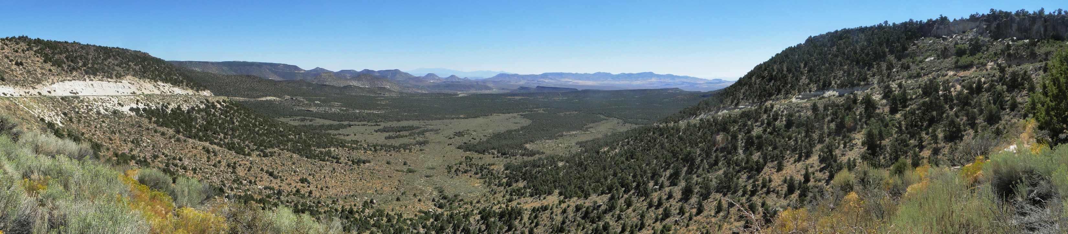
Pahute Mesa Modeling
Complex volcanic geology and hydrology of NNSS presents challenges that are addressed through drilling, well sampling, characterization, and computer model development
Evaluate the potential transport of radionuclides via groundwater for 1,000 years
Panorama of Pahute Mesa Pass

Slide 10
The Need for a Conceptual Model
FFACO requires develop of a groundwater flow and transport model of radionuclides from underground nuclear tests on Pahute Mesa to understand the risks to down gradient water users and the environment
Data are critical, but expensive and difficult to obtain
  Very large area – NNSS larger than Rhode Island
  Unpopulated and largely undeveloped
  Deep flow systems – depth to water table ranges from ~zero (springs) to more than 2,500 feet – depth of the flow system 4,000 feet or more
  A single well may cost $6-10 million dollars
To maximize the utility of the data, a conceptual model was developed over 3 decades
Allowed the modeling team to make efficient use of the data available to build a 3-D model of radionuclide transport consistent with observations

Slide 11
Conceptual Model Components
Hydrogeologic Framework Model
  Stratigraphy, lithology, hydrostratigraphy, faults, structural relationships, degree of fracturing
Hydrologic Conceptual Model
  Material properties, potentiometric surface, geochemistry, water balance, recharge, discharge
Source Term Model
  Radionuclides of interest, release mechanisms, probabilistic evaluation of source concentrations
Transport Model Processes
  Advection, dispersion, matrix diffusion, colloid transport, radioactive decay, sorption, radionuclide observations

Slide 12
Conceptual Model - Team Effort
By 2020, the project had benefited from a collaborative approach to understand the nature and extent of groundwater contamination
  Navarro Research and Engineering, Inc. (Navarro – contractor to DOE EM Nevada)
  Mission Support and Test Services, LLC (MSTS – M&O contractor to DOE NNSA)
  Lawrence Livermore National Laboratory (LLNL)
  Los Alamos National Laboratory (LANL)
  Desert Research Institute (DRI)
  United States Geological Survey (USGS)
Represented multiple disciplines (geology, hydrogeology, geochemistry, radionuclide chemistry, groundwater flow and transport modeling)
Many contributors to the conceptual model had decades experience with NNSS geology, hydrology, geochemistry, and radionuclide flow and transport modeling
State of Nevada Division of Environmental Protection (NDEP)
  Regulatory personnel received routine updates during development of the conceptual model, were given access to personnel developing it, and were asked for their input at many critical points during its development

Slide 13
Conceptual Model Development Team
 | M&O (MSTS) | DRI | LLNL | LANL | USGS | Navarro
Geology and Stratigraphy | X |  |  | X | X | X
HydroStrat | X | X | X | X | X | X
Water Budget Rech / Disch |  | X |  | X | X
Potentiometric |  |  |  |  | X
Aquifer Param |  | X |  |  | X | X
Transport Parameters |  | X | X | X | X
Pathways via Geochemistry |  | X | X | X | X | X
Rad Chem | X | X | X | X |  | X
Source Information |  |  | X | X

Slide 14
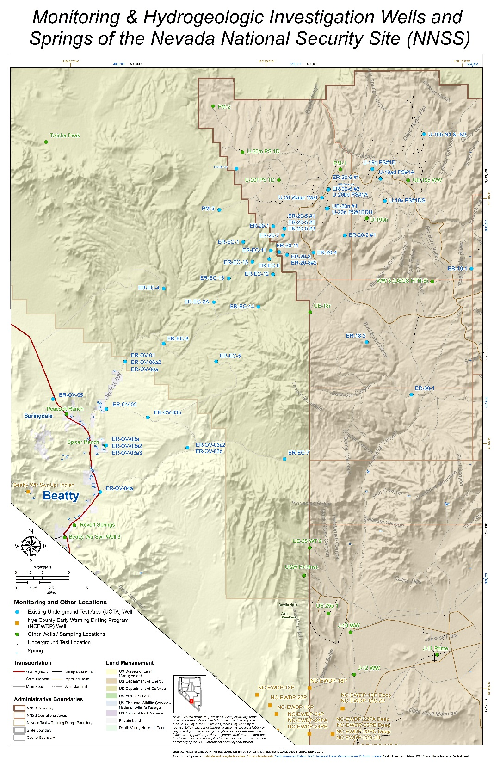
Data Collection
Iterative process over more than 30 years (drilling, data collection, analysis, and modeling)
  Pre-Phase I drilling and testing during the active testing program (1965-1992)
    1996 3-D flow, 1-D transport
  Phase I 1995-2005
    2006-2009 3-D flow and transport
  Phase II 2009-2015
    2022 3-D flow and transport
  Model Evaluation 2023-2025
Pre-Phase I Wells
Phase I Wells
Phase II Wells

Slide 15
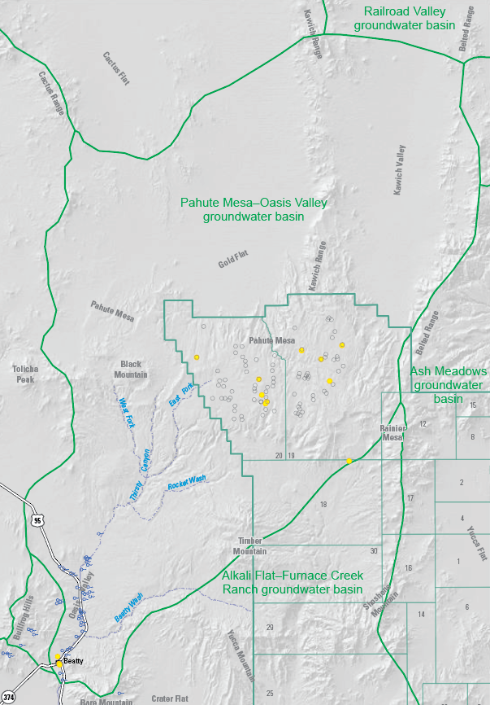
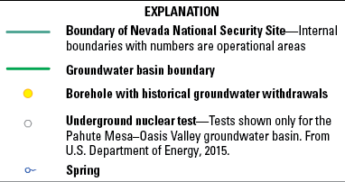

Study Area: PM-OV Groundwater Basin
Starts with regional analysis
Geologic, hydrologic, geochemical, and radionuclide data are integrated to develop this flow conceptualization
Lateral boundaries are no-flow, cross-flow minor
Source: Fenelon et al, 2016 - USGS SIR 2015-5175

Slide 16
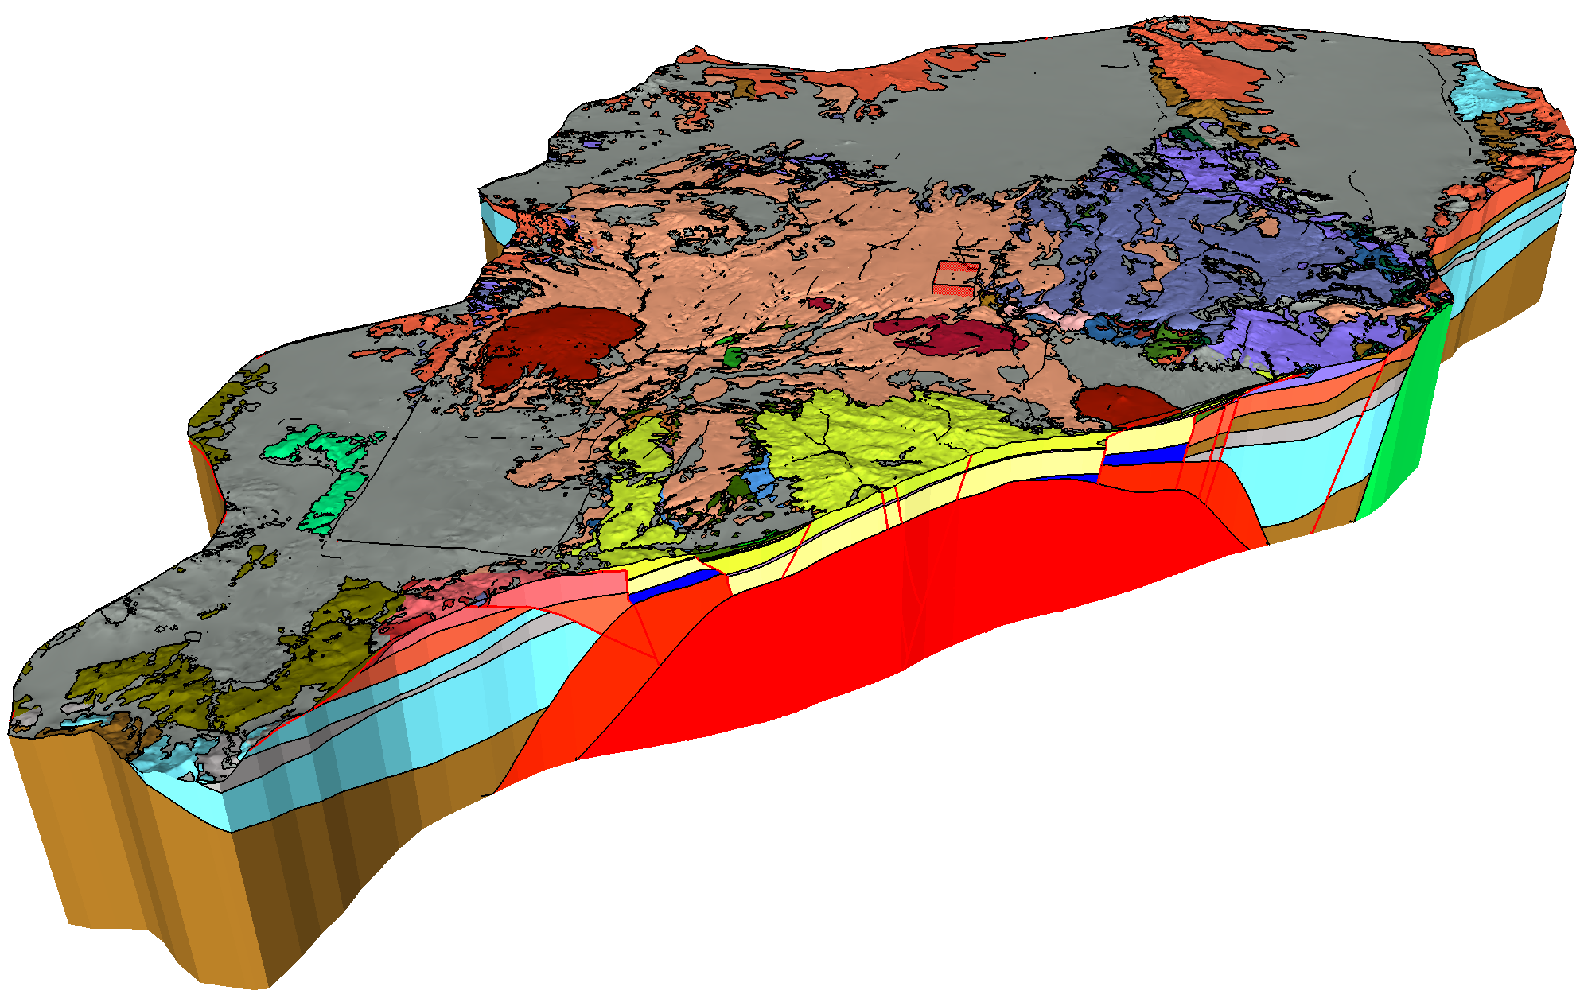
Pahute Mesa-Oasis Valley (PM-OV) Hydrostratigraphic Framework Model (HFM)
Drill cuttings, XRD/XRF, borehole and surface geophysics, surface mapping, potentiometric surface, test locations, aquifer tests, well locations

Slide 17
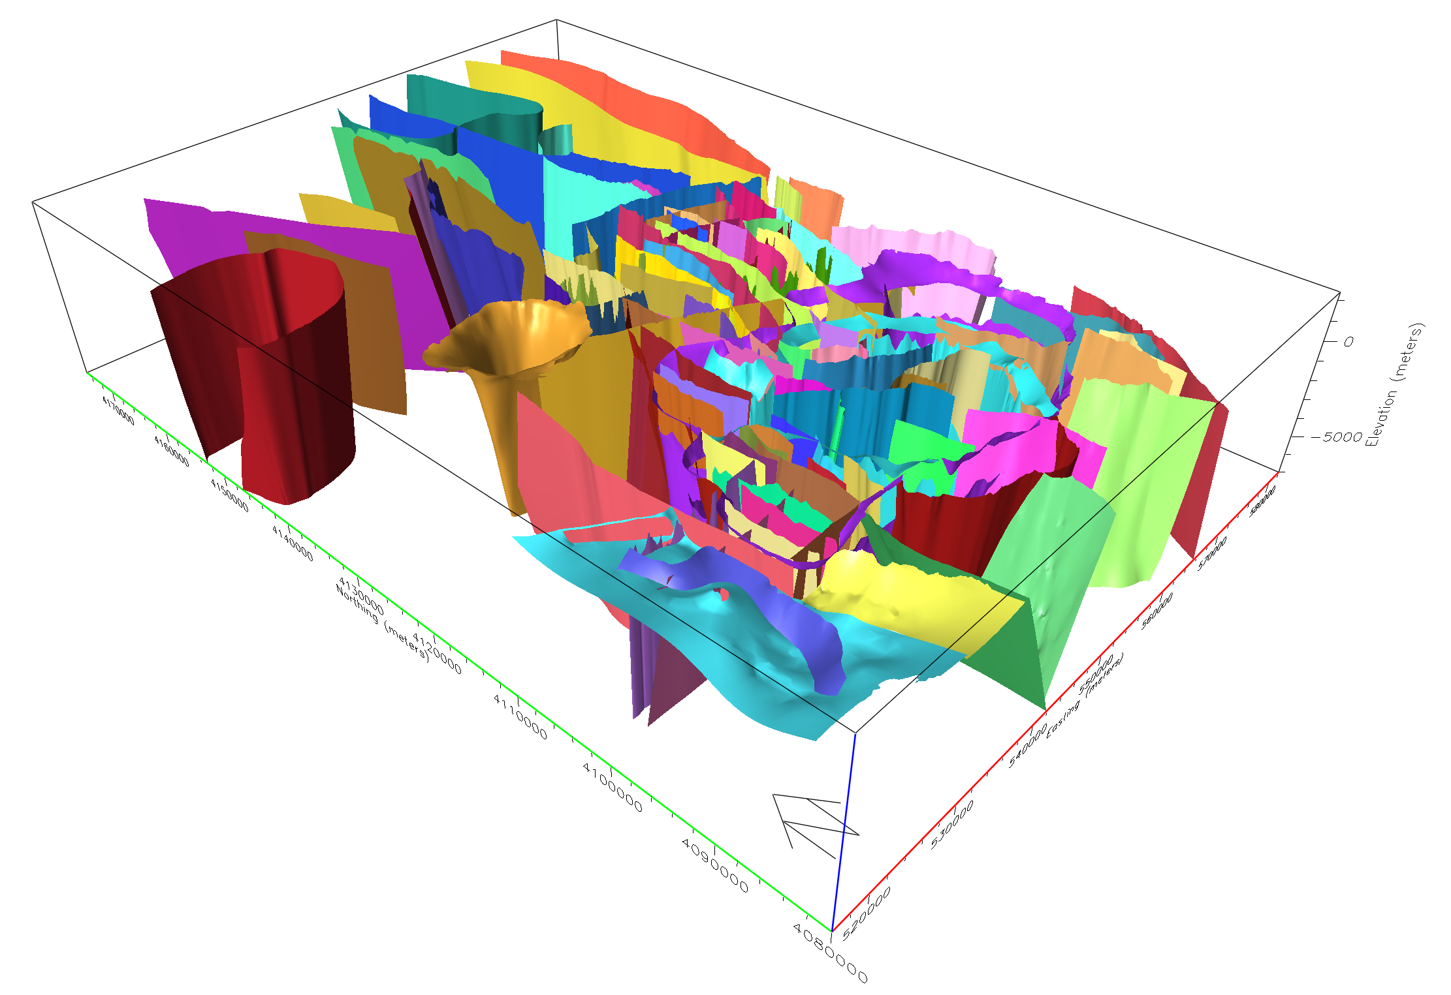
HFM Construction: Structural Surfaces
Structural surface model
Five fault types
HFM contains 105 structural features
63 normal faults
Juxtaposition of units across faults may create barriers to flow or conduits
Some faults are known barriers to flow
Some faults are hypothesized to be conduits for flow

Slide 18
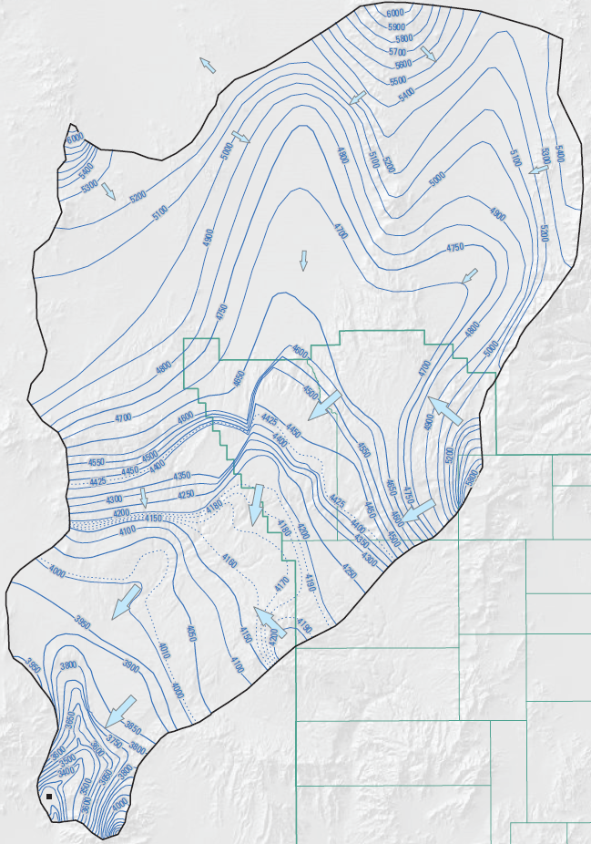

Potentiometric Map
Regional map is 2D portrayal of horizontal gradients and regional groundwater-flow directions
Map represents head in most transmissive rocks at any given horizontal location
Potentiometric contours indicate that groundwater generally flows south-southwest and discharges at Oasis Valley
Water-level data indicates flow from NNSS to Oasis Valley is southwesterly
Water level change from central Area 20 to Oasis Valley ~600 to 1,000 ft
Source: Jackson et al, 2021 – USGS SIR 2020-5134
Potentiometric Surface Elevation
(feet above mean sea level)

Slide 19
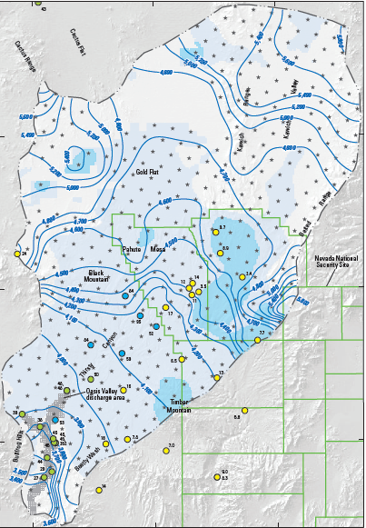
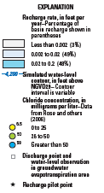
Recharge/Discharge
Recharge to the water table is combination of slow, steady diffuse percolation (very old) and rapid infiltration following wet winters in the uplands
Infiltration occurs over highlands via fractures and faults
Runoff via ephemeral washes
Semi-perched zones occur locally diverting water laterally
Natural discharge occurs only in Oasis Valley
Source: Fenelon et al, 2016 – USGS SIR 2015-5175
Discharge/Recharge distribution
Fenelon et al., 2016; Fig 3

Slide 20
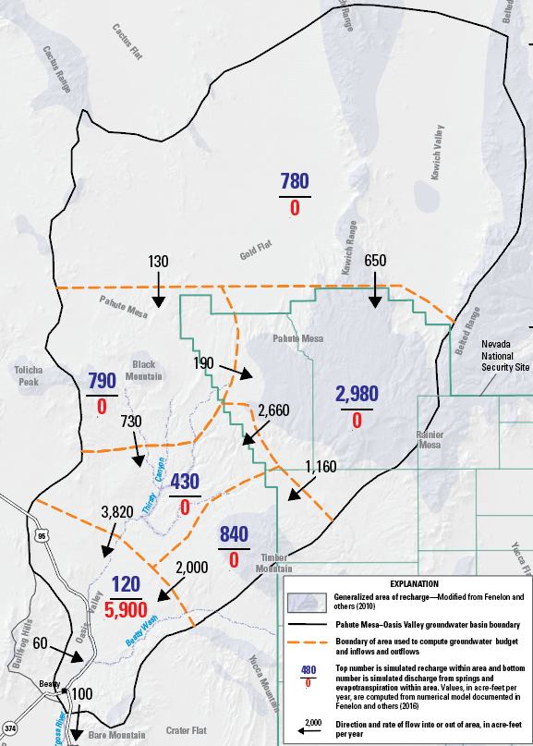
Water Budget
Eastern PM
Jackson and others, 2021 evaluated water budgets for subregions of the groundwater basin
Accounts for ~50% of the recharge in PM-OV basin
65% of groundwater discharging at Oasis Valley flows through area
_{Eastern Pahute Mesa}
Source: Jackson et al, 2021 – USGS SIR 2020-5134

Slide 21
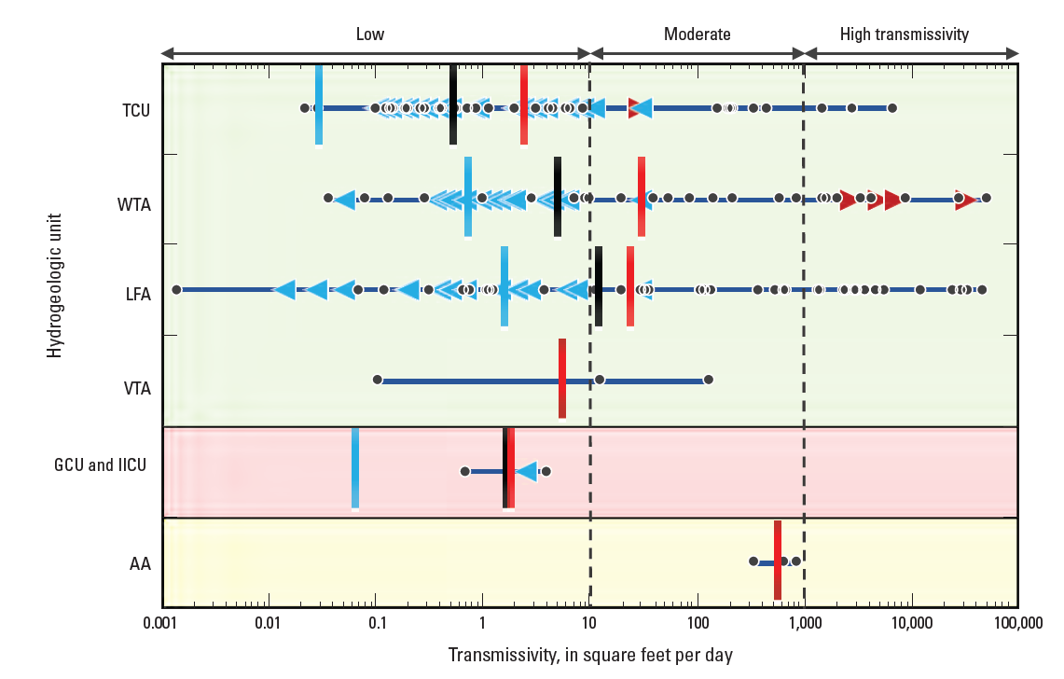
Transmissivity
Data from 347 completions in 71 boreholes including multi-well interference tests
Range of geometric mean values shown
Source: Jackson et al, 2021 – USGS SIR 2020-5134

Slide 22
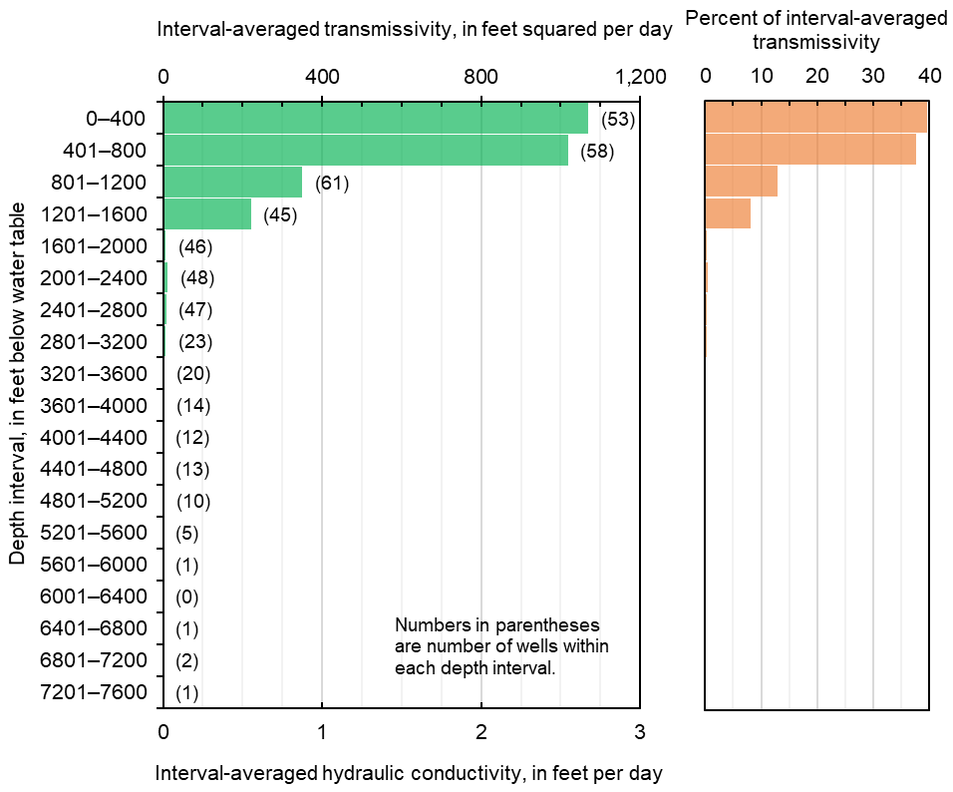
Lower Boundary of Flow System
From groundwater flow perspective, a lower boundary at 1,600 ft below the water table encompasses greater than 90 percent of transmissivity, and therefore, nearly all flow
Lower boundary should encompass all underground nuclear tests and tritium plumes
Depth of 4,000 ft below water table is sufficiently deep for lower boundary to encompass all nuclear tests, tritium plumes, and nearly all flow
Source: Frus and Halford, 2018 USGS SIR 2018-5096

Slide 23
Source Term
Screening analysis provided by Lawrence Livermore National Laboratory
Evaluated variability in
  Radionuclide inventory
  Spatial distribution
  Partitioning to melt glass
  Minerology/alteration/sorption
  Fracture parameters
  Matrix porosity/bulk density
  Groundwater chemistry
Source: Carle et al, 2020 – LLNL-TR-812351

Slide 24
Source Term – Other Radionuclides
Source: Carle et al, 2020 – LLNL-TR-812351

Slide 25
Underground Radiologic Inventory at PM Includes 43 Long-Lived Isotopes
(modified from Finnegan et al. 2016, Table 7)
A short list of 15 radionuclides of relevance or potential relevance (at or above 10% of the SDWA standard) for PM CAU model were selected for simulation
Al-26 not shown, would plot to right of Am-243

Slide 26
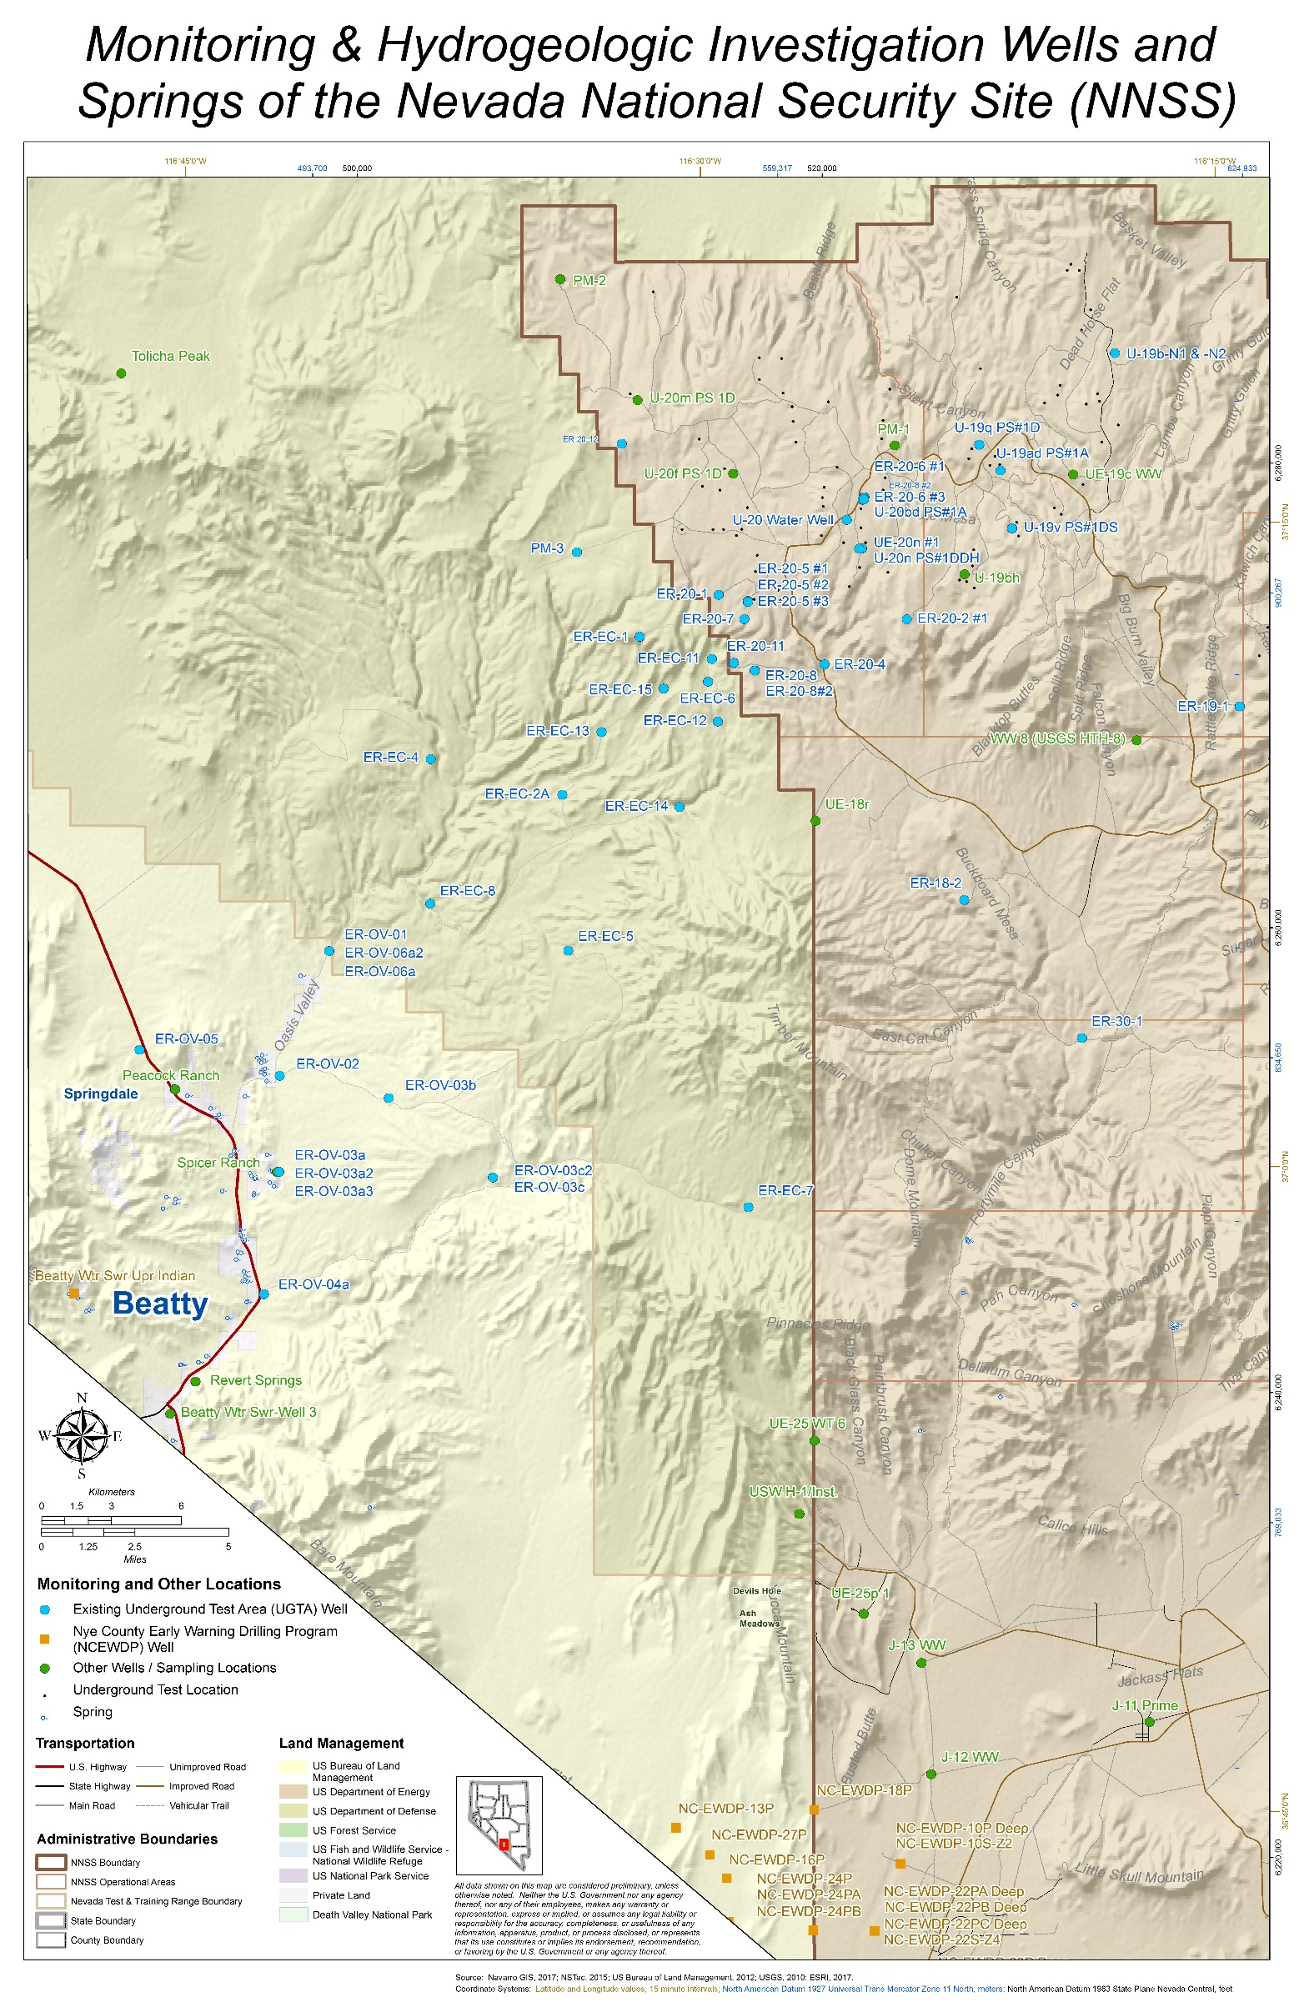
Tritium as of 2022
after ~50 years of transport
Approximate Area of Tritium above the MCL
_{HANDLEY}
_{BENHAM}
_{CHESHIRE}
Conceptualized Tritium Extent above the MCL (10-4 dispersed edge not center of mass)
Ambient migration for ~50 years is 2-4 km Center of mass ~ ½ this distance
Other plumes may exist but are not yet observed

Slide 27
Key Conceptual Model Features
Development of conceptual model was a long-term, iterative, and collaborative process
PM-OV is a closed basin surrounded by no-flow boundaries
Discharge is measured at 5,900 acre-ft/year (+/- 15%)
Steady-state: Recharge = discharge within the basin
More than 90% of transmissivity is in the upper 1,600 ft of the groundwater system
The most rapid radionuclide transport will occur in the upper portion of the flow system – leading edge migration ~2-4 km/50 years
Rock unit transmissivity is heterogeneous and controlled by fracture density and permeability
Two alternative fault conceptualizations are considered
  Faults juxtapose units to create permeability contrasts
  Faults are separate permeability regions and can be barriers or conduits

Slide 28
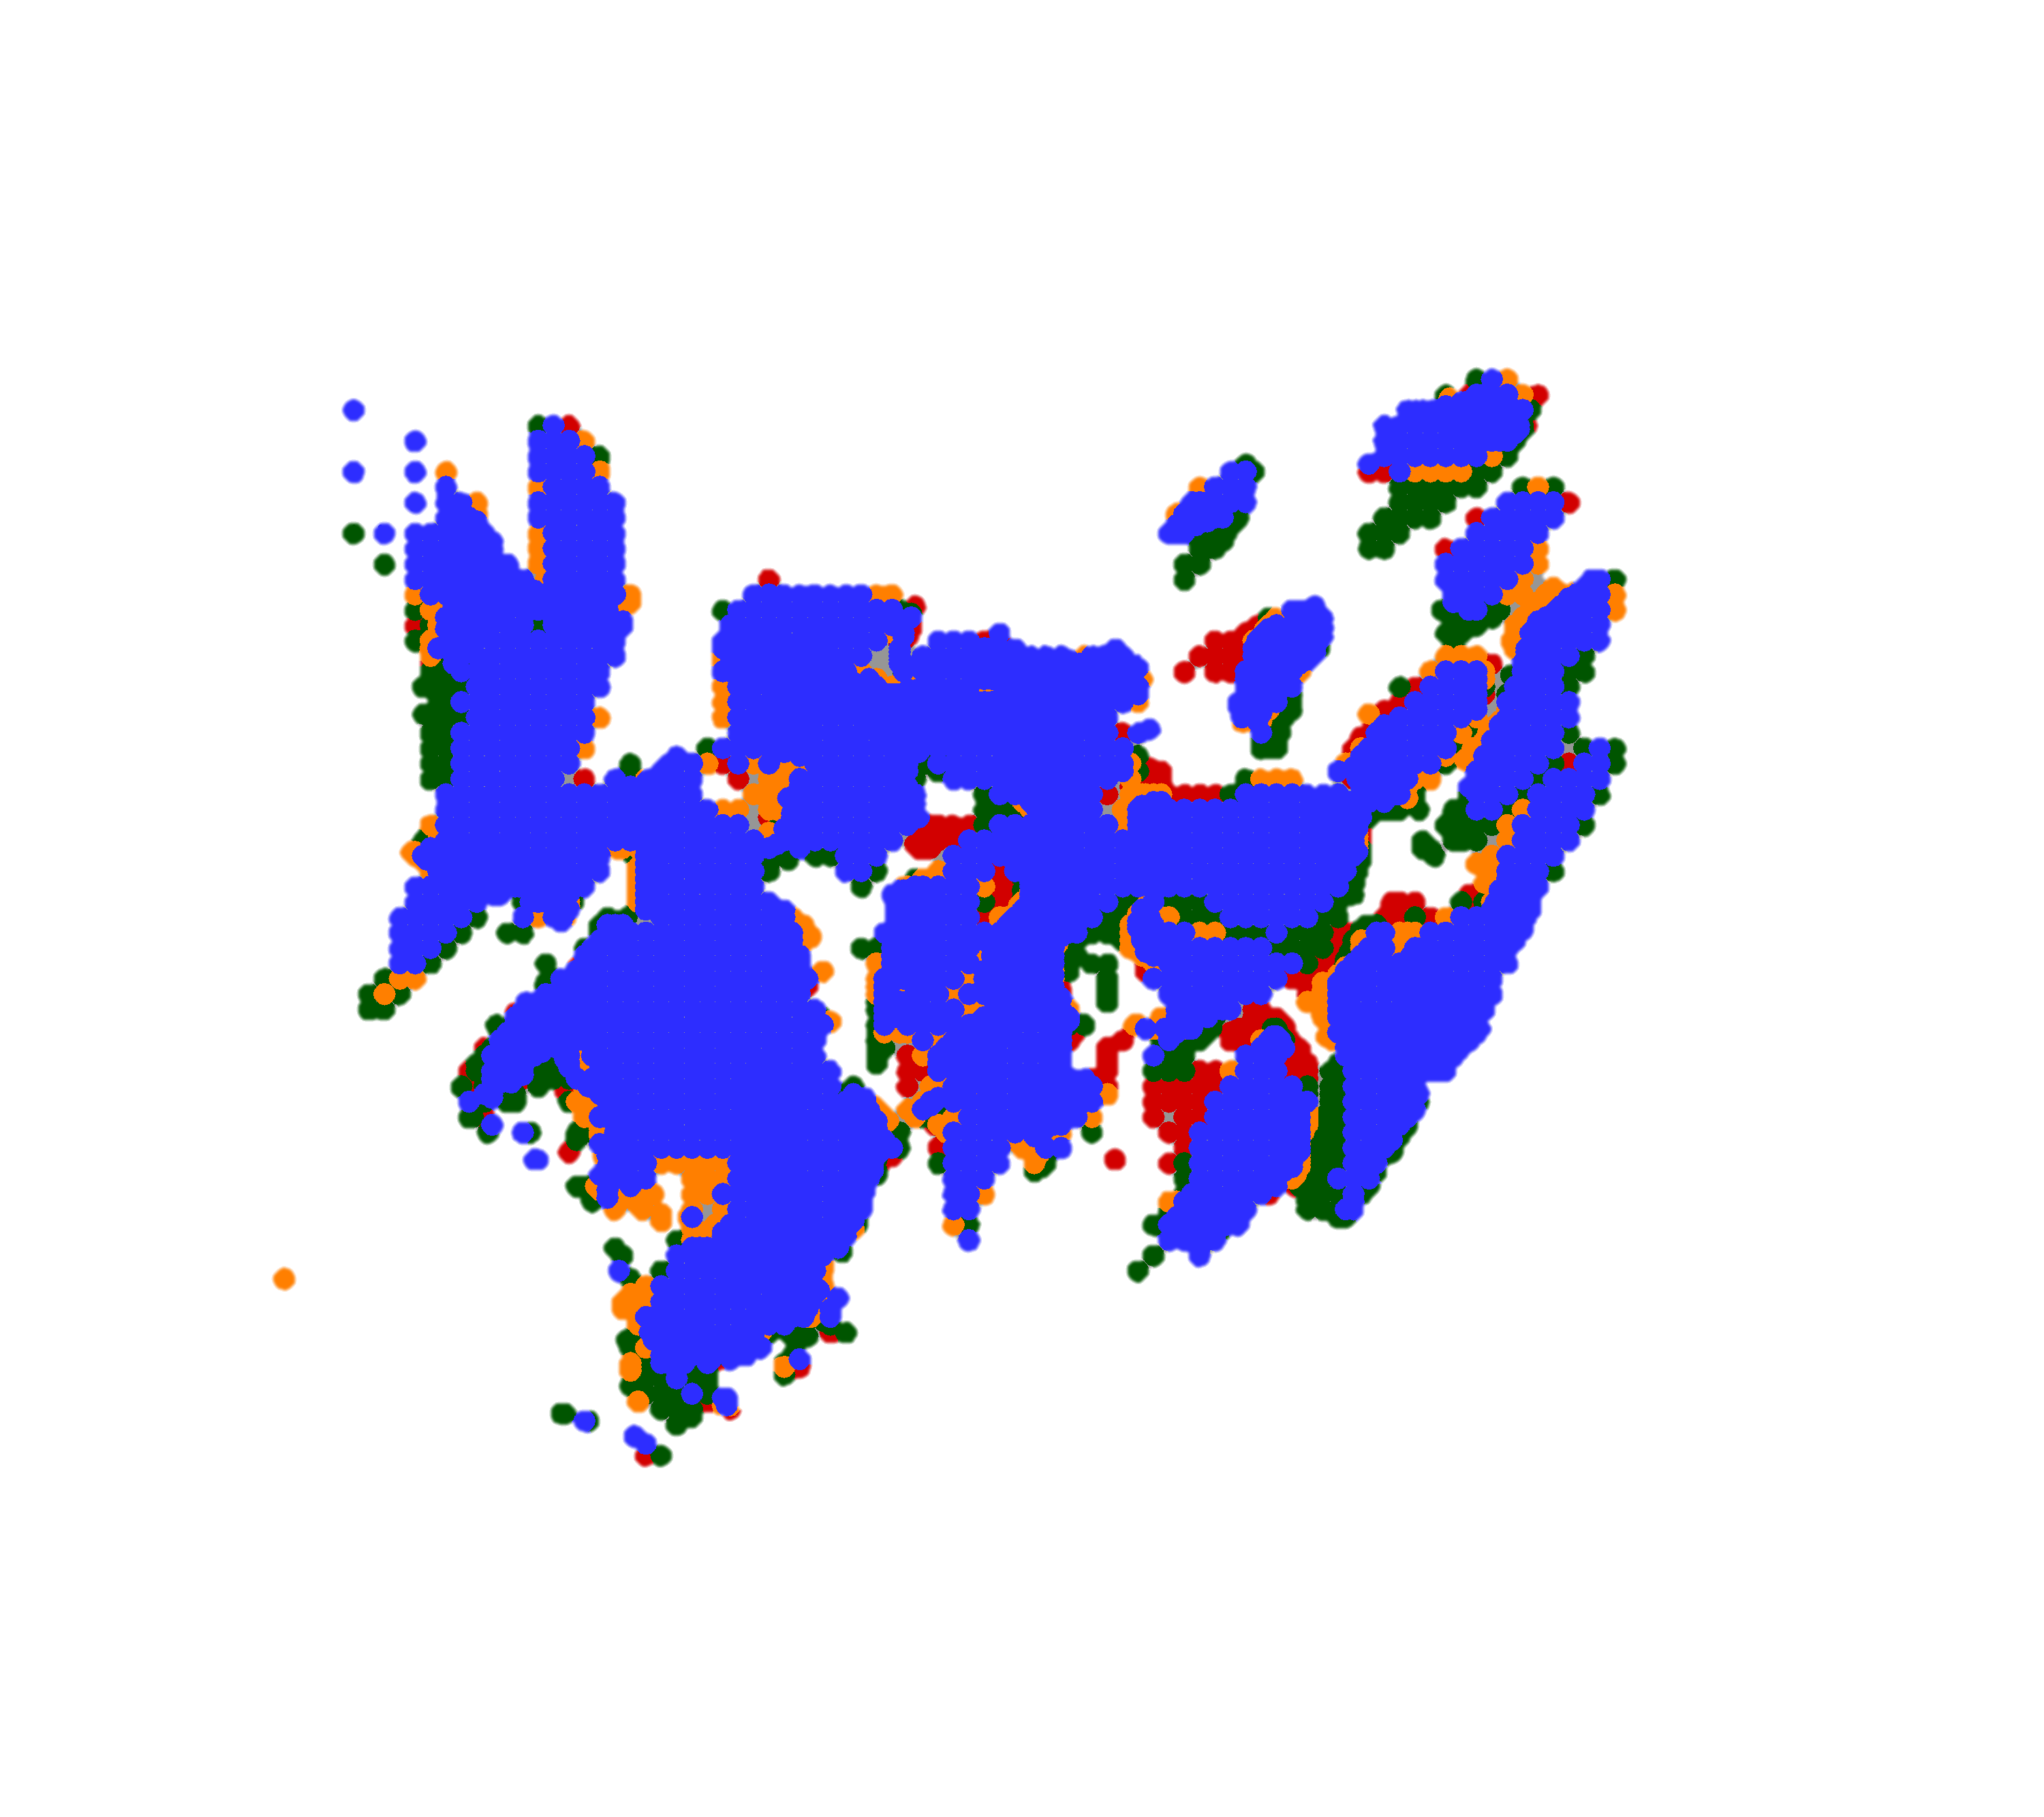
Final Simulated 1,000-Year Contaminant Boundary at 95th Percentile
Conceptual model integrated all the different information into a self consistent picture
Groundwater flow, water budget, aquifer properties, radionuclide observations provided a consistent interpretation
Based on current knowledge, contaminated groundwater is not expected to reach publicly accessible locations within 1,000 years

