Slide 1
NRC’s Integrated Low-Level Radioactive Waste Disposal Rulemaking
DOE Performance And Risk Assessment Community of Practice Webinar
Priya Yadav
David Esh
July 13, 2023

Slide 2
Agenda
Rulemaking background
Safety case and technical assessments
Radon and Table Calculator
Timeframes (compliance period)
Waste acceptance
GTCC waste considerations
Exception criteria and significant quantities
Implementation guidance
Schedule and contacts

Slide 3
Prior Rulemaking Efforts
LLW Disposal rulemaking to address waste streams that differ significantly in quantity and concentration from what Part 61 originally assumed
SECY-16-0106 to the Commission as draft final rule
Regulatory basis for the disposal of Greater-than-Class-C (GTCC) waste through means other than deep geological disposal (SRM-SECY-15-0094)
In 2019 the NRC issued the draft regulatory basis for public comment
The regulatory basis concluded that most of the GTCC waste streams are potentially suitable for near-surface disposal

Slide 4
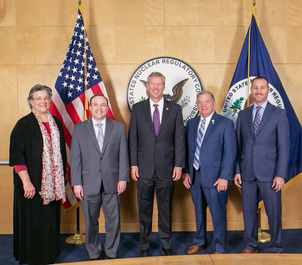
Commission Directions
Combine the Part 61 and GTCC efforts to address overlapping technical requirements, streamline stakeholder outreach, and gain efficiency in proceeding as one rulemaking activity (SECY-20-0098)
Commission issued Staff Requirements Memorandum (SRM-SECY-20-0098) on April 5, 2022

Slide 5
Integrating the LLW Rulemakings
Depleted Uranium
GTCC waste
TRU Waste
Site-Specific Analyses
Consolidate and integrate criteria for GTCC and 10 CFR Part 61 rulemaking
Conduct site-specific analyses for all waste streams including DU and GTCC waste
Include graded approach for compliance period
Include TRU waste in the definition of LLW
Address physical protection and criticality concerns in GTCC waste streams
Provide for Agreement State licensing of certain GTCC waste streams
Integrated
Low-Level Radioactive Waste Disposal
Rulemaking

Slide 6
Safety Case and Technical Assessments
Safety Case
Widely recognized internationally
Original Part 61 has many elements
Useful to stakeholders to better understand basis for decisions
Technical Analyses (61.13)
Performance assessment (not new – renamed)
Intruder assessment (new)
Site stability assessment (new for significant quantities of long-lived)
Operational safety assessment (for some types of GTCC waste)
Performance period analyses (for significant quantities of long-lived)

Slide 7
Safety Case
A high-level summary of the information and analyses that support the demonstration that the land disposal facility will be constructed and operated safely – think executive summary.
Provides reasonable assurance that the disposal site will be capable of isolating waste and limiting releases to the environment.
Describes the strength and reliability of the technical analyses.

Slide 8
Performance Assessment
The technical analyses completed for existing sites for the potential impacts to an offsite member of the public are considered synonymous with a modern performance assessment
Understanding, tools, and capabilities have improved significantly since the early 1980’s
Significant guidance developed to support the proposed requirements for performance assessment (e.g., FEPs, uncertainty, model support)

Slide 9
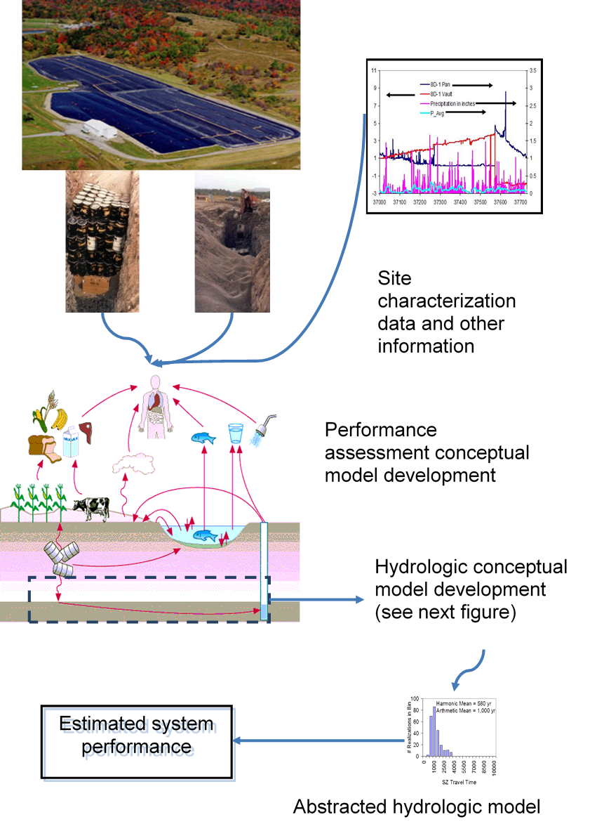
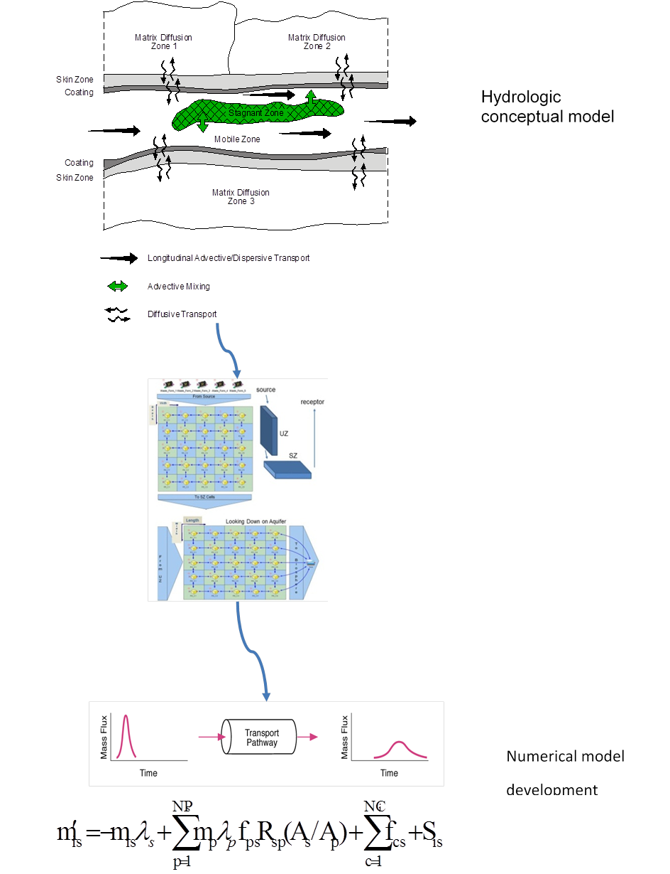
Performance Assessment – Guidance Example

Slide 10
Performance Assessment - Radon
Some regulations have radon flux limits whereas others include radon in dose limits
EPA - 40 CFR 61 in some cases provides radon flux limits (DOE, phosphogypsum stacks, uranium mill tailings disposal) and in others provides standards to include radon as part of public dose limits @ 10 mrem/yr (uranium mines, non-NRC federal facilities)
Cannot resolve the different treatments of radon in regulations in this rulemaking
Can ensure treatment is internally consistent within Part 61 and within NRC in general

Slide 11
Performance Assessment - Radon
Current Part 61 considered only small quantities of uranium, therefore, radon was not an issue
Existing guidance – include radon (NUREG-1573)
The receptors for different performance objectives (offsite vs. intruder) create practical challenges for application of flux limits
NRC public dose limit (10 CFR Part 20.1301) includes all pathways and all radionuclides.
10 CFR Part 40 (offsite public) and 10 CFR Part 20 subpart E (restricted release) include radon

Slide 12
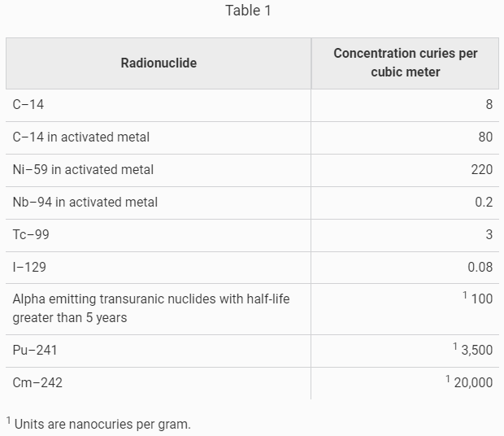
Intruder Assessment
The basis for 61.55 in the current regulation is an NRC intruder assessment
Revised requirements would allow for a site-specific intruder assessment
This is a flexible and risk-informed approach

Slide 13
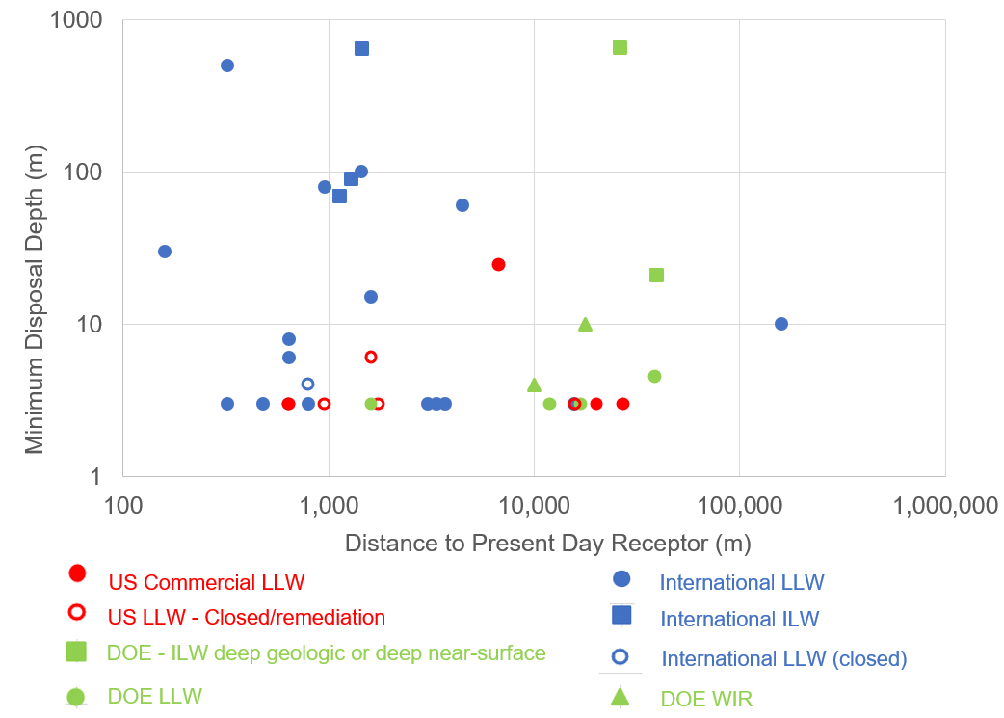
Intruder Assessment

Slide 14
TableCalculator
To increase understanding of Part 61 and facilitate commenting on proposed regulations NRC completed the TableCalculator project
The original calculations supporting 61.55 were found in a series of large NUREGs
TableCalculator is a modern tool to increase transparency (available through the NRC RAMP website)
NRC is not changing the 61.55 tables in the integrated rulemaking (will evaluate in future)

Slide 15
TableCalculator

Slide 16
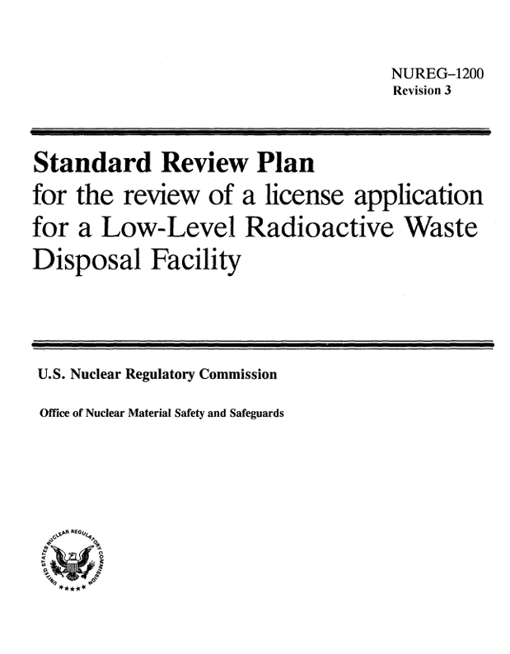
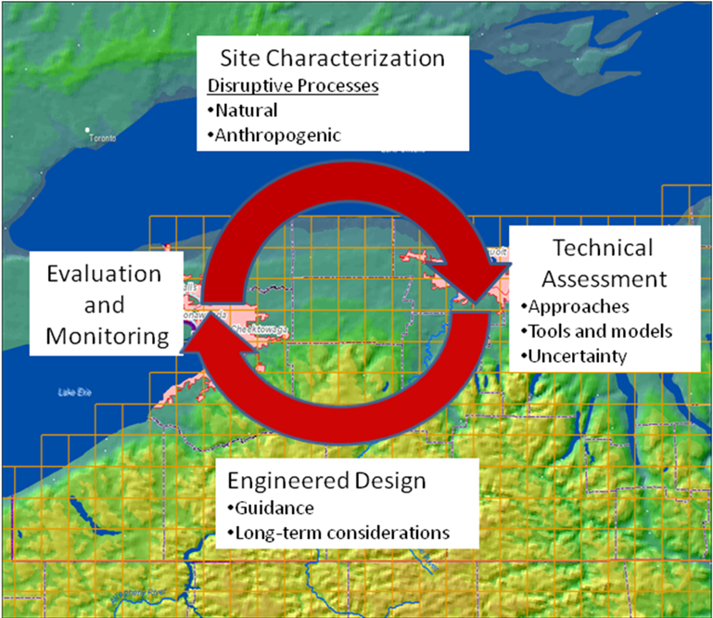
Site Stability Assessment
Most problems with early disposal sites arose from short-term stability issues
Those problems were addressed through design and site characteristic requirements
Disposal of significant quantities of long-lived radionuclides may require long-term stability assessment
Addressed in the context of 61.41 and 61.42

Slide 17
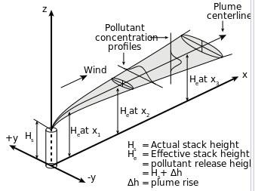
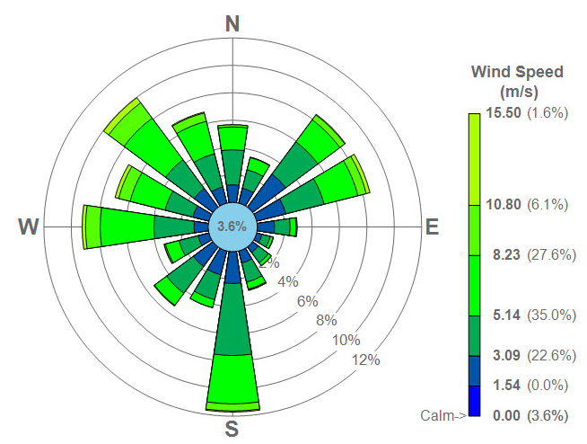
Operational Safety Assessment
Operational safety (61.43) is typically achieved through a combination of systems, procedures, controls, and training
Accidents scenarios were evaluated by NRC when 10 CFR 61 was developed
Some GTCC waste may contain sufficient radioactivity that an operational safety assessment may be necessary

Slide 18
Performance Period Analyses
Performance period only applies if significant quantities of long-lived radionuclides will be disposed
Expected proposed standard is to reduce exposures to the extent reasonably achievable
Provide transparency to stakeholders on the expected long-term performance of the disposal system
Long-term results not a measure of projected human health impacts

Slide 19
Safety and Compliance
Safety can be achieved through different means:
Disposal concept
Prescriptive design
Technical analyses
Proposed approach leans more heavily on technical analyses to afford greater flexibility

Slide 20
Timeframes (Compliance Period)
Commission direction has two options
Peak dose or
Use different compliance periods depending on the long-lived component of the waste
Staff is considering the latter option – flexible and site-specific
Compliance period of 1,000 years without significant quantities of long-lived radionuclides otherwise 10,000 years and performance period

Slide 21
Timeframes (Compliance Period)
Carefully examined comments on this issue
Primary consideration is current practices by Agreement States (AS)
Compatibility class will likely allow the AS to be more restrictive
Considered what has been done in the US and internationally

Slide 22
Timeframes (Compliance Period)
Uncertainties in societal and environmental conditions will increase over time
Regulatory approval to allow disposal needs to evaluate impacts, recognizing the uncertainty – not stop the analysis
Other approaches could be used to mitigate uncertainties:
Require deep geologic disposal (i.e., Germany)
Place restrictions on long-lived radionuclides appropriate for near-surface disposal
Use design requirements (e.g., 10+ m disposal depth for large quantities of depleted uranium)

Slide 23
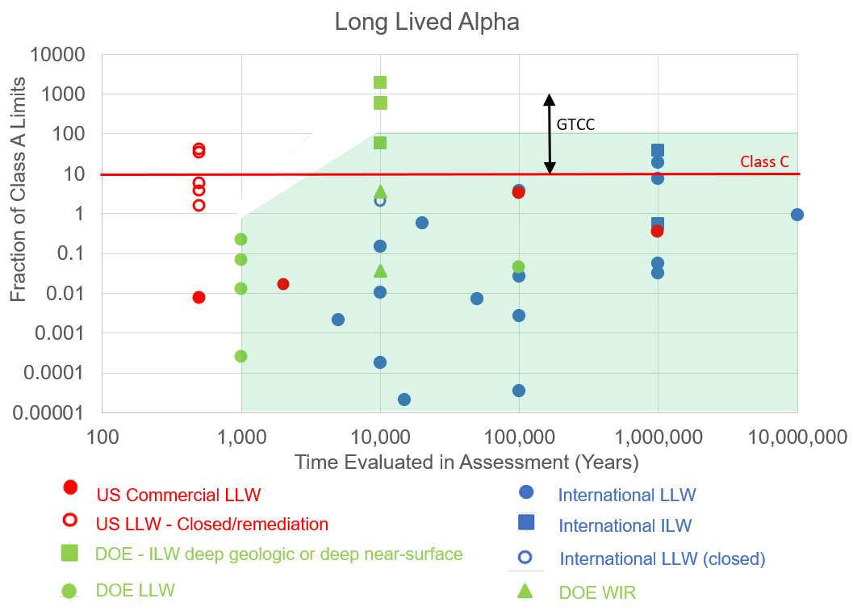
Timeframes (Compliance Period)
DRAFT

Slide 24
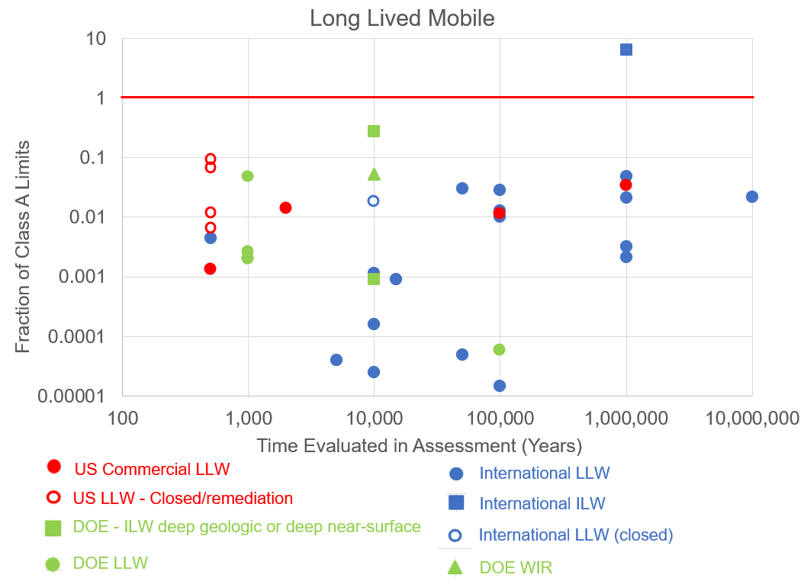
Timeframes (Compliance Period)
Class A
DRAFT

Slide 25
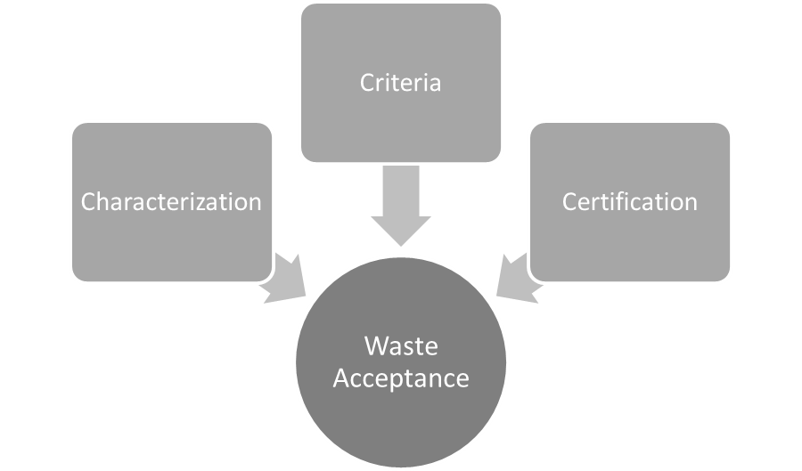
Waste Acceptance
Site-Specific Waste Acceptance Criteria (WAC) (§ 61.58)
Generic: Use §61.55 limits, §61.56
Site-Specific: results of §61.13 technical analyses
Licensees review their waste acceptance program annually
If approved, incorporated into license
Generators still use §61.55 for waste classification
25

Slide 26
GTCC Waste Considerations - Disposal
Near-surface disposal requires 5 m depth and intruder barrier
10,000 nCi/g threshold
Case-by-case approval by Commission
Additional waste characteristics requirements in § 61.56
Heat generation, radiolysis, criticality
Not dispersible

Slide 27
GTCC Waste Considerations - Criticality
Current requirements under Part 61 require demonstration of criticality safety procedures for preventing criticality accidents without consideration of the concentration of fissile material in the waste (prior to disposal)
Provide an exemption for radioactive waste with very dilute concentrations of fissile material for which there are no credible means to achieve a critical condition
Include an additional requirement for disposal units containing significant amounts of fissile material (following disposal)
Applicant must identify design measures that limit the potential for reconcentration of fissile material
27

Slide 28
GTCC Waste Considerations – Physical Protection
Current requirements mandate licensees receiving or possessing nuclear material (SNM) in quantities that exceed the 10 CFR 150.14
Must satisfy the physical security requirements of 10 CFR 73.67, a “common defense and security” regulation that can only be enforced by the NRC
Provide an exemption in NRC Regulations (10 CFR 73.67) for physical protection of waste at a near-surface disposal facility containing very dilute quantities of SNM
Physical protection of radioactive waste commensurate with the threat and limited attractiveness
Physical protection requirements remain under 10 CFR Parts 20 and 37
28

Slide 29
Exception Criteria
§ 61.1 (b) (Purpose and scope)
Exception criteria
the land disposal facility license was originally issued before the effective date of this rule; and
the licensee does not accept a significant quantity of long-lived radionuclides after the effective date of this rule
Licensees who meet these exceptions do not need to comply with revised Technical Analyses (§ 61.13), revised Performance Objectives (§ 61.41 and § 61.42), and WAC (§61.58)
Excepted licensees would be required to comply with original Part 61 regulations

Slide 30
What are Significant Quantities?
Definition in § 61.2
Significant quantities of long-lived radionuclides means an amount (volume or mass) and concentration accepted for disposal after the [effective date of this rule] that could, if released, result in the performance objectives of subpart C of this part not being met.
Amount for selection of compliance period (1,000 or 10,000 years)
Amount for demonstrating meeting exception criteria
For the purposes of this paragraph, less than 10 metric tons of depleted uranium is not considered a significant quantity of long-lived radionuclides.

Slide 31
Significant Quantities
Site-specific calculations to determine what amounts are significant
Though a simple approach is preferred, to properly account for the multiple key factors a more complex approach could be needed
Determined by licensee and approved by regulators
Example approaches included in NUREG-2175
Table of concentrations of long-lived radionuclides for potential use as generic screening values

Slide 32
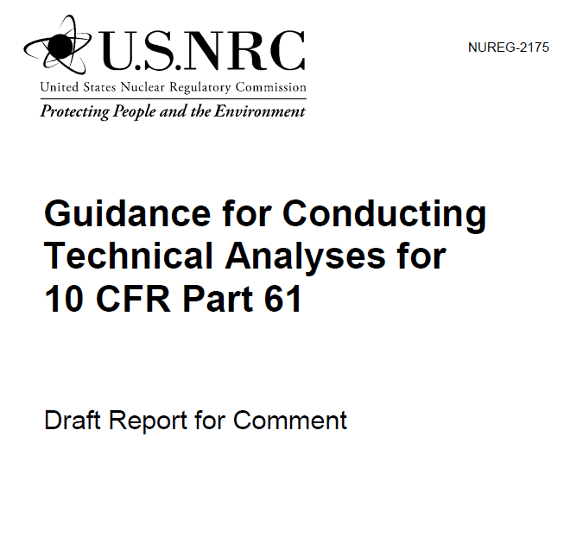
Implementation Guidance
Draft in NUREG-2175 in 2015 for public comment
Draft final version of guidance published in 2016 on NRC Part 61 website
Updates for Revision 1
Appendix for GTCC waste disposal considerations
Appendix for approach to calculate significant quantities of long-lived radionuclides
Revisions based on proposed rule language

Slide 33
Schedule
You are here
Rulemaking
Develop Proposed Rule that Integrates GTCC and 10 CFR Part 61 Rulemaking
Submit to Commission for Approval
Publish Proposed Rule
Hold Public Meetings and Comment Period
Develop Final Rule
Submit to Commission for Final Approval
Publish Final Rule
5/17/23 Public Meeting
Onsite meetings at “sited” states and virtual meetings
May 2024
November 2025
Guidance
Revise NUREG-2175 and Develop GTCC Guidance
Hold for Commission Approval of Proposed Rule
Publish Draft Guidance
Hold Public Meetings and Comment Period
Develop Final Guidance
Hold for Commission Approval of Final Rule
Issue Final Guidance

Slide 34
Contacts
George Tartal george.tartal@nrc.gov 301-415-0016 Priya Yadav
priya.yadav@nrc.gov 301-415-6667
David Esh David.Esh@nrc.gov
301-415-6705
Cardelia Maupin cardelia.maupin@nrc.gov 301-415-4127

