Slide 1
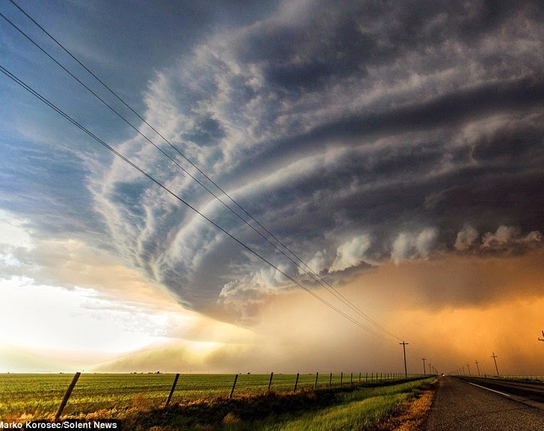
Risk and Natural Hazards
Exploring the relationship between our environment, society, and the risks we face

Slide 2
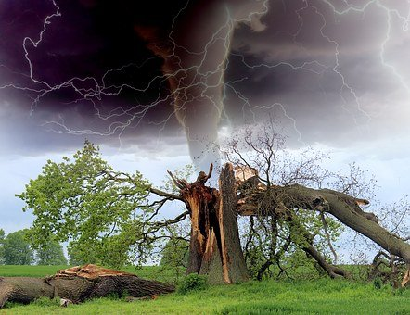
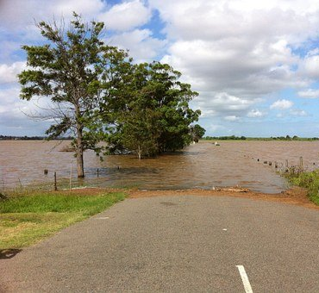
What is a natural hazard?
Natural hazards are potentially catastrophic events with natural origins that can lead to fatalities, property damage and social environmental disruption [1]. When one of these potential events occur, it can become a natural disaster
Some examples include:
Floods
Tornadoes
Hurricanes
Can you name others?

Slide 3
By the end of this unit, you should be able to
Describe what a natural hazard is and the associated risks it presents
Provide reasons why people might choose to accept risky situations
Explore decision-making strategies and solutions used to manage risk

Slide 4
Hazard-specific risks
Exploring the risks that natural hazards pose in our community

Slide 5
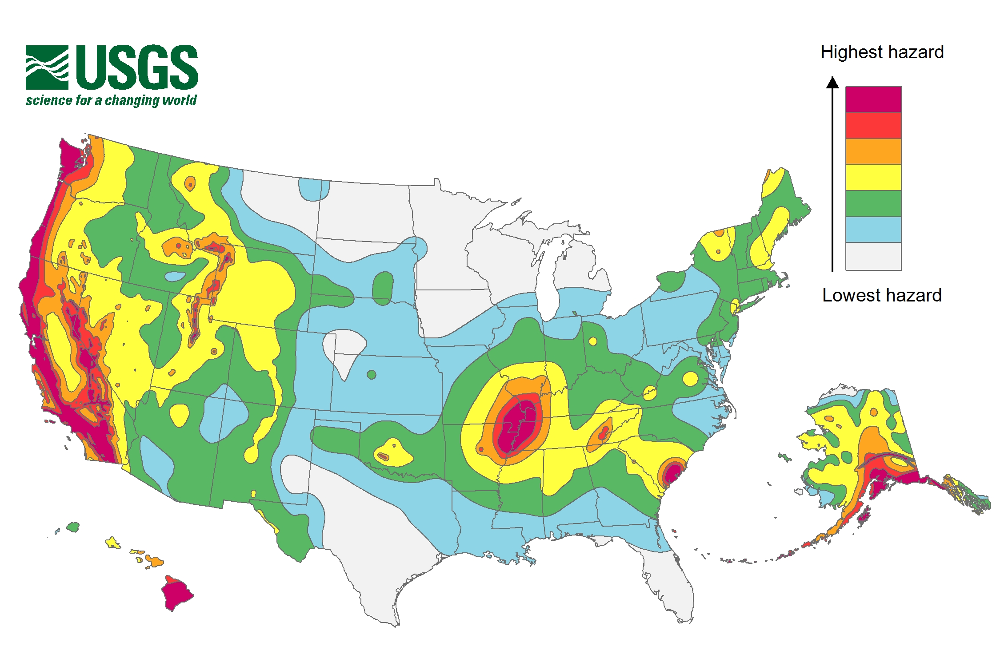
Earthquake Risk
Earthquakes occur when two landmasses on earth's crust are in contact and shift position, releasing energy in the form of waves
Based on the map to your right, what is the risk level in your area?
LOW?
MEDIUM?
HIGH?
VERY HIGH?
[1] 2018 Long-term National Seismic Hazard Map (usgs.gov)

Slide 6
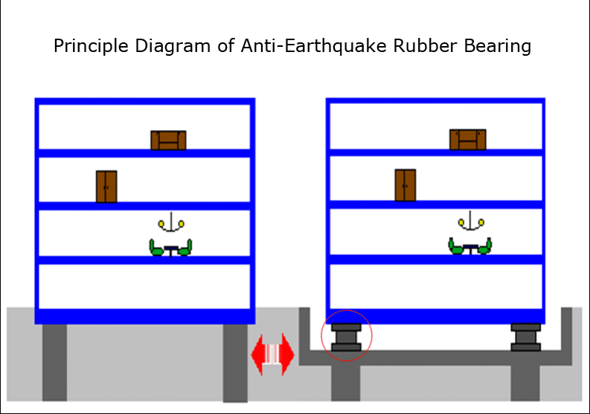
How can we respond to an earthquake?
While we cannot stop an earthquake, there are technologies that have been developed to limit the effects of the seismic waves.
One method called base isolation places the building on flexible rubber bearings that absorb some of the energy when the ground moves (see figure)
- Retrofit for avg. high school building: $781,000 [2]
- Retrofit for avg. home: $17,000 [2]
Based on the risk in your area, do you think this method is worth the price? Why?
Bonus: Find another method used to earthquake-proof a building

Slide 7
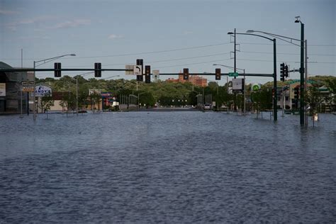
Flood Risk
Flooding, the most common disaster, occurs when an area collects more water than can be naturally drained in a given time. While flooding mostly results from natural causes (e.g., heavy rain), human actions can increase the damages.
Find your school's address here:
FEMA Flood Map
What is the risk level in your area?
LOW? MEDIUM? HIGH? VERY HIGH?

Slide 8
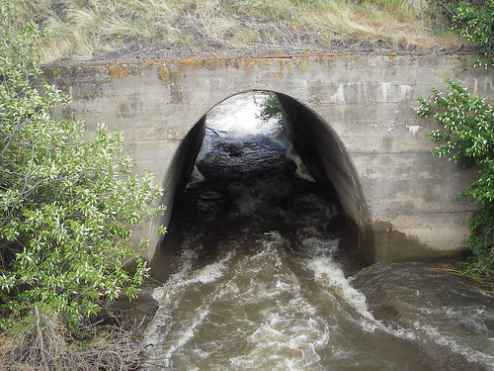
Flood Risk
Engineers design structures like levees, retention ponds, and stormwater drains to help redirect water to safe spaces
When these aren't enough, government programs focus on other methods, such as:
Offering Flood Insurance
Buying land in flood zones
Offering funding to those looking to build flood-resistant infrastructure

Slide 9
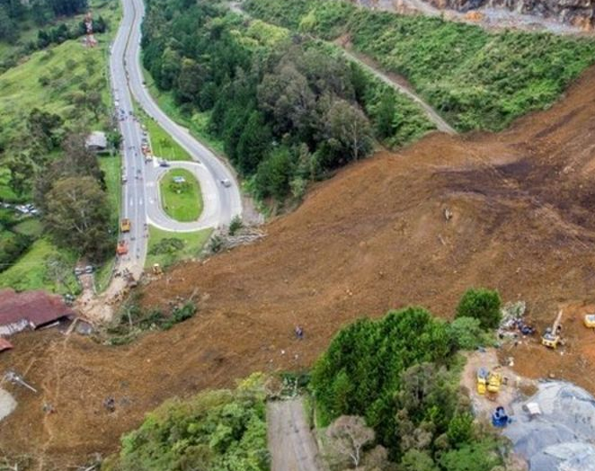
Landslide risk
A landslide is defined as the movement of a mass of rock, debris, or earth down a slope
Steep slopes, roads, underlying geology, earthquakes, and forest loss can make landslides more likely [3]
Check out landslide risk on a global scale:
A Global View of Landslide Susceptibility

Slide 10
How can we prevent a Landslide?
Keeping a good number of trees and vegetation can limit soil movement and make a landslide less likely.
Building retaining walls & similar structures also may help to limit damage to property and lives

Slide 11
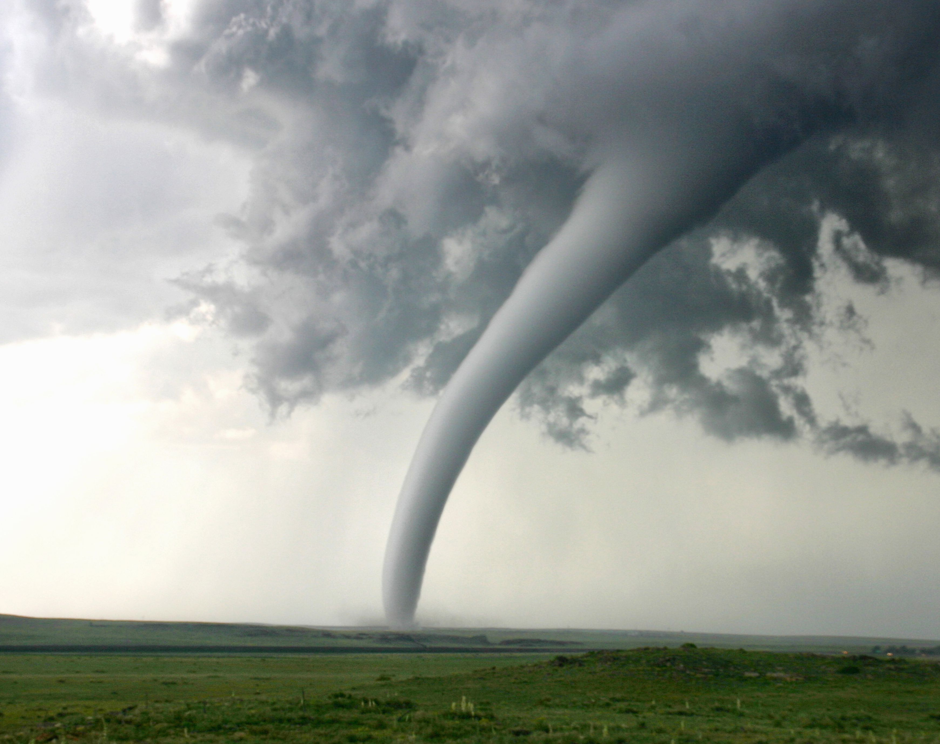
Tornado risk
A tornado is a vertical funnel of violently spinning air, produced when areas of high pressure and low pressure in storm clouds
Tornado intensity is rated based on the Enhanced Fujita (EF) Scale where EF0 is the weakest category with gusts up to 85 mph and EF5 is the strongest with wind gusts over 200 mph [5]
Tornado facts and information (nationalgeographic.com)
Tornadoes | UCAR Center for Science Education

Slide 12
Can we predict a tornado?
Weather modelling has allowed for weather stations to give early warning for tornado events
Tornado Watch : A watch means conditions are in place in parts of a state or several states
Tornado Warning: A warning means a tornado has been seen by radar and/or spotters and is a serious danger to life and property to those in its path. [4]
Severe Weather 101: Tornado Basics (noaa.gov)

Slide 13
Natural Hazards and Society
Exploring the effects of disaster and how to limit vulnerability

Slide 14
Case Study: City Budget
Your town is prone to experiencing floods, so the city put some extra money aside to help fix the issue. There is a $ 1 million budget, and the following options are available to help:
Which programs would you spend your money on? Break into groups and discuss.
 | Economic Cost ($) | Risk Reduction Impact (Rating) | Number of people affected
Upgrade the Emergency Alert System | $250,000 | Medium | High
Upgrade infrastructure (e.g. Levees, retention ponds) | $900,000 | High | Medium
Offer to purchase 3 homes in flood-prone areas | $750,000 | Very High | Low
Improve Disaster Preparedness Training | $150,000 | Medium | High

Slide 15
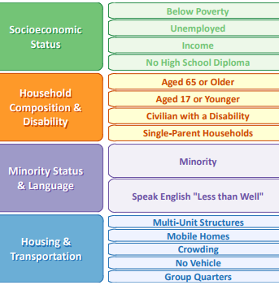
The Effects of Natural Disasters
Typically, disasters don’t affect everyone equally. Vulnerable populations suffer more from disasters and take longer to recover [2].
The following factors potentially play a role in a community's vulnerability:
Socio - economic status: those in poverty may not have insurance
Age & health: Young children, the elderly, and the disabled may lack transportation
Location: some neighborhoods may be in high-risk areas
Access to transportation: people may be unable to evacuate without a car
Ethnicity: population differences influenced by historic or current biases may place some at greater risk to disaster
Social Vulnerability Index (SVI) metrics from the CDC

Slide 16
How dangerous is it? Depends who you ask.
How people react to potential risks is based on several factors, including but not limited to:
Familiarity with the risk
Level of control they have
Risk of personal loss
Personal experience
Look at these three cases and see which factors they use to determine the risk of natural disaster
Person 1: "My family has lived near the coast for generations, and we've never been displaced by a flood, hurricane, or any other disaster. I just don't think that will change."
Person 2: "I have many family members that have been affected by natural disasters, and I personally lost my home to a wildfire. I take any threat seriously"
Person 3: "I worry that in the event of a disaster, I won't be able to get to safety in time. I try to live in places with low risk for extreme events"
Notes:
Person 1: Familiarity and experience
Person 2: Personal experience
Person 3: Level of control/risk of personal loss

Slide 17
What hazards are in your area?
Explore the potential risks in your region HERE: The Most Common Natural Disasters Across The U.S. | Red Cross

Slide 18
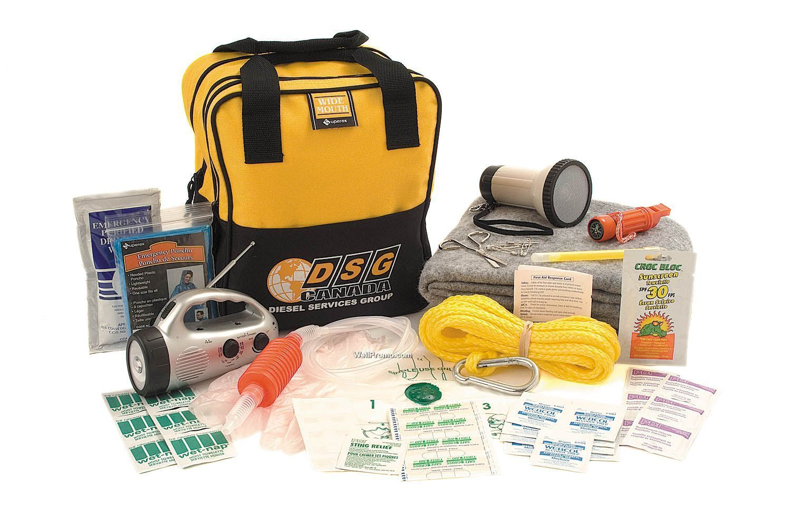
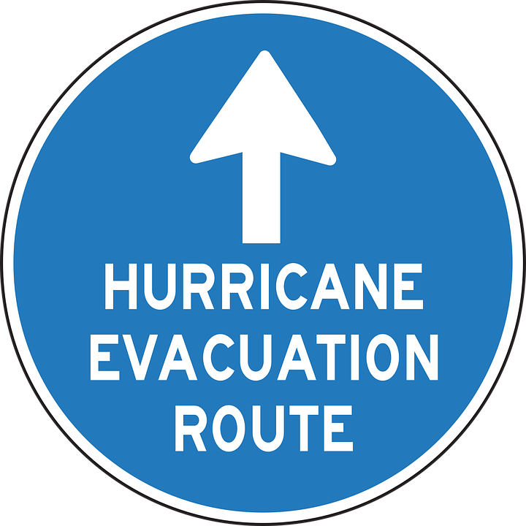
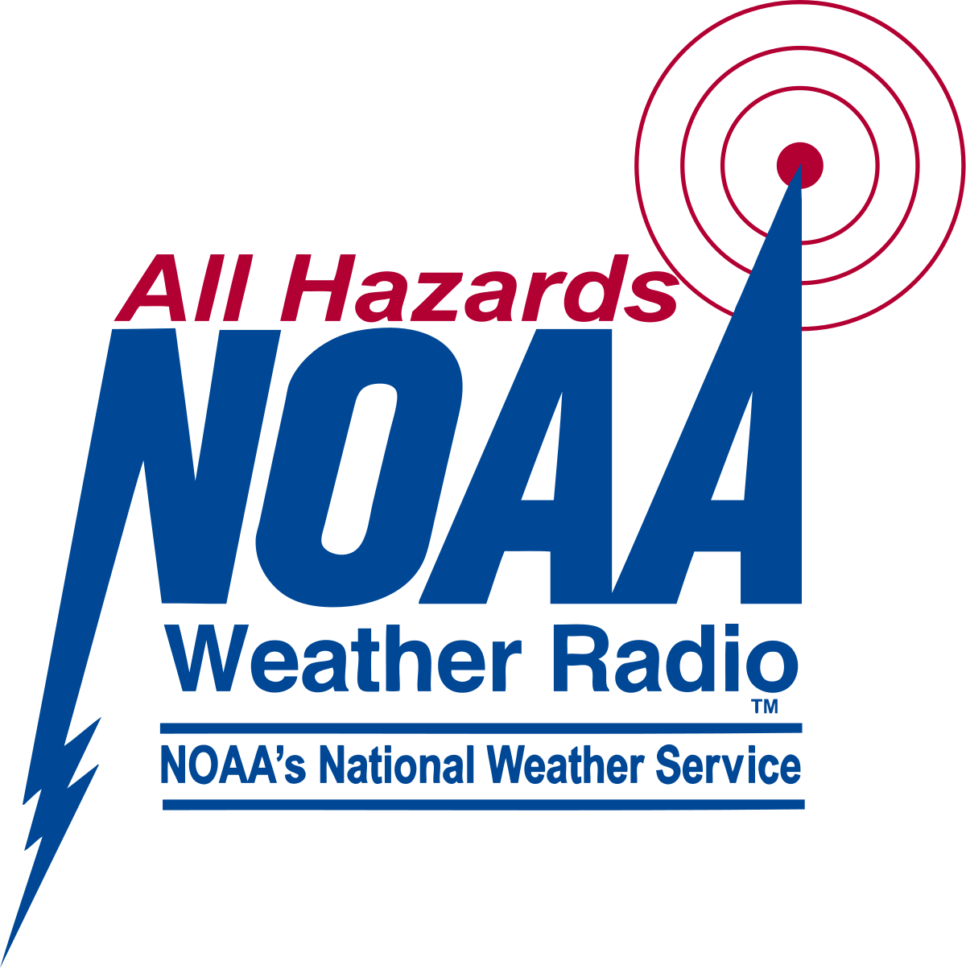
So how do we prepare?
Talk to your family members about making an emergency preparedness kit
Discuss having a household evacuation plan in case of an emergency
Have a communications plan for those in your home and neighbors
Stay informed about potential severe weather threats

Slide 19
Teen CERT
There are
Community Emergency Response Teams in Action – YouTube

Slide 20
Sources
[1] USGS, “2018 Long-term National Seismic Hazard Map,” www.usgs.gov. [Online]. Available: https://www.usgs.gov/media/images/2018-long-term-national-seismic-hazard-map
[2] D. Blatt, “Infographic Of The Day: How To Earthquake-Proof A Building,” Fast Company, 19-Apr-2011. [Online]. Available: https://www.fastcompany.com/1748533/infographic-day-how-earthquake-proof-building?cid=search. [Accessed: 01-Sep-2021]
[3] American Red Cross, “Landslide Safety,” Redcross.org, 2018. [Online]. Available: https://www.redcross.org/get-help/how-to-prepare-for-emergencies/types-of-emergencies/landslide.html
[4] National Geographic Staff, “Tornado facts and information,” Environment, 28-Aug-2019. [Online]. Available: https://www.nationalgeographic.com/environment/article/tornadoes
[5] National Center for Atmospheric Research, “Tornadoes | UCAR Center for Science Education,” Ucar.edu, 2009. [Online]. Available: https://scied.ucar.edu/learning-zone/storms/tornadoes
[6] Red Cross, “Common Natural Disasters Across US,” www.redcross.org. [Online]. Available: https://www.redcross.org/get-help/how-to-prepare-for-emergencies/common-natural-disasters-across-us.html#all
[7] Ready, “Disaster Facts | Ready.gov,” Ready.gov, 2019. [Online]. Available: https://www.ready.gov/kids/disaster-facts

