Slide 1
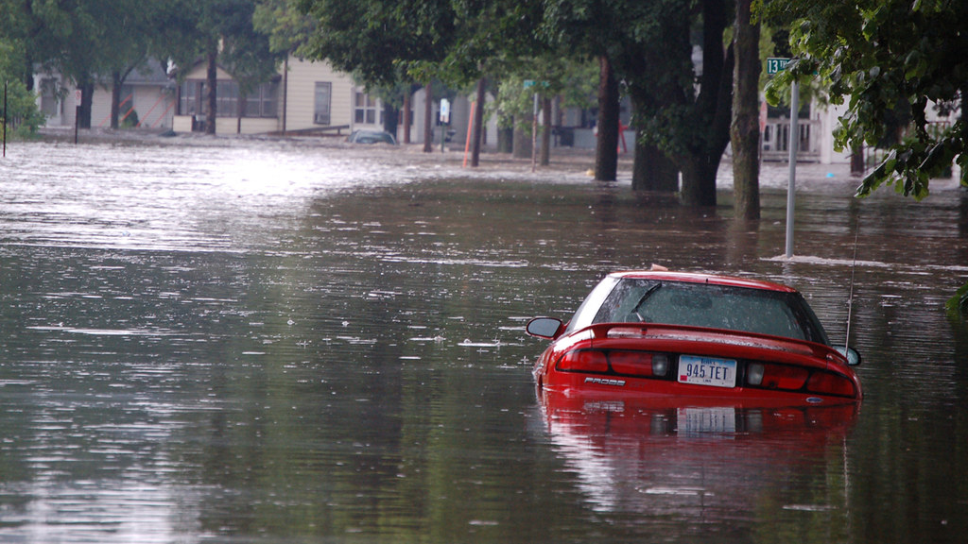
Flood Hazards
The causes, effects, and how to deal with them

Slide 2
By the end of this module, you should be able to :
Identify the causes of floods and how they affect people differently
Provide examples of methods of flood prevention
Recognize best practices to use to help your community prepare for a flood

Slide 3
The causes of floods

Slide 4
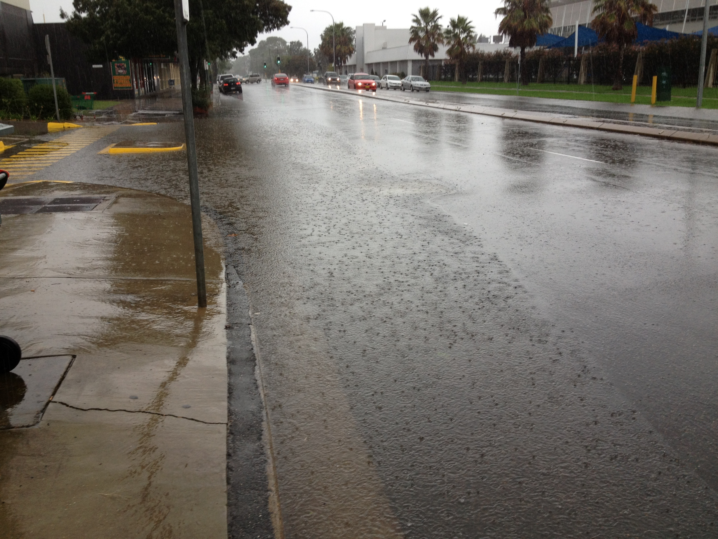
What causes floods?
Flooding occurs when there is more water in an area than can be naturally drained at any point in time
This can be brought about by natural and human factors

Slide 5
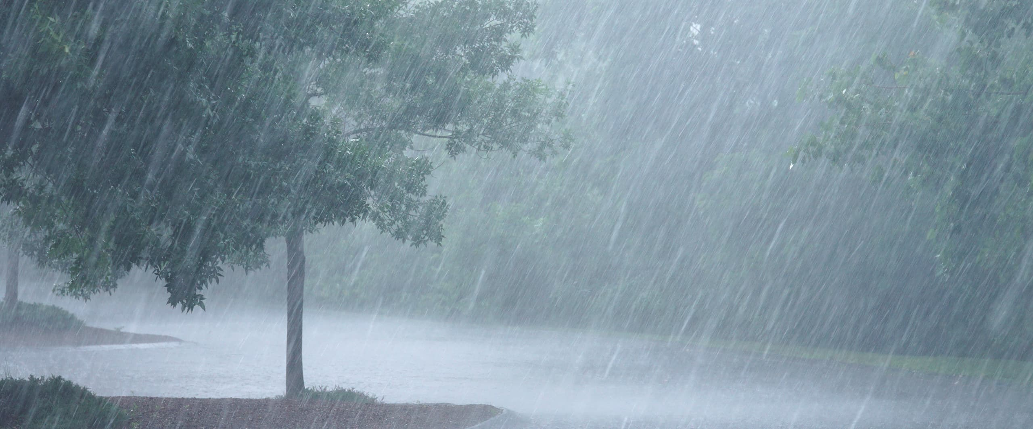
Causes of Flooding
Natural
Artificial
Heavy Rain
Tropical Storms/Hurricanes
Snow Melt
Geography/Topography
Debris Jam
Land Development/Deforestation
Infrastructure Failure
Poor Farming Practices

Slide 6
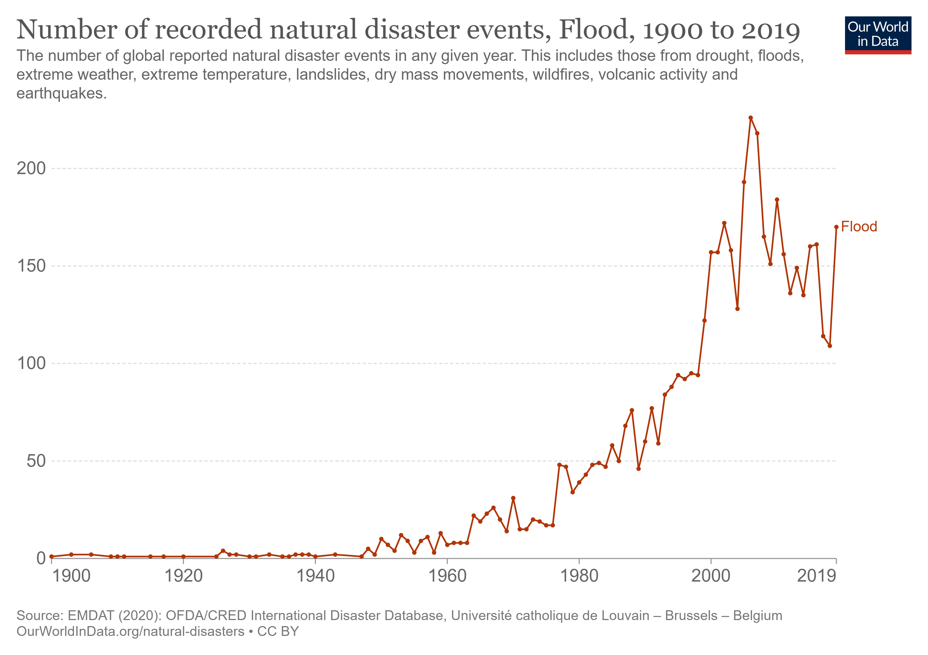
Flooding & Climate
Worldwide, instances of flooding have become more frequent and more severe
This is likely due to a combination of changing weather patterns and the migration of people to high-risk areas

Slide 7
Flooding & Infrastructure
Typically, public infrastructure is designed with a capacity to withstand a certain level of extreme flooding. Often this will involve a "100-year storm" design, which is the level of rainfall that has a 1% of occurring each year.
Much of the current infrastructure was designed with projections from decades ago
Question: If the frequency of severe storms that exceed the designed capacity of a building increases, how can we adapt?

Slide 8
Flood Maps & Flood Zones
Flood maps show us areas that are more likely to flood during a particular event
Flood Zones are areas where it's been estimated that the chance of is at least 1%. This has been referred to as a 100-year storm, but it can happen at anytime
Picture: A map of flood zones (highlighted in dark grey) in Nashville, TN

Slide 9
The effects of flooding

Slide 10
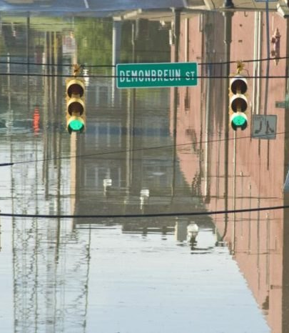
Tough Decisions: 2010 Nashville Flood
The 2010 Flood in Nashville, TN is an example of a tough decision.
Regional rainfall exceeded 17 in. within two days, a record amount
Operators were faced with a decision: Either perform a controlled release of water to avoid catastrophic dam failure which would be uncontrollable
May 2010 Flood (army.mil)

Slide 11
Flooding at each of the dams during the Nashville flood (video)

Slide 12
How to deal with flooding

Slide 13
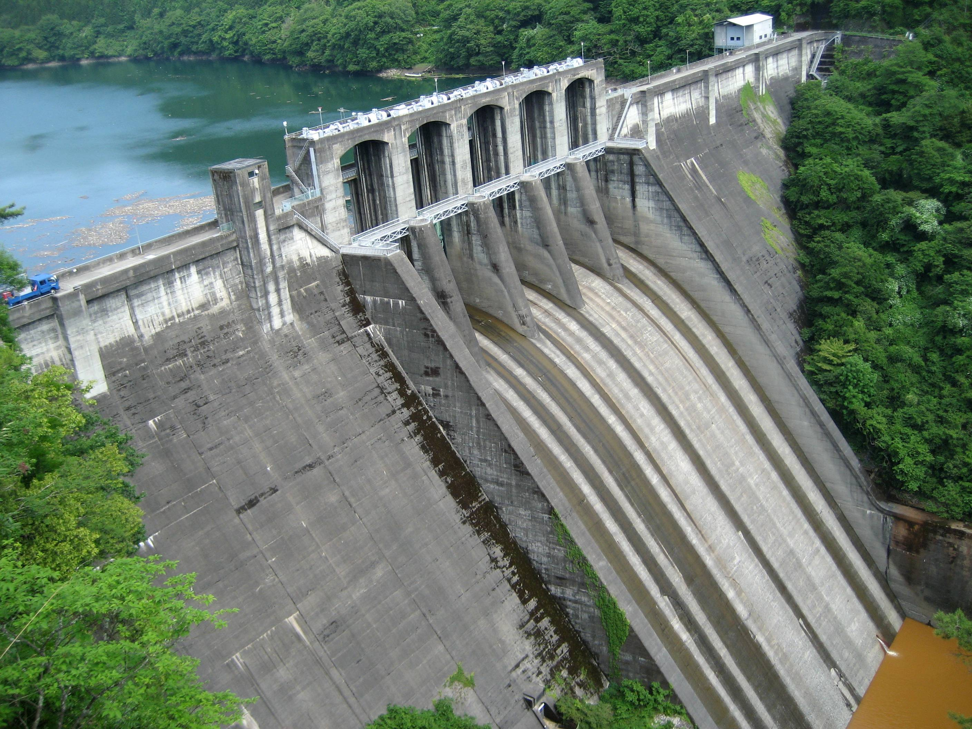
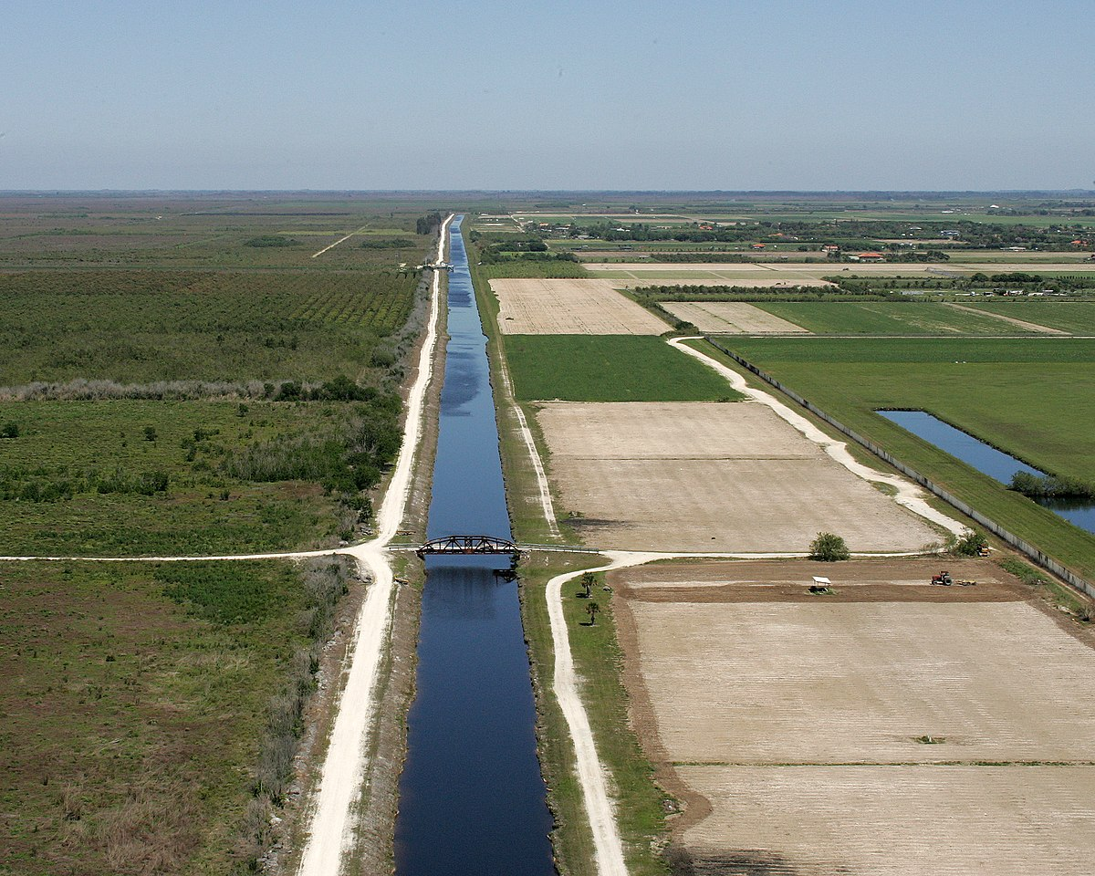
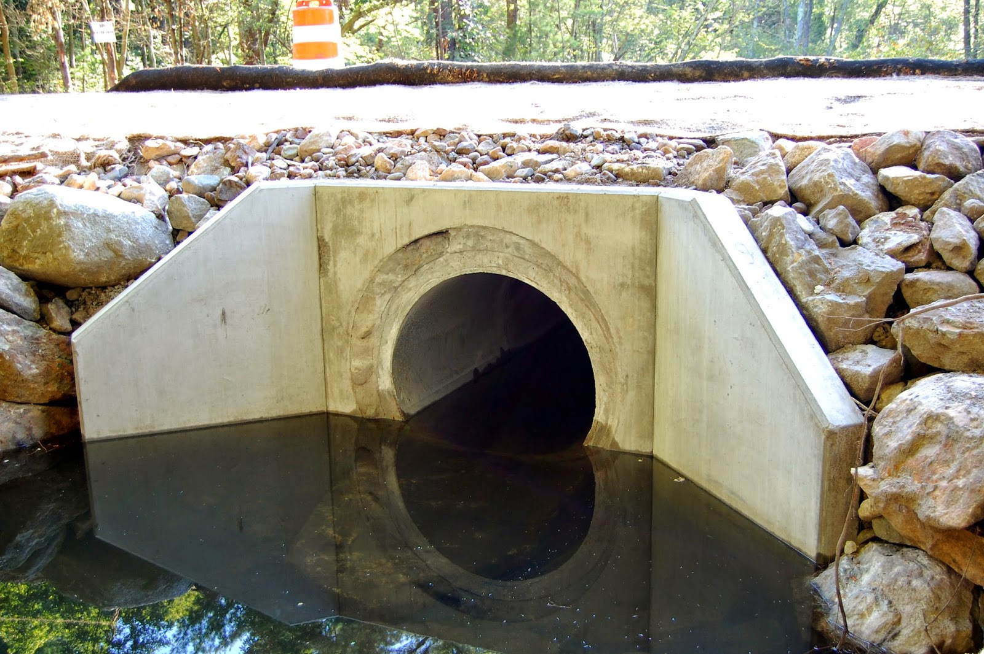
Physical Infrastructure
Dams Levees Culverts
Structure built along a river to control the flow of water
Structure built alongside a river to hold water back
Built to allow water to flow beneath the roads

Slide 14
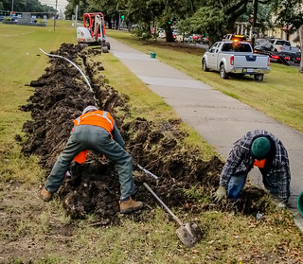
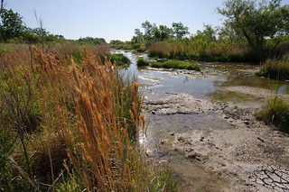
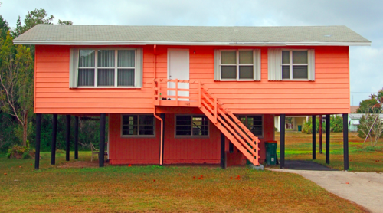
Local Solutions
Adding Vegetation Land Adjustments Elevating Homes
Planting trees and foliage along a river to add a buffer to water flow
Sloping the land or adding a ditch to redirect the water flow
Building to allow water to flow beneath the main part of the home

Slide 15
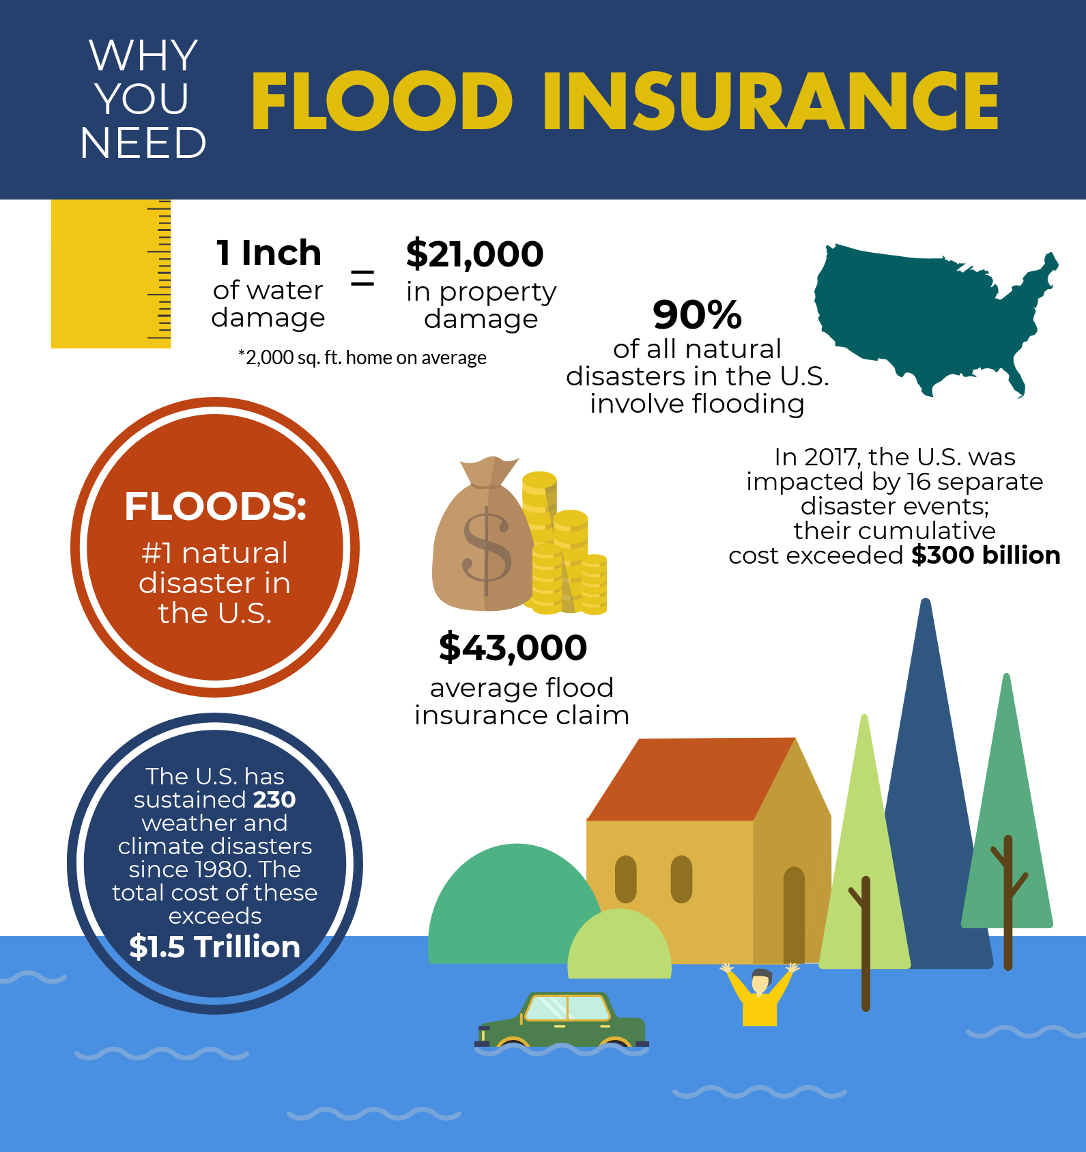
What is flood insurance?
When you buy insurance, you pay an agreed upon amount monthly or annually (called a premium) so that the insurance agency can cover a large expense.
Flooding is not covered by regular home insurance policies
The average annual cost of flood insurance as of 2019 was $700, or about $58 per month (FEMA)
Historical Flood Risk and Costs | FEMA.gov
Source: DeanDraper.com

Slide 16
National Flood Insurance Program
Passed in 1968 to reduce flood damages and provide protection for property owners via insurance policies
Later, the Flood insurance Act of 1973 established that flood insurance is required for properties in high-risk areas
Question: Why should someone consider getting insurance?

Slide 17
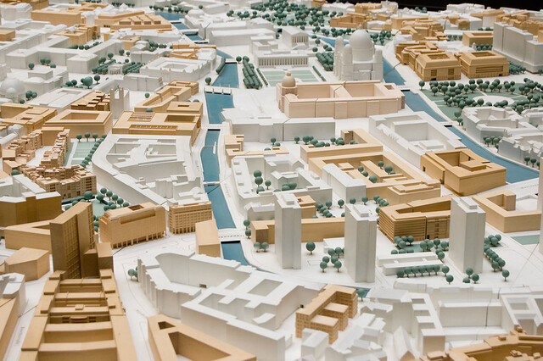
Case Study: Local Planner
You are a city official that is seeking to improve your city's ability to respond to a flood. Examine a map of your city. What would you do to help protect residents during a flood?
Think about the following questions:
What areas are close to water?
What residents would be unable to evacuate by themselves?
Which buildings are most important to protect?
How do we communicate warnings?

Slide 18
References
What Causes a Flood? | NOAA SciJinks – All About Weather
[1] US Department of Commerce, NOAA, National Weather Service, “Flooding in Tennessee,” Weather.gov, 2011. https://www.weather.gov/safety/flood-states-tn (accessed Sep. 22, 2021).
May 2010 Flood (army.mil)
Historical Flood Risk and Costs | FEMA.gov

