Slide 1
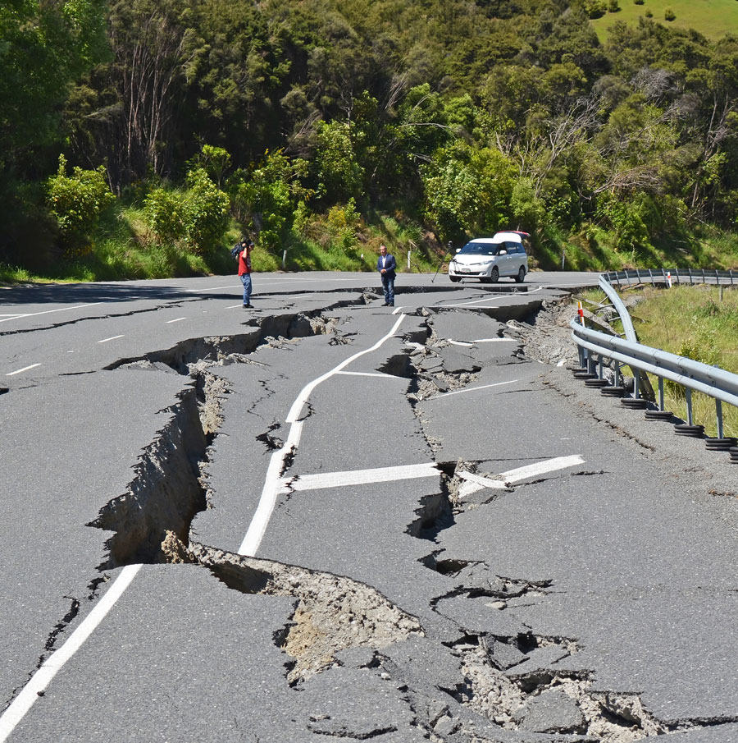
Earthquakes
The causes, effects and how to deal with them

Slide 2
By the end of this module, you should be able to :
Describe how earthquakes occur and how they are measured
Provide examples of how earthquakes affect the environment and ways engineering can help minimize damage
Recognize best practices to use to help your community prepare for an earthquake

Slide 3
The causes of earthquakes

Slide 4
How earthquakes work
Earthquakes occur when sliding pieces of earth's crust that are in contact each other slip and release stored energy
Faults are the fractures between pieces of crust where earthquakes can occur
The more potential energy that builds up between plates, the stronger the earthquake will be when the
TRY IT!:
Place your fists against one another and slowly try to push them together. Do you notice the tension? Now try to slide one hand above while pushing. What happens?
This Photo by Unknown author is licensed under CC BY.
Notes:
Teachers: See in class activity here: ShakeOut_ES3_FaultHandModels.pdf

Slide 5
Types of Faults
Normal Fault
Reverse Fault
Strike-Slip Fault
Normal Faults occur when one wall (hanging wall) drops below the other wall (footwall) as the plates pull away from each other
Reverse Faults occur when the hanging wall is pushed up against the footwall as the plates move closer towards each other
Strike-Slip Faults occur when two walls making contact with each other slide by each other horizontally
Source: USGS Earthquake Glossary

Slide 6
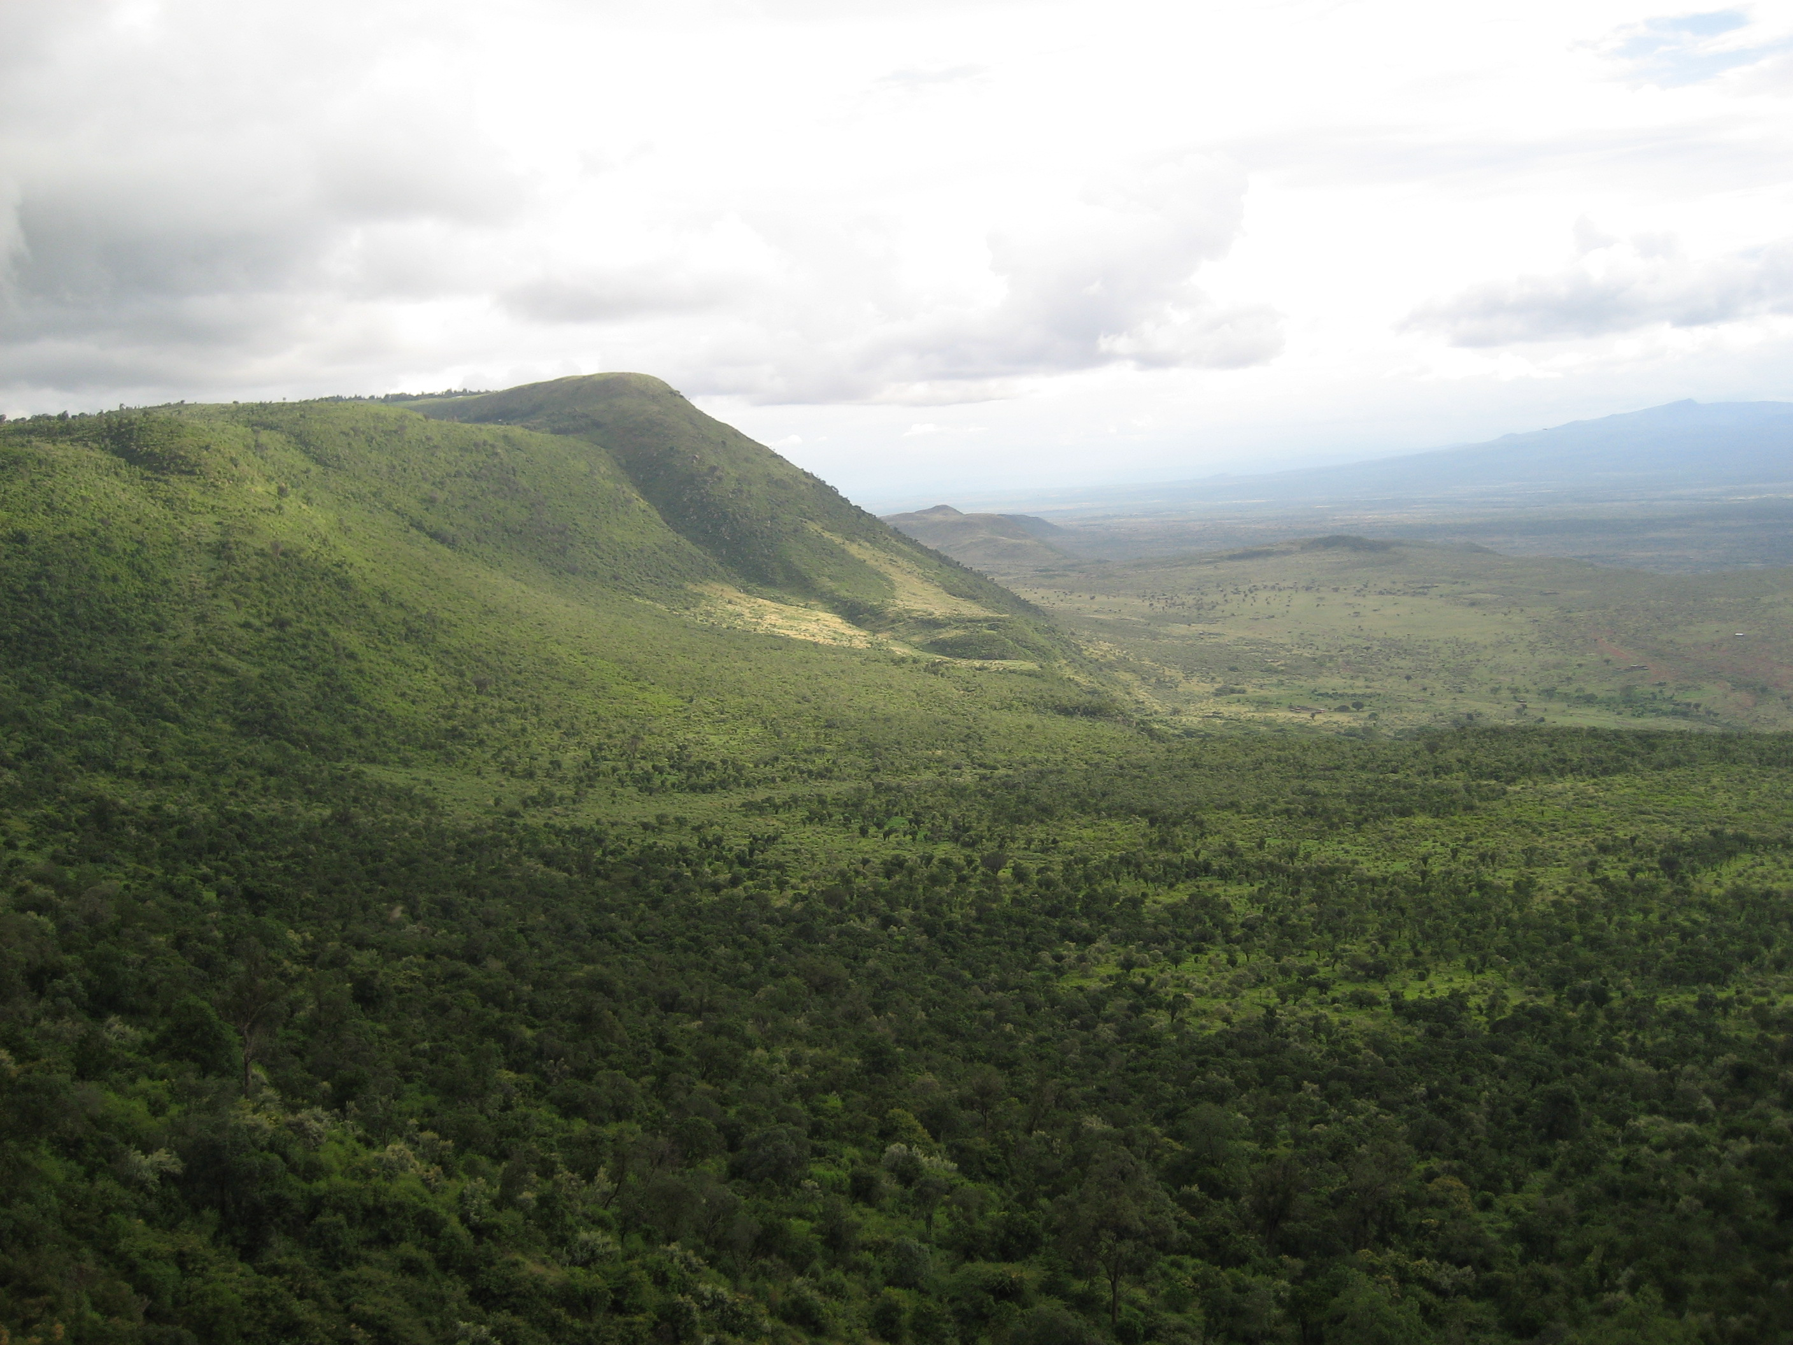
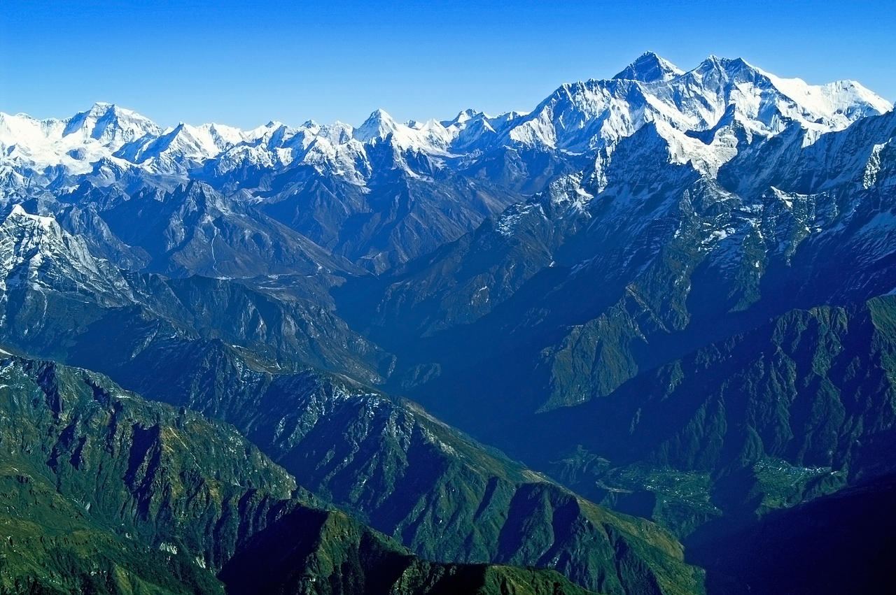
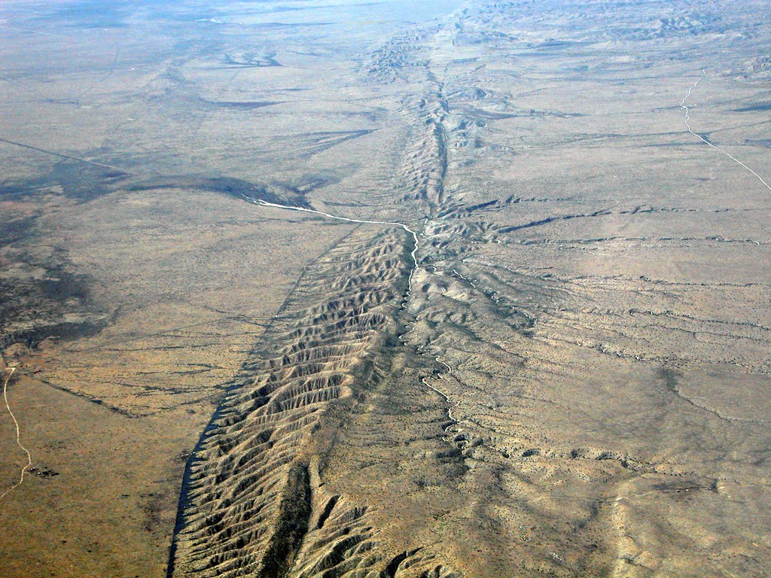
Types of Faults
Normal Fault
Reverse Fault
Strike-Slip Fault
Great Rift Valley
(East Africa)
Himalaya Mountains
(Southeast Asia)
San Andreas Fault
(Western U.S.)

Slide 7
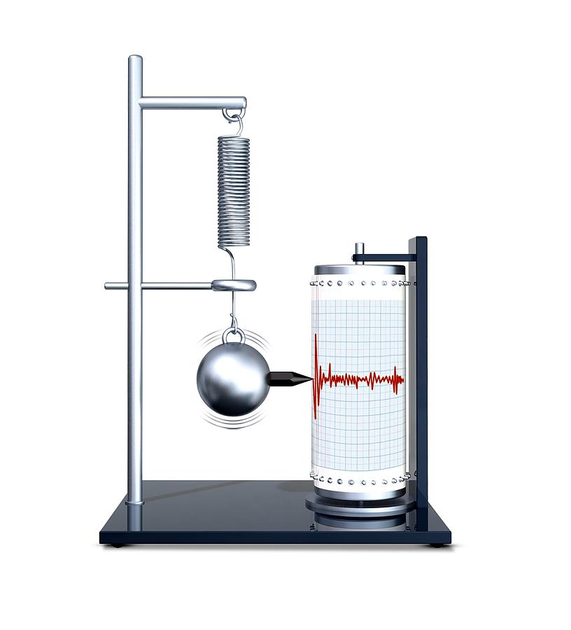
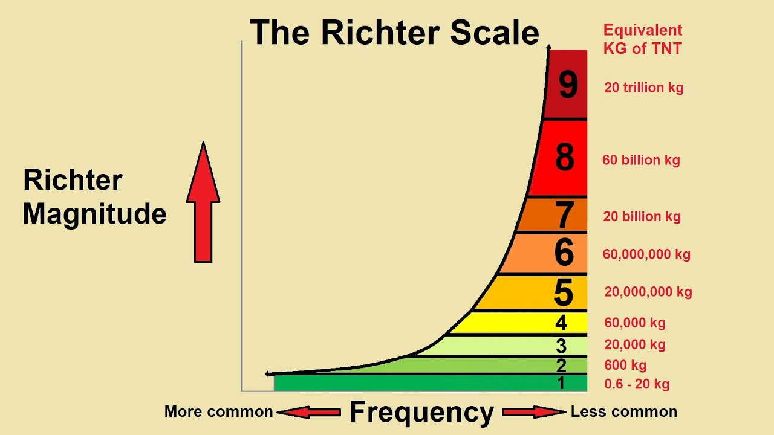
How do we measure earthquakes?
Seismometers detect nearby ground movements and record them as waves of seismic energy
Magnitude of seismic waves is measured using the following measures:
Richter Scale – (log-based) measures intensity, each level is 10x more powerful than the previous one
Modified Mercalli Scale – (observation-based rating I - XII) measures observed effects, levels corresponds to a roman numeral ranking
Fig. : The frequency and intensity of earthquakes on the Richter scale

Slide 8
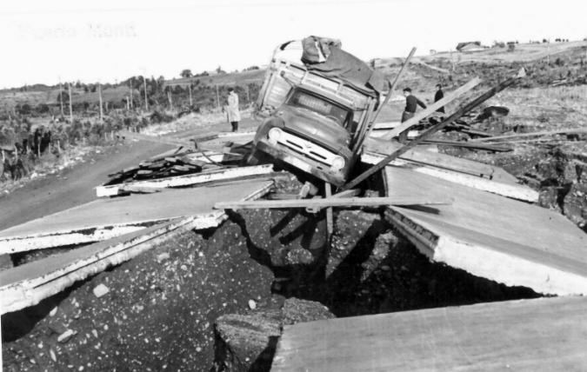
How common are earthquakes?
Worldwide, several hundreds of earthquakes occur daily
Most are magnitude M_{b} 2 or below
Larger ones ( ≥ M_{b} 7) are less frequent, but cause more damage
Checkout the most recent quakes:
LatestEarthquakes(usgs.gov)
The largest earthquake in recorded history: 9.5 earthquake in Chile

Slide 9
The effects of earthquakes

Slide 10
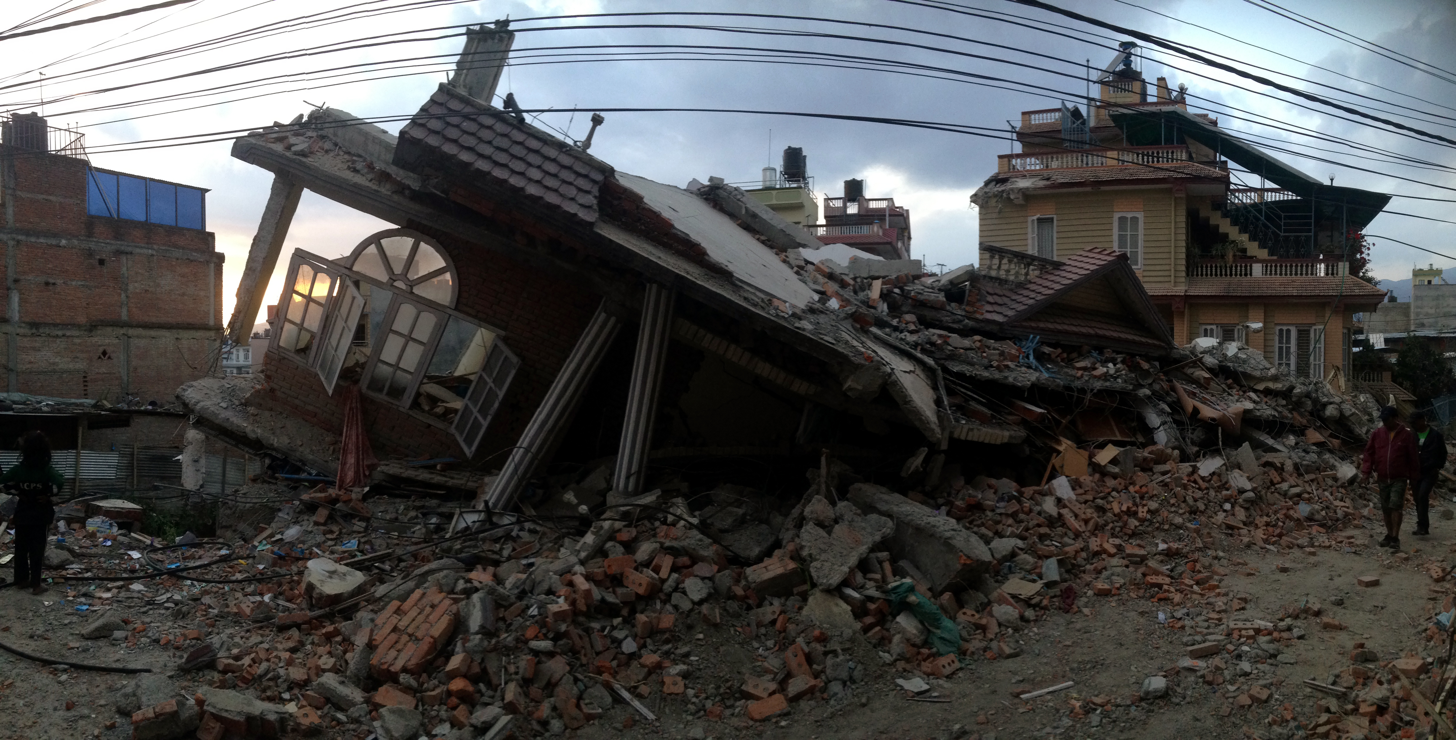
Potential effects of an earthquake
Compromised infrastructure (roads, bridges, power plants)
Blocked riverways
Landslides/Mudslides
Damaged buildings/homes
Liquefaction

Slide 11
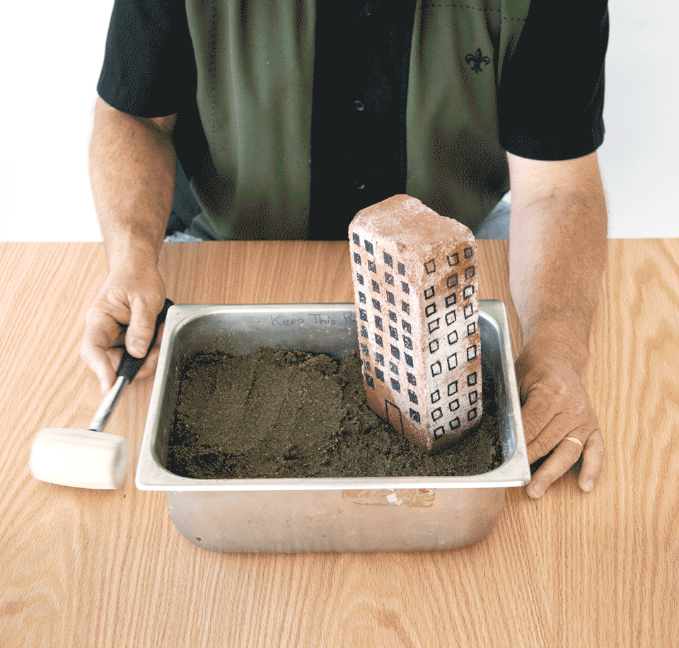
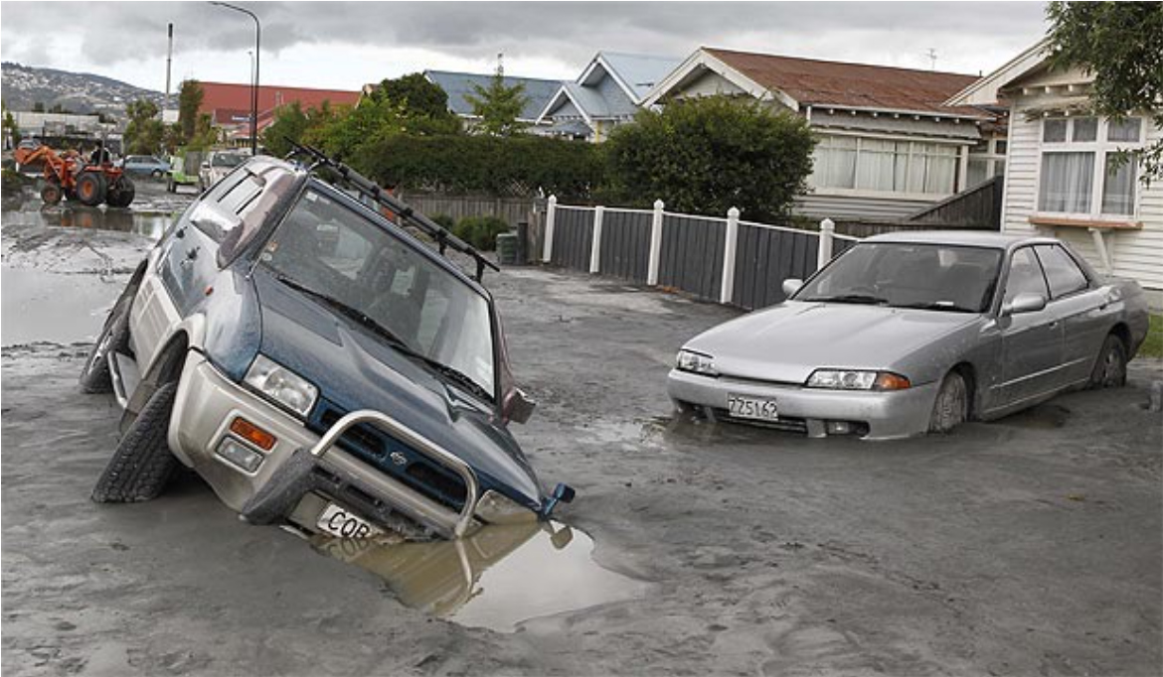
Liquefaction
Occurs when saturated soils experience an event (e.g., earthquake) that causes pore water pressure to increase, separating soil particles from each other
Causes the soil to act like a liquid, ground becomes unstable
In-class experiment

Slide 12
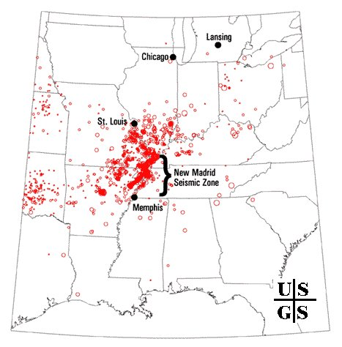
Case Study: New Madrid Seismic Zone
Fault line runs 120 mi. from IL to AK
Most recent earthquake: 1811-1812
magnitude 7.4, 7.2, & 7.0
Potential for earthquake of ~ M7 to occur in the next 50 years
Immediate hazard to over 200 K people and a potential hazard to the Memphis region of 1.3 mil. people [1].
Earthquakes in this region can shake an area approximately 20x larger than earthquakes in California [2]
This Photo by Unknown author is licensed under CC BY-SA.

Slide 13
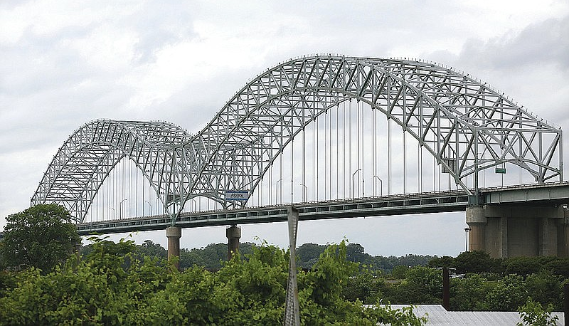
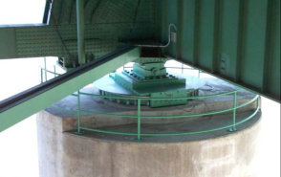
Case Study: New Madrid Seismic Zone
Hernando DeSoto Bridge
One of two connections across the Mississippi from the Memphis region
Retrofitted with technology to withstand a 7.7 magnitude earthquake (cost: $268 million)
(Source: TRC Engineers)
Source: Interstate 40 Hernando DeSoto Bridge (tn.gov)
Friction Pendulum Bearing on bridge (Source: TRC Engineers)

Slide 14
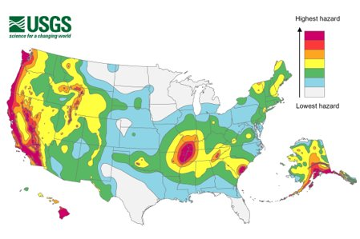
Class discussion
Consider the following questions and discuss with your classmates:
Would you move to an area that is at risk for earthquakes?
What level of risk are you willing to live with?
What precautions would make you feel safer?

Slide 15
Addressing earthquake risks

Slide 16
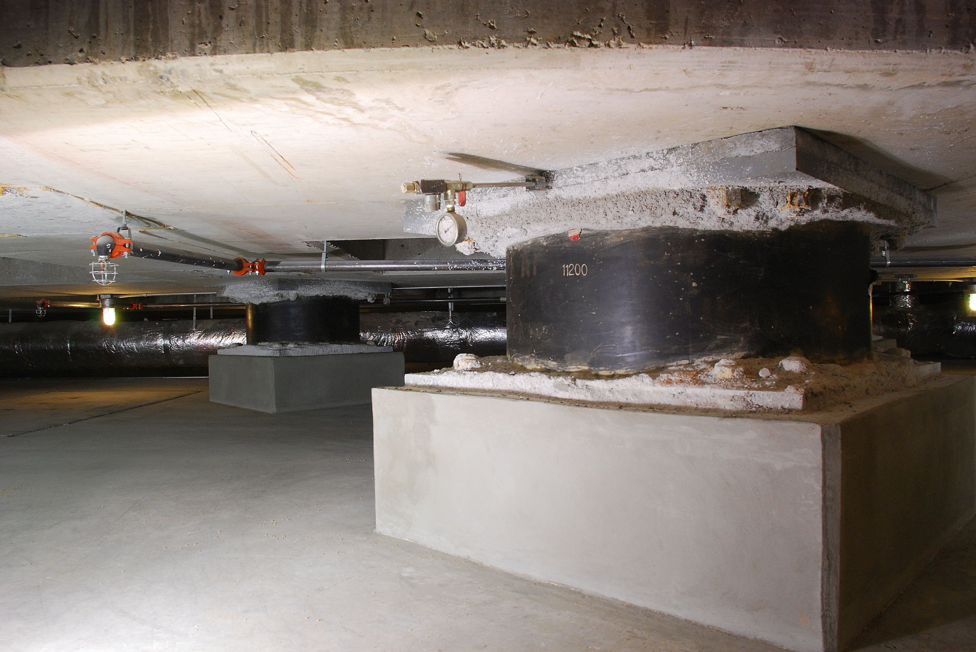
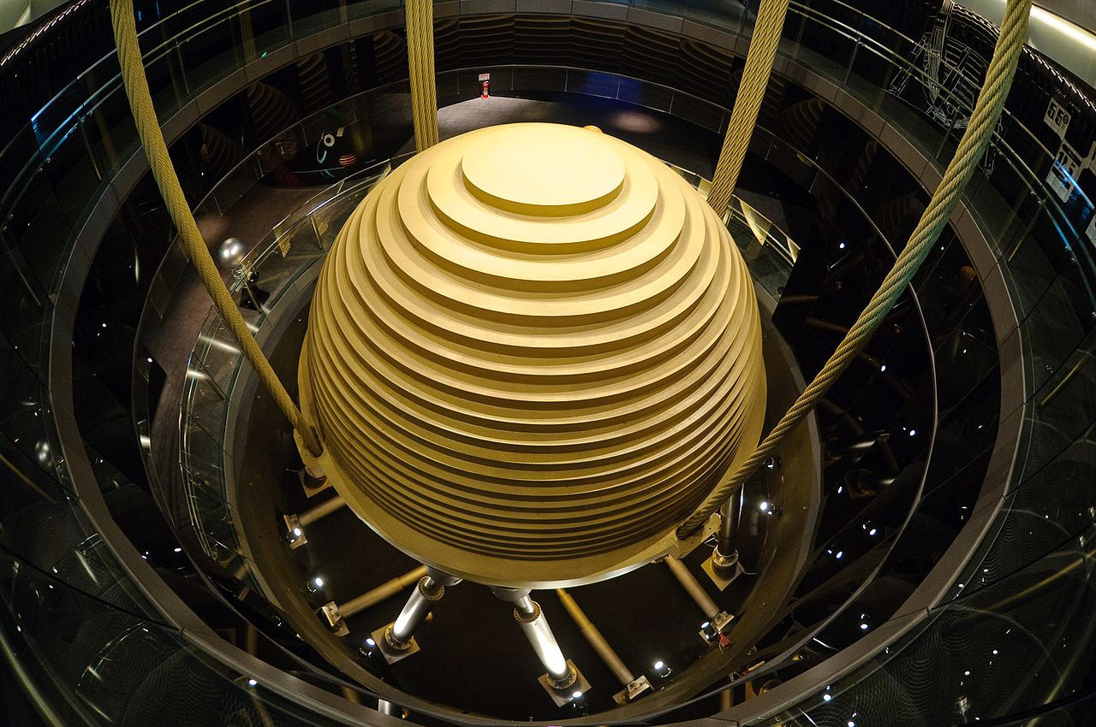
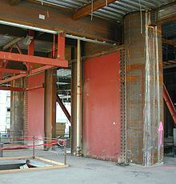
Mitigation Strategies
Creative technologies have been developed, including:
Rubber Base Isolation
Tuned Mass Damper
Steel Plate Shear Walls
Many of these methods are not as feasible for single family homes and apartments, so other strategies are needed
Rubber Base Isolation
Tuned Mass Damper
Steel Plate Shear Walls

Slide 17
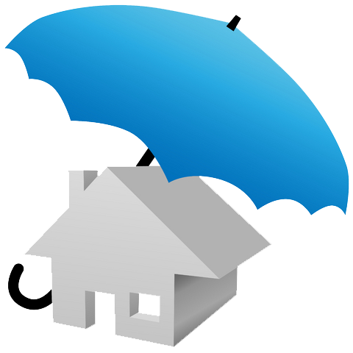
Earthquakes and Insurance
Most homeowner's insurance policies do not cover damages from earthquakes, but some do offer earthquake coverage for a premium
Insurance premiums can cost anywhere from $300-$3500 a year
Despite California being a high-risk area, only 13% of homeowners carry earthquake insurance [6]
Would you buy earthquake insurance?

Slide 18
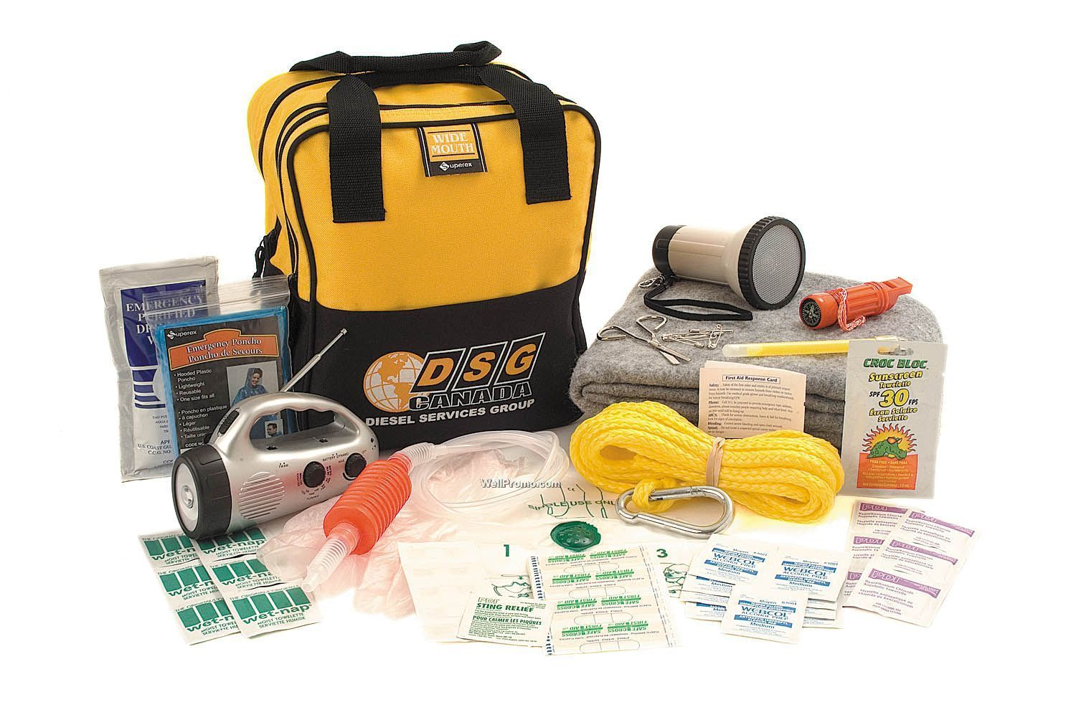
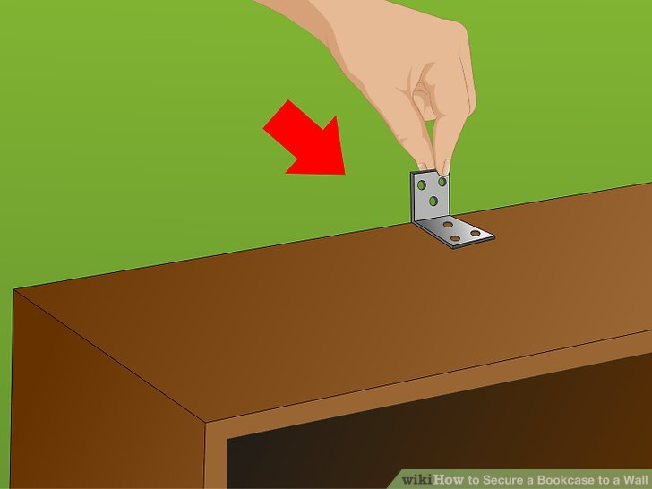
So how else do we prepare?
Talk to your family members about making an emergency preparedness kit and stocking up on nonperishable food & water
Have a communications plan for those in your home and neighbors
Secure heavy items in your home to prevent them from falling
In the event of an earthquake,
Drop, Cover, and Hold on!

Slide 19
References
[1] S. Hickman, “Earthquake Mitigation | U.S. Department of the Interior,” 2018.
[2] “Earthquakes,” Earthquakes | Ready.gov. [Online]. Available: https://www.ready.gov/earthquakes. [Accessed: 30-Jun-2021].
“Facts about the New Madrid Seismic Zone,” Missouri Department of Natural Resources. [Online]. Available: https://dnr.mo.gov/geology/geosrv/geores/techbulletin1.htm. [Accessed: 30-Jun-2021].
[3] “Great ShakeOut Earthquake Drills,” Great ShakeOut Earthquake Drills . [Online]. Available: https://www.shakeout.org/schools/resources/. [Accessed: 30-Jun-2021].
[4 ]M. Samuels, What to Expect in a Big Urban Earthquake. [Online]. Available: https://wim.usgs.gov/geonarrative/safrr/WTE_earthquake/. [Accessed: 30-Jun-2021].
[5] R. Schamber, D. DeLeeuw, M. Christensen, A. Kalidindi, and C. Pinkerton, rep.
[6] “Why Only 13% Of California Homeowners Have Earthquake Insurance,” NPR, 09-Jul-2019. [Online]. Available: https://www.npr.org/2019/07/09/739999709/why-only-13-of-california-homeowners-have-earthquake-insurance. [Accessed: 30-Jun-2021].
[7]USGS. “The Modified Mercalli Intensity Scale,” The modified mercalli intensity scale. [Online]. Available: https://www.usgs.gov/natural-hazards/earthquake-hazards/science/modified-mercalli-intensity-scale?qt-science_center_objects=0#. [Accessed: 25-Aug-2021].

Slide 20
Multimedia resources
What to do during an earthquake – ShakeOut : https://youtu.be/GSDmqLQmMN0
When The Earth Shakes - FEMA: https://youtu.be/MKILThtPxQs
Brief Reading Material – “Rising earthquake-insurance costs put millions of Missourians, economy at risk”: https://www.thecentersquare.com/missouri/rising-earthquake-insurance-costs-put-millions-of-missourians-economy-at-risk/article_2b08f1d4-e99d-11eb-b028-b355b0bfef93.html
Moderate Reading Material - “Forget Doorframes: Expert Advice on Earthquake Survival Strategies” : https://www.scientificamerican.com/article/forget-doorframes-expert-advice-on-earthquake-survival-strategies/
Advanced Reading Material – “The Really Big One”: https://www.newyorker.com/magazine/2015/07/20/the-really-big-one

