Slide 1
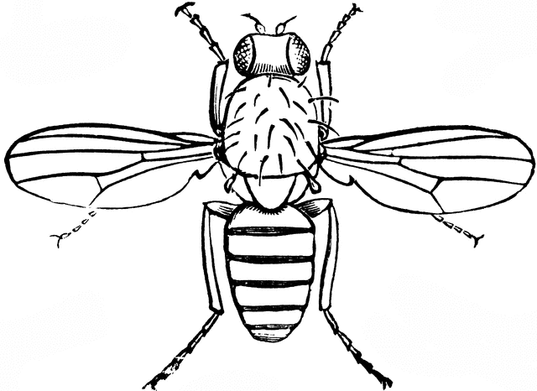
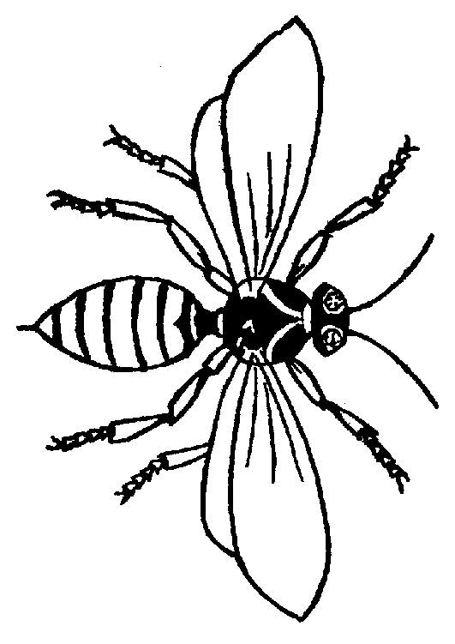
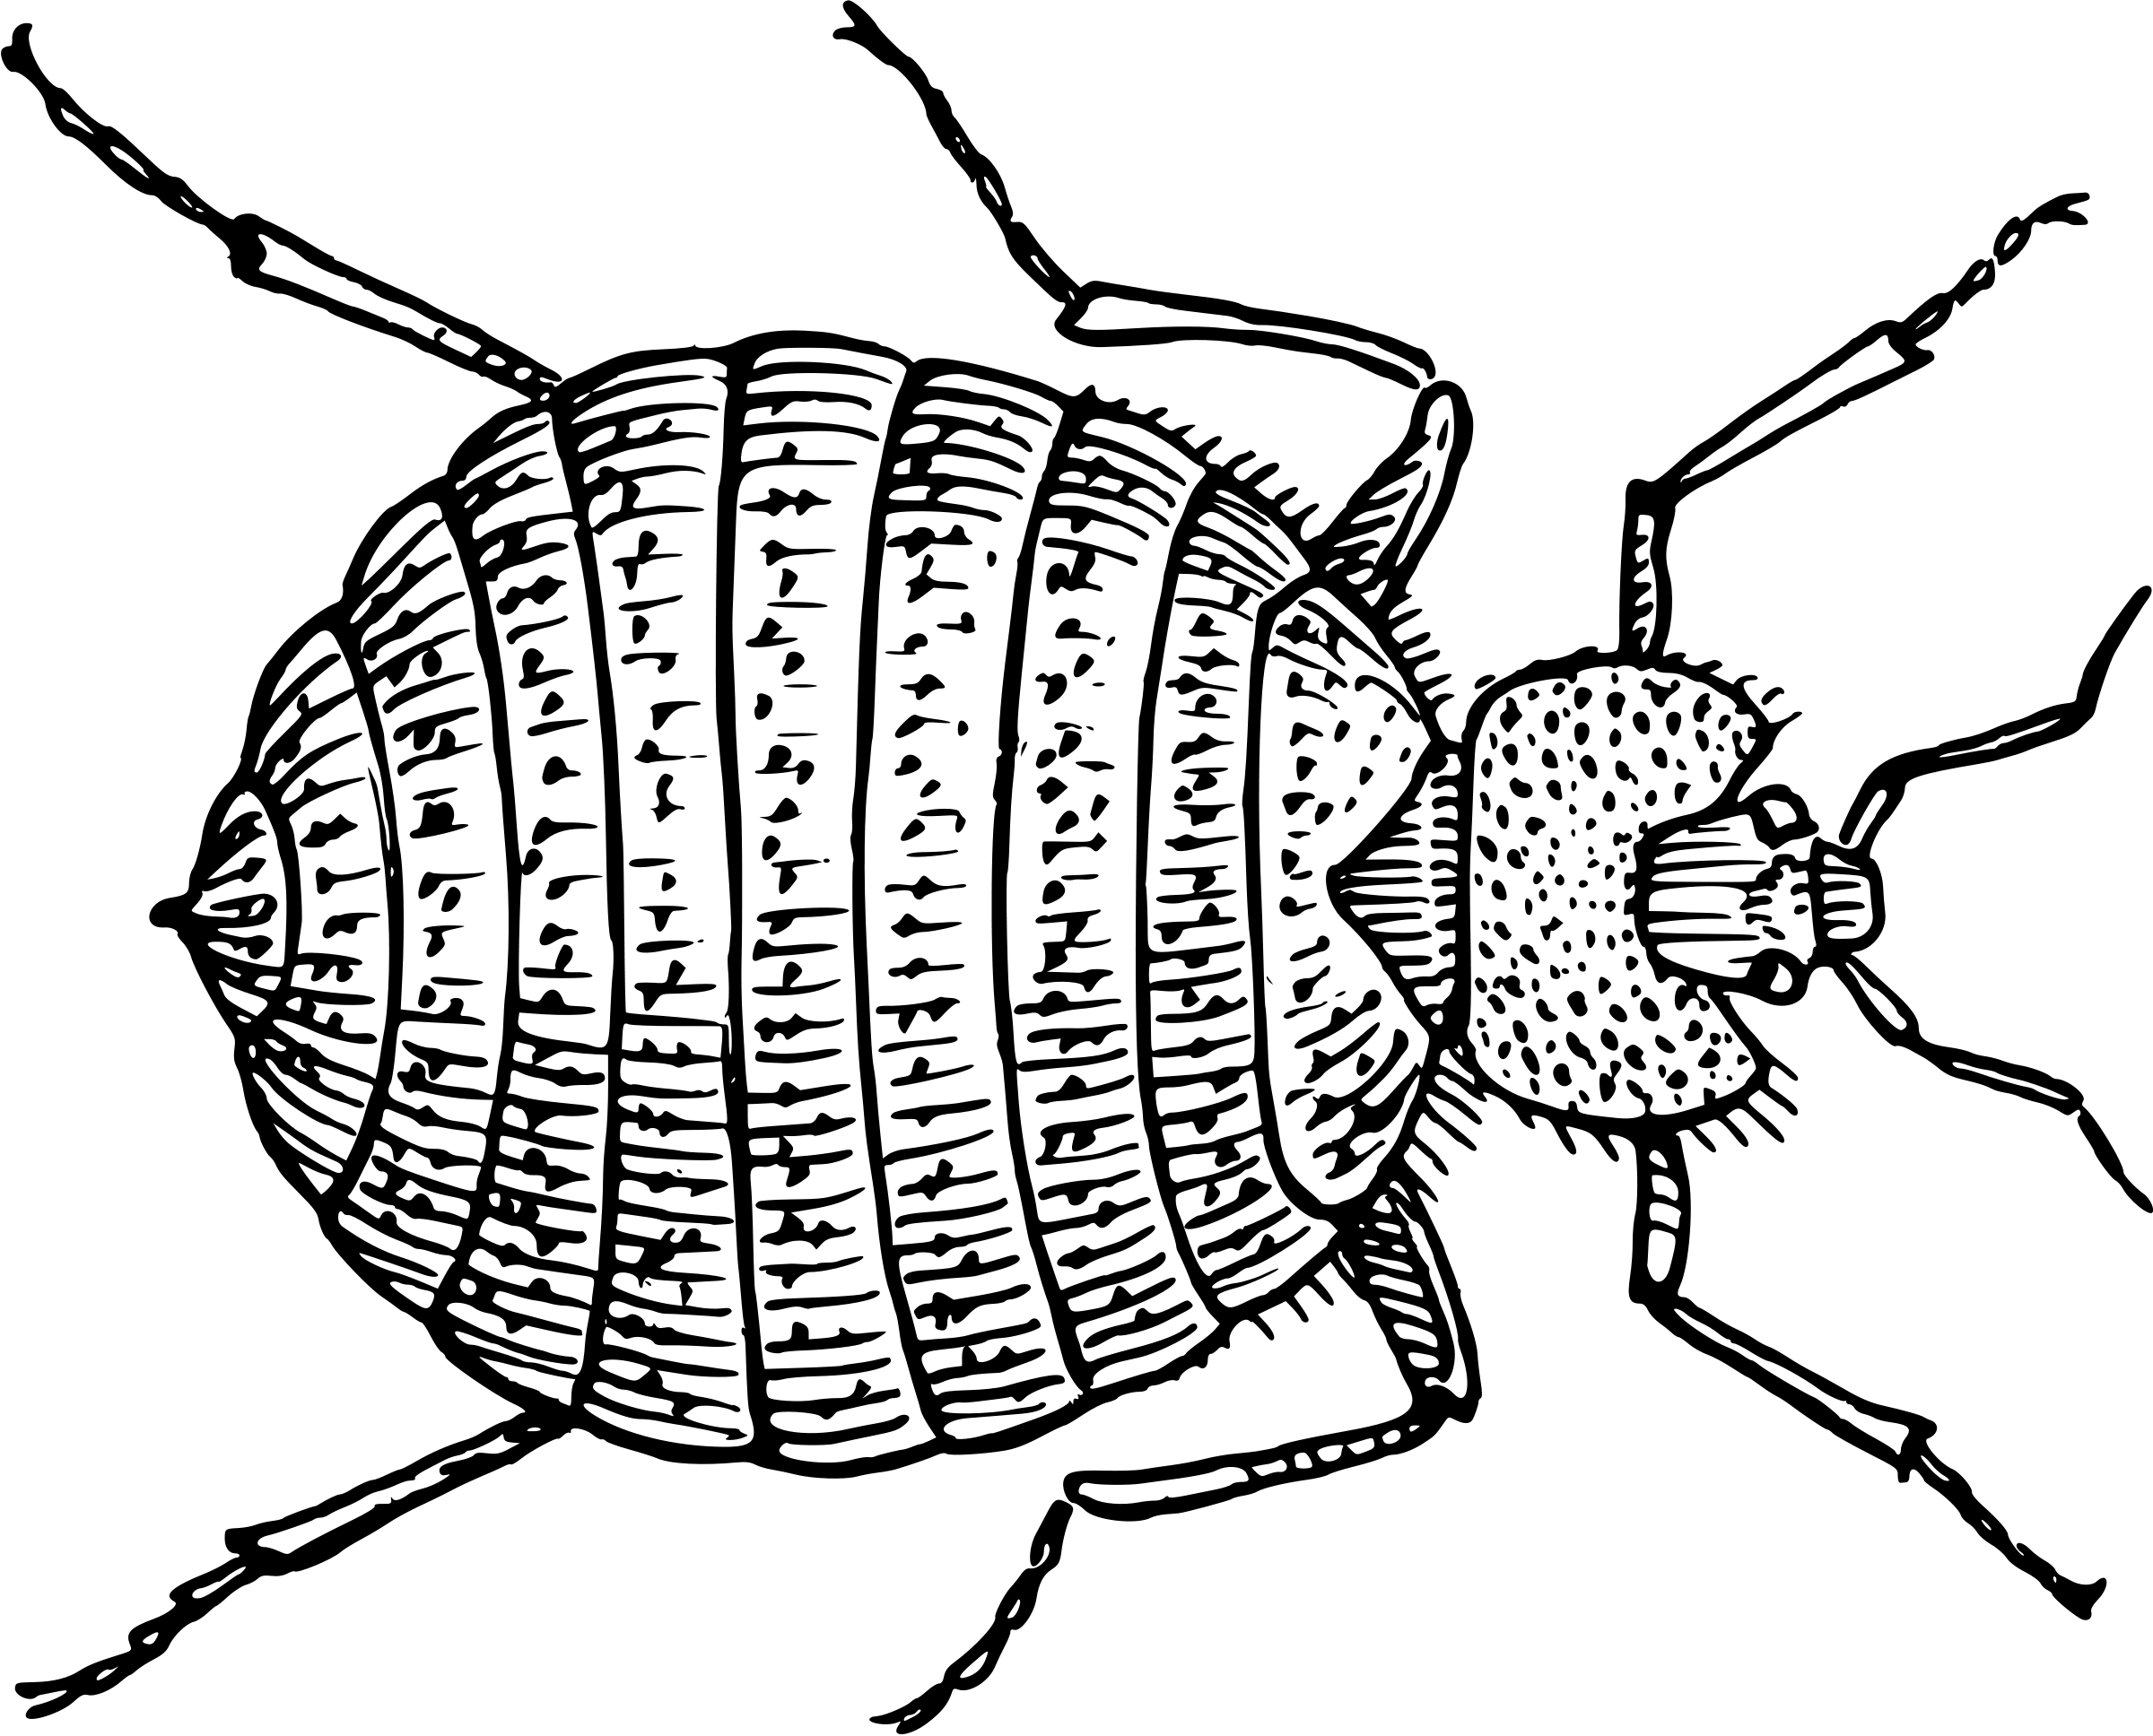
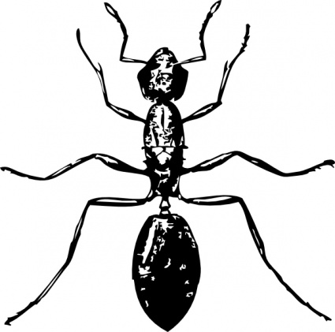
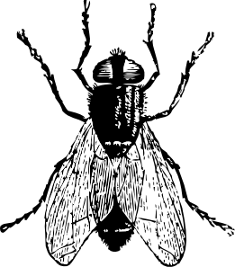
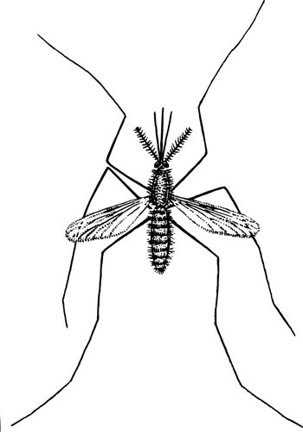
Wolbachia &
Reproductive Parasitism

Slide 2
Wolbachia is a Reproductive Parasite
Assume that the average clutch size is 10 (5F : 5M). Record the expected number of male and female offspring for each arthropod and label the phenotype.
Observation:
Answer with:
Yellow fever mosquitoes are usually uninfected; therefore, offspring will develop normally.
Cheerios
(or black pen)
In ladybugs, or lady beetles, Wolbachia can induce male-killing.
Froot Loops
(or colored pen)
In roly polies, or pill bugs, Wolbachia can induce feminization.
Froot Loops
(or colored pen)
In clover mites, a type of spider mite, Wolbachia can induce parthenogenesis.
Froot Loops
(or colored pen)

Slide 3
Key to Genetic Crosses
Wolbachia is maternally-transmitted
Female
Male
Wolbachia-infected
Uninfected
SEX
INFECTION STATUS

Slide 4
Wolbachia Induces Cytoplasmic Incompatibility
Assuming that the average clutch size is 5, record the expected number of Wolbachia-infected (Froot Loops/colored pen) vs. uninfected (Cheerios/black pen) for each cross.
Cross:
Offspring:
Uninfected male x Uninfected female
Survival
Uninfected male x Infected female
Survival
Infected male x Uninfected female
Death
Infected male x Infected female
Survival

Slide 5
Wolbachia & Vector Control
World Mosquito Program: http://www.eliminatedengue.com/our-research/wolbachia
Debug: https://debug.com/
MosquitoMate: https://mosquitomate.com/how-it-works/
Vanderbilt Research: https://news.vanderbilt.edu/2017/02/27/new-tool-for-combating-mosquito-borne-disease-insect-parasite-genes/
Population Replacement Strategy
Sterile Insect Technique
Genetic Engineering

