Slide 1
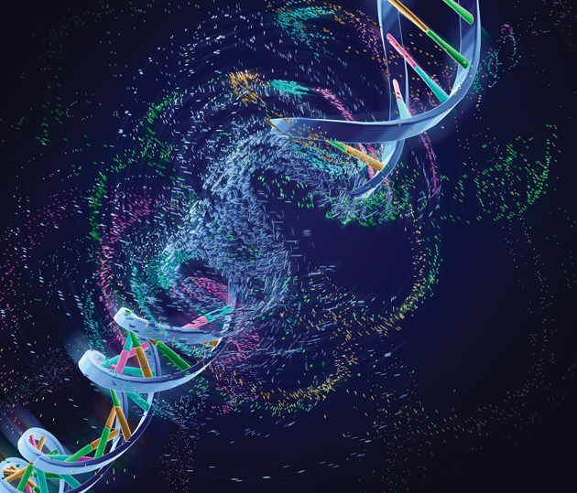
PCR Basics
A review

Slide 2
Where are we now? What is next?
DNA
Gene encoding
ribosomal RNA
3. Sequence DNA.
Aligned rRNaA
gene sequences
3
A
G
T
G
G
G
T
A
G
1
A
T
T
C
C
G
T
A
Cells
G
2
1
A
G
C
G
G
T
T
A
1. Isolate DNA
each
organism.
2. Make copies
of rRNA gene
by PCR.
4. Analyze
sequence.
G
3
5. Generate
phylogenetic
tree.
A
G
C
T
A
A
G
2
Notes:
2
Figure 1.6a Evolutionary relationships and the phylogenetic tree of life.

Slide 3
DNA Extraction
Homogenize arthropod in Phosphate Buffered Saline (PBS)
Lyse cells by boiling with Instagene Matrix
Instagene Matrix binds macromolecules that can inhibit PCR.
Centrifuge to pellet the Instagene Matrix
Transfer supernatant to a clean ependorf tube.
Supernatant contains “PCR ready” DNA.

Slide 4
Where are we now? What is next?
DNA
Gene encoding
ribosomal RNA
3. Sequence DNA.
Aligned rRNaA
gene sequences
3
A
G
T
G
G
G
T
A
G
1
A
T
T
C
C
G
T
A
Cells
G
2
1
A
G
C
G
G
T
T
A
1. Isolate DNA
each
organism.
2. Make copies
of rRNA gene
by PCR.
4. Analyze
sequence.
G
3
5. Generate
phylogenetic
tree.
A
G
C
T
A
A
G
2
Notes:
4
Figure 1.6a Evolutionary relationships and the phylogenetic tree of life.

Slide 5
Polymerase Chain Reaction
A way to make many copies of a target gene.
This allows us to visualize the amplicons (PCR products) on a gel.
Also allows us to make enough DNA for sequencing.
Laboratory version of DNA replication in cells.
Revolutionized the field of molecular biology.

Slide 6
STEPS IN PCR
1. Set up your Master Mix. This contains buffer, Taq Polymerase, dNTPs, MgCl₂, primers.
2. Aliquot MM into PCR tubes.
3. Into your appropriately labeled tubes, add template DNA (your extracted DNA), DNA for your positive controls and sterile water into your negative controls.
4. Place your tubes into the PCR machine.
5. So what kind of crazy magic happens in there, anyway???

Slide 7
PCR Cycling Conditions
If you have HotStart MM, then you heat the reaction to 95°C for 10 minutes. This activates the HotStart Taq.If not….
Heat the reaction to 95°C for 30 -45 seconds. This denatures the double stranded DNA template.
Lower the temperature to allow the primers to anneal. This temperature depends upon the DNA sequence of the primer. https://www.idtdna.com/site
Raise the temperature to 72°C to allow Taq Polymerase to bind and begin incorporating dNTPs

Slide 8
PCR Cycling Conditions
Repeat steps 2 – 4, 25-30 times. This results in exponential amplification of the DNA template.
Your final extension step is 72°C for 10 minutes to “fill in” any single stranded DNA.
Cool to 4°C indefinitely.
PCR products will be stored at -20°C until tomorrow when you will come in and run them out on an agarose gel.

Slide 9
https://www.youtube.com/watch?v=2KoLnIwoZKU

