Slide 1
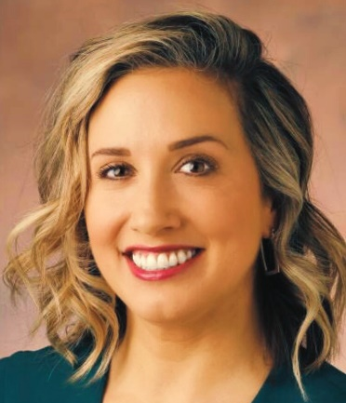
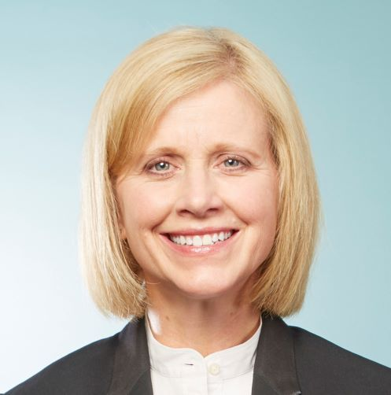
Vanderbilt University
Representative 1: Cara Tuttle Bell, J.D.
Director, Project Safe Center for Sexual Misconduct Prevention and Response
Senior Lecturer, Gender and Sexuality Studies
cara.tuttle.bell@vanderbilt.edu
Representative 2: Mary Roy, J.D.
Director, Title IX Office
Title IX Coordinator
mary.roy@vanderbilt.edu
Representative 3: Tracey E. George, J.D.*
Charles B. Cox III & Lucy D. Cox Family Chair in Law & Liberty, Law School
Professor of Political Science, Arts and Science
Vice Provost for Faculty Affairs
tracey.george@vanderbilt.edu
*indicates primary points of contact for questions regarding institutional efforts

