Slide 1
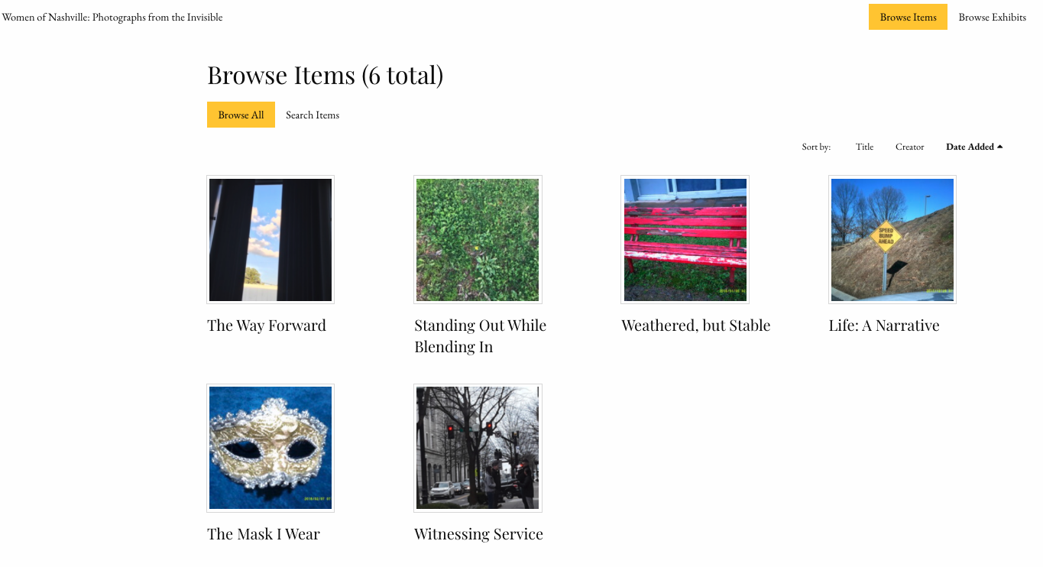
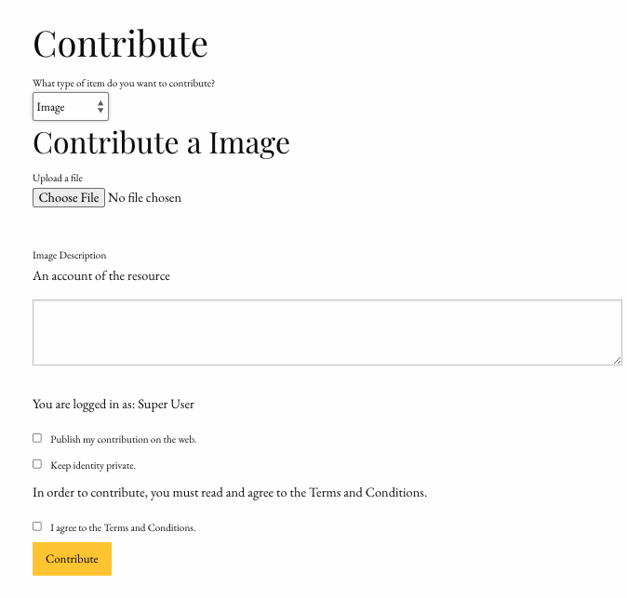
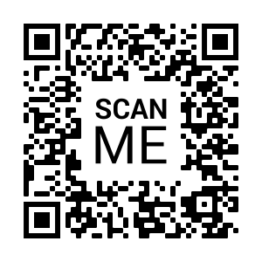
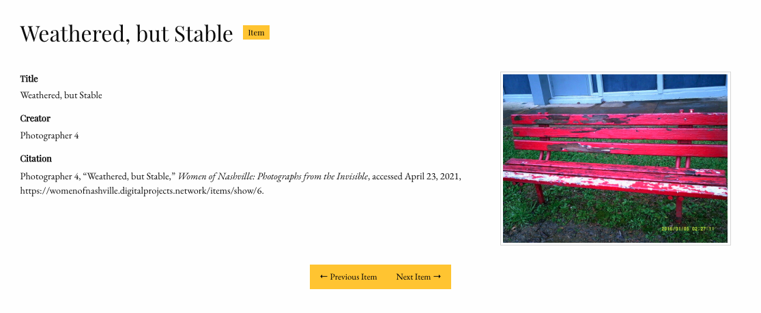
Women of Nashville: Photographs from the Invisible
Rachel R. Underwood | Department of Sociology
Abstract
The Gallery
What’s Next?
Women are a marginalized group and women experiencing homelessness are made further vulnerable by their invisibility in research on individuals experiencing homelessness (Bukowski & Buetow 2011). As the number of single women experiencing homelessness increases (HUD 2020), closing this research gap becomes a priority community need. This digital humanities project is one piece of a three-part endeavor that conducted a sociological analysis answering pertinent social questions about this population subgroup by highlighting the first-person narratives of women experiencing homelessness through photographs and critical dialogue. In partnership with the Center for Digital Humanities, I created an online gallery (using the Omeka platform) showcasing photographs and narratives generated by women experiencing homelessness. This digital exhibit will accompany two physical exhibits to be held in 2022 in Nashville, TN.
Further collection of photographs has been stalled due to the Coronavirus pandemic. However, this web site opens up new opportunities for image and narrative collection. For example, I was able to add a ”Contribute” page to the exhibit site. This would allow anyone visiting the site to upload their own images (and coinciding stories) that – with approval – could be featured as part of the exhibit!
The goal of this site was to create a living digital space for the Nashville community – and any other interested viewers – to learn more about women experiencing homelessness in our city. The exhibit is told through the eyes of the photographers, with each image being a response to the question:
“What do you want the world to know about?”
Omeka allows viewers to peruse the gallery by collection, exhibit, or image. Our site only features images at this point; exhibits and/or collections will be built out once we gather more images to display.
To see the gallery,
visit:
References
Bukowski K and Buetow S. 2011. “Making the invisible visible: A Photovoice exploration of homeless women’s health and lives in central Auckland.” Social Science & Medicine 72:739-746.
U.S. Department of Housing and Urban Development (HUD). 2020. “Homelessness Assistance Programs.” Retrieved from https://www.huduser.gov/portal/sites/default/files/pdf/2020-AHAR-Part-1.pdf
https://womenofnashville.digitalprojects.network/
Title of Photograph
What is Omeka?
Artist
Omeka is an open-source digital platform that allows users to create and share online exhibits and collections of images. This project used the “Omeka Classic” version embedded into a WordPress site hosted by Reclaim Hosting. All web site hosting costs were generously funded as part of the fellowship.
For more information on Omeka: https://omeka.org/classic/
How to cite this image
Acknowledgements
When viewing an individual image Omeka provides the viewing with as much information about the image as possible. At the very least, viewers will see an enlarged image, the image title, artist/creator*, and citation for the image.
*Please note that artists and other identifying information are not included as part of this gallery to protect the identity of participants.
This work was funded by an Andrew W. Mellon Fellowship for the Digital Humanities.
Supplemental portions of this project were funded by the Community Engaged Research Core (CERC) of the Vanderbilt-Meharry Alliance and the Curb Center for Art, Enterprise, and Public Policy.
This presentation poster was designed by FPPT.
Notes:
You can add your presentation notes here. This presentation template for research posters is fully editable so text, graphics and content can be updated to fit your own research needs.
Download more poster presentation templates from FPPT.com

