Slide 1
The Cambridge School of Architecture
A Network Analysis
Kevin D. Murphy
Andrew W. Mellon Chair in the Humanities
Professor and Chair
Dept. of History of Art and Architecture
2019-2020

Slide 2
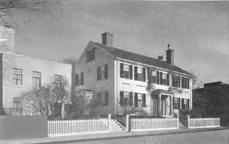
Women in Architectural Practice: Pathways in American Modernism
This project maps the network of social and professional relationships between the graduates of the Cambridge School of Architecture in Massachusetts which operated from 1915 until the nearby Harvard University architecture program began accepting women, in 1942. While the graduates worked in a variety of fields—architecture, landscape architecture, urban planning and housing policy, and so on—and designed in a number of styles, a group of them produced early and under-discussed modern designs. In this respect, the most important of the alumnae was Eleanor Raymond (1887-1889, graduated 1916) who remained deeply connected with the school as a trustee and supporter of its graduates. She operated a Boston architecture practice for decades in which she employed many women architects. Together with her life partner, Ethel Power (1881-1969, also a Cambridge School graduate), the longtime editor of House Beautiful, she was the hub of a spoke of networks that supported women architects as they made their ways in a male-dominated, sexist profession.
This project supports the book, co-authored by myself and Dr. Mary Anne Hunting: Women in Architectural Practice: Pathways in American Modernism which is under contract with Princeton University Press.
The Cambridge School of Architecture (c. 1928) from the Annual Bulletin.

Slide 3
The Network(s)--Objectives:
We sought to map the relationships between the graduates of the Cambridge School as a means of understanding how those connections enabled women to succeed as they pursued work in a variety of design fields.
Our initial impression, after years of archival research, was that women were especially dependent on networks of associations because of the barriers to professional practice they faced.
Those networks helped them as they branched out from architectural practice (where they were often unwelcome) to allied fields such as publishing, curating, interior design, retail, and more.

Slide 4
Constructing the Networks:
To construct the network analysis and assemble the data, drawn largely from the Annual Bulletin of the Cambridge School, we hired as consultants Dr. Scott Weingart (Carnegie Mellon University) and Dr. Margaret Laster (New York City).
Dr. Laster has assembled our data into two spreadsheets (see following slides) showing the people in whom we are interested (segregated into the categories of Primary and Secondary significance) and showing their interactions according to a schema we collectively established.

Slide 5
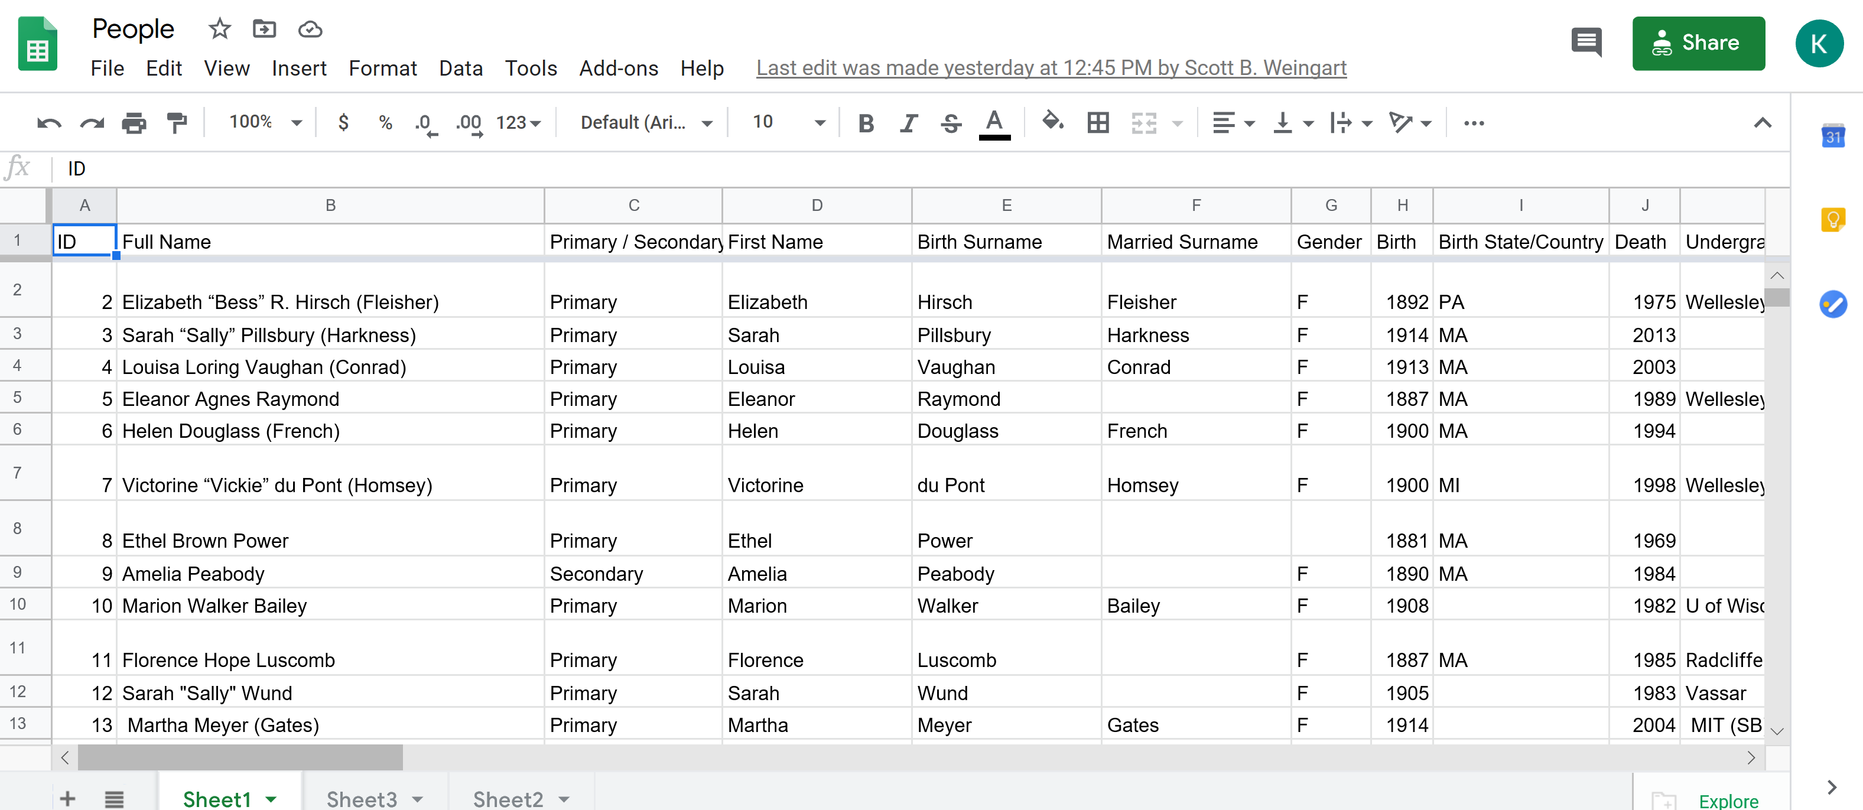
Networks: People (partial)

Slide 6
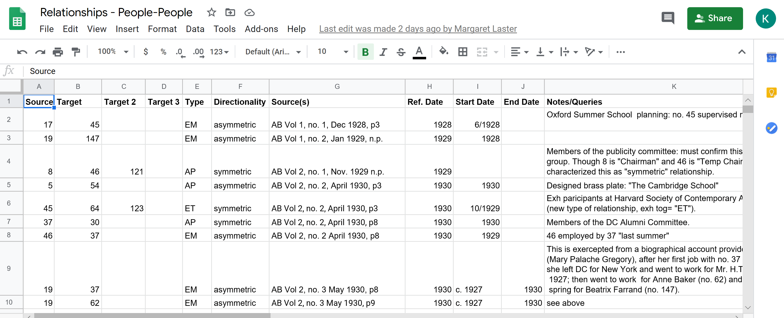
Networks: Relationships

Slide 7
Mapping the Networks:
Dr. Weingart has begun the process of constructing the networks. The first visualization is based on data from the first three volumes of the Cambridge School Annual Bulletin. (See following slide for the preliminary result of the visualization.)
Over the course of the following month we will be adding to the database of relationships, based on further mining of the Annual Bulletin and other sources and the visualizations will take shape.

Slide 8
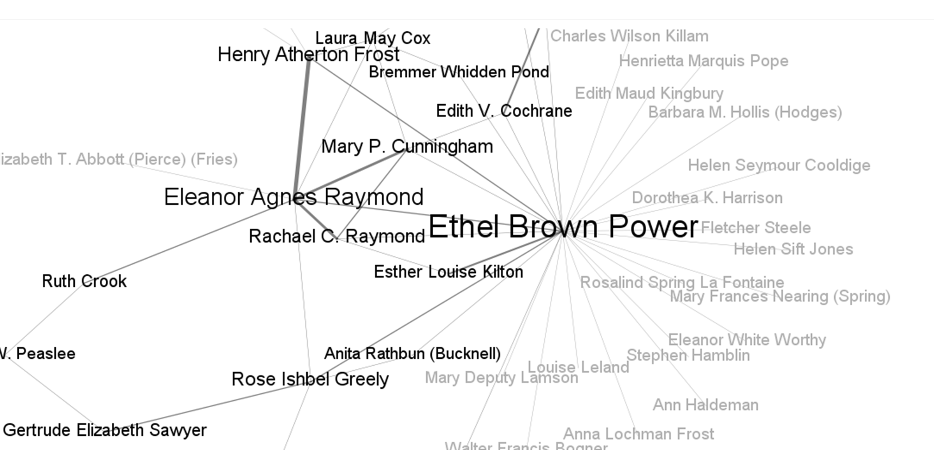
Preliminary Network Visualization:

Slide 9
Conclusions:
The network analysis will enable us to visualize the relationships between these women that we intuited were important to them.
The visualizations will also show who were the major figures connecting the women to one another, and to male figures in the field.
The fellowship enabled me to undertake a kind of analysis which I would not otherwise have been able to pursue. It will be a key foundation on which to build the argument of what we hope will be an important contribution to the fields of architectural history and women’s studies.

