Slide 1
Community Archival Indexing and the Pine Mountain Settlement School

Slide 2
Pine Mountain Settlement School Harlan County, Kentucky

Slide 3
Pine Mountain Settlement School Harlan County, Kentucky

Slide 4
Pine Mountain Settlement School Harlan County, Kentucky
“A National Historic Landmark, Pine Mountain Settlement School was founded in 1913 as a school for children in the commonwealth's remote southeastern mountains and a social center for surrounding communities. The school was the dream of a local man, William Creech Sr., who was troubled by the area's lack of educational opportunities, and the prevalence of social problems and rampant disease. He donated land for the school and recruited two women, Katherine Pettit of Lexington, Kentucky, and Ethel DeLong, New Jersey native, to establish and run the new institution. These two women enlisted the help of architect Mary Rockwell Hook of Kansas City to draw up plans for the campus and its buildings.”
Special Collections at Belk Library Finding Guide
Appalachian State

Slide 5
PMSS History
The Pine Mountain Settlement School (PMSS) is a cultural, historical, environmental education institution in rural Harlan County, Kentucky.
PMSS was founded in 1913 by William Creech, a native of Harlan County, and run by educators May Stone and Katherine Pettit, the institution was part of the larger settlement school movement.
Social reform movement that began in London during the late 19th century, was repeated in major urban centers like New York (the Henry Street Settlement) and Chicago (Jane Addams’ Hull House), and then spread throughout Appalachia, beginning around the turn of the 20th century.

Slide 6
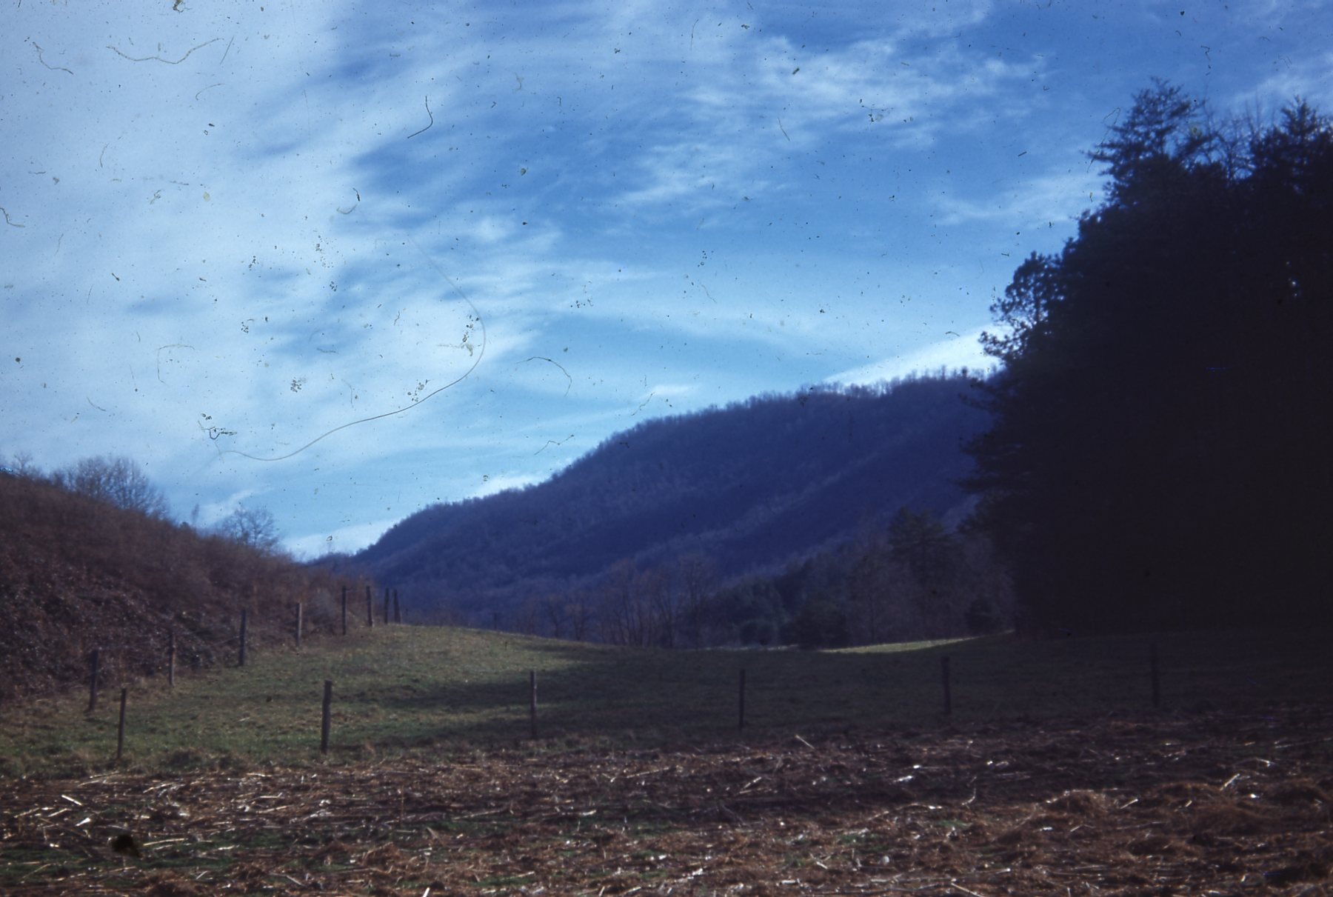
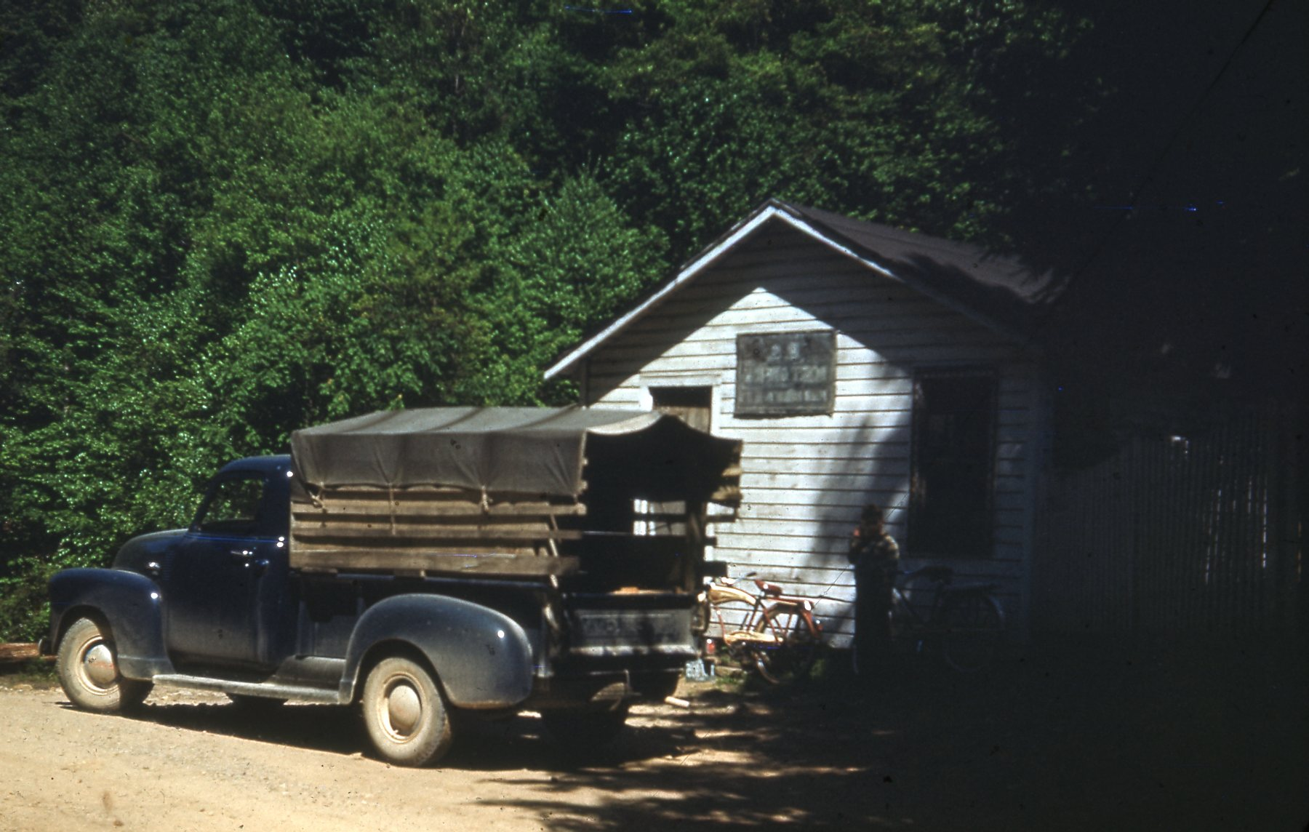
Looking toward Pine Mtn., 1950
Looking toward Pine Mtn., 1950
(Photos from the PMSS Archives)
Pine Mountain Post Office, May 1950

Slide 7
PMSS History
While all settlement schools were envisioned as engines of social uplift and education, rural settlement schools in Appalachia also understood their mission—often religiously inflected—as mitigating the effects of cultural and physical isolation.
Functioned as a boarding school for elementary and middle-school students from 1913 to 1930. By this point, local opportunities for school-aged children had developed, and PMSS pivoted to teaching high-school students. The school prioritized academics but stressed vocational and artistic training as well.

Slide 8
PMSS History
The community high school functioned until the 1970s, when PMSS pivoted and began focusing on environmental education.
Of the many settlement schools that were established during the early decades of the 20th century, few remain in operation. Along with the Hindman Settlement School, in Hindman, KY, which became an important regional literary center, PMSS is one of the few settlement schools in the state to continue operating and finding new ways to serve the local community even as its initial educational mission has shifted.

Slide 9
Pine Mountain Teacher’s Workshop
During the Summer of 2019, I was invited by Dr. Jason Cohen of Berea College in Central Kentucky to help facilitate a workshop for high school teachers at PMSS.
The aim of the week-long meeting was to help introduce educators to the PMSS archives, as well as to Helen Wykle, the school’s archivist, and help them develop middle and high school curricula based on primary source holdings.
This was all intended to provide Kentucky public school students with instruction in local history, politics, and culture.
Over the course of the workshop, I helped teachers navigate the PMSS archive, identify secondary sources to flesh out their research, and construct clusters of research material to serve as the foundation for lesson plans.

Slide 10
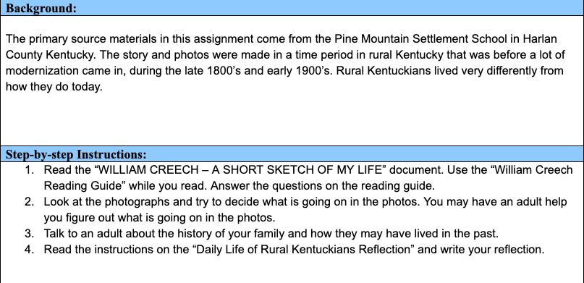
(curriculum samples by Holly Longair, Rockastle County School System)

Slide 11
Pine Mountain Teacher’s Workshop
Using the archives, the teachers collaboratively produced dozens of lesson plans that drew on primary source archival documents and covered a range of subjects, including:
The history of resource extraction in Appalachia
The effects of industrialization on frontier era gender roles
Ballads and ballad collecting
Race and injustice at PMSS
Environmental effects of coal mining and the institutional politics of resistance
Labor organizing in Appalachia
Each lesson utilized at least one primary document and was built around teaching students to interpret archival sources and apply them in their schoolwork.

Slide 12
PMSS Archives
“The Vision of the Pine Mountain Settlement School Archives is to provide a voice that will encourage transformations in our relationship to the cultures of the Appalachian region through access to a unique and extensive body of material about a rural settlement school within the region. The rural settlement school movement and its impact on the people of Eastern Kentucky and the Southern Appalachians is a story that has sometimes been misrepresented, romanticized, or only partially understood. We envision an accessible, deep, vibrant and vital resource that will encourage exploration and collaborative dialogue about the hidden and sometimes contested history of rural settlement schools. We envision a broader dissemination of research materials across all public, private, and federal sectors interested in Southern Appalachian cultures and life.”
from pinemountainsettlement.net
https://pinemountainsettlement.net/?page_id=51237

Slide 13
PMSS Archives
The PMSS archives represent a unique and extensive collection of Appalachian historical documents collected over the course of the school’s century long existence.
It is a small archive, physically speaking, maintained almost entirely by Helen Wykle, a librarian by training, and intended to serve as a resource for researchers as well as the public more generally.
Many of the archive’s visitors are descendants, or relatives of settlement school students and much of their research is genealogical in scope, but the holdings are also of interest to academic researchers working on Appalachian issues more broadly.

Slide 14
PMSS Archives —> Small Collections Project
The summer workshop I assisted with helped make the archive accessible to a new population: high school teachers and their students.
The following fall, Kylie Korsnack—a visiting professor of English at Berea College and a former colleague from the Vanderbilt English PhD program—and I began developing a project based off of Dr. Cohen’s summer workshop, which at this point had formed the shared core of new high school curricular materials, currently being taught in seven districts in Eastern and Central Kentucky to over 450 students in subjects ranging from Government to Literary Studies to Biology and Environmental Studies.
Using the PMSS/summer teacher workshop as a model, we proposed a project that would utilize the school’s archives to develop an accessible guide for creating rudimentary finding aides.
Our intention was that this guide, which would follow and document our own process creating a finding aid within the PMSS archives, could be used by community and amateur researchers in any small collection. It would explain the process of creating such an aid and allow researchers to leave the archive with a description of their findings that could be useful for future inquiries.

Slide 15
Small Collections Community Archival Project
Our outline for the project included the following steps:
Create new findings aids and curriculum based on uncatalogued archival holdings at PMSS.
Document our processes and produce instructional materials that can be used—by professional and nonprofessional researchers—to replicate, adapt, and carry forward our work.
Summarize the practical and pedagogical findings of this project in a scholarly article.
In the winter we received a grant from the Mellon Foundation to pursue this research, however a number of issues arose that prevented us from getting underway and by the time we were able to recommence, the onset of COVID-19 further limited our ability to travel to Pine Mountain and do our on-site research.

Slide 16
Small Collections Community Archival Project
At present, the status of our project is unclear. Due to both COVID-19 and project participants moving on to new jobs, it is unlikely that our work at Pine Mountain will continue as initially planned.
However, we outlined the project with flexibility in mind and may well reconstitute it in line with another small collection in the future.
Working in the PMSS archives—a very well maintained, established small collection—gave us a sense of just how useful these institutions could be for many different types of researchers, but also how crucial it was for the archive to have a dedicated caretaker like Wykle and a corpus of indexed materials.
Our hope is that if we are able to restart the project we will be able to create a guide and a set of reflections that might help even smaller, underesourced archives to institute self-documentation programs that can in turn make them more accessible and visible to more and more researchers.

