Slide 1
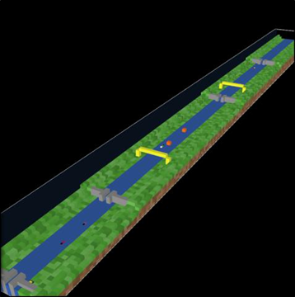
Utilizing Agent-based Modeling to Evaluate Operational Impacts of an Incident and Possible Alternatives on U.S. Waterways TRB Annual Meeting – January 2020
Janey camp, Kate Nelson, Craig Philip, Miguel Moravec, DOUG ScHEFFLER, PAUL JOHNSON
Vanderbilt engineering center for transportation and operational resiliency (VECTOR)

Slide 2
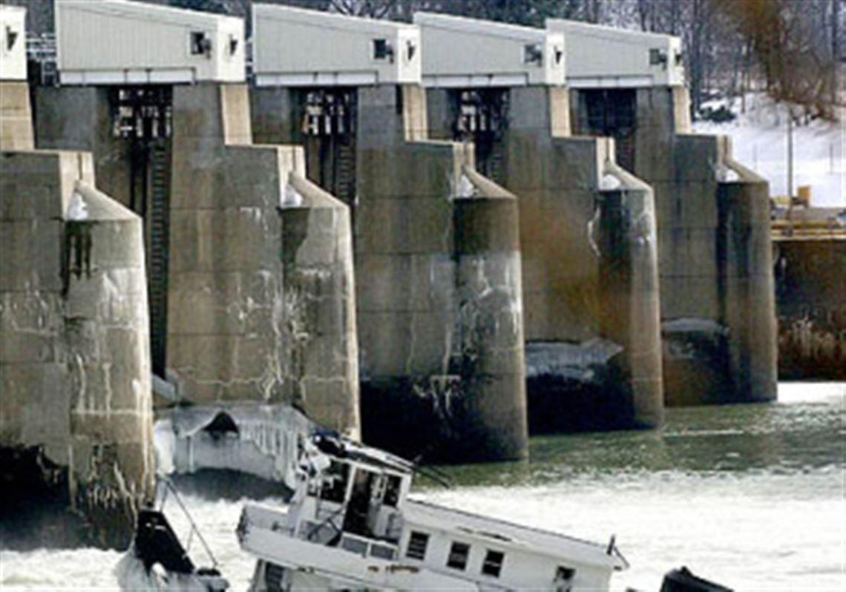
Objectives
Utilize an agent-based model for inland waterway tow movements to demonstrate and estimate the operational impacts (transit time, vessel delays, congestion, etc.) that might occur under various scenarios that may be considered in an economic evaluation.
Note: Contributing factors identified in the Elizabeth M investigation included items that are covered today by Sub M and Safety Management System inspections.

Slide 3
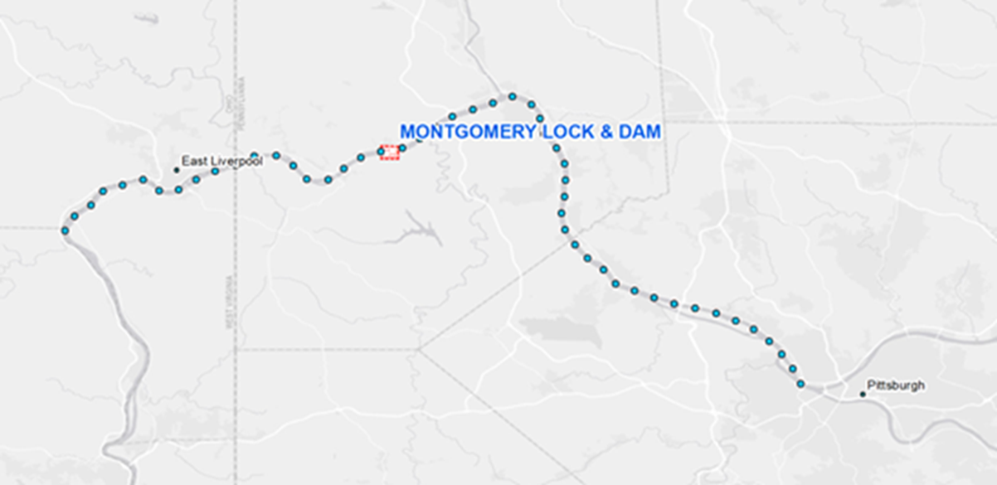
PROJECT SCOPE
Elizabeth M incident conditions used as foundation for constructing the model
Report of Investigation, NPRM and Final Rule documents used as foundational information toward modifying the model parameters
Model boundaries
Pittsburg to MM 74
Includes multiple locks and dams (New Cumberland, Montgomery, Dashields, and Emsworth)
Notes:
NPRM – notice of proposed rulemaking

Slide 4
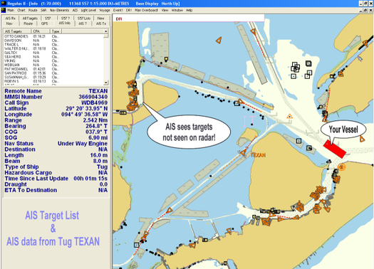
Model Setup, Calibration and Validation
Data Utilized for Model Setup
Automatic Identification System (AIS) tow movement data for 2013 and 2014 used
Calibrate and validate the model
Provide metrics for incident simulation
To generate tows entering the “system” either upbound or downbound
30 minute intervals
Truncated at river mile 74 near Wellsburg, OH
R software used to format data for input into model
Source: USCG Navigation Center AIS System Overview

Slide 5
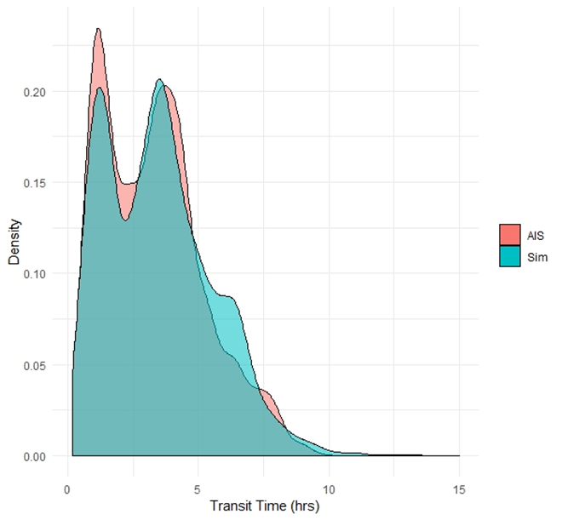
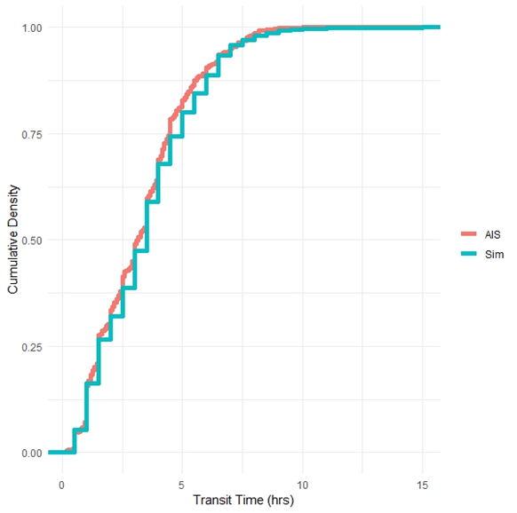
Calibration and Validation
Samples of 2013 and 2014 data were used to train and test the model
Training - AIS data from 2013 was used to adjust model parameters/settings to those that most closely matched overall tow transit time distributions for the Upper Ohio River
Testing - Resulting ABM with adjusted model parameters and settings was validated against 2014 AIS data

Slide 6
Resulting ABM

Slide 7
Scenarios
Title (Model Output Representation) | Scenario Description
Baseline(Control) | Run with settings that provide best match with AIS assuming no incident and no restrictions on horsepower or tow sizes.
Traffic Management 1 (Towsize_10) | No incident but implemented a reduced maximum tow size of 10.
Traffic Management 2 (HP_Ratio_200) | No incident but implement an increased HP to Barge ratio of 200.
Traffic Management 3 (HP_Ratio_150) | No incident but implement an increased HP to Barge ratio of 150.
Incident Simulation (Incident_base) | Elizabeth M incident is ON (with a default 7 day lock closure time) and no incident response.
Incident with Traffic Delayed at Dock Post Incident (Dock) | Elizabeth M incident is ON and wait at dock regulation turned ON as incident response..
Incident with Traffic Diverted Post Incident (Divert) | Elizabeth M incident is ON and divert tows turned ON as incident response. Tows that would pass through Montgomery Locks and Dam are removed from the system and presumed to be rerouted to another transport mode.
Traffic Delayed and Diverted (Wait for Help) | Elizabeth M incident is ON and wait for help regulation with a wait time of 2 days turned ON as incident response.

Slide 8
Outputs and System Performance Metrics
Number of tow trips (UPSTREAM, DOWNSTREAM)
Number of barges (on waterway, heading upstream, heading downstream)
Average travel time for tow trips, transit time for upstream/downstream trips
Average tow speed for the entire simulation period, all upstream/downstream tows
Total hours of “DELAYED” status for all tows, all upstream/downstream tows
Total number of barges delivered from origin to destination during the simulation
Aggregate system barge delivery rate in terms of barges delivered per total hours of tow transit time

Slide 9
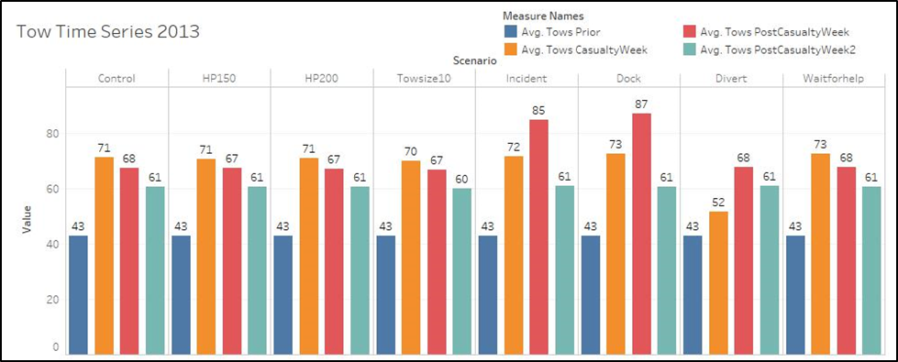
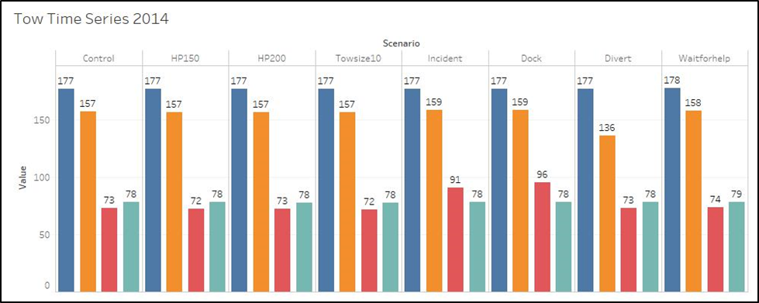
Comparison between 2013 and 2014
Traffic patterns vary significantly across years, yet the increase in waterway traffic shortly following the incident is consistent for both years.
Notes:
Comparison of the average number of all tows on the river for (a) 2013 and (b) 2014 represented in weekly time periods relative to the incident week. The number of tows for the week prior to the incident in 2014 for all scenarios are more than double that in 2014. Here, one should compare across scenarios within a given year to consider the impacts of the incident and recovery.

Slide 10
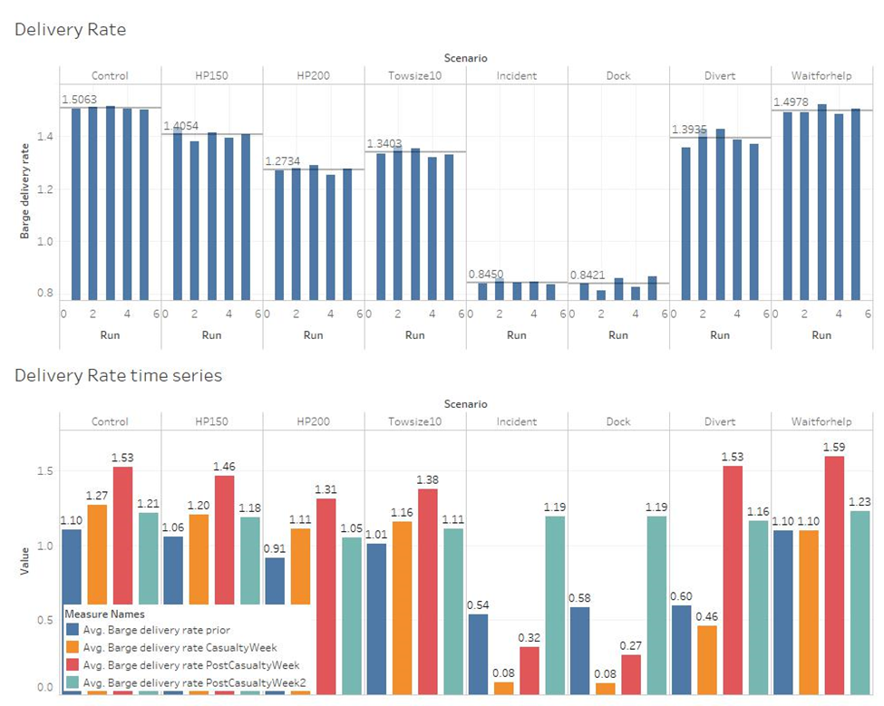
Delivery Rates
Traffic management decreases average delivery rates, but much less so than the incident which drops delivery rates to nearly 0 for ~2 weeks.
Notes:
Why does number of barges delivered drop so much in reduced tow size/speed compared to control?
The reduction is because we are simply reducing the number of barges that the tows can carry from baseline conditions of a max tow size of 15 and required Horsepower per barge of 100. So for the 200 HP/barge ratio scenario the number of barges that any tow can carry is essentially halved.

Slide 11
Key Operational Impacts Quantified in the Case Study
Recovery - System performance metrics achieve a full recovery to pre-incident levels after 1 week.
Resilience - Diversion of freight during incidents would result in improved transit times and delivery rates.
Resilience - Tow size restrictions which might help avoid future incidents decrease the number of total barges that can be delivered. However, these restrictions still result in shorter transit times and better barge delivery rates than incident scenarios.

Slide 12
Conclusions
An ABM can be used to simulate and demonstrate operational impacts of closures, incidents, etc.
An ABM can produce outputs that may be used for economic analysis
Data sets such as AIS can be used to calibrate and replicate real world behavior in models at a granular level
ABM modeling can inform regulatory and operational decision making and planning
Understanding of recovery time can inform cost-benefit analyses for down-time related to planned closures for lock maintenance operations and can be communicated to suppliers and shippers for improved cargo management to meet customer demands
Notes:
Representativeness of the recovery times: Truly these are the best conceivable recovery times and likely underestimate actual recovery times to a considerable degree. Why? Because the model only uses a First-In-First-Out queuing mechanism that does not account for time delays for lock refilling. The model does not account for delays due to tow reconfiguration, etc..., and basically considers that all tows move as efficiently as possible and that the lock can be operated non-stop for an extended period of time.

Slide 13
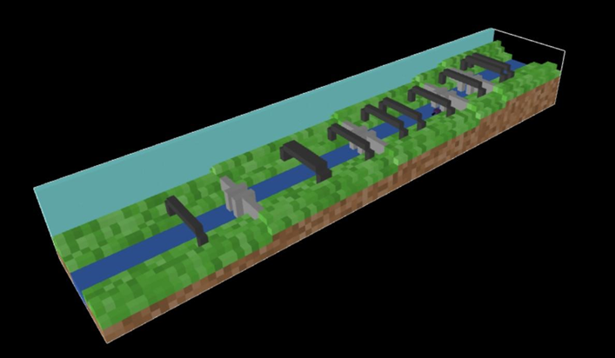
Thank you!
Janey Camp
janey.camp@Vanderbilt.edu
Kate Nelson
ksnelson@ksu.edu
Craig Philip
craig.e.philip@vanderbilt.edu
Doug Scheffler
dougscheffler@aol.com

