Slide 1
Vacuums and Air Pressure
Vanderbilt Student Volunteers for Science
Training Presentation
Spring 2019

Slide 2
IA. What is the Atmosphere?
Write the following terms on the board: atmosphere, air pressure, vacuum
EVERYONE MUST WEAR GOGGLES!
Explain that the atmosphere surrounds the planet and is mainly composed of gases.
Ask the students if they know what kinds of gases?
Nitrogen, oxygen, argon, carbon dioxide, and other trace gases
Is there anything else in the atmosphere?
Also small liquid and solid particles (dust, smoke, chemicals, water vapor)

Slide 3
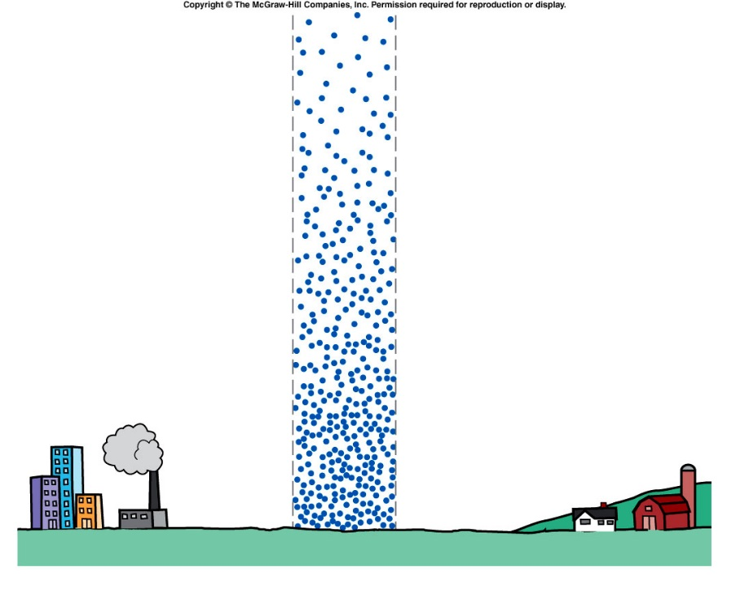
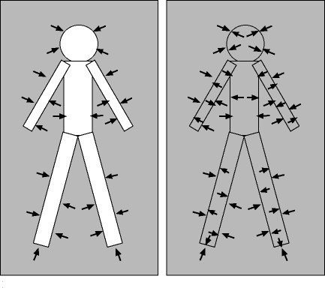
IB. What is Air Pressure?
Explain that air particles still have mass and therefore, gravity acts on them.
There are gas particles about 300 miles (480 km) above us, and all the weight of those particles presses down on us. This is atmospheric pressure.
Can we feel the weight? If so, why don’t we get crushed?
The air inside our bodies exerts an equal amount of pressure outwards as the air outside exerts on us

Slide 4
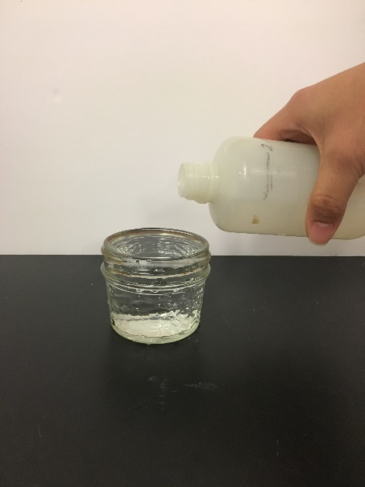
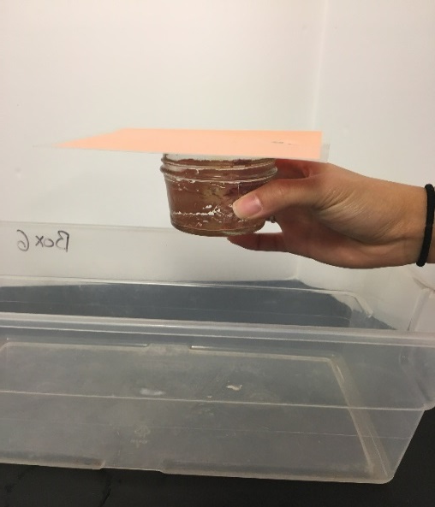
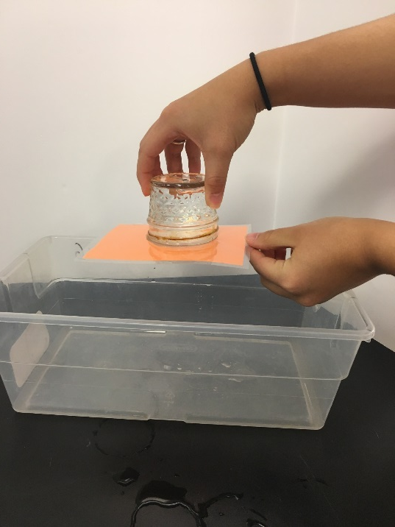
IB. What is Air Pressure? (cont.)
COMPLETELY fill a glass with water.
Cover it with a card.
Slowly invert the glass over a bin.
The card should stick to the cup, and the water should stay in the cup without outside support!
Explain that atmospheric pressure “pushes” the card in place.

Slide 5
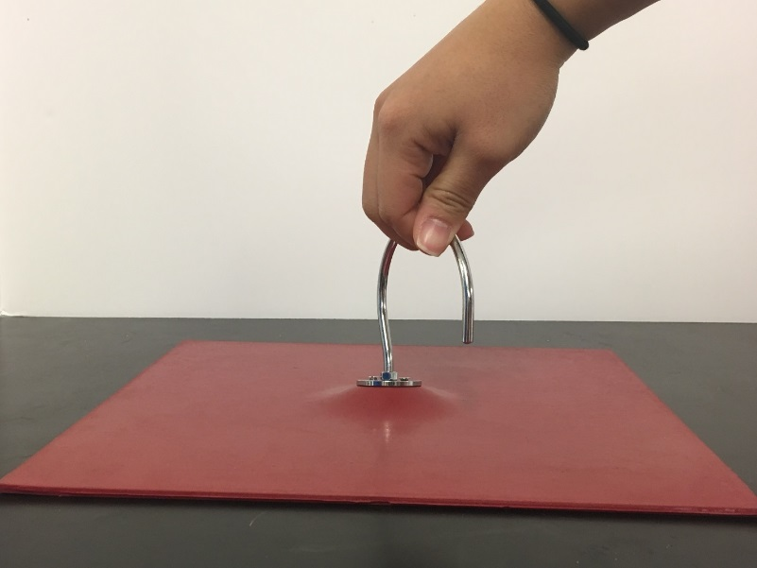
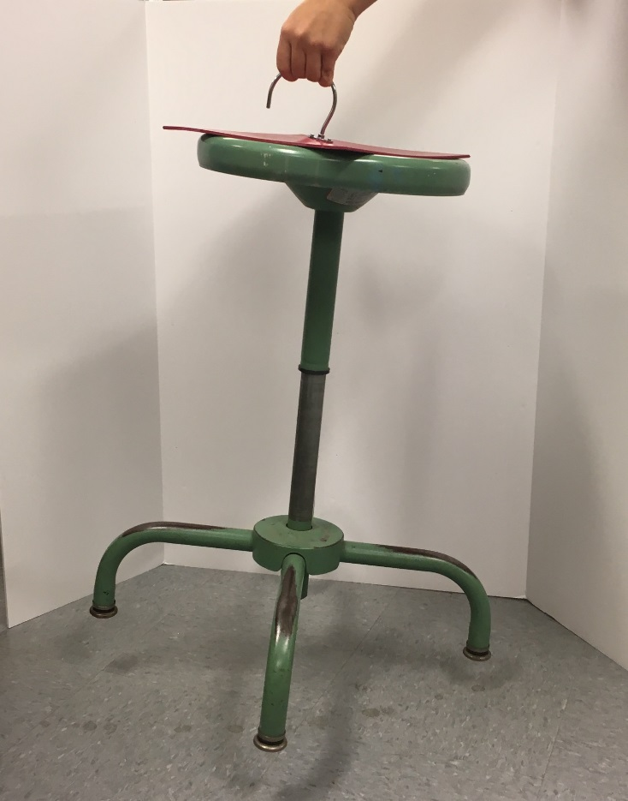
IC. Atmospheric Mat
Place the atmosphere mat on a table (must be flat).
Show that you can freely slide the mat around and pick it up from the edge.
Ask a student, teacher, VSVSer to try lifting the mat with the hook.
Repeat to show you can lift the mat by the edge but not hook.
Place the mat on a free-standing object with a flat surface (book, chair, etc), and lift it by the hook.
Explain the mat is held down by atmospheric pressure. 1 atm (15 psi) acting on an area of 100 in² is 1500 lbs (about the mass of a cow)!

Slide 6
IIA. Using a Vacuum Pump.
Ask the student if they know what a vacuum is?
Space with no matter (not even gas)
Most students may think of outer space.
Divide students into 10 groups of 3-4, and pass out bell jar apparatus. Point out each part on the handout.
Bell jar and base, hand pump syringe, tubing with 2 check valves

Slide 7
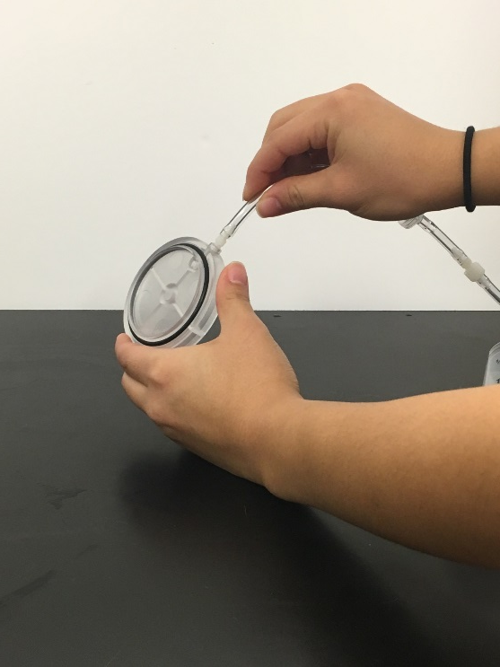
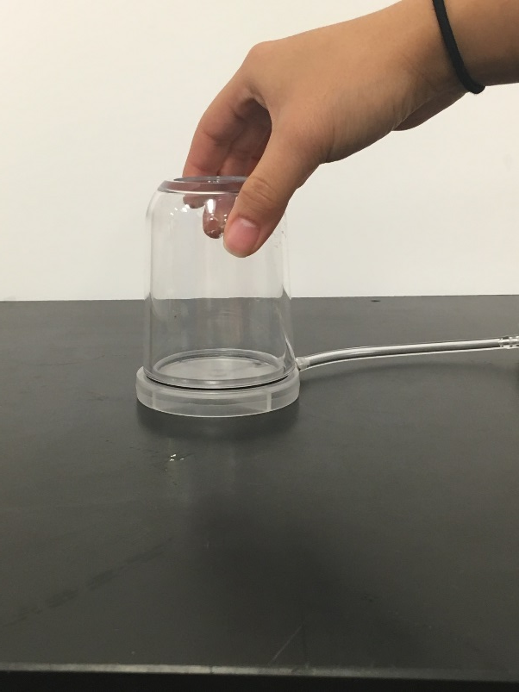
IIA. Using a Vacuum Pump (cont.)
Ask students what is in the bell jar?
Air is still in the bell jar, not nothing.
Take turns pushing the syringe and listening to the airflow in the tubing. Check valves only allow air to pass in one direction. Connect it to the base.
Push firmly on the bell jar to the base and make sure it is aligned on the “O” ring.

Slide 8
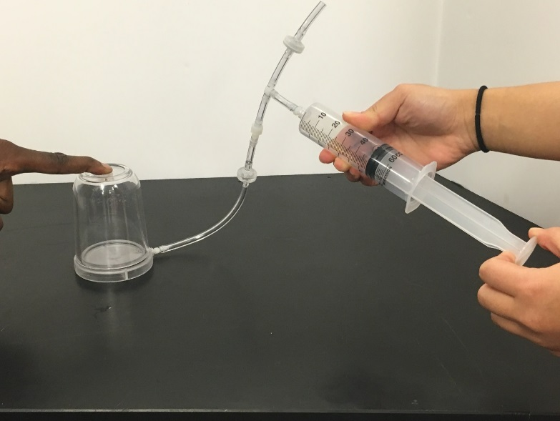
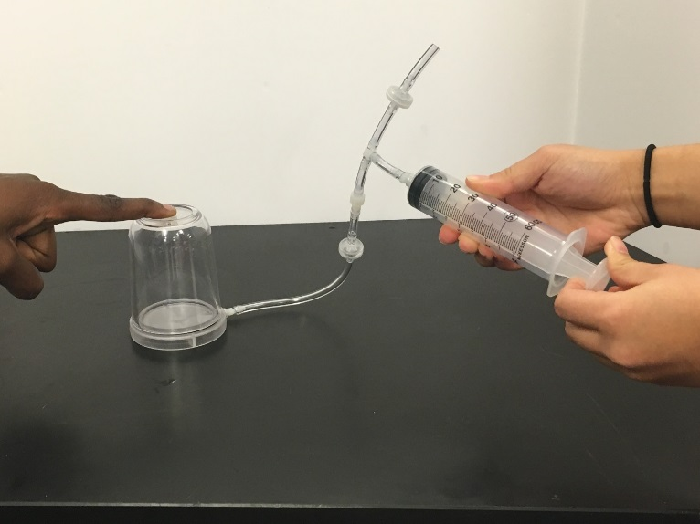
IIA. Using a Vacuum Pump (cont.)
Draw the syringe out to 60mL
Where does the air come from?
From inside the jar.
Briefly let go of the piston, then push it back to 0mL.
Where did the air go? (Hint: listen for the hiss)
Out the open end of the tube
Repeat these steps five times rapidly
Ask the students what happened to the force required to pull the syringe? It should get harder to pull
Explain there is less air pressure inside the jar that used to push the syringe from the inside
Repeat another 10-20 times until it is difficult to pull the syringe.
What is in the bell jar?
Close to nothing, or a vacuum
Students need to keep the vacuum in the bell jar for the next experiment.

Slide 9
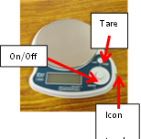
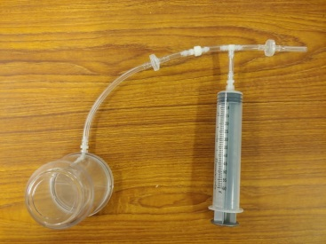
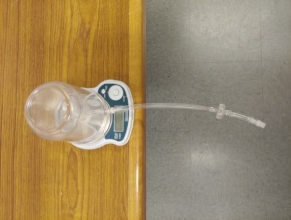
IIB. Does Air Have Mass?
Place scale on flat surface, turn on, and tare (zero).
Make sure the scale is measuring in grams (a small g will be on the screen).
Detach where tubing and syringe connect.
Place the bell jar and tubing on the scale. Allow the tubing to hang off the edge of table.
Measure mass.
Detach tubing from bell jar. Air should now rush in.
Measure mass again. It should be heavier by 0.1-0.3 g.

Slide 10
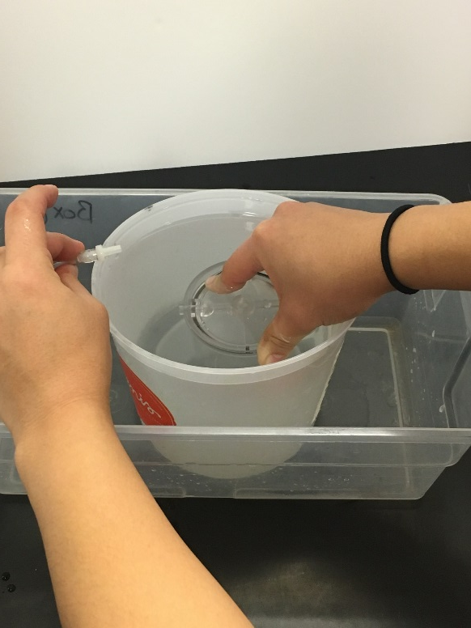
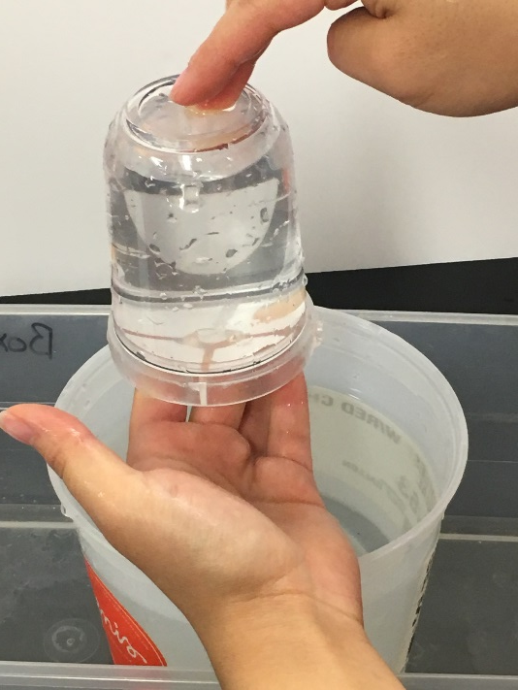
IIC. Demonstration: How Much Air is Being Removed?
VSVS member will repeat the procedure from IIA to evacuate bell jar, and detach where the tubing connects to the syringe.
Hold the bell jar upside-down in a container of water. Be sure the jar and base are attached at all times!
While the bell jar is immersed, detach the tubing from bell jar.
Water should 90% fill the jar, then carefully lift the jar.
The volume of water takes the place of the vacuum.

Slide 11
III. Volume and Changes in Air Pressure
Ask students if they’ve ever carried a plastic bottle to higher altitudes, or in an airplane bag. What happened?
As air pressure decreases, the density of its contents also decreases because its volume increases. Airplanes have a slightly lower air pressure than ground level pressure.
Show students a slightly inflated balloon.
Ask what they think will happen to it if air pressure is decreased.
Tell students to place balloon in bell jar and make sure it does not touch the “O” ring.

Slide 12
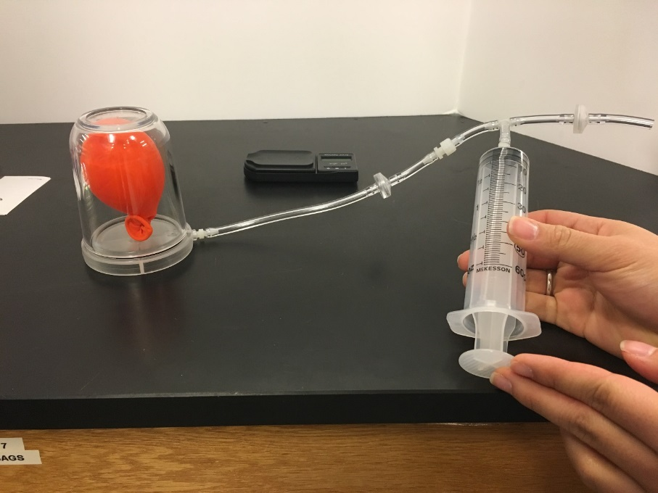
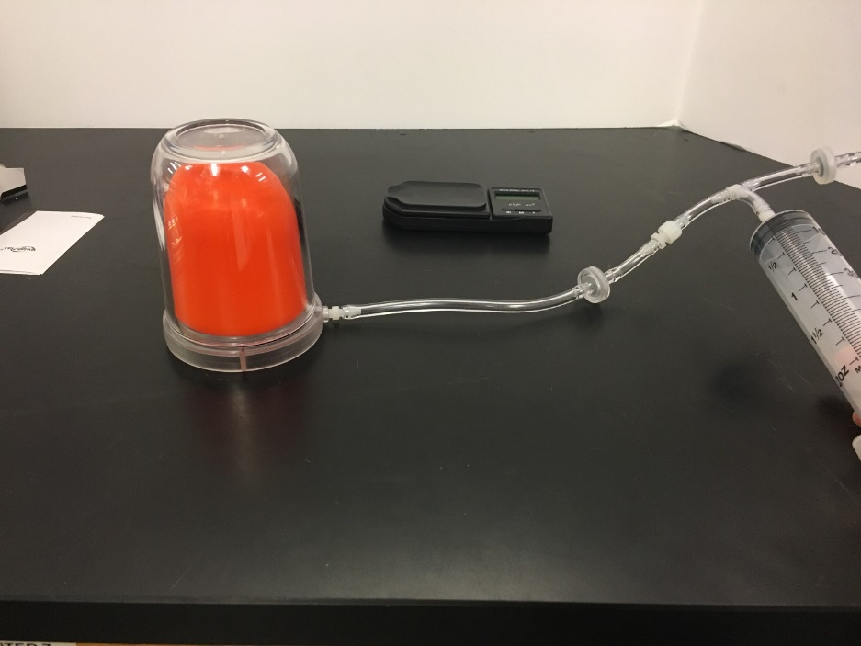
IIIA. Changes in Air Pressure (cont.) Balloon Activity
Make sure to push on the bell jar so it presses against the base.
What happens when a student begins pumping the syringe?
The balloon grows larger because the air surrounding it has been removed. The air inside the balloon keeps pushing at the same pressure, causing the balloon to expand.
Why is this important? Explain how this is the same way your lungs inflate. The pressure in your chest decreases and allows the lungs to expand.
What happens when the tubing is loosened and air is allowed back inside the bell jar?
The balloon contracts to its original size.

Slide 13
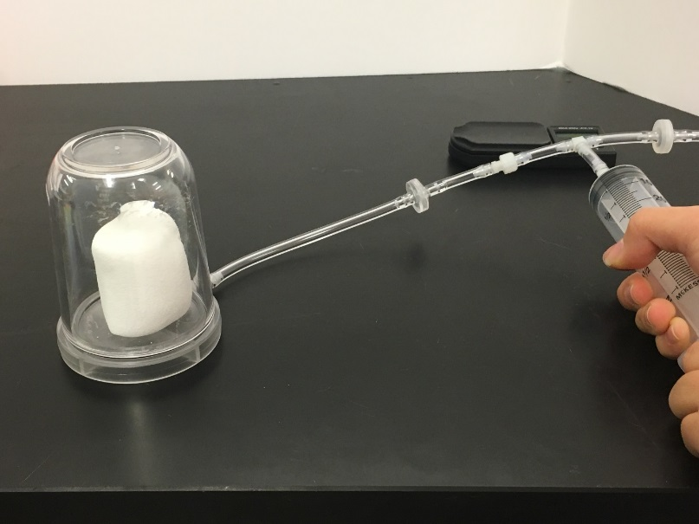
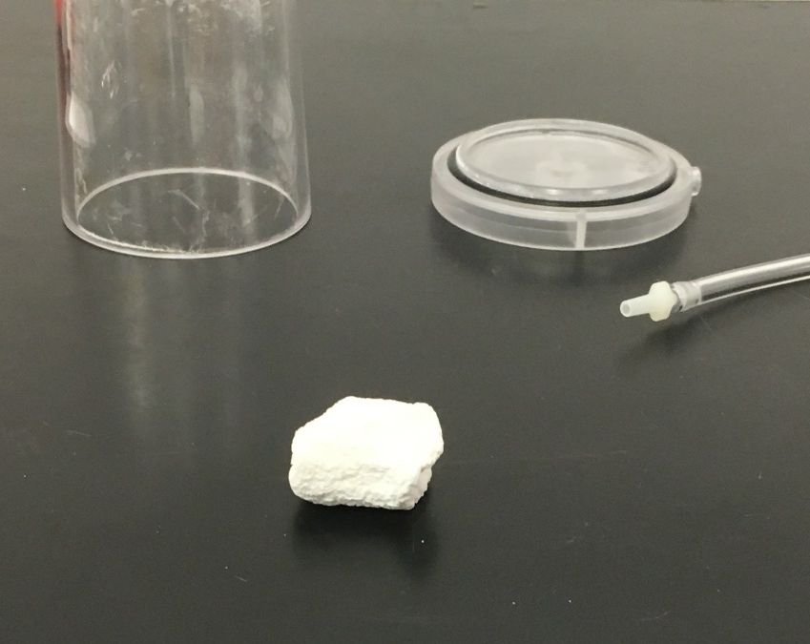
IIIB. Marshmallow Activity
Ask the students what they think will happen when the marshmallow is placed in the bell jar?
Marshmallows have pockets of air. Think of them like small balloons.
Repeat the same procedure with the marshmallow as with the balloon.
The marshmallow should expand as the syringe is pumped. Unlike the balloon, the marshmallow does not quite look the same after the jar is repressurized.

Slide 14
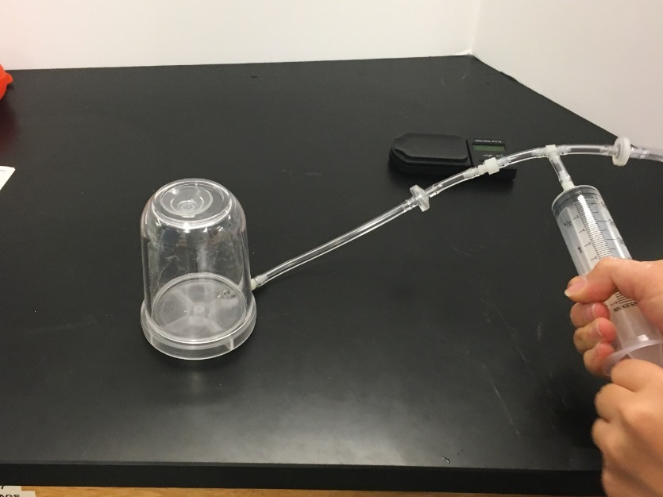
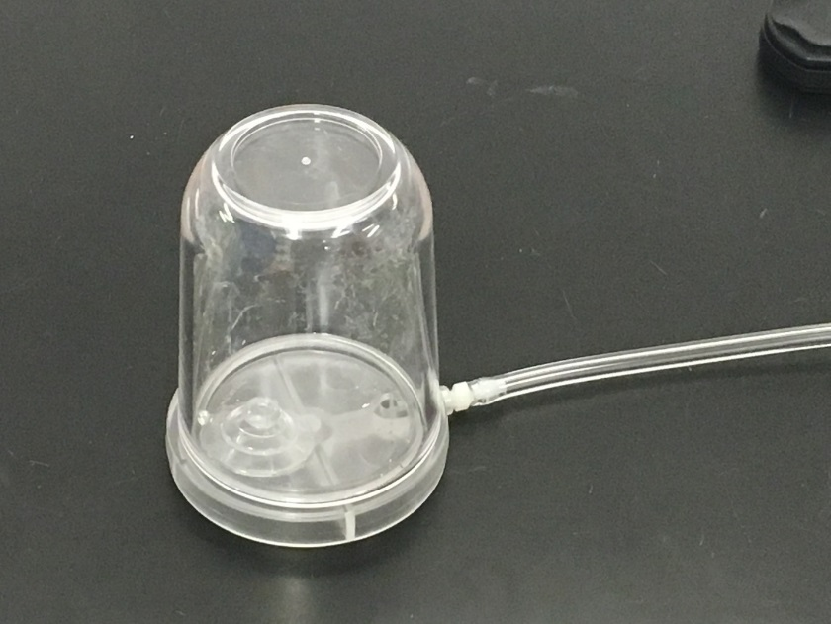
IIIC. Suction Cup Activity – Optional if Time Permits.
Stick the suction cup to the top (inside) of the bell jar.
Why does the suction cup stick? (Hint: think of atmosphere mat)
Ask the students what they think will happen when the atmospheric pressure is removed.
Evacuate the bell jar until something happens to the suction cup.
The suction cup falls off because the outside pressure holding the cup is removed.

Slide 15
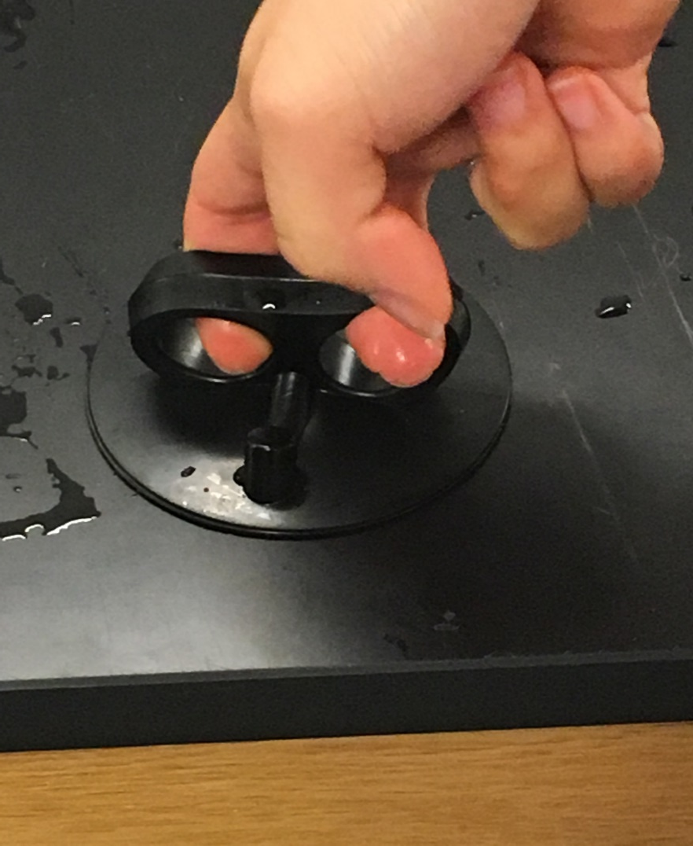
IV Optional. Magdeburg Hemispheres
Each pair of students gets one hemisphere.
Tell the students to press down on the desk and try to lift up.
Explain that when you press down, the gas particles are forced out. Since there are more air particles outside, the atmospheric pressure is greater than the inside pressure.
This is similar to how suction cups work.

