Slide 1
Stratigraphy and Fossils
Vanderbilt Student Volunteers for Science
Spring 2019

Slide 2
Why is the science in this lesson important?
An understanding of stratigraphy is useful for understanding when and how life originated on Earth, as well as for studying evolution and historical changes in Earth's ecosystems. Potential careers that benefit from an understanding of stratigraphy include paleontologists, archaeologists, and soil scientists.

Slide 3
IA. Reviewing Sedimentary Rocks
Learning Goals:
Students understand how sedimentary rocks are formed.
Students experiment with forming sedimentary layers and understand that fossils are deposited at the same time the as the sediment.
Students understand that sediments are deposited in horizontal layers
Students understand that older layers are at the bottom in a sedimentary layer, while younger layers are at the top
Sedimentary rock facts:
Formed from sediments deposited in oceans, lakes or rivers.
Sediments form layers that pile on top of each other.
Rock layers are called strata.
Common all over the world.
Sandstone, limestone, and shale.

Slide 4
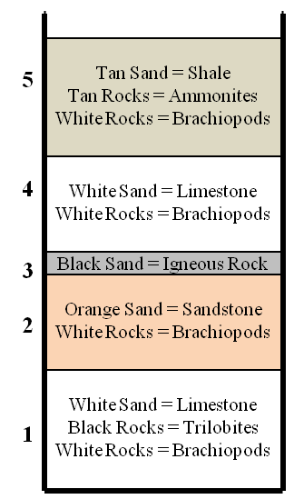
IB. Activity - Creating a Model of Sedimentary Layers
Set up at the front of the class, 1 plate, 1 column (tennis ball container), 1 bottle of water, 5 numbered jars of sand:
Jar 1: White sand containing black and white stones.
Jar 2: Orange sand containing white stones.
Jar 3: Black sand.
Jar 4: White sand containing white stones.
Jar 5: Tan sand containing white and tan/red stones.
And hand out similar group materials (10 groups): 1 jar containing water plus jars of sand
Draw diagram on board representing column
Draw each section of the diagram as it is poured into the column.
Add in correct order.

Slide 5
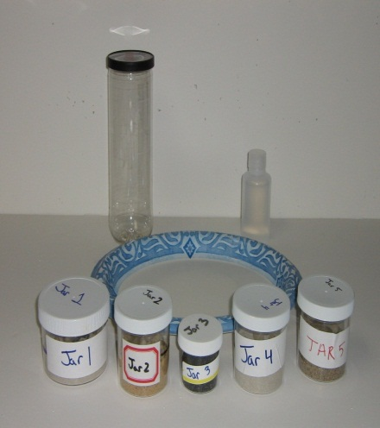
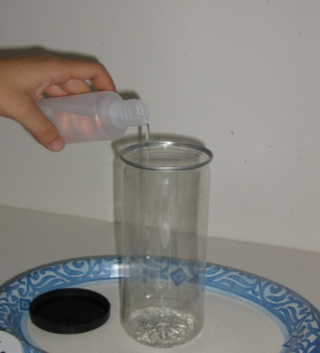
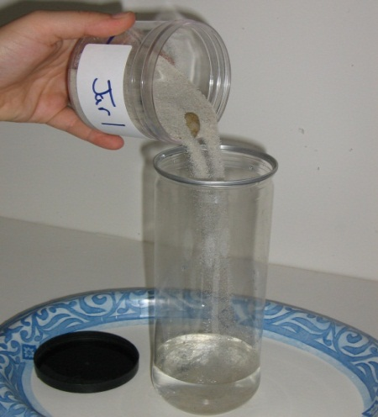
IB. Activity - Creating a Model of Sedimentary Layers (cont.)
One VSVS member constructs demo column at front of class while students follow along.
Column or jar is on plate to catch spills.
Pour container of water into the column. (Water is already in student’s jar.)
Pour all of the sand and rocks from Jar #1 into the column.
Wait until each layer is settled and pour the next layer (jar #2).
Continue with all jars, updating the drawing as you go.
Explain: Sediments are deposited in flat, horizontal layers and stay that way unless something disturbs it.
Have students answer Question 1 on their observation sheet.
Sediments settle and form rocks in ___horizontal_layers.

Slide 6
IC. Explaining the Column
Fossils are deposited at the same time the rock material is deposited. Therefore the ages of the fossil and rock in which it is found are the same.
Have students answer Question 2 on their observation sheet.
What is the age of a fossil relative to the rock in which it is found? The same
Tell students to imagine that the process of creating their sand columns took millions of years to occur.
Q. Ask students which layer is the oldest in the column.
The bottom layer; it was deposited first and other layers were deposited on top of it.
Q. Ask students which layer is the newest in the column.
The top layer; it was deposited last, on top of all other layers.
How old are the middle layers? (You can’t tell for sure! But they are older than the top layer and younger than the bottom layer.)
Have students answer Question 3 on their observation sheet.
#3. Older layers are ___at the bottom ____in a column of sedimentary layers, while younger layers are ____are at the top._____
Fossils succeed each other in a definite order – the oldest fossils in a series of layers will be in the lowest layer.

Slide 7
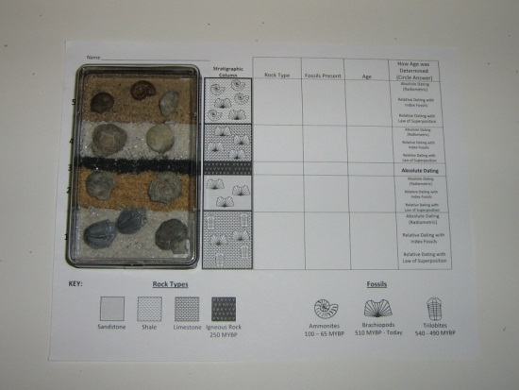
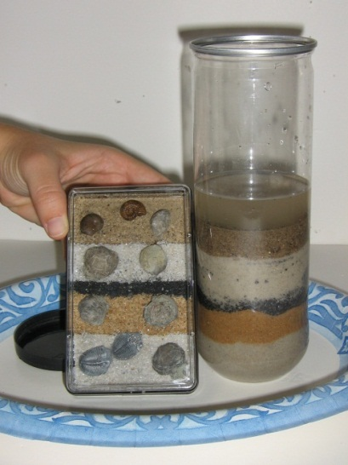
ID. Index Fossils
Pass out 1 model of rock layers/fossils encased in boxes and 1 “Column Analysis” sheet to each group of students.
Help students orient model correctly on observation sheet.
Help student match up model with column they created.
Tell students names of type of rock and fossils in each layer.
Models contain real fossils that are represented by pebbles in their created column.
Help students fill in the first two columns on sheet.
Explain that a Stratigraphic Column is the way geologists represent rock columns – diagram to the right.

Slide 8
ID. Index Fossils cont.
Tell students that in real sedimentary rocks, some fossils are found in many layers, while some are found in only one layer.
Ask students which type of fossil, one found in many layers or one found in only one layer, would be more useful for identifying/finding the age of a rock layer.
Fossils found only in one layer can be used for identifying and finding the age of a rock layer, because they are unique to that layer. They are called Index Fossils.
Ask students which fossil(s) in their column would be considered index fossils, and which would not be considered index fossil(s)?
Ammonites and trilobites are only found in one layer, so they would be considered index fossils; others in their columns are not.

Slide 9
ID. Radioactive dating
Learning goals:
Students observe a model of a stratigraphic column that includes fossils.
Students correlate the model with the sedimentary column that they created.
Students learn that radioactive elements are used for dating rock layers.
Tell students to look at layer # 3 in their column – the thin black layer.
When there is a dark, skinny layer in a sedimentary rock column, it is usually the result of lava or volcanic ash interrupting a sedimentary rock layer – it is an igneous rock, not a sedimentary rock.
Igneous rocks contain radioactive elements like uranium, rubidium, thorium, and potassium – scientists can use these elements to determine the exact age of these rocks!

Slide 10
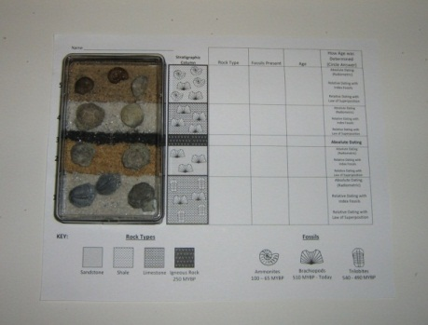
IE. Finding the Rock Ages in our Column
Learning Goals: Students will determine the ages of the layers in the model.
Tell students they are now going to use their model to determine the ages of the “rock” layers.
Write ranges on board as you go through them so students can fill them in in their worksheet.
Black layer – is an igneous rock and so we can date it via absolute dating with radioactive elements = 250 million years old (in this hypothetical case).
The top and bottom layers contain index fossils and we know the range they were deposited
Ammonites (top layer) - 100 million years ago until 65 million years ago
Trilobites (bottom layer) - 540 million years ago until 490 million years ago
The other two layers are dated by Relative dating – intervening ranges between the layers on either side.

Slide 11
II. Stratigraphy IIA. National Park Rock Sequences
Learning Goals:
Students look at a real life example of stratigraphic columns in 3 National Parks.
Students learn how geologists can correlate sedimentary layers many miles apart.
Pass out the paper-clipped colored stratigraphic columns to students (they have been cut from the columns to the right, labeled on the back with respective national park name).
Tell students that these columns represent actual sedimentary layers taken from the National Parks
Students should put the columns in stratigraphic order, then place them at the correct national parks
Columns can correlate even across long distances

Slide 12
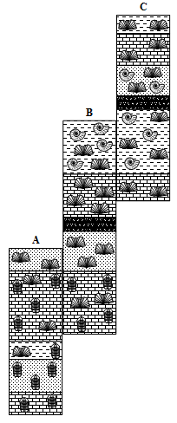
IIB. Stratigraphy
Sedimentary rock layers often stretch across entire continents. Sometimes these layers are connected; however, often layers have been removed in some locations by erosion, and some are buried under other layers and can’t be seen by us yet.
Pass out the set of 3 stratigraphic sequences to each student. Tell students to imagine that these are 3 sequences of rocks found in different places around the US.
Tell students to find in sequences A and B at least 2 layers whose index fossils and rock types match.
Emphasize that the depth of the layers does not have to be the same.
Students should place the sequences side-by-side with matching layers touching.
Have them repeat the process with sequences B and C.
Pass out the longer laminated strip (1 per pair) and tell the students that this geological column is the one they have just compiled from their short sequences. This can tell us a lot more about the geologic history of the earth than the individual columns can.

Slide 13
II. Stratigraphy cont.
Q. Which short strip has the oldest rocks exposed and how do we know?
Location A, because it contains the oldest fossils and has the bottom layers in the geological columns.
These layers still exist at locations B and C, they just haven’t been exposed yet.
Q. Which short strip has the youngest rocks exposed and how do we know?
Location C, because it has the top layers in the geological column.
These layers are missing at locations A and B because of erosion.

Slide 14
III. Timeline of the Earth
Learning Goals: Students can “see” the time scale of earth’s history from a model.
Ask the class if anyone knows how old the earth is.
4.6 billion years old, or 4600 million years old. Write the number out in full on the board so they understand how much time this is (4,600,000,000).
Tell students that the timeline of earth’s history is called the geologic time scale. We will show them a rope that represents, to scale, this timeline.
It is divided into eons, which are further divided into eras.
Note – the string is 19 feet long, so make sure you have enough room to “spread”.
One VSVS member or student volunteer will hold the string and another will hold the container and walk to the right while removing each eon and stopping when a knot is reached.
A VSVS member will describe each eon to the students, while another writes the information regarding each eon and era on the board as they are introduced

Slide 15
III. Hadean Eon
Pull the first (camouflage) section of the string out & stop as soon as you get to the first knot (between color changes)
Tell Students:
4.6-3.8 billion years ago
Major event: the earliest known rocks were formed The oldest Earth rock in North America is found in the Canadian Rockies & is dated at 4030 million years ago
The only known older rocks come from meteorites and the moon
Rocks are dated using radioactive isotopes

Slide 16
III. Archean Eon
Pull the string out until the second knot is reached at the end of the tan section
Tell Students:
3.8-2.5 billion years ago
Major event: the first single-celled organism evolved – fossils of these are found in Australia & are given an age of 3770 million years
Hadean Eon (Camouflage)
Archean Eon (Tan)

Slide 17
III. Proterozoic Eon
Pull the string out until the next knot is reached at the end of the white section
Tell Students:
2.5 billion years – 540 million years ago
Major event: multi-celled organisms evolved; the earliest multi-celled fossil was found in Michigan & is dated at 2.2 billion years
Hadean Eon (Camouflage)
Archean Eon (Tan)
Proterozoic Eon (White)

Slide 18
III. Phanerozoic Eon
Pull the string out until the end is reached.
Tell students:
540 million years ago – Present day
Major events: life evolves from multi-celled organisms to plants, fish, and animals as we know them today
Humans only existed in the very last knot of the rope (see the dangling skeleton!)
The eon is subdivided into 3 smaller time intervals called eras, which are color coded with colored string twisted around the black cord
Hadean Eon (Camouflage)
Archean Eon (Tan)
Proterozoic Eon (White)
Phanerozoic Eon (Black)
Mr. Skeleton

Slide 19
IIIC. Paleozoic Era
Pink Sections – The Paleozoic Era:
Invertebrates such as trilobites, brachiopods, crinoids, and ammonites flourished in this era.
Invertebrates lack a backbone.
Early fish develop
The frilled shark is considered a “living fossil” – it still exists but is rarely seen because it lives deep in the sea)
Sharks constantly shed their teeth. The skeleton of the shark is cartilaginous and so the teeth (which are bony) are more likely to be found as fossils
Early land plants develop – ferns.
Early reptiles developed.
Ends with the largest mass extinction– 90% of all species became extinct.
Make sure students know what extinction means. The species will never be alive again.

Slide 20
IIIC. Mesozoic Era
Green Sections – The Mesozoic Era:
Age of Reptiles - many major reptile groups were dominant life forms.
Dinosaurs, birds, small mammals, flowering plants, and flies flourished Ends with mass extinction of 50% of all species, including dinosaurs.
It coincides with the impact of a huge meteorite in Mexico.

Slide 21
IIIC. Cenozoic Era
Yellow Sections – The Cenozoic Era:
Cenozoic means “recent life.”
This is the Age of Mammals. Note - Some are already extinct (woolly mammoth, saber-toothed cat).
The last knot represents the time that humans have lived on earth.

