Slide 1
Potato Power
Vanderbilt Student Volunteers for Science
Training Presentation
Spring 2019

Slide 2
I. Introduction
Sources of Electricity: Ask students where electrical energy comes from.
Power plants that burn fossil fuels
Nuclear power plants
Hydroelectric power plants
Solar
Wind
Batteries

Slide 3
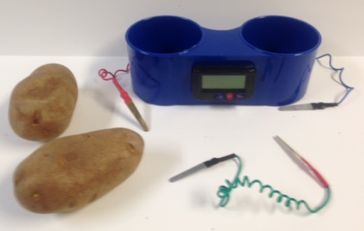
II. Chemical Energy to Electrical Energy: Potato Battery Demonstration
Show potato battery clock to students
What is causing the clock to run?
No traditional battery is present
Clock parts:
2 zinc electrodes, 2 copper electrodes: Conductors that can carry a current
Wires carry electric current
Potato: acid reacts with zinc electrode to produce electrons
Electrons flow from zinc to copper. This flow produces electricity.

Slide 4
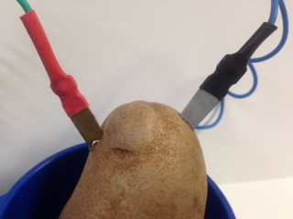
II. Demonstration Using One Potato
Put the 2 electrodes connected to the clock into 1 potato to show that the clock does not work as well.
Tell students that other fruits such as apples, oranges, lemons, and limes could be used to power the clock.
What kind of energy was the chemical energy in the clock converted to?
Electrical energy

Slide 5
III. Making a Battery: Using the Meter
This meter can measure both voltage and current.
Use the left setting, labeled 5V.
The voltage measurement (V) tells how much pressure is pushing the electrons to move through the circuit.
The current measurement (A or mA) tells how much electricity is flowing through the wires each second.

Slide 6
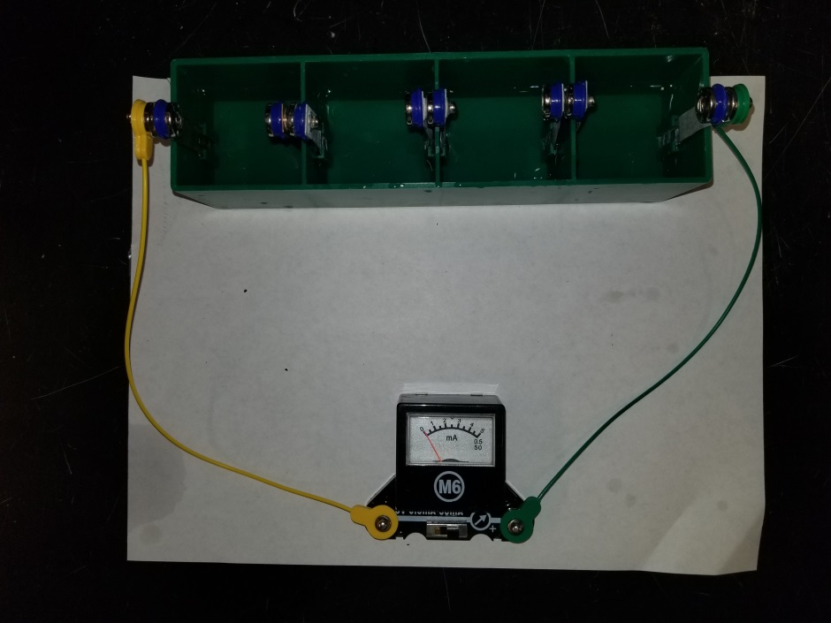
III. Assembling the Battery
Fill each compartment of the green container with distilled water about half full.
Help students identify the copper (orange colored) and zinc (silver colored) electrodes. Point out the arrangement of the electrodes – the metals alternate.
Orient the green container so that the zinc electrode is on the left.
Place the M6 meter below the green container. Connect the cables, meters, and the green container.
Connect the green jumper cable from the right hand side (+) terminal of the meter to the right side of the container and the yellow jumper cable from the left hand terminal of the meter to the zinc electrode.
Distilled water does not contain ions and does not conduct electrical currents, so little or no voltage should be measured.

Slide 7
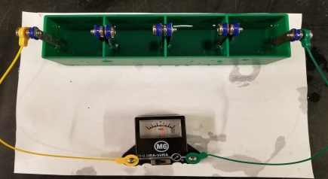
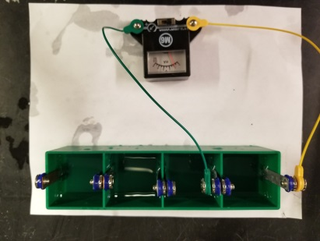
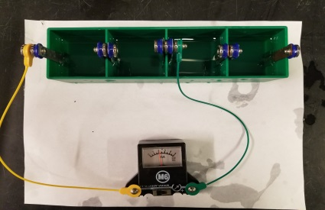
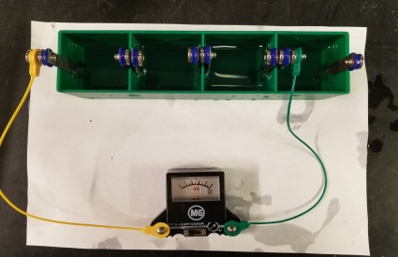
III. Assembling the Battery cont.
Add two scoops of sodium bisulfate to each compartment. Stir with a coffee stirrer.
Measure and record the voltage. (~3V)
Now change the green jumper cable from the (+) terminal of the M6 meter to the copper electrode at the end of the 1st compartment and measure the voltage (0.75V). Repeat for the 2nd and 3rd compartments. Record the voltage for all arrangements (1.5V and 2.3V)
Ask students what arrangement gave the highest voltage.
Each compartment is a cell that produces 0.75V. The 4 compartments are connected in series so the voltages add together.

Slide 8
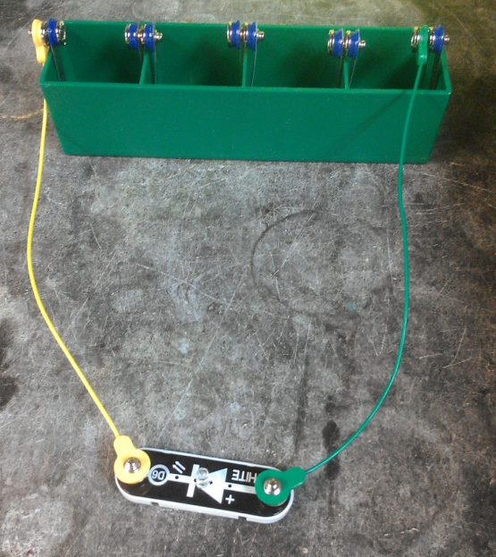
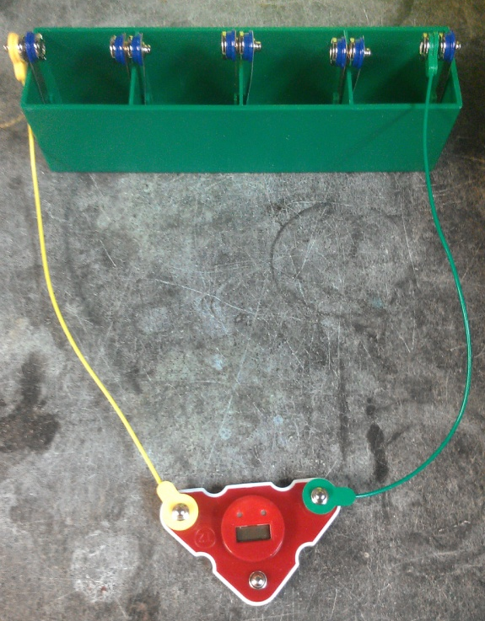
What could this battery power?
Is this battery strong enough to power a digital clock like the potatoes did?
Remove the jumper wire snaps from the meter and set the meter aside. Leave the wires attached to the battery tank.
Place the LED in front of the battery tank so that the arrow is pointing from left to right. Connect the green jumper cable to the positive end of the LED and the yellow jumper cable to the negative end.
How many compartments are needed to make the LED glow?
How many compartments are needed to make the clock work?

Slide 9
Household Batteries
Dry Cell batteries:
Most common household batteries
Zinc and carbon electrodes.
The electrolyte is ammonium chloride or zinc chloride.
Electrolytes conduct electric current
Alkaline battery: manganese dioxide and zinc powder as the electrodes and potassium hydroxide as the electrolyte.

Slide 10
IV. Review
Ask students what kind of battery has been produced
Chemical
Make sure students record voltages measured on their observation sheets.

