Slide 1
Electromagnetism
Vanderbilt Student Volunteers for Science
Training Presentation
Fall 2018

Slide 2
I. Introduction Learning Goal: Students understand the main ideas about magnets, and electromagnets.
Ask students what they know about magnets.
All magnets have two poles.
Poles in a bar magnet are at the ends. One is labelled N (for North) and the other S (for South)
Same poles repel each other, but opposite poles attract
Magnets all have a 3-D magnetic field surrounding them.
Ask students what they know about electromagnets
Electromagnets are made by wrapping wire around a core and passing current through that coil
They differ from permanent magnets in that they are temporary

Slide 3
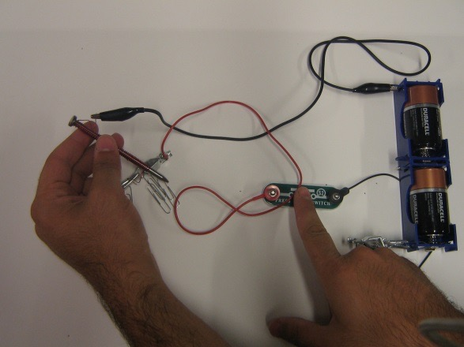
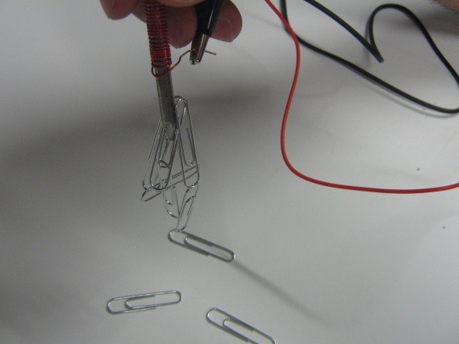
II. Making an Electromagnet Using Batteries, a Nail and Copper Wire Learning Goal: Students understand the components necessary for making an electromagnet and the steps needed to do so.
Students will make the circuit as shown with the nail with 10 coils
Students should observe that the nails, when not connected to the circuit, will not attract paperclips
Students should press the switch and hold the nail so that the point of the nail is in the middle of a pile of paper clips.
They will see that when the circuit is completed, the nail with fewer (10) coils is not even able to pick up one or two paperclips
Students will remake the circuit using the nail with 50 coils, and they should see that it is able to pick up many more paperclips

Slide 4
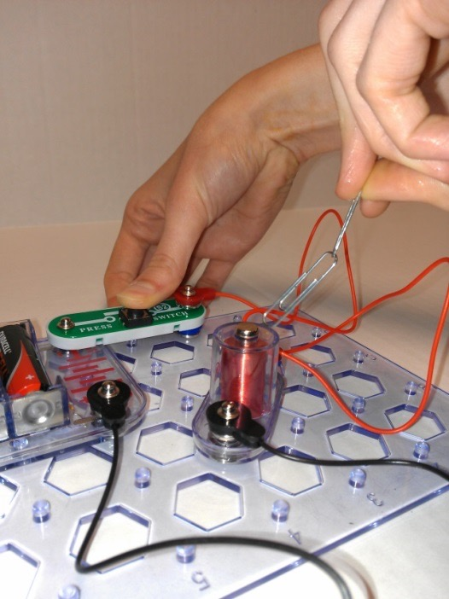
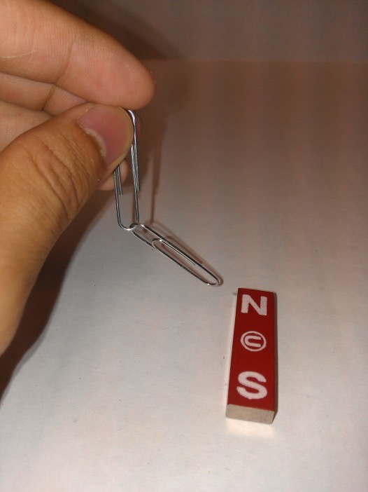
III. Comparing Properties of Magnets and Electromagnets Learning Goals: Students understand the components necessary for making an electromagnet and the steps needed to do so. Students explore how electromagnets’ magnetic properties can be modified.
Students will test the attraction, field and strength of an electromagnet and a regular magnet by using 2 paperclips looped onto another
Students should construct the circuit shown in the middle picture to make the electromagnet. Be aware there’s a #1 connector under the switch.
Hang the connected paperclips next to the magnet to test its strength.
Compare this to what occurs when the same paperclip loop is held next to the electromagnet, when it is both on and off.

Slide 5
IV. Using Electricity and an Electromagnet to make a Motor
Explanation:
* An electric motor uses a magnetic field to turn electricity into motion.
We know that an electromagnet has a magnetic field when an electrical current flows through it. Magnets also have permanent magnetic fields. The 2 magnetic fields can attract or repel each other.
The motor works because electricity flows through the coil and a magnetic field is formed. The magnetic fields from the magnet and electromagnet repel each other.
The coil pushes away from the magnet with enough force to turn it around. As the coil rotates around, the coated side makes contact with the copper supports and breaks the electrical circuit.
Momentum carries the coil around to its starting position, when the stripped wire now comes back into contact with the copper supports.
The circuit is again completed, so the magnetic field in the electromagnet is created again, and the coil continues to spin.
.

Slide 6
IV. Using Electricity and an Electromagnet to Make a Motor contd. Learning Goal: Students can give examples of everyday uses of electromagnets.
Tell students to look at the motor and identify the following parts: a permanent magnet, an electromagnet. copper wire, and a battery.
Point out the copper supports that connect the battery to the coil.
Point out that the copper wire is covered with an enamel coating for insulation. Tell students to look closely at the 2 straight ends of the copper coil. Both ends have had the enamel coating stripped from one side of the wire (it does not have the same shiny copper color as the other side). The coated side will not conduct electricity, whereas the stripped side will allow a current to flow through the coil.

Slide 7
IV. Using Electricity and an Electromagnet to Make a Motor contd.
Tell students to:
1. Place the straightened wires from the coil into the U of the copper supports. The shiny (insulated) side must be facing UP.
2. Give the coil a gentle tap. If it spins continuously, the student has succeeded in making a motor.
3. If the coil does not spin, have the student tap it in the other direction.
Optional:
Flip the magnet over (so that a different pole will now be facing up). Repeat steps 1-3. What happens?

Slide 8
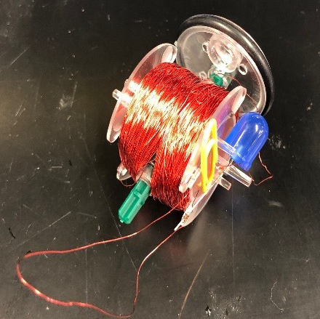
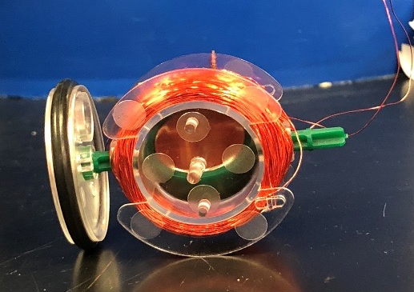
V. Making Electricity with Magnets and Coil
Learning Goals: Students know that an electric current can be induced by using a magnet and a wire.
Give each group a generator
Tell them to identify the different
parts – magnet, LED, coil, spindle.

Slide 9
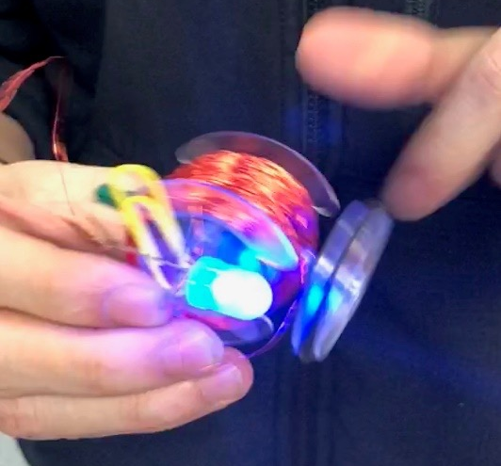
V. Making Electricity with Magnets and Coil cont.
Ask students to identify what happens when the spindle moves (it rotates the magnet). Students should twirl the spindle with a finger, Do not let them run the wheel on the desk.
What happens when you turned the
spindle of the transparent generator
SLOWLY? (nothing)
What happens when you turned the
spindle of the transparent generator
FASTER? (the LED lights up)
* A generator uses a magnetic field to turn motion into electricity

Slide 10
Clean Up
Have the students reassemble the circuit components the way they received them.
Make sure all circuit components are collected and packaged properly.
Return all supplies to the VSVS lab.

