Slide 1
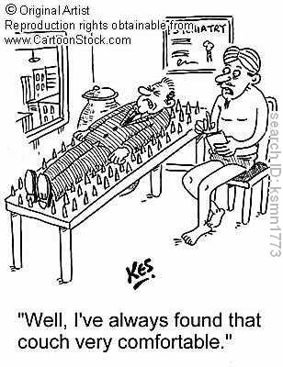
Bed of Nails
Vanderbilt Student Volunteers for Science

Slide 2
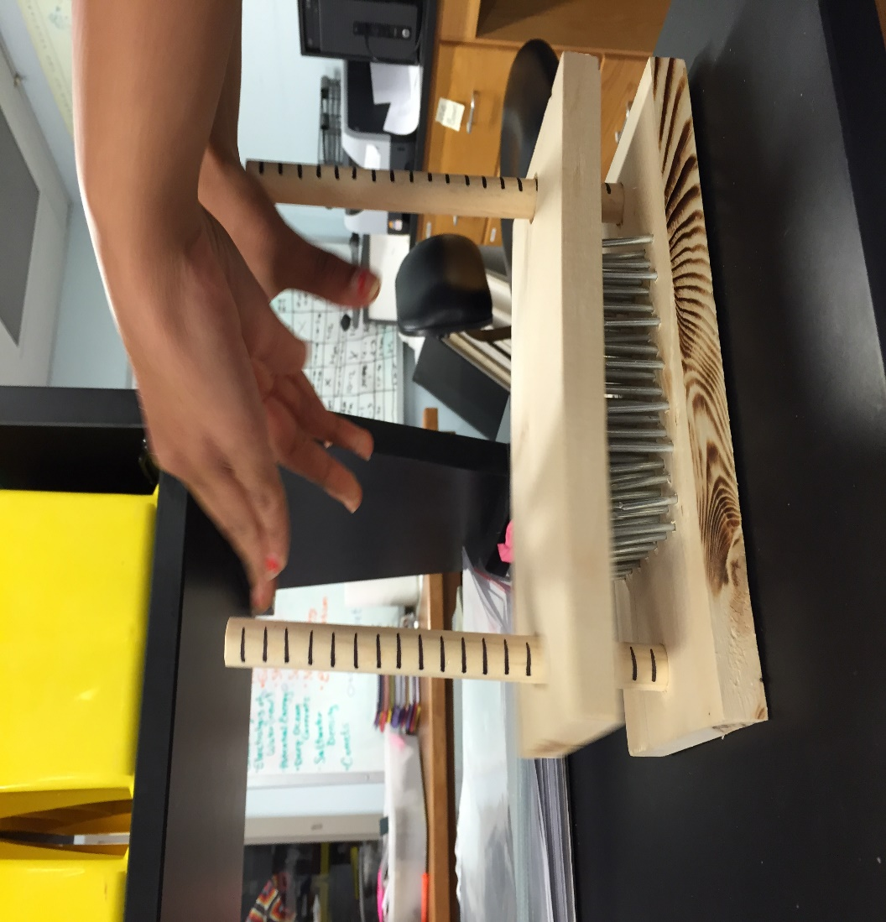
II. Preparation
Prepare:
One block with all 25 nails embedded
Two rods
Bottom block with nails and top block
One empty block with 6 nails NOT embedded.

Slide 3
II. Preparation (cont.)
Use the balloon pump to blow up two 7” balloons.
Use 8 pumps - 1 pump is up and back.
Put one of the circumference strings around each balloon and either add air or let out air until balloon has this circumference.
Tie off the balloon.

Slide 4
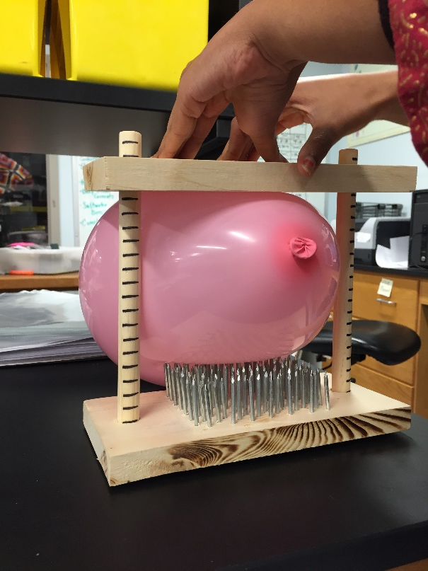
III. Doing the Demo
Slowly push down on the top board
Record the height of the top board when the balloon pops!

Slide 5
III. Doing the Demo (cont.)
Get Creative!! – Encourage students to rearrange six nails on their blank block different shapes
What shapes make it pop the quickest or slowest?

Slide 6
VSVS Notes
As the number of nails is increased, the amount of pressure required to pop the balloon should increase.
Have the students use the circumference string to get each inflated balloon to the same size.
The pattern of the nails is an important determinant in judging the accuracy of the data.
For example, six nails arranged in a sporadic pattern will pop a balloon much easier than six nails in a tight, cubic pattern.
Have the students predict what might happen when the number of nails is increased or decreased.

