Slide 1
Science of Soda Pop
Fall 2012

Slide 2
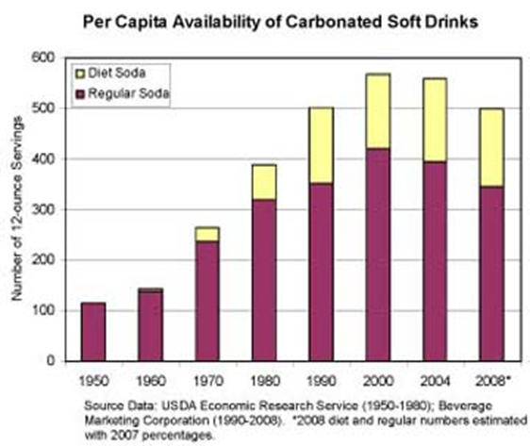
A. Look at graph showing availability of soft drinks.

Slide 3
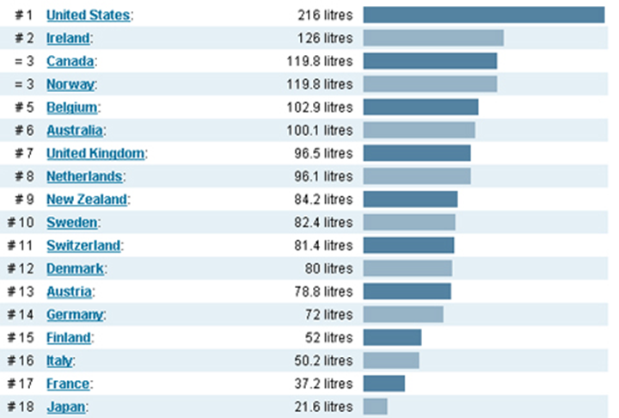
B. Look at graph comparing soda consumption between different countries.

Slide 4
II. What is in a soda?
Regular Coke | Diet Coke | Regular Sprite | Diet Sprite
Fat | Fat | Fat | Fat
Protein | Protein | Protein | Protein
Fiber | Fiber | Fiber | Fiber
Sodium | Sodium | Sodium | Sodium
Carbohydrates | Carbohydrates | Carbohydrates | Carbohydrates
Sugars | Sugars | Sugars | Sugars
Vitamins | Vitamins | Vitamins | Vitamins
Calcium | Calcium | Calcium | Calcium
Carbonated Water | Carbonated Water | Carbonated Water | Carbonated Water
HFCS | HFCS | HFCS | HFCS
Phosphoric Acid | Phosphoric Acid | Phosphoric Acid | Phosphoric Acid
Citric Acid | Citric Acid | Citric Acid | Citric Acid
Essentially, there is very little nutritional value found in sodas.

Slide 5
Defining Density
You can think of density as how much mass there is in a given volume.
D= mass/volume
Regular Coke Diet Coke
Volume: 382 mL Volume: 382 mL
Mass: 387 g Mass: 367 g
Volumes are the same, but the masses are different.
Density calculations:
Regular: D= 387 g / 382 mL = 1.01 g/mL
Diet: D= 367 g/ 382 mL = 0.96 g/mL

Slide 6
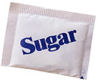
IV. Density of Coke and Diet Coke
Regular soda contains 39 g of sugar (= 14 packets of sugar), while diet soda contains none (but it does have artificial sweetener).

Slide 7
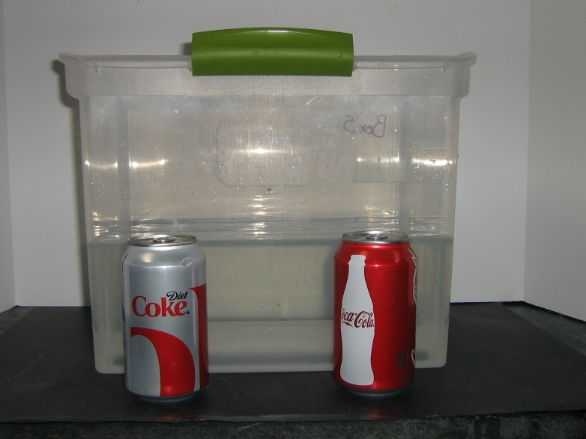
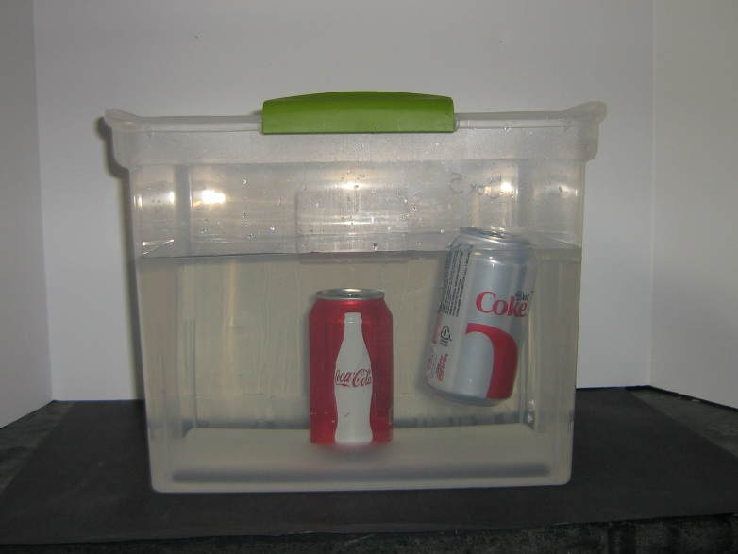
III. Coke/Diet Coke Density: Demo
Fill clear bucket with water and place 1 Coke can and 1 Diet Coke can next to it.
Ask students what will happen when you place the cans in water.
Put Coke can in water (sinks). Put Diet Coke can in water (floats).
After students try to guess why, tell them that the difference between the cans is density.

Slide 8
III. Defining Density
After asking for students’ definitions, tell them that they can think of density as how much mass there is in a given volume.
Write the density equation on the board (D= m/v) and explain that density equals mass divided by volume.

Slide 9
III. Defining Density: Demo
Show students glass jar with marbles in it. Explain that marbles represent water molecules.
Pour 1 packet of sugar into jar. Explain that sugar packs around water molecules in regular Coke just as it does in water.
Ask students why regular Coke is denser than Diet Coke. Answer: Regular Coke has a higher mass because of the added sugar, which makes it denser.

Slide 10
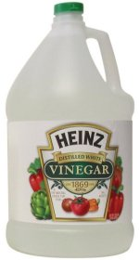
V. Are Soda Pop Drinks Acidic or Basic?
Pure Water
pH = 7
Coke Classic
pH = 2.63
Place well plate on observation sheet
Using different pipette for each liquid, follow the chart and half-fill each well with the correct liquid.
Vinegar
pH = 2.4
Battery Acid
pH = 1.0
Pepsi
pH = 2.49

Slide 11
V. Are Soda Pop Drinks Acidic or Basic?
Add a squirt of Universal Indicator to the liquids in row 1 and determine their pHs.
Is there any difference between regular and diet sodas?
Is the pH of sodas closer to vinegar or to water?

Slide 12
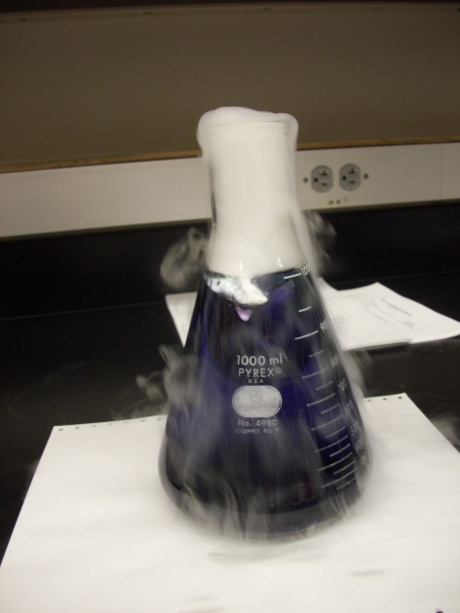
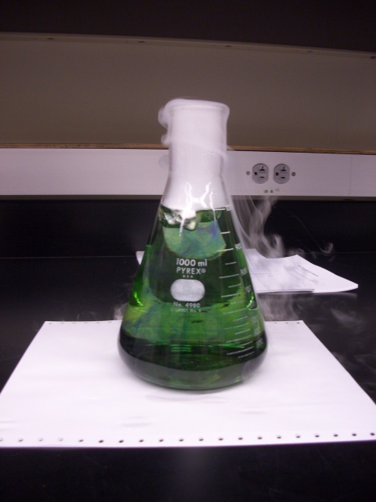
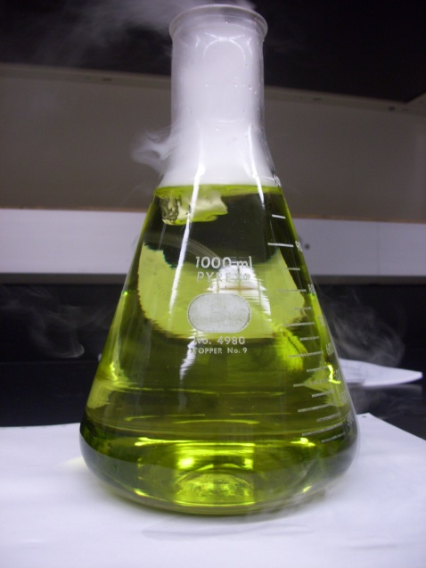
VI. Why Are Soda Pops Acidic? Demo
Add a piece of dry ice to a cup or bucket full of water with a good amount of universal indicator. Note the color change.
CO₂ + H₂O → H₂CO₃ (carbonic acid)

Slide 13
VI. Why Are Soda Pops Acidic? Experiment
Compare ingredients of soda pops and club soda. Club soda has no other additives besides CO₂.
Follow the chart and use a pipette to half-fill each well with the correct liquid in row 2.
Add a squirt of universal indicator to the liquids in row 2 and determine their pHs.
Questions
Did “degassing” the club soda change the pH?
What causes the acidic pH of club soda?

Slide 14
VI. Why Are Soda Pops Acidic? Experiment
Ask questions:

Slide 15
VII. Testing for Sugars
What do you use as a sweetener on or in foods? (sugar, maple syrup, honey, artificial sweeteners such as aspartame)
Background info:
All the sweetener consumed in 1970 came from cane or sugar beets.
White stuff that you have in a bowl at home, called sucrose.

Slide 16
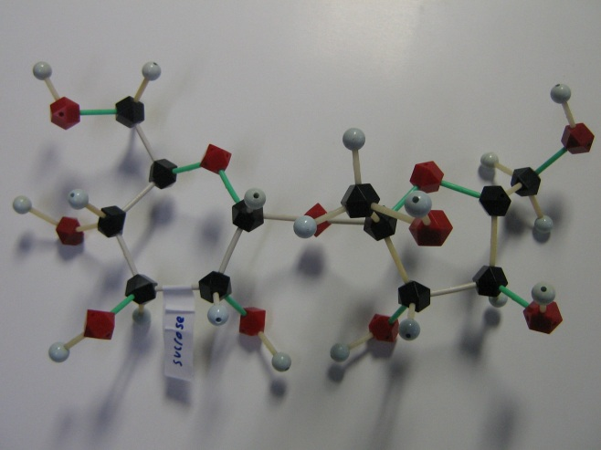
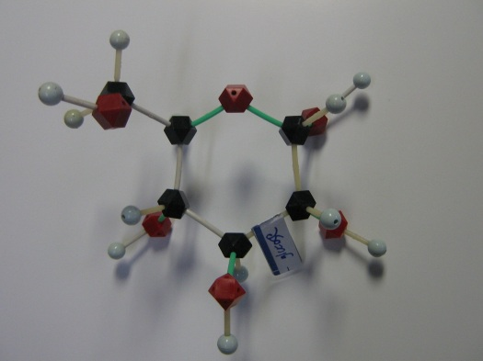
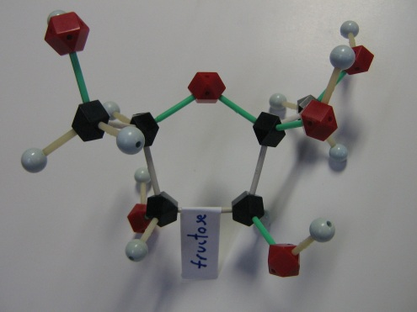
VII. Testing for Sugars
What is the difference between sucrose and high fructose corn syrup? (sucrose is a disaccharide, composed of glucose and fructose)
Do our bodies use these different sugars in different ways?
Glucose is an intermediate form of energy and requires insulin to regulate its metabolism. Excess glucose is excreted.
Fructose, however, functions independent of insulin and excess is stored as fat.
+
=
Glucose + Fructose = Sucrose

Slide 17
VII. Testing for Sugars
Background (cont’d)
Although glucose and fructose have the same calories per gram, our bodies store them in different ways
Glucose is an intermediate form of energy and requires insulin to regulate its metabolism. Excess glucose is excreted.
Fructose, however, functions independent of insulin and excess is stored as fat.
Glucose test strips indicate glucose levels for diabetic patients.

Slide 18
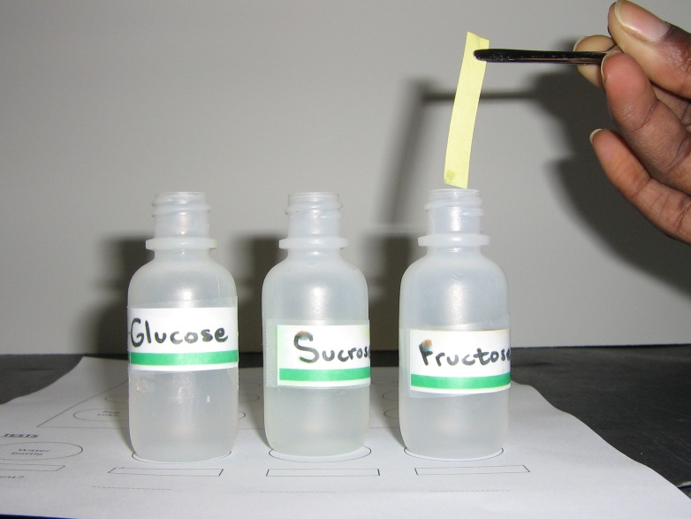
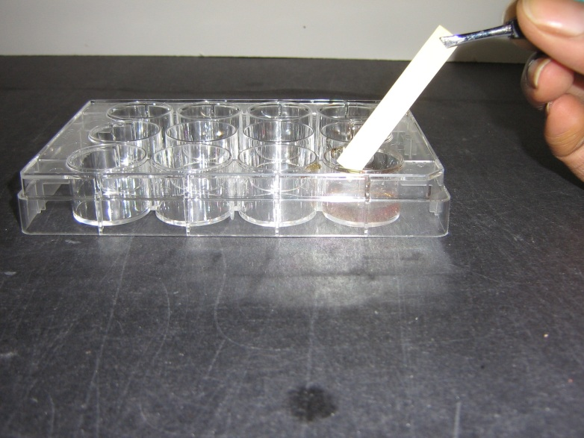
VII. Testing for Sugars
Experiment:
Place bottles of glucose, fructose, sucrose, and water on appropriate circles on Observation Sheet. Remove caps.
Use tweezers to dip a test strip in each bottle, and place test strip in corresponding rectangle on Observation sheet.
Pipette correct soda into indicated wells of plate, and follow procedure above with glucose test strips.
Replace caps on bottles. Wait a few minutes, then compare color development on test strips.

Slide 19
VII. Testing for Sugars
What coloration do you notice?
What do you think green vs. yellow means?
What does the absence of green on some test strips indicate?
Did green develop for non-glucose sugars? What does this imply about the specificity of the glucose molecule?
If glucose was found in soda, are there still other sugar molecules? (Remember that soda uses HFCS)

