Slide 1
Properties of CO₂
Vanderbilt Student Volunteers for Science
Training Presentation
Spring 2016

Slide 2
Important
Please use this resource to reinforce your understanding of the lesson! Make sure you have read and understand the entire lesson prior to picking up the kit!
We recommend that you work through the kit with your team prior to going into the classroom.
Read through the quiz in the car on the way to the classroom.
This presentation does not contain the entire lesson—only selected experiments that may be difficult to visualize and/or understand.

Slide 3
Before you begin…
One VSVS volunteer will fill the 32 6 oz cups 1/3 full with water. 16 will be handed out (1 per pair) in section II and the other 16 in section IV.
Another VSVS volunteer will copy the thermometer diagram and the vocabulary words onto the board.
Divide the students into pairs.
Give each pair an instruction sheet (contains thermometer diagram on back). This includes the procedures students need to follow for their hands-on activities. You will still need to guide them through the procedures and make sure they are completing the observation sheet.
Students will need to use their own pencils.
While one team member starts the introduction, another should write the following vocabulary words on the board: dry ice, sublimation, physical change, chemical change, changes of state. Whenever possible, refer to vocabulary words throughout the lesson and during review.
SAFETY NOTE: Students should not hold pieces of dry ice. The temperature of dry ice is -78° C, and students could get frostbite burns if their skin is in contact with dry ice for more than a few seconds.
Note: In this lesson use the words carbon dioxide and the term CO₂ interchangeably so the students will become familiar with both.

Slide 4
I. Introduction
A. The States of Matter: Solids, Liquids, and Gases
Ask students what the 3 states of water are? Ice (solid), liquid, and water vapor (gas).
Tell students that carbon dioxide also has 3 states, but that only 2 exist at normal conditions: a solid (called dry ice) and gas.
Substances change their states of matter by physical processes. Changes of state are also called phase changes.
Ask students if they can name the physical processes that lead to changes of state. Write the processes in between the states. Be sure to include the following information in the discussion, and refer to the thermometer to show students where the various points are on the thermometer.
There are 6 changes of state: freezing, melting, vaporization, condensation, and sublimation, deposition.

Slide 5
I. Introduction
A. Physical and Chemical Changes
Ask students if they understand the difference between chemical changes and physical changes. Make sure to include the following information in the discussion.
Physical changes change the state of the substance, not its chemical composition.
The physical properties of the substance change, not its chemical structure.
An example of a physical change is in making peanut butter. Grinding peanuts is a physical change because the peanuts are still peanuts, even though they are ground up (in a different form) and have different texture (physical property change).
Changes of state are physical changes: when liquid water is frozen, it changes from a liquid to a solid. Each state, however, is chemically the same (all H₂O).
Sublimation is a change of state where a substance goes directly from a solid state to gas state without passing through the liquid state.
In chemical changes, a new substance is formed due to a chemical reaction. For example, rusting of iron and burning paper are all chemical changes. The chemical properties of the starting and finished products are different.

Slide 6
I. Introduction
What is CO₂?
Discuss the cold temperature of dry ice
Ask students: What do the C and the O stand for? C stands for carbon and O stands for oxygen
Ask students: What does the ₂ stand for? "2" means 2 O’s for every 1 C
Ask students: What is dry ice?
Demo: Put small pieces of dry ice in plastic dewar (wear gloves)
Place cup with ~5 mL water in dewar on dry ice, pack a few pieces around the cup
- Wait until the end of the lesson
to show results.

Slide 7
II. Comparing Dry Ice to Water Ice
Give a plate to each pair.
Using gloves, place a piece of dry ice in a small ziploc bag for each pair and close the bag.
Also place a piece of water ice in a small ziploc bag for each group, and close it.
Remind students that they should not touch the dry ice.
Ask students to describe the appearance of the two types of ice.
Ask students to observe both pieces of ice in the Ziploc bags for a few minutes.
Have students describe what happens and record their observations
Note: The dry ice ziploc bag will inflate because of the CO₂ gas being given off by the solid.
“Smoke” comes off the dry ice.
The dry ice moves around the plate and sometimes buzzes.
Later when the two pieces have disappeared, the students will notice a puddle where the H₂O ice was and there will be no puddle where the dry ice was.

Slide 8
II. Comparing Dry Ice to Water Ice
Tell students to open the ziploc bags and carefully empty the pieces of dry ice and ice onto the plate.
Have one student in each pair push a small piece of dry ice and the piece of water ice around with a pencil.
Have students describe what happens. (Record observations on the Observation Chart.)
Compare the dry ice with the H₂O ice.
Tell students to leave the two pieces of ice on the plate, do not move them, but observe them periodically to see what happens to the dry ice and the water ice over time.

Slide 9
III. Observation: Fog
Give each pair a clear plastic cup that is about one-third full of water.
Using gloves, a VSVS volunteer should place a small piece of dry ice into the cup.
Tell the students to start observing and recording their observations (as many as they can) as soon as the dry ice is added to the cup.
Have a VSVS volunteer ask each pair to share something they observed. Draw a picture of the cup on the board and record the observations.

Slide 10
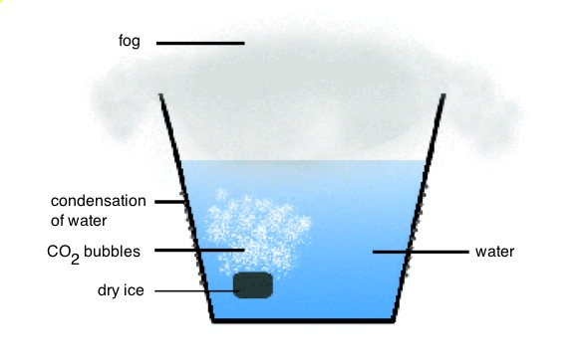
III. Observation: Fog
Dry ice gives off bubbles when it is added to water.
A white fog appears over the water in the top of the glass.
The white fog stays in the top of the glass and any white fog that leaves the glass goes down along the side of the glass rather than up into the air.
Fog that goes down along the glass disappears near the bottom of the glass.
The following are all physical changes:
Observation 1: Dry ice gives off bubbles when it is added to water.
Observation 2: A white fog appears over the water in the top of the glass.
Observation 3: The white fog stays in the top of the glass and any white fog that leaves the glass goes down along the side of the glass rather than up in the air.
Tell students that dry ice is often used to create smoke and fog-like effects in the movies and at concerts.
Observation 4: Fog that goes down along the glass disappears near the bottom of the glass.

Slide 11
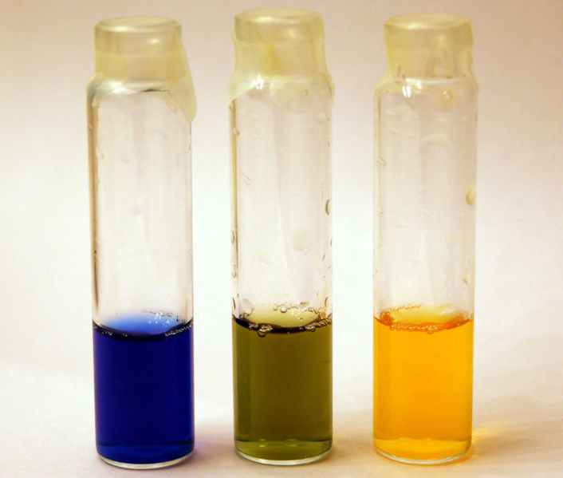
IV. Chemical Changes Involving Carbon Dioxide
Ask students to name some common acids and bases
Scientists can use indicators to test if something is acidic, basic, or neutral.
Hand out the Bromothymol blue color charts and tell the students to look at it.
Give each pair another 6 oz clear cup half filled with water.
Add a squirt of the indicator to the each of the cups of water until the color is intense.
Refer to the chart and make sure the students can tell you whether the water in their cup is acidic, neutral or basic. It should be basic (blue) but maybe more green (closer to neutral). Tap water naturally contains minerals that make tap water slightly basic.
Tell the students they need to observe what happens to the color of the BTB after the dry ice is added to the cup.
VSVS members place a small piece of dry ice to the cup of water/indicator mixture.
Ask students if the water became more acidic or basic as the dry ice bubbled in the water? (More acidic, as shown by the change to a yellow color.)
Basic
Neutral
Acidic

Slide 12
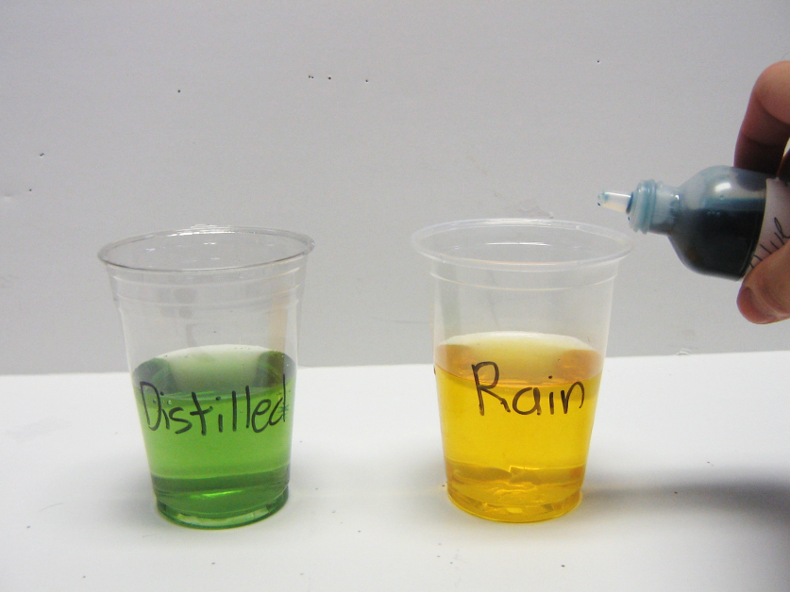
IV. Carbon Dioxide and Water
Tell the students you have bottles of water that are examples of rain water and distilled water
Pour the waters into the 2 labeled 10 oz. cups and add several drops of BTB indicator until there is an obvious color.
Ask students to look at the BTB color charts and label the waters as acidic, basic or neutral.
Ask the students: Can they suggest why rainwater is more acidic than distilled water?

Slide 13
V. Finish Earlier Demo: Freezing Water with Dry Ice
Check cup of water in dry ice to see if it is frozen. Show students the frozen water in the cup.
Remove the cup of water from the container of dry ice and have the students observe that the water is frozen.
Explanation: Tell students to look at their thermometer diagram to see that the temperature of dry ice is much colder (-78°C or -108°F) than H₂O ice (0°C or 32°F). So dry ice can freeze liquid water.

Slide 14
VI. (Optional) Demo: CO₂ as a Fire Extinguisher
Place a small candle on a safe surface (aluminum pan) and light the candle. (You may need to place a chair on a table so the candle will be visible to students.) Place a few pieces of dry ice in a cup.
Ask students to predict what will happen when CO₂ gas from the dry ice touches the candle.
Put a few pieces of dry ice in a container and add a little bit of water to make it fog up.
Hold the container of dry ice near the candle and let the CO₂ gas float onto the candle to extinguish it. (You may need to tilt the container so the CO₂ will float down to the candle. Do not let any water spill onto the candle.)
Ask students, Why did the flame go out? (CO₂ is a good fire extinguisher because CO₂ is heavier than air. The CO₂ deprives the candle of the oxygen needed to keep it burning. This causes the flame to be extinguished.)
Have students record observations on their observation chart.

Slide 15
VII. Review
What is CO₂? Carbon dioxide
What does CO₂ look like? Usually a gas- you cannot see it.
What does sublimation mean? Solid -> gas
Is CO₂ heavier or lighter than air? heavier
What is dry ice? Solid CO₂
What happens when dry ice is dropped into water? Bubbles of CO₂ are given off, a cloud forms above the water, and the cloud stays in the container instead of floating in the air. If any of the cloud falls out of the container it floats down and disappears.

