Slide 1
Evidence of Chemical Reactions (Elementary)
Vanderbilt Student Volunteers for Science
Fall 2012

Slide 2
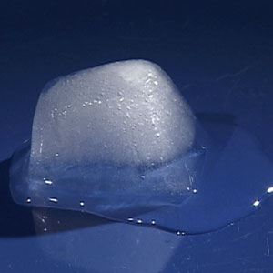
Introduction
What is a physical change?
- A physical change does not change the properties of a substance. No new substance is formed during a physical change.
-Examples of a physical change include changes in shape, size, or shape of matter.

Slide 3

Introduction (cont.)
What is a chemical change?
- A chemical change starts with one kind of matter and after the reaction, it becomes a different kind of matter.

Slide 4
Other evidence of chemical changes
A color change
A gas given off (it may smell)
The formation of a precipitate (a new solid)
An energy (temperature, light) change

Slide 5
Experiments
After reviewing safety rules, split students into groups of two
Pass out the test tube holders, a set of test tubes (A, B, C, D), and plates

Slide 6
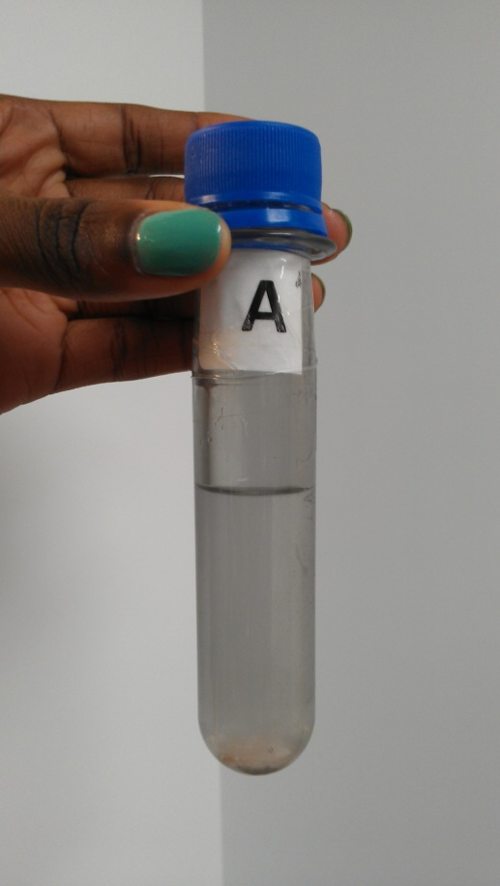
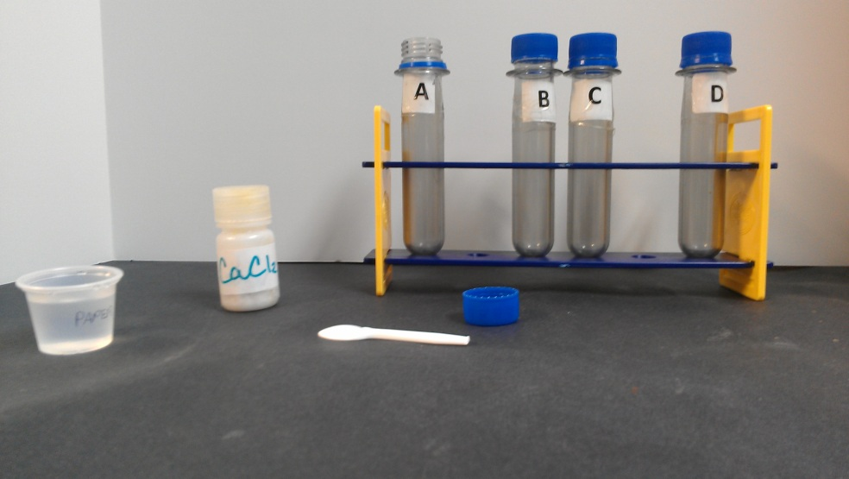
Experiment 1A
Add 1 oz water to test tube
Have students record feeling of test tube temp.
Add three taster-spoons of calcium chloride (CaCl₂)
Cap and shake tube
Feel the tube again and record new observations

Slide 7
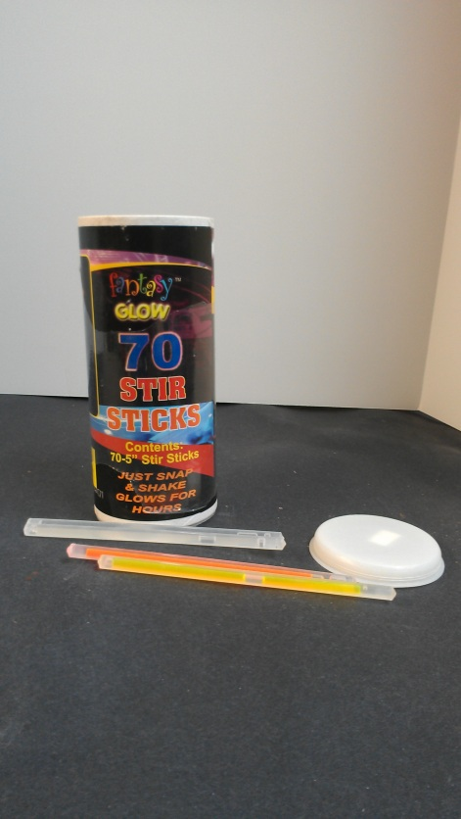
Experiment 1B
Pass lightsticks out to pairs
Ask the teacher if it is fine to turn out the lights; if it is not, continue with lights on
Bend the tube to break the inner vial
Shake the lightstick
Explain to students what is happening

Slide 8
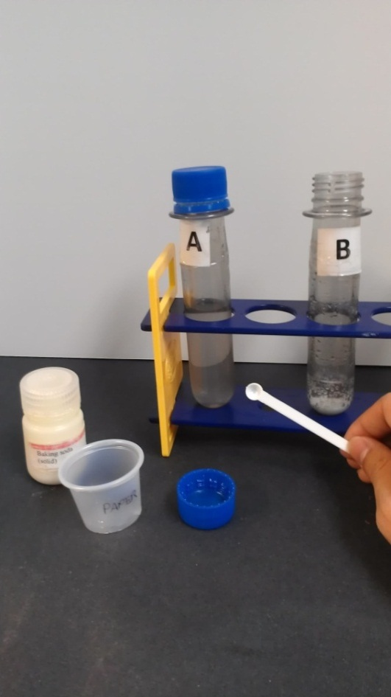
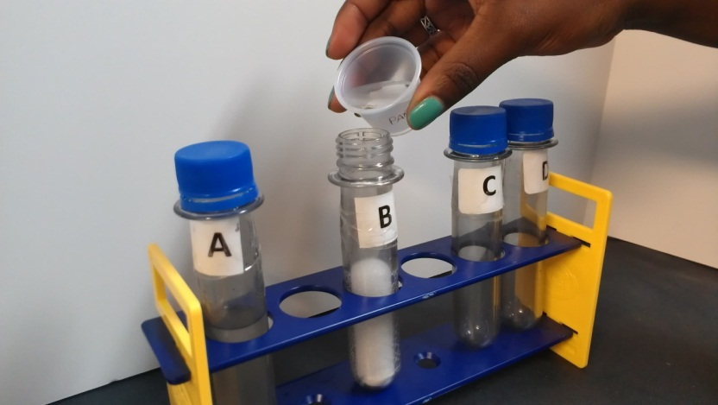
Experiment 2
Add ONE mini-spoonful of baking soda to Test Tube B
Add the 1 oz of vinegar from the 1 oz cup
Record observations

Slide 9
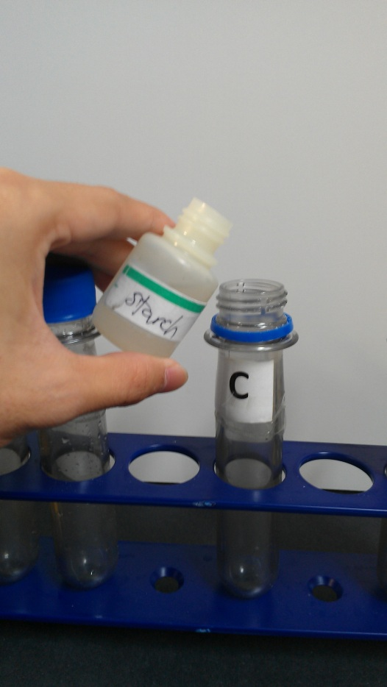
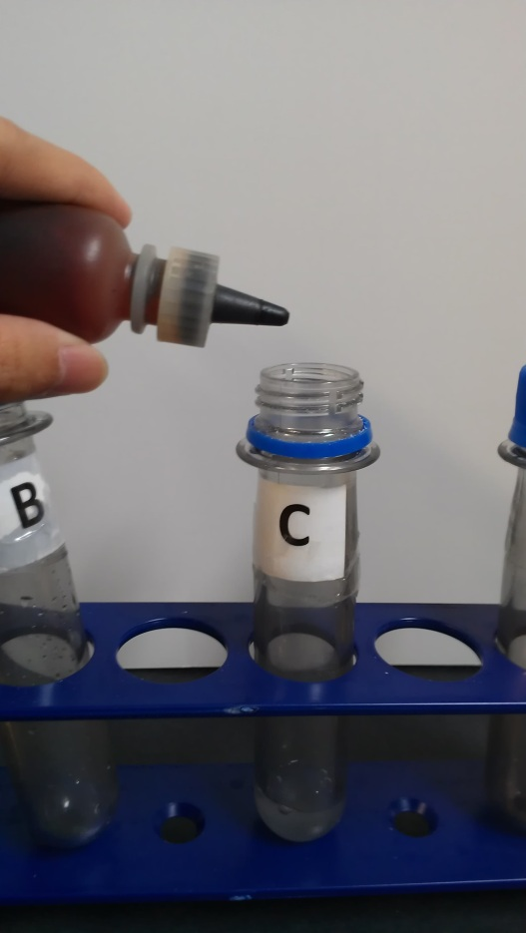
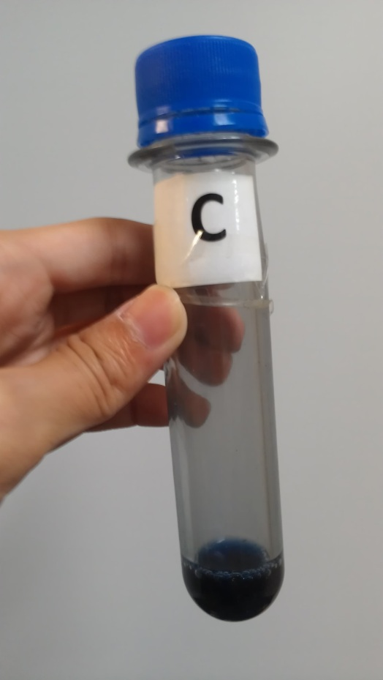
Experiment 3
Add starch to Test Tube C
Add a squirt of iodine
Cap the tube and invert it
Record any observations

Slide 10
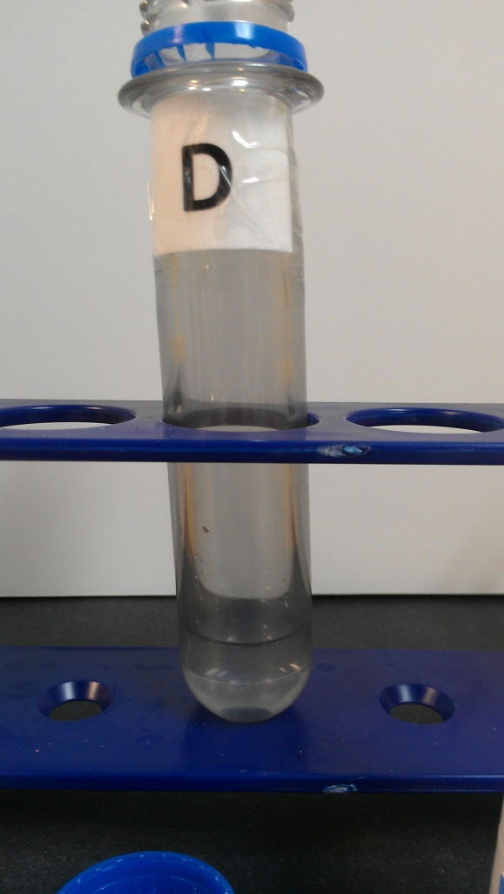
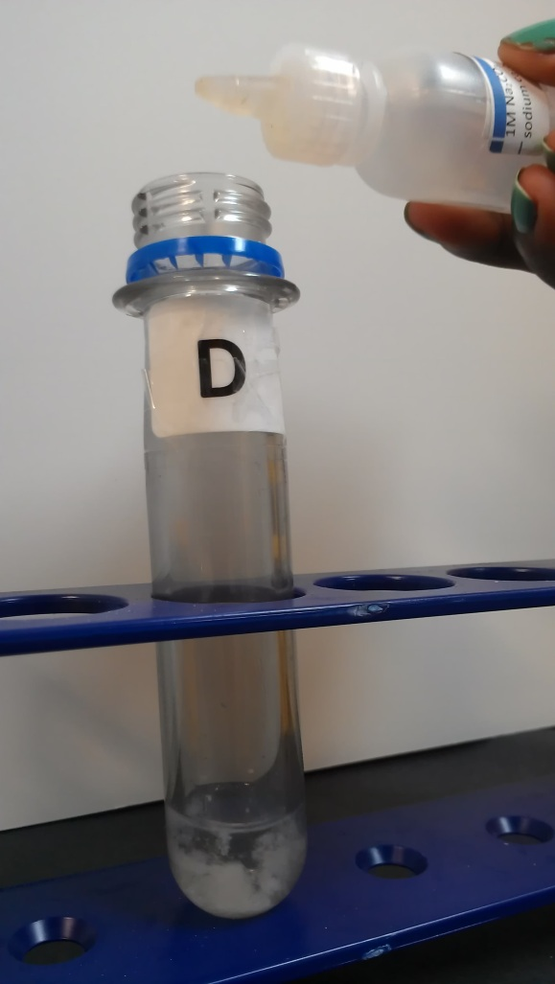
Experiment 4
Add calcium chloride (CaCl₂) to Test Tube D
Ask students if the solution is clear of cloudy
Slowly add drops of sodium carbonate solution
Record observations

Slide 11
Results & Review
What happened in the test tubes?
What is the difference between physical and chemical change?
What type of evidence did you observe in the experiments for chemical reactions?

