Slide 1
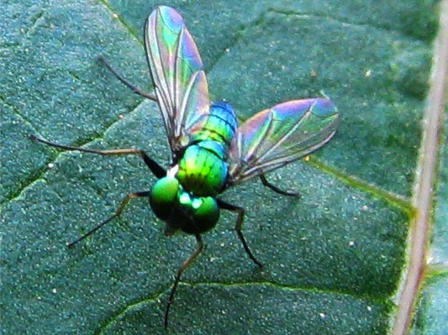
Thin Films & Nanotech
Vanderbilt Student Volunteers for Science

Slide 2

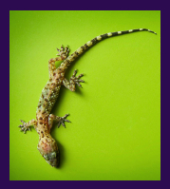
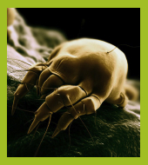
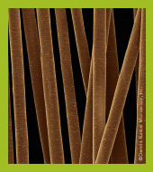
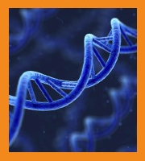
What is nanotechnology?
A nanometer is a billionth of a meter. That’s really, really tiny!
Nanoscale science focuses on things that are measured in nanometers, including atoms and molecules, the basic building blocks of our world.
Soccer ball
(70 centimeters)
Gecko
(13 centimeters)
Dust mite
(300 micrometers)
Human hair
(75 micrometers)
DNA
(2.5 nanometers)

Slide 3
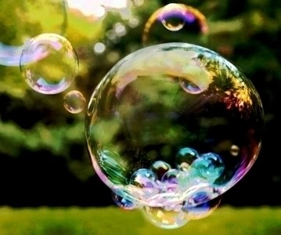
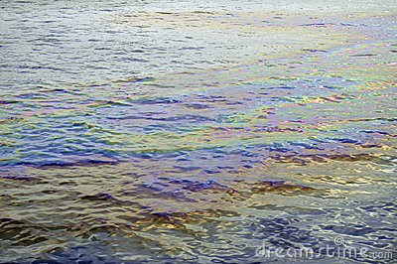
What are thin films?
A thin film is a layer of material ranging from less than a nanometer (one billionth of a meter) to several micrometers thick. Everyday examples of thin films include soap bubbles, oil slicks on water, and anti-reflection coating on eyeglasses.

Slide 4
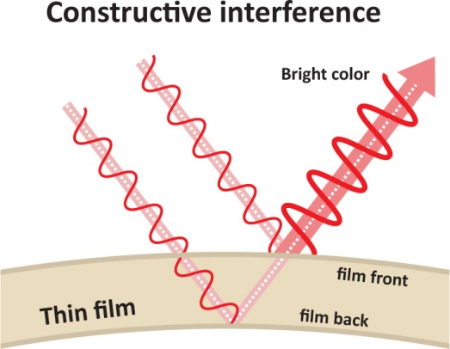
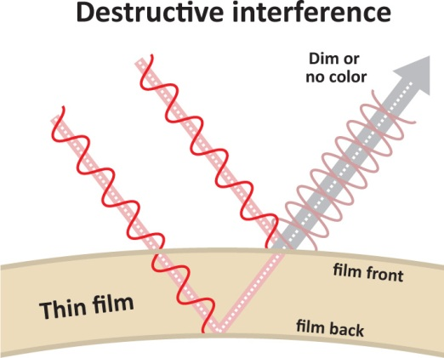
What’s so special about thin films?
White light is made up of all wavelengths, or colors, of light. When white light hits a thin film, some of the light is reflected from the front surface of the film, and some travels through it and is reflected from the back surface.
If the waves reflected from the front and back have crests that overlap, they reinforce each other and the reflected color is bright. This is called constructive interference.
If the waves reflected from the front and back have crests that overlap with troughs, the waves cancel each other out and the reflected color is dim. This is called destructive interference.
The thickness of the film determines which colors will be bright and which will be cancelled out. In a very thin film (less than 400 nanometers thick) all the colors cancel out, and the film appears black.

Slide 5
What’s so special about thin films?
White light is made up of all wavelengths, or colors, of light. When white light hits a thin film, some of the light is reflected from the front surface of the film, and some travels through it and is reflected from the back surface.
The thickness of the film determines which colors will be bright and which will be cancelled out. In a very thin film (less than 400 nanometers thick) all the colors cancel out, and the film appears black.

Slide 6
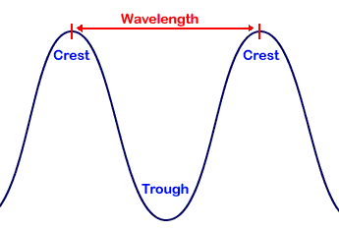
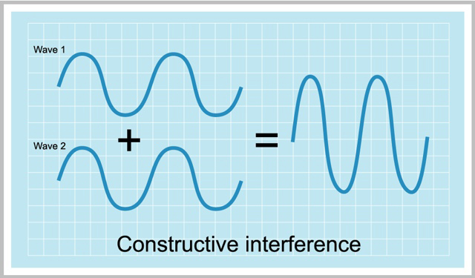
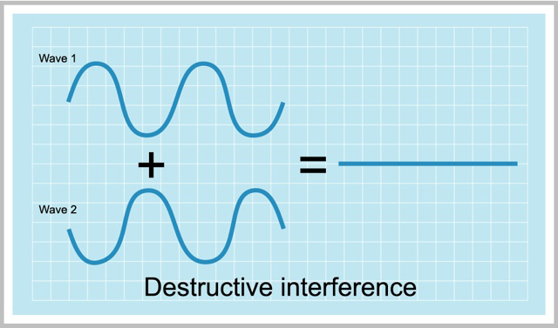
What is interference?
If the waves reflected from the front and back have crests that overlap, they reinforce each other and the reflected color is bright. This is called constructive interference.
If the waves reflected from the front and back have crests that overlap with troughs, the waves cancel each other out and the reflected color is dim. This is called destructive interference.

Slide 7
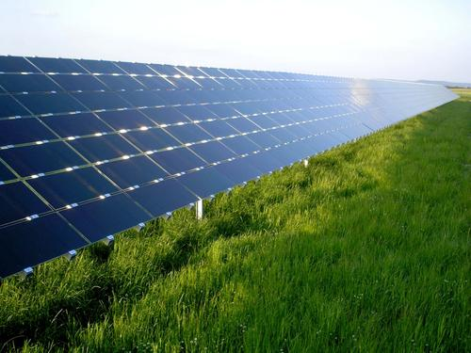
Thin films in action

Slide 8
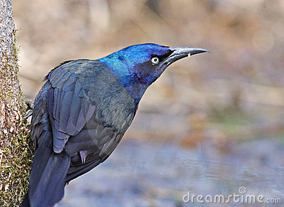
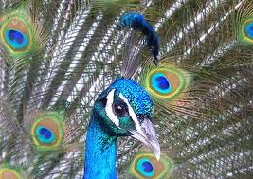
What color are these birds?
Most people say blue, but most people are wrong! The feathers on these birds are covered in thin films that reflect back light to make them look blue, but in reality, they’re completely colorless!

Slide 9
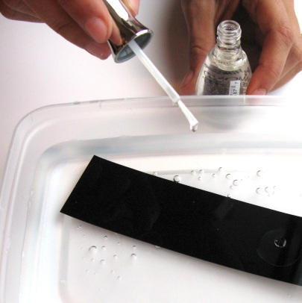
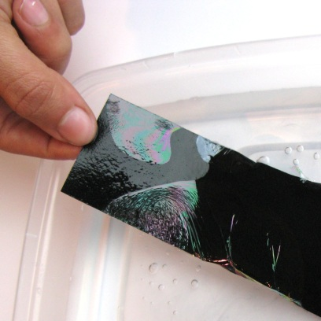
The Experiment
Tell students to:
1. Write your name on a strip of black paper.
2. Use the brush to drip one drop of nail polish onto the surface of the water. The polish will spread out into a thin film.
3. Slide the paper into the pan. Make sure it’s completely under water.
4. Hold one end of the paper and lift it up out of the water. The film of nail polish will stick to the paper. Does the nail polish still look clear?

Slide 10
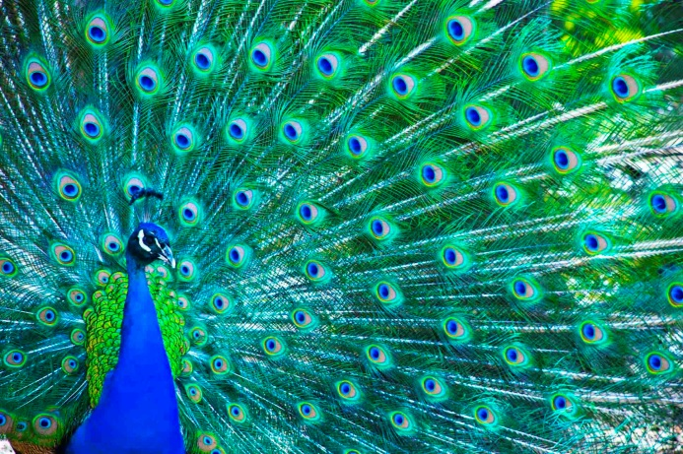
What just happened?
Black paper is used for this activity because it absorbs all visible light. The colors that appear are created by the interaction of light with the thin film.
The nail polish spreads out into a super-thin film, which creates iridescent, rainbow colors on the paper. The thin film is only a few hundred nanometers thick, about as thick (or thin!) as a soap bubble. The film is slightly thicker in some places and thinner in others. As the thickness of the film changes, the color changes.

