Slide 1
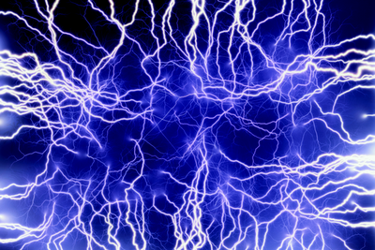
STATIC ELECTRICITY

Slide 2
INTRODUCTION
There are 2 types of electricity, static and current.
Current electricity is moving electrical charge, usually electrons. Current electricity is used for lighting our buildings, cooking food, making machines work…..
Static electricity is the build-up of electrical charge. It does not flow. It can make your hair stand on end, make your pants cling to your legs, or “zap” you when it is discharged. Lightning is another example of static electricity being discharged.
Photocopiers function because of static electricity.

Slide 3
TELL STUDENTS…
All matter is made up of atoms.
Show students the diagram of an atom and point out the parts (protons, electrons, neutrons and other particles).
The protons are positively charged and the electrons are negatively charged.
Electrons can easily move from one object to another, but protons cannot.
Matter is not charged, but can become charged when electrons are removed or added.
Ask students where they have experienced static electricity?
Clothes that come out of the dryer stick together.
Plastic wrap sticks together when it is unrolled, and also sticks to food storage containers.

Slide 4
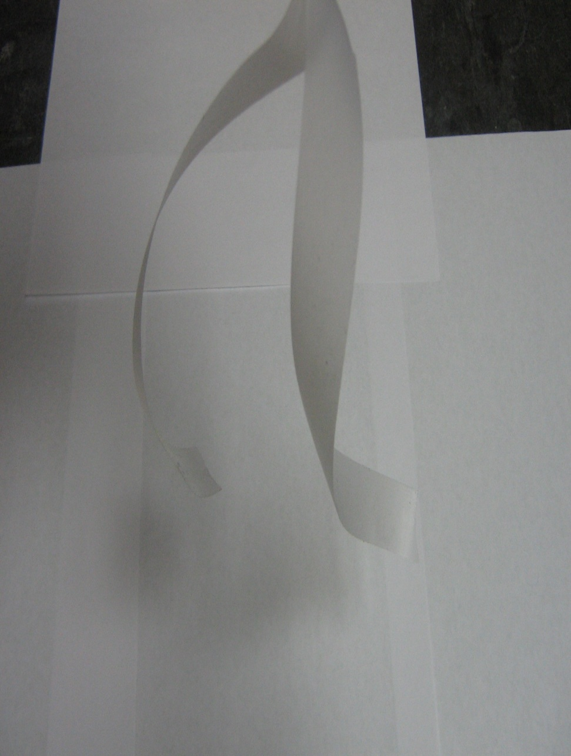
ACTIVITY
Stick 2 6" pieces of scotch tape on the table in front of each student so that about 1" remains free.
Tell students to grasp the free ends and rip both pieces up at the same time and hold them in the air, about 1' away from each other.
Move the strips towards each other and note what happens. (The pieces will repel each other.)
Now stick one piece of tape back on table (with 1"hanging free) and put the other piece on top of it. Remove the tape and pull the pieces apart. Move them towards each other and note what happens. (The pieces will attract each other.)

Slide 5
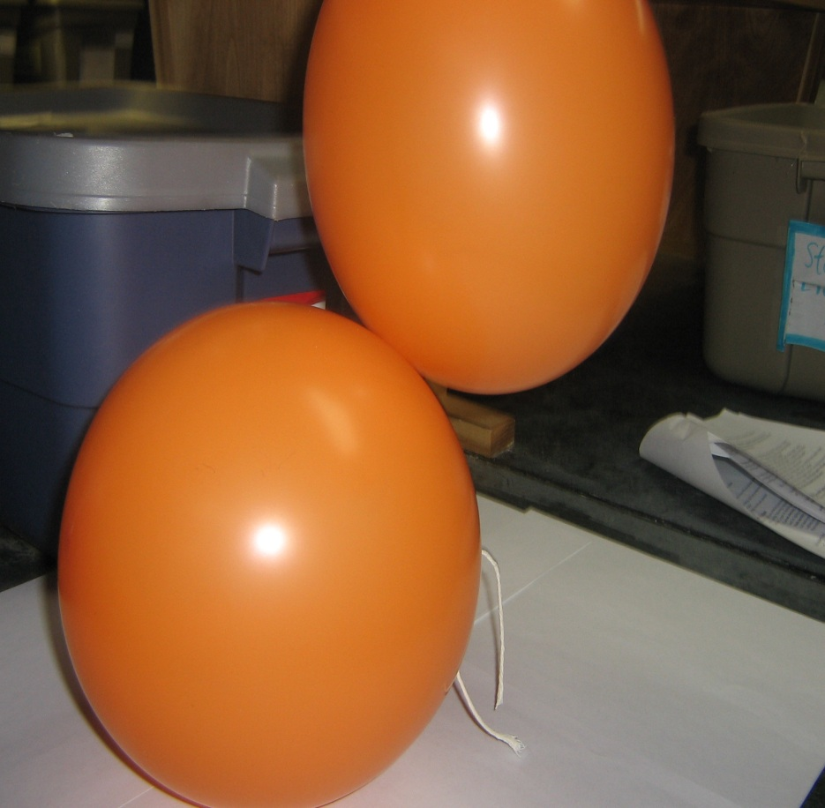
CREATING STATIC ELECTRICITY—DEMO
Blow up 2 balloons and tie a string on each (take care to avoid rubbing the balloons with
anything). Move the balloons towards each other. How do the balloons behave?
Rub 1 balloon with the wool and move the 2 balloons towards each other. What happens? Do they attract each other or repel?
Rub both balloons with the wool. Do they attract or repel each other? (They should repel each other.)
Ask the students what they think is happening.
Electrons are pulled off the wool and onto the balloon.
The free electrons on the balloon are removed when it is rubbed with a hand.

Slide 6
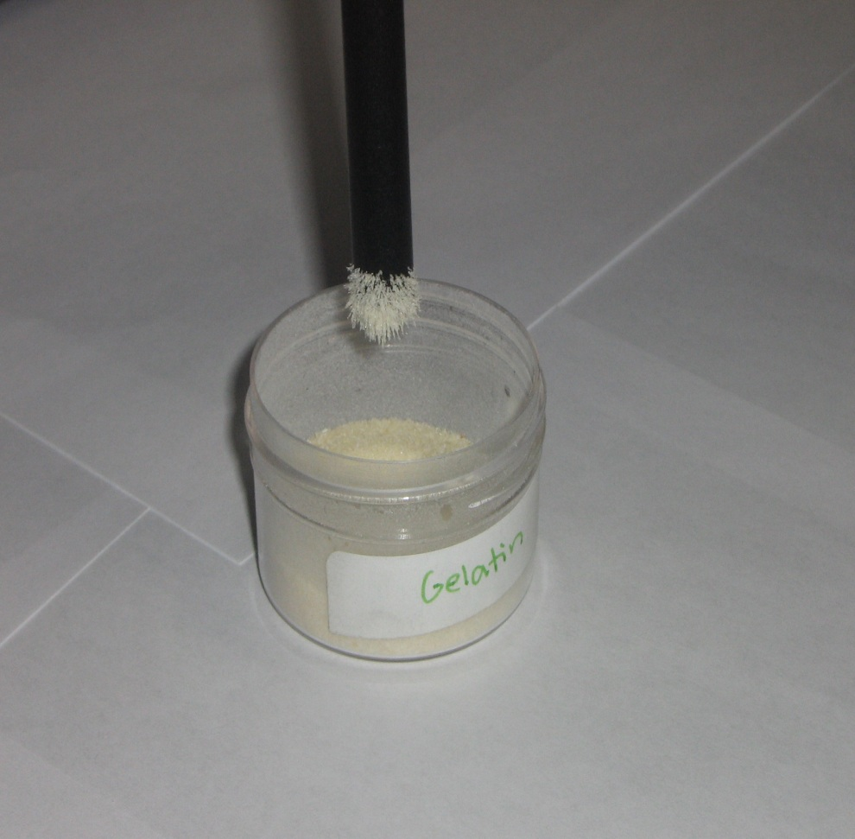
ACTIVITY I: CREATING STATIC ELECTRICITY
Tell students to:
Lower the black rod into the gelatin, lift it up and look for gelatin particles clinging to the rod (there should be none).
Charge the rod by rubbing it with the piece of wool (several times).
Bring it close to the gelatin. What happens?
Explanation:
When you rubbed the rod with the wool, some of the electrons from the wool collected on it. The electrons have a NEGATIVE charge and so now that the rod has a negative charge. The rod now attracts other materials that are neutral or positively charged. This attraction makes the gelatin or “jump” and cling to the rod.

Slide 7
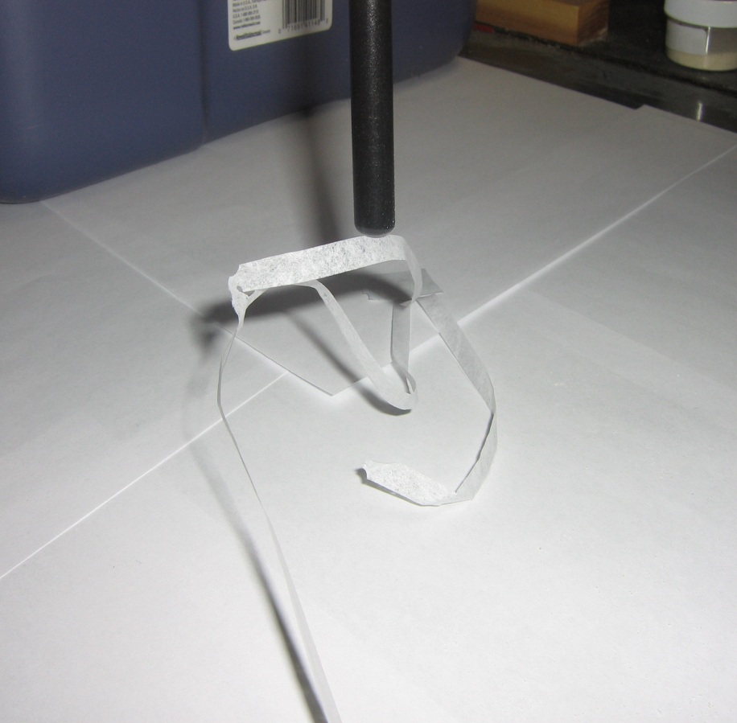
ACTIVITY II: WHAT MATERIALS CREATE THE MOST STATIC ELECTRICITY?
Activity II: What materials create the most static electricity?
Tape one end of the piece of crepe paper onto the desk top. Rub the black rod with the wool and lower the rod close to the free end of the paper. What happens?
Tell the students they are going to repeat this experiment, using different materials. They will use the same crepe paper and vary the materials rubbed together. They will observe the distance the rod needs to be lowered to attract the paper (are there combinations that are better than others?)
Rub the rod 10 times with the wool (count carefully) and lower the rod towards the paper.
Stop lowering the rod as soon as the paper starts to move, and estimate the distance from the paper.
Repeat, using the golf club protector piece, PVC pipe, ping pong ball. Anything else in the classroom that the students want to try.

Slide 8
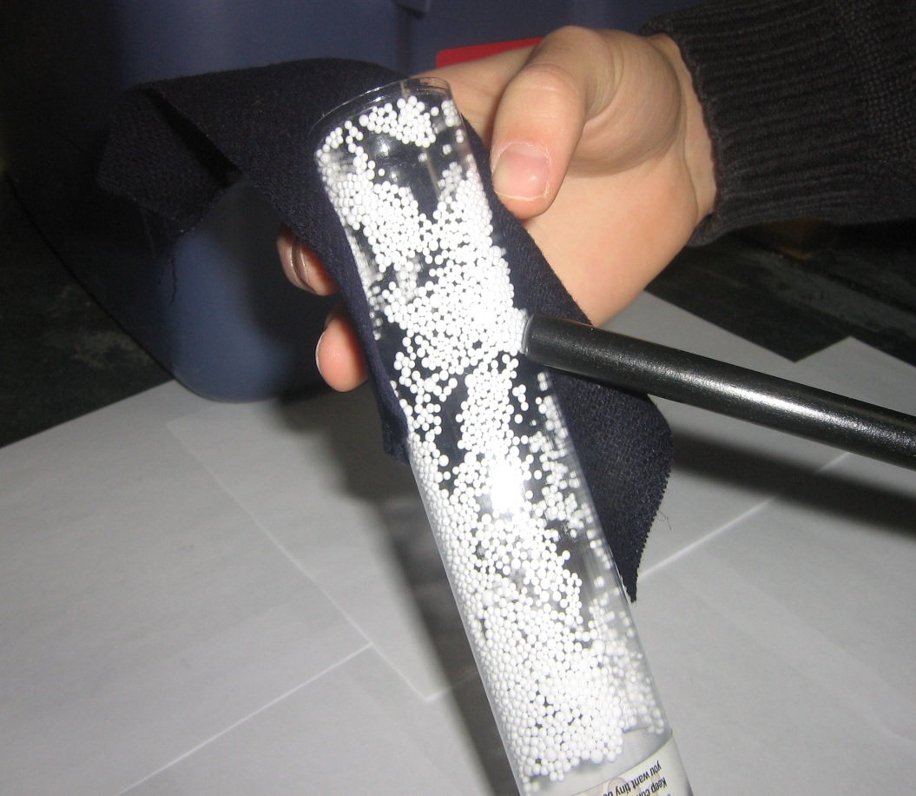
ACTIVITY III: USING A STATIC TUBE
Rub the static tube with wool and observe what happens to the Styrofoam peas inside the tube. (they cling to the sides of the tube and move with the wool)
Turn the static tube upside down (peas do not fall to the bottom, but remain stuck to the sides)
Chase the peas around the tube with a finger
Rub the black rod with wool. Move the rod close to the tube. What happens to the peas? (They try to move away from the rod.)

Slide 9
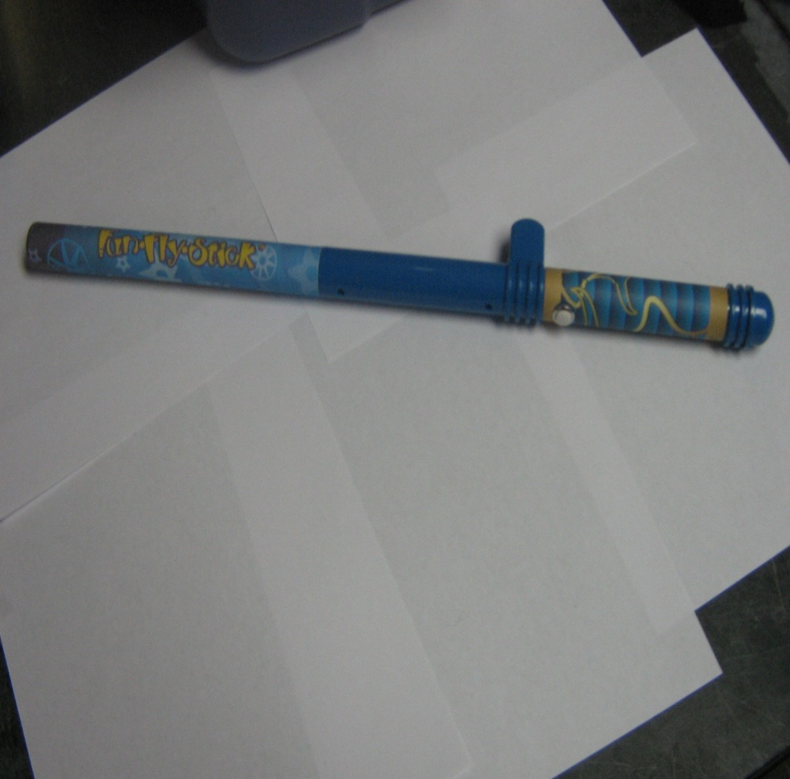
ACTIVITY IV: USING A VAN DE GRAAF GENERATOR
Ask students: Has anyone seen a Van de Graaff generator? Show them a picture…
Tell the students that the Van de Graaff generator creates (or generates, as the name implies) electrical charges. These charges are generated the same way that you can generate an electrical charge when you rub your feet on the carpet. Except, in the case of the Van de Graff generator, you are rubbing a pulley against a belt.
Show them the parts of the generator.
Tell students that the battery drives a belt that creates static electricity which collects on the cardboard tube.
Tell the students that we are now going to conduct static electricity activities involving the Van de Graaff generator.

Slide 10
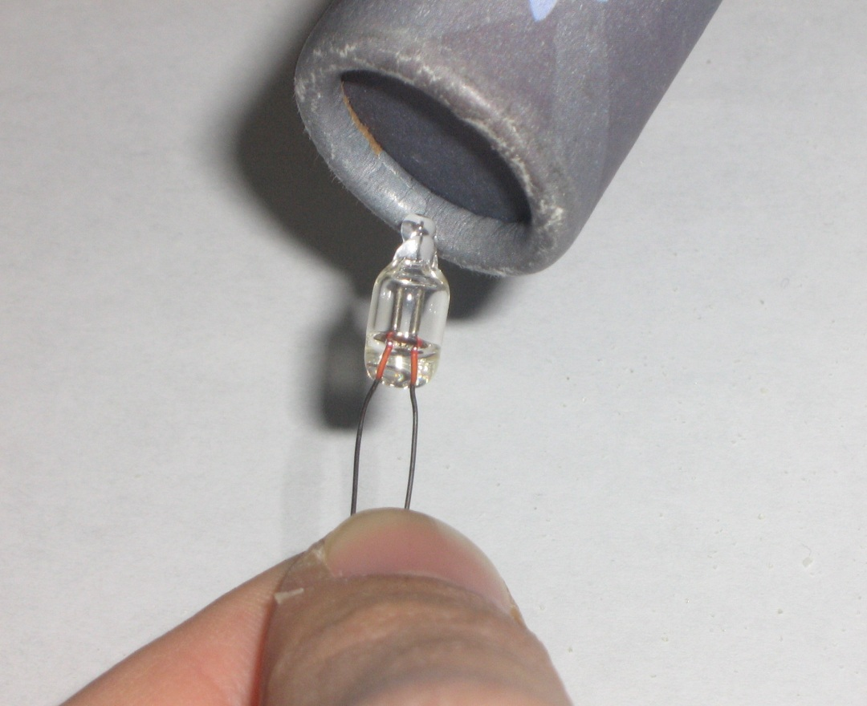
ACTIVITY IV: USING A VAN DE GRAAF GENERATOR
Tell students to:
Turn on Van de Graaff generator and bring it close to the piece of crepe paper. What happens? Is it the same as using the rods and wool or fur?
Hold the generator above (but not touching) a partner’s hair and observe that hair is attracted to it (this may not work if the air is humid). Hairs on arms can also be tested, but warn students that they may get a harmless static shock. They may also hear crackling noises.
Place the ping pong ball close to the generator (not touching) and observe what happens.
Hold one lead of the neon lamp with your fingers and bring the activated generator close to the other lead. Watch for an orange/red glow.
Note that the generator charges the gas that is inside the lamp creating plasma. This is the same process as in a plasma TV.

Slide 11
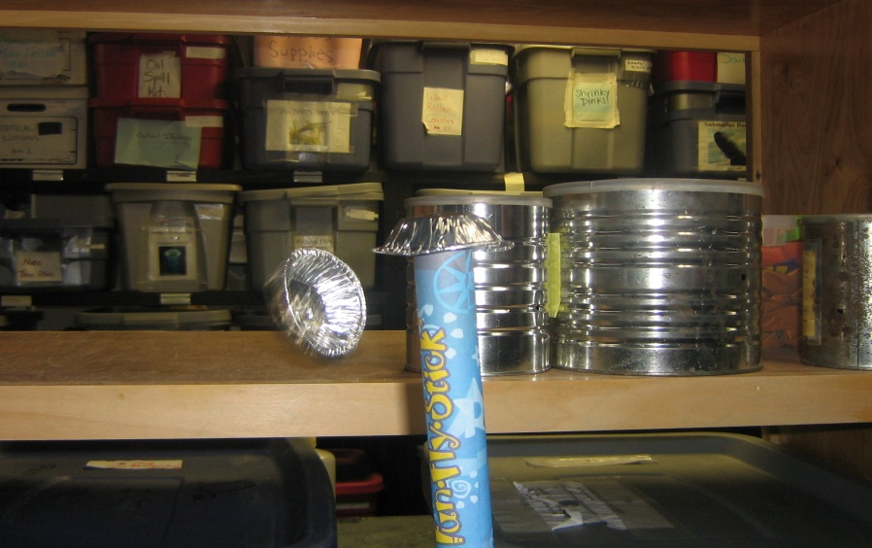
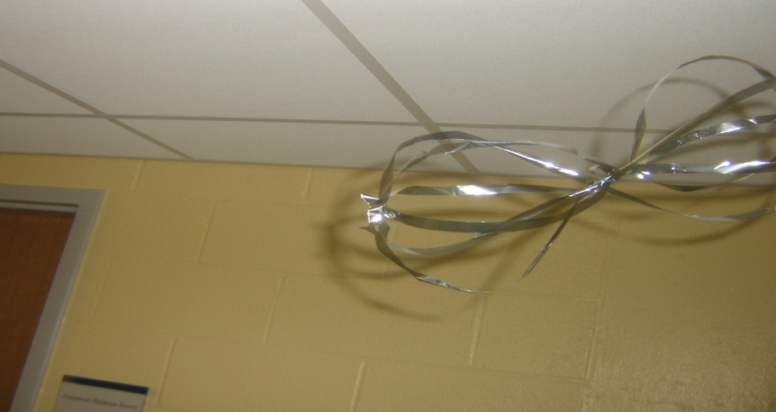
ACTIVITY IV: USING A VAN DE GRAAF GENERATOR
Repulsion of like charges can be shown using the cupcake pans. Stack the pans on top of the generator and activate it. The pans fly off, 1 at a time. Why?
Aluminum pans are conductors. When the generator is turned on, all of them become charged with the same charge and repel each other. The top pan has the most charge and will repel first.
“Chase” a piece of mylar tinsel with the generator.
Show students how to do similar experiments at home with the plastic (golf club protector) tubes, wool and tinsel shapes
To do at home:
Investigate other materials that create static electricity.
Tear the top of the paper casing around a straw. Move the straw up and down so that it is rubbing against the paper. Carefully remove the straw (do not let it touch anything) and “stick” it to the palm of your other hand (held vertical).

Slide 12
MODELING AN ATOM (OPTIONAL)
Tell students we are going to make a human model of two atoms (Atom A and Atom B).
Explain to students that the chair represents all the neutrons in the nucleus of an atom.
Ask students if the neutrons are positive, negative or neutral. Answer: neutral
Choose four volunteers. Have students (2 for one chair, 2 for another chair) stand near the chairs. Explain that these students are the protons in the nucleus. Ask students if they have a positive or negative charge? Answer: positive. (Make sure the students know who is Atom A and Atom B.)
Ask students: If we want to have a balance in the charge of these two atoms, how many electrons (negative charge) do we need? Answer: two for each atom.
Choose another four volunteers to be the electrons. Explain that the electrons are orbiting around each nucleus. For each nucleus (neutron (chair) plus 2 student protons), have one student walk in one direction around the chair. Explain this is the first electron shell of the atom.
Next, have the other students walk in the other direction around each nucleus. Explain that this is the second shell. Point out that all charges are now balanced.

Slide 13
MODELING AN ATOM (OPTIONAL)
In an atom, the protons and neutrons that make up the nucleus are held together very tightly and rarely does the nucleus experience a change. However, some of the electrons that are associated with the atom are loosely held to their orbital. These electrons, which typically reside in the outer orbits, can move from one atom to another. When an atom loses electrons, it has more positive particles than negative particles, which results in a positive net charge for the atom. An atom that acquires electrons has more negative particles than positive particles and, thus, has a negative net charge.
Tell students that an electron can move from one atom to another, creating electricity!
Explain to the students that the two atoms now come close together, touch and then separate. When they separate, an electron from “A” goes with “B” atom. Have the student in the second shell of Atom A “ jump” over to Atom B and start orbiting the nucleus.
Tell students that the atoms now have charge! Atom A lost an electron so it has more positive than negative particles (protons than electrons). It has a positive net charge!
Atom B gained an electron so it has more negative than positive particles (more electrons than protons). It has a negative charge.
Now we have a buildup of charge on each atom or an imbalance of charge. Another term is STATIC ELECTRICITY!

