Slide 1
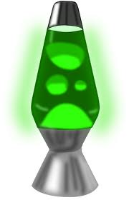
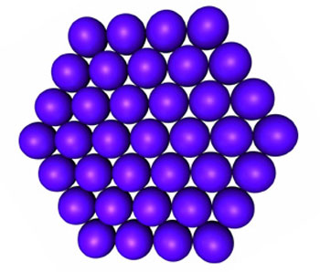


Solids, Liquids, Gases, and Lava Lamps
VSVS
Fall 2012

Slide 2
The States of Matter
Ask students to name the 3 states of matter are?
Ask students to name the 3 states of water are? Ans. Ice (solid), liquid, and water vapor (gas).
Note: Write the different states on the board. Ask the students to identify the processes
involved in each change of state, and add to diagram. (melts, vaporizes, condenses, freezes)
Solid (melts) →Liquid (vaporizes) →Gas
Gas (condenses) →Liquid (freezes) →Solid

Slide 3
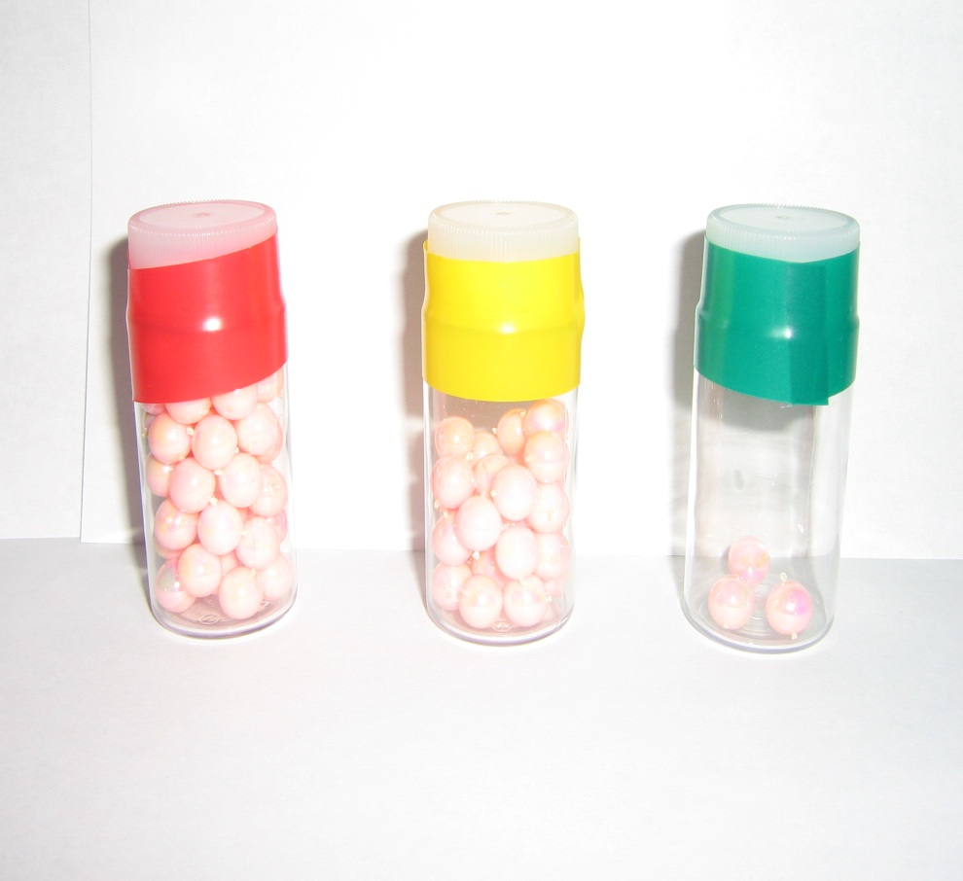
The States of Matter
Pass out the jars of beads to the groups. Tell students that the beads represent water molecules.
  Tell students to pick up the jar that is completely filled and have them gently shake it. This is like the molecules in a solid, like ice. The molecules move very little.
    Solids can change to liquids by melting.

Slide 4
The States of Matter cont.
  Tell students to pick up the jar that is half filled and have them gently shake it. There is more movement of the molecules, as in a liquid such as water. Liquids changes to a gas by vaporization (boiling).
  Tell students to pick up the jar that has only 3 beads in it and have them gently shake it. This is like the molecules in a gas, like steam.

Slide 5
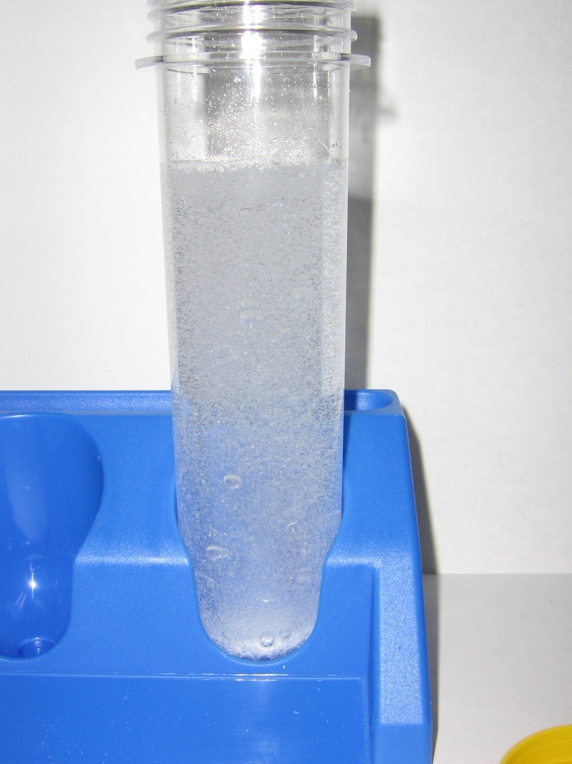
The States of Matter cont.
Tell students they are going to do an experiment involving a solid, liquid and gas.
The Alka Seltzer tablet is the solid, water is the liquid, and a gas is given off when the 2 are added together.
Ask students what they know about Alka Seltzer or effervescent table. See lesson for explanation.
Remind students that the tablets and water must be treated like chemicals, and kept away from mouths.

Slide 6
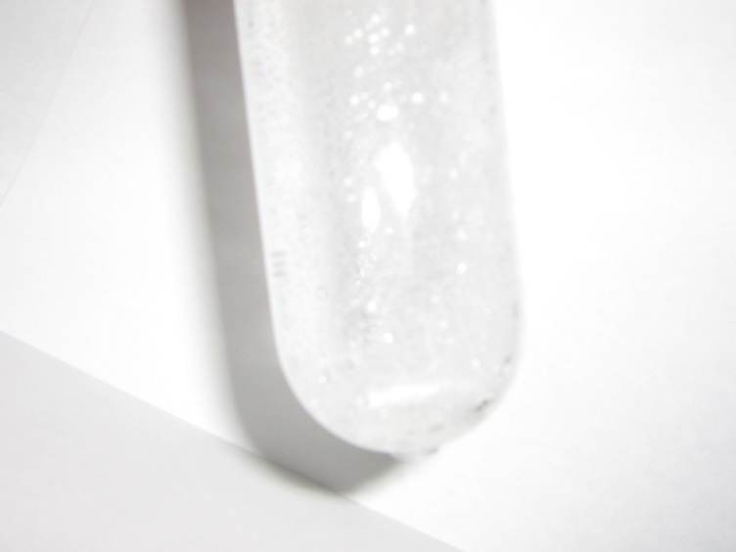
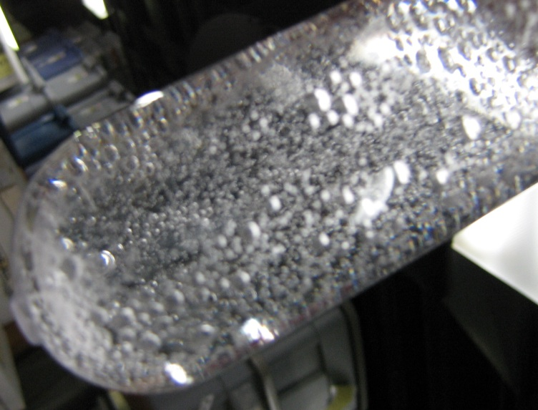
Experiment IA: Alka Seltzer in Water
Ask students to tell you which chemical is the solid (the alka seltzer tablet), and liquid (water). How do they know?
Pass out test tubes in rack, bottles of water and a piece of alka seltzer tablet(1/4 piece per pair).
Tell students to pour all the water into the test tube. Remind students that liquids take the shape of a container.
Add the Alka Seltzer tablet piece to the water and observe what happens.
(bubbles, fizzing, solid disappears,..)
See lesson for other observations

Slide 7
Experiment IA: Alka Seltzer in Water cont.
Give students another ¼ alka seltzer tablet and tell students to repeat the experiment and to look closely for all the observations mentioned above.
Explanation (adapt to the grade level – see lesson)
The Alka-Seltzer tablet reacts with the water to make bubbles of carbon dioxide gas.
The gas bubbles have a thin skin of water.
The bubbles are lighter than water and rush upwards.
Once at the surface, the skin breaks and carbon dioxide bubbles burst into the surrounding air.

Slide 8
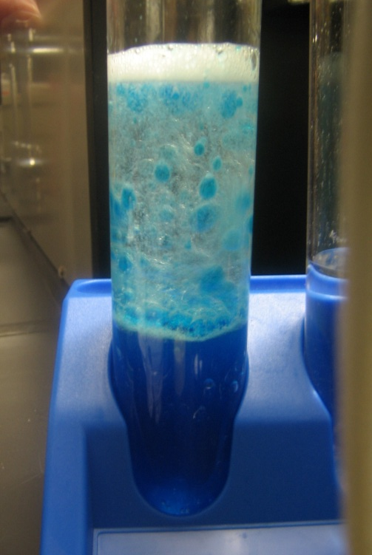
Experiment IIA: Making a Lava Lamp
Safety Considerations: DO NOT seal the bottles while the Alka-Seltzer reaction is in progress.
Add 1-2 drops of food coloring to the water in each test tube.
Pass out a 2oz bottle of oil to each pair and another ¼ tablet. Tell students to add the 2 oz bottle of oil to the test tubes.
Ask the students what they observe. -
-They should see the 2 layers.
Explain that both the oil and water are liquids, and that oil always sits on top of water because it is less dense (lighter) than water. Oil and water don’t mix because water molecules are not attracted to oil molecules.
Note that the food coloring stays in the water and not the oil.

Slide 9
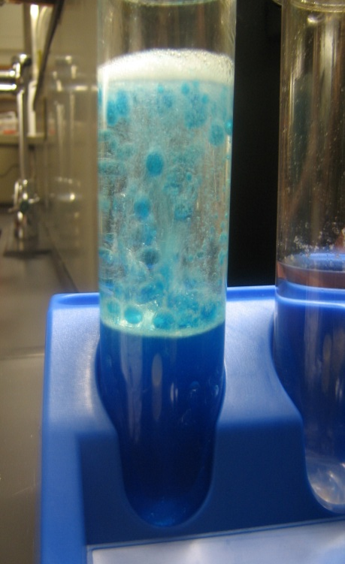
Experiment IIB: Making a Lava Lamp
Tell students they are going to add another piece of Alka Seltzer tablet to the test tube. Ask students if the can predict what might happen.
-Write predictions on the board.
Tell them to add the ¼ tablet to the water/oil and ask students to tell you their observations
  – write them on the board.
Ask students: how do you know it is the water falling back down (it is blue)?

Slide 10
Review
Ask students to tell you which of the materials used today are solids, liquids or gases?

